Slide 1
Cluster analysis and spike sorting
Kenneth D. Harris 15/7/15

Slide 2
Exploratory vs. confirmatory analysis
Exploratory analysis
Helps you formulate a hypothesis
End result is often a nice-looking picture
Any method is equally valid – because it just helps you think of a hypothesis
Confirmatory analysis
Where you test your hypothesis
Multiple ways to do it (Classical, Bayesian, Cross-validation)
You have to stick to the rules
Inductive vs. deductive reasoning (K. Popper)

Slide 3
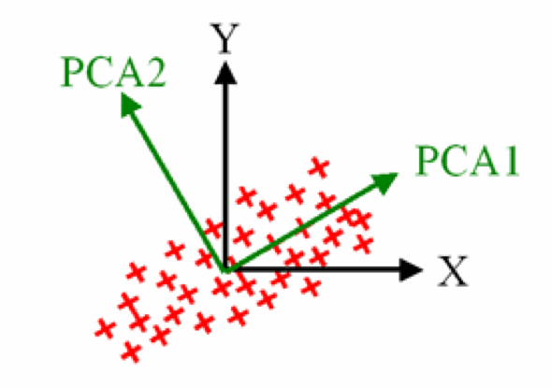
Principal component analysis
Finds directions of maximum variance in a data set
These correspond to the eigenvectors of the covariance matrix

Slide 4
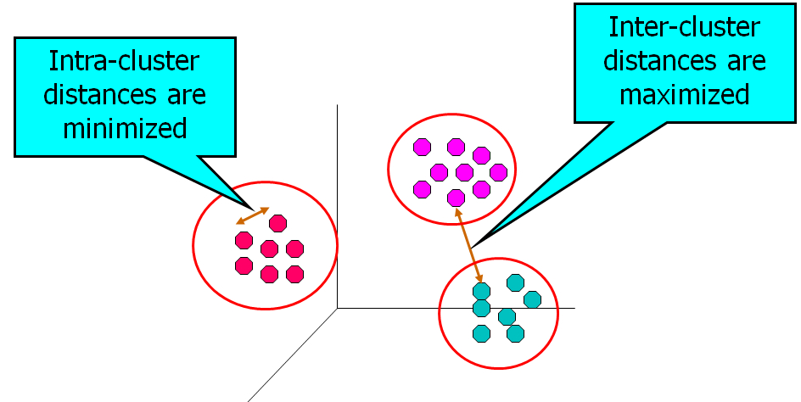
Cluster analysis

Slide 5
Two main ways to do cluster analysis
Model-free
Requires a distance measure between every pair of points
Model-based
Assumes that points come from a probability distribution

Slide 6
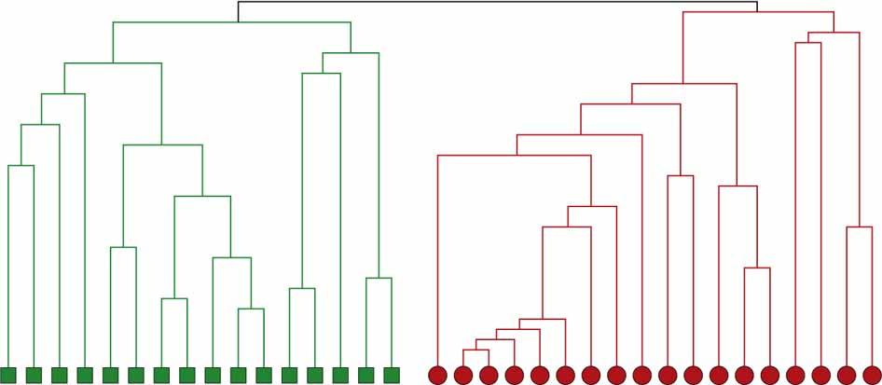
Hierarchical clustering
Model-free method
Agglomerative
“Bottom up”
Sequentially merge similar points/clusters
Divisive
“Top down”
Sequentially split clusters
Need to define how to split clusters
Can be slow, but can give better results
Choose number of clusters by “slicing” dendrogram
Both slow for large numbers of points: O(N³) unless you use tricks

Slide 7
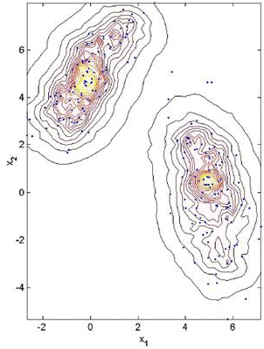
Mean-shift clustering
Compute a density estimate
Compute its gradient
Move each point “uphill”
Number of clusters is set by density estimation prarameters

Slide 8
Rodriguez-Laio clustering
Distance to closest denser point
Density
Number of clusters set by how many points you select
Both Rodriguez-Laio and Mean Shift are order N² unless you use tricks

Slide 9
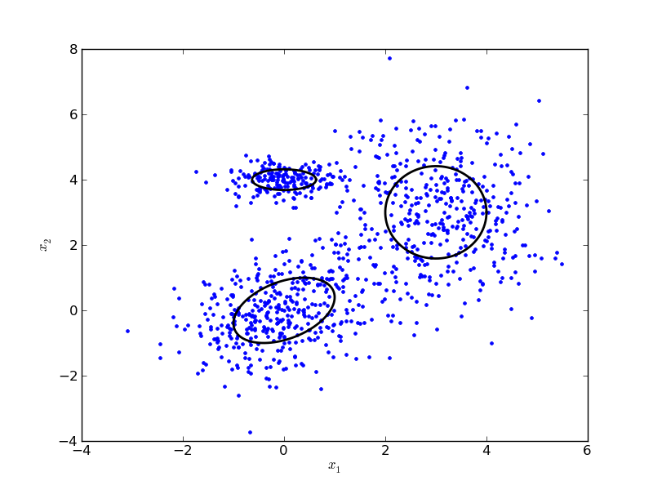
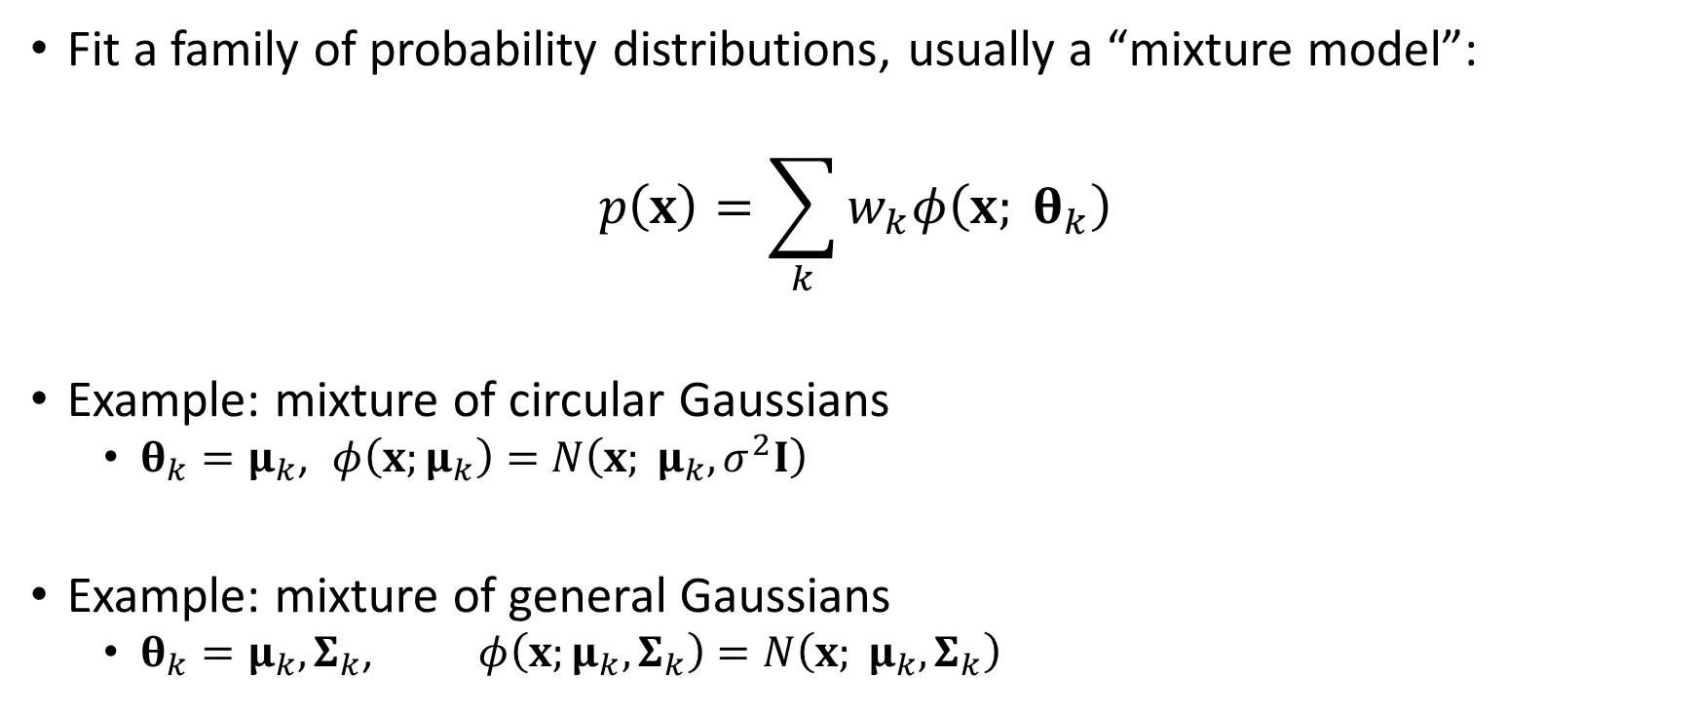
Model-based clustering
Fit a family of probability distributions, usually a “mixture model”:
$$p\left(x\right)=\sum_{k}{w_{k}φ\left(x; θ_{k}\right)}$$
Example: mixture of circular Gaussians
$θ_{k}=μ_{k}$, $φ\left(x;μ_{k}\right)=N\left(x; μ_{k}, σ^{2}I\right)$
Example: mixture of general Gaussians
$θ_{k}=μ_{k},Σ_{k}$, $φ\left(x;μ_{k},Σ_{k}\right)=N\left(x; μ_{k},Σ_{k}\right)$

Slide 10
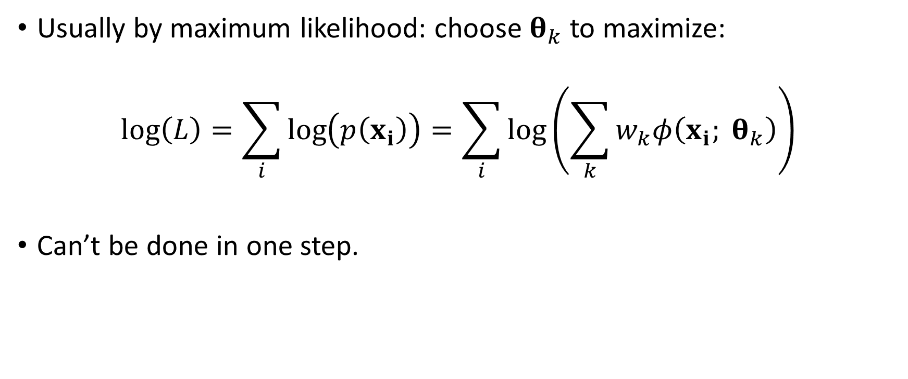
How to fit?
Usually by maximum likelihood: choose $θ_{k}$ to maximize:
$$\log\left(L\right)=\sum_{i}{\log\left(p\left(x_{i}\right)\right)}=\sum_{i}{\log\left(\sum_{k}{w_{k}φ\left(x_{i}; θ_{k}\right)}\right)}$$
Can’t be done in one step.

Slide 11
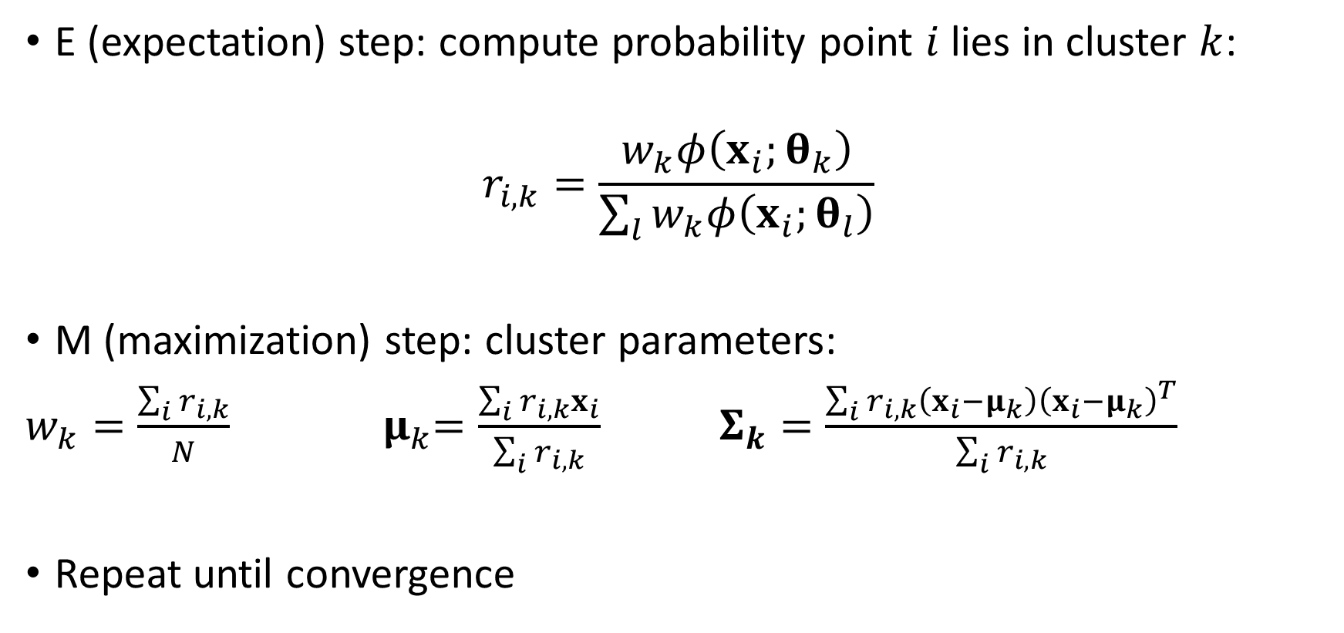
E-M algorithm
E (expectation) step: compute probability point $i$lies in cluster $k$:
$$r_{i,k}=\frac{w_{k}φ\left(x_{i};θ_{k}\right)}{\sum_{l}{w_{k}φ\left(x_{i};θ_{l}\right)}}$$
M (maximization) step: cluster parameters:
$w_{k}=\frac{\sum_{i}{r_{i,k}}}{N}$ ${ μ}_{k}=\frac{\sum_{i}{r_{i,k}x_{i}}}{\sum_{i}{r_{i,k}}}$ $Σ_{k}=\frac{\sum_{i}{r_{i,k}\left(x_{i}−μ_{k}\right){\left(x_{i}−μ_{k}\right)}^{T}}}{\sum_{i}{r_{i,k}}}$
Repeat until convergence

Slide 12
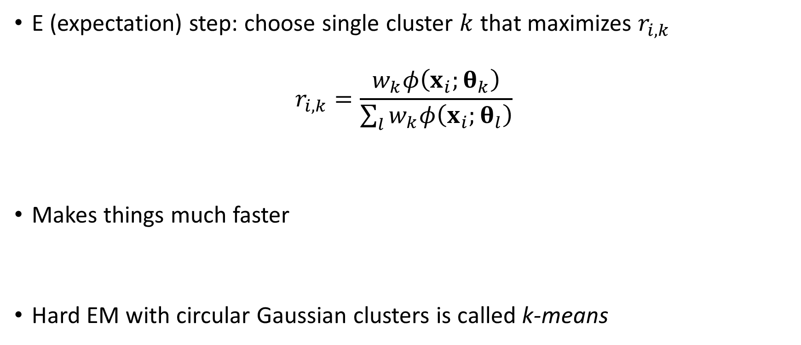
“Hard” EM algorithm
E (expectation) step: choose single cluster $k$ that maximizes $r_{i,k}$
$$r_{i,k}=\frac{w_{k}φ\left(x_{i};θ_{k}\right)}{\sum_{l}{w_{k}φ\left(x_{i};θ_{l}\right)}}$$
Makes things much faster
Hard EM with circular Gaussian clusters is called k-means

Slide 13
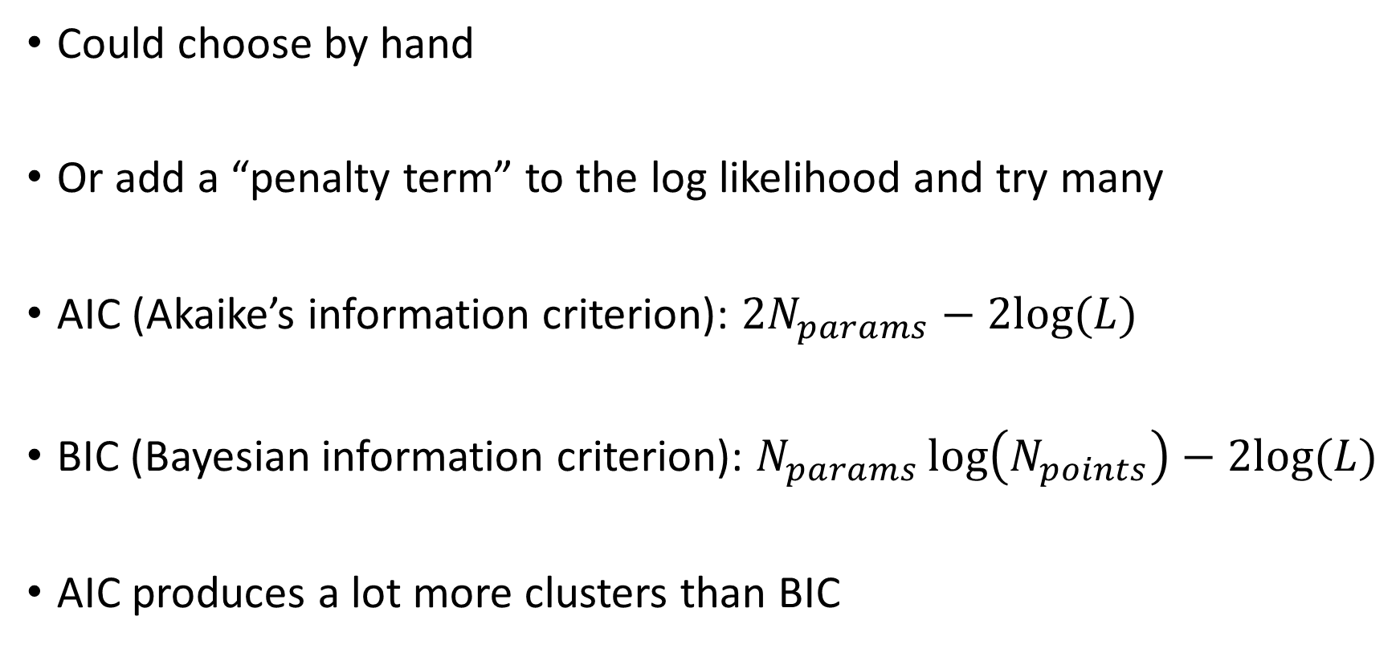
How many clusters?
Could choose by hand
Or add a “penalty term” to the log likelihood and try many
AIC (Akaike’s information criterion): $2N_{params}−2log⁡(L)$
BIC (Bayesian information criterion): $N_{params}\log\left(N_{points}\right)−2log⁡(L)$
AIC produces a lot more clusters than BIC

Slide 14
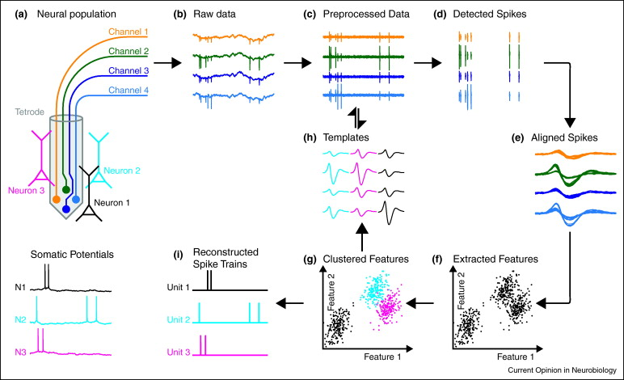
Spike sorting

Slide 15
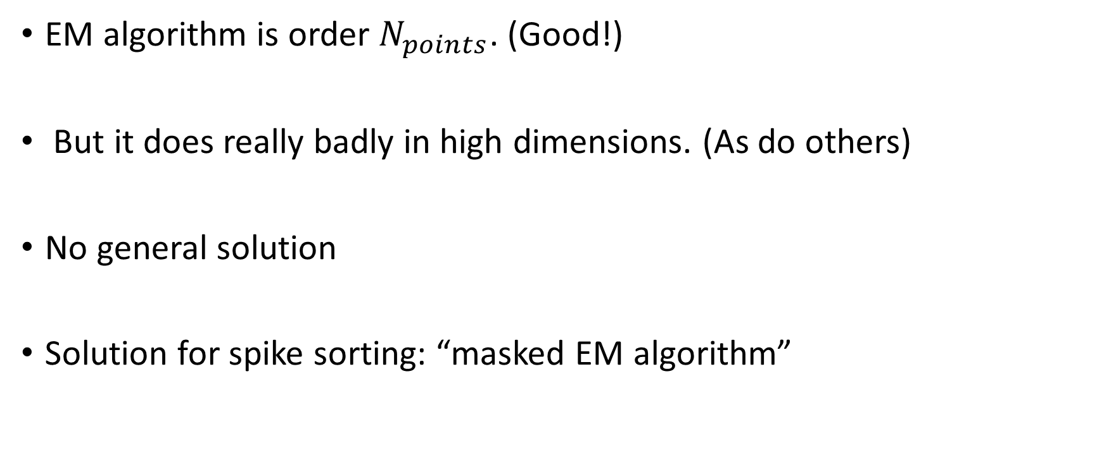
High dimensions
EM algorithm is order $N_{points}$. (Good!)
But it does really badly in high dimensions. (As do others)
No general solution
Solution for spike sorting: “masked EM algorithm”

Slide 16
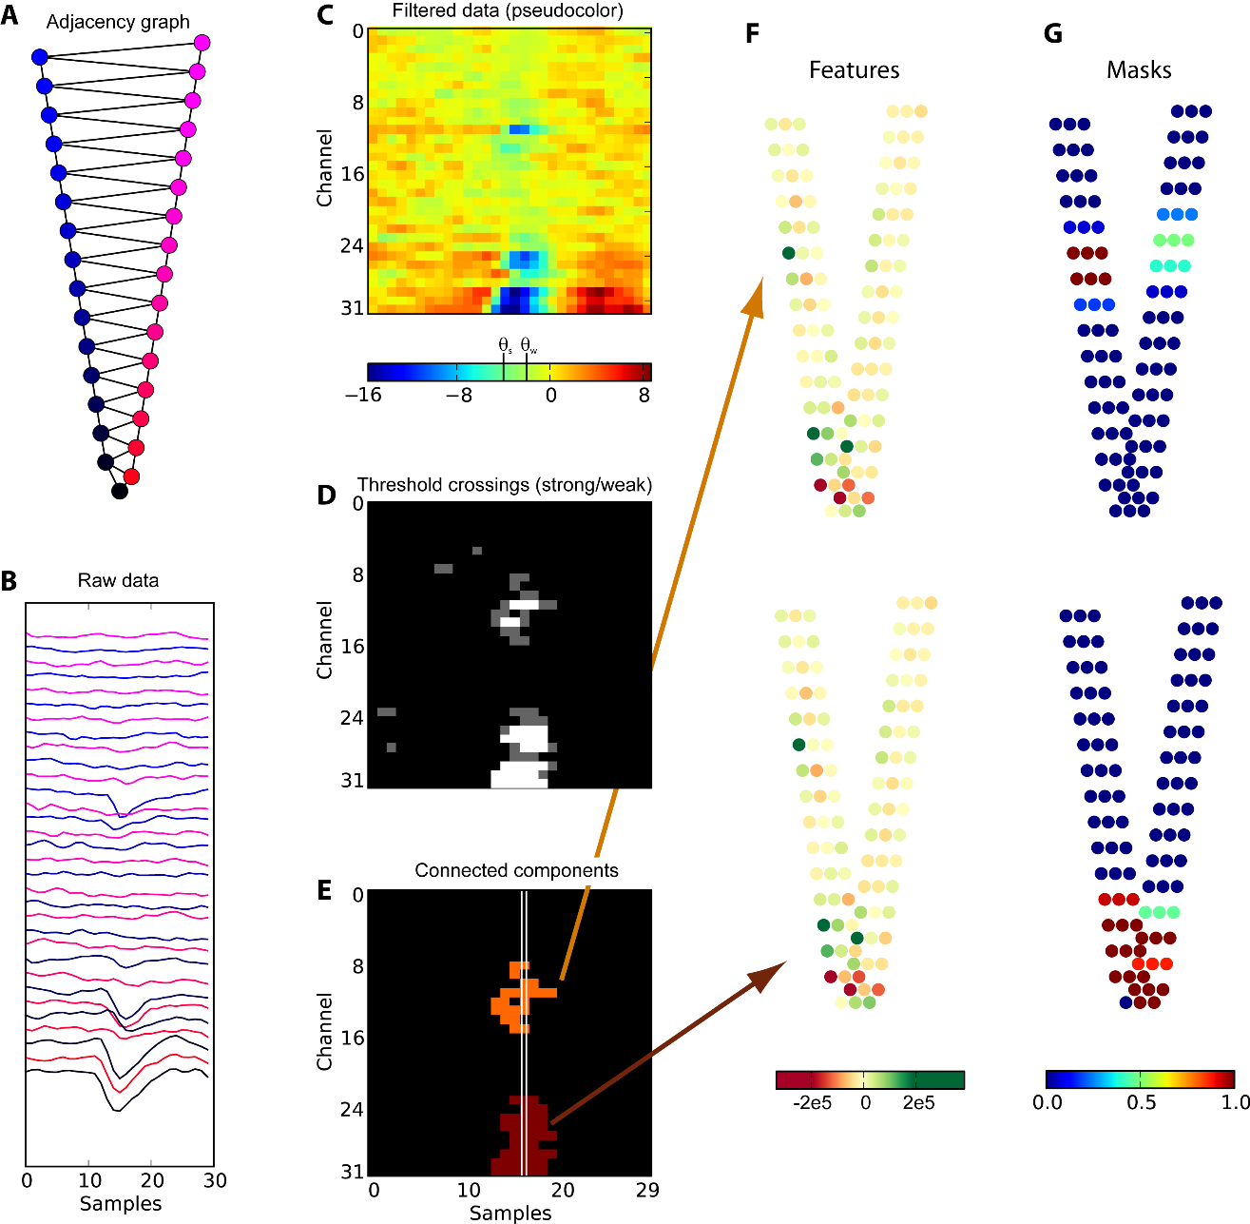
Local spike detection

Slide 17
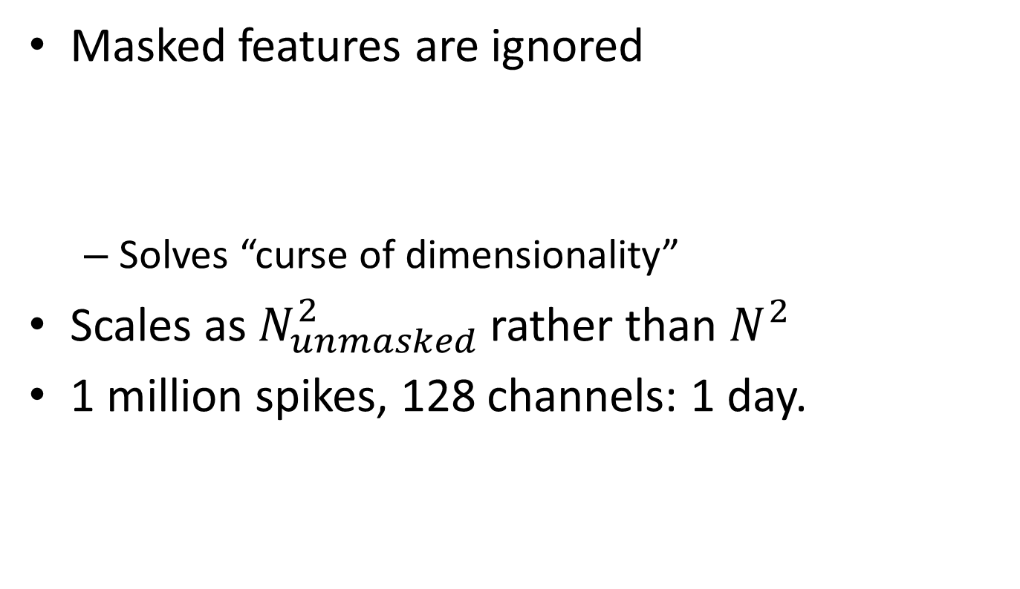
Step 2: Masked EM algorithm
Masked features are ignored
Solves “curse of dimensionality”
Scales as $N_{unmasked}^{2}$ rather than $N^{2}$
1 million spikes, 128 channels: 1 day.
Kadir et al, Neural Computation 2014

Slide 18
Estimating performance

Slide 19
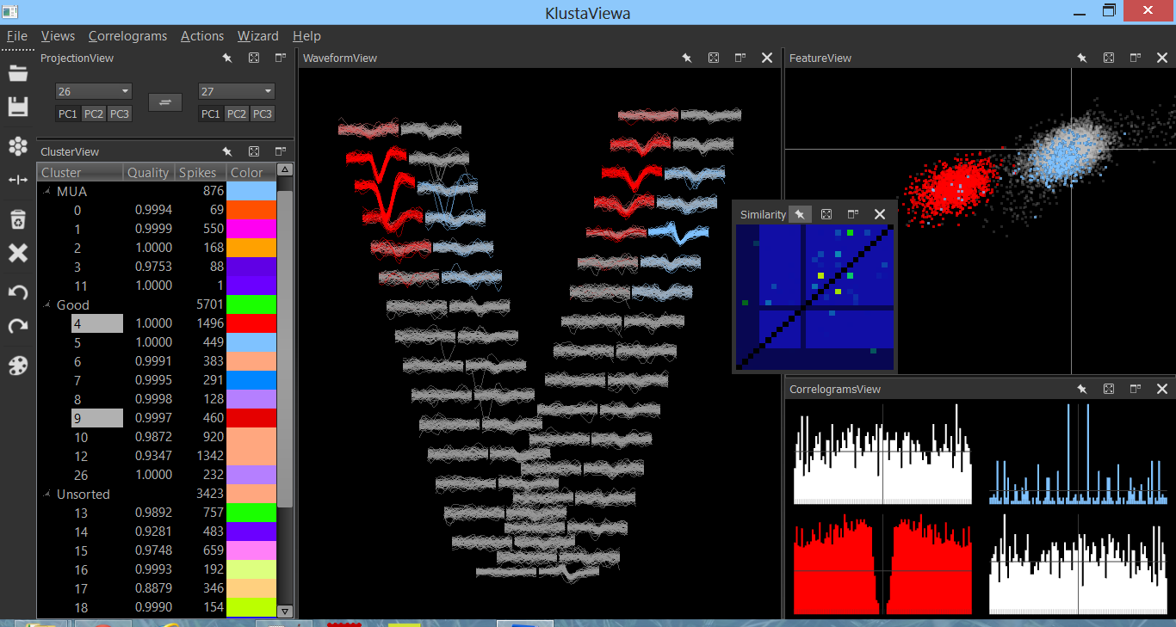
Manual verification essential
http://klusta-team.github.io/ https://github.com/kwikteam/phy

