Slide 1
LFPs
Kenneth D. Harris
11/2/15

Slide 2
Local field potentials
Slow component of intracranial electrical signal
Physical basis for scalp EEG

Slide 3
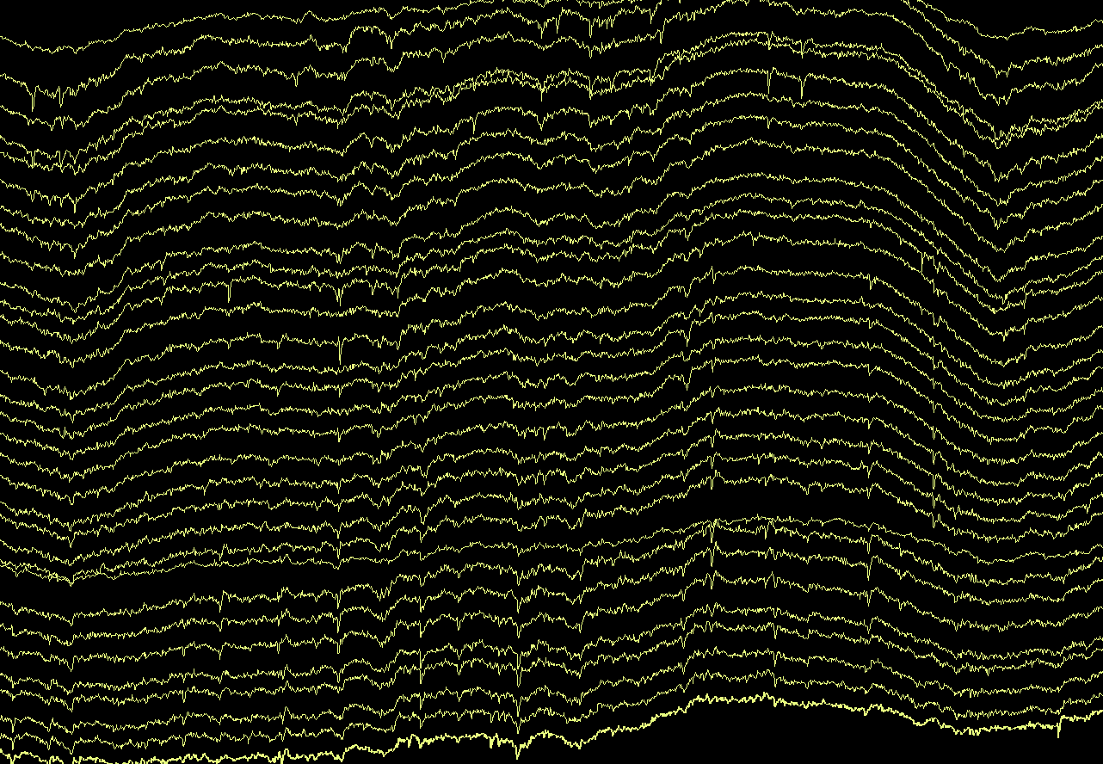

Slide 4
Today we will talk about
Physical basis of the LFP
Current-source density analysis
Some math (signal processing theory, Gaussian processes)
Spectral analysis

Slide 5
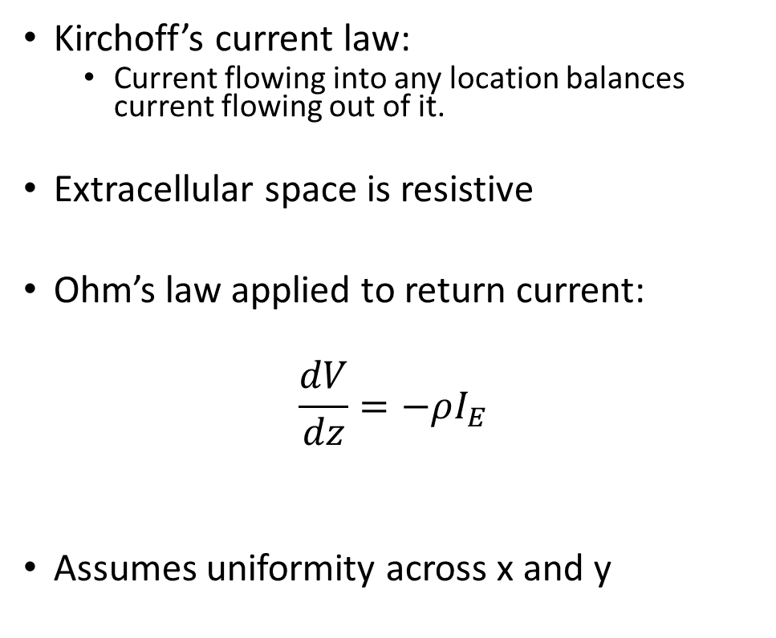
Physical basis of the LFP signal
Kirchoff’s current law:
Current flowing into any location balances current flowing out of it.
Extracellular space is resistive
Ohm’s law applied to return current:
$$\frac{dV}{dz}=−ρI_{E}$$
Assumes uniformity across x and y
Synaptic input
Return current
Intracellular current
Charging current (capacitive)
plus leak current (resistive)

Slide 6
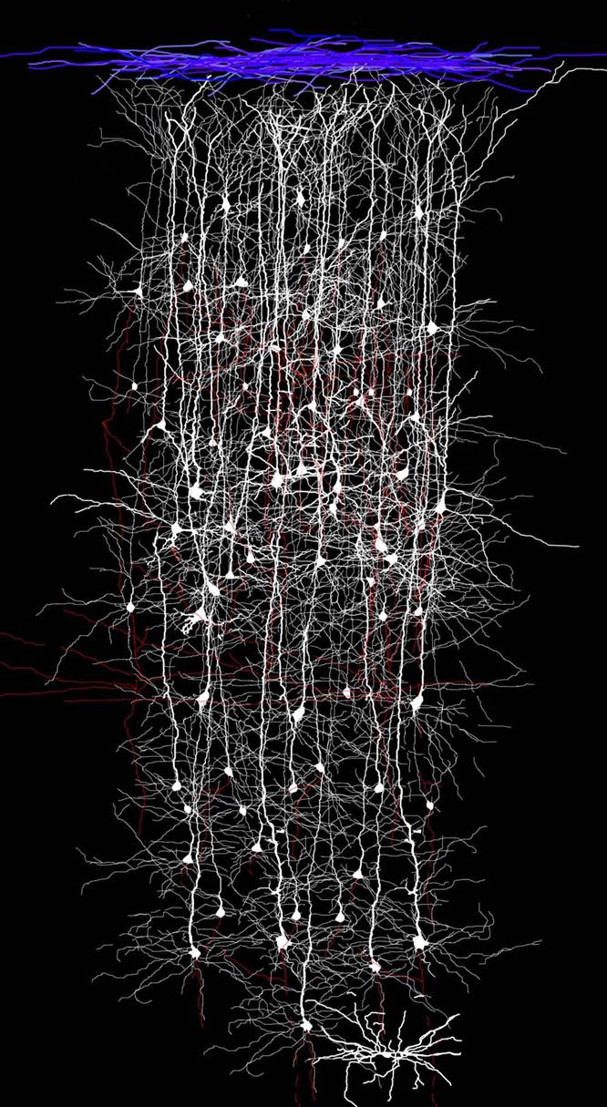
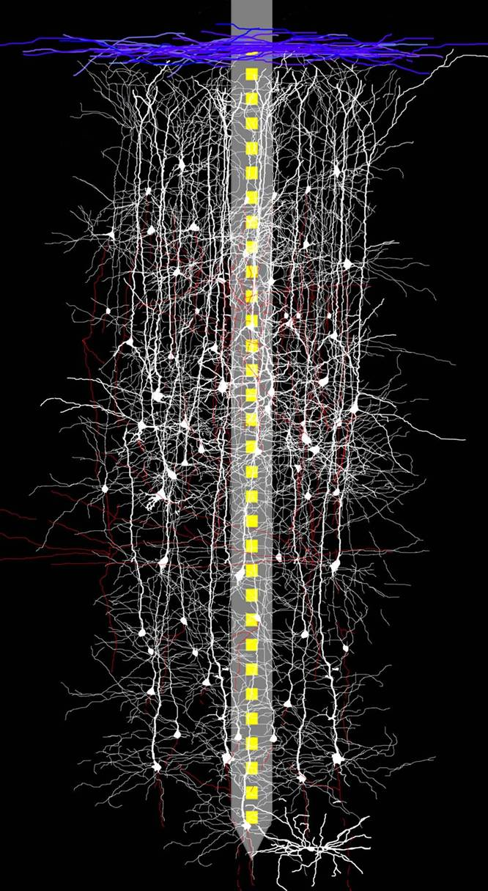
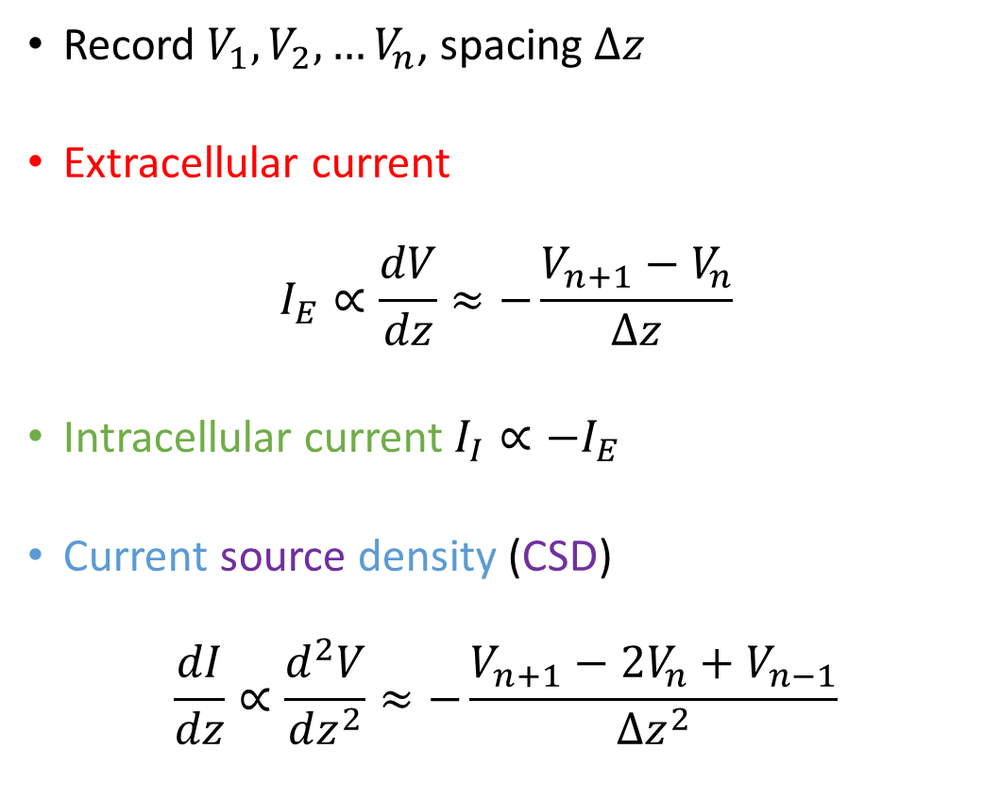
Linear probe recordings
Record $V_{1}, V_{2},…V_{n}$, spacing $Δz$
Extracellular current
$$I_{E}∝\frac{dV}{dz}≈−\frac{V_{n+1}−V_{n}}{Δz}$$
Intracellular current$I_{I}∝−I_{E}$
Current source density (CSD)
$$\frac{dI}{dz}∝\frac{d^{2}V}{dz^{2}}≈−\frac{V_{n+1}−2V_{n}+V_{n−1}}{Δz^{2}}$$

Slide 7
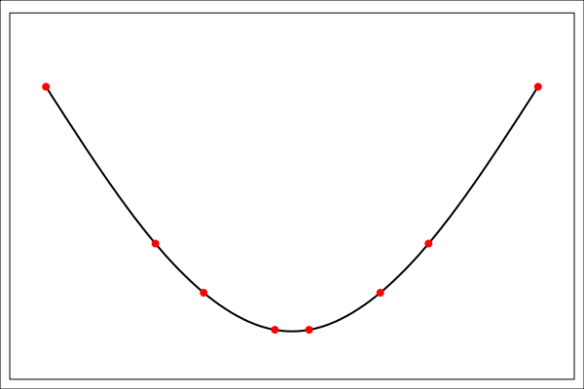
Spatial interpolation
To make nicer figures, interpolate before taking second derivative.
Which interpolation method?
Linear?
Quadratic?
Cubic spline method fits 3rd-order polynomials between each “knot”, 1st and 2nd derivative continuous at knots.

Slide 8
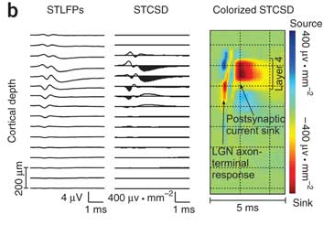
Current source density
Laminar LFP recorded in V1
Triggered average on spikes of simultaneously recorded thalamic neuron
Getting the sign right
Remember current flows from V+ to V–
Local minimum of V(z) = Current sink =second derivative positive
Jin et al, Nature Neurosci 2011

Slide 9
Current source density: potential problems
Assumption of (x,y) homogeneity
Gain mismatch
The CSD is orders of magnitude smaller than the raw voltage
If the gain of channels are not precisely equal, raw signal bleeds through
Sink does not always mean synaptic input
Could be active conductance
Can’t distinguish sink coming on from source going off
Because LFP data is almost always high-pass filtered in hardware
Plot the current too! (i.e. 1st derivative). This is easier to interpret, and less susceptible to artefacts.

Slide 10
Signal processing theory

Slide 11
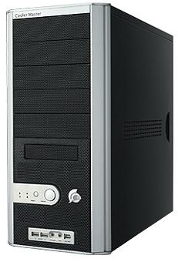
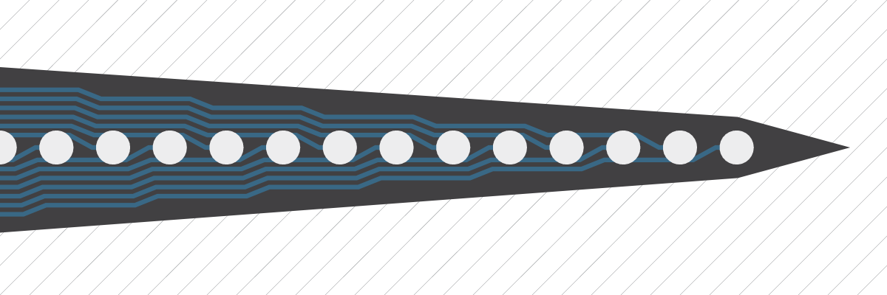
Typical electrophysiology recording system
Amplifier
Filter
A/D converter
Filter has two components
High-pass (usually around 1Hz). Without this, A/D converter would saturate
Low-pass (anti-aliasing filter, half the sample rate).

Slide 12
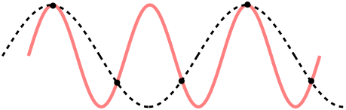
Sampling theorem
Nyquist frequency is half the sampling rate
If a signal has no power above the Nyquist frequency, the whole continuous signal can be reconstructed uniquely from the samples
If there is power above the Nyquist frequency, you have aliasing

Slide 13
Power spectrum and Fourier transform
They are not the same!
Power spectrum estimates how much energy a signal has at each frequency.
You use the Fourier transform to estimate the power spectrum.
But the raw Fourier transform is a bad estimate.
Fourier transform is deterministic, a way of re-representing a signal
Power spectrum is a statistical estimator used when you have limited data

Slide 14
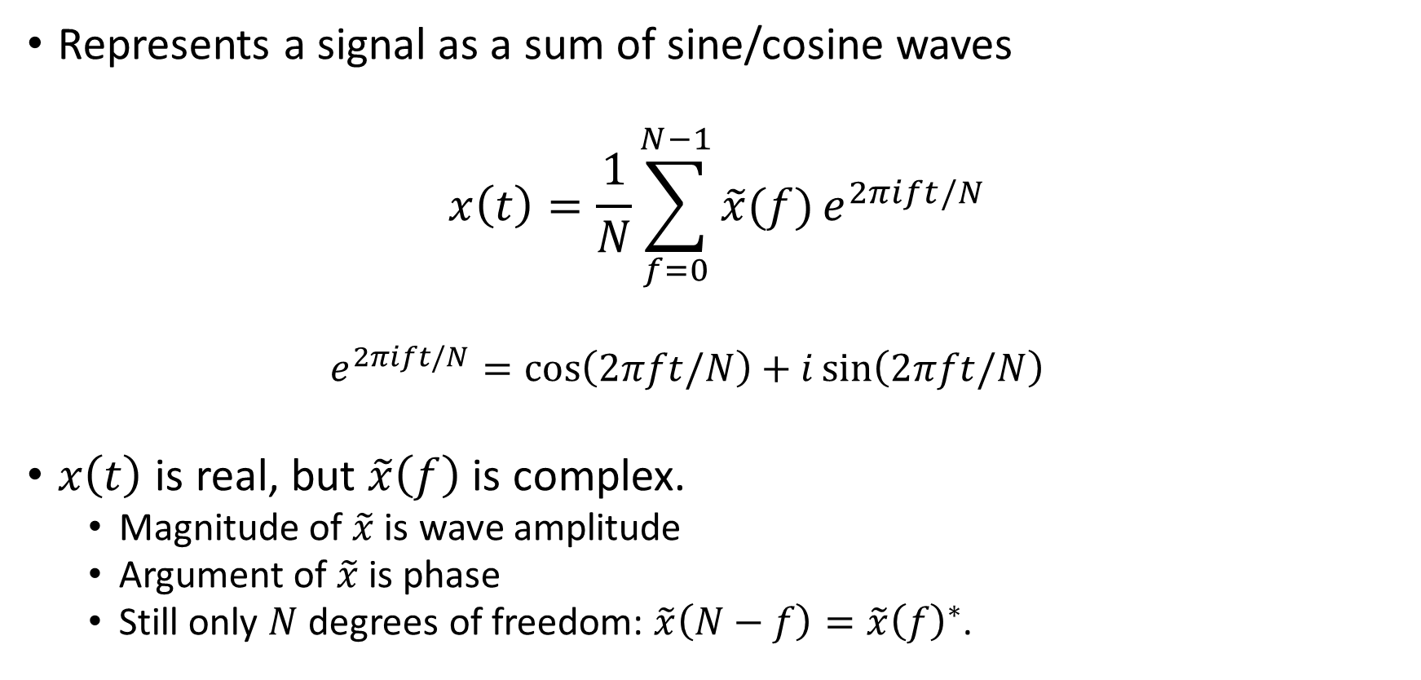
Discrete Fourier transform
Represents a signal as a sum of sine/cosine waves
$$x\left(t\right)=\frac{1}{N}\sum_{f=0}^{N−1}{\tilde{x}(f)}e^{2πift/N}$$
$$e^{2πift/N}=\cos\left(2πft/N\right)+i\sin\left(2πft/N\right)$$
$x\left(t\right)$ is real, but $\tilde{x}\left(f\right)$is complex.
Magnitude of $\tilde{x}$ is wave amplitude
Argument of $\tilde{x}$ is phase
Still only $N$ degrees of freedom: $\tilde{x}\left(N−f\right)=\tilde{x}{\left(f\right)}^{∗}$.

Slide 15
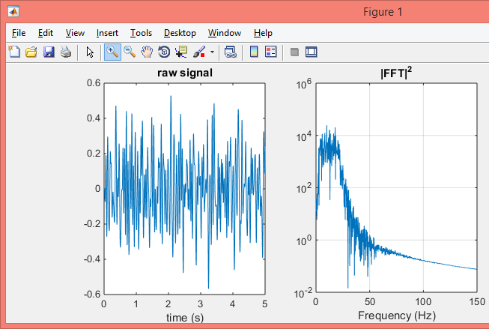
Using the Fourier transform to estimate power
Noisy!

Slide 16
Power spectra are statistical estimates
Recorded signal is just one of many that could have been observed in the same experiment
We want to learn something about the population this signal came from
Fourier transform is a faithful representation of this particular recording
Not what we want

