Slide 1
Information Theory
Kenneth D. Harris
18/3/2015

Slide 2
Information theory is…
Information theory is a branch of applied mathematics, electrical engineering, and computer science involving the quantification of information. (Wikipedia)
Information theory is probability theory where you take logs to base 2.

Slide 3
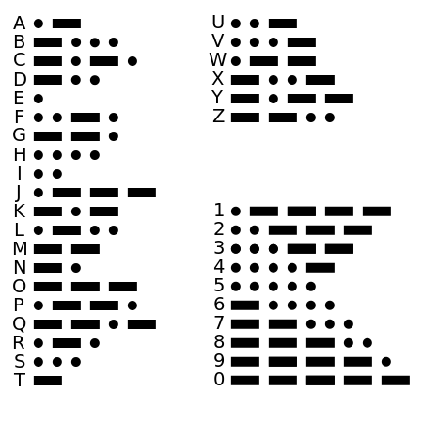
Morse code
Code words are shortest for the most common letters
This means that messages are, on average, sent more quickly.

Slide 4
What is the optimal code?
X is a random variable
Alice wants to tell Bob the value of X (repeatedly)
What is the best binary code to use?
How many bits does it take (on average) to transmit the value of X?

Slide 5
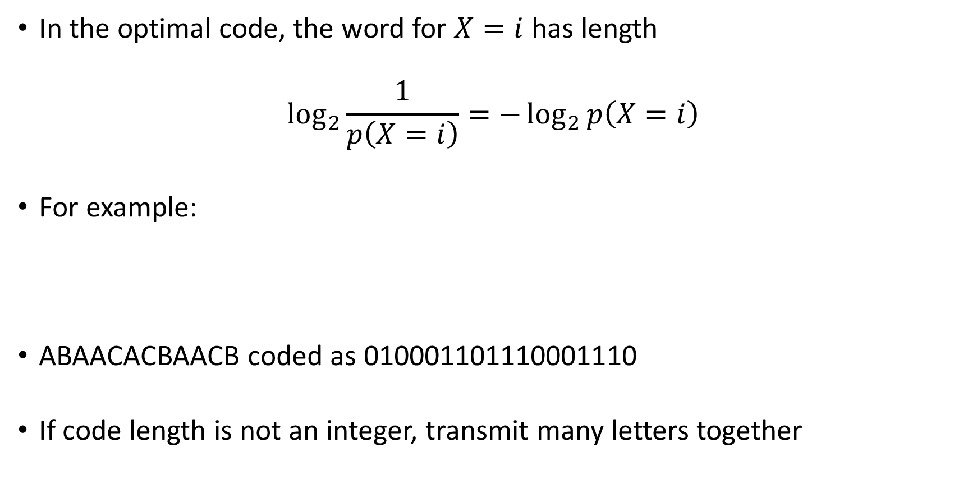
Optimal code lengths
In the optimal code, the word for $X=i$has length
$$\log_{2}{\frac{1}{p\left(X=i\right)}}=−\log_{2}{p\left(X=i\right)}$$
For example:
ABAACACBAACB coded as 010001101110001110
If code length is not an integer, transmit many letters together
Value of X | Probability | Code word
A | ½ | 0
B | ¼ | 10
C | ¼ | 11

Slide 6
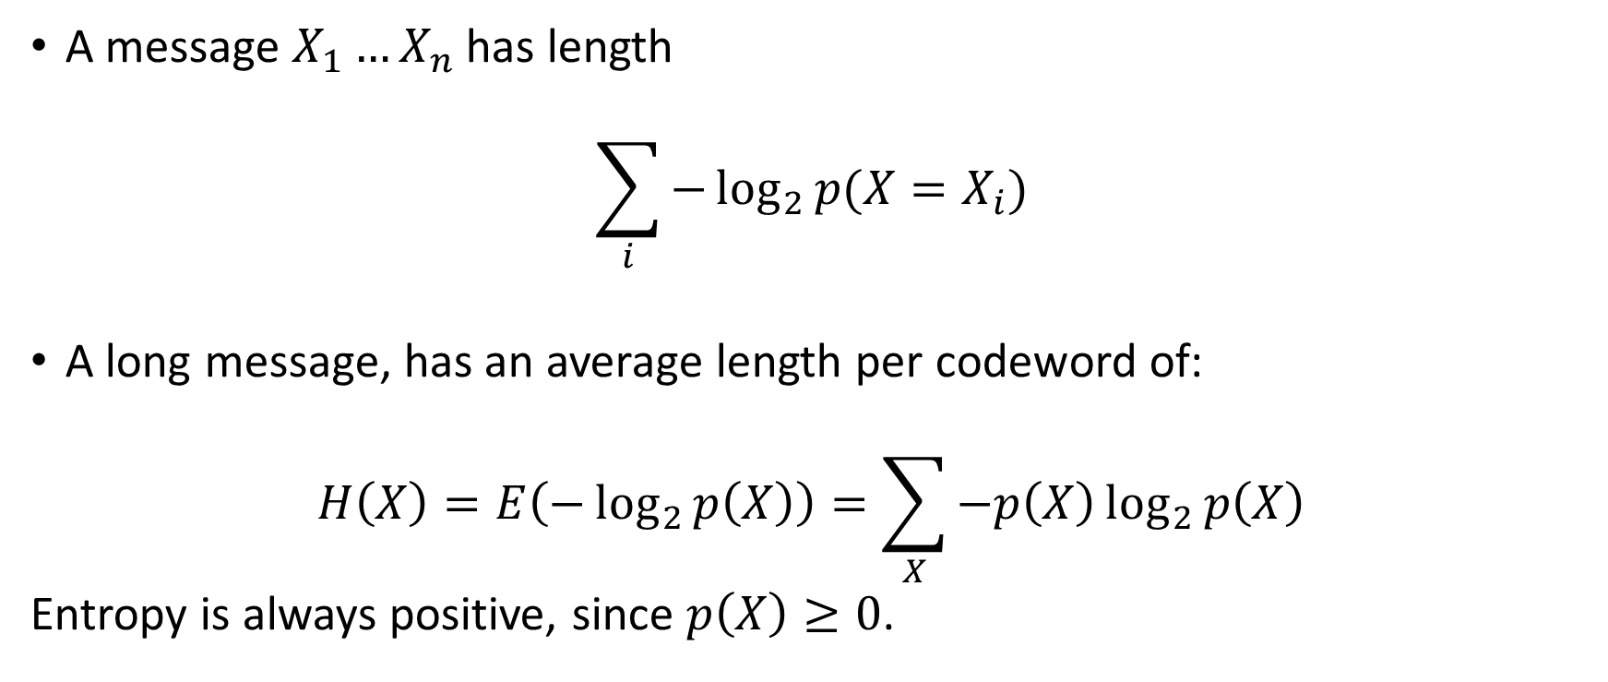
Entropy
A message $X_{1}…X_{n}$ has length
$$\sum_{i}{−\log_{2}{p(X=X_{i})}}$$
A long message, has an average length per codeword of:
$$H\left(X\right)=E\left(−\log_{2}{p\left(X\right)}\right)=\sum_{X}{−p\left(X\right)\log_{2}{p\left(X\right)}}$$
Entropy is always positive, since $p\left(X\right)≥0$.

Slide 7
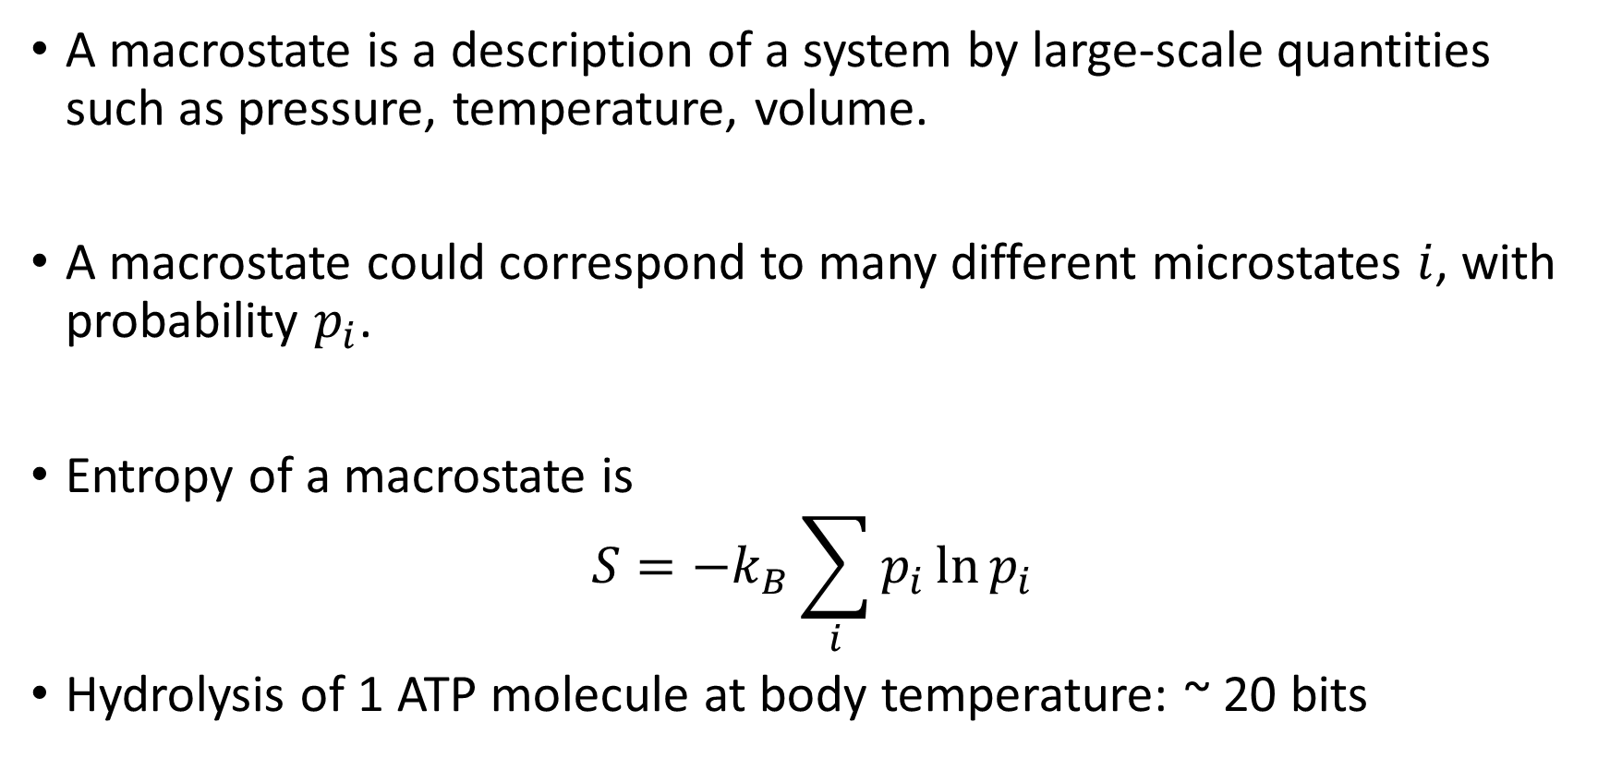
Connection to physics
A macrostate is a description of a system by large-scale quantities such as pressure, temperature, volume.
A macrostate could correspond to many different microstates $i$, with probability $p_{i}$.
Entropy of a macrostate is
$$S=−k_{B}\sum_{i}{p_{i}\ln{p_{i}}}$$
Hydrolysis of 1 ATP molecule at body temperature: ~ 20 bits

Slide 8
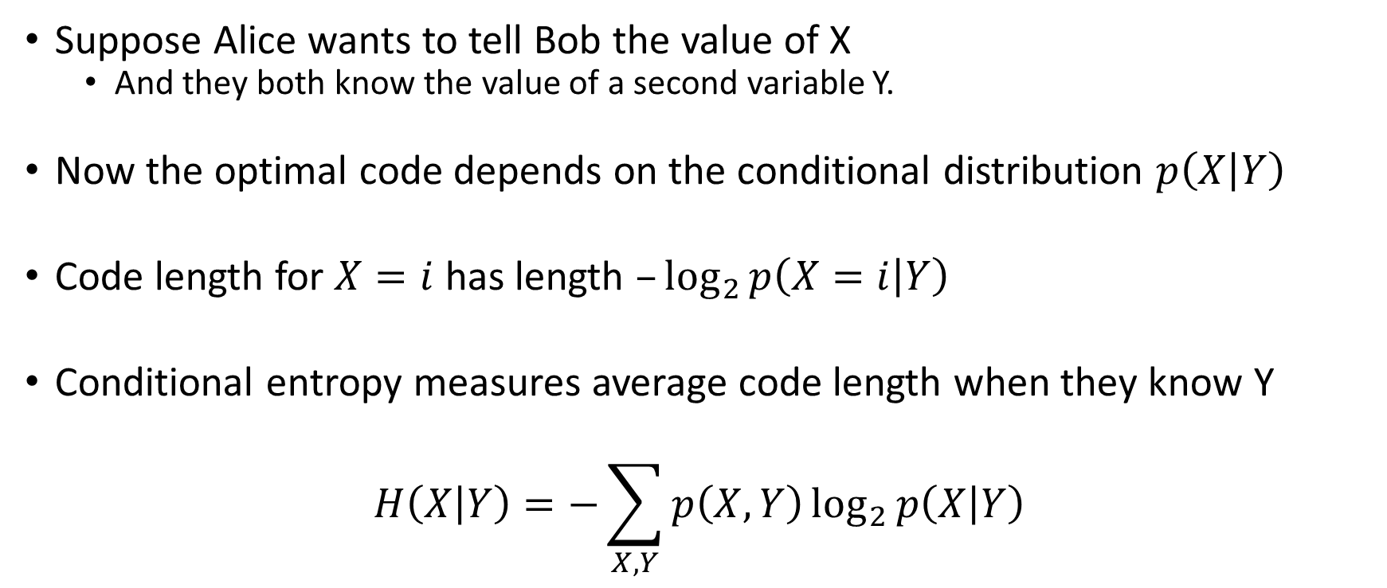
Conditional entropy
Suppose Alice wants to tell Bob the value of X
And they both know the value of a second variable Y.
Now the optimal code depends on the conditional distribution $p\left(X | Y\right)$
Code length for $X=i$ has length $–\log_{2}{p\left(X=i | Y\right)}$
Conditional entropy measures average code length when they know Y
$$H\left(X | Y\right)=−\sum_{X,Y}{p\left(X,Y\right)\log_{2}{p\left(X | Y\right)}}$$

Slide 9
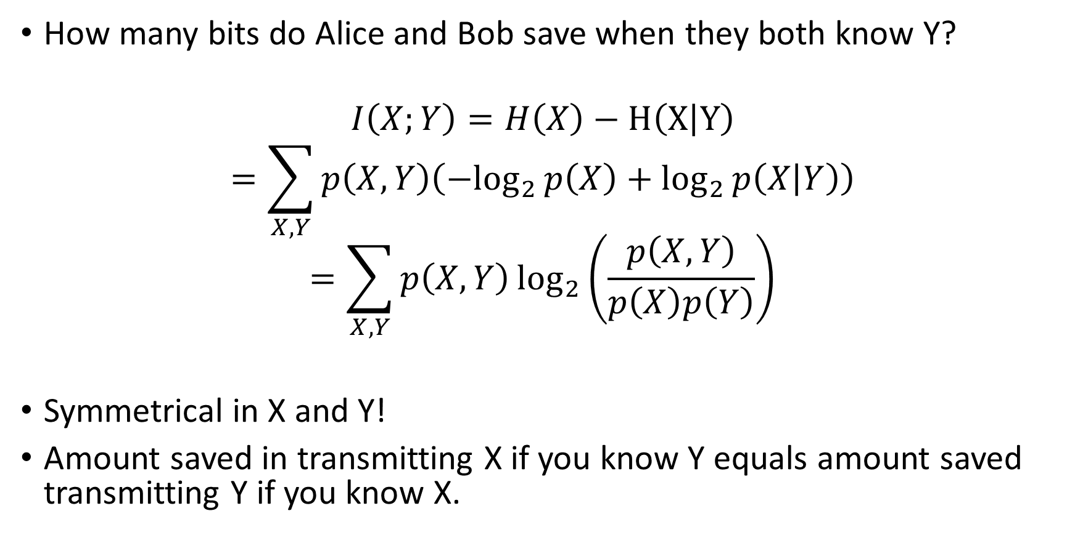
Mutual information
How many bits do Alice and Bob save when they both know Y?
$$I\left(X;Y\right)=H\left(X\right)−H\left(X | Y\right)$$
$$=\sum_{X,Y}{p\left(X,Y\right)\left({−log}_{2}{p\left(X\right)+\log_{2}{p\left(X | Y\right)}}\right)}$$
$$=\sum_{X,Y}{p\left(X,Y\right)\log_{2}\left(\frac{p\left(X,Y\right)}{p\left(X\right)p\left(Y\right)}\right)}$$
Symmetrical in X and Y!
Amount saved in transmitting X if you know Y equals amount saved transmitting Y if you know X.

Slide 10
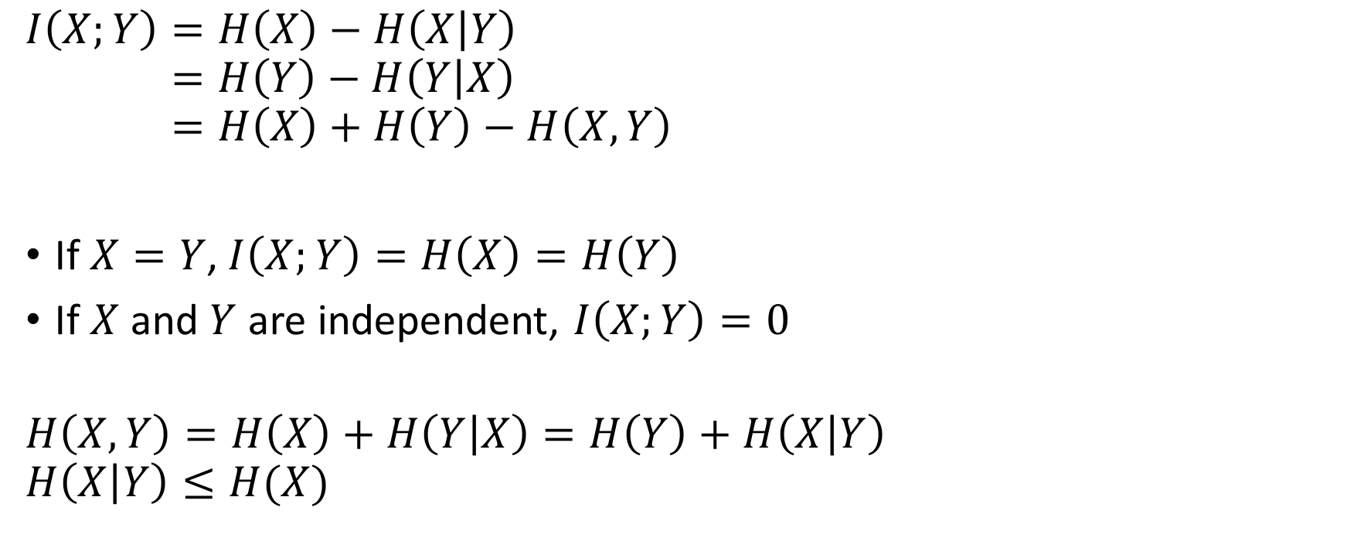
Properties of mutual information
$$I\left(X;Y\right)=H\left(X\right)−H\left(X | Y\right) \\ =H\left(Y\right)−H\left(Y | X\right) \\ =H\left(X\right)+H\left(Y\right)−H\left(X,Y\right)$$
If $X=Y$, $I\left(X;Y\right)=H\left(X\right)=H\left(Y\right)$
If $X$and $Y$ are independent, $I\left(X;Y\right)=0$
$$H\left(X,Y\right)=H\left(X\right)+H\left(Y | X\right)=H\left(Y\right)+H\left(X | Y\right) \\ H\left(X | Y\right)≤H(X)$$

Slide 11
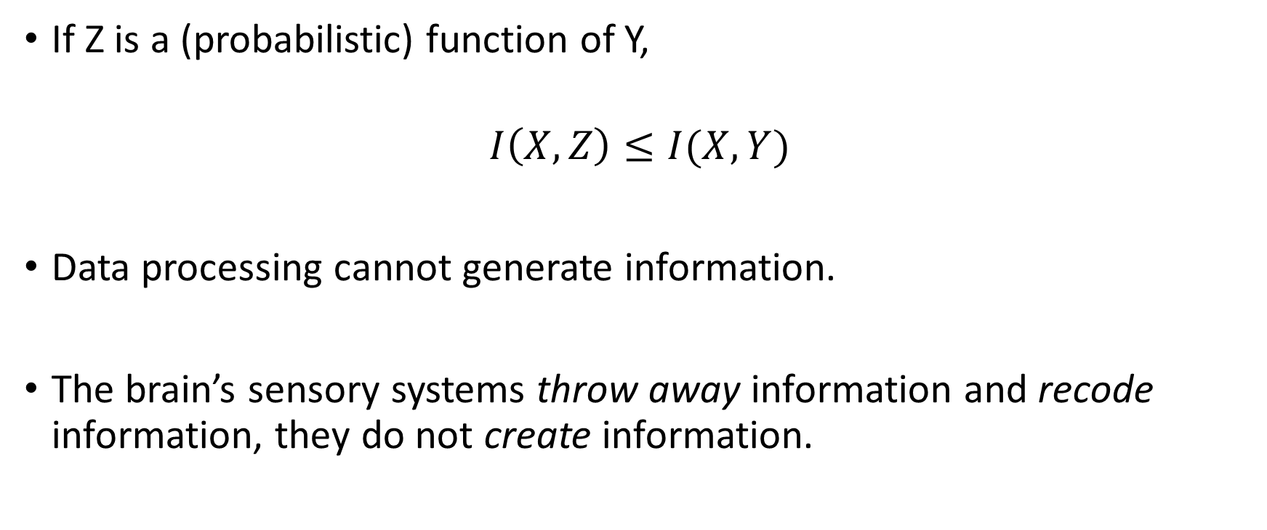
Data processing inequality
If Z is a (probabilistic) function of Y,
$$I\left(X,Z\right)≤I(X,Y)$$
Data processing cannot generate information.
The brain’s sensory systems throw away information and recode information, they do not create information.

Slide 12
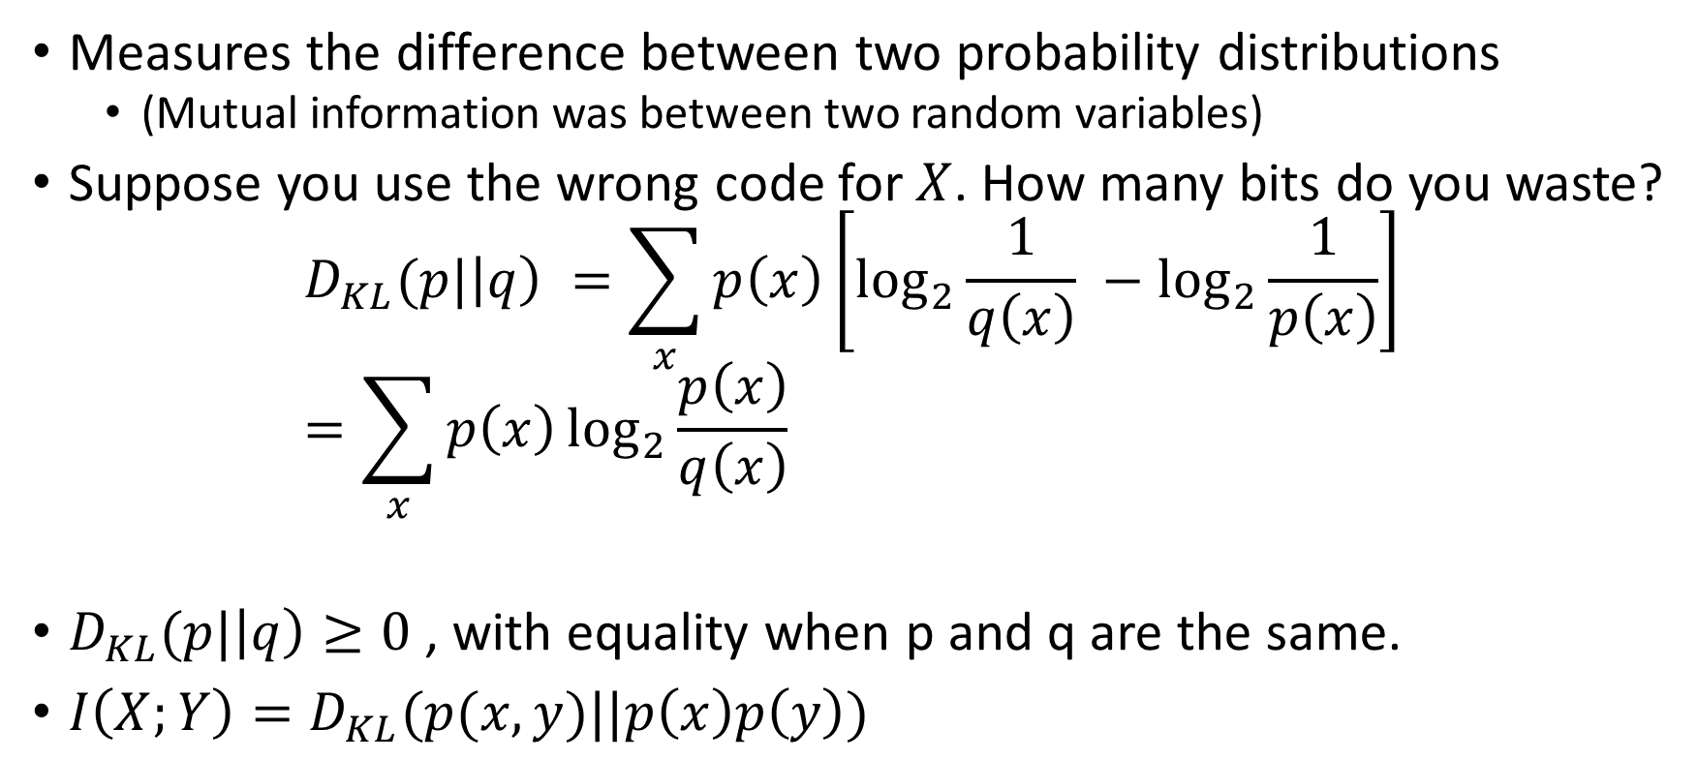
Kullback-Leibler divergence
Measures the difference between two probability distributions
(Mutual information was between two random variables)
Suppose you use the wrong code for $X$. How many bits do you waste?
$$D_{KL}(p|\left|q\right) =\sum_{x}{p\left(x\right)\left[\log_{2}{\frac{1}{q\left(x\right)} }−\log_{2}{\frac{1}{p\left(x\right)}}\right]} \\ =\sum_{x}{p\left(x\right)\log_{2}{\frac{p\left(x\right)}{q\left(x\right)} }}$$
$D_{KL}(p|\left|q\right)≥0$, with equality when p and q are the same.
$I\left(X;Y\right)=D_{KL}(p(x,y)||p\left(x\right)p\left(y\right))$
Length of codeword
Length of optimal codeword

Slide 13

Continuous variables
$X$ uniformly distributed between 0 and 1.
How many bits required to encode X to given accuracy?
Can we make any use of information theory for continuous variables?
Decimal places | Entropy
1 | 3.3219
2 | 6.6439
3 | 9.9658
4 | 13.2877
5 | 16.6096
Infinity | Infinity

Slide 14
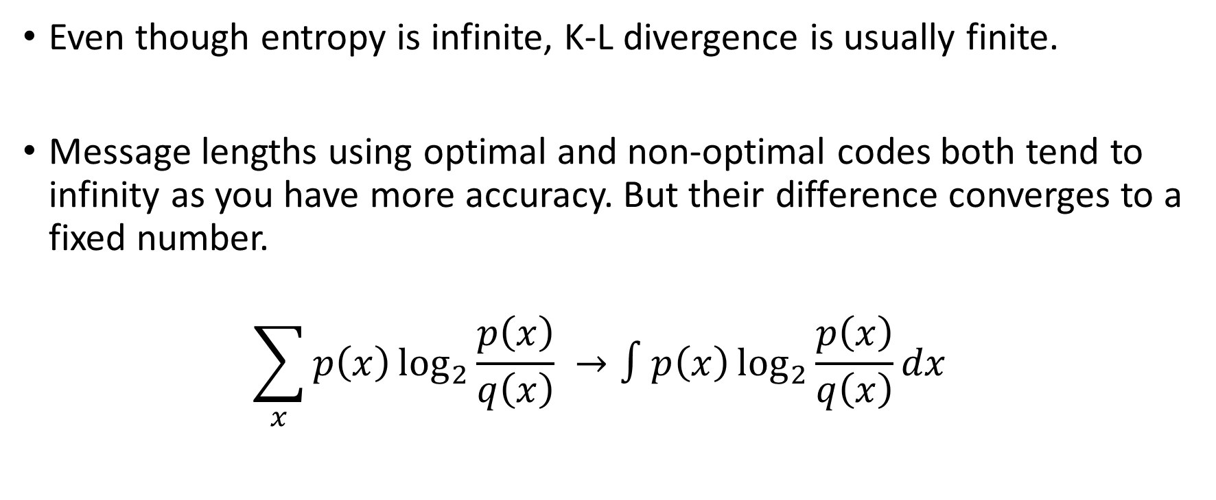
K-L divergence for continuous variables
Even though entropy is infinite, K-L divergence is usually finite.
Message lengths using optimal and non-optimal codes both tend to infinity as you have more accuracy. But their difference converges to a fixed number.
$$\sum_{x}{p\left(x\right)\log_{2}{\frac{p\left(x\right)}{q\left(x\right)} }}→∫p\left(x\right)\log_{2}{\frac{p\left(x\right)}{q\left(x\right)}}dx$$

Slide 15
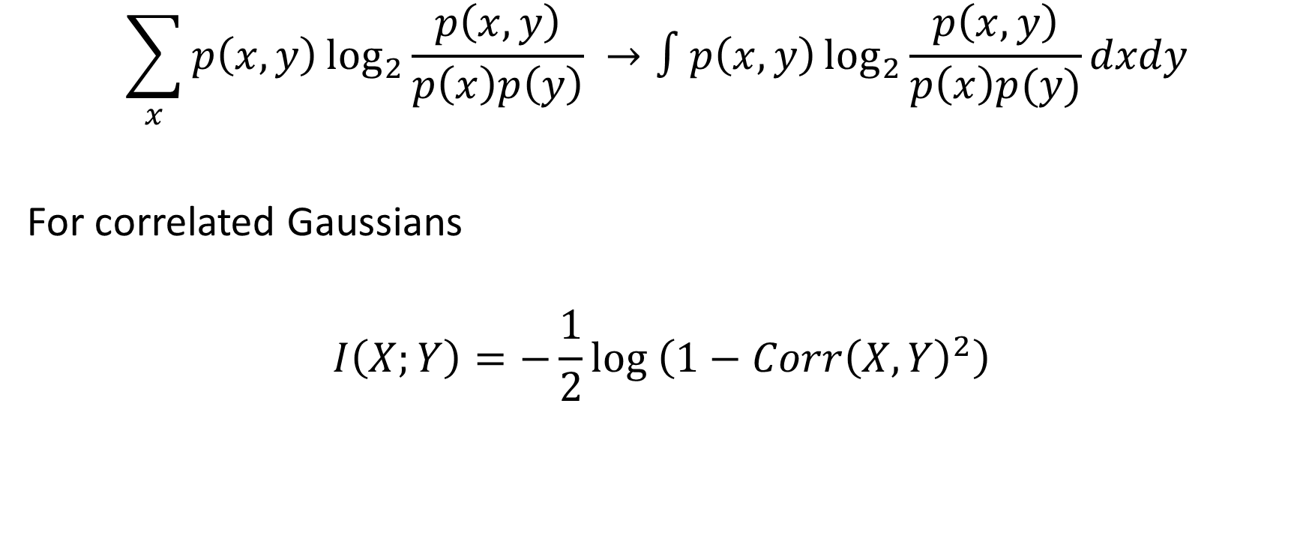
Mutual information of continuous variables
$$\sum_{x}{p\left(x,y\right)\log_{2}{\frac{p\left(x,y\right)}{p\left(x\right)p\left(y\right)} }}→∫p\left(x,y\right)\log_{2}{\frac{p\left(x,y\right)}{p\left(x\right)p(y)}}dxdy$$
For correlated Gaussians
$$I\left(X;Y\right)=−\frac{1}{2}\log\left(1−Corr{\left(X,Y\right)}^{2}\right)$$

Slide 16
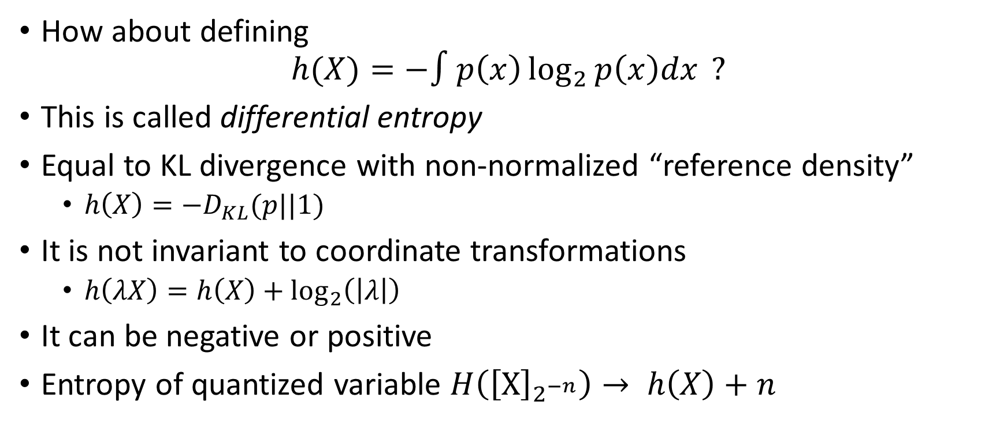
Differential entropy
How about defining
$$h(X)=−∫p\left(x\right)\log_{2}{p\left(x\right)dx }?$$
This is called differential entropy
Equal to KL divergence with non-normalized “reference density”
$h\left(X\right)=−D_{KL}(p||1)$
It is not invariant to coordinate transformations
$h\left(λX\right)=h\left(X\right)+\log_{2}\left(\left|λ\right|\right)$
It can be negative or positive
Entropy of quantized variable $H\left({\left[X\right]}_{2^{−n}}\right)→ h\left(X\right)+n$

Slide 17
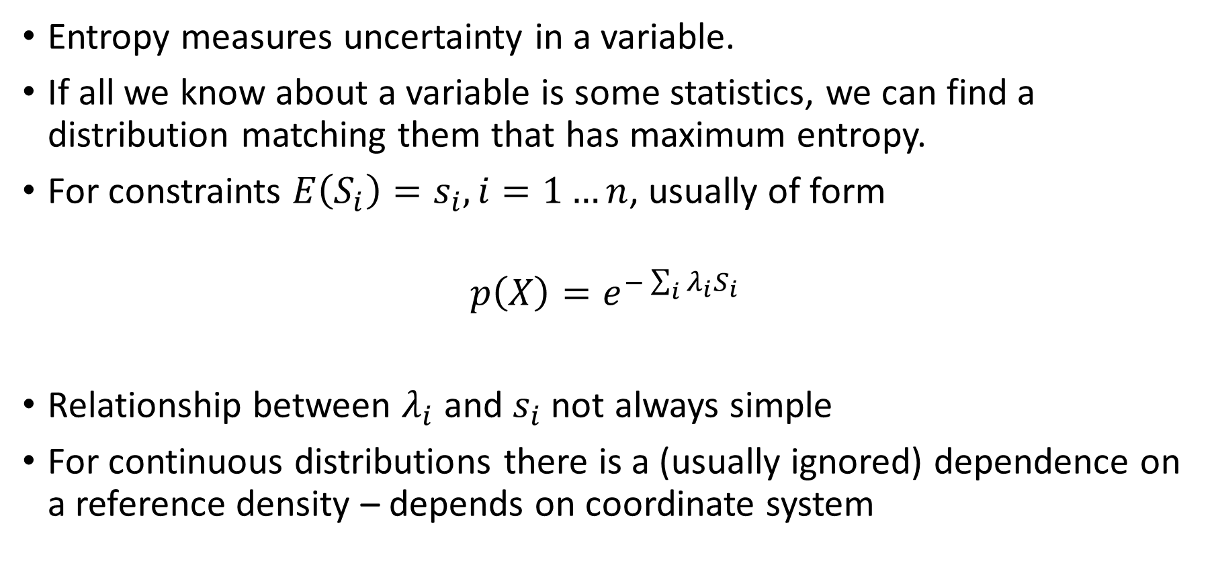
Maximum entropy distributions
Entropy measures uncertainty in a variable.
If all we know about a variable is some statistics, we can find a distribution matching them that has maximum entropy.
For constraints $E\left(S_{i}\right)=s_{i}, i=1…n$, usually of form
$$p\left(X\right)=e^{−\sum_{i}{{λ_{i}S}_{i}}}$$
Relationship between $λ_{i}$ and $s_{i}$ not always simple
For continuous distributions there is a (usually ignored) dependence on a reference density – depends on coordinate system

Slide 18
Examples of maximum entropy distributions
Data type | Statistic | Distribution
Continuous | Mean and variance | Gaussian
Non-negative continuous | Mean | Exponential
Continuous | Mean | Undefined
Angular | Circular mean and vector strength | Von Mises
Non-negative Integer | Mean | Geometric
Continuous stationary process | Autocovariance function | Gaussian process
Point process | Firing rate | Poisson process

Slide 19
In neuroscience…
We often want to compute the mutual information between a neural activity pattern, and a sensory variable.
If I want to tell you the sensory variable and we both know the activity pattern, how many bits can we save?
If I want to tell you the activity pattern, and we both know the sensory variable, how many bits can we save?

Slide 20
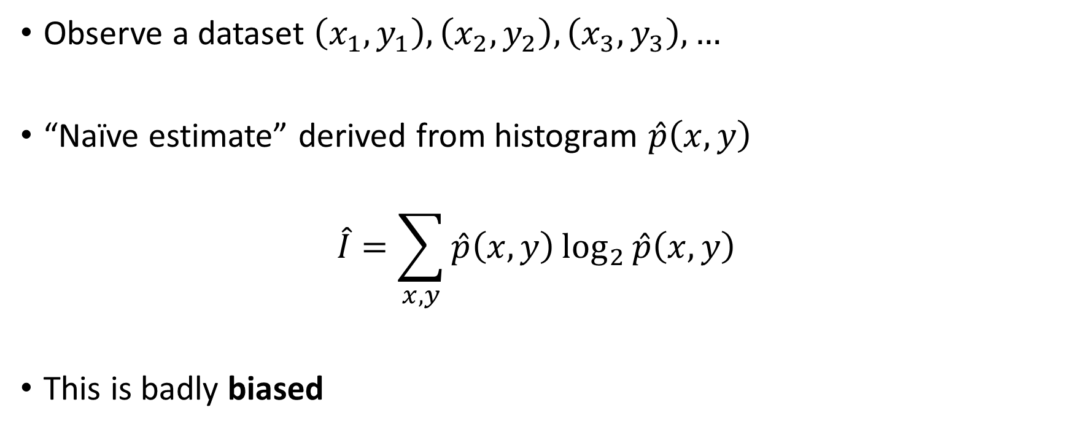
Estimating mutual information
Observe a dataset $\left(x_{1},y_{1}\right),\left(x_{2},y_{2}\right), \left(x_{3},y_{3}\right),…$
“Naïve estimate” derived from histogram $\hat{p}\left(x,y\right)$
$$\hat{I}=\sum_{x,y}{\hat{p}\left(x,y\right)\log_{2}{\hat{p}\left(x,y\right) }}$$
This is badly biased

Slide 21
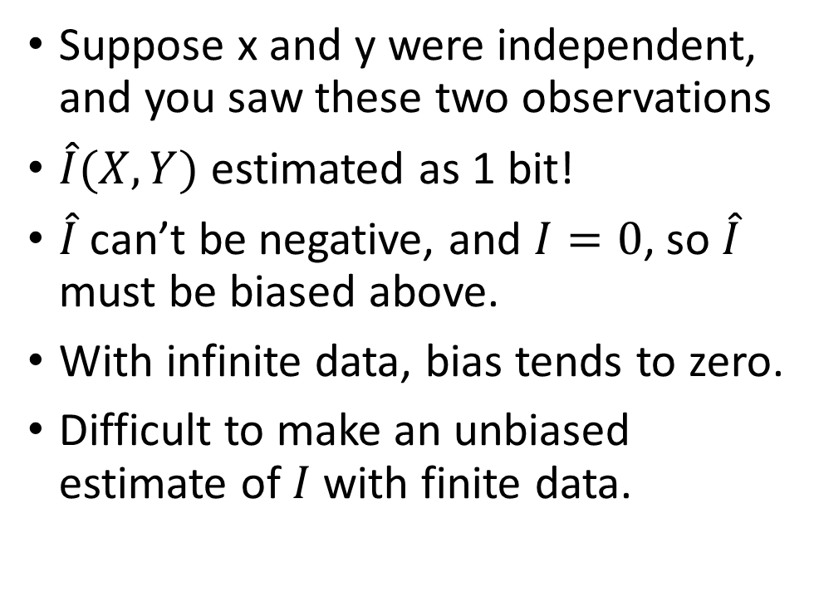
Naïve estimate
Suppose x and y were independent, and you saw these two observations
$\hat{I}(X,Y)$ estimated as 1 bit!
$\hat{I}$ can’t be negative, and $I=0$, so $\hat{I}$ must be biased above.
With infinite data, bias tends to zero.
Difficult to make an unbiased estimate of $I$ with finite data.
 | X=0 | X=1
Y=0 | 0 | 1
Y=1 | 1 | 0

