Slide 1
Predictions 1. Multiple linear regression
Kenneth D. Harris
April 29, 2015

Slide 2
Predictions in neurophysiology
Predict neuronal activity from sensory stimulus/behaviour
“encoding model”
Predict stimulus/behaviour from neuronal activity
“decoding model”
In principle, these are equivalent. In practice, very different.

Slide 3
Different types of prediction
What are you predicting?
Data type
Dimensionality
What are you predicting it from?
Data type
Dimensionality
How many data points do you have?
What sort of prediction do you need?
What sort of relationship can you assume?

Slide 4
Different types of prediction
What are you predicting?
Data type | Continuous, binary, count, nominal
Dimensionality
What are you predicting it from?
Data type | Continuous, binary, count, nominal
Dimensionality
How many data points do you have?
What sort of prediction do you need?
What sort of relationship can you assume?

Slide 5
Different types of prediction
What are you predicting?
Data type | Continuous, binary, count, nominal
Dimensionality
What are you predicting it from?
Data type | Continuous, binary, count, nominal
Dimensionality
How many data points do you have?
What sort of prediction do you need? | Probability distribution, or single best guess?
What sort of relationship can you assume?

Slide 6
Different types of prediction
What are you predicting?
Data type | Continuous, binary, count, nominal
Dimensionality
What are you predicting it from?
Data type | Continuous, binary, count, nominal
Dimensionality
How many data points do you have? | N
What sort of prediction do you need? | Probability distribution, or single best guess?
What sort of relationship can you assume?

Slide 7
Different types of prediction
What are you predicting?
Data type | Continuous, binary, count, nominal
Dimensionality
What are you predicting it from?
Data type | Continuous, binary, count, nominal
Dimensionality | p
How many data points do you have? | N
What sort of prediction do you need? | Probability distribution, or single best guess?
What sort of relationship can you assume?

Slide 8
Different types of prediction
What are you predicting?
Data type | Continuous, binary, count, nominal
Dimensionality | Often irrelevant (assume independent predictions)
What are you predicting it from?
Data type | Continuous, binary, count, nominal
Dimensionality | p
How many data points do you have? | N
What sort of prediction do you need? | Probability distribution, or single best guess?
What sort of relationship can you assume?

Slide 9
Different types of prediction
What are you predicting?
Data type | Continuous, binary, count, nominal
Dimensionality | Often irrelevant (assume independent predictions)
What are you predicting it from?
Data type | Continuous, binary, count, nominal
Dimensionality | p
How many data points do you have? | N
What sort of prediction do you need? | Probability distribution, or single best guess?
What sort of relationship can you assume? | Lots of choices…

Slide 10
Linear regression, no offset
What are you predicting?
Data type | Continuous
Dimensionality | 1
What are you predicting it from?
Data type | Continuous
Dimensionality | 1
How many data points do you have? | Enough
What sort of prediction do you need? | Single best guess
What sort of relationship can you assume? | Linear

Slide 11
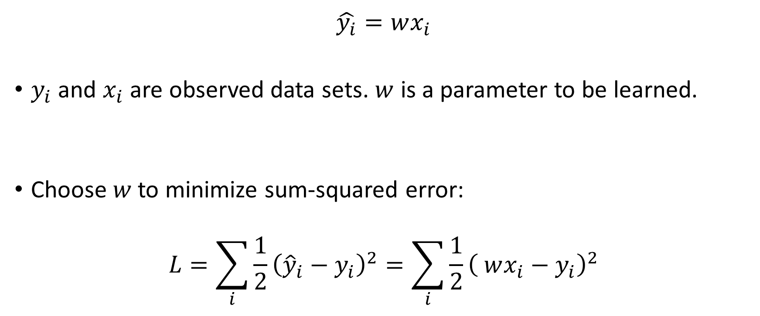
Linear regression, no offset
$$\hat{y_{i}}=wx_{i}$$
$y_{i}$ and $x_{i}$ are observed data sets. $w$ is a parameter to be learned.
Choose $w$to minimize sum-squared error:
$$L=\sum_{i}{{\frac{1}{2}\left({\hat{y}}_{i}−y_{i}\right)}^{2}}=\sum_{i}{{\frac{1}{2}\left( wx_{i}−y_{i}\right)}^{2}}$$

Slide 12
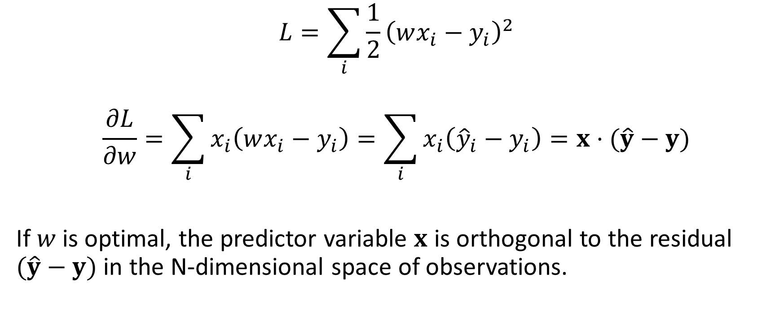

What is optimal $w$?
$$L=\sum_{i}{{\frac{1}{2}\left(wx_{i}−y_{i}\right)}^{2}}$$
$$\frac{∂L}{∂w}=\sum_{i}{x_{i}\left(wx_{i}−y_{i}\right)}=\sum_{i}{x_{i}\left({\hat{y}}_{i}−y_{i}\right)=x⋅(\hat{y}−y)}$$
If $w$is optimal, the predictor variable $x$ is orthogonal to the residual $(\hat{y}−y)$ in the N-dimensional space of observations.

Slide 13




Geometric picture
Circle of equal error
Target $y$
$$Residual y−\hat{y}$$
Predictor $x$
$$Fit \hat{y}$$

Slide 14
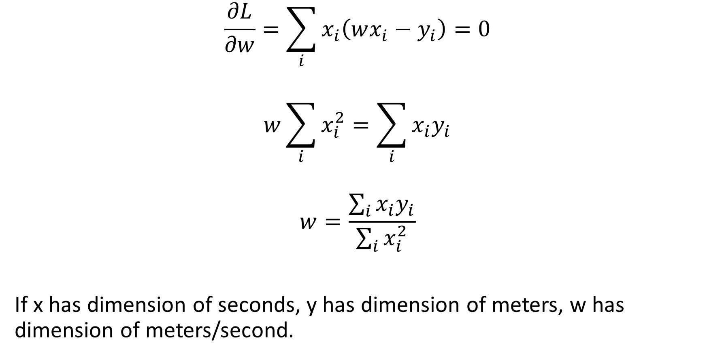
What is optimal $w$?
$$\frac{∂L}{∂w}=\sum_{i}{x_{i}\left(wx_{i}−y_{i}\right)}=0$$
$$w\sum_{i}{x_{i}^{2}}=\sum_{i}{x_{i}y_{i}}$$
$$w=\frac{\sum_{i}{x_{i}y_{i}}}{\sum_{i}{x_{i}^{2}}}$$
If x has dimension of seconds, y has dimension of meters, w has dimension of meters/second.

Slide 15


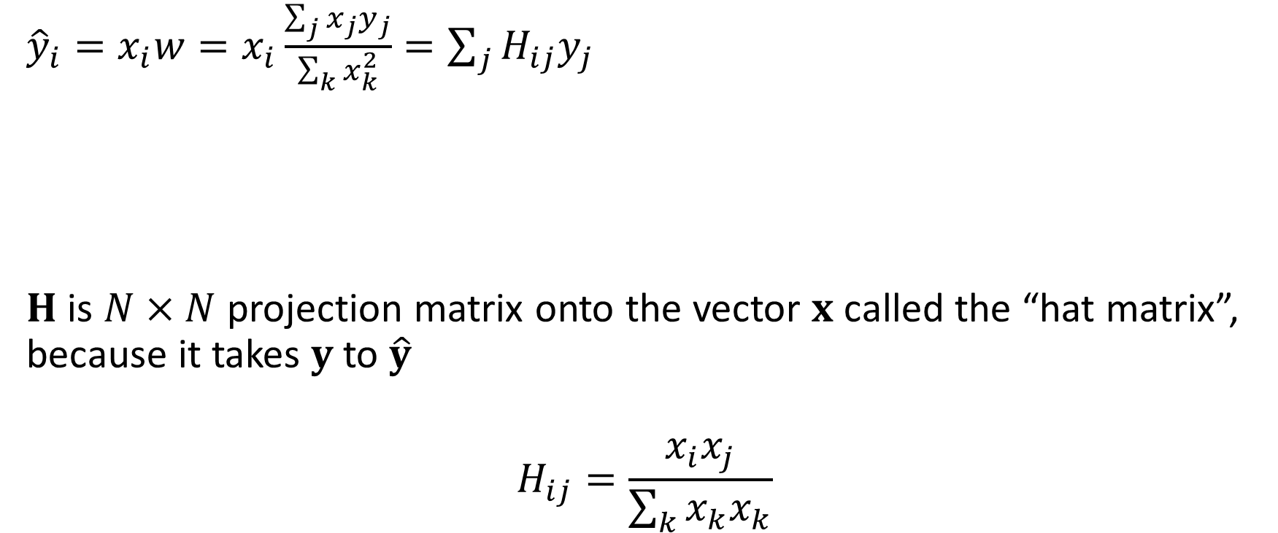

Geometric picture
Target $y$
${\hat{y}}_{i}=x_{i}w=x_{i}\frac{\sum_{j}{x_{j}y_{j}}}{\sum_{k}{x_{k}^{2}}}=\sum_{j}{H_{ij}y_{j}}$
$H$ is $N×N$ projection matrix onto the vector $x$ called the “hat matrix”, because it takes $y$to $\hat{y}$
$$H_{ij}=\frac{x_{i}x_{j}}{\sum_{k}{x_{k}x_{k}}}$$
Predictor $x$
$$\hat{y}=Hy$$

Slide 16
Multiple linear regression, no offset
What are you predicting?
Data type | Continuous
Dimensionality | 1
What are you predicting it from?
Data type | Continuous
Dimensionality | p
How many data points do you have? | Enough
What sort of prediction do you need? | Single best guess
What sort of relationship can you assume? | Linear

Slide 17




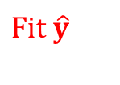
Geometric picture
Predictor $x_{2}$
Target $y$
$$Residual \hat{y}$$
Predictor $x_{1}$
$$Fit \hat{y}$$
This is the $N$-dimensional space of one predictor on all trials,
NOT the p-dimensional space of all predictors on a single trial

Slide 18
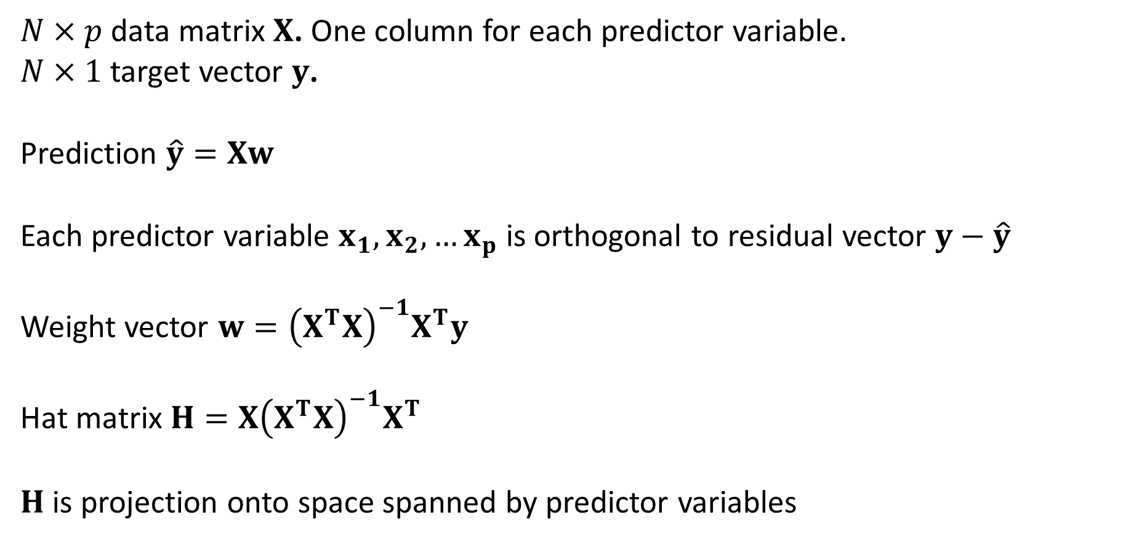
Multiple linear regression
$N×p$data matrix $X$. One column for each predictor variable.
$N×1$target vector $y$.
Prediction $\hat{y}=Xw$
Each predictor variable $x_{1},x_{2},…x_{p}$ is orthogonal to residual vector $y−\hat{y}$
Weight vector $w={\left(X^{T}X\right)}^{−1}X^{T}y$
Hat matrix $H={X\left(X^{T}X\right)}^{−1}X^{T}$
$H$is projection onto space spanned by predictor variables

Slide 19
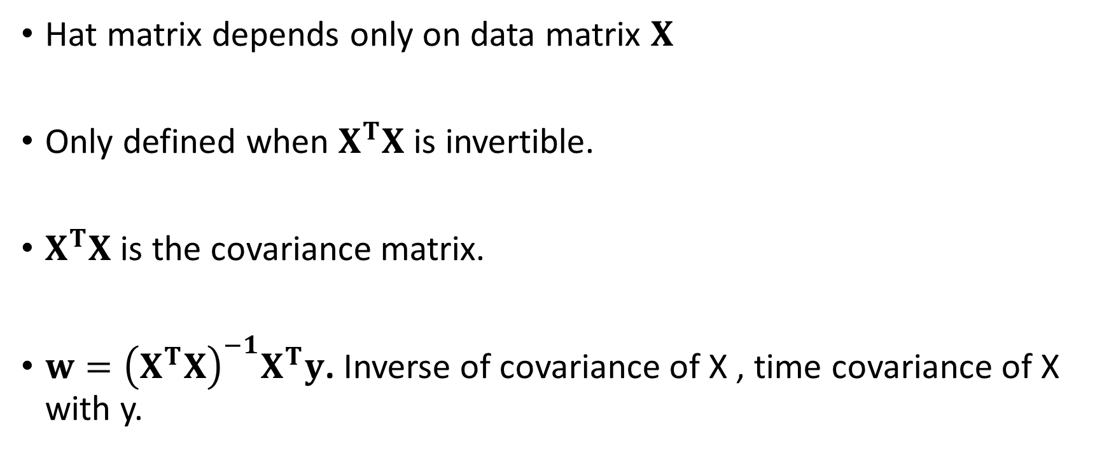
Things to remember
Hat matrix depends only on data matrix $X$
Only defined when $X^{T}X$ is invertible.
$X^{T}X$ is the covariance matrix.
$w={\left(X^{T}X\right)}^{−1}X^{T}y$. Inverse of covariance of X , time covariance of X with y.

Slide 20

What about offsets?
“Classical” linear regression: $y=mx+c$.
Add a column of all ones to $X$.
Then $Xw→Xw+w_{0}$

