Slide 1
Ridge regression and Bayesian linear regression
Kenneth D. Harris
6/5/15

Slide 2
Multiple linear regression
What are you predicting?
Data type | Continuous
Dimensionality | 1
What are you predicting it from?
Data type | Continuous
Dimensionality | p
How many data points do you have? | Enough
What sort of prediction do you need? | Single best guess
What sort of relationship can you assume? | Linear

Slide 3
Multiple linear regression
What are you predicting?
Data type | Continuous
Dimensionality | 1
What are you predicting it from?
Data type | Continuous
Dimensionality | p
How many data points do you have? | Not enough
What sort of prediction do you need? | Single best guess
What sort of relationship can you assume? | Linear

Slide 4
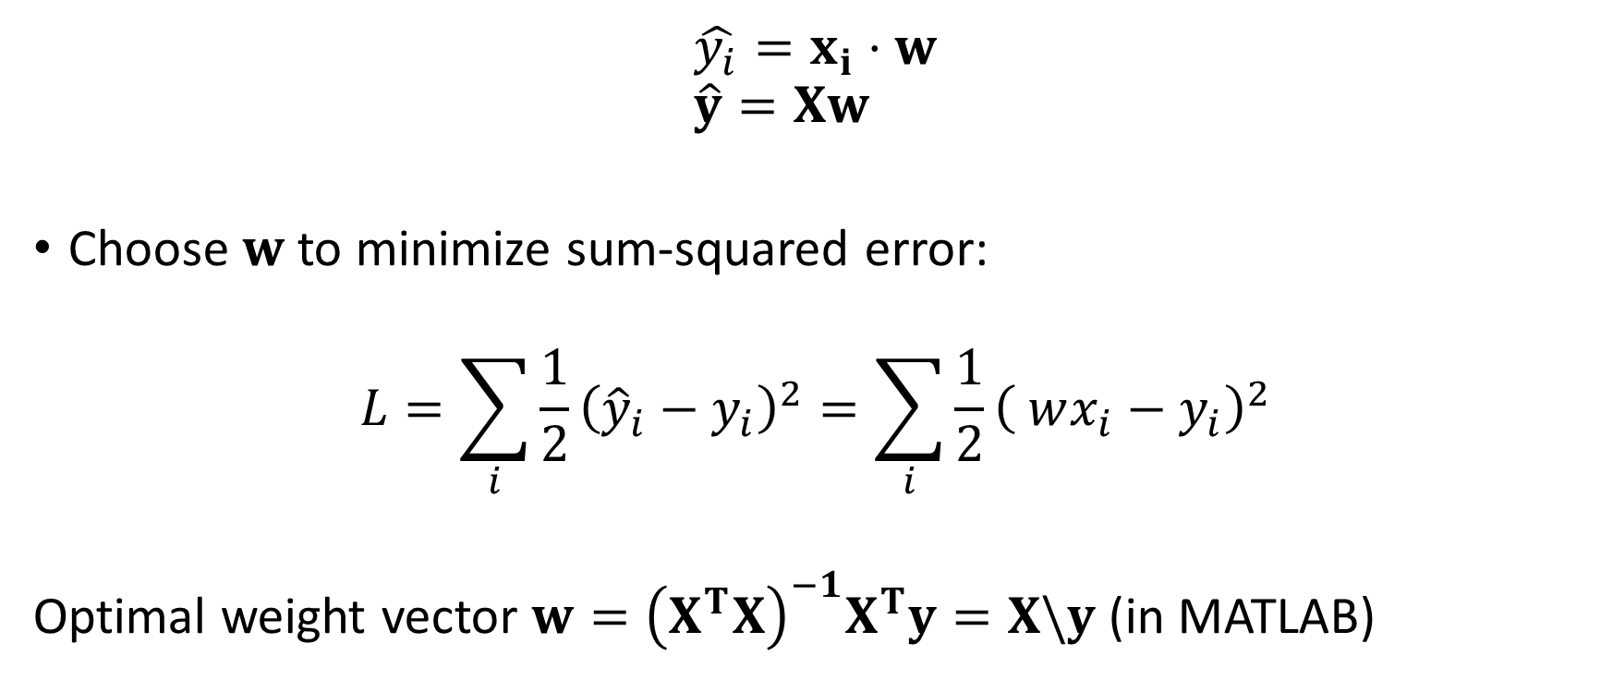
Multiple predictors, one predicted variable
$$\hat{y_{i}}=x_{i}⋅w \\ \hat{y}=Xw$$
Choose $w$to minimize sum-squared error:
$$L=\sum_{i}{{\frac{1}{2}\left({\hat{y}}_{i}−y_{i}\right)}^{2}}=\sum_{i}{{\frac{1}{2}\left( wx_{i}−y_{i}\right)}^{2}}$$
Optimal weight vector $w={\left(X^{T}X\right)}^{−1}X^{T}y=X\backslash y$ (in MATLAB)

Slide 5
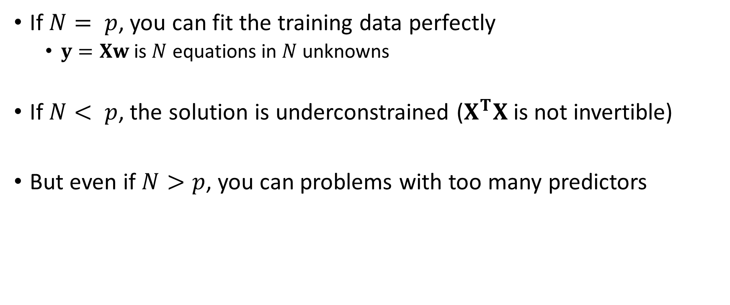
Too many predictors
If $N= p$, you can fit the training data perfectly
$y=Xw$ is $N$ equations in $N$ unknowns
If $N< p$, the solution is underconstrained ($X^{T}X$ is not invertible)
But even if $N>p$, you can problems with too many predictors

Slide 6
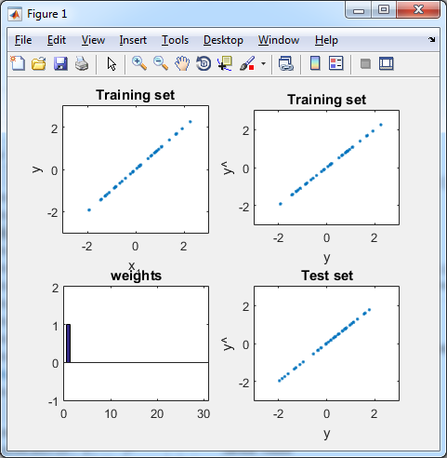
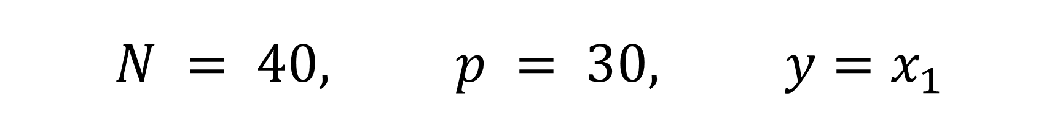
$$N = 40, p = 30, y=x_{1}$$

Slide 7
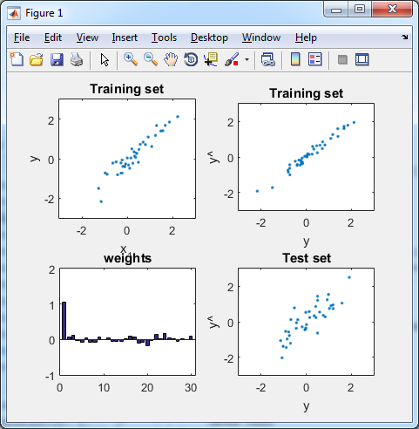
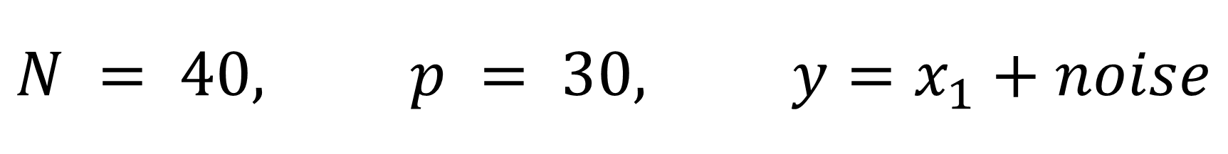
$$N = 40, p = 30, y=x_{1}+noise$$

Slide 8
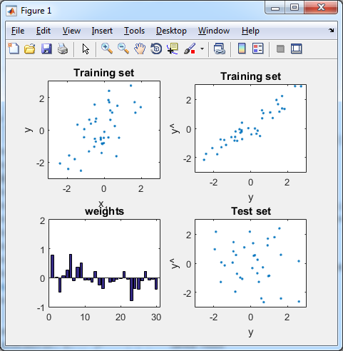
$$N = 40, p = 30, y=x_{1}+noise$$

Slide 9



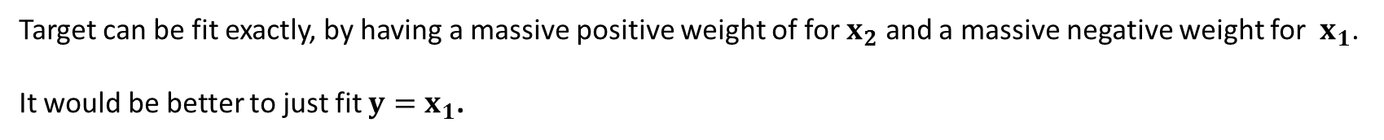
Geometric interpretation
Noise
Target $y$
$$x_{2}$$
$$x_{1}$$
Signal
Target can be fit exactly, by having a massive positive weight of for $x_{2}$ and a massive negative weight for $x_{1}$.
It would be better to just fit $y=x_{1}$.

Slide 10
Geometric interpretation
Noise
Target $y$
$$x_{2}$$
$$x_{1}$$
Signal
Target can be fit exactly, by having a massive positive weight of for $x_{2}$ and a massive negative weight for $x_{1}$.
It would be better to just fit $y=x_{1}$.

Slide 11
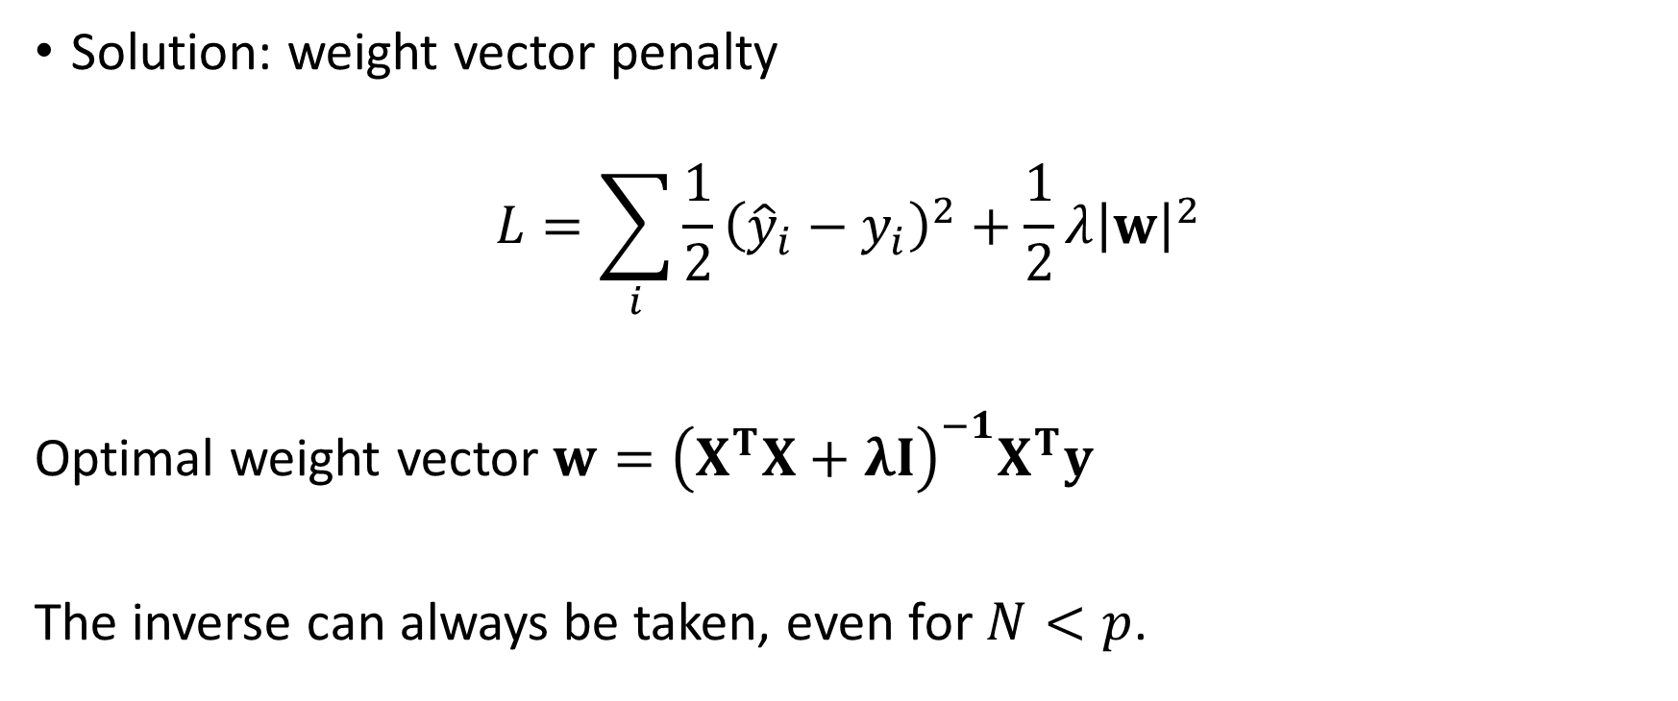
Overfitting = large weight vectors
Solution: weight vector penalty
$$L=\sum_{i}{{\frac{1}{2}\left({\hat{y}}_{i}−y_{i}\right)}^{2}}+\frac{1}{2}λ{\left|w\right|}^{2}$$
Optimal weight vector $w={\left(X^{T}X+λI\right)}^{−1}X^{T}y$
The inverse can always be taken, even for $N<p$.

Slide 12
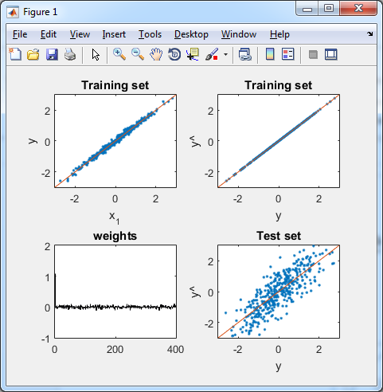
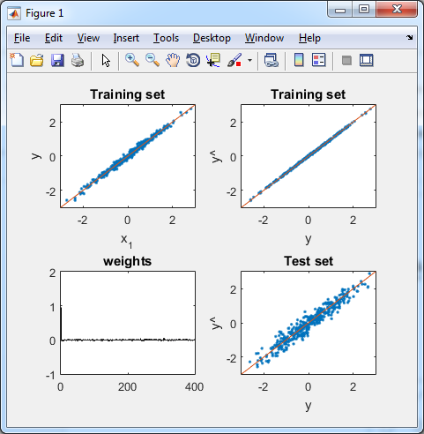


Example
$$λ=0$$
$$λ=3$$

Slide 13
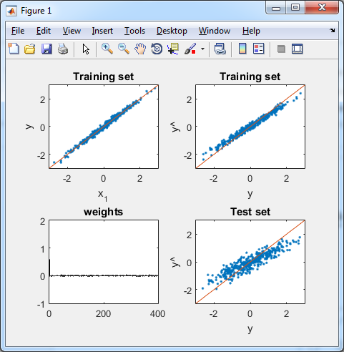


Ridge regression introduces a bias
$$λ=0$$
$$λ=50$$

Slide 14
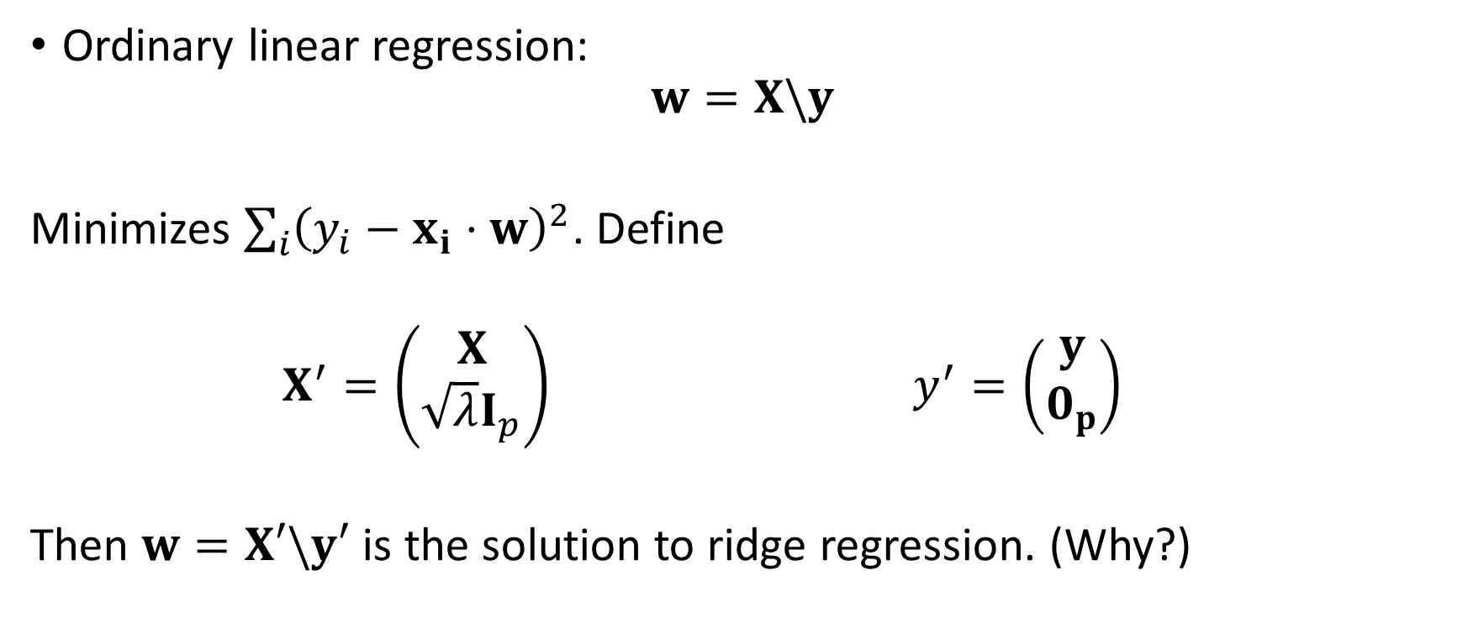
A quick trick to do ridge regression
Ordinary linear regression:
$$w=X\backslash y$$
Minimizes $\sum_{i}{{\left(y_{i}−x_{i}⋅w\right)}^{2}}$. Define
$X^{′}=\left(\begin{matrix}X \\ \sqrt{λ}I_{p}\end{matrix}\right)$ $y^{′}=\left(\begin{matrix}y \\ 0_{p}\end{matrix}\right)$
Then $w=X′\backslash y′$ is the solution to ridge regression. (Why?)

Slide 15
Regression as a probability model
What are you predicting?
Data type | Continuous
Dimensionality | 1
What are you predicting it from?
Data type | Continuous
Dimensionality | p
How many data points do you have? | Enough
What sort of prediction do you need? | Probability distribution
What sort of relationship can you assume? | Linear

Slide 16
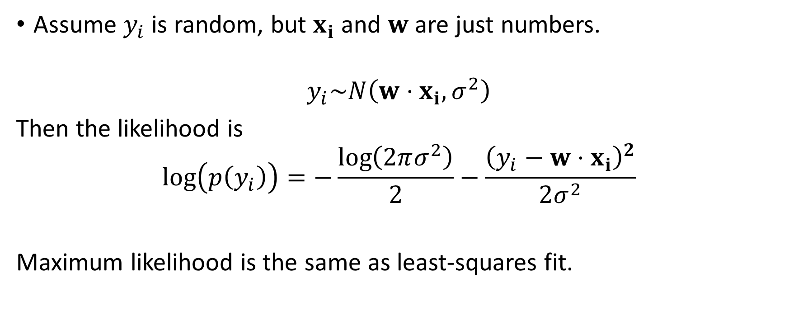
Regression as a probability model
Assume $y_{i}$ is random, but $x_{i}$ and $w$ are just numbers.
$$y_{i}\sim N\left(w⋅x_{i}, σ^{2}\right)$$
Then the likelihood is
$$\log\left(p\left(y_{i}\right)\right)=−\frac{\log\left(2πσ^{2}\right)}{2}−\frac{{\left(y_{i}−w⋅x_{i}\right)}^{2}}{2σ^{2}}$$
Maximum likelihood is the same as least-squares fit.

Slide 17
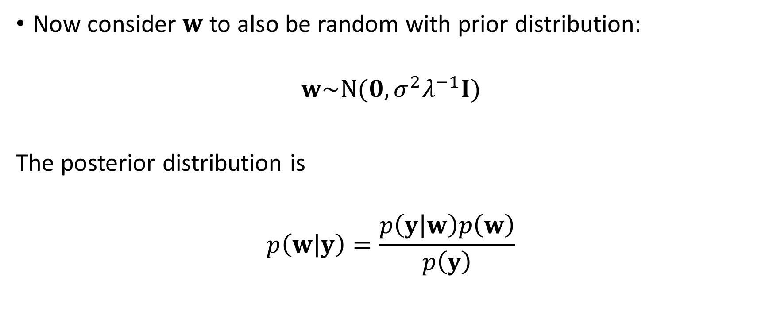
Bayesian linear regression
Now consider $w$ to also be random with prior distribution:
$$w\sim N(0, {σ^{2}λ}^{−1}I)$$
The posterior distribution is
$$p\left(w | y\right)=\frac{p\left(y | w\right)p\left(w\right)}{p\left(y\right)}$$

Slide 18
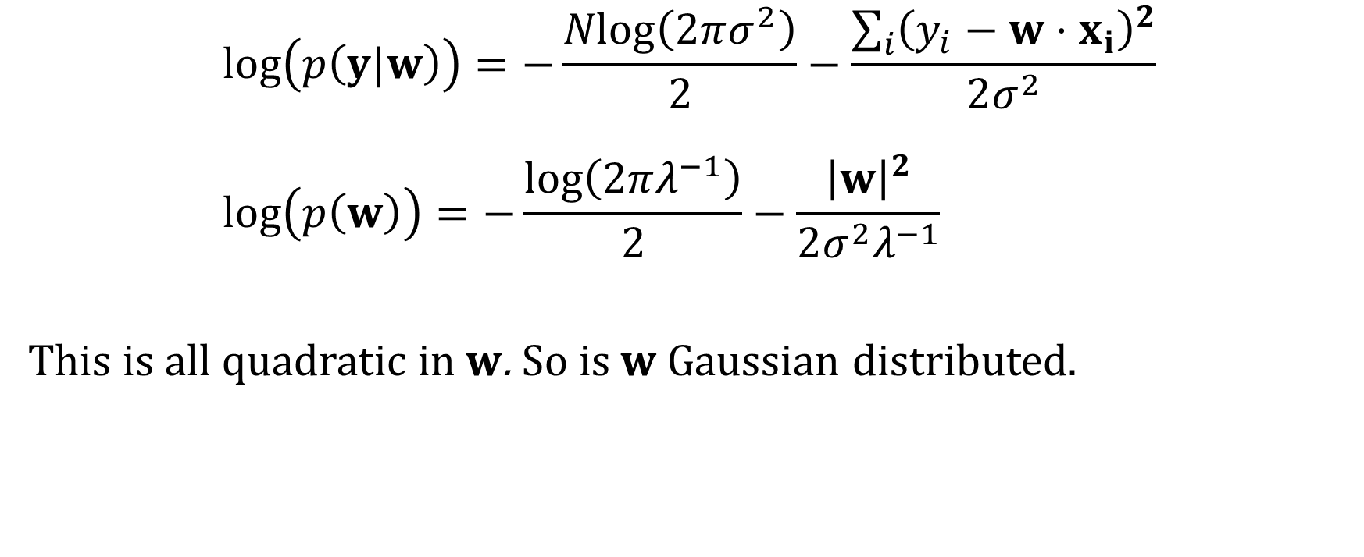
Bayesian linear regression
$$\log\left(p\left(y|w\right)\right)=−\frac{\operatorname{Nlog}\left(2πσ^{2}\right)}{2}−\frac{\sum_{i}{{\left(y_{i}−w⋅x_{i}\right)}^{2}}}{2σ^{2}} \\ \log\left(p\left(w\right)\right)=−\frac{\log\left(2πλ^{−1}\right)}{2}−\frac{{\left|w\right|}^{2}}{2{σ^{2}λ}^{−1}}$$
This is all quadratic in $w$. So is $w$Gaussian distributed. $$⁡$$

Slide 19
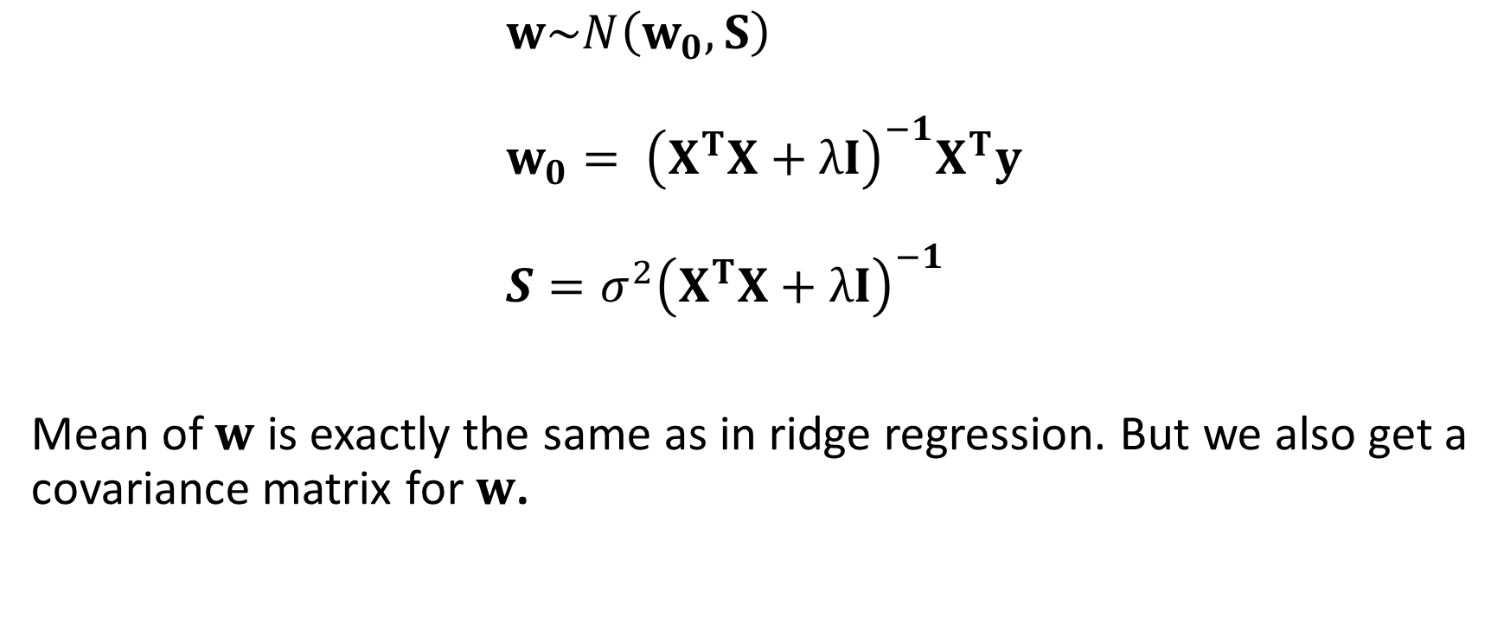
Bayesian linear regression
$$w\sim N\left(w_{0},S\right) \\ w_{0}= {\left(X^{T}X+λI\right)}^{−1}X^{T}y \\ S={σ^{2}\left(X^{T}X+λI\right)}^{−1}$$
Mean of $w$ is exactly the same as in ridge regression. But we also get a covariance matrix for $w$.

Slide 20
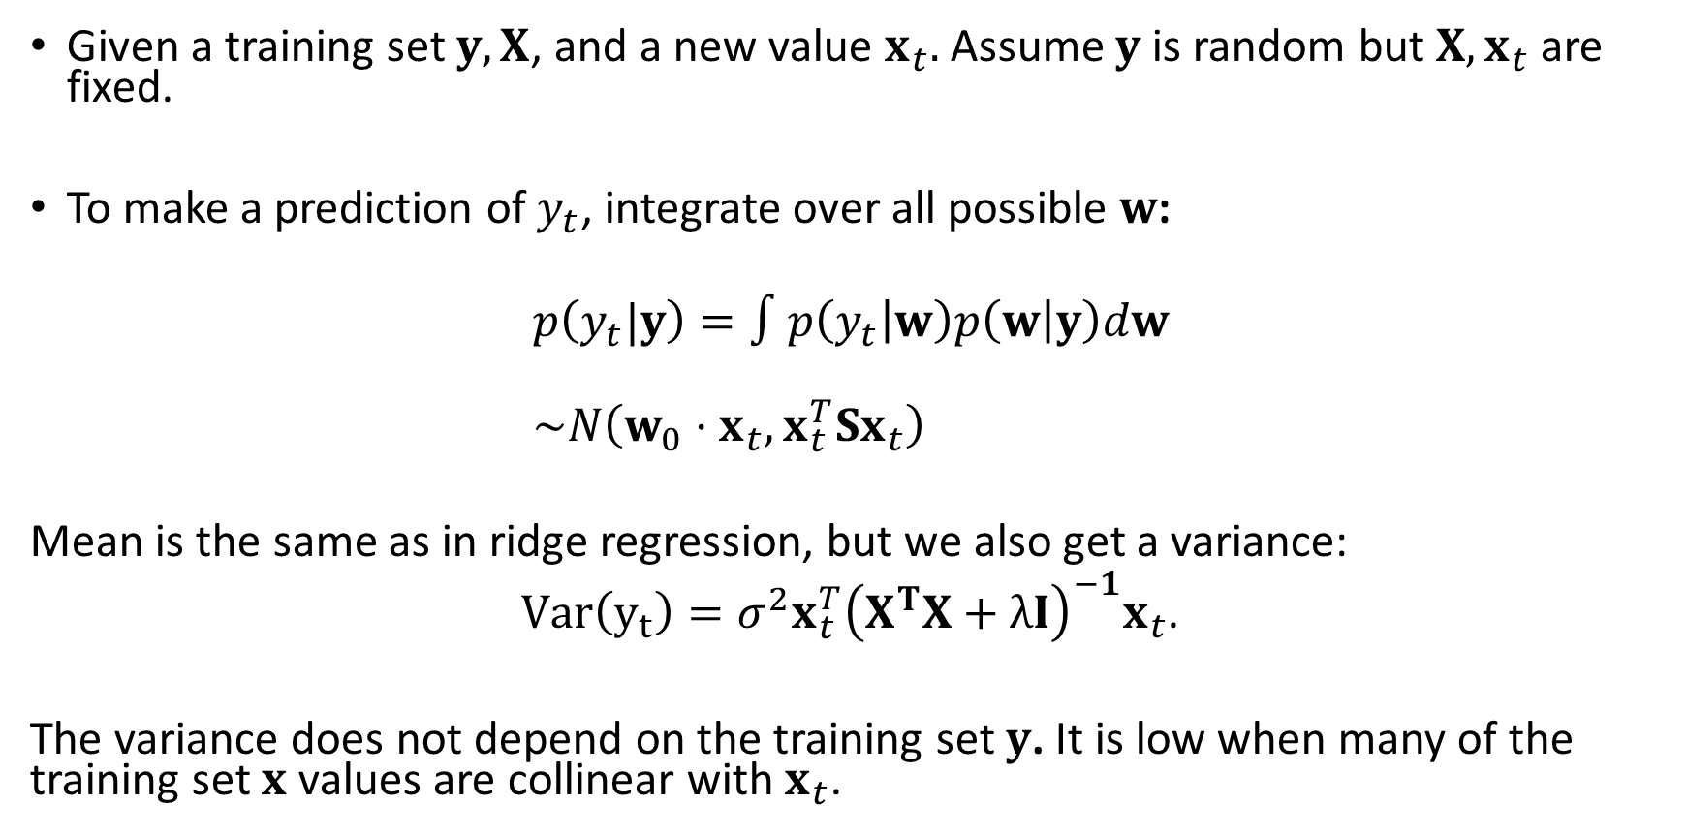
Bayesian predictions
Given a training set $y, X$, and a new value $x_{t}.$Assume $y$ is random but $X, x_{t}$ are fixed.
To make a prediction of $y_{t}$, integrate over all possible $w$:
$$p\left(y_{t}|y\right)=∫p\left(y_{t} | w\right)p\left(w | y\right)dw \\ \sim N\left(w_{0}⋅x_{t}, x_{t}^{T}Sx_{t}\right)$$
Mean is the same as in ridge regression, but we also get a variance:
$Var\left(y_{t}\right)={σ^{2}x_{t}^{T}\left(X^{T}X+λI\right)}^{−1}x_{t}$.
The variance does not depend on the training set $y$. It is low when many of the training set $x$ values are collinear with $x_{t}$.

