Slide 1
Lasso, Support Vector Machines, Generalized linear models
Kenneth D. Harris
20/5/15

Slide 2
Multiple linear regression
What are you predicting?
Data type | Continuous
Dimensionality | 1
What are you predicting it from?
Data type | Continuous
Dimensionality | p
How many data points do you have? | Enough
What sort of prediction do you need? | Single best guess
What sort of relationship can you assume? | Linear

Slide 3
Ridge regression
What are you predicting?
Data type | Continuous
Dimensionality | 1
What are you predicting it from?
Data type | Continuous
Dimensionality | p
How many data points do you have? | Not enough
What sort of prediction do you need? | Single best guess
What sort of relationship can you assume? | Linear

Slide 4
Regression as a probability model
What are you predicting?
Data type | Continuous
Dimensionality | 1
What are you predicting it from?
Data type | Continuous
Dimensionality | p
How many data points do you have? | Not enough
What sort of prediction do you need? | Probability distribution
What sort of relationship can you assume? | Linear

Slide 5
Different data types
What are you predicting?
Data type | Discrete, integer, whatever
Dimensionality | 1
What are you predicting it from?
Data type | Continuous
Dimensionality | p
How many data points do you have? | Not enough
What sort of prediction do you need? | Single best guess
What sort of relationship can you assume? | Linear – nonlinear

Slide 6
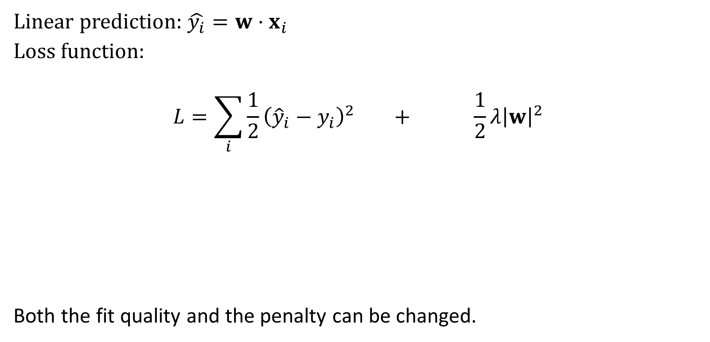
Ridge regression
Linear prediction: $\hat{y_{i}}=w⋅x_{i}$
Loss function:
$$L=\sum_{i}{{\frac{1}{2}\left({\hat{y}}_{i}−y_{i}\right)}^{2}} + \frac{1}{2}λ{\left|w\right|}^{2}$$
Both the fit quality and the penalty can be changed.
Fit quality
Penalty

Slide 7
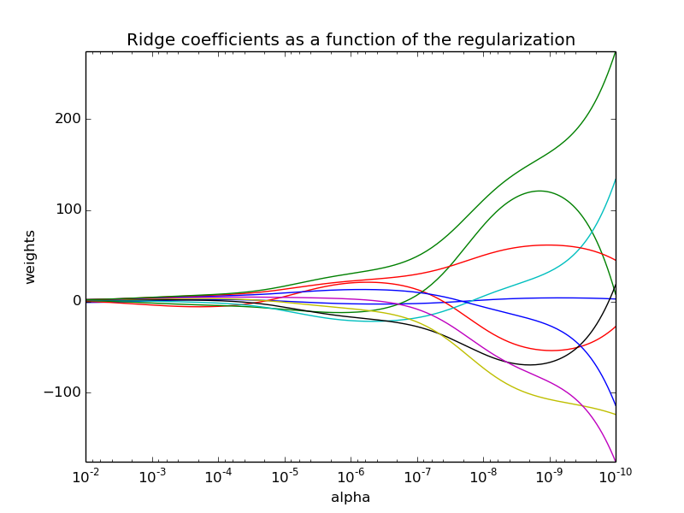
“Regularization path” for ridge regression
http://scikit-learn.org/stable/auto_examples/linear_model/plot_ridge_path.html

Slide 8

Changing the penalty
$\left|w\right|=\sqrt{\sum_{i}{w_{i}^{2}}}$ is called the “$L_{2}$ norm”
${\left|w\right|}_{1} =\sum_{i}{\left|w_{i}\right|}$ is called the “$L_{1}$ norm”
In general ${\left|w\right|}_{p} =\sqrt[p]{\sum_{i}{{\left|w_{i}\right|}^{p}}}$ is called the “$L_{p}$ norm”

Slide 9

The LASSO
Loss function:
$$L=\sum_{i}{{\frac{1}{2}\left({\hat{y}}_{i}−y_{i}\right)}^{2}} + \frac{1}{2}λ{\left|w\right|}_{1}$$
Fit quality
Penalty

Slide 10
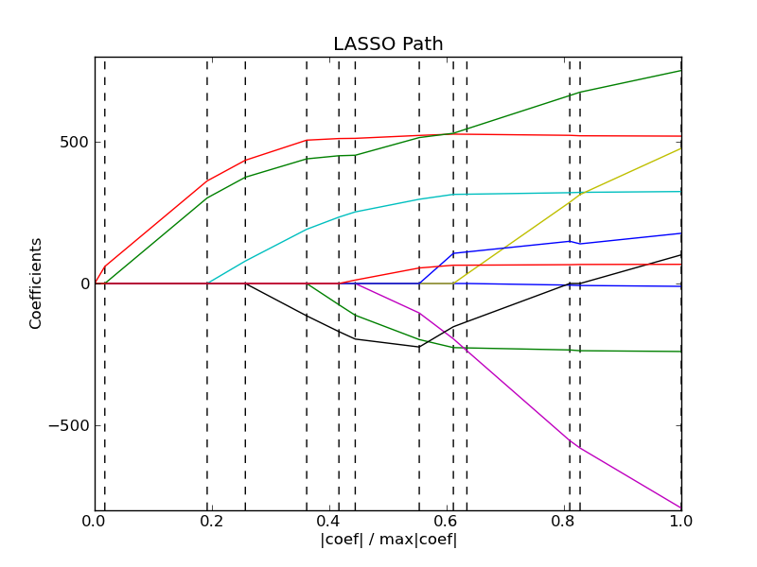
LASSO regularization path
Most weights are exactly zero
“sparse solution”, selects a small number of explanatory variables
This can help avoid overfitting when p>>N
Models are easier to interpret – but remember there is no proof of causation.
Path is piecewise-linear
http://scikit-learn.org/0.11/auto_examples/linear_model/plot_lasso_lars.html

Slide 11
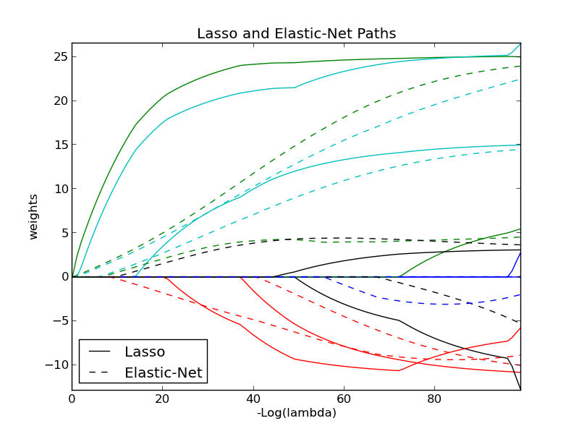

Elastic net
$L=\sum_{i}{{\frac{1}{2}\left({\hat{y}}_{i}−y_{i}\right)}^{2}}+\frac{1}{2}λ_{1}{\left|w\right|}_{1}+\frac{1}{2}λ_{2}{\left|w\right|}_{2}^{2}$

Slide 12

Predicting other types of data
Linear prediction: $f_{i}=w⋅x_{i}$
Loss function:
$$L=\sum_{i}{E\left(f_{i}, y_{i}\right)} + \frac{1}{2}λ{\left|w\right|}^{2}$$
For ridge regression, $E\left(f_{i}, y_{i}\right)=\frac{1}{2}{\left(f_{i}−y_{i}\right)}^{2}$. But it could be anything…
Fit quality
Penalty

Slide 13

Support vector machine
For predicting binary data
“Hinge loss” function
$E\left(f_{i}, y_{i}\right)=\left\{\begin{matrix}0 & y_{i}=1,f_{i}≥1 \\ 1−f_{i} & y_{i}=1,f_{i}<1 \\ 0 & y_{i}=−1, f_{i}≤−1 \\ 1+f_{i} & y_{i}=−1, f_{i}>−1\end{matrix}\right.$
E
f

Slide 14
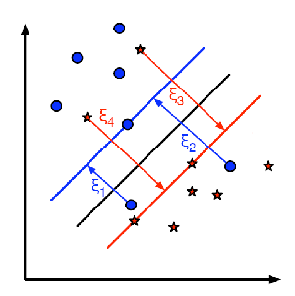
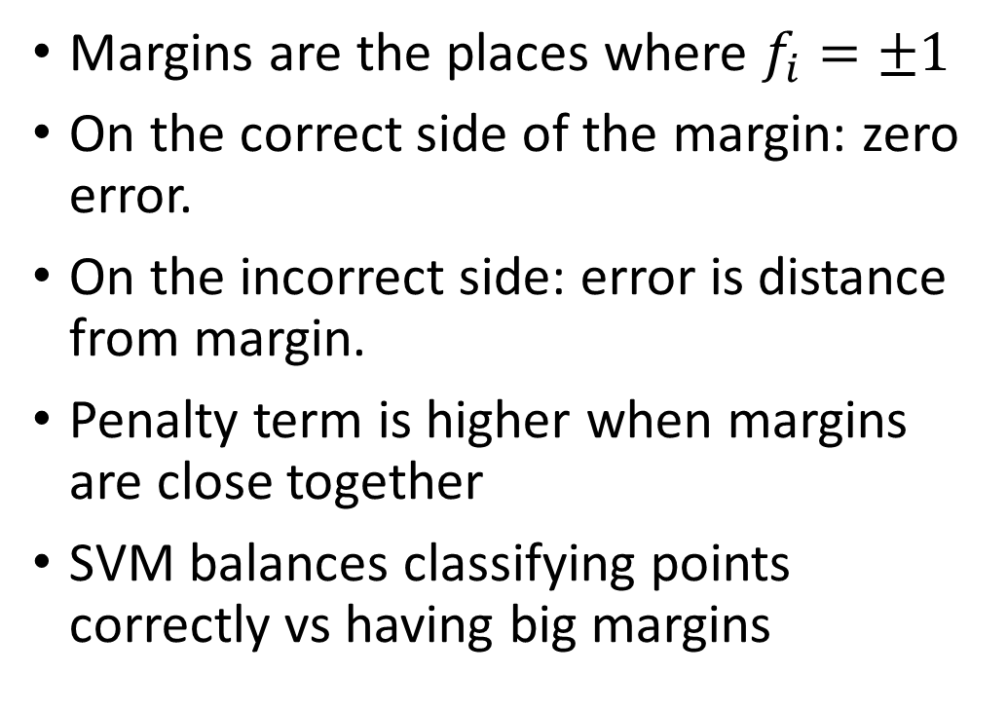
Errors vs. margins
Margins are the places where $f_{i}=±1$
On the correct side of the margin: zero error.
On the incorrect side: error is distance from margin.
Penalty term is higher when margins are close together
SVM balances classifying points correctly vs having big margins

Slide 15
Generalized linear models
What are you predicting?
Data type | Discrete, integer, whatever
Dimensionality | 1
What are you predicting it from?
Data type | Continuous
Dimensionality | p
How many data points do you have? | Not enough
What sort of prediction do you need? | Probability distribution
What sort of relationship can you assume? | Linear – nonlinear

Slide 16
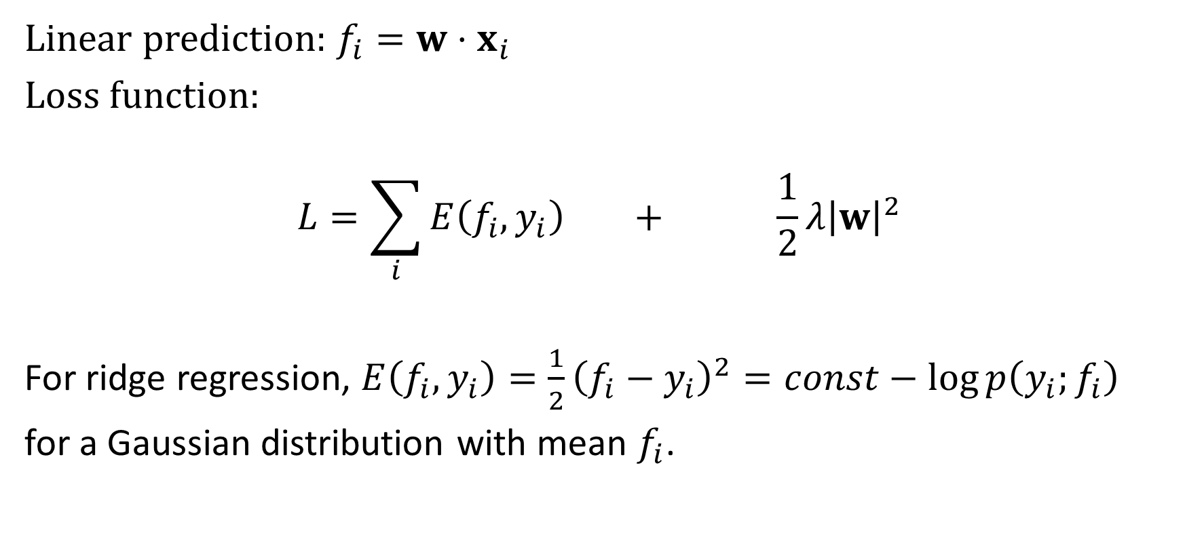
Generalized linear models
Linear prediction: $f_{i}=w⋅x_{i}$
Loss function:
$$L=\sum_{i}{E\left(f_{i}, y_{i}\right)} + \frac{1}{2}λ{\left|w\right|}^{2}$$
For ridge regression, $E\left(f_{i}, y_{i}\right)=\frac{1}{2}{\left(f_{i}−y_{i}\right)}^{2}=const−\log{p\left(y_{i};f_{i}\right)}$
for a Gaussian distribution with mean $f_{i}$.

Slide 17

Generalized linear models
Linear prediction: $f_{i}=w⋅x_{i}$
Loss function:
$$L=\sum_{i}{−\log{p\left(y_{i};f_{i}\right)}} + \frac{1}{2}λ{\left|w\right|}^{2}$$
Where $p\left(y_{i};f_{i}\right)$ is a probability distribution for $y_{i}$ with parameter $f_{i}$.

Slide 18
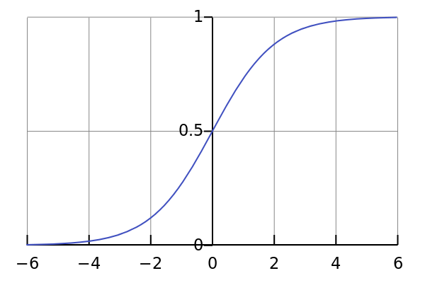

Example: logistic regression
$p\left(y_{i};f_{i}\right)=\left\{\begin{matrix}\frac{1}{1+e^{−f_{i}}} & y_{i}=1 \\ \frac{1}{1+e^{f_{i}}} & y_{i}=−1\end{matrix}\right.$
P(y; f)
f

Slide 19
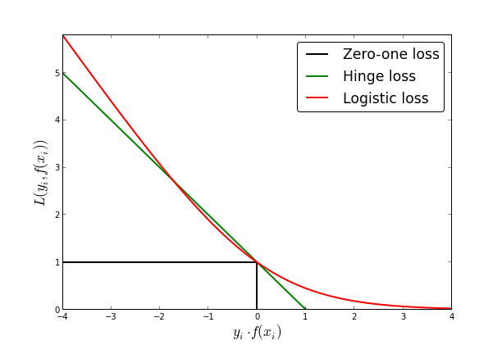

Logistic regression loss function
$E\left(f_{i}, y_{i}\right)=\log{p\left(y_{i};f_{i}\right)=\log\left(1−e^{−f_{i}y_{i}}\right)}$

Slide 20
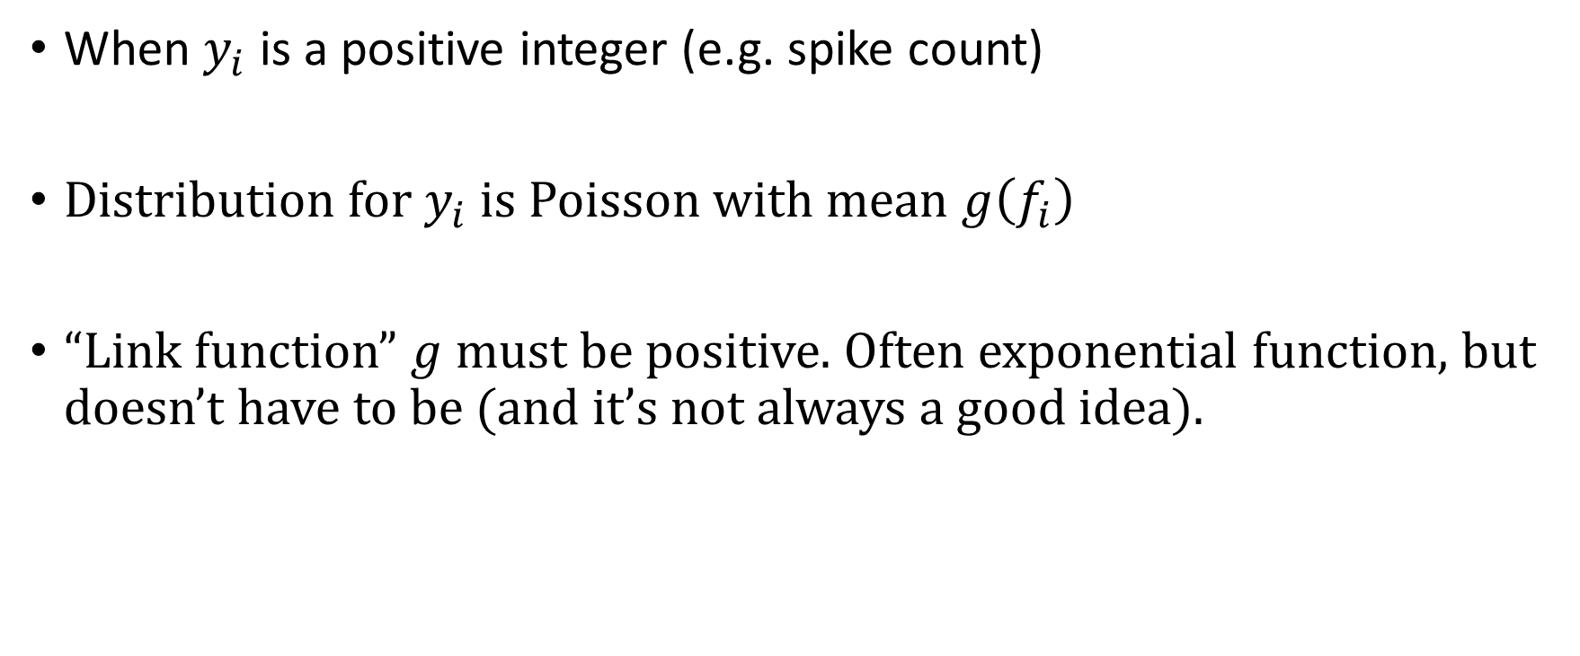
Poisson regression
When $y_{i}$ is a positive integer (e.g. spike count)
Distribution for $y_{i}$ is Poisson with mean $g\left(f_{i}\right)$
“Link function” $g$ must be positive. Often exponential function, but doesn’t have to be (and it’s not always a good idea).

Slide 21
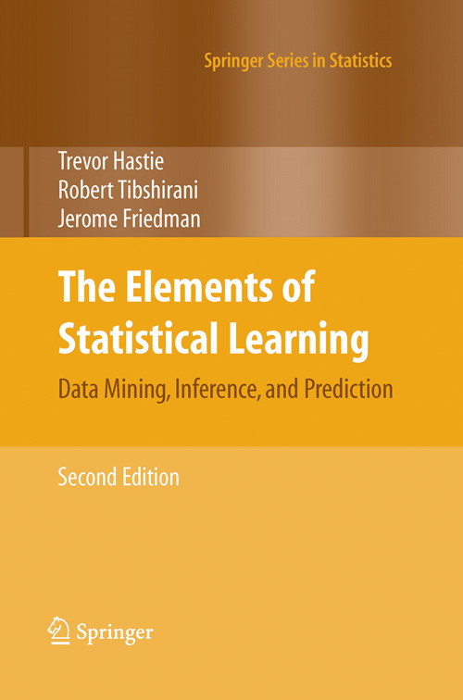
What to read; what software to use
http://web.stanford.edu/~hastie/glmnet_matlab/

