Slide 1
Confirmatory analysis for multiple spike trains
Kenneth D. Harris 29/7/15

Slide 2
Exploratory vs. confirmatory analysis
Exploratory analysis
Helps you formulate a hypothesis
End result is often a nice-looking picture
Any method is equally valid – because it just helps you think of a hypothesis
Confirmatory analysis
Where you test your hypothesis
Multiple ways to do it (Classical, Bayesian, Cross-validation)
You have to stick to the rules
Inductive vs. deductive reasoning (K. Popper)

Slide 3
Permutation test
Data
Statistic
Frequency
Actual value
Shuffled data
Statistic
Distribution of shuffled values
Shuffled data
Statistic
Statistic
Shuffled data
Statistic
This area = p-value
…
…
Shuffled data
Statistic

Slide 4
Caveat of hypothesis testing
Of course your null hypothesis is wrong; you already knew that
You get more information by understanding how it is wrong
Or by seeing which of several hypotheses is less wrong.
There are multiple criteria to judge how wrong a hypothesis is, and they can give different answers

Slide 5

Multiple spike trains
4D Spike count array summarizing sensory responses
$$n=\left\{n_{t,r,c,s}\right\}$$
Peri-stimulus time
Repeat
Cell
Stimulus
c
c
c
s=1
s=2
s=3
r
r
r
t
t
t

Slide 6
Null hypotheses
There are lots of different null hypotheses you could have
Different shuffling methods define different null hypotheses
When you say you shuffled the data, you have to say how!

Slide 7
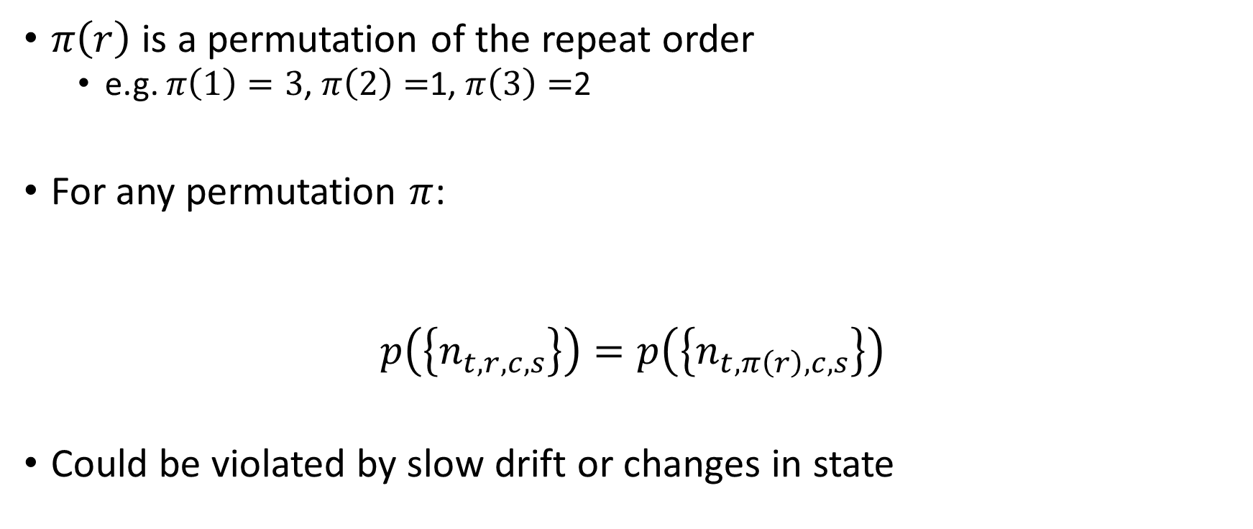
Exchangeability of repeats
$π\left(r\right)$ is a permutation of the repeat order
e.g. $π\left(1\right)=3$, $π\left(2\right)=$1, $π\left(3\right)=$2
For any permutation $π$:
$$p\left(\left\{n_{t,r,c,s}\right\}\right)=p\left(\left\{n_{t,π\left(r\right),c,s}\right\}\right)$$
Could be violated by slow drift or changes in state

Slide 8

All stimuli the same
$π\left(s\right)$ is a permutation of the stimulus order
For any permutation $π$:
$$p\left(\left\{n_{t,r,c,s}\right\}\right)=p\left(\left\{n_{t, r,c,π\left(s\right)}\right\}\right)$$

Slide 9
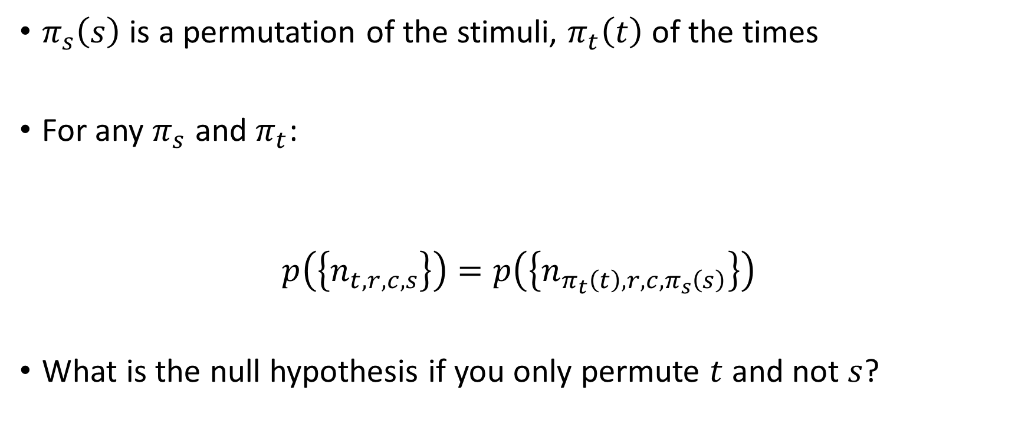
No effect of stimulus
$π_{s}\left(s\right)$ is a permutation of the stimuli, $π_{t}\left(t\right)$ of the times
For any $π_{s}$ and $π_{t}$:
$$p\left(\left\{n_{t,r,c,s}\right\}\right)=p\left(\left\{n_{π_{t}\left(t\right), r,c,π_{s}\left(s\right)}\right\}\right)$$
What is the null hypothesis if you only permute $t$ and not $s$?

Slide 10
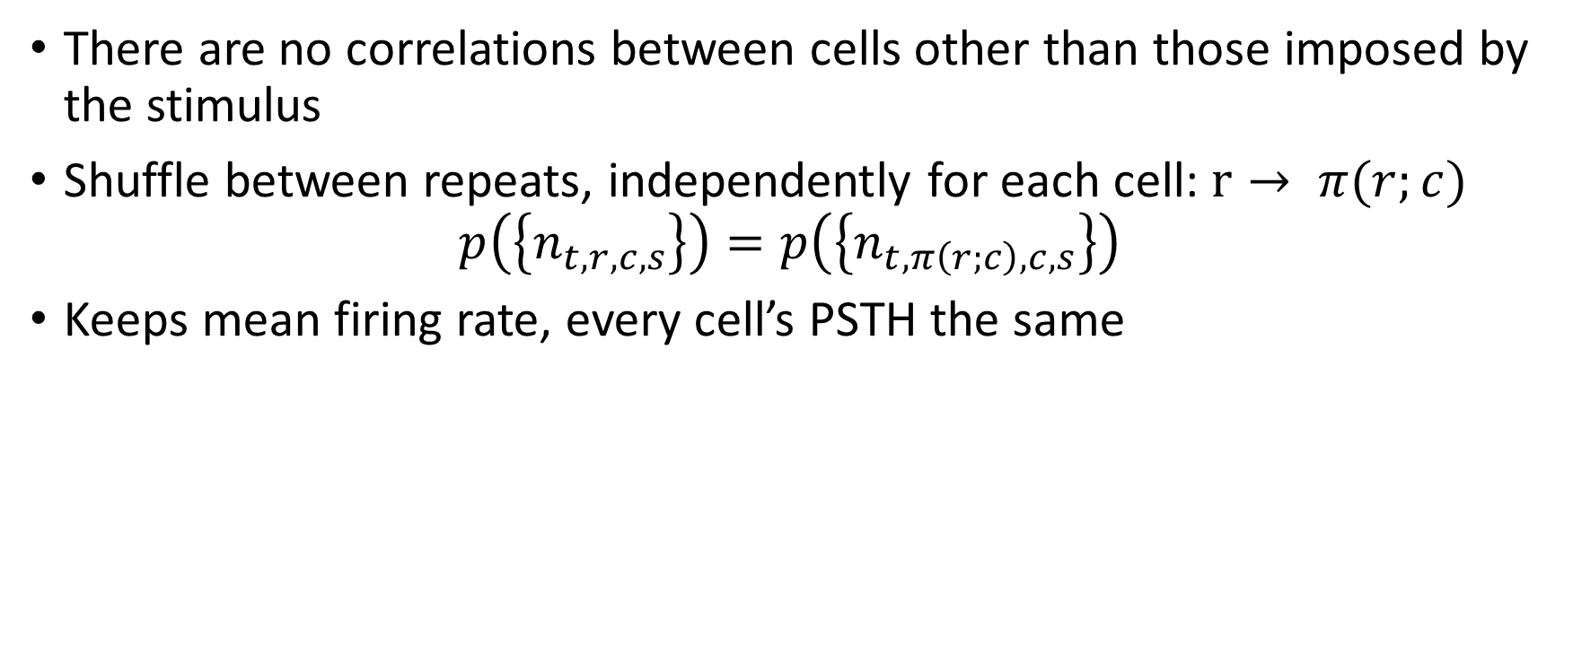
Conditional independence
There are no correlations between cells other than those imposed by the stimulus
Shuffle between repeats, independently for each cell: $r→ π(r;c)$
$$p\left(\left\{n_{t,r,c,s}\right\}\right)=p\left(\left\{n_{t, π\left(r;c\right),c,s}\right\}\right)$$
Keeps mean firing rate, every cell’s PSTH the same
Repeat
Repeat
Cell
Cell

Slide 11

All cells the same
$π\left(c\right)$ is a permutation of the cells
For any $π$:
$$p\left(\left\{n_{t,r,c,s}\right\}\right)=p\left(\left\{n_{t, r,π\left(c\right),s}\right\}\right)$$
Violated just by different cells having different mean rates

Slide 12
PSTH shape independent of stimulus
Test “temporal coding” hypothesis
Assume one cell. Want to shuffle keeping each stimulus’ firing rate constant, but equalizing PSTH shape across stimuli
Stimulus
Stimulus
“Raster marginals model” Okun et al, J Neurosci 2012
Time
Time

Slide 13
There are many more possibilities…
Think carefully about what null hypothesis you want to test
Is there a systematic classification of shuffling methods?

Slide 14
Test statistics
How do you see if shuffling made a difference?
Best choice depends on what question you are asking
E.g. for conditional independence: variance of population rate across trials
Repeat
Repeat
Cell
Cell

Slide 15
Graphical analysis of shuffled data
You have two null hypothesis, and neither is exactly correct
Which one is better?
Use them to make predictions
Okun et al, J Neurosci 2012

Slide 16

Peer-prediction method
Test null hypothesis of conditional independence by predicting a cell from stimulus, then seeing if you can predict further from other cells
Works when you don’t have explicit trials
$$L=\sum_{s}{\log{λ\left(t_{s}\right)}}−∫λ\left(t\right)dt \\ Q=\sum_{s}{λ\left(t_{s}\right)}−\frac{1}{2}∫λ{\left(t\right)}^{2}dt$$
Harris et al Nature 2003
Pillow et al Nature 2008

Slide 17
Timescale of peer prediction
Harris et al Nature 2003

Slide 18
Summary
There are lots of possible null hypotheses
None of them are exactly correct, but some might be quite good approximations
By seeing which null hypotheses can approximate which observations well, you learn how to understand the data in a simple manner

