Slide 1
Neuroinformatics 18: the bootstrap
Kenneth D. Harris
UCL, 5/8/15

Slide 2
Types of data analysis
Exploratory analysis
Graphical
Interactive
Aimed at formulating hypotheses
No rules – whatever helps you find a hypothesis
Confirmatory analysis
For testing hypotheses once they have been formulated
Several frameworks for testing hypotheses
Rules need to be followed

Slide 3
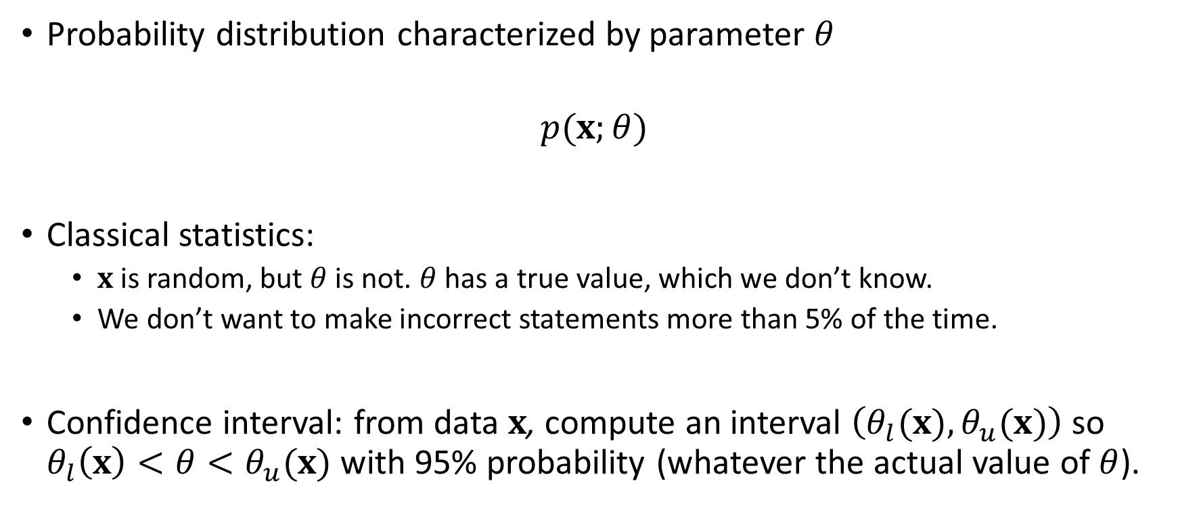
Confidence interval
Probability distribution characterized by parameter $θ$
$$p(x;θ)$$
Classical statistics:
$x$is random, but $θ$ is not. $θ$ has a true value, which we don’t know.
We don’t want to make incorrect statements more than 5% of the time.
Confidence interval: from data $x$, compute an interval $\left(θ_{l}(x), θ_{u}(x)\right)$ so $θ_{l}\left(x\right)<θ<θ_{u}(x)$ with 95% probability (whatever the actual value of $θ$).

Slide 4
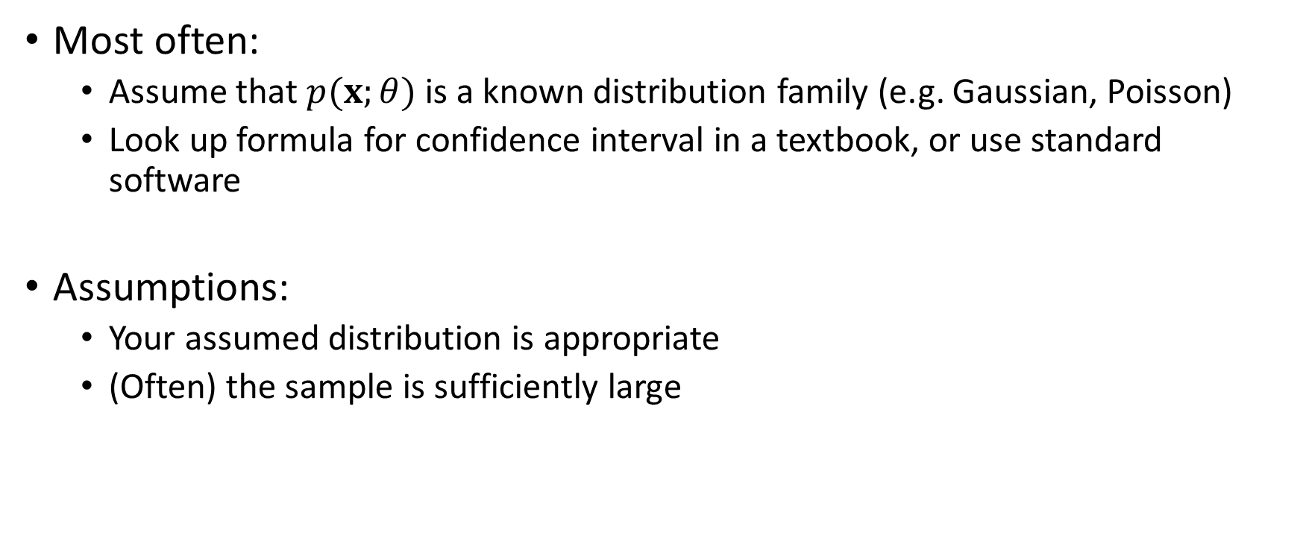
How to compute a confidence interval
Most often:
Assume that $p(x;θ)$ is a known distribution family (e.g. Gaussian, Poisson)
Look up formula for confidence interval in a textbook, or use standard software
Assumptions:
Your assumed distribution is appropriate
(Often) the sample is sufficiently large

Slide 5
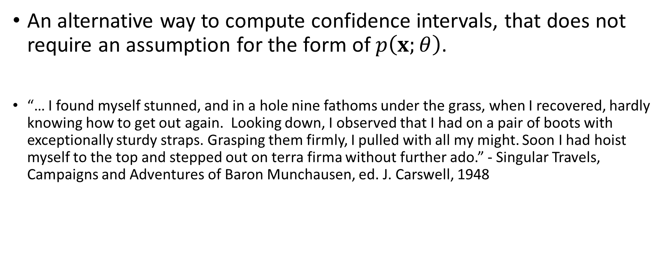
The bootstrap
An alternative way to compute confidence intervals, that does not require an assumption for the form of $p\left(x;θ\right)$.
“… I found myself stunned, and in a hole nine fathoms under the grass, when I recovered, hardly knowing how to get out again. Looking down, I observed that I had on a pair of boots with exceptionally sturdy straps. Grasping them firmly, I pulled with all my might. Soon I had hoist myself to the top and stepped out on terra firma without further ado.” - Singular Travels, Campaigns and Adventures of Baron Munchausen, ed. J. Carswell, 1948

Slide 6
Use the bootstrap with caution
It looks simple, but…
There are many subtly different variants of the bootstrap
Different variants work in different situations
Often they you false-positive errors (without warning)
Like Baron Munchausen’s way of getting out of a hole, the bootstrap is not guaranteed to work in all circumstances.

Slide 7
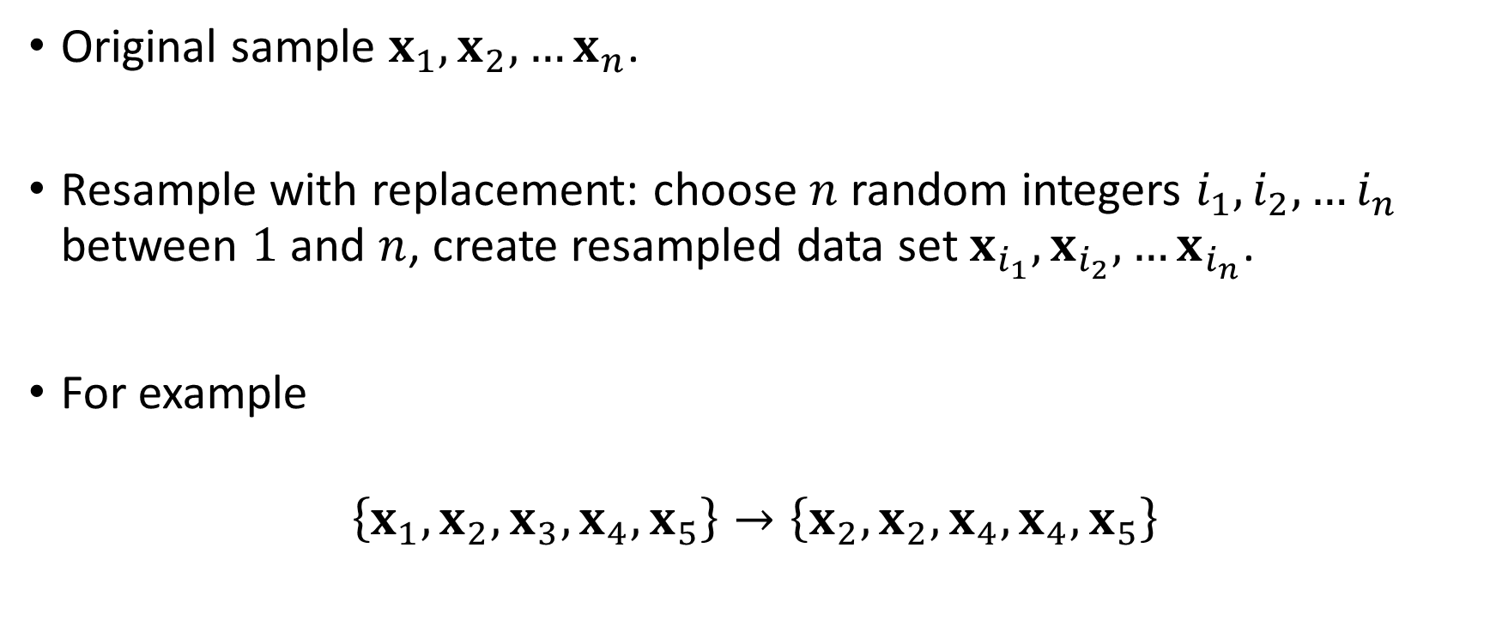
Bootstrap resampling
Original sample $x_{1},x_{2}, …x_{n}$.
Resample with replacement: choose $n$ random integers $i_{1}, i_{2},…i_{n}$ between $1$ and $n$, create resampled data set $x_{i_{1}},x_{i_{2}}, …x_{i_{n}}$.
For example
$$\left\{x_{1},x_{2},x_{3}, x_{4},x_{5}\right\}→\left\{x_{2},x_{2},x_{4},x_{4},x_{5}\right\}$$

Slide 8
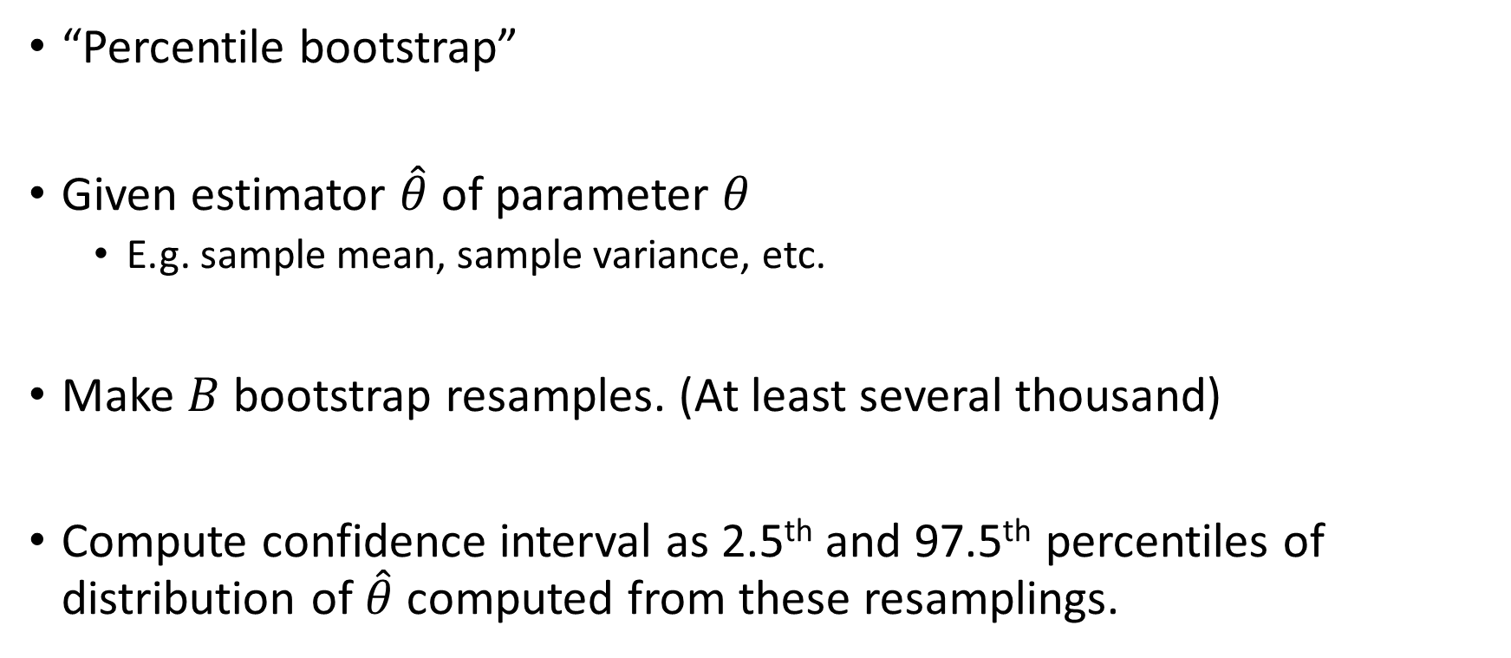
Simplest method
“Percentile bootstrap”
Given estimator $\hat{θ}$ of parameter $θ$
E.g. sample mean, sample variance, etc.
Make $B$ bootstrap resamples. (At least several thousand)
Compute confidence interval as 2.5th and 97.5th percentiles of distribution of $\hat{θ}$ computed from these resamplings.

Slide 9
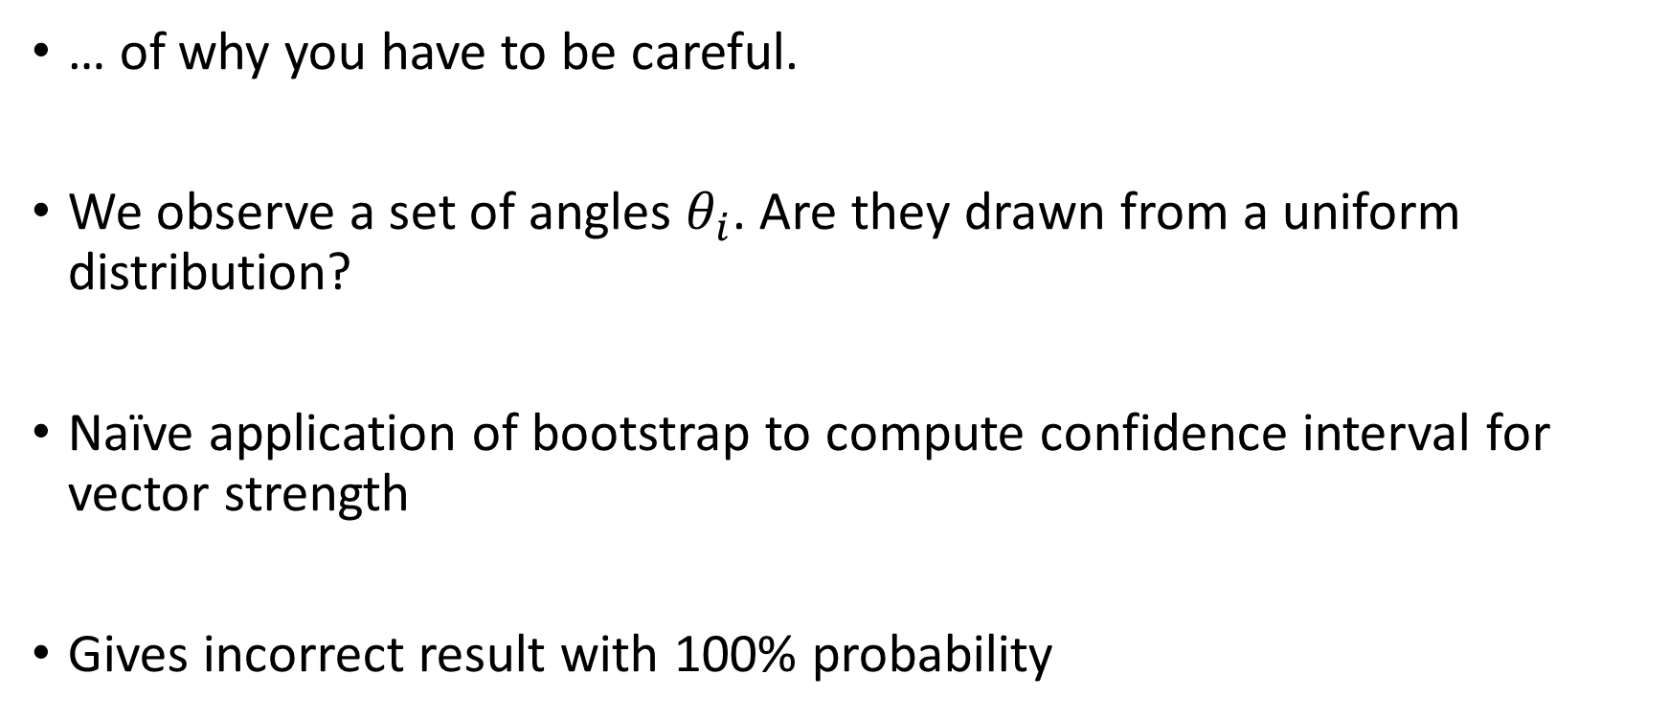
An example
… of why you have to be careful.
We observe a set of angles $θ_{i}$. Are they drawn from a uniform distribution?
Naïve application of bootstrap to compute confidence interval for vector strength
Gives incorrect result with 100% probability

Slide 10
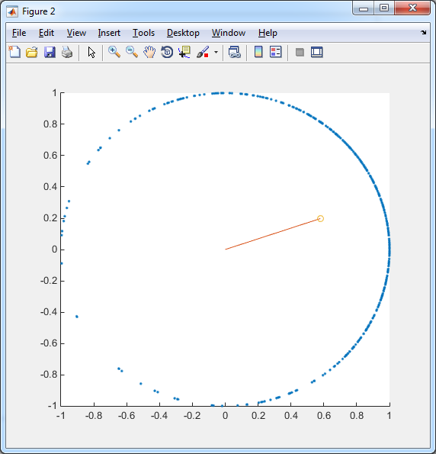




Circular mean
Treat angles as points on a circle
The mean of these gives you
Circular mean $\overline{θ}$
Vector strength $R$
If all angles are the same:
$\overline{θ}$ is this angle
$R$ is 1
If angles are completely uniform
$R$ is 0
$\overline{θ}$ is meaningless.
$$z=e^{i θ}$$
$$\overline{z}=Re^{i\overline{θ}}$$
R
$$θ$$

Slide 11
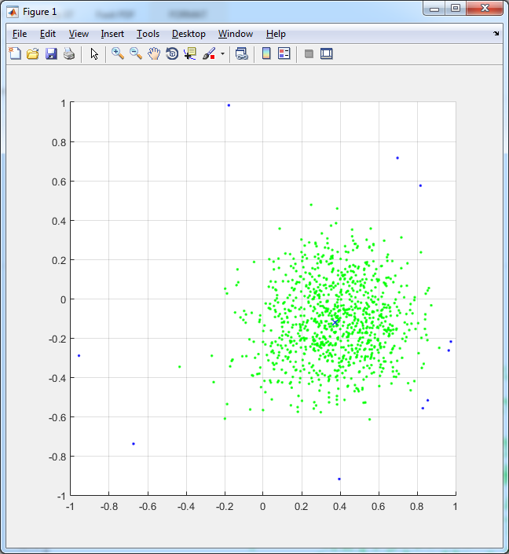
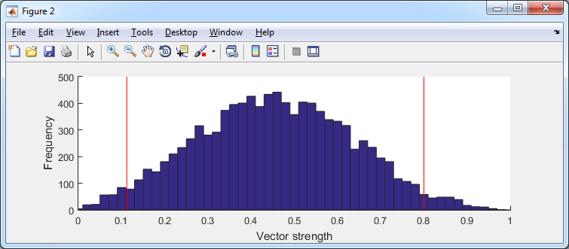

Bootstrap resamples of vector strength
95% confidence interval
$$e^{iθ}$$
Bootstrap resamples
Circular mean
The actual vector strength was zero
There is a 0% chance that this will fall within the bootstrap confidence interval

Slide 12
Why did it go wrong?
Vector strength is a biased statistic
The bias gets worse the smaller the sample size
Bootstrapping makes the equivalent sample size even smaller
There are variants of the bootstrap that make this kind of mistake less often, but you need to know exactly when to use which version.

Slide 13
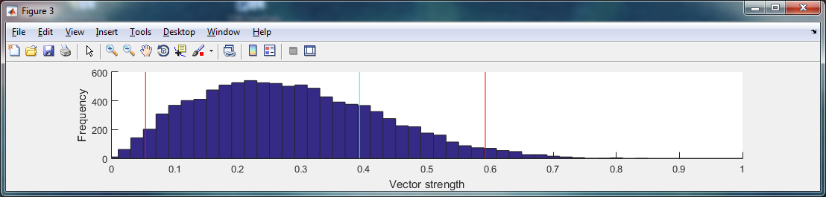
Bootstrap vs. permutation test
Permutation test: is the observed statistic in the null distribution?
Bootstrap: is the null value in the bootstrap distribution?
95% interval for null distribution
Observed statistic
95% interval of bootstrap distribution
Observed statistic
Null value

Slide 14
When to use the bootstrap
When you can’t use a traditional method (e.g. permutation test)
When you actually understand the conditions for a particular bootstrap variant to give valid results
When you can prove these conditions hold in your circumstance

Slide 15
When NOT to use the bootstrap
When you tried a traditional test, but it gave you p>0.05

