Slide 1
5. Spectrograms and non-stationary signals
Kenneth D. Harris
25/2/15

Slide 2
Welch method in practice
In MATLAB:
[p, fo] = pwelch(x,window,noverlap,nfft, fs)
Higher values -> more frequency resolution but more noisy. Fit as largest value with reasonable amount of noise.
Rule of thumb: to get n Hz resolution, take fs/n.
Can be as large as you like
Higher => evaluated at more frequencies, but stays as smooth / noisy as before

Slide 3
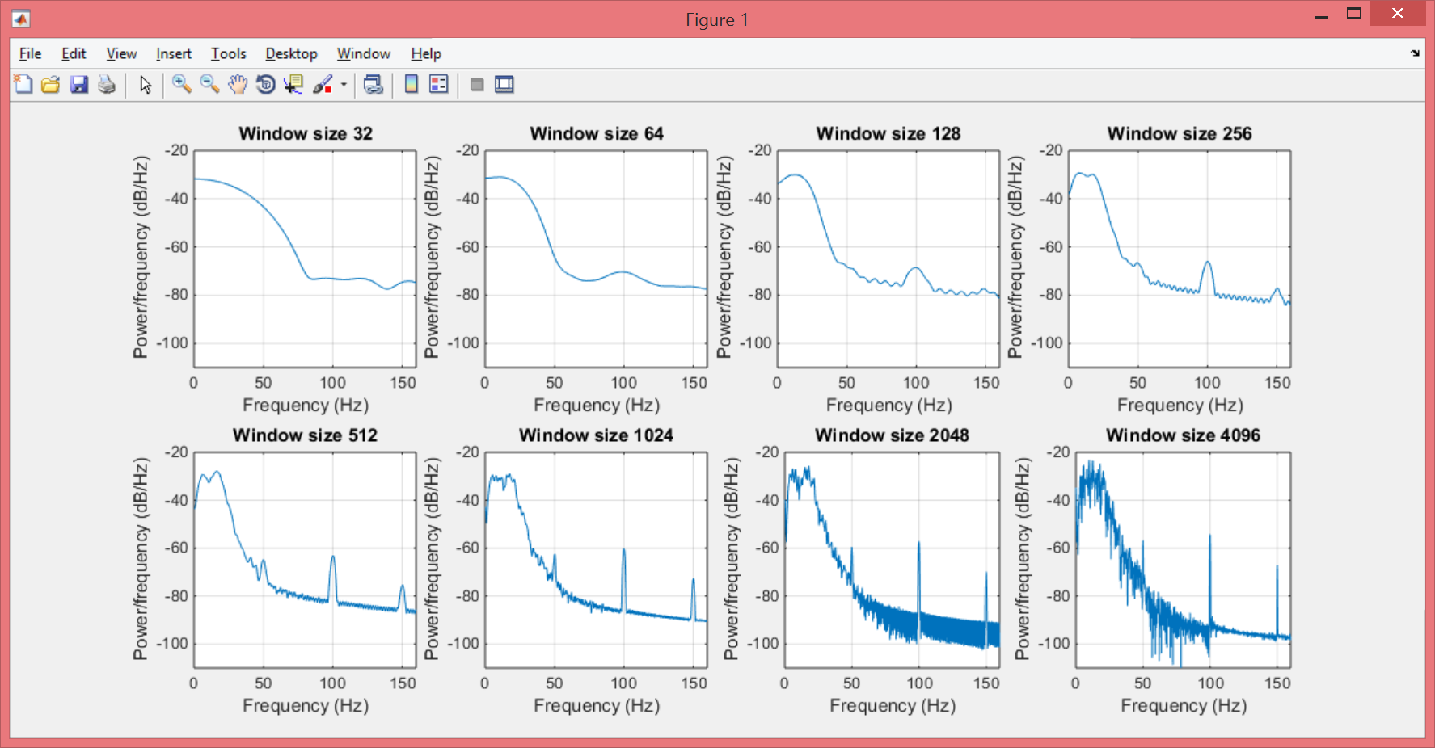
Welch examples

Slide 4
Multitaper method in practice
In MATLAB:
[p, fo] = pxx = pmtm(x,nw,nfft,fs)
Higher values -> less frequency resolution, but less noisy. Fit as smallest value with reasonable amount of noise. 3 often a good first choice.
Can be as large as you like
Higher => evaluated at more frequencies, but stays as smooth / noisy as before

Slide 5
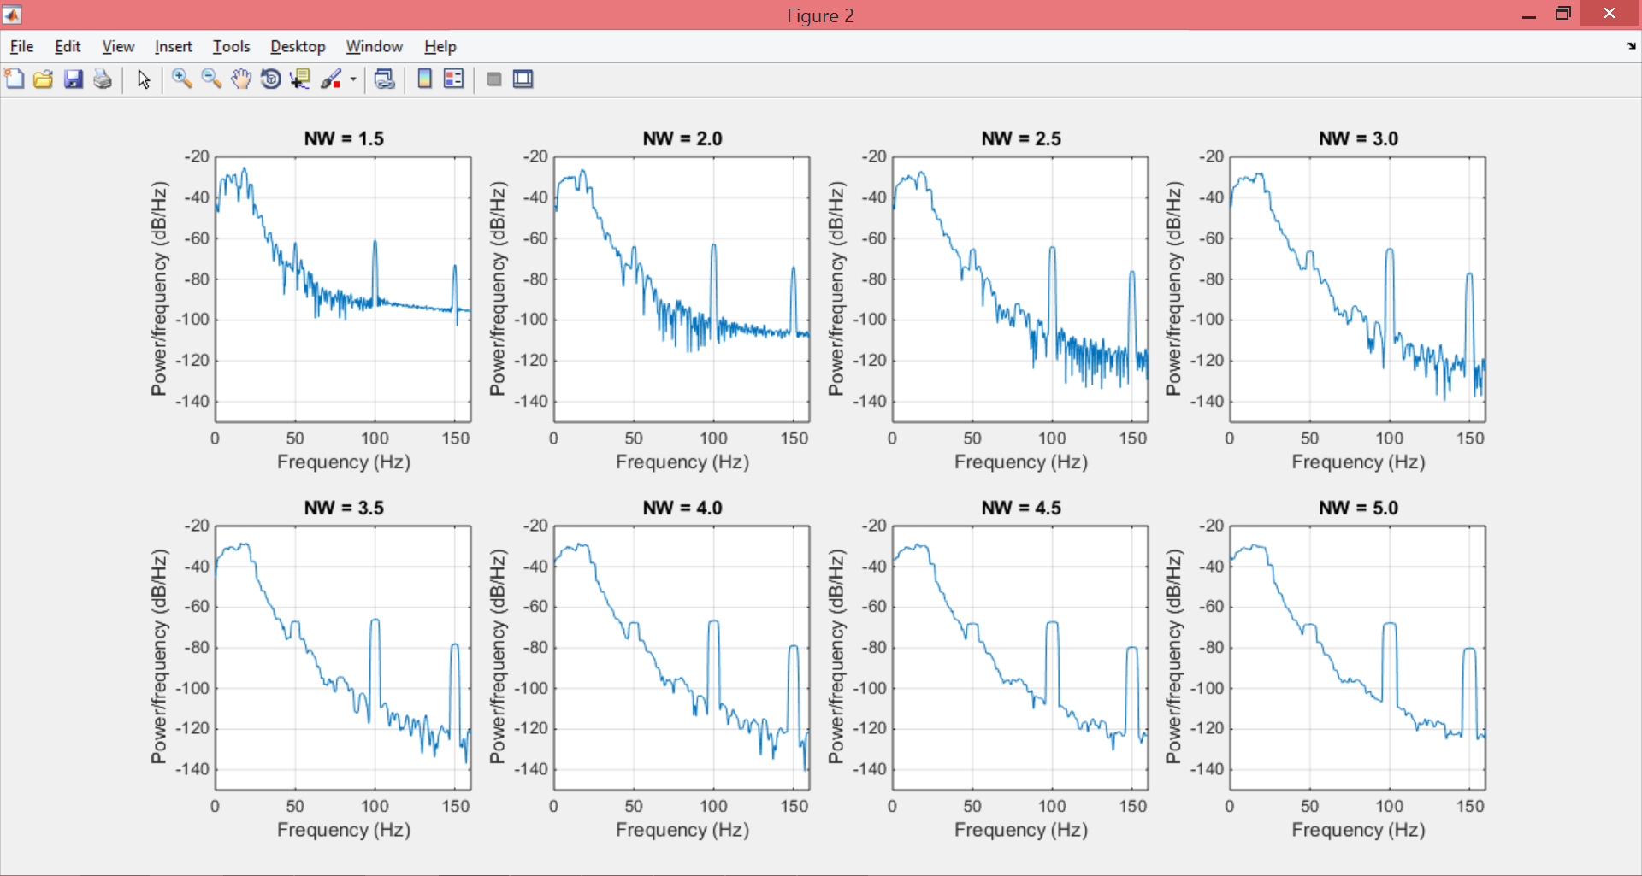
Multitaper examples

Slide 6
Nonstationary signals
Recall stationary signal is one you can shift in time and it would have been just as likely as the original
A process can only be nonstationary if there are multiple instances relative to defined moments in time (e.g. stimulus onset).

Slide 7
The spectrogram
Series of power spectra of a series of short signal snippets
Frequency
Time

Slide 8
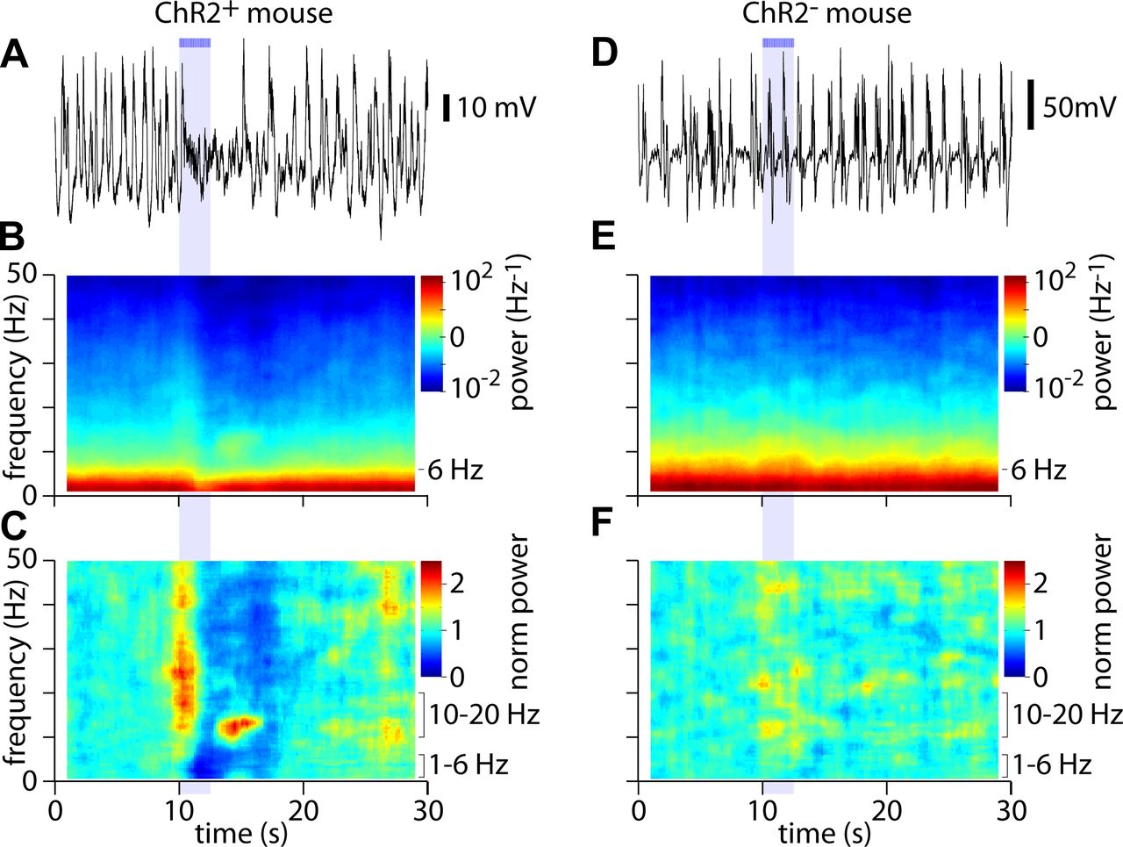
Average spectrogram of LFP
S1, urethane, ChR2 in cholinergic fibers
Kalmbach & Waters, J Neurophys 2014

Slide 9
Practical issues
All the problems of power spectra get harder since the signals are so short.
Can average over multiple presentations.
Can use multitaper method.
Trade off between time resolution and frequency resolution.

Slide 10
“Time-bandwidth product”
Frequency
Frequency
Time
Time

Slide 11
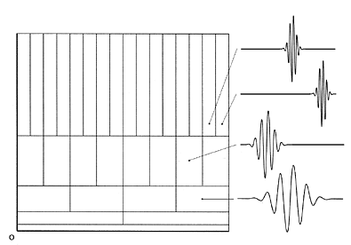
Wavelets slice time/frequency space differently
Frequency bins on a log scale (e.g. octaves)
More time resolution for higher frequencies

Slide 12
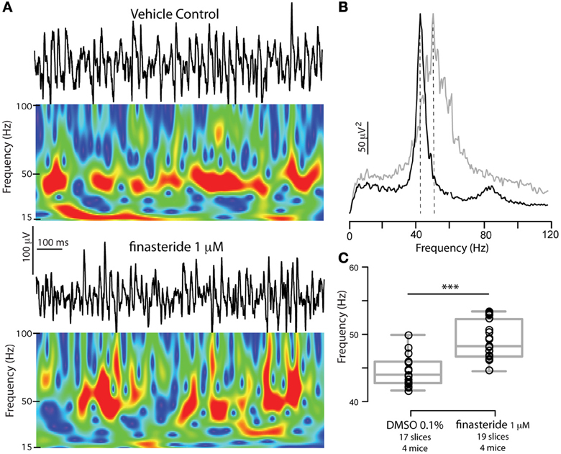
Wavelet LFP analysis
F
Ferando & Mody, Front Neural Circuits 2013

Slide 13
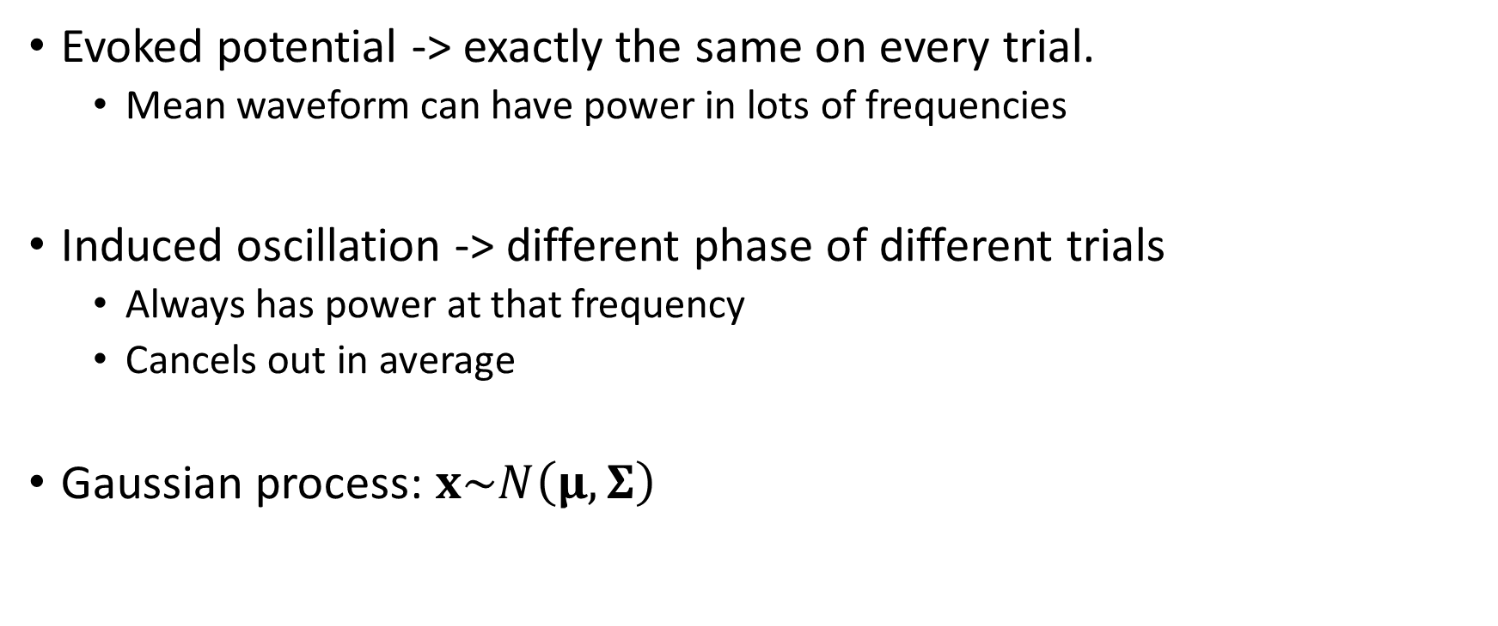
Evoked and induced oscillations
Evoked potential -> exactly the same on every trial.
Mean waveform can have power in lots of frequencies
Induced oscillation -> different phase of different trials
Always has power at that frequency
Cancels out in average
Gaussian process: $x\sim N\left(μ, Σ\right)$
Evoked
Induced

Slide 14
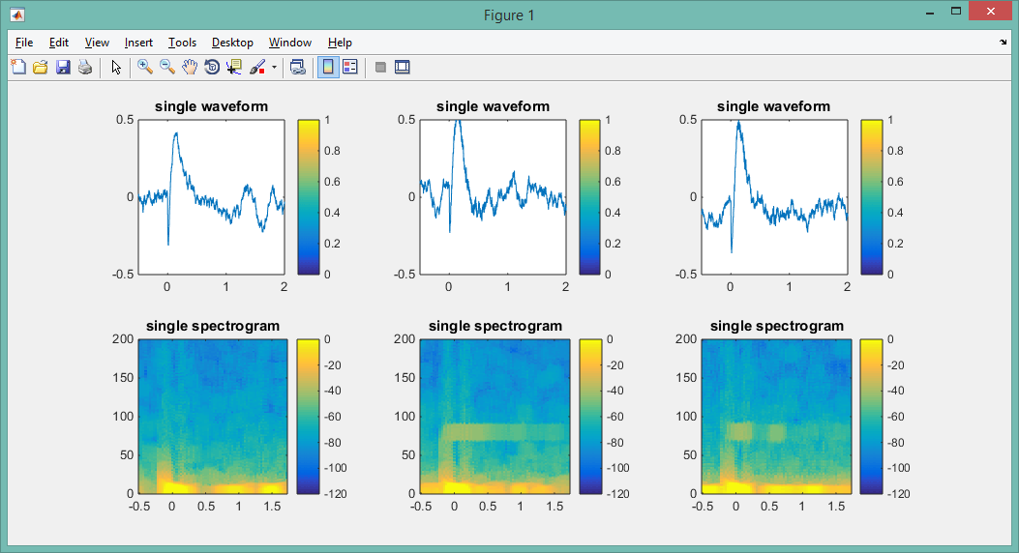
Evoked and Induced oscillations

Slide 15
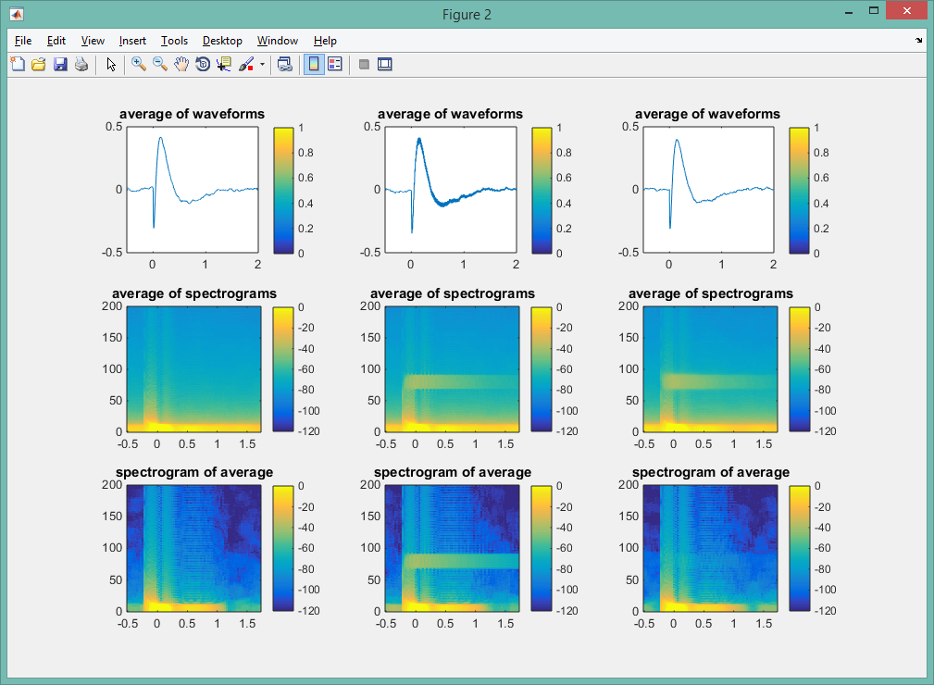

Slide 16
What can you compute from a spectrogram?

Slide 17
“Comodugram”
Correlation of instantaneous power in different frequencies
Won’t happen for a stationary Gaussian process
Mouse hippocampus
Buzsaki et al Neuroscience 2003

Slide 18
Phase-amplitude coupling
Gamma power highest on peak of theta oscillation

Slide 19
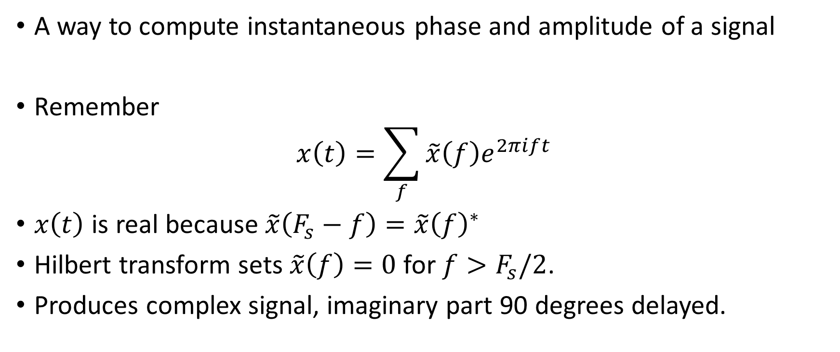
Hilbert transform
A way to compute instantaneous phase and amplitude of a signal
Remember
$$x\left(t\right)=\sum_{f}{\tilde{x}\left(f\right)e^{2πift}}$$
$x\left(t\right)$ is real because $\tilde{x}\left(F_{s}−f\right)=\tilde{x}{\left(f\right)}^{∗}$
Hilbert transform sets $\tilde{x}\left(f\right)=0$ for $f>F_{s}/2$.
Produces complex signal, imaginary part 90 degrees delayed.

Slide 20
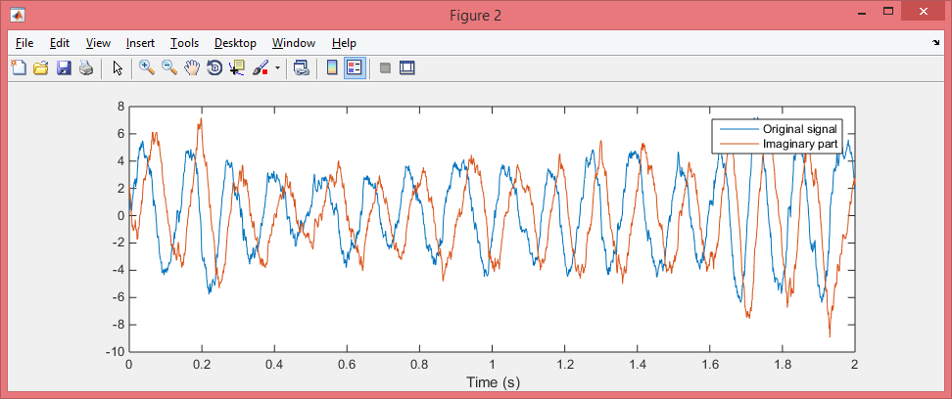
Hilbert example

Slide 21
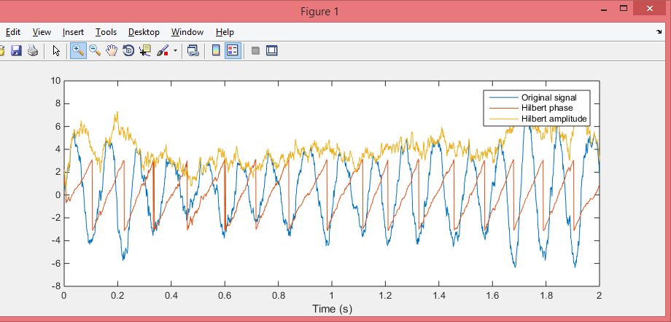
Phase is angle, amplitude is magnitude

Slide 22
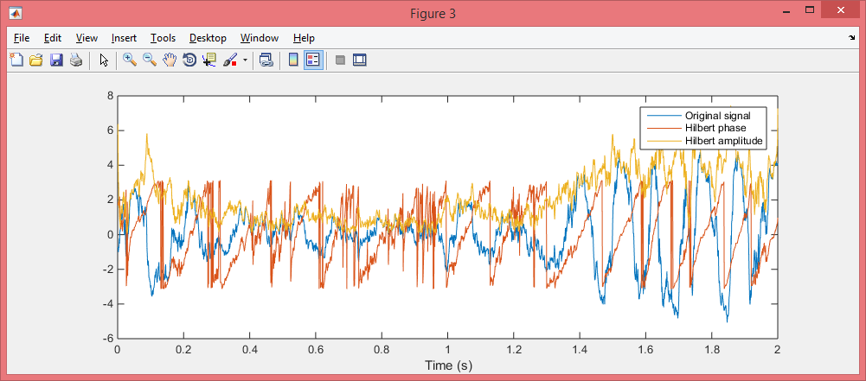
Be careful with Hilbert transform
When it doesn’t work you get junk. Check by plotting
You often need to filter very narrowband

Slide 23
Relating amplitude of one frequency to phase of another
Buhl et al, J Neurosci 2003

Slide 24

Confirmatory statististics
What is null hypothesis?
Stationary Gaussian process
Permutation test
Phase randomization
$$x_{rand}\left(t\right)=\sum_{f}{\tilde{x}\left(f\right)e^{2πift+Φ_{rand}}}$$

