Slide 1
Circular statistics Maximum likelihood Local likelihood
Kenneth D. Harris
4/3/2015

Slide 2
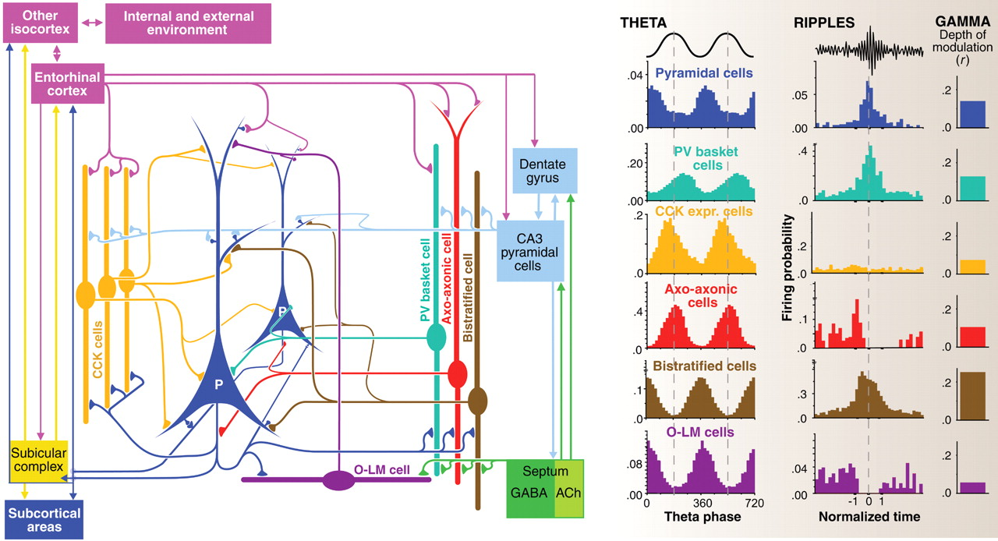
Relationship of cells to oscillations
Klausberger & Somogyi, Science 2008

Slide 3
Relationship of cells to oscillations
O’Keefe & Recce, Hippocampus 1993

Slide 4
How do we quantify:
A cell’s average phase of firing?
How phase depends on other variables?

Slide 5
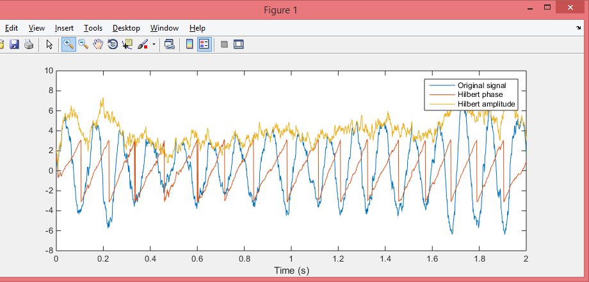
Computing instantaneous phase
Hilbert transform
Peak fitting

Slide 6
Phase histogram
Different cells prefer different phases
How do we compute each cell’s mean phase?

Slide 7
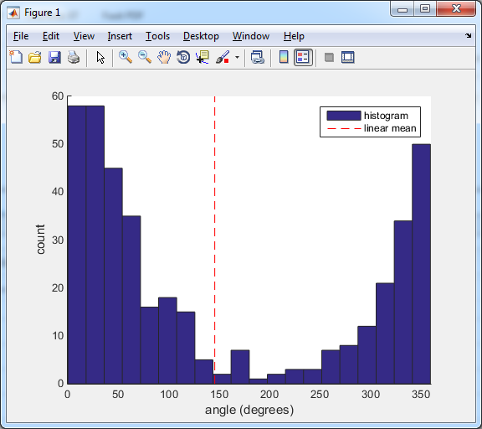
Linear mean doesn’t work

Slide 8
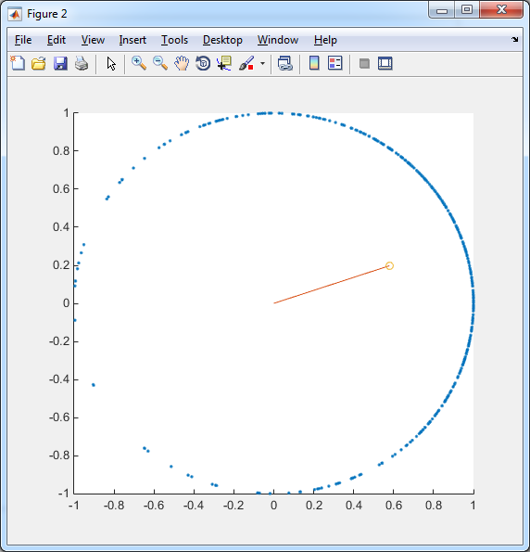




Circular mean
Treat angles as points on a circle
The mean of these gives you
Circular mean $\overline{θ}$
Vector strength $R$
If all angles are the same:
$\overline{θ}$ is this angle
$R$ is 1
If angles are completely uniform
$R$ is 0
$\overline{θ}$ is meaningless.
$$z=e^{i θ}$$
$$\overline{z}=Re^{i\overline{θ}}$$
R
$$θ$$

Slide 9
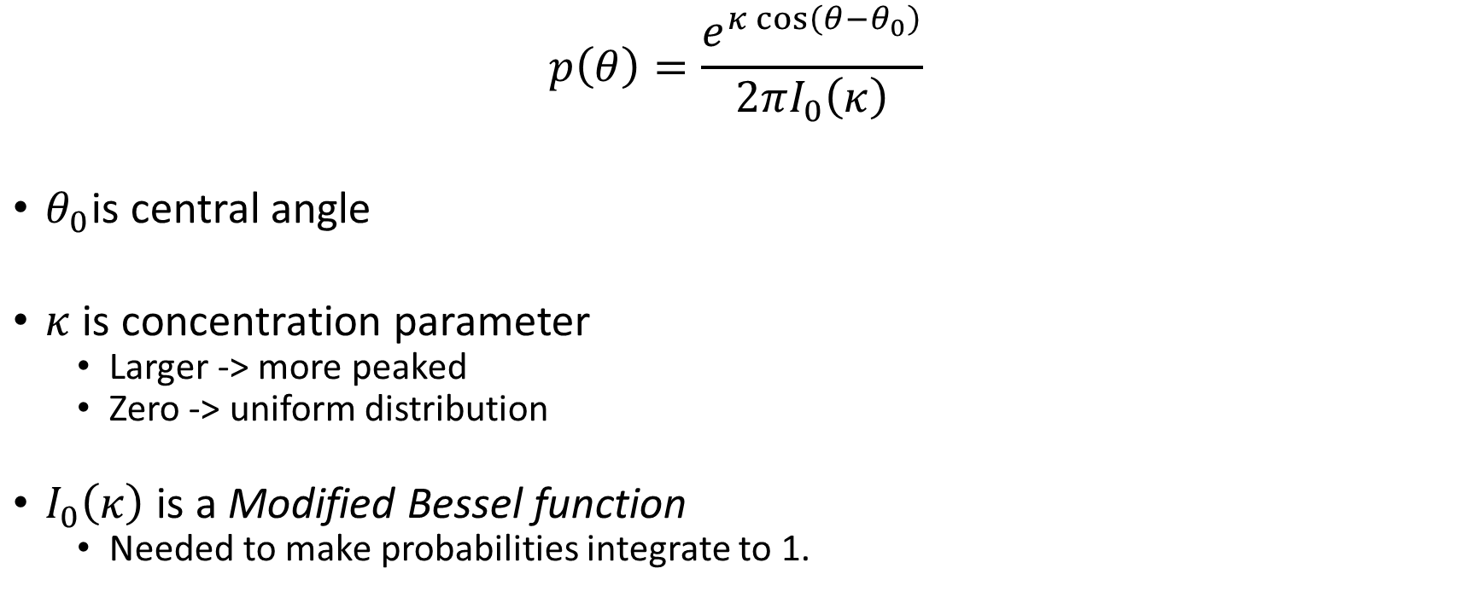
von Mises distribution
$$p\left(θ\right)=\frac{e^{κ\cos\left(θ−θ_{0}\right)}}{2πI_{0}\left(κ\right)}$$
$θ_{0}$is central angle
$κ$ is concentration parameter
Larger -> more peaked
Zero -> uniform distribution
$I_{0}\left(κ\right)$ is a Modified Bessel function
Needed to make probabilities integrate to 1.

Slide 10
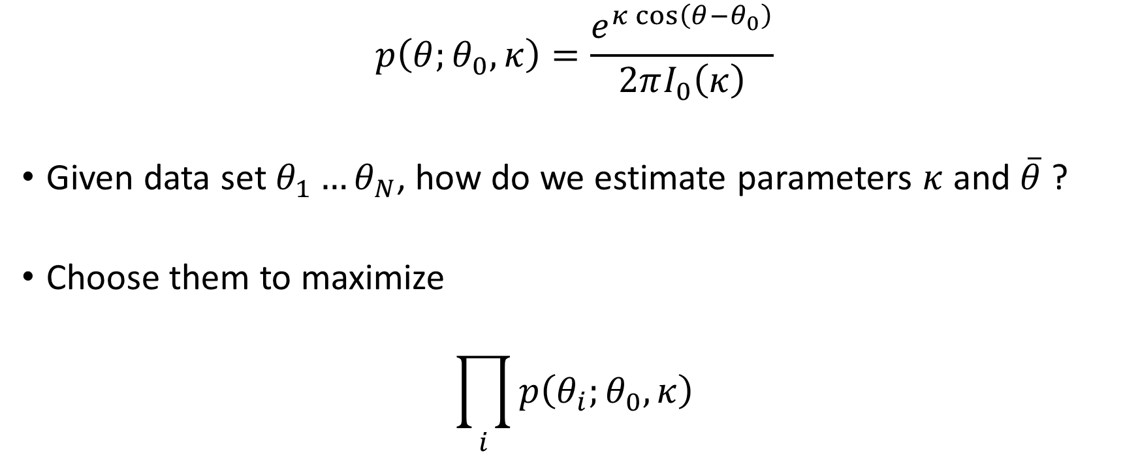
Maximum likelihood estimation
$$p\left(θ;θ_{0}, κ\right)=\frac{e^{κ\cos\left(θ−θ_{0}\right)}}{2πI_{0}\left(κ\right)}$$
Given data set $θ_{1}…θ_{N}$, how do we estimate parameters $κ$ and $\overline{θ}$ ?
Choose them to maximize
$$\prod_{i}{p\left(θ_{i};θ_{0}, κ\right)}$$

Slide 11
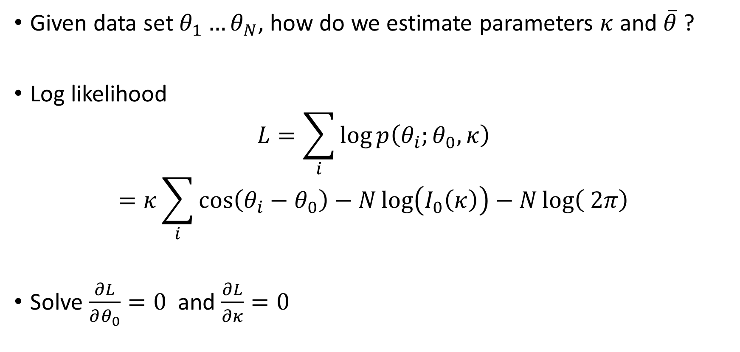
Maximum likelihood estimation
Given data set $θ_{1}…θ_{N}$, how do we estimate parameters $κ$ and $\overline{θ}$ ?
Log likelihood
$$L=\sum_{i}{\log{p\left(θ_{i};θ_{0},κ\right)}}$$
$$=κ\sum_{i}{\cos\left(θ_{i}−θ_{0}\right)}−N\log\left(I_{0}\left(κ\right)\right)−N\log\left( 2π\right)$$
Solve $\frac{∂L}{∂θ_{0}}=0$ and $\frac{∂L}{∂κ}=0$

Slide 12

Maximum likelihood von Mises
$θ_{0}=\overline{θ}$, ($\overline{θ}$ = circular mean).
$κ$ is the solution of $\frac{I_{1}\left(κ\right)}{I_{0}\left(κ\right)}=R$, ($R$ = vector strength).
$I_{1}\left(κ\right)$ is another modified Bessel function.

Slide 13
How does phase depend on another variable?
Don’t use linear regression!

Slide 14
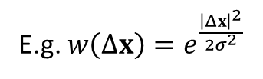
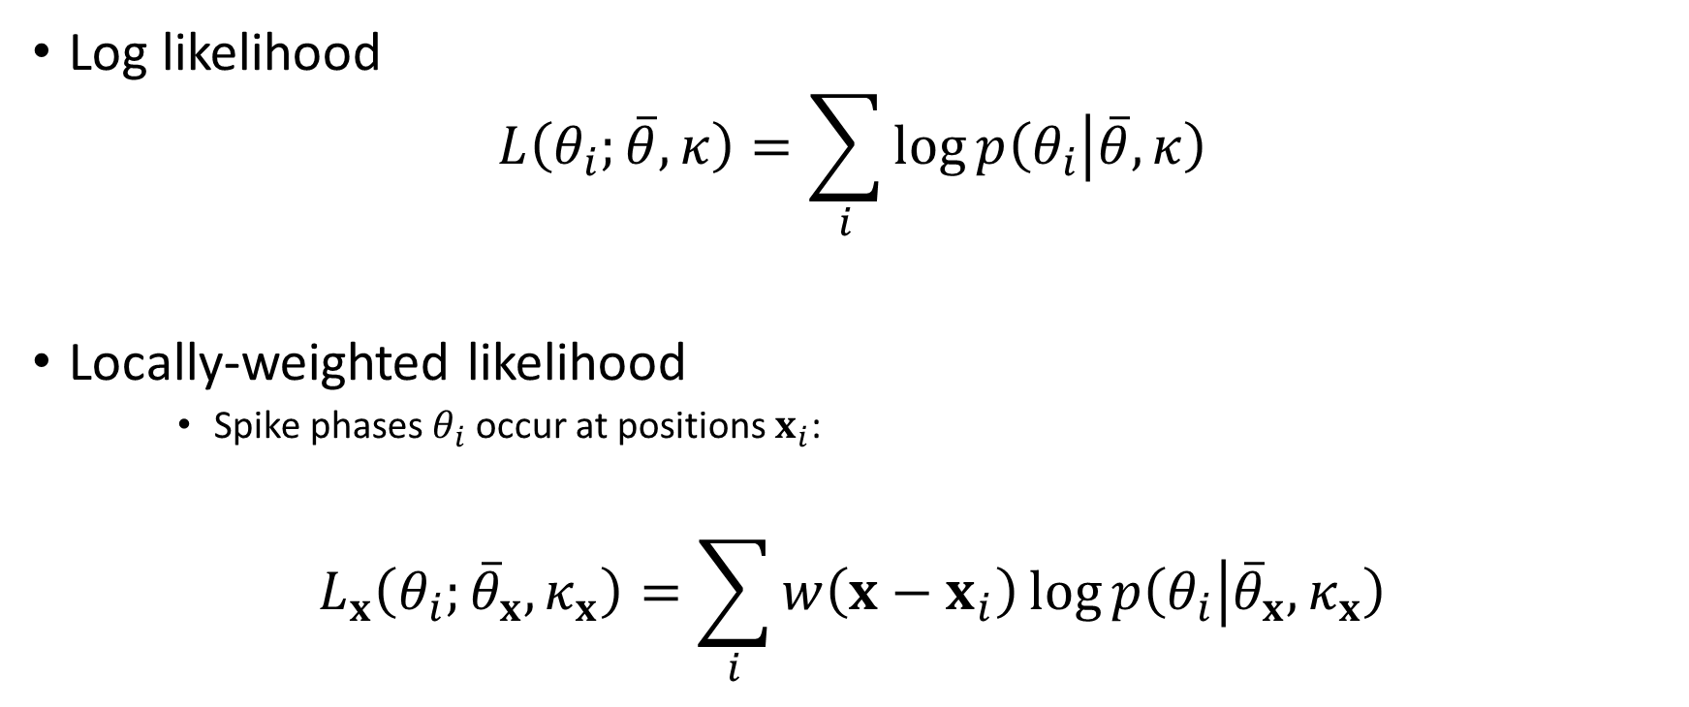
Locally-weighted likelihood
Log likelihood
$$L\left(θ_{i};\overline{θ},κ\right)=\sum_{i}{\log{p\left(θ_{i} | \overline{θ},κ\right)}}$$
Locally-weighted likelihood
Spike phases $θ_{i}$ occur at positions $x_{i}$:
$$L_{x}\left(θ_{i};{\overline{θ}}_{x}, κ_{x}\right)=\sum_{i}{w\left(x−x_{i}\right)}\log{p\left(θ_{i} | {\overline{θ}}_{x}, κ_{x}\right)}$$
E.g. $w\left(Δx\right)=e^{\frac{{\left|Δx\right|}^{2}}{2σ^{2}}}$

Slide 15
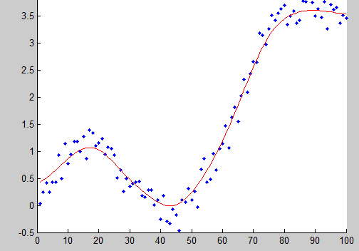

Kernel smoother
$$\hat{y}(x)=\frac{∑y_{i}w\left(x−x_{i}\right)}{∑w\left(x−x_{i}\right)}$$
Is local likelihood for a Gaussian

Slide 16
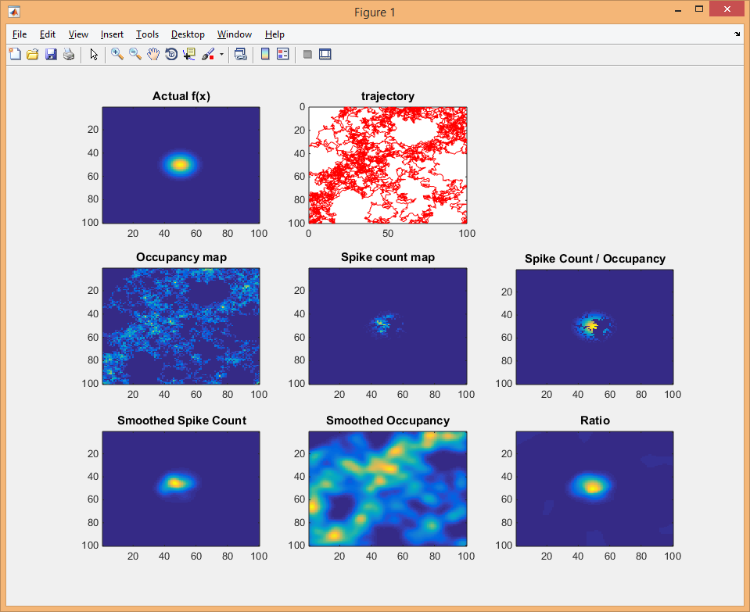
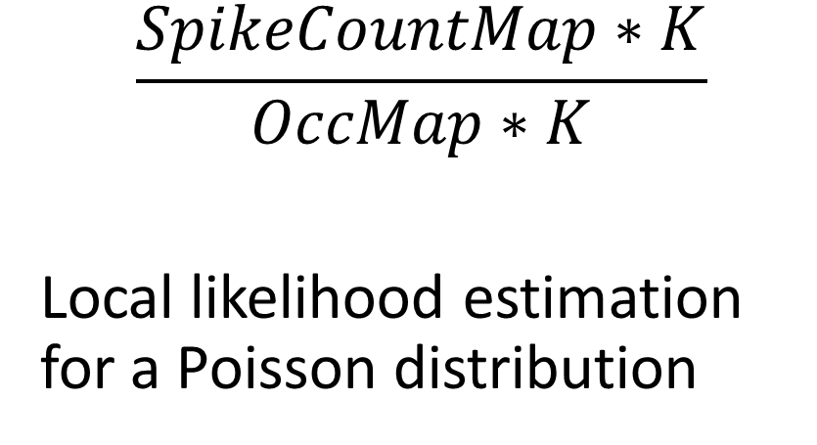
Place field estimation
$$\frac{SpikeCountMap∗K}{OccMap∗K}$$
Local likelihood estimation for a Poisson distribution

Slide 17
Phase field
Abstract space
Local likelihood estimation for von Mises
Physical space
Harris et al Nature 2002

Slide 18
Confirmatory statistics:
How to test that phase is independent of place?
Shuffling method?
Test statistic?

