Slide 1
Estimating mutual information
Kenneth D. Harris
25/3/2015

Slide 2

Entropy
$$H\left(X\right)= \sum_{i}{−\log_{2}{p(X=X_{i})}}$$
Number of bits needed to communicate $X$, on average

Slide 3
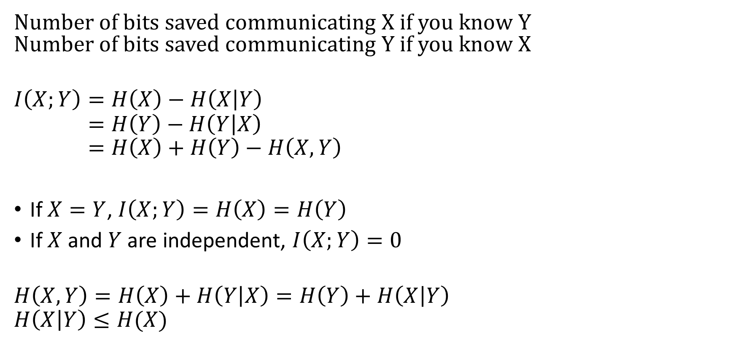
Mutual information
Number of bits saved communicating X if you know Y Number of bits saved communicating Y if you know X
$$I\left(X;Y\right)=H\left(X\right)−H\left(X | Y\right) \\ =H\left(Y\right)−H\left(Y | X\right) \\ =H\left(X\right)+H\left(Y\right)−H\left(X,Y\right)$$
If $X=Y$, $I\left(X;Y\right)=H\left(X\right)=H\left(Y\right)$
If $X$and $Y$ are independent, $I\left(X;Y\right)=0$
$$H\left(X,Y\right)=H\left(X\right)+H\left(Y | X\right)=H\left(Y\right)+H\left(X | Y\right) \\ H\left(X | Y\right)≤H(X)$$

Slide 4

“Plug in” measure
Compute histogram of X and Y, $\hat{p}\left(X,Y\right)$.
Estimate
$$\hat{I}=\sum_{XY}{\hat{p}\left(X,Y\right)\log_{2}\left(\frac{\hat{p}\left(X,Y\right)}{\hat{p}\left(X\right)\hat{p}\left(Y\right)}\right)}$$
Biased above

Slide 5
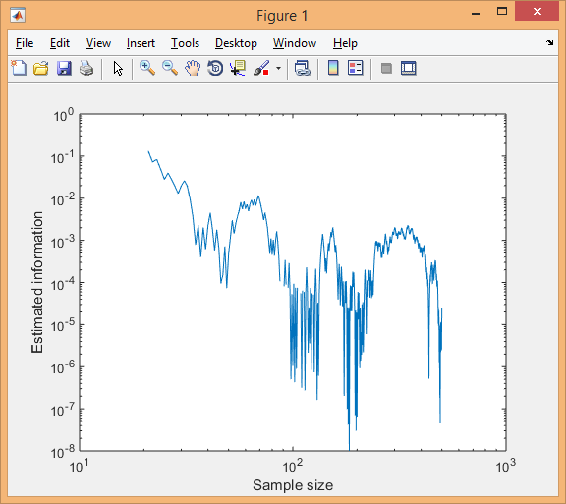
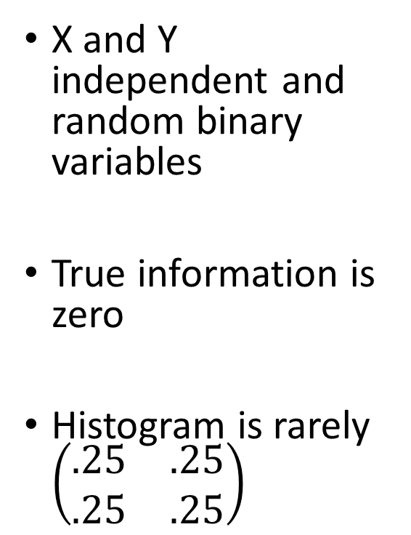
No information
X and Y independent and random binary variables
True information is zero
Histogram is rarely $\left(\begin{matrix}.25 & .25 \\ .25 & .25\end{matrix}\right)$

Slide 6
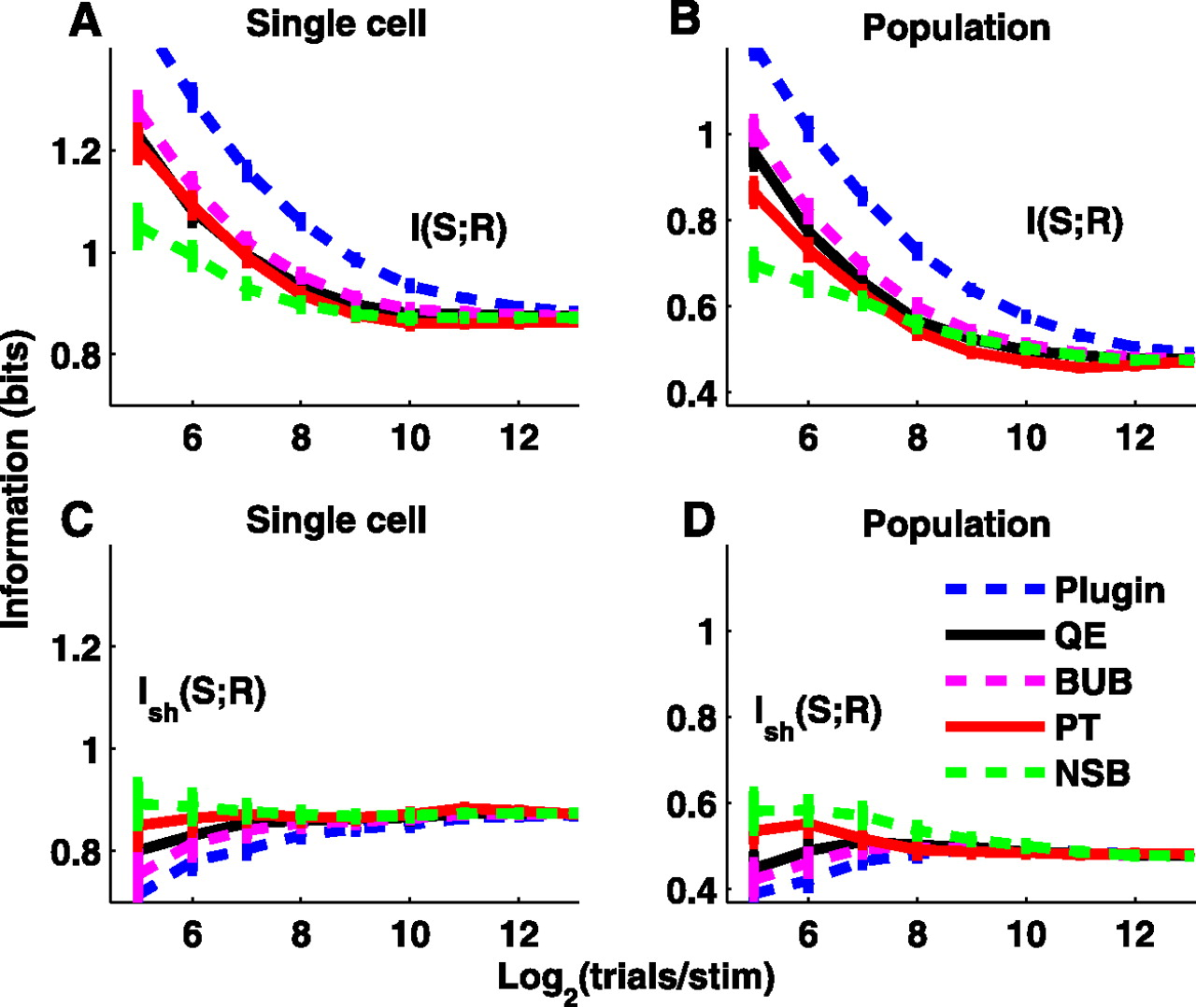
Bias correction methods
Not always perfect
Only use them if you truly understand how they work!
Panzeri et al, J Neurophys 2007

Slide 7
Cross-validation
Mutual information measures how many bits I save telling you about the spike train, if we both know the stimulus
Or how many bits I save telling you the stimulus, if we both know the spike train
We agree a code based on the training set
How many bits do we save on the test set? (might be negative)

Slide 8

Strategy
Use training set to estimate
$$\hat{p}\left(Spikes | Stimulus\right)$$
Compute
$$\frac{1}{N}\sum_{test set}{−\log_{2}{\hat{p}(Spikes)}}−\left(−\log_{2}{\hat{p}\left(Spikes|Stimulus\right)}\right)$$
Codeword length when we don’t know stimulus
Codeword length when we do know stimulus

Slide 9
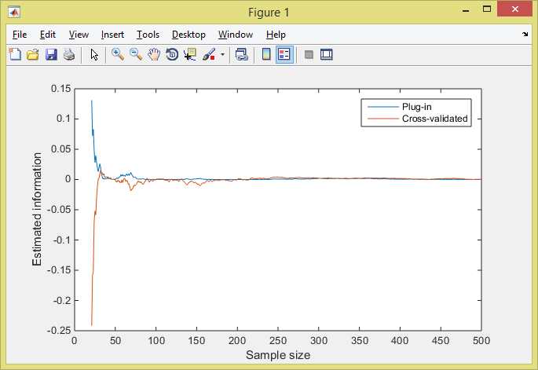
This underestimates information
Can show expected bias is negative of plug-in bias

Slide 10
Two choices:
Predict stimulus from spike train(s)
Predicted spike train(s) from stimulus

Slide 11
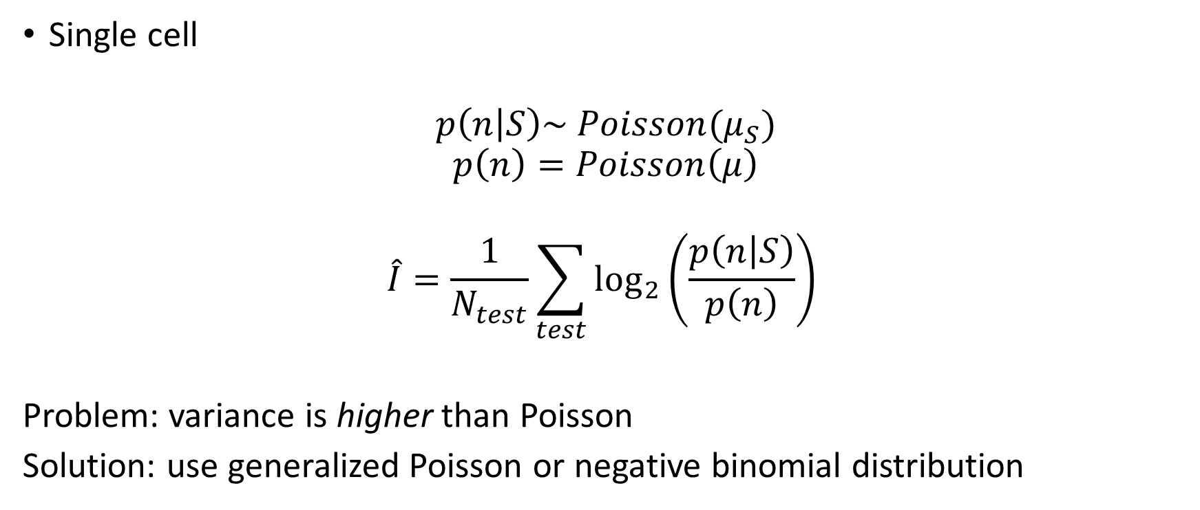
Predicting spike counts
Single cell
$$p\left(n | S\right)\sim Poisson(μ_{S})$$
$$p\left(n\right)=Poisson\left(μ\right)$$
$$\hat{I}=\frac{1}{N_{test}}\sum_{test}{\log_{2}\left(\frac{p\left(n | S\right)}{p\left(n\right)}\right) }$$
Problem: variance is higher than Poisson
Solution: use generalized Poisson or negative binomial distribution
Likelihood ratio

Slide 12
Unit of measurement
“Information theory is probability theory with logs taken to base 2”
Bits / stimulus
Bits / second (Bits/stimulus divided stimulus length)
Bits / spike (Bits/second divided mean firing rate)
High bits/second => dense code
High bits/spike => sparse code.

Slide 13
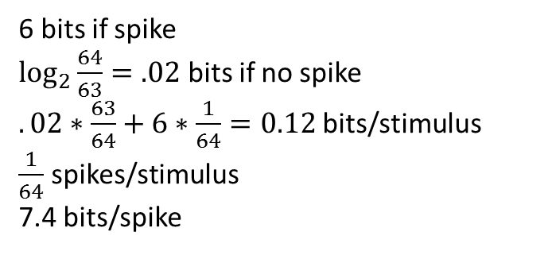
Bits per stimulus and bits per spike
1 bit if spike
1 bit if no spike
1 bit/stimulus
.5 spikes/stimulus
2 bits/spike
6 bits if spike
$\log_{2}{\frac{64}{63}}=.02$ bits if no spike
$.02∗\frac{63}{64}+6∗\frac{1}{64}=0.12$bits/stimulus
$\frac{1}{64}$ spikes/stimulus
7.4 bits/spike

Slide 14
Measuring sparseness with bits/spike
Sakata and Harris, Neuron 2009

Slide 15
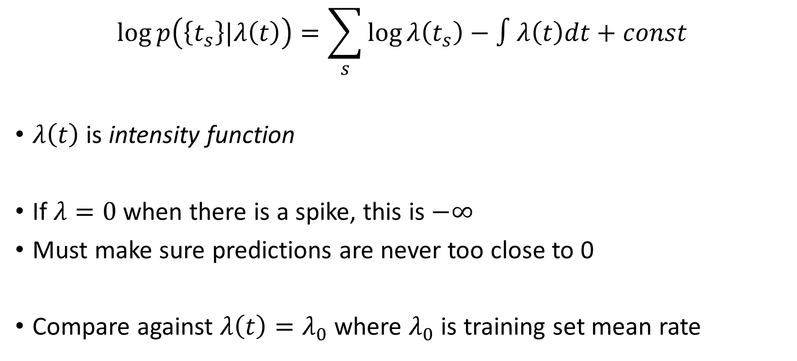
Continuous time
$$\log{p\left(\left\{t_{s}\right\}|λ\left(t\right)\right)}=\sum_{s}{\log{λ\left(t_{s}\right)}}−∫λ\left(t\right)dt+const$$
$λ\left(t\right)$ is intensity function
If $λ=0$ when there is a spike, this is $−∞$
Must make sure predictions are never too close to 0
Compare against $λ\left(t\right)=λ_{0}$ where $λ_{0}$ is training set mean rate
Itskov et al, Neural computation 2008

Slide 16
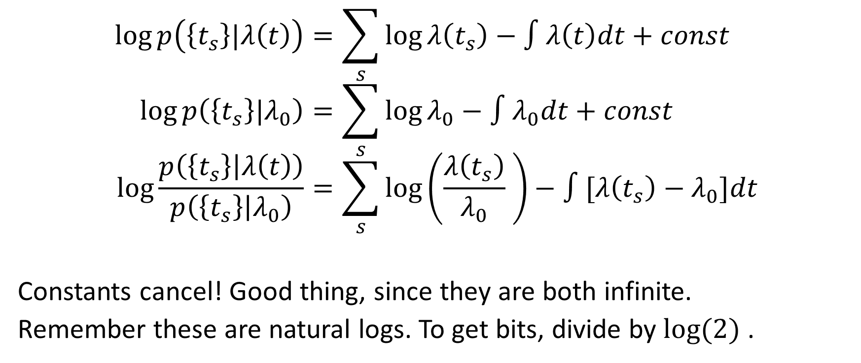
Likelihood ratio
$$\log{p\left(\left\{t_{s}\right\}|λ\left(t\right)\right)}=\sum_{s}{\log{λ\left(t_{s}\right)}}−∫λ\left(t\right)dt+const \\ \log{p\left(\left\{t_{s}\right\}|λ_{0}\right)}=\sum_{s}{\log{λ_{0}}}−∫λ_{0}dt+const \\ \log{\frac{p\left(\left\{t_{s}\right\} | λ\left(t\right)\right)}{p\left(\left\{t_{s}\right\} | λ_{0}\right)}}=\sum_{s}{\log\left(\frac{λ\left(t_{s}\right)}{λ_{0}} \right)}−∫[λ\left(t_{s}\right)−λ_{0}]dt$$
Constants cancel! Good thing, since they are both infinite.
Remember these are natural logs. To get bits, divide by $log⁡(2)$ .

Slide 17
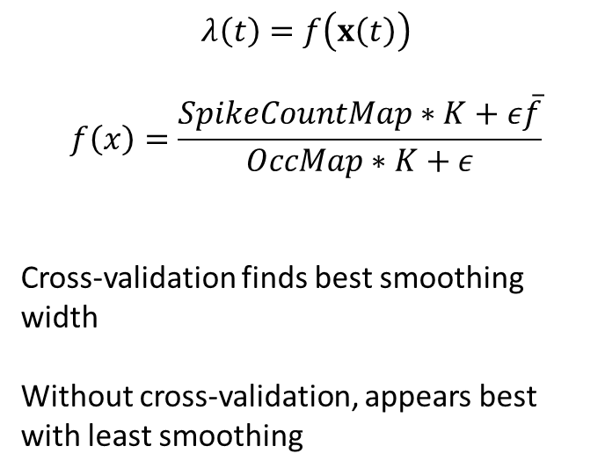
Predicting firing rate from place
$$λ\left(t\right)=f\left(x\left(t\right)\right)$$
$$f\left(x\right)=\frac{SpikeCountMap∗K+ε\overline{f}}{OccMap∗K+ε}$$
Cross-validation finds best smoothing width
Without cross-validation, appears best with least smoothing
Harris et al, Nature 2003

Slide 18
Comparing different predictions
Harris et al, Nature 2003

