Slide 1
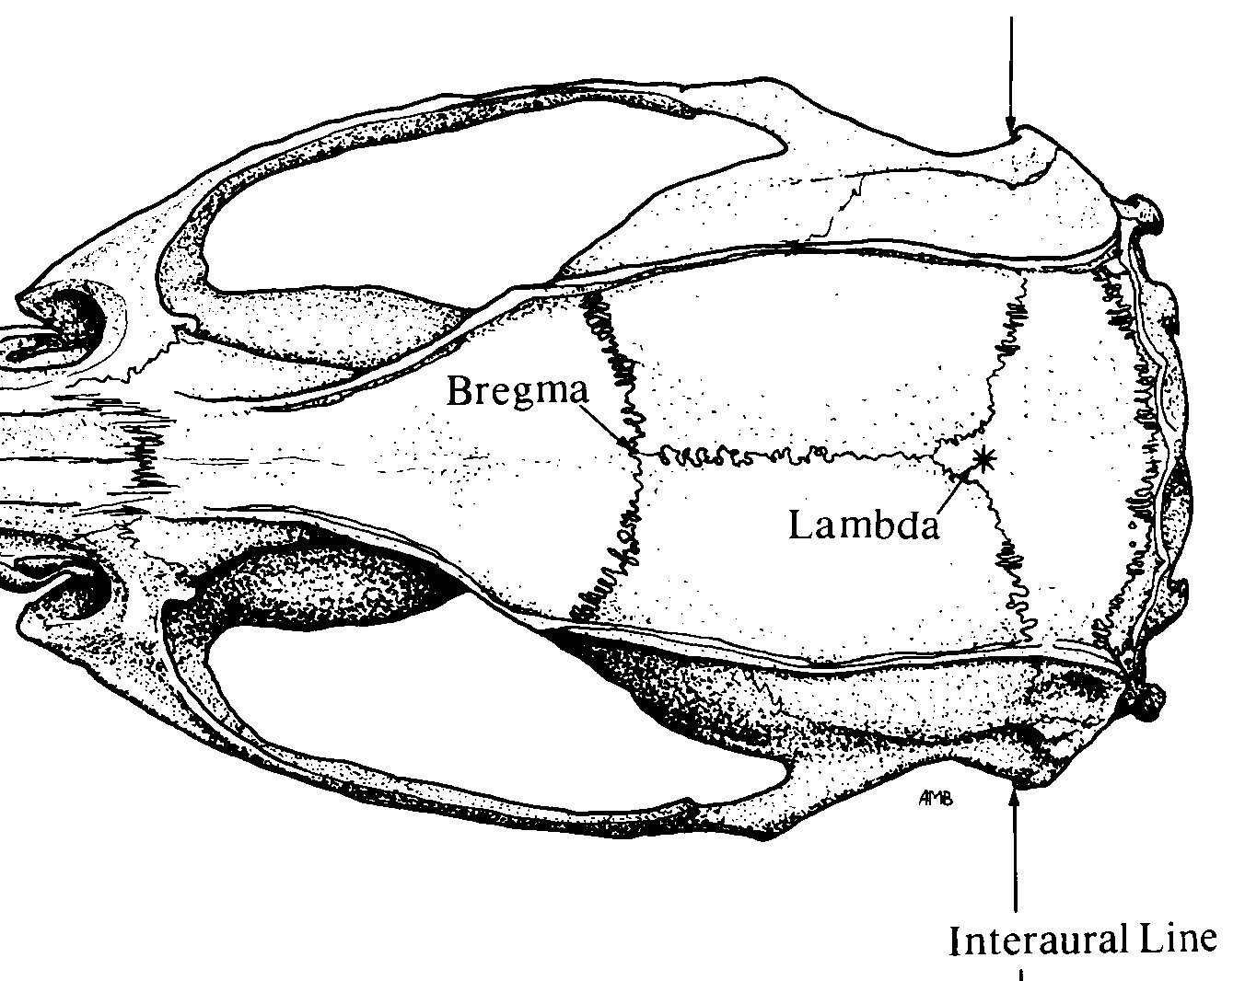
Implant Map
Stereotaxic Coordinates
Location | Bregma | Midline | D-V
LC | - 5.45 mm (anterior) | ±1.20 mm (lateral) | -4.00 mm
*
Bregma
Lambda
❶
❶
Nuchal muscle

