Slide 1
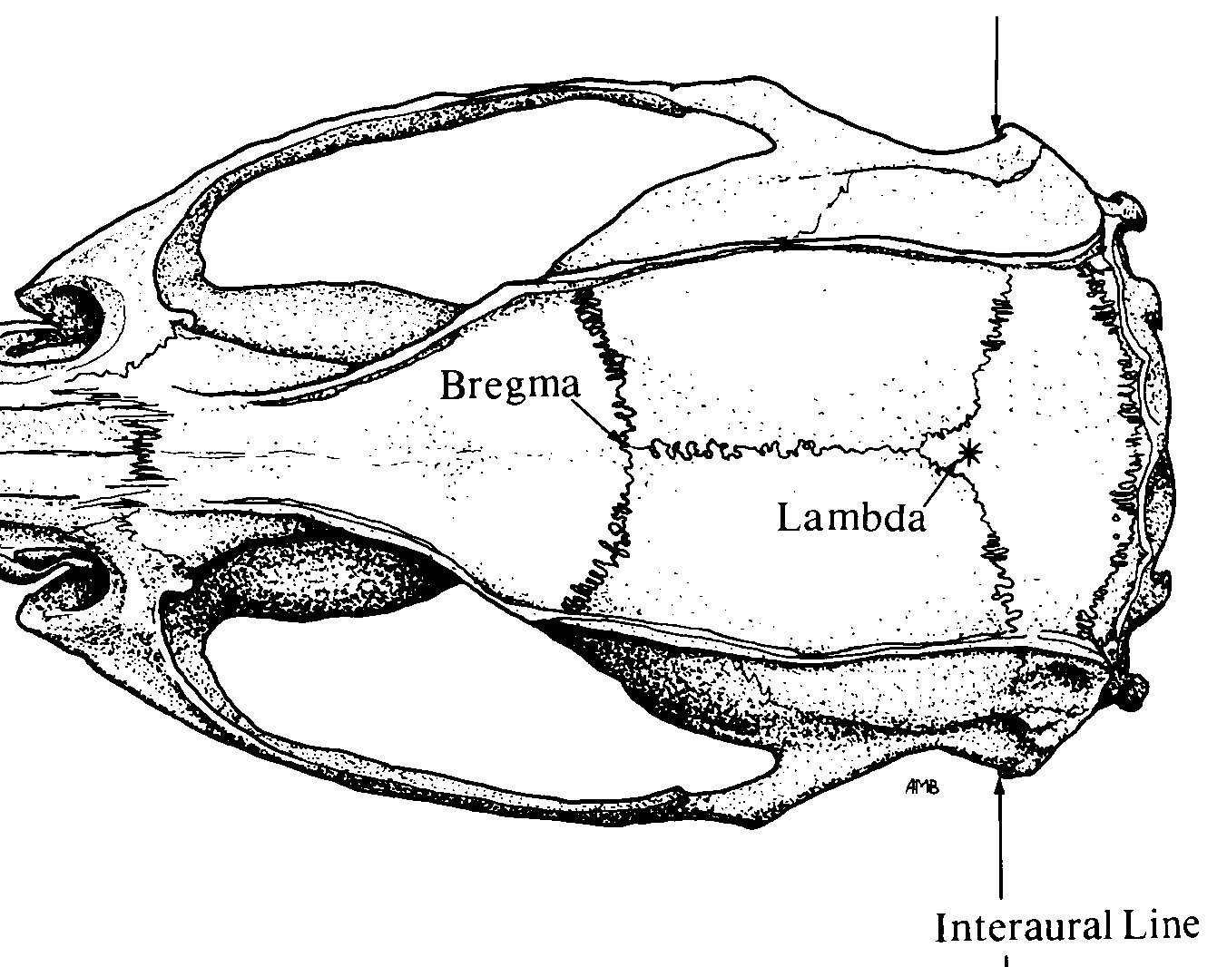

Implant Map
Pin-out
1 GND | 2 R-M1 (Chan2) | 3 EMG wire (Chan3)
4 Depth/Cannula | 5 Depth/Cannula (Chan1) | 6 EMG wire (Chan3)
White out
*
Bregma
Stereotaxic Coordinates
Location | Bregma | Midline | D-V
LC | - 5.45 (anterior) | ±1.20 (lateral) | -2.00
Lambda
❶
Nuchal muscle
*
Anchor screw
Adjust ratio $=\frac{Measured X B−L}{Reference X B−L}$

