Slide 1
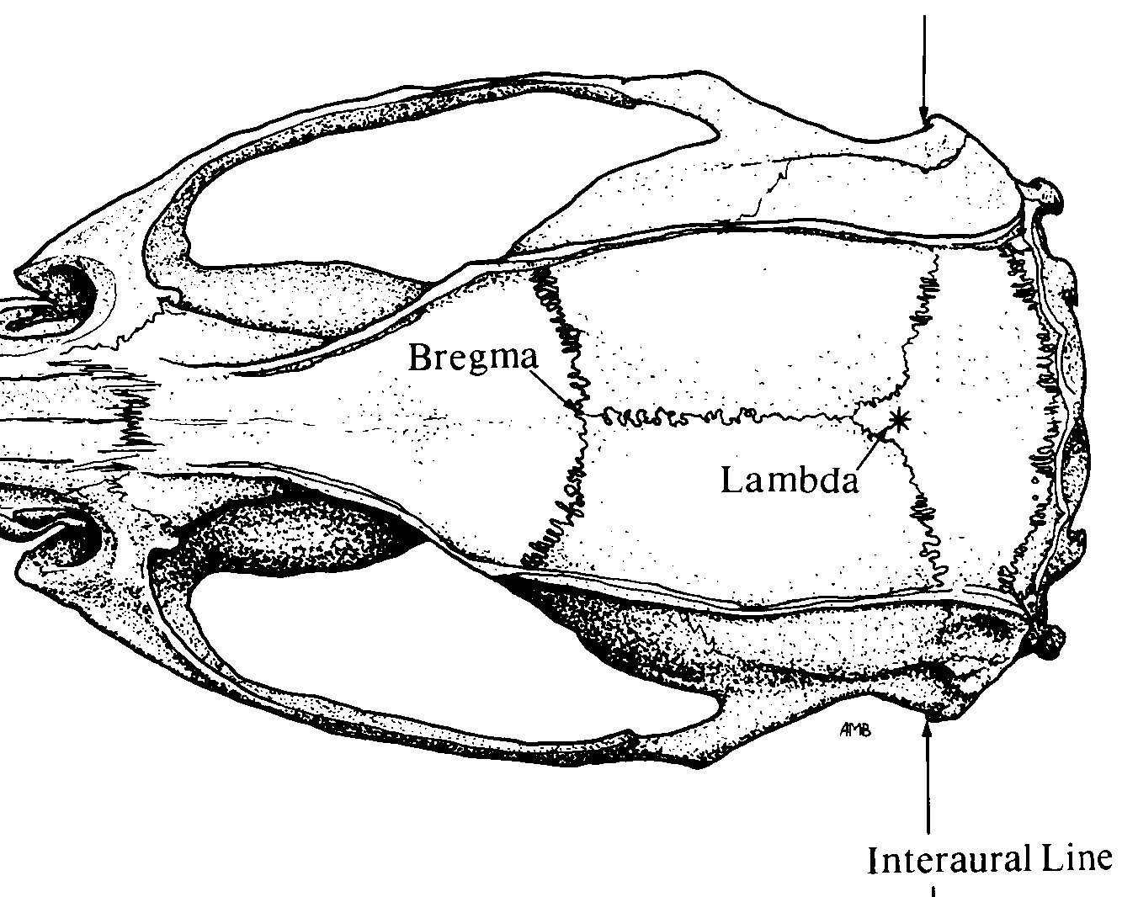
Implant Map
Stereotaxic Coordinates
Location | Bregma | Midline | D-V
LC | - 5.45 (anterior) | ±1.20 (lateral) | -2.00
*
Bregma
Lambda
❶
❶
Nuchal muscle

