Slide 1
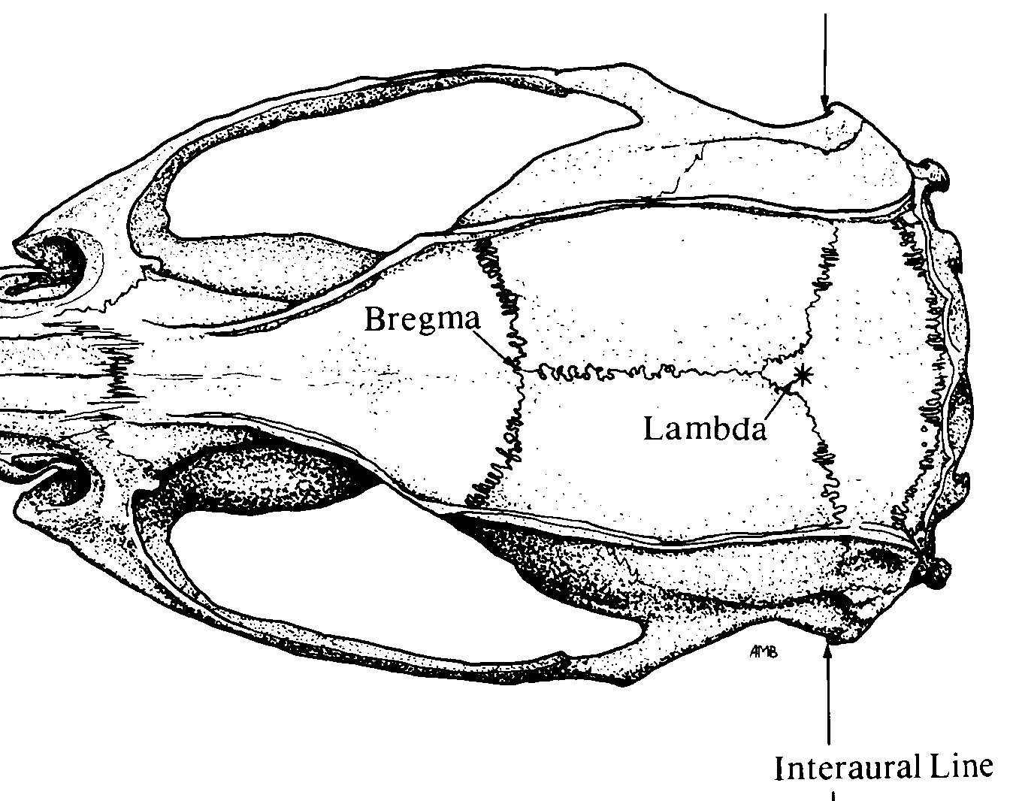
Implant Map
Stereotaxic Coordinates
Location | Bregma | Midline | D-V
LC | -5.50 mm (anterior) | ±0.85 mm (lateral) | -3.60 mm
Locus coeruleus input to hippocampal CA3 drives single-trial learning of a novel context
Bregma
Lambda
❶
❶
Nuchal muscle

