Slide 1
Title
Comment

Slide 2
March 2020

Slide 3
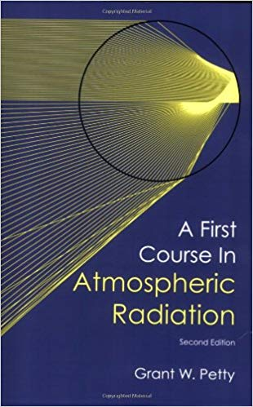
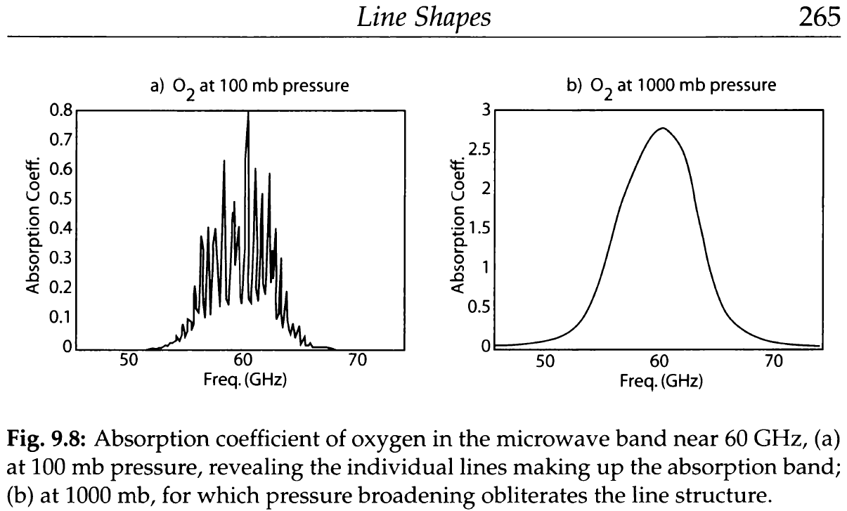
Potential benchmark (& Lorentz profile is criticized on same page)

Slide 4
Some ideas
Voigt takes ~90% of runtime. Needs acceleration. How:
1. Refactoring of the existing ‘humlichek’
2. In time-domain, convolution is replaced with multiplication
3. Call ‘humlichek’ fewer times: dnu = 0.01 to catch line peaks. What if we run ‘humlichek’ precisely at the peaks (location is known and only slightly shifted with Temp & Press) and use dnu~1 elsewhere?
4. Do we need to use Voigt at all (Lorentz is wrong anyway)?

Slide 5
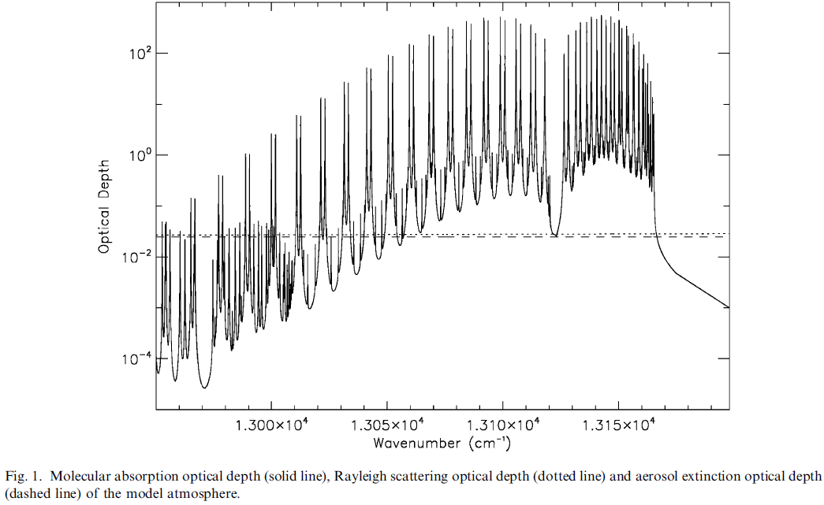
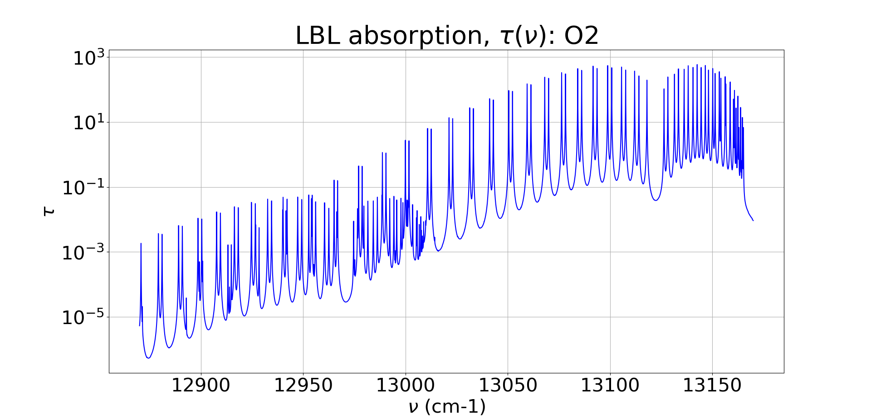
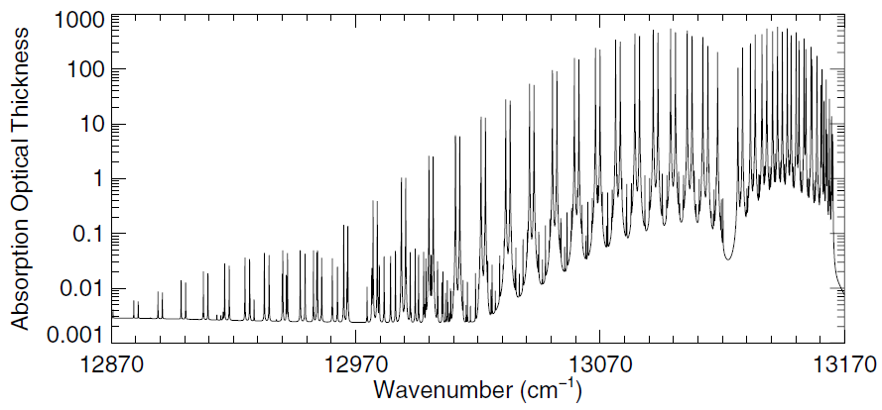
O2: A-band +1:

Slide 6
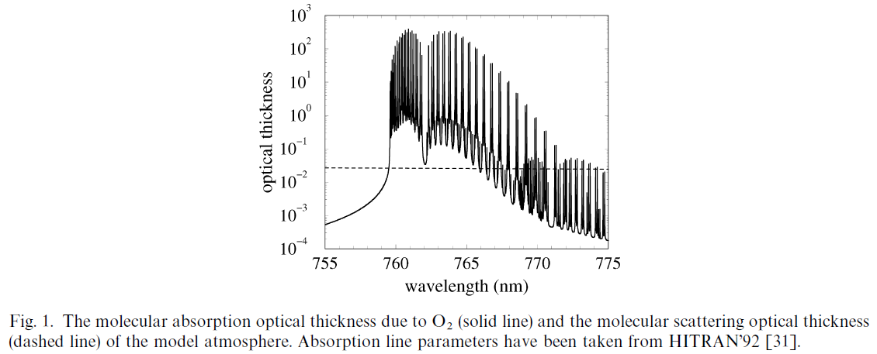
O2: A-band (?)

Slide 7
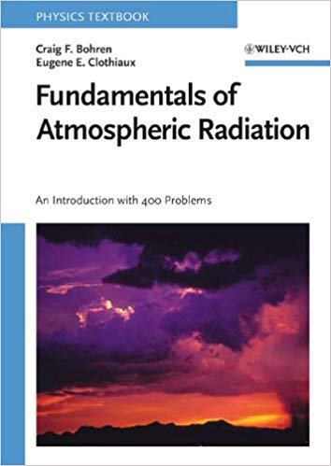
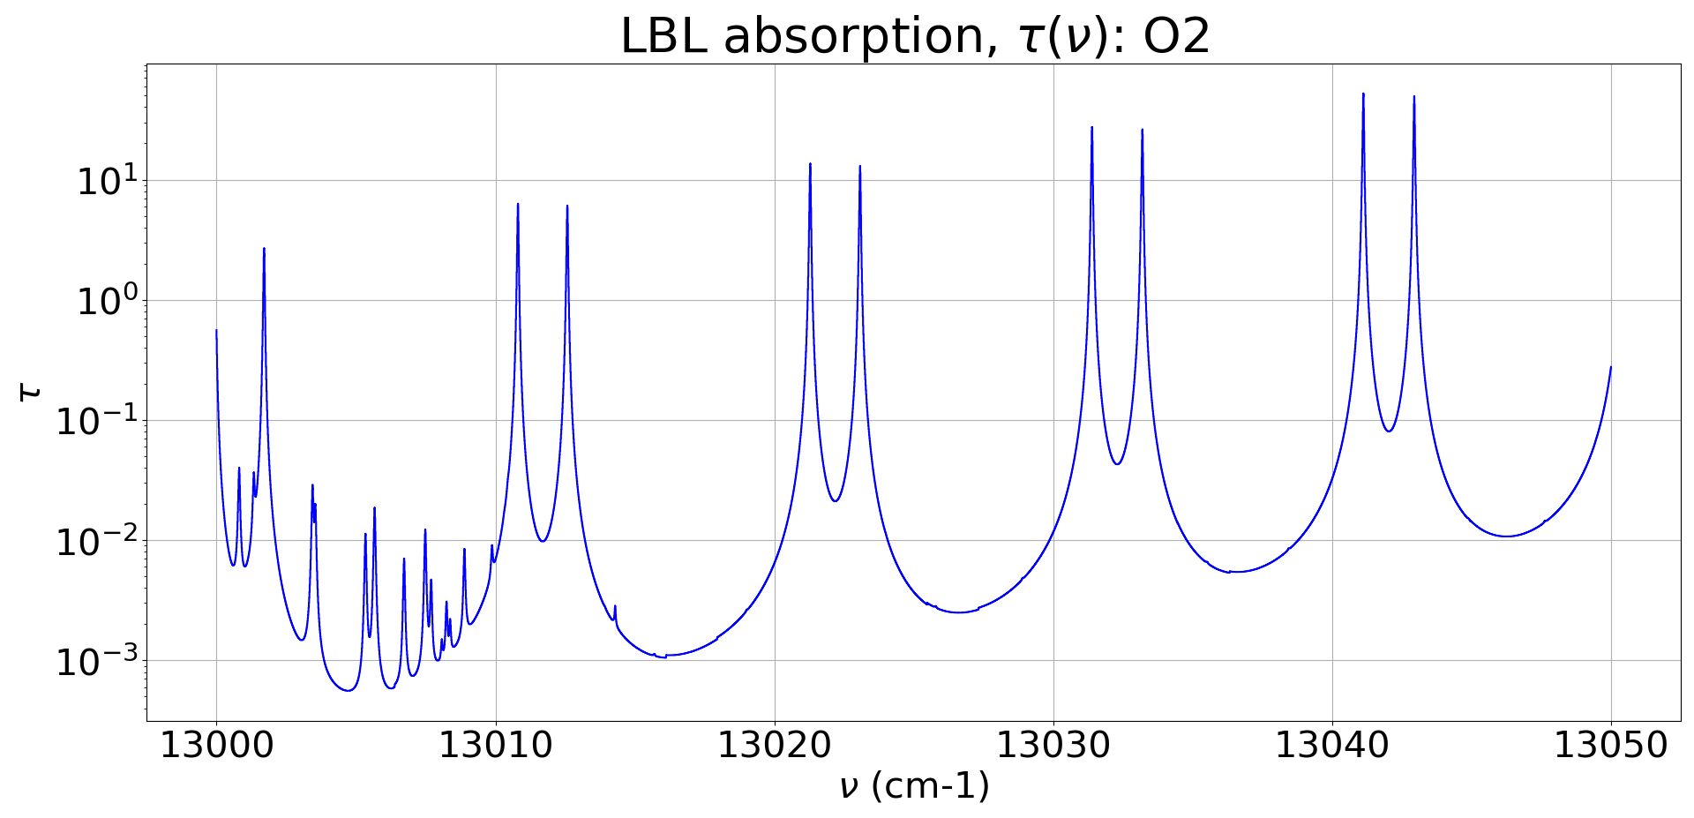
O2: 100 km atmosphere Bohren C & Clothiaux E: Fig. 6.14, p.321 (ref to Q.Min)
dν = 0.01 & 0.001 & 0.0001

Slide 8
February 2020

Slide 9
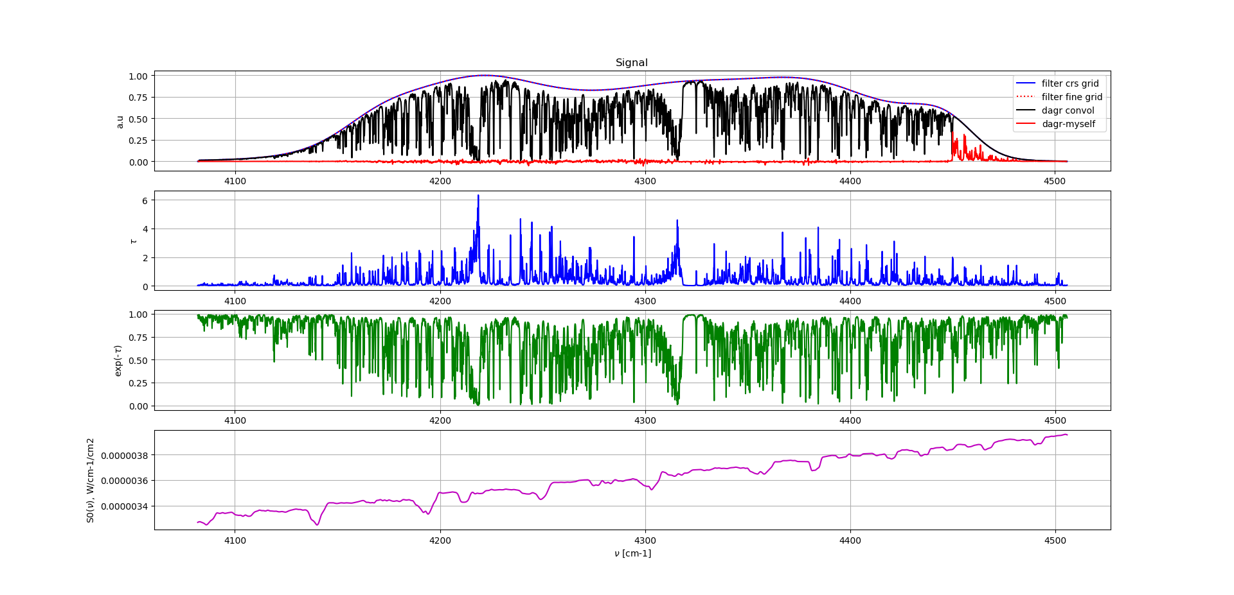
Gas Cell Test: Convolution

Slide 10
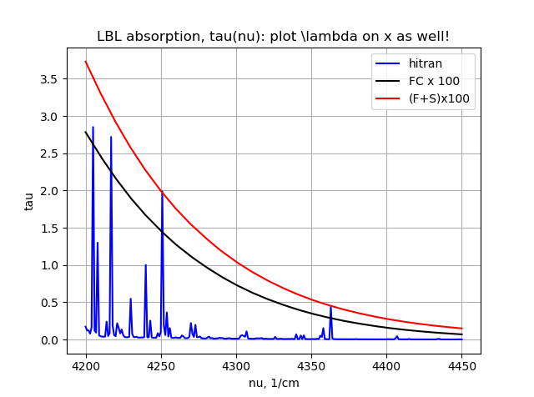
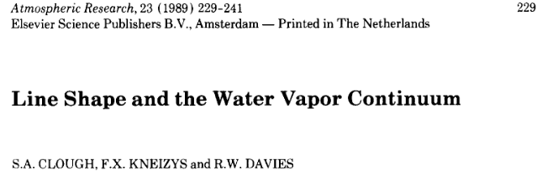
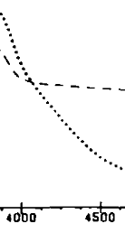
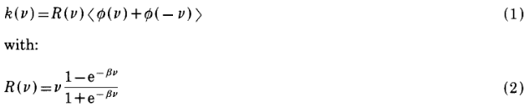
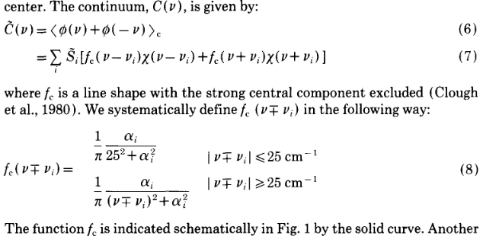
H2O: continuum (1 cm-1 for simplicity)

Slide 11
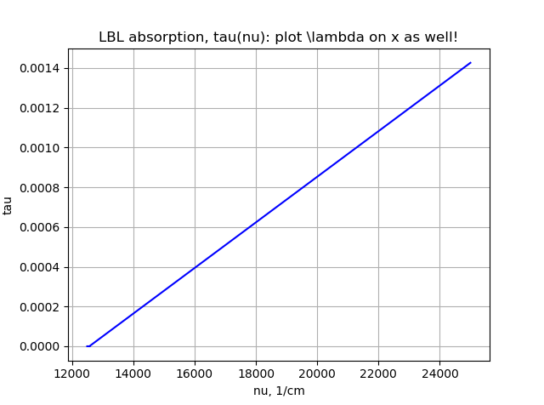
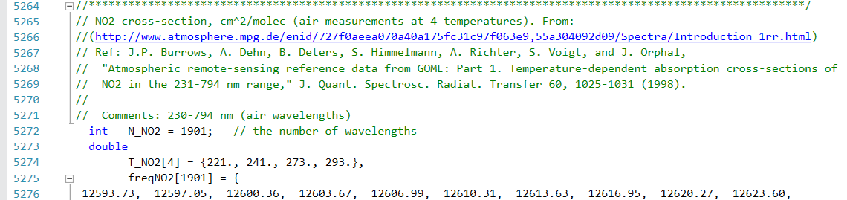
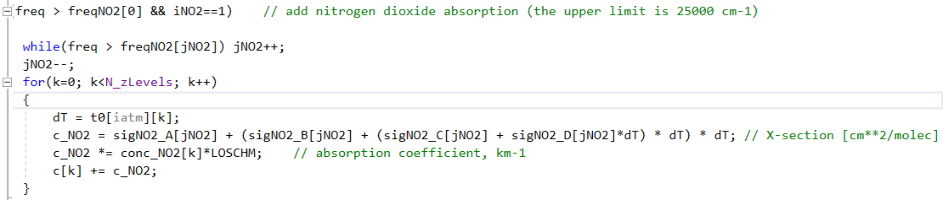
NO2 in Atmosphere: continuum (???)
Outdated (1998, weblink does not work)
4 temperatures are not used (?)
We don’t need it now (CH4_band < NO2_continuum = 12500 - 25000)

Slide 12
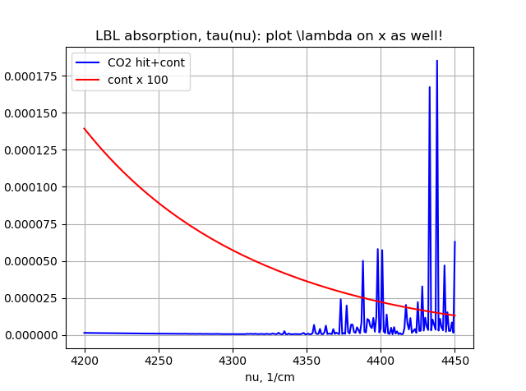
CO2 continuum @ BOA:

Slide 13
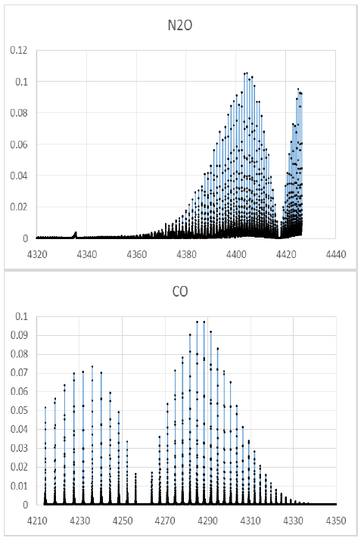
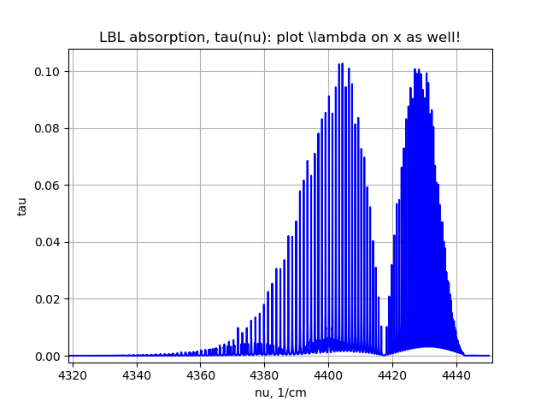
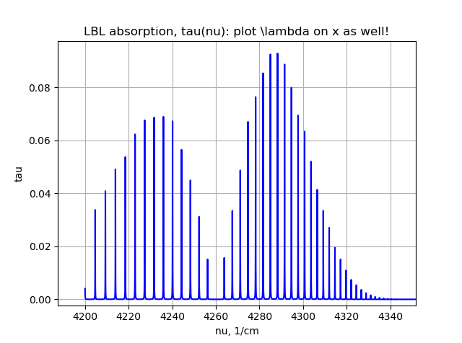
N2O & CO:
ppmv n2o = 0.307
ppmv co = 0.111
dν = 0.01 cm-1

Slide 14
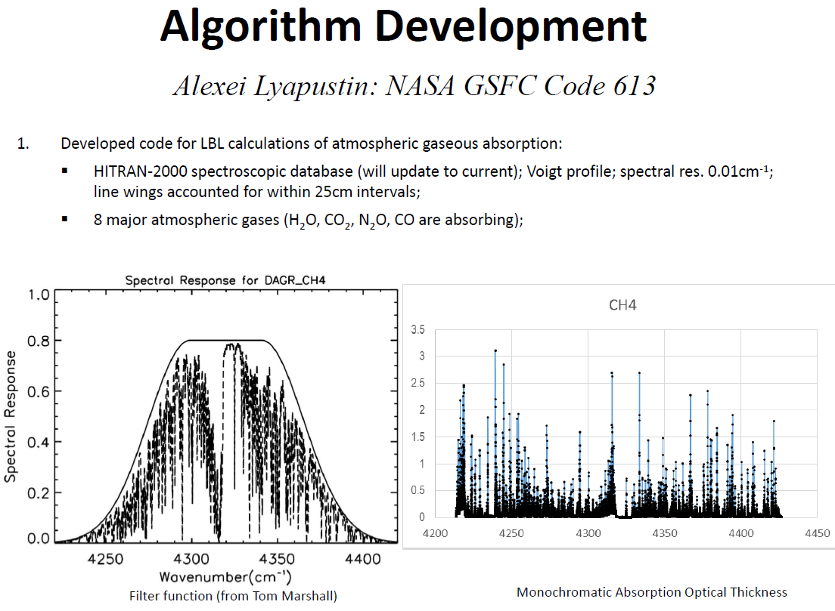
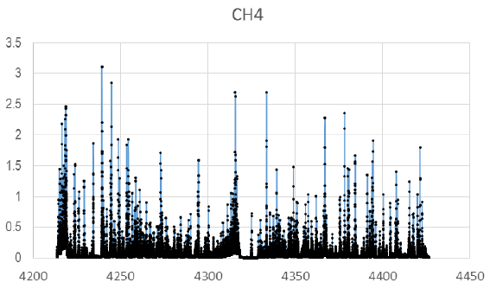
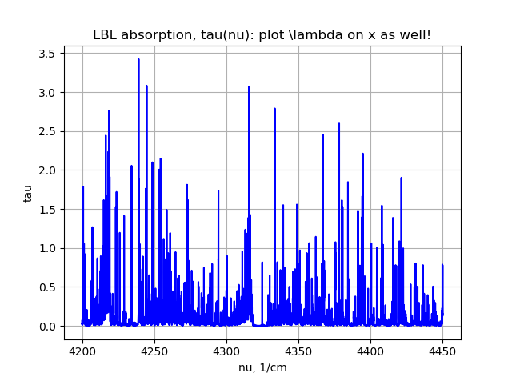
CH4 in Atmosphere: benchmark = Alexei’s talk
@ BOA; runtime =3min (Release).
dν = 0.01 cm-1
ppmv = 1.65
Old HITRAN2000 & LOWTRAN

Slide 15
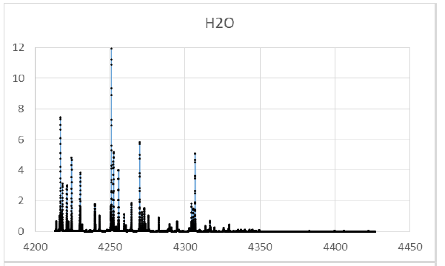
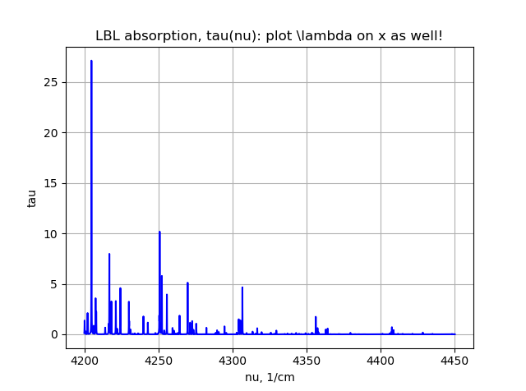
H2O in Atmosphere (default WV = 1.45 cm): benchmark = Alexei’s talk (? cm of WV)

Slide 16
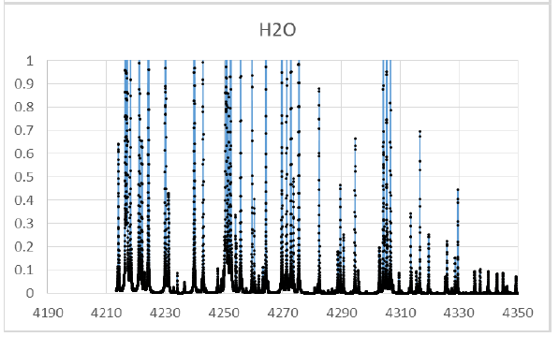
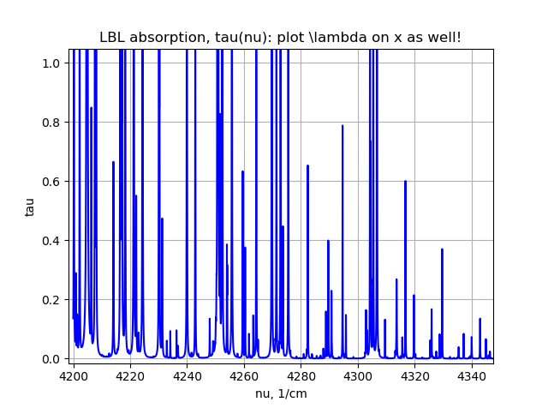
H2O in Atmosphere (details of the same): benchmark = Alexei’s talk (? cm of WV)

Slide 17
January 2020

Slide 18
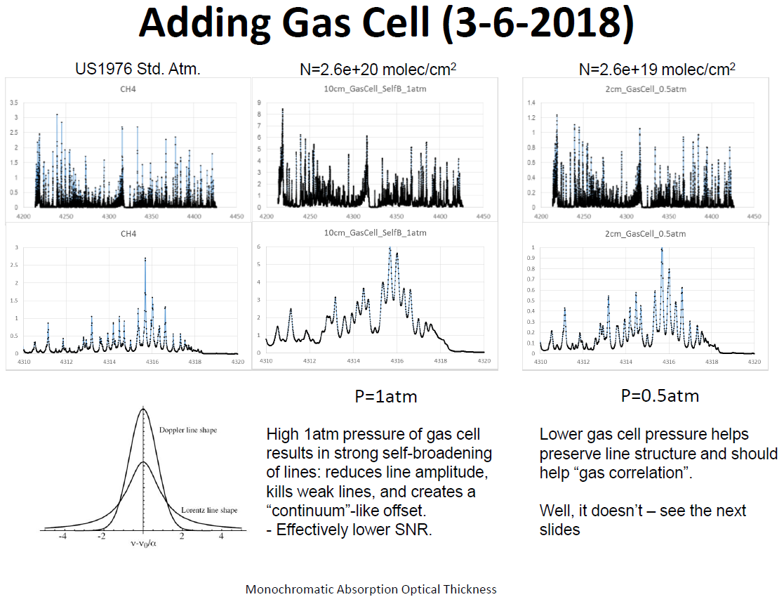
CH4 filled gas cell: benchmark = Alexei’s talk
T[K] = ?
From
N = 2.6e+20 molec/cm2, p=1 atm,
l=10cm:
T = 283K = +10C
dν = 0.01 cm-1

Slide 19
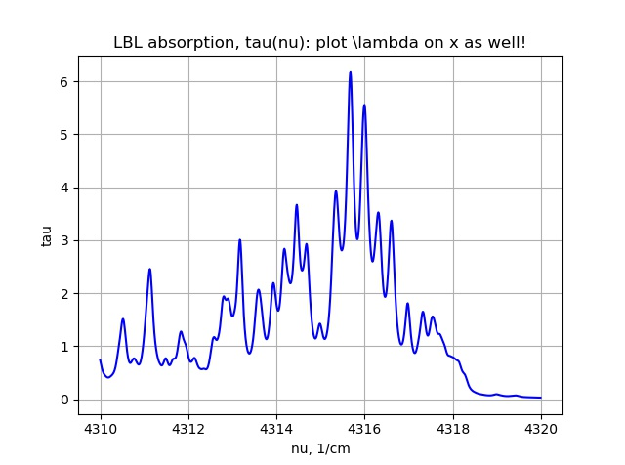
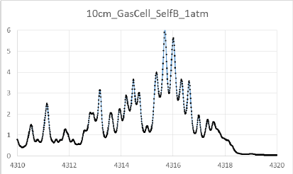
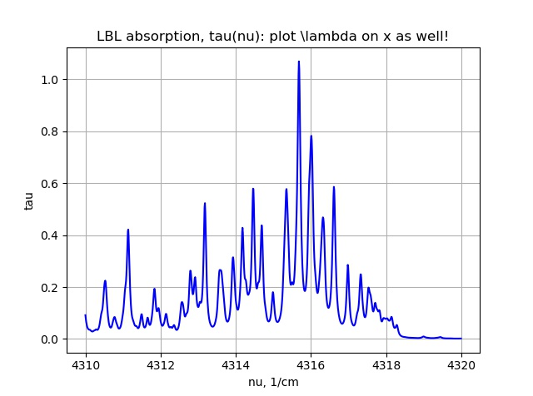
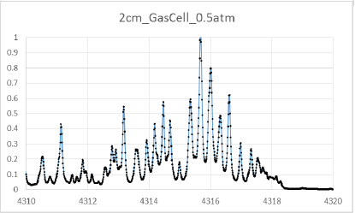
Narrow range

Slide 20
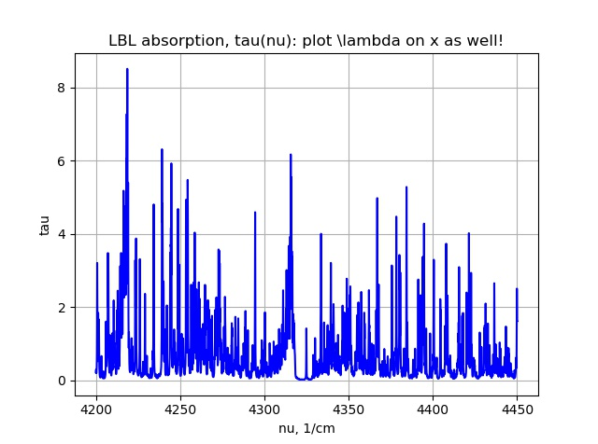
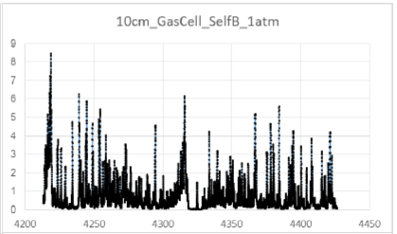
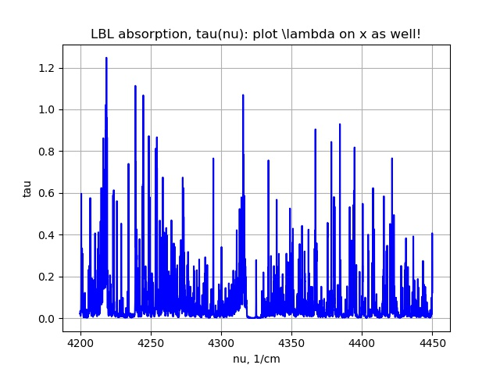
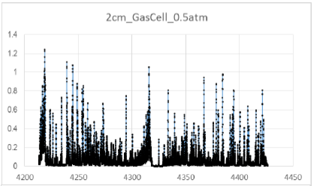
Wide range

Slide 21
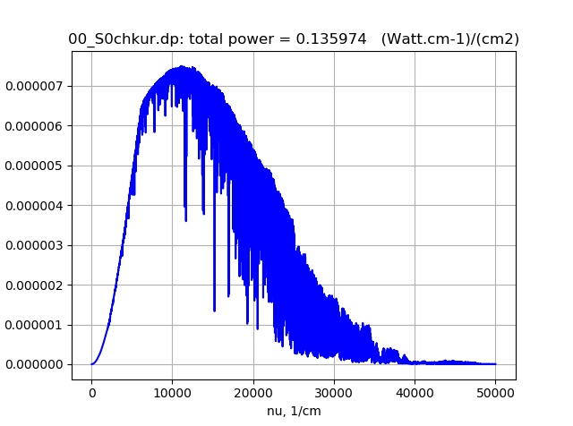

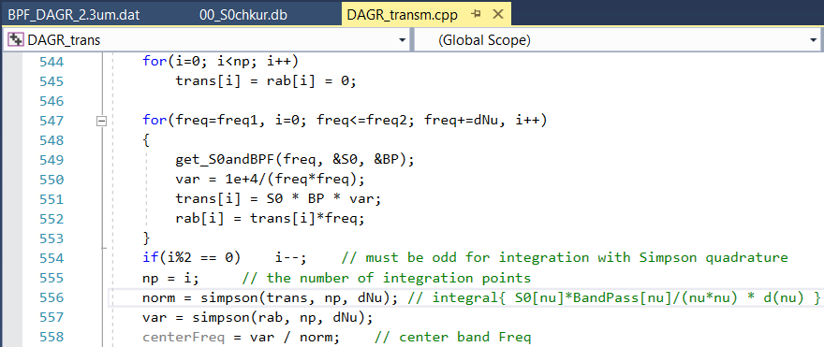
∫..dν vs ∫..dλ & Trapz vs Simpson
∫..dν
∫..dλ
Ratio
Simpson
0.13597383813740
0.13597383813734
1.0000000000005
Trapz
0.1359752049
0.1359752070
0.999999984

Slide 22
Gas Cell Transmittance

