Slide 1
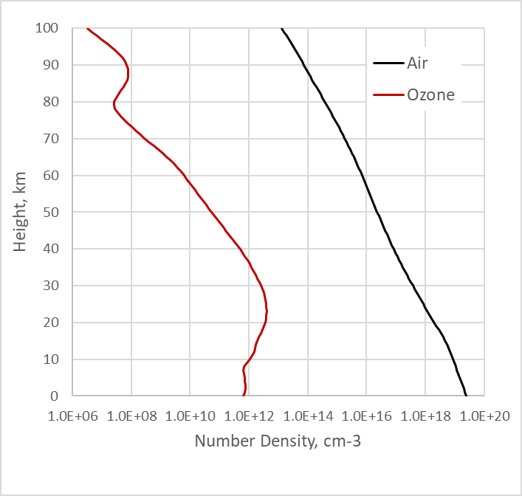
Limb Single Scattering
Zawada et al., AMT (2021): SASKTRAN-HR (options: SCIATRAN, GSLS)
9 solar geometries: SZA & RAZ
11 wavelengths (943, 1020, 1700) → 8
3 compositions: R, R+O3, R+O3+A → 2
3 surface albedos → 1
80 tangent heights
Total: 9 x 8 x 2 x 80 = 11,520 test cases (points) w/o aerosol …
…or 9 x 8 x 2 = 144 plots of Iss vs. tangent height

Slide 2
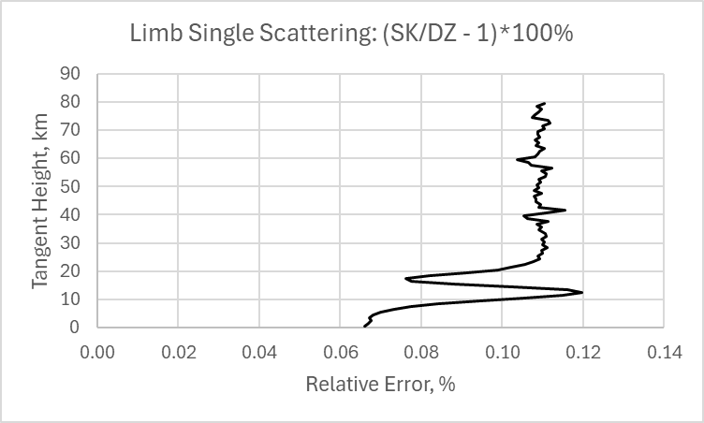
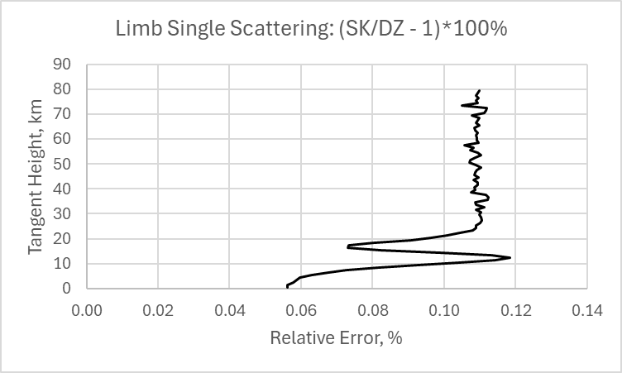
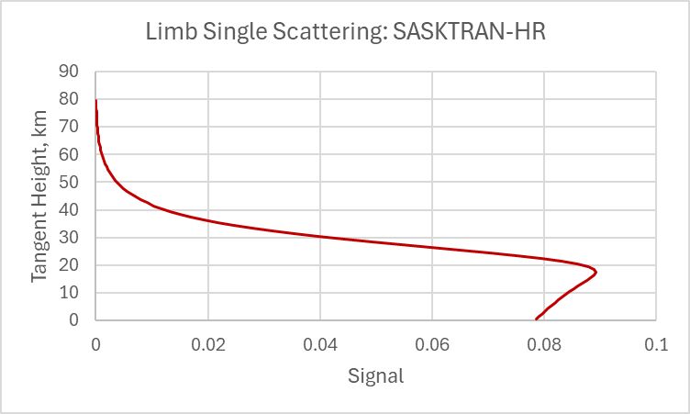
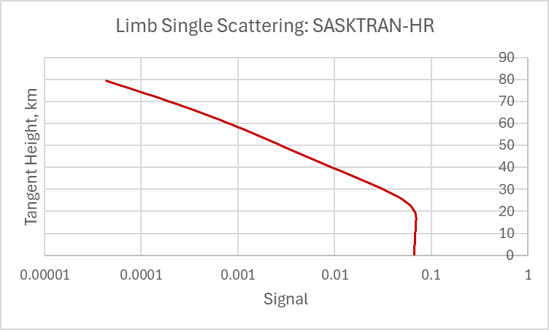
Comparison vs. Benchmark by Zawada et al., AMT (2021): goal ~ 0.2%
351nm
Rayleigh OT: 0.6167
Ozone OT: 0.001 x 0
SZA=70 RAA=30
SCA=35.5
Same except for
SZA=50 RAA=130
SCA = 119.5
Note log scale on X

Slide 3
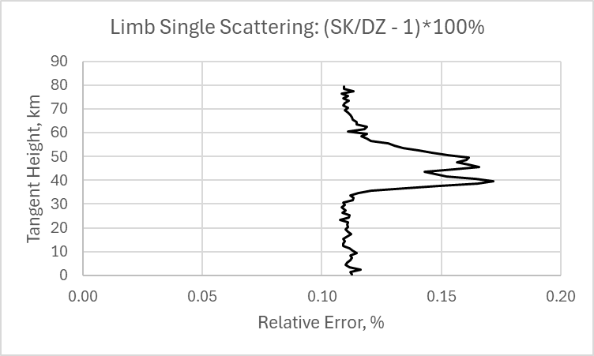
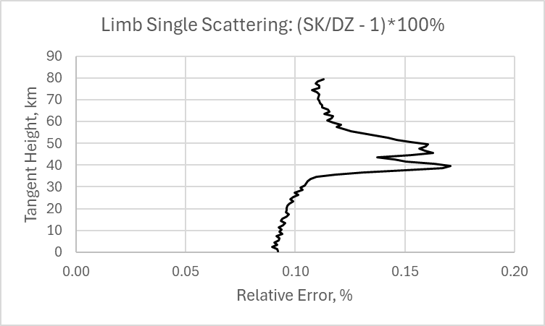
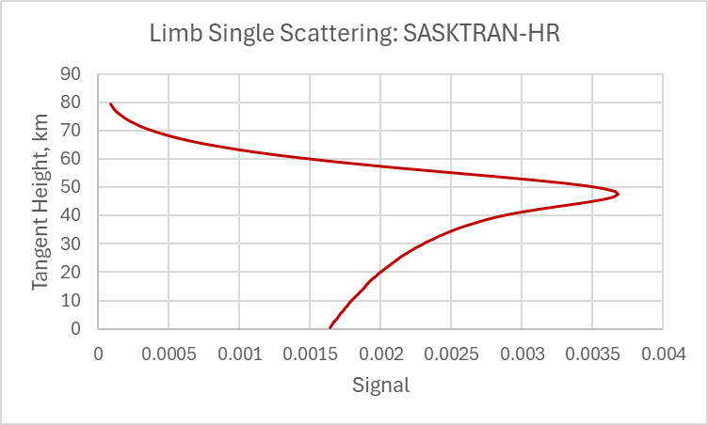
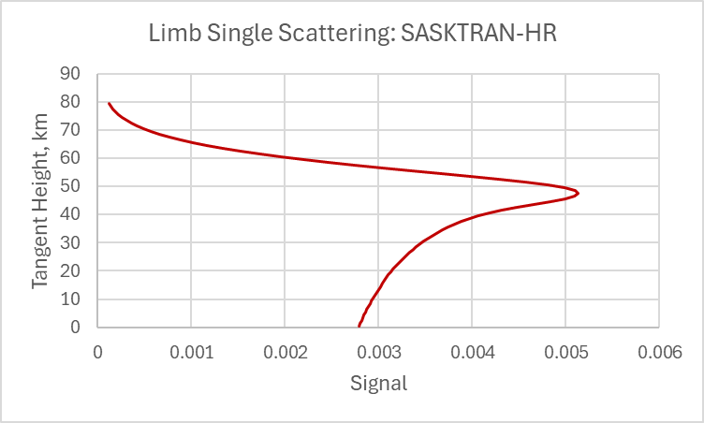
Comparison vs. Benchmark by Zawada et al., AMT (2021): goal ~ 0.2%
300nm
Rayleigh OT: 1.2002
Ozone OT: 2.9165
SSA: 0.29
SZA=80 RAA=60
SCA=60.5
Same except for
SZA=80 RAA=150
SCA = 148.5

Slide 4

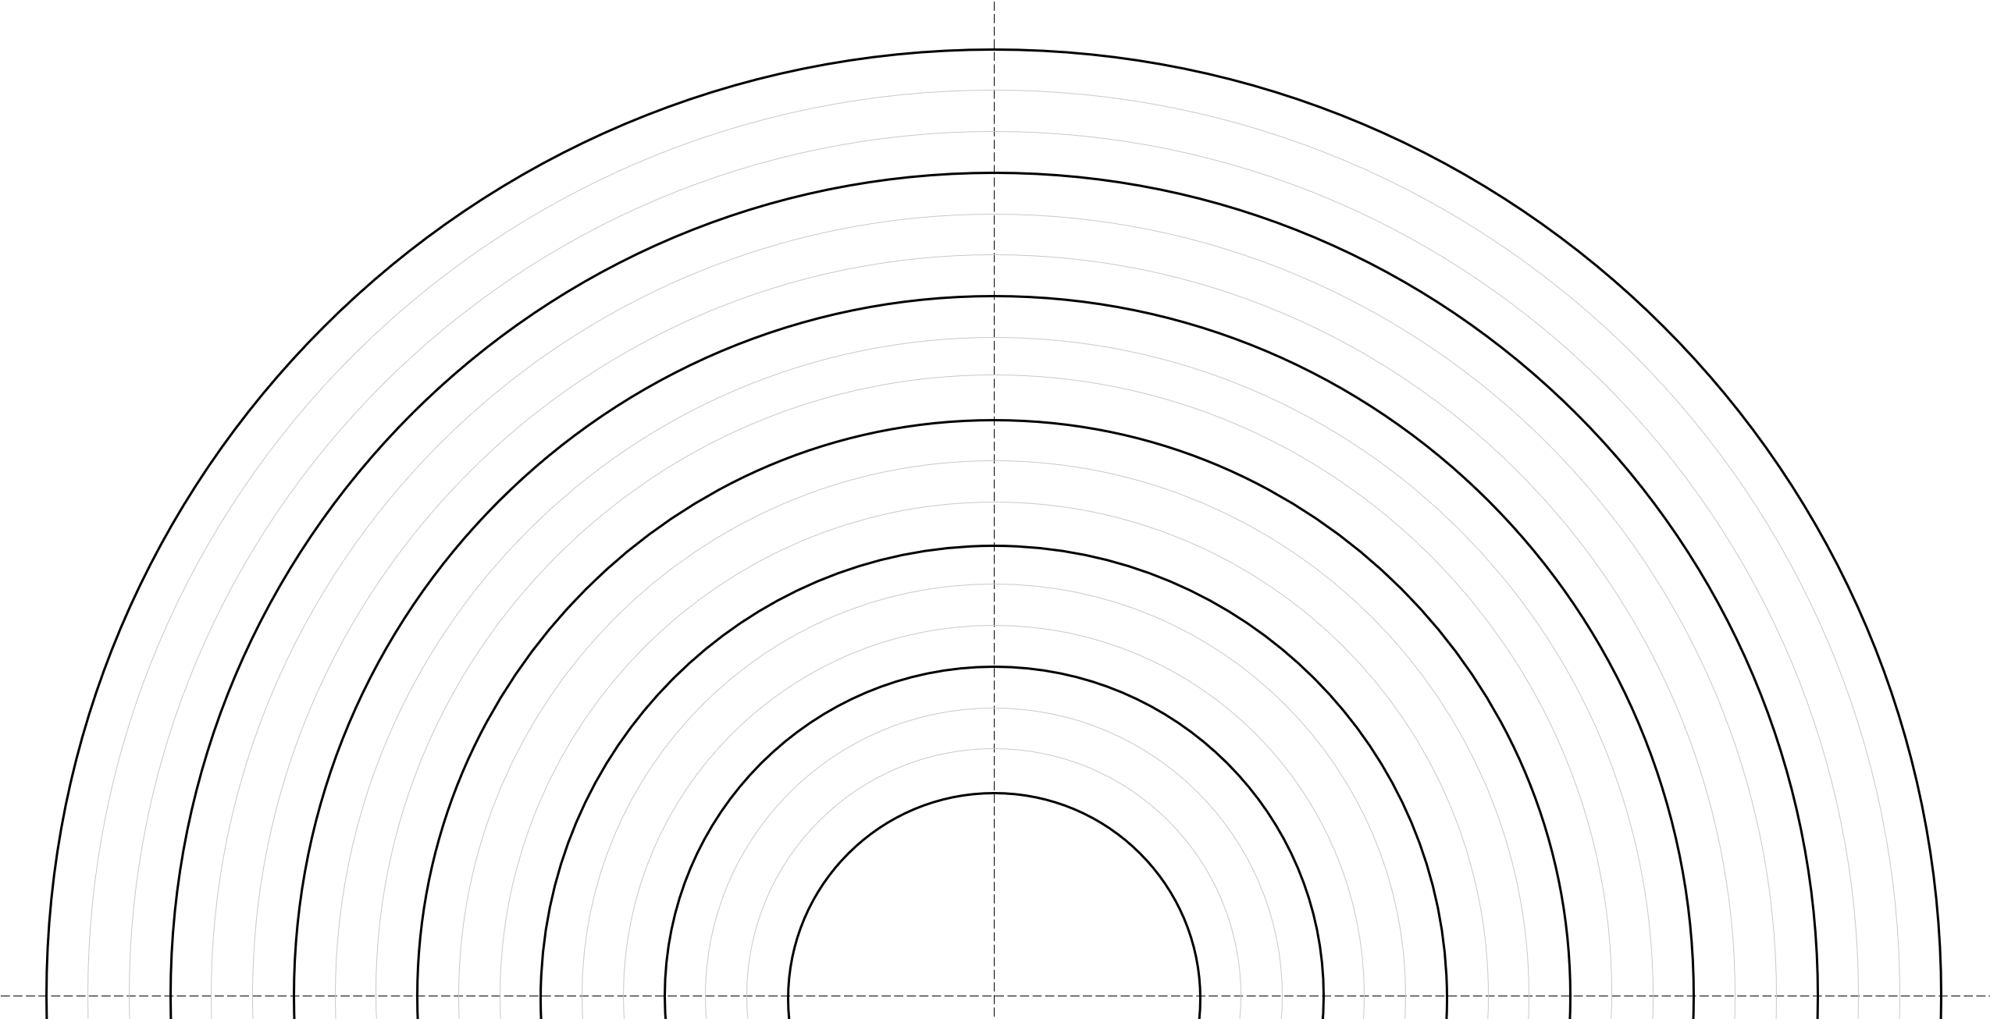
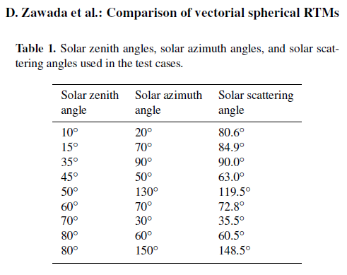

Step 1: Check for Twilight (SZA > 90)
Worst case (point W): r = max, RAA = 0
Convert all angles from T to W
Make sure none results in the twilight condition
Z
two points of intersection above Z_{T}
Local Normal
SZA _{T} < 90
SZA > 90
T
W
LOS
O
X

Slide 5
Two Systems of Coordinates: 3D {O-XYZ} & 2D {O-LOS = O-XY}
“main” shells: ε =a r + b ( km⁻¹ )
Z
same for scattering, σ ( km⁻¹ )
optical layer: fixed a & b
auxiliary shells: more S-points
τ_{Sol}(s)
equidistant over r following
optical layer: r_{i} … r_{i+1}
T
S
τ_{LOS}(s)
LOS: RAA – relative azimuth angle z_{TP} = R_{E} + h_{TP}
r
Y
R_{E}
RAA
O
X
X
O

Slide 6
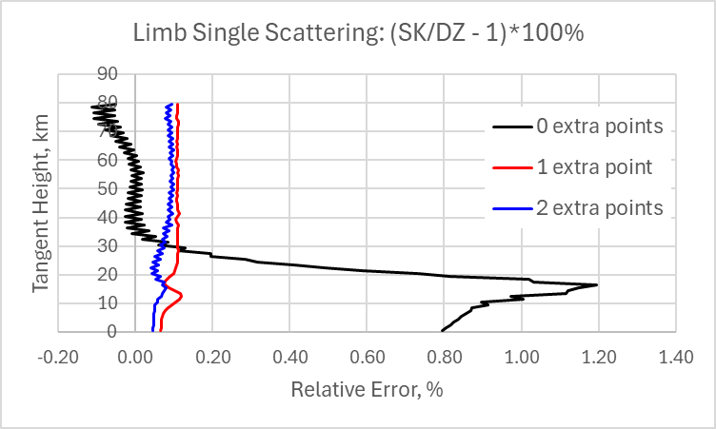
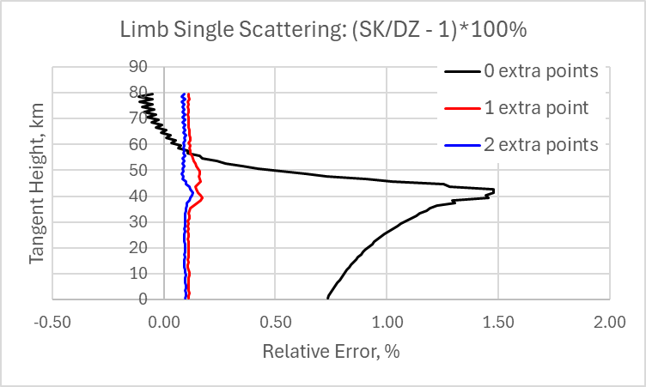
Auxiliary Shells & Extra Points S
351nm
Rayleigh OT: 0.6167
Ozone OT: 0.001 x 0
SZA=70 RAA=30
T
300nm
Rayleigh OT: 1.2
Ozone OT: 2.9
SZA=80 RAA=60
S

Slide 7
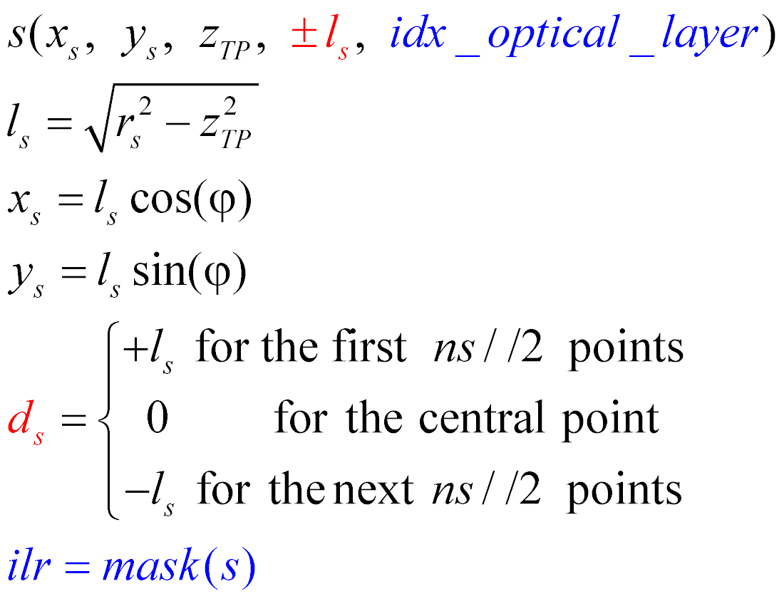
Add Auxiliary Shells, Define Location of All S-points: Main & Aux
Z
τ_{Sol}(s)
optical layer: r_{i} … r_{i+1}
T
S
τ_{LOS}(s)
LOS: The number of S-points, ns, is ODD = symmetric intersection + TP
This is convenient for Simpson rule
r
Y
R_{E}
RAA
O
X
X
O

Slide 8
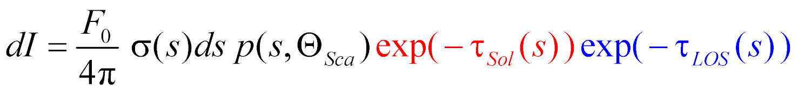
What Happens at Point S (“Monte Carlo” approach):
Z
τ_{Sol}(s)
T
S
τ_{LOS}(s)
LOS
O
X

Slide 9
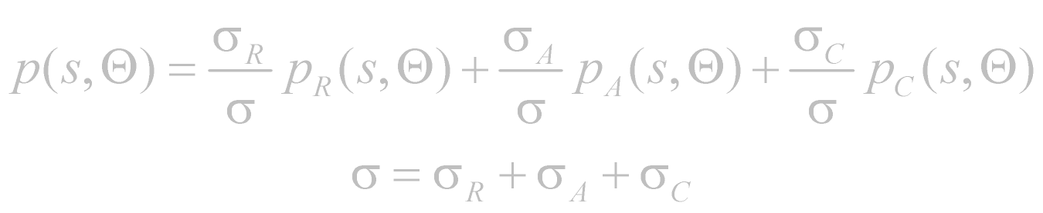
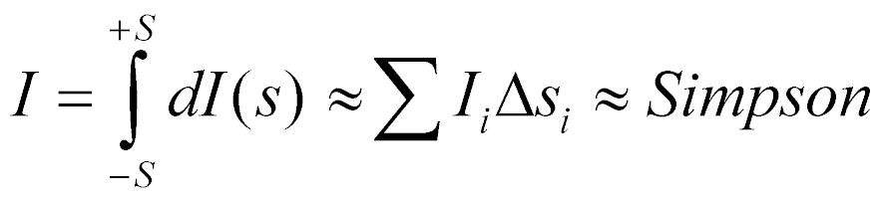
What Happens at Point S:
Solar flux per unit area perpendicular to solar beam: Fo = 1 1/4π – normalization of the phase function p(s)
Z
τ_{Sol}(s)
Scattering optical thickness dτ (unitless)
T
S
τ_{LOS}(s)
LOS
O
X

Slide 10
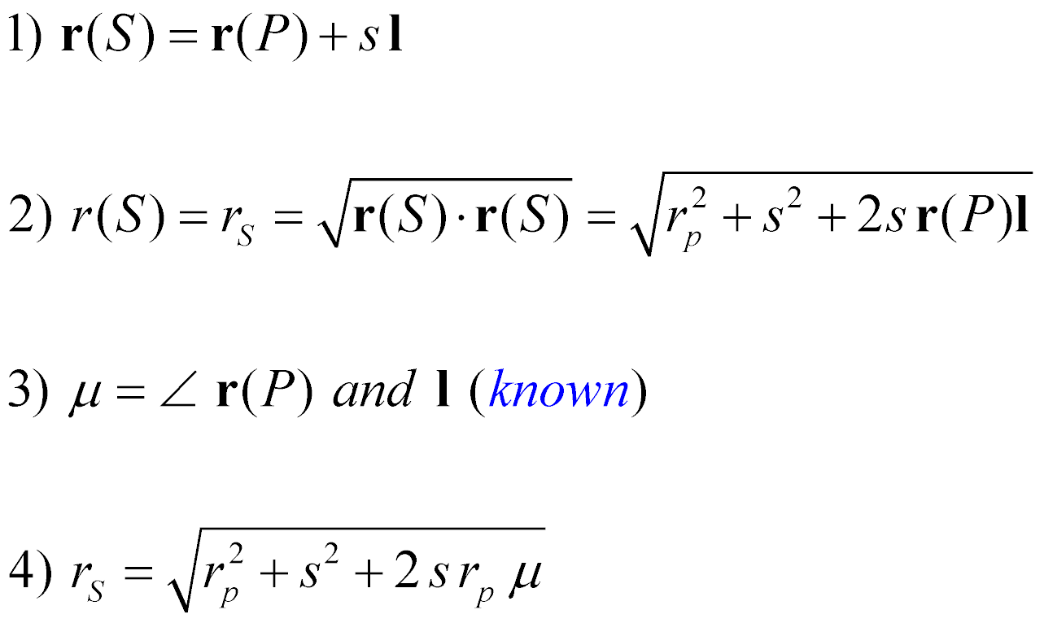
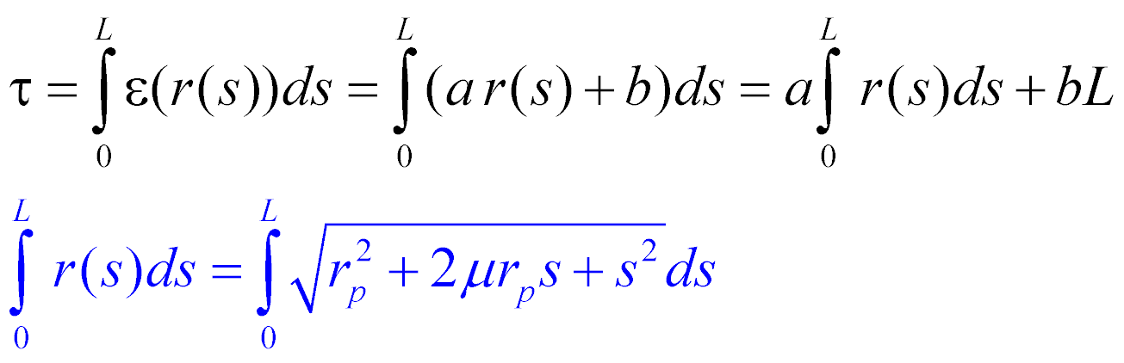
Optical Path of Segment
P – start point (known)
Q – end point (known); must share optical layer with P
l = PQ – unit direction vector (note bold font)
L – distance between P & Q
S – arbitrary point between P & Q, s – distance from P to S
Sum of vectors: OS = OP + PS
ε =a r + b ( km⁻¹ )
r
P (x_{p}, y_{p}, z_{p})
s
r_{p}
S
Q (x_{q}, y_{q}, z_{q})
Optical path of the segment PQ:
r_{s}
O

Slide 11

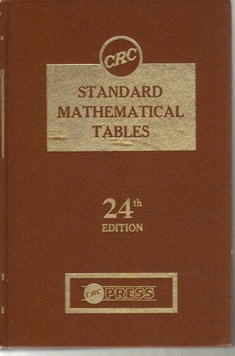
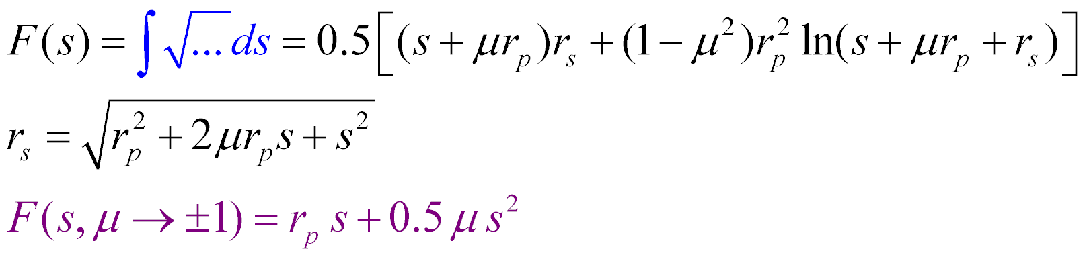
Optical Path of Segment: Analytical Antiderivative
ε =a r + b ( km⁻¹ )
r
P (x_{p}, y_{p}, z_{p})
Antiderivative (including a special case, differ from RL’s )
s
r_{p}
S
Q (x_{q}, y_{q}, z_{q})
r_{s}
Final solution: τ = a [ F(L) – F(0) ] + b L
Process optical layers (with fixed interpolation coefs a and b ) one by one adding up the results
O

Slide 12
Optical Path along LOS:
The total number of points along LOS is 2n+1 (n – number of shells above the TP)
Start from the observation point (“right” most) and move “left” – against positive S direction
We know location of all points S[i]: both XYZ and optical layer (recall: I have a mask)
Accumulate optical path:
Z
τ_{Sol}(s)
tau[n] = 0
for i = n-1, -n, step -1:
t = tau_segment (s[i], s[i+1])
tau[i] = tau[i+1] + t
τ_{LOS}(s)
S_{n-2}
S_{n}
S_{-n}
T
S₀
S
S_{n-3}
S_{n-1}
LOS
t : OT of a segment
between 2 points S
O
X

Slide 13
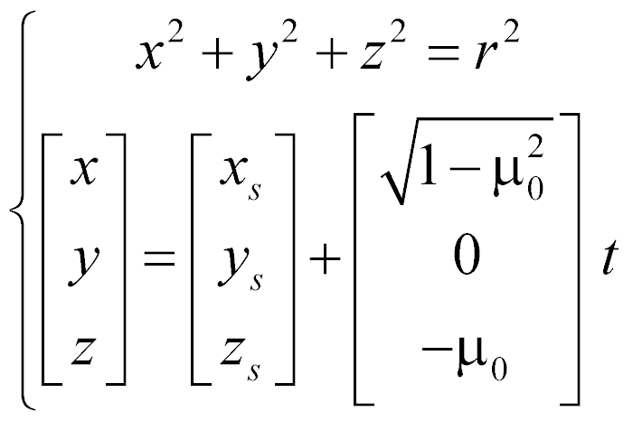
Optical Path along Sol:
Solar paths are unique for each point S
No accumulation between different points S
Find intersections of the solar beam with main shells only…
….and add a piece between the last shell “above” S and S itself
Theoretical background: the equation of the sphere and the parametric equation of the line in XYZ
Z
τ_{Sol}(s)
Known point on LOS
T
S
τ_{LOS}(s)
LOS:
Solar beam
direction
parameter
Solve the above system for t
Pick the one that yields z > z_{s}
Do it for 2 main shells
Call tau_segment(p1, p2)
r
R_{E}
O
X

Slide 14
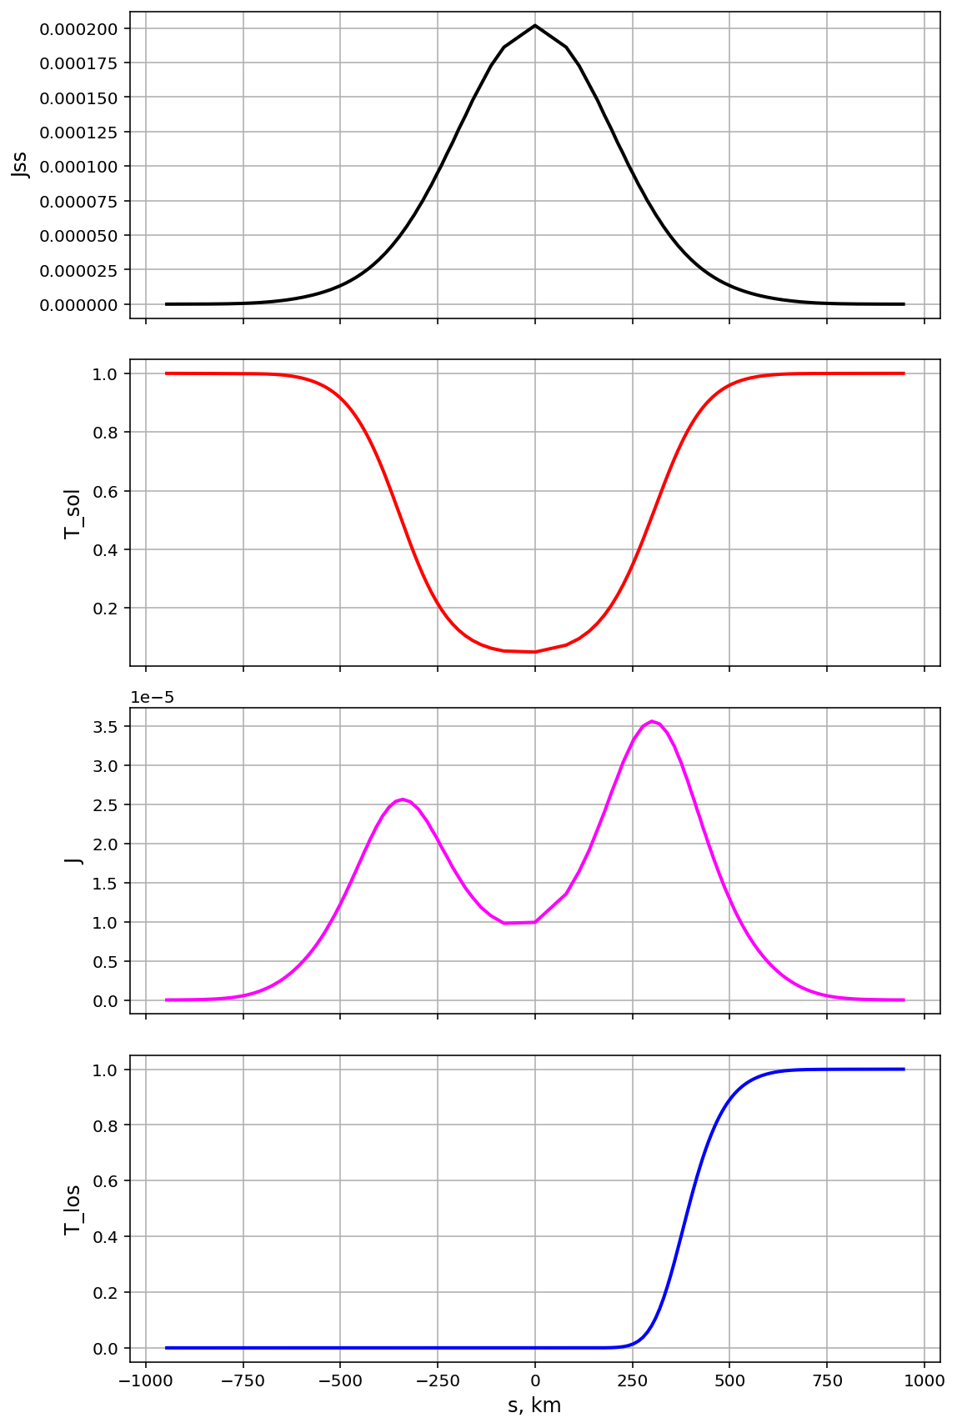
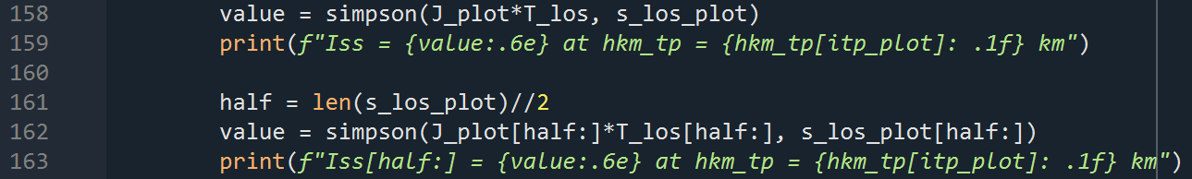
Contributing points:
Fo ∙σ ∙p /4π
Case:
300nm
Rayleigh OT: 1.2002
Ozone OT: 2.9165 – strong absorption
SZA=80 RAA=150 SCA=148.5 (backscattering)
h_tp = 30.5 (km) { FYI: 279 S-points; ds ~ 2000km/(279-1) = 7.2km }
Benchmark: 3.484267E-3
exp(-τ_{Sol})
Source Function:
J = Fo ∙σ ∙p exp(-τ_{Sol}) / 4π
or + 0.1% vs. the benchmark & +0.03% vs. the benchmark (better match!)
exp(-τ_{LOS})
Plots vs. coordinate along LOS; TP: s = 0; OP (most right): max(s) > 0

Slide 15
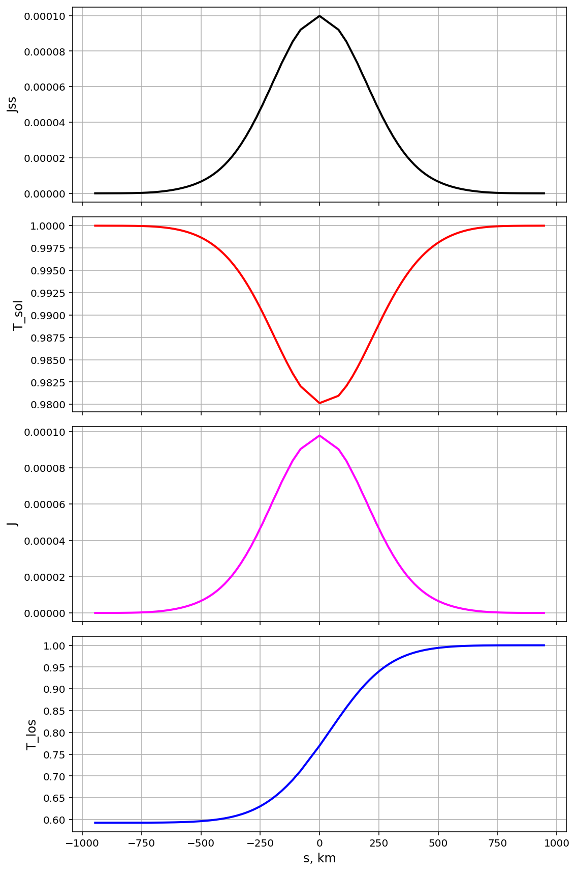

Contributing points:
Fo ∙σ ∙p /4π
Case:
351nm
Rayleigh OT: 0.6167
Ozone OT: 0.0 – no absorption
SZA=70 RAA=30 SCA=35.5 (backscattering)
h_tp = 30.5 (km) { FYI: 279 S-points; ds ~ 2000km/(279-1) = 7.2km }
Benchmark: 3.9848E-3
exp(-τ_{Sol})
Source Function:
+0.1% vs. benchmark
J = Fo ∙σ ∙p exp(-τ_{Sol}) / 4π
“half”-trick does not work
Note:
plateau = 0.6!
exp(-τ_{LOS})
Plots vs. coordinate along LOS; TP: s = 0; OP (most right): max(s) > 0

Slide 16
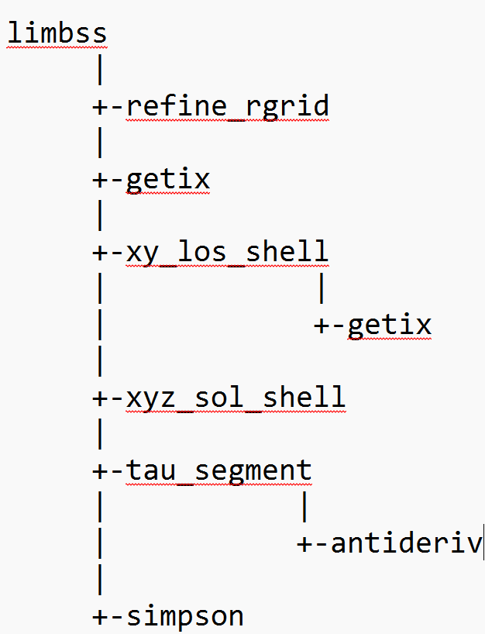
Current Structure (optimization/simplification is possible)
limbss – main function
refine_rgrid – adds auxiliary shells and LOS points to the main ones
getix – returns location (left ixlo & right ixhi indices) of the interval x[ixlo:ixhi] containing x0
xy_los_shell – returns XY-coordinates for points S on LOS (Z = z_tp); S are points where LOS intersects with shells
xyz_sol_shell – returns XYZ for a point where the solar beam heading to the point S intersects a shell with size R
tau_segment – returns optical path between 2 points in the same optical layer
antideriv – returns the value of analytical antiderivative
simpson – numerically integrates along LOS using Simpson rule

Slide 17
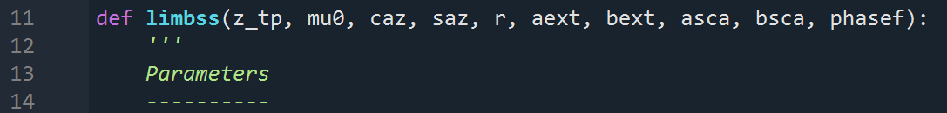
Current Structure of Input/Output (optimization / extension is possible)
Output: Iss – one value (scalar)
z_tp: Z-coordinate of tangent point, km; z_tp = Re + h_tp
mu0: cos(SZA) > 0
caz & saz: cos & sin of RAA (saves a few calls to cos & sin and DEG → RAD inside limbss)
r[nlr+1]: array of the shell radii, km; r = Re + zkm
asca, bsca[nlr]: arrays of linear interpolation parameters, sca = a*r + b, for scattering coefficient [1/km]
aext, bext[nlr]: same but for extinction for coefficient [1/km]
phasef[nlr]: array of the phase function values at the scattering angle = f(mu0, caz)
nlr: number of optical layers; nlr+1 – number of main shells
num_extra – number of extra shells (accuracy); currently it is an internal parameter, but it should come on input

Slide 18
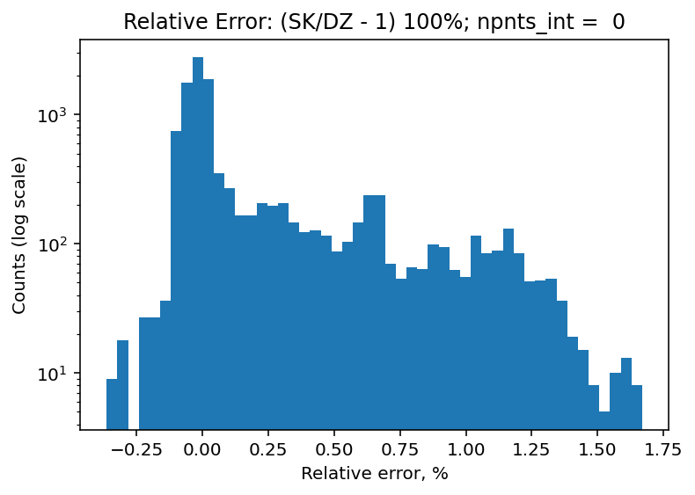
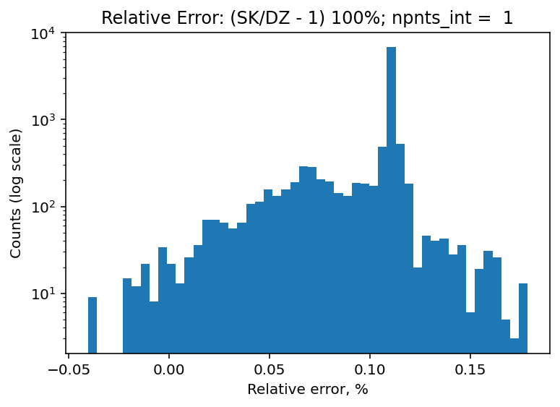
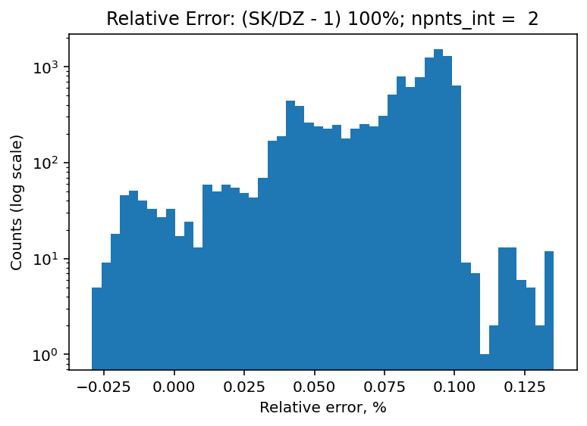
Relative Deviation in % for ~11.5K points
max |err| = 1.67%
avr |err| = 0.23%
9 solar geometries: SZA & RAZ
9 wavelengths: 300 … 675 nm
Rayleigh & Rayleigh + Ozone
80 tangent heights
Time = t
max |err| = 0.14%
avr |err| = 0.08%
max |err| = 0.18%
avr |err| = 0.10%
Time = 2t
Time = 3t

