Slide 1
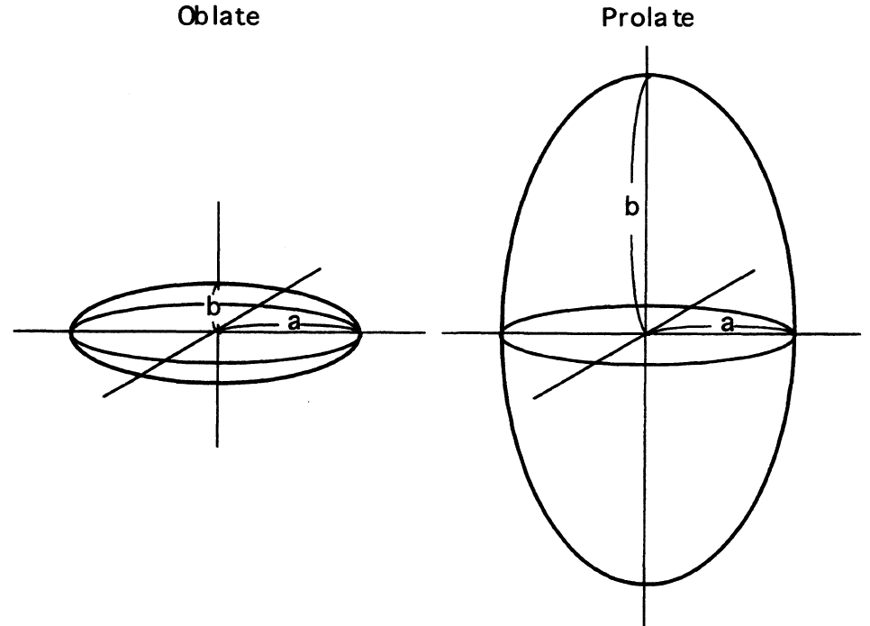
Spheroid Model: DLS Code Refactoring Notes
A group of randomly oriented, symmetric particles
Aspect ratio
Size (radius) r
Size parameter
Kernel (LUT)
Fixed kernel
Log-spline or log-linear interpolation
Optical characteristics:

Slide 2
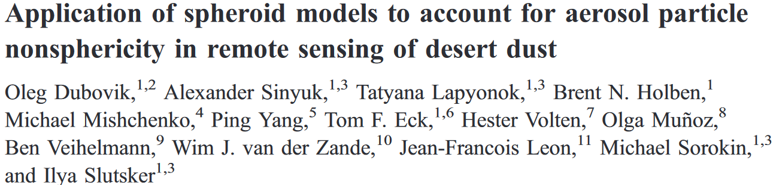
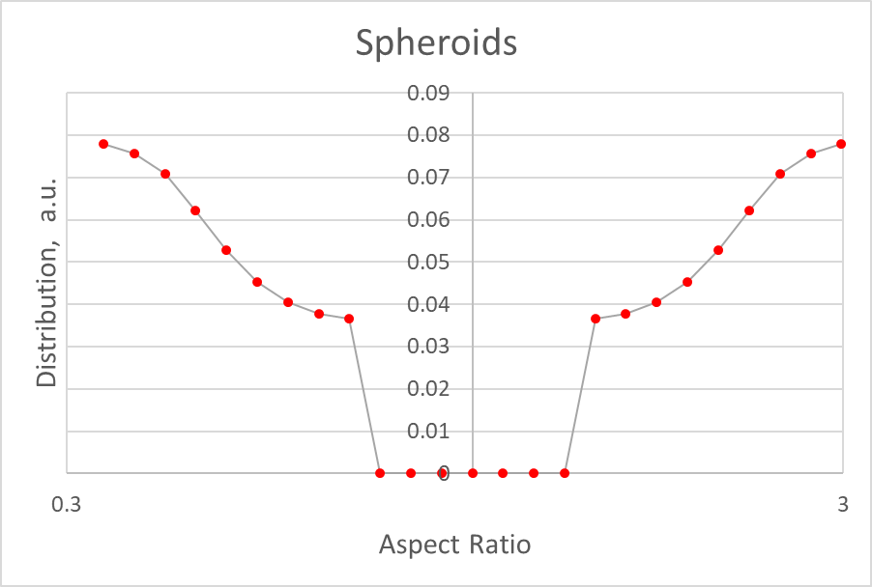
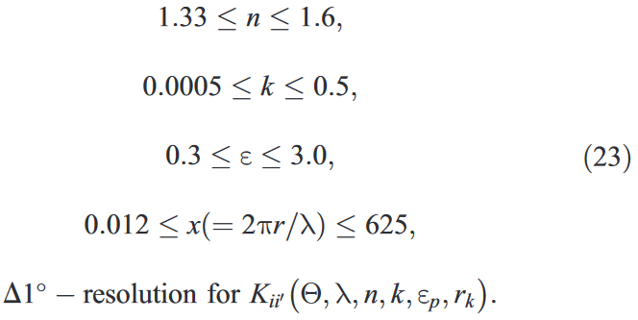


What is DLS Code?
Using BIG kernels K(…) and some aspect ratio, ε, distribution (note: Mie = spheres) …
1
…
See Sec.2 for theory & numerical details
…
1/3
3
1/3
1
3
… one generalates fixed kernels k(…) (takes time – save as ASCII LUTs). For MAIAC, we did once in 2012.
Using the fixed kernels k(…) , user’s wavelength, refractive index, and particle size distribution ( r_{user} ) …
… one generalates generates optical characteristics for MAIAC RT LUTs (on the fly)

Slide 3
One Slide Documentation:
In
→
Out
#include "const_param_spheroids.h" // grids (e.g., size grid), constants (e.g., sizes of arrays, pi=3.14…), file names/paths
main(): // Runs Cases 1 & 2; in test_optichar.cpp; for the rest: subroutine_name = file_name
|
+-optichar() // for given input returns aerosol extinction, single scattering albedo, and normalized phase matrix
|
+-getix() // for given x0 and X[] returns indices i1 & i2, so that X[i1] < x0 < X[i2]
|
+-interpolate_kernel_ext()
| |
| +-read_fixkernel_ext_bin() // reads extinction and absorption fixed kernels
| |
| +-bilinear() // performs bilinear interpolation (over refractive index)
|
+-interpolate_kernel_fij()
| |
| +-read_fixkernel_fij_bin() // reads fixed kernels for phase matrix elements, fij
| |
| +-bilinear()
|
+-lognorm() // calculates lognormal distribution
|
+-ddot() // calculates dot product of 2 vectors
|
+-spline_grid() // optional: interpolates from one grid into another using NAG cubic spline
| |
| +-e02baf() & e02bbf() // optional: NAG cubic spline subroutines
|
+-simpson() // optional: numerical integration using Simpson’s rule
In:
Out:

Slide 4
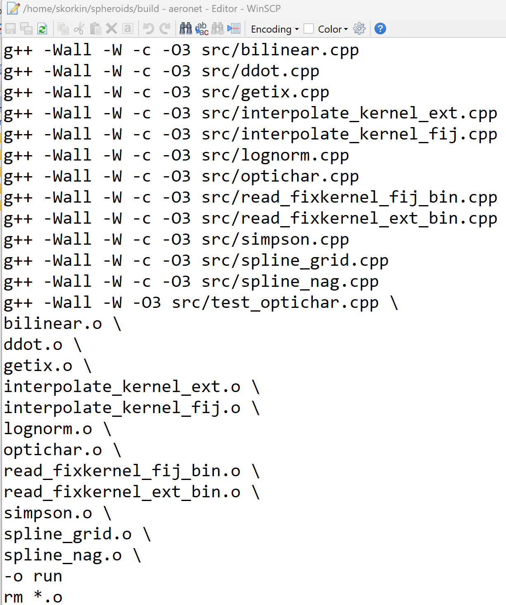
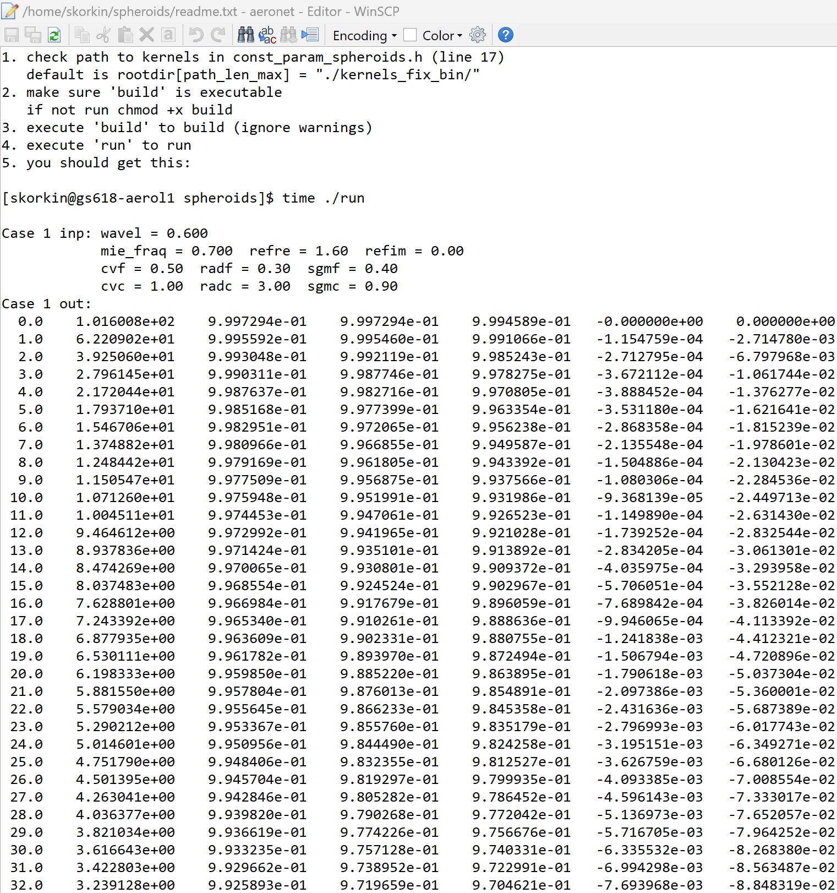
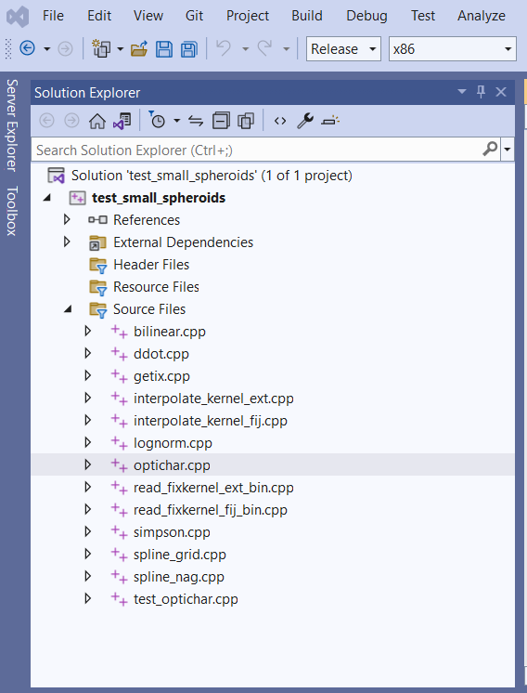
See readme.txt for instructions & tests

Slide 5
Tests -- 2 cases: q*Mie+(1-q)*Srd, Cvf + Cvc
Parameter | Notation | Units | Case 1 | Case 2 | Comments
Wavelength | λ | µm | 0.6 | 0.4 | Red & blue
Refractive index: real part | n | - | 1.6 | 1.3 | n = [1.29 : 1.70]
Refractive index: imaginary part | k | - | 0.001 | 0.1 | k = [0.0005 : 0.5] > 0
Mean radius, fine fraction | rvf | µm | 0.3 | 0.3 | Same in both cases
Width parameter, fine fraction | σf | ? | 0.4 | 0.4 | Same in both cases
Concentration, fine fraction | Cvf | a. u. | 0.5 | 1.5 | a.u. – arbitrary units
Mean radius, coarse fraction | rvc | µm | 3.0 | 3.0 | Same in both
Width parameter, coarse fraction | σc | ? | 0.9 | 0.9 | Same in both
Concentration, coarse fraction | Cvc | a. u. | 1.0 | 1.0 | a.u. – arbitrary units
Mie fraction | q | r. u. | 0.7 | 0.3 | q = 1 means Mie only

Slide 6
Numerical results (5 digits) & summary of changes
v.0: DLS – original DLS package
v.1: cpp – C version with kernels in *.bin files, flip sequence of interpolation – first over refractive index (bilinear), then r-spline
v.2: cpp – same loglin interpolation for all fij (not reflected in the table); see slide “”
v.3: cpp – lognormal distribution over size parameter (full range as in kernels, no r-spline); no artificial smoothing of f33 & f44 (next slide)
scalef - ?
Parameter | Case 1 |  |  |  | Case 2
 | v.0: DLS | v.1: cpp | v.2: cpp | v.3: cpp | v.0: DLS | v.1: cpp | v.2: cpp | v.3: cpp
Extinction | 5.1080 | 5.1080 | 5.1080 | 5.1098 | 9.8634 | 9.8634 | 9.8634 | 9.8643
S. S. Albedo | 0.98922 | 0.98922 | 0.98922 | 0.98913 | 0.59104 | 0.59104 | 0.59104 | 0.59100
x0 = intg{F11} | 0.99768 | 0.99720 | 0.99722 | 0.99749 | 1.0001 | 0.99902 | 0.99902 | 0.99965
intg{ F11/x0 } | 1.0000 | 1.0000 | 1.0000 | 1.0000 | 1.0000 | 1.0000 | 1.0000 | 1.0000
F11(0) | 89.951 | 89.988 | 89.988 | 101.60 | 199.64 | 199.86 | 199.86 | 220.86
F11(90) | 0.26762 | 0.26771 | 0.26771 | 0.26774 | 0.067541 | 0.067597 | 0.067597 | 0.067541
F11(180) | 0.57250 | 0.57268 | 0.57268 | 0.57301 | 0.027849 | 0.027881 | 0.027881 | 0.027849
Aver. S. Cos | 0.66682 | 0.66672 | 0.66672 | 0.66667 | 0.87397 | 0.87387 | 0.87387 | 0.87386

Slide 7
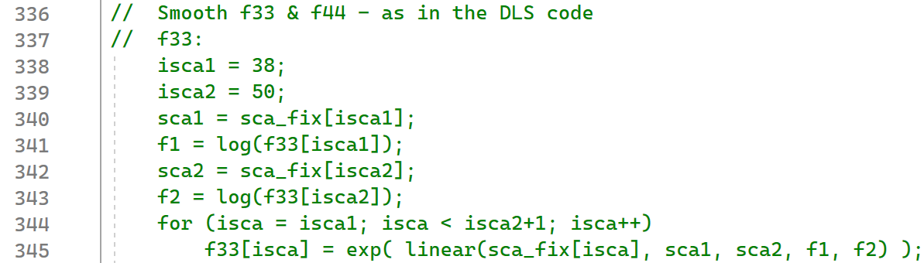
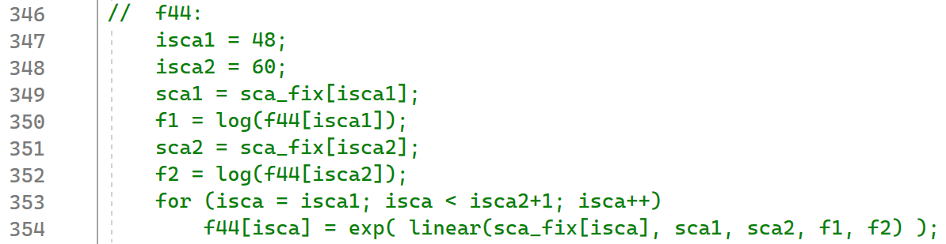
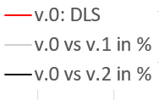
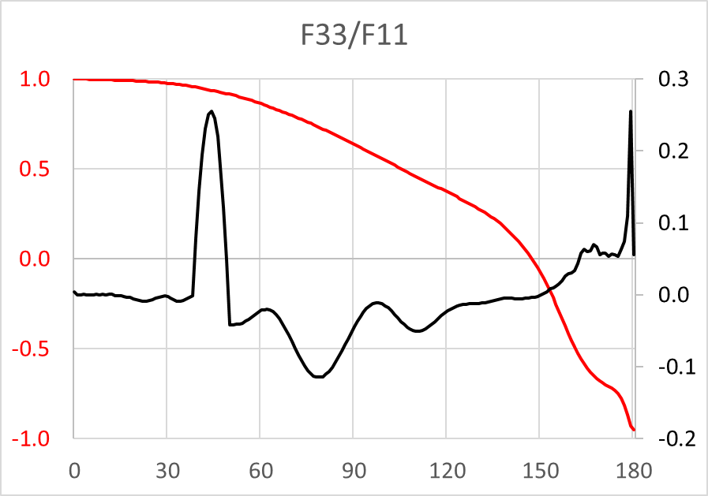
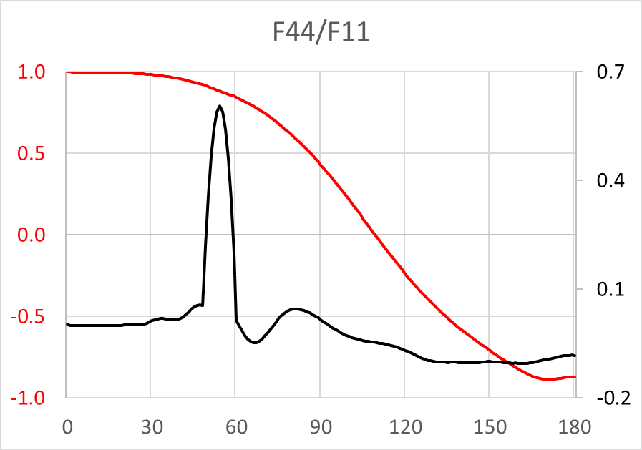
Graphical results: smoothing
F44 is not used IPOL and many other vRT codes
Hard-coded in DLS
Case 1
Case 2
=50%
%
%
Smoothed
~90%
~80%
0.6 %
Not: v.3 vs DLS
%
%

Slide 8
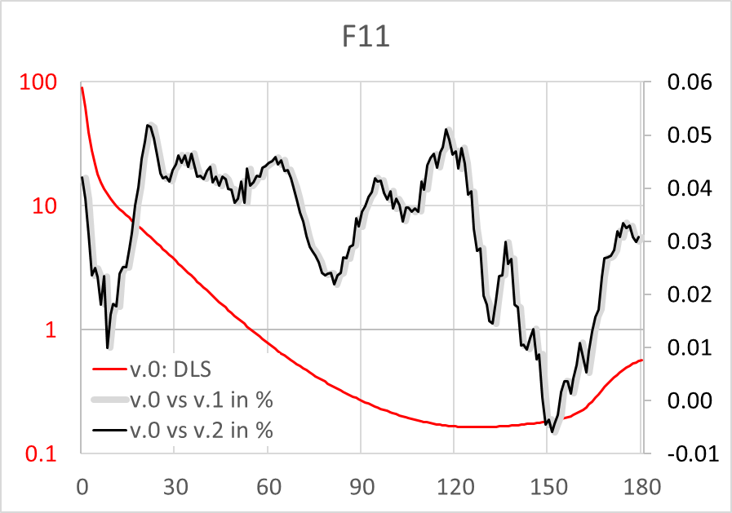
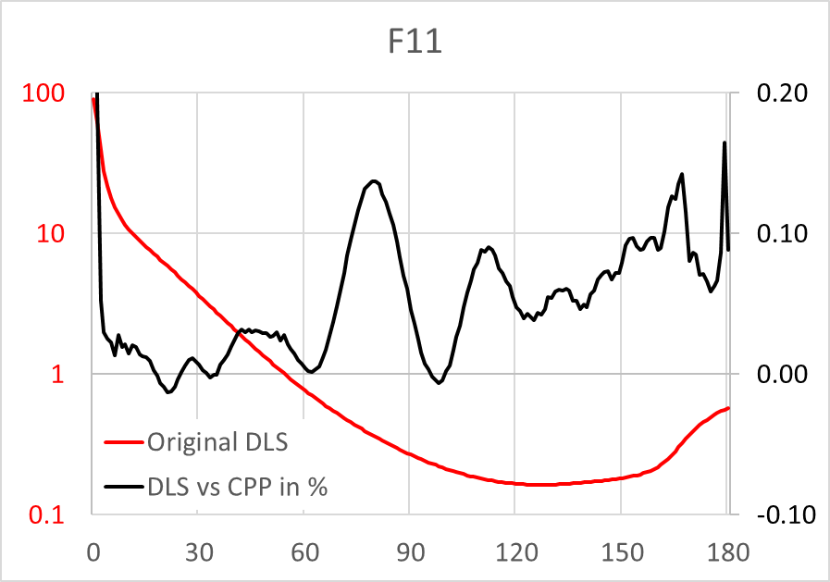
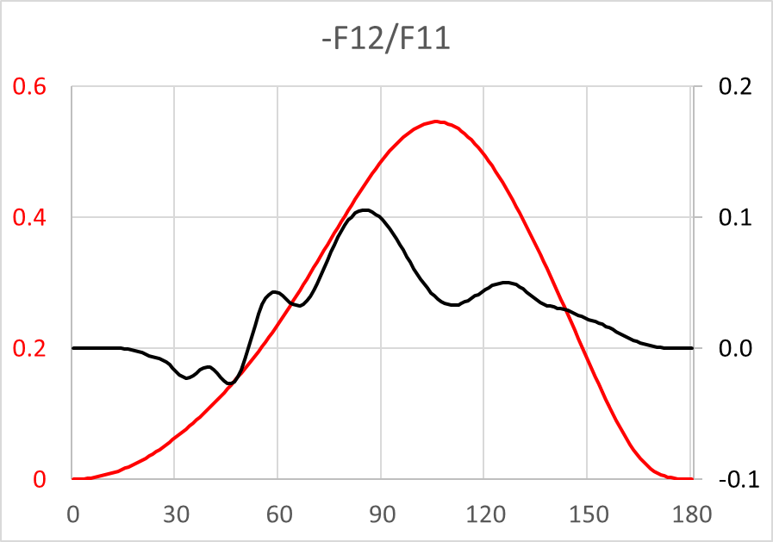
Graphical results: general
~12% “error”
DLS vs v.3, in %
Case 1
DLS vs v.3, in %
~10% “error”
DLS vs v.3, in %
Case 2

Slide 9
PS: What if F & C fractions (or Mie & Srd… or both…) have different, e.g. n-ik, … or other parameters ?
Example:
Cvf / Cvc = 0.3 / 1
Q: How to predict unpredictable & account for unaccountable? Where will our research lead us tomorrow?
A: The new package must have maximum flexibility. Discussion to follow…

Slide 10
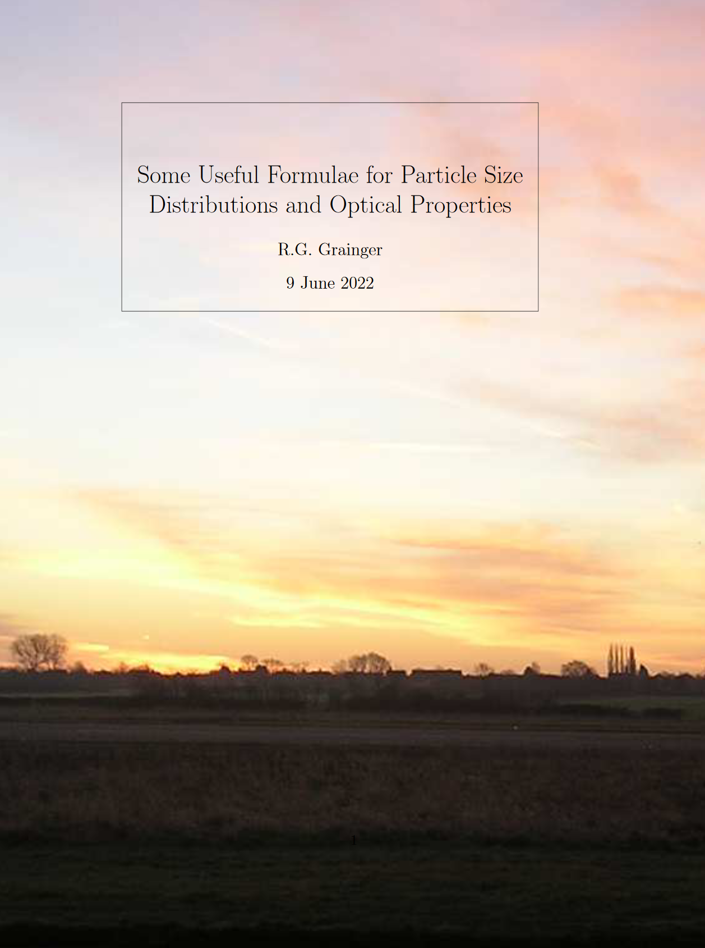
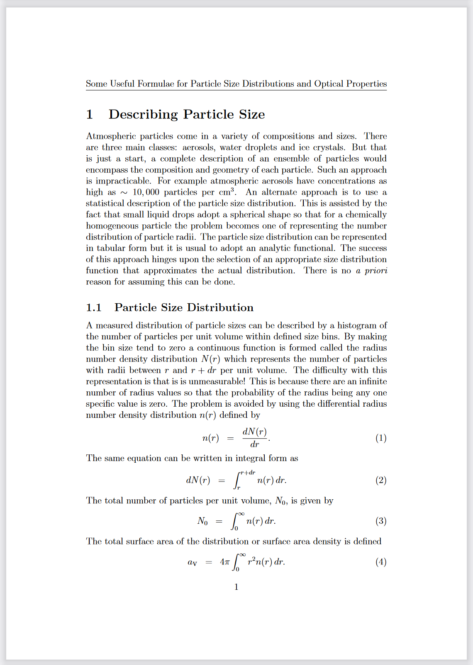
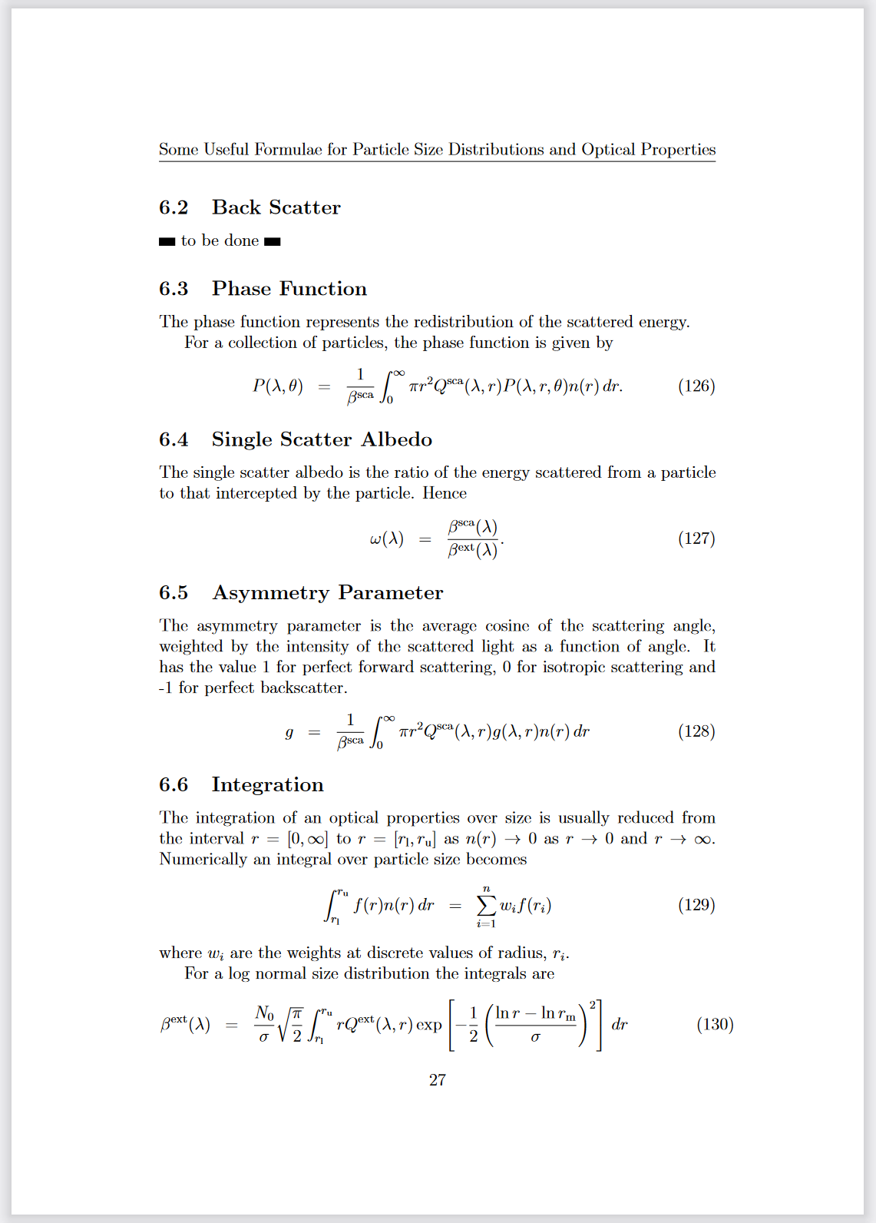
PS: Very good (concise!) summary on the topic
https://eodg.atm.ox.ac.uk/user/grainger/research/aerosols.pdf

