Slide 1
DSA 210 Term Project
Number of Steps Analysis
By İlbars Efe Korkmaz (30669)

Slide 2

Dataset I’m Going to Use
Number of Steps information from Apple Health

Slide 3
Why do I do this?
I have always been a very active person. I've always loved walking, while listening to music, thinking and sometimes just to walk. In this term project, I will analyze my number of steps data, and find out how changes in my life changed my walking behavior and try to get insights from the data about my life's going.

Slide 4
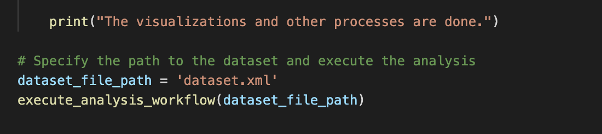
The output visualizations that we get. Let’s have a look at them.

Slide 5
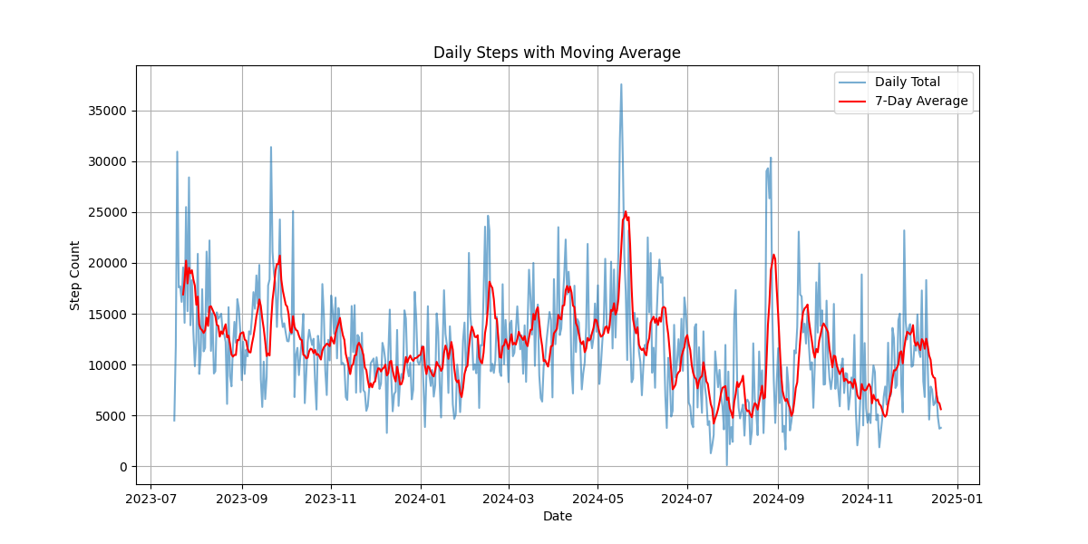
Figure 1: Daily Steps with Moving Average
I created this visualization not just to only see the trend, but rather to be able to pinpoint some of the spikes.

Slide 6
Figure 1: Daily Steps with Moving Average
My trip to Germany
Offtown Festival
My trip to Denmark
I created this visualization not just to only see the trend, but rather to be able to pinpoint some of the spikes.

Slide 7
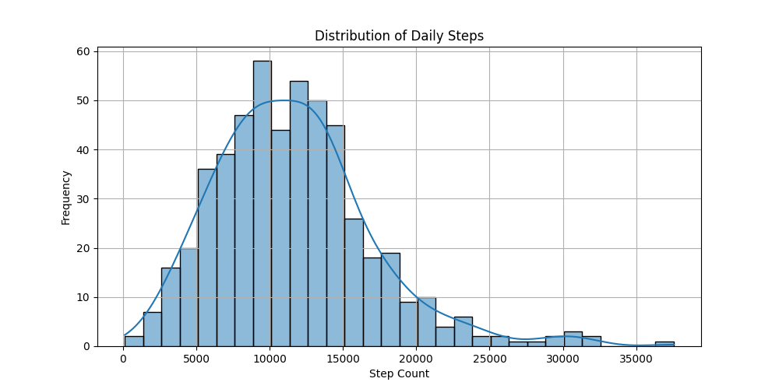
Figure 2: Histogram of Dist. Of Daily Steps
Here, we can see that my daily step amount clusters around 10,000 steps, which is the widely recommended
Amount for staying healthy and active. Therefore, I’m happy.

Slide 8
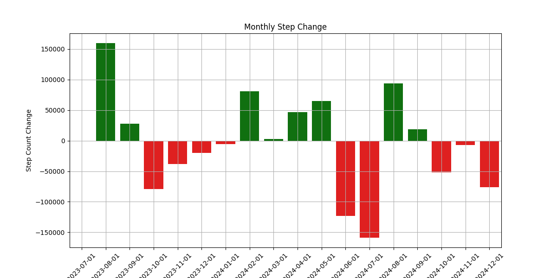
Figure 3: Monthly Step Change
Here, we see how much the number of steps changed, compared to the previous amount. I use this
Data to see how the significant transition phases affect my number of steps.

Slide 9
Figure 3: Monthly Step Change
Summer trips
Realized I need to
walk more
Midterms arrived
I left the dorm,
moved in to
an apartment
(very sedentary)
School begins
After the summer trips
Here, we see how much the number of steps changed, compared to the previous amount. I use this
Data to see how the significant transition phases affect my number of steps.

Slide 10
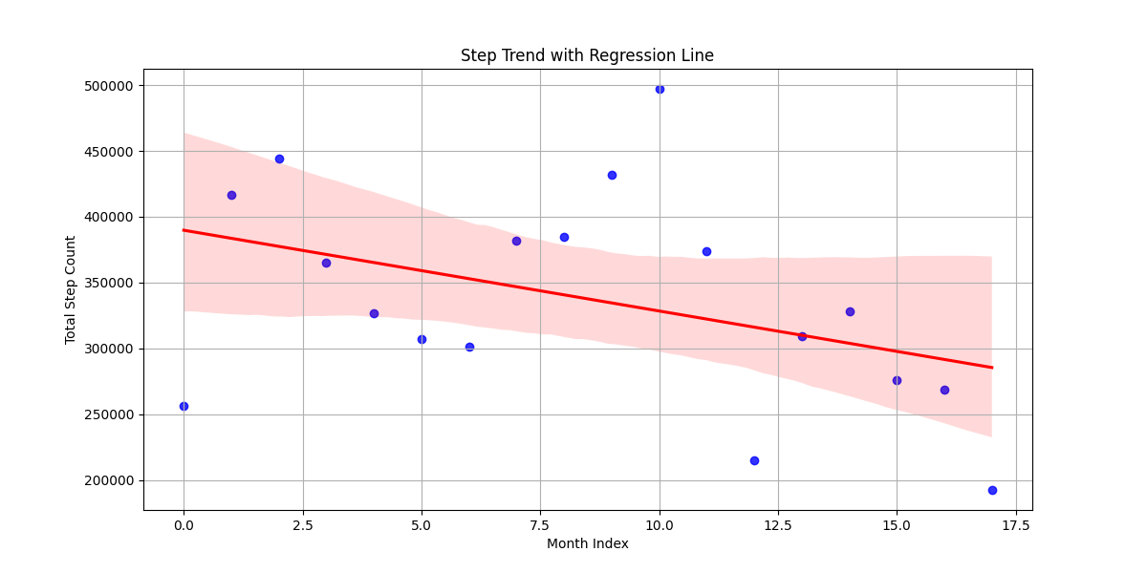
Figure 4: Step Trend with Regression Line
The downward slope points out a decline in the activity, blue dots representing the variability.

Slide 11
Results. What do we learn?
By using the right dataset, and the right analysis methods,
We can gather insights and findings about the factors that affect us.
By using just a simple dataset, I can see what I did, how it goes, and what
I should do, by using the right techniques.

Slide 12
What could be improved?
Prediction of the number of steps
Incorporation with more health data
Automation of the analysis process
Advanced statistical analysis

Slide 13
Thank you very much for listening to me.

