Slide 1

G2M Case Study
Virtual Internship
EMRE KORKUSUZ
20-Jan-2021

Slide 2
Background –G2M(cab industry) case study
XYZ is a private equity firm in US. Due to remarkable growth in the Cab Industry in last few years and multiple key players in the market, it is planning for an investment in Cab industry.
Objective : Provide actionable insights to help XYZ firm in identifying the right company for making investment.
The analysis has been divided into four parts:
Data Understanding
Forecasting profit and number of rides for each cab type
Finding the most profitable Cab company
Recommendations for investment

Slide 3
Data Exploration
24 Features( including 9 derived features)
Timeframe of the data: 2016-01-31 to 2018-12-31
Total data points :355,032
Assumptions:
Outliers are present in Price_Charged feature but due to
unavailability of trip duration details ,we are not treating this as outlier.
Profit of rides are calculated keeping other factors constant and only
Price_Charged and Cost_of_Trip features used to calculate profit.
Users feature of city dataset is treated as number of cab users in the city.
we have assumed that this can be other cab users as well(including Yellow and
Pink cab)
Cab_Data.csv
Customer_ID.csv
Transaction_ID.csv
City.csv
Final cab data

Slide 4
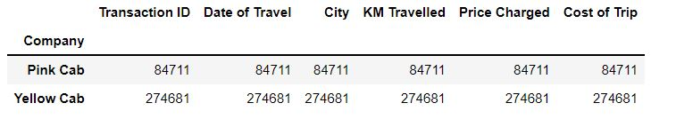
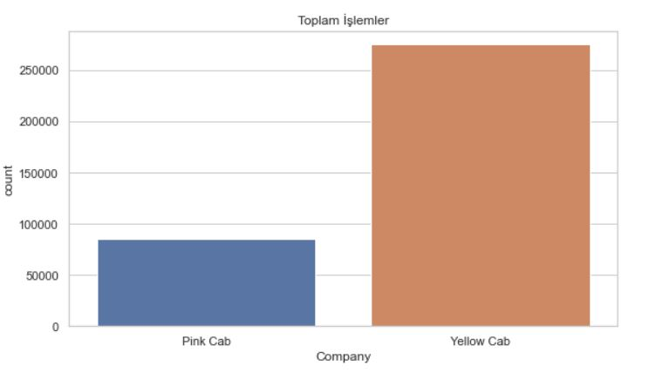
Which one has the maximum at a given time?
It was determined in which hour interval the two taxi companies reached the maximum number of users and it was shown with a graph.

Slide 5
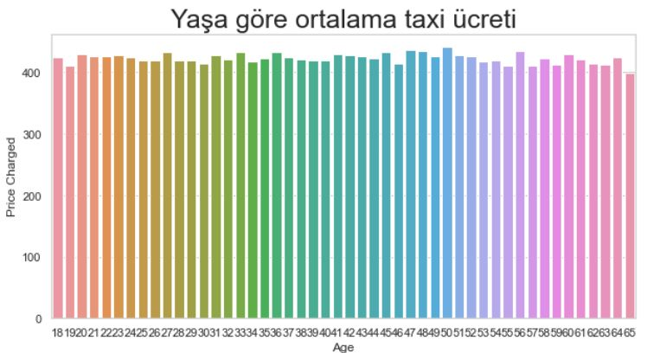
Average taxi fare by age
The average taxi fares according to the age of the people are given in the graph on the side.

Slide 6
Number of users by company
The number of users by company is given.

Slide 7
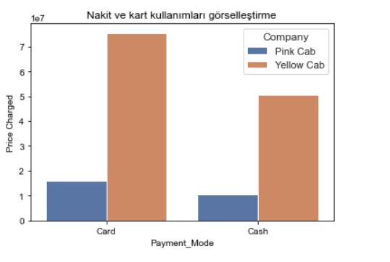
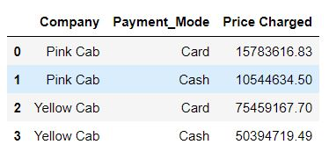
fuel and card usage
Graphic display of how much card and how much cash payment was used in which companies.

Slide 8
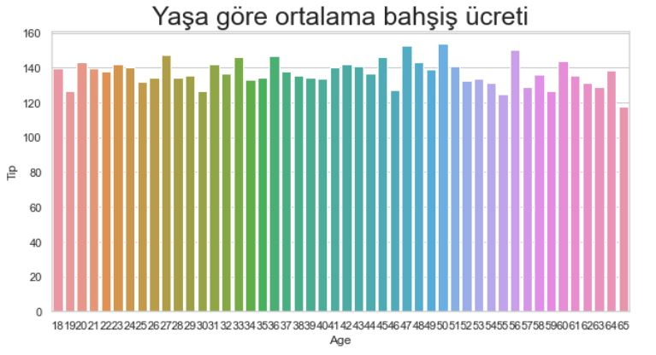
Average tip fee by age
The average tip fee according to the age of the people is given with the bar graph.

Slide 9
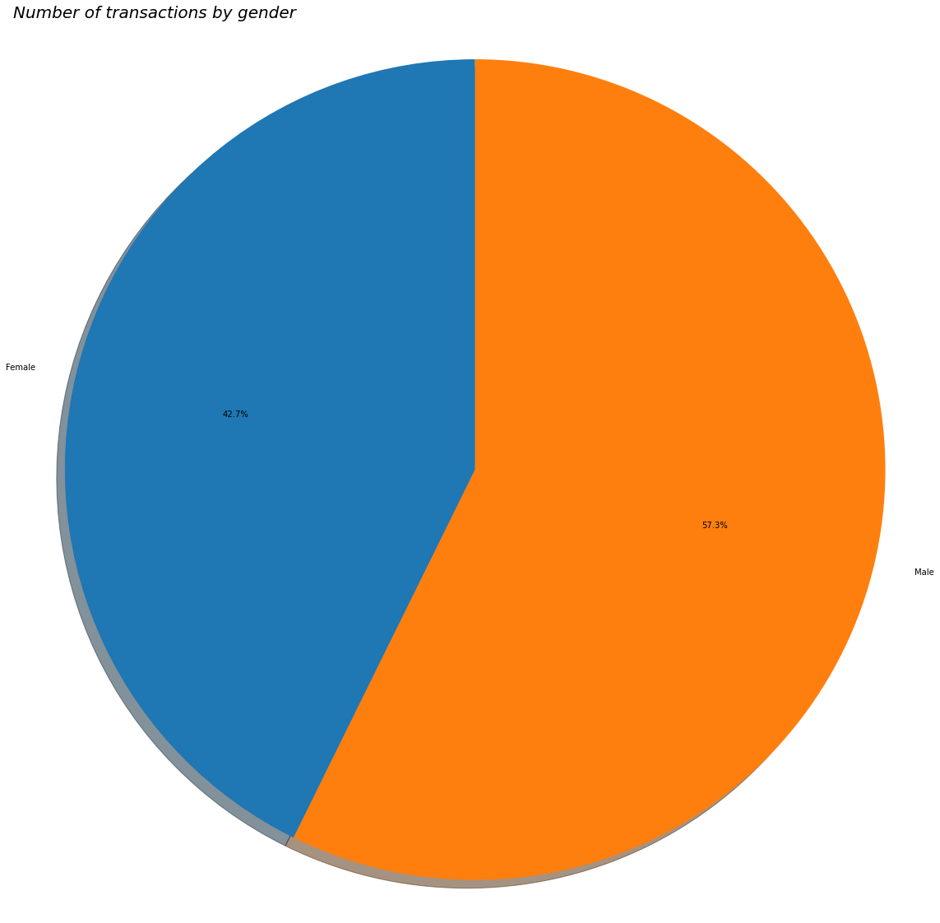

Number of transactions by gender
From this graph, we can see that men use it 7% more often than women.

Slide 10
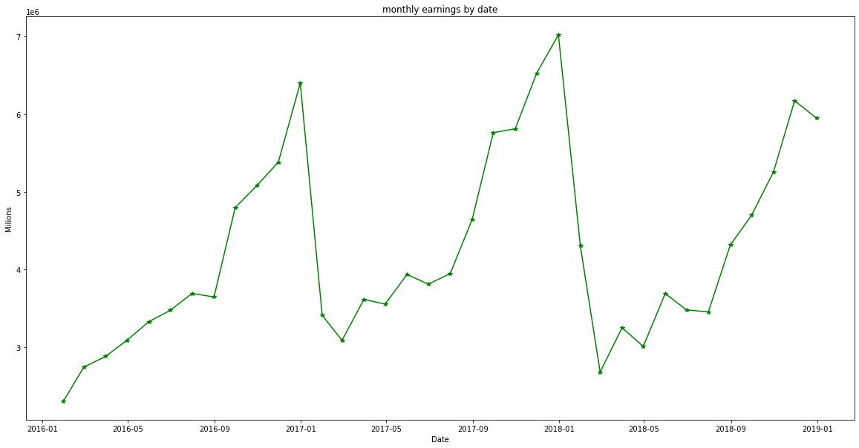
Monthly earnings by date
In this chart, we observe that the highest gain is in January and the lowest gain is in February.
Overall, we observe an increase in earnings from February to the following January.

Slide 11
recommendation
When we examine the graphics, the yellow taxi company is far ahead of the pink company. If the pink taxi company is smaller than the yellow taxi company, it needs to grow itself, if it is the same as the company size, it needs to make campaigns and gain customers.
Taxi usage rate over the age of 40 is low. Taxi opening fee may not be charged in order to gain customers over the age of 40.
Usually, payment is made by card. Installing POS devices without POS devices in taxis will increase the company's turnover.
When we examined the graphs, we observed that the location of the companies affected the earnings a lot. For this reason, companies should invest according to locations.

Slide 12
THANK YOU
STAY WELL

