Slide 1
Diffusion models for simulating distributions of observables
Korl Železnikar,
January, 2026

Slide 2
Introduction
Tested models: stohastic DDPM + variants and (all?) SDE/score models: NCSN, VP, subVP, VE, DDIM, EDM, EDM2.
Most models underperform, two show „promising“ results.
Model details in the supplementary info section.

Slide 3
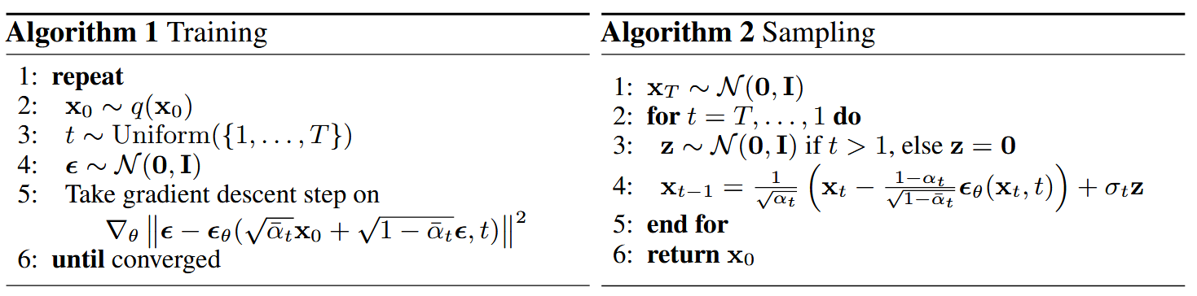
DDPM/stohastic frameworks
Reverse sampling stochastically from Gaussians; the models are preconditioned to learn added noise.
Learning variance unstable, with no visible improvements over learning only the mean.
Cosine schedule for the forward process was used.

Slide 4
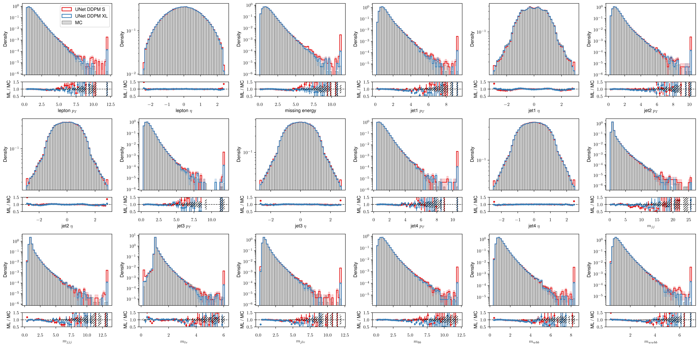
DDPM sampling
After inverting the (rank-Gauss) transformed sampled data, all the outliers are mapped to tails of distributions

Slide 5
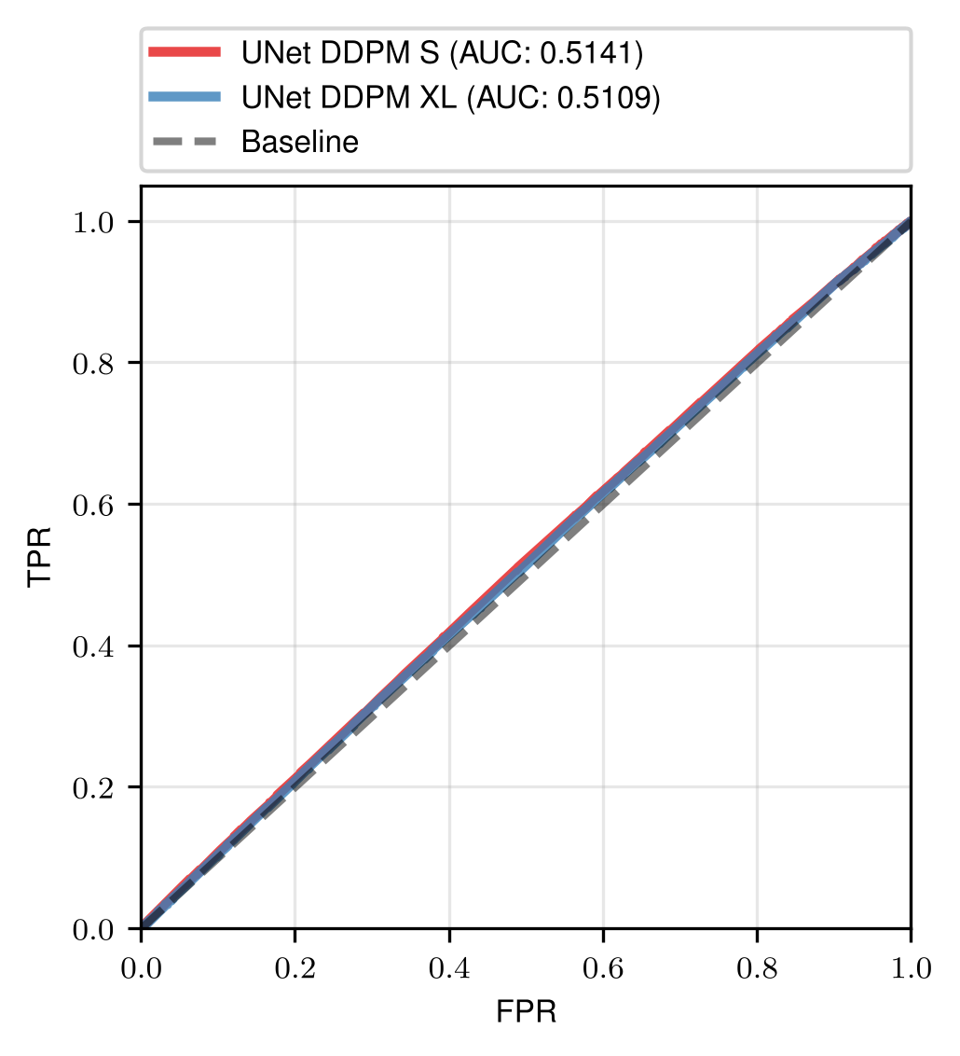
C2ST tests
Tested for 10⁶ generated samples for all models
Data quality probably lowered by large variance for DDPM
AUC classifier scores for DDPM models

Slide 6
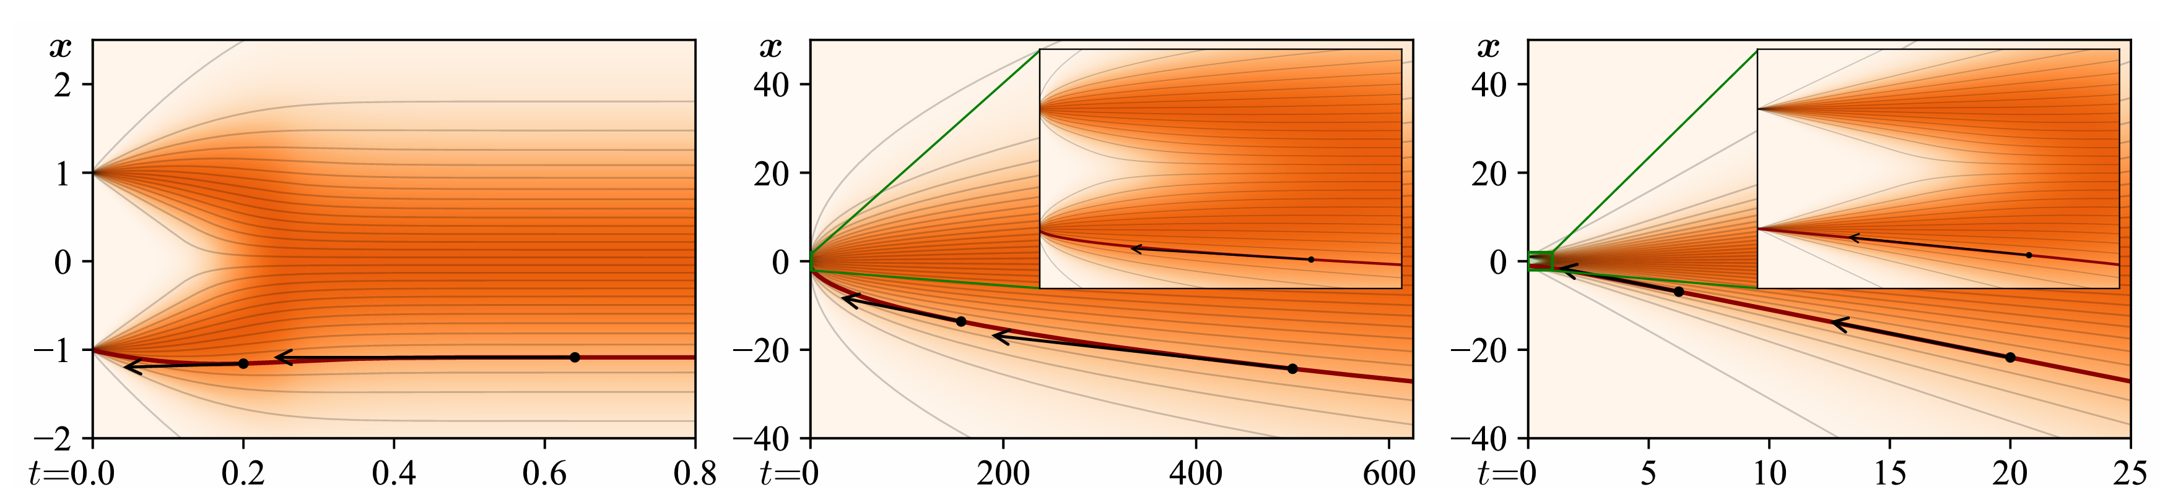
Score based frameworks
Variance preserving (VP) – continuous version of DDPM, stable
Variance exploding (VE) – nonlinear in the low noise region
EDM – straightest trajectories = better sampling? (in theory)
VP
VE
EDM
Example trajectories for the 3 variants, starting from two delta functions at t = 0.

Slide 7
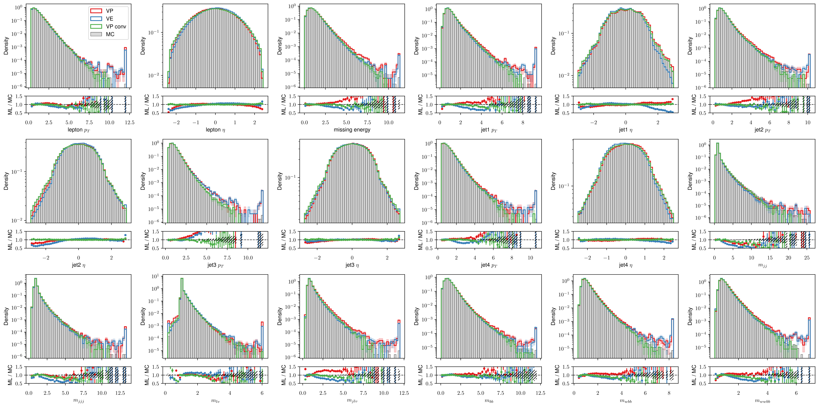
VP, VE, VP (conv. net) samples

Slide 8
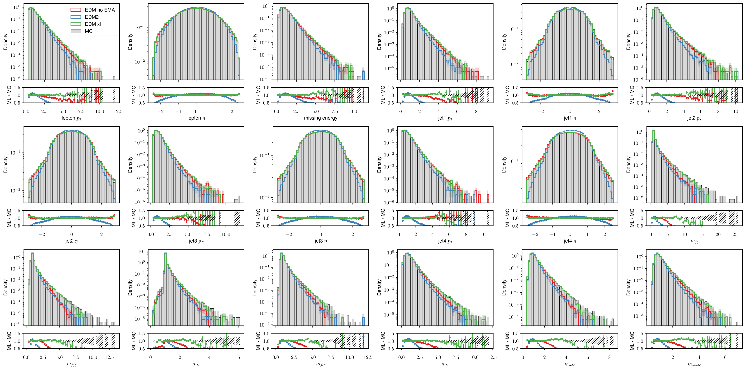
EDM, EDM2 samples
Variance undershooting problems/samples converge to the middle in high level features.

Slide 9
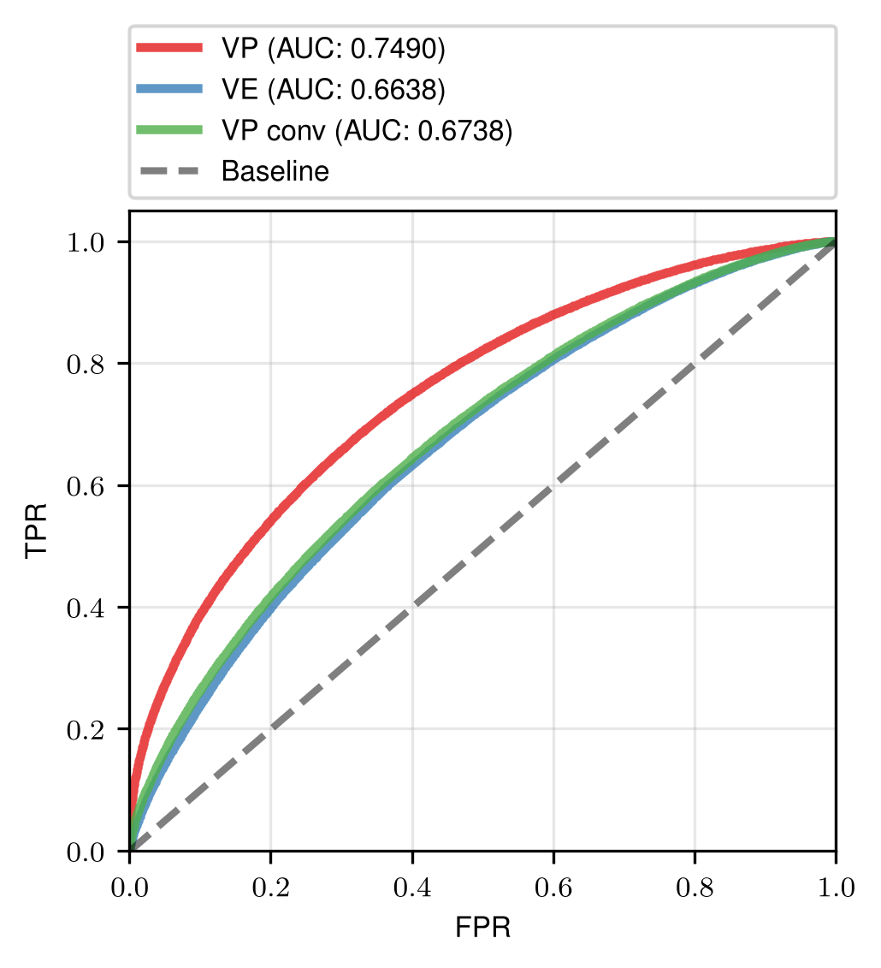
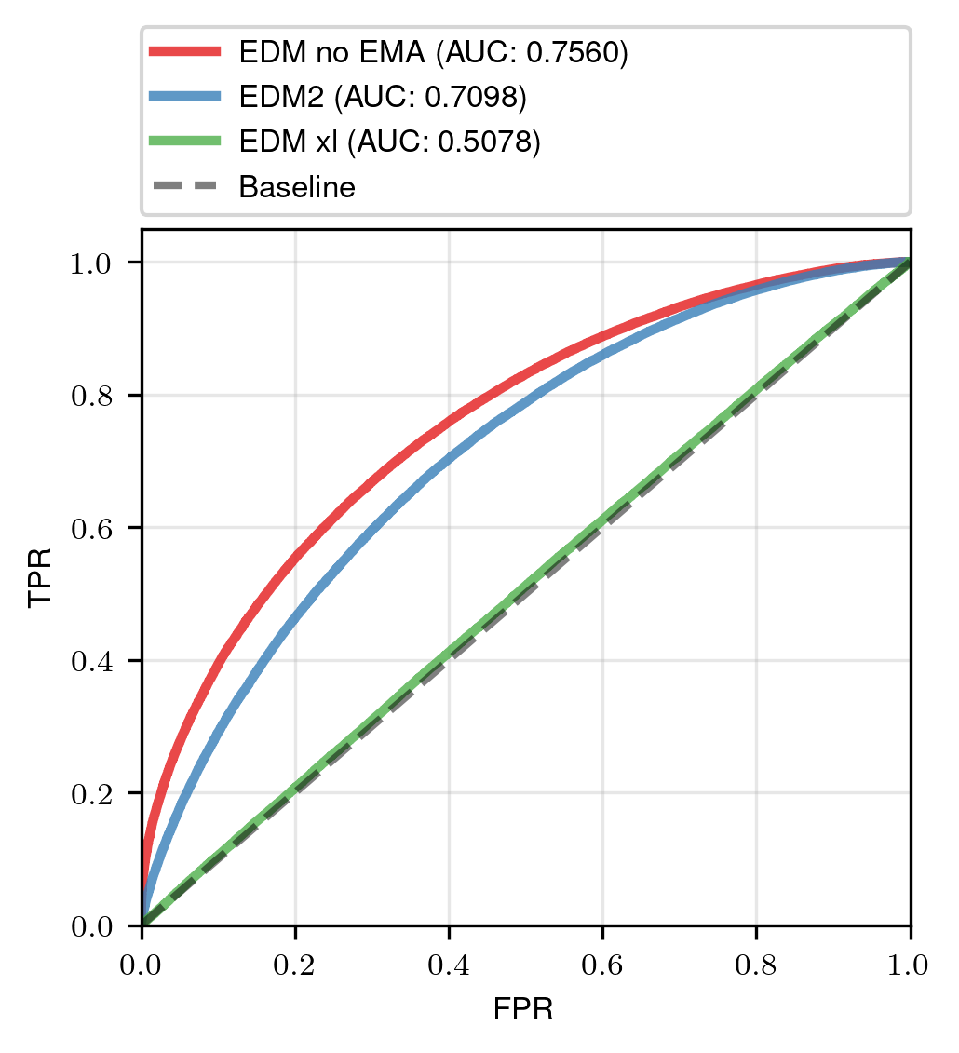
Big improvement with the XL model (brute force works)
AUC classifier scores for VP, VE and VP conv. models
AUC classifier scores for EDM models

Slide 10
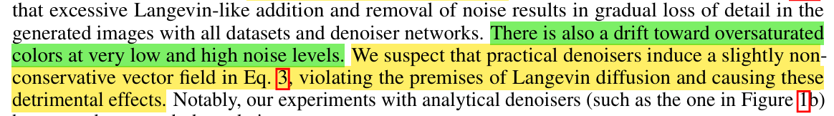



EDM sampling problems
These have been „optimized“, but low variance problems remain after training.

Slide 11
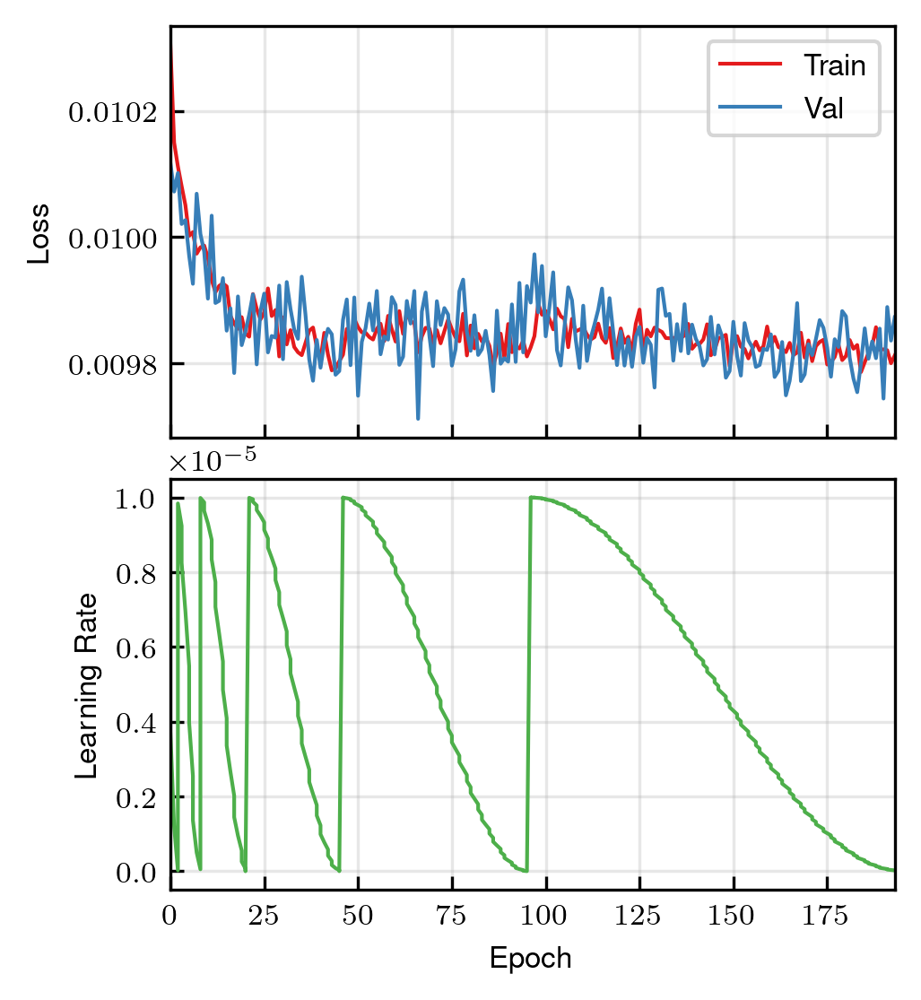
EDM training
Starting loss already small, then it barely improves.
Noisy even at low learning rates (1E-5)
Cosine annealing schedule with warm restarts and increasing period worked best.

Slide 12
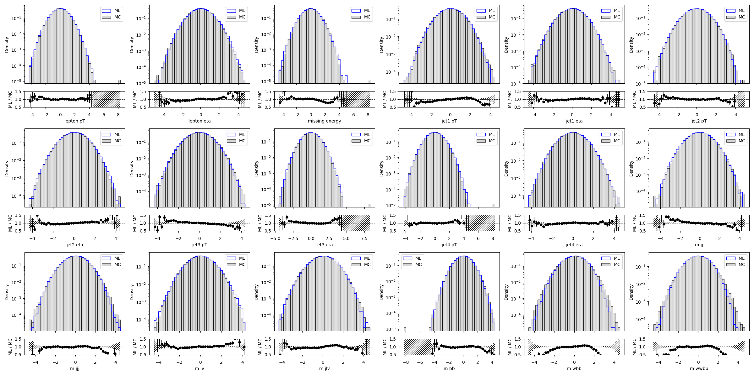
Training samples snapshots for EDM
Epoch 0/196

Slide 13
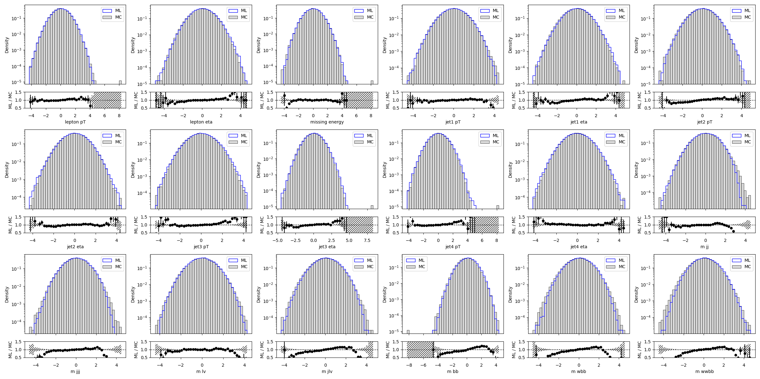
Training samples snapshots for EDM
Epoch 93/196
Epoch 0/196

Slide 14
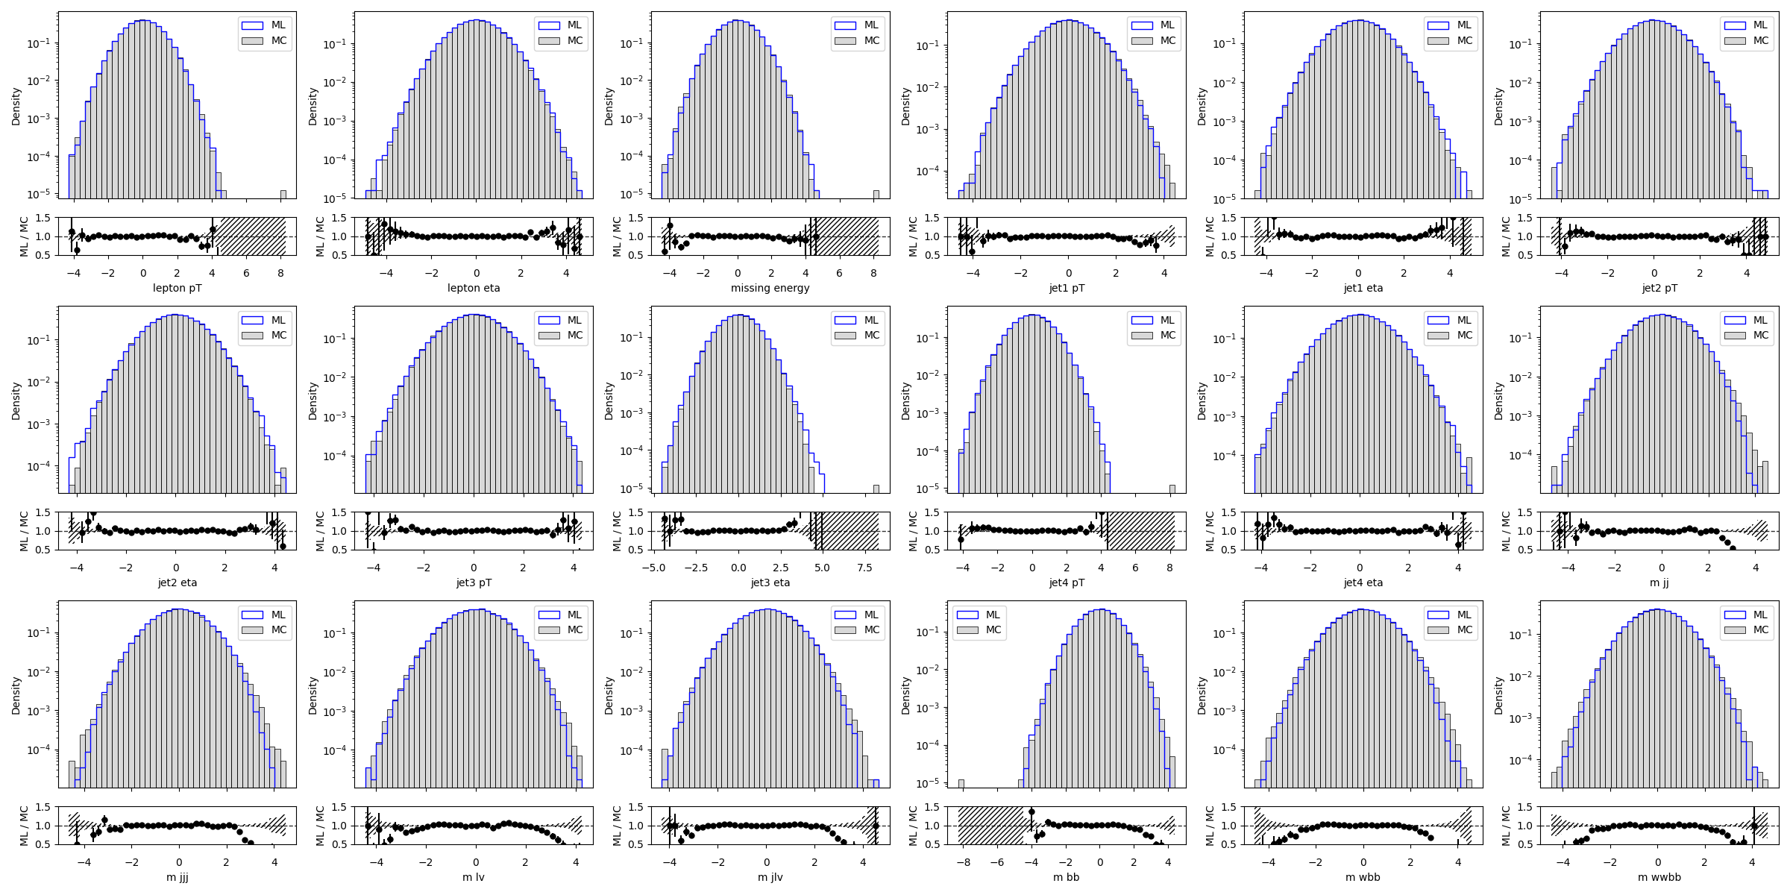
Training samples snapshots for EDM
Epoch 192/196
Epoch 93/196
Epoch 0/196

Slide 15
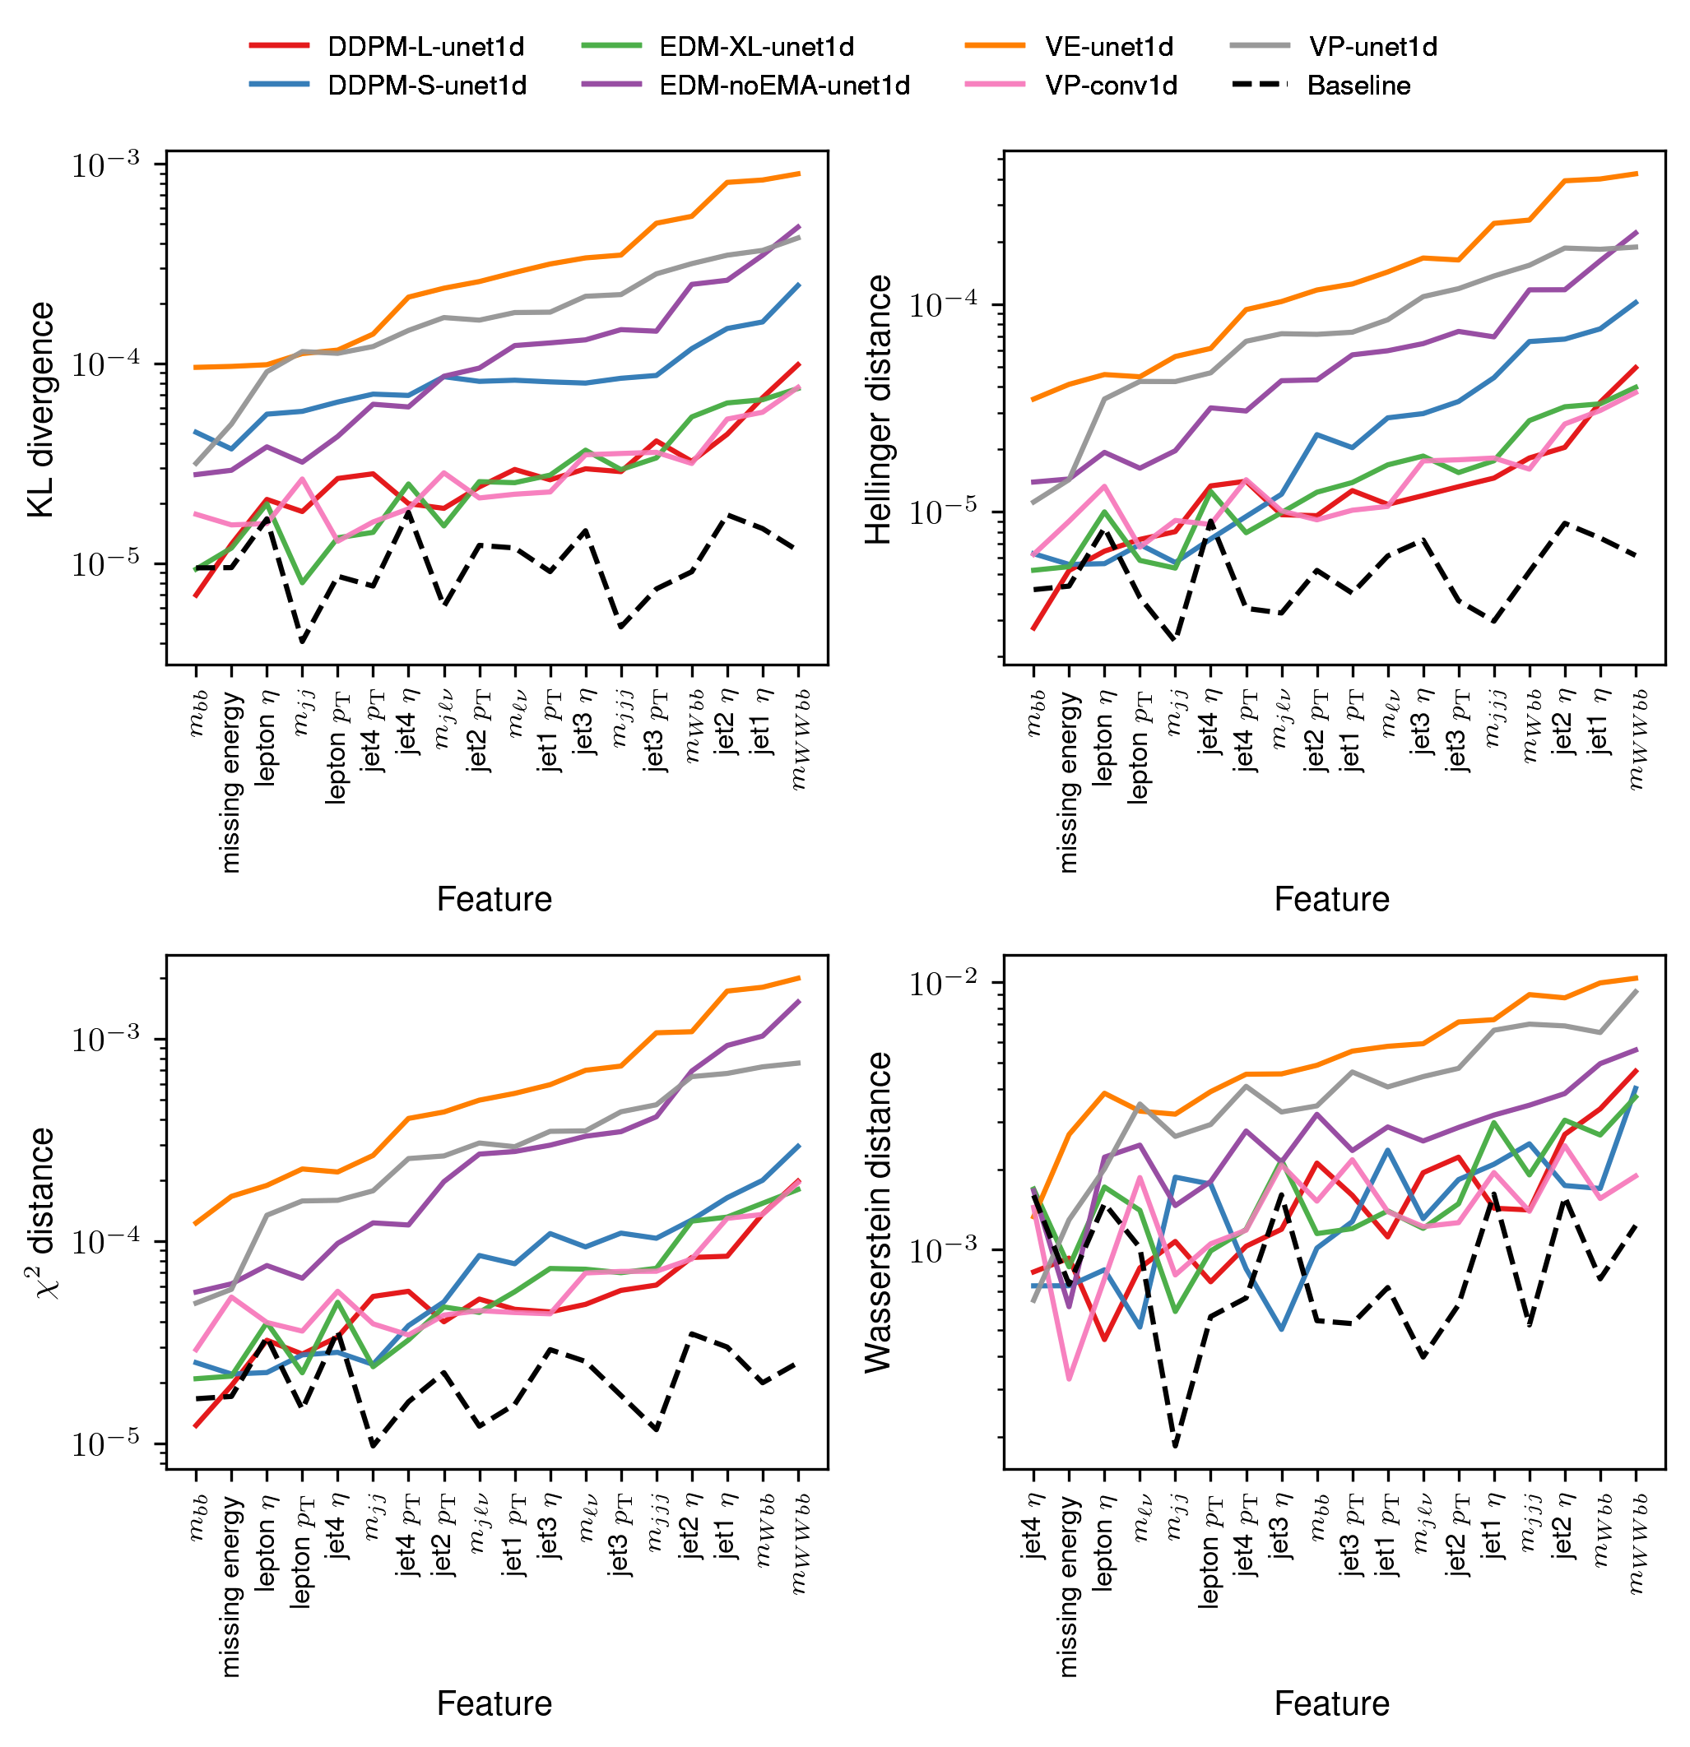
Distribution distances
Best performers: EDM xl, VP conv. and DDPM
VP conv. underperforms on the C2ST test despite good distance results

Slide 16
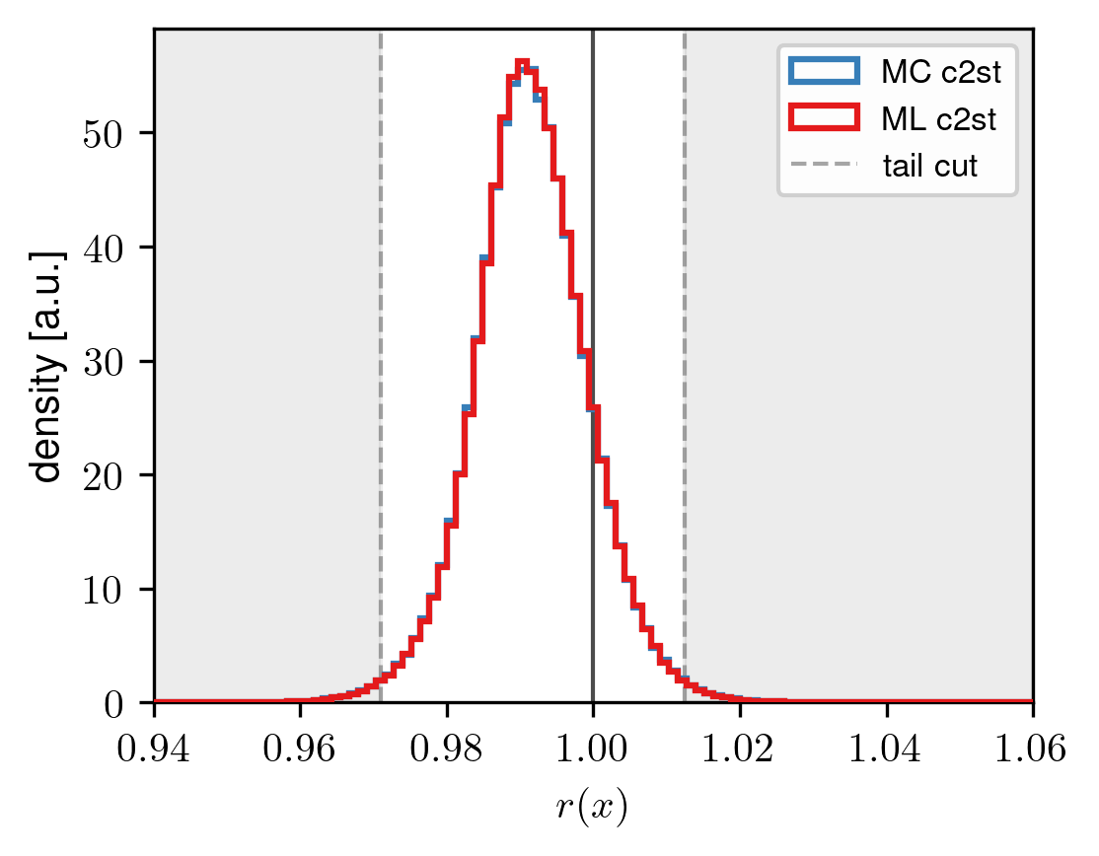
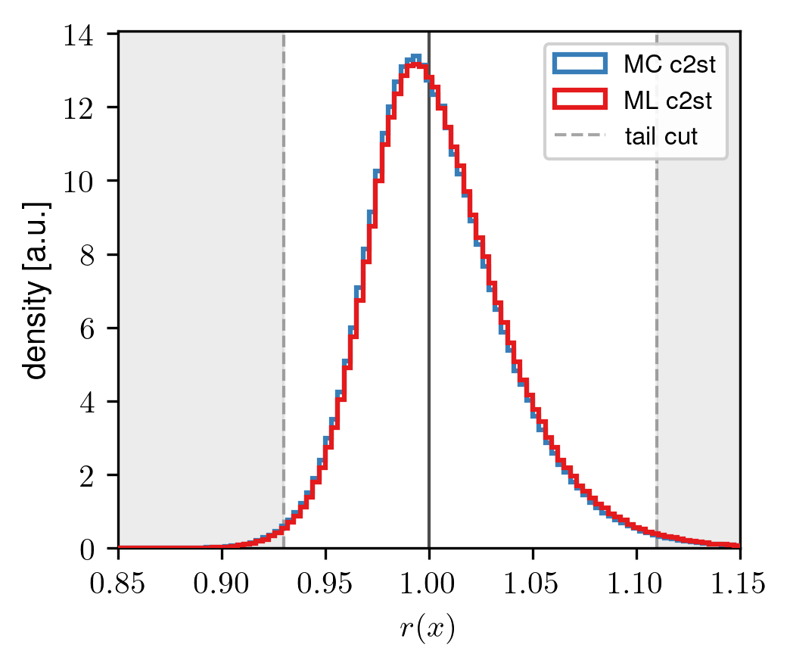

Ratio tests
C2ST Classifier output
r(x)=P_{ML}(x) / P_{MC}(x) estimated as r(x)≈exp($σ^{−1}$[f(x; $θ$)])
~1.5 % of data in the tails
DDPM
EDM (xl model)

Slide 17
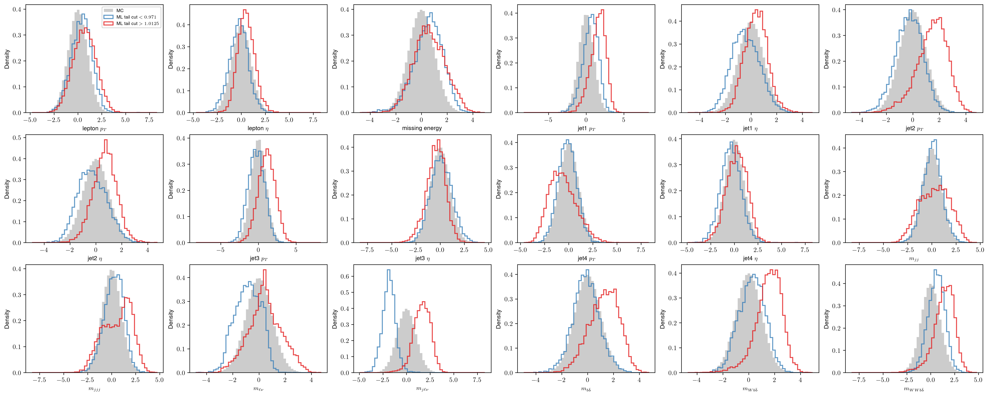
Distributions after the cut
EDM struggles with high level features, low varince problem
DDPM

Slide 18
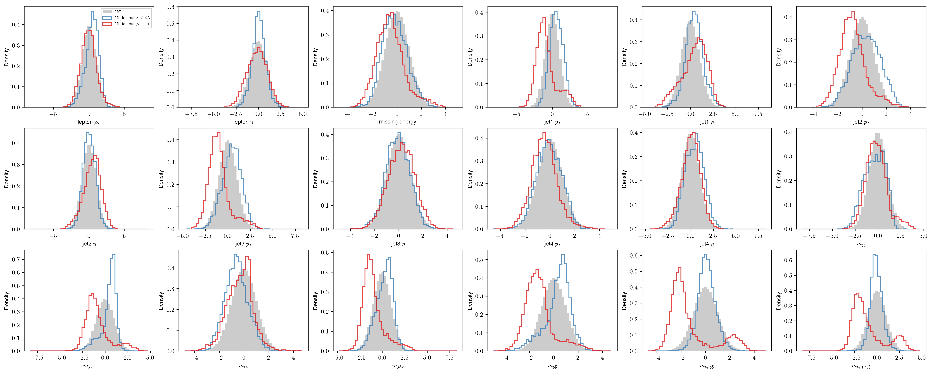
Distributions after the cut
EDM struggles with high level features, low varince problem
EDM
DDPM

Slide 19
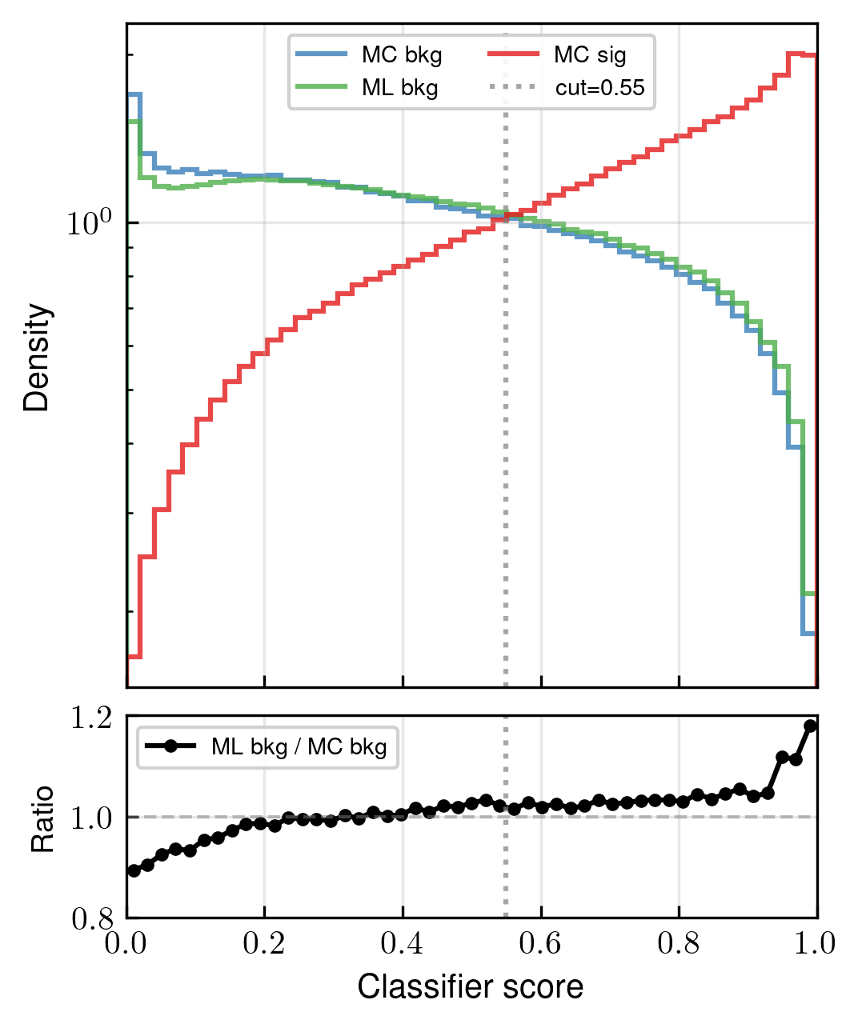
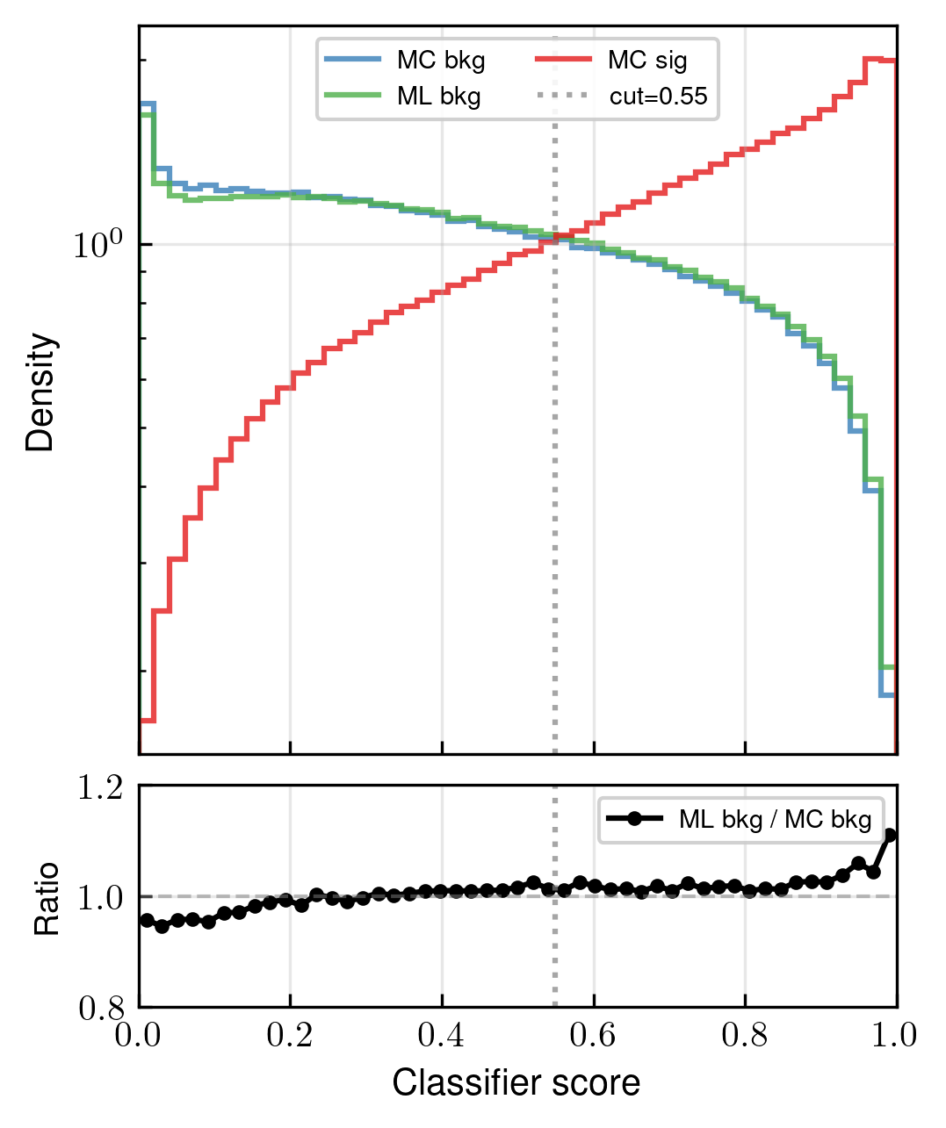
Sig.-Bkg. ratios
Sig.-bkg. classifier outputs for MC sig., MC bkg. and ML bkg. (~2.6 mil. events each)
DDPM
EDM (xl model)

Slide 20
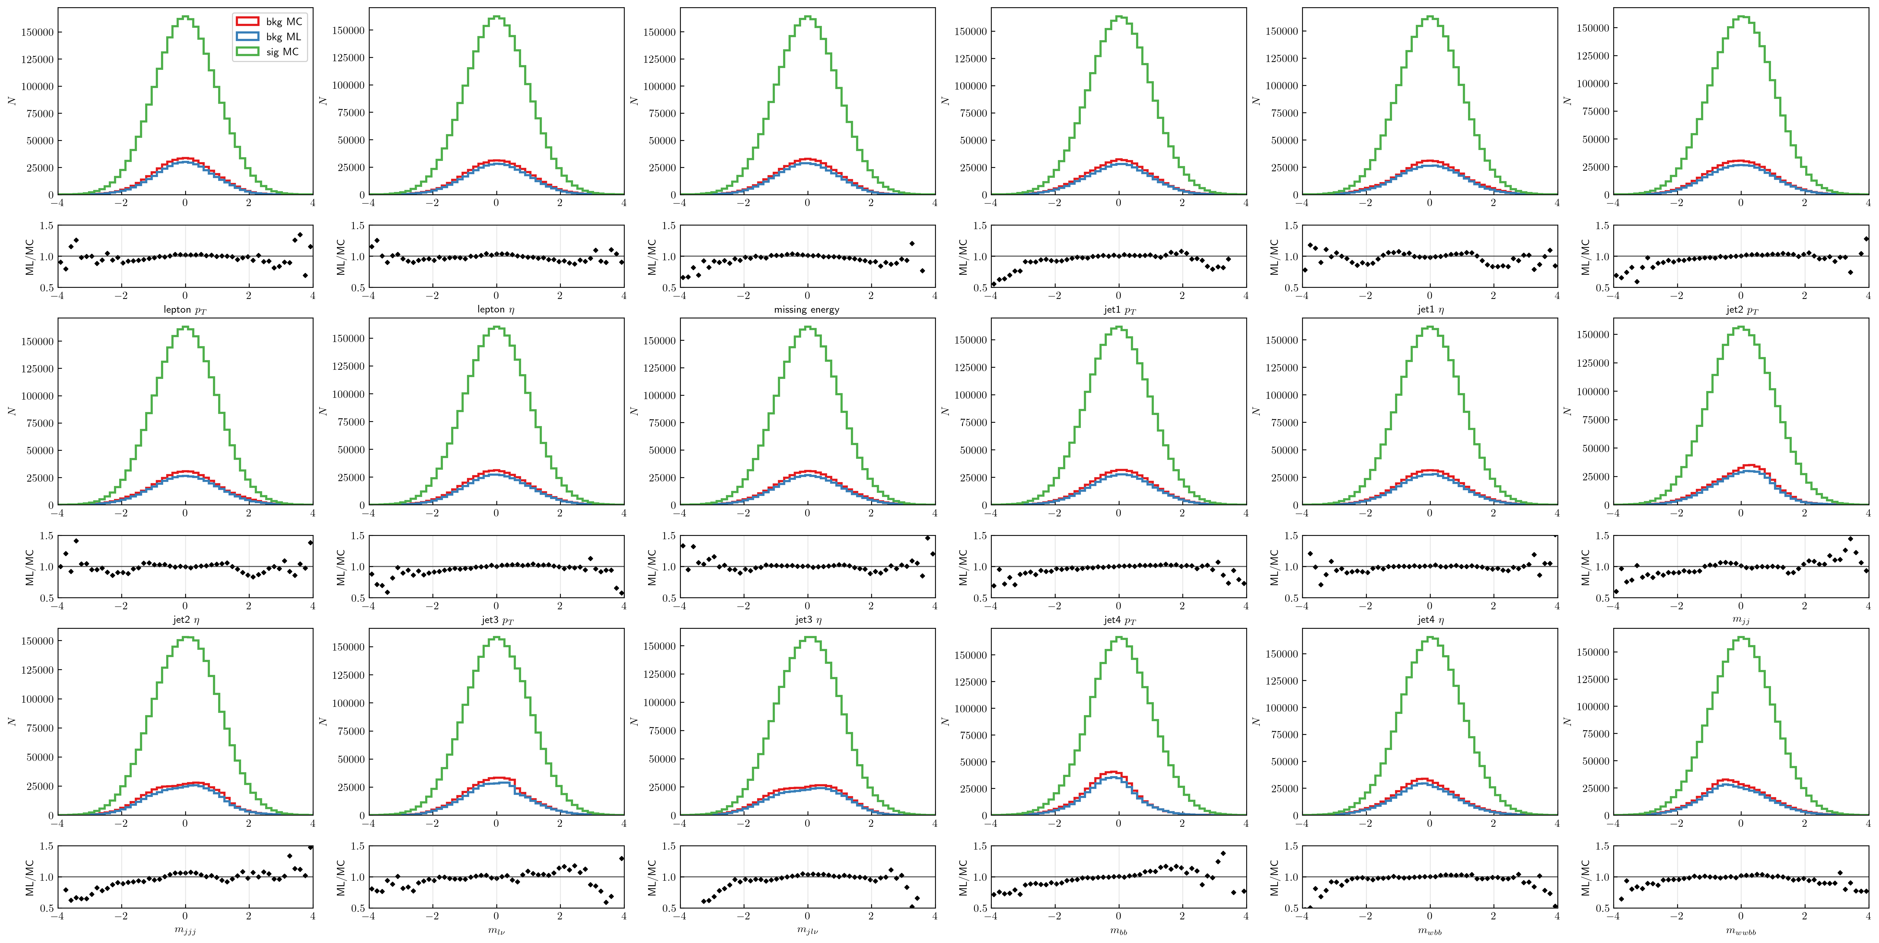
Distributions after the cut
DDPM
Distributions after the cut on the classifier, at score of 0.55 +
ratios of bkg. ML/MC densities

Slide 21
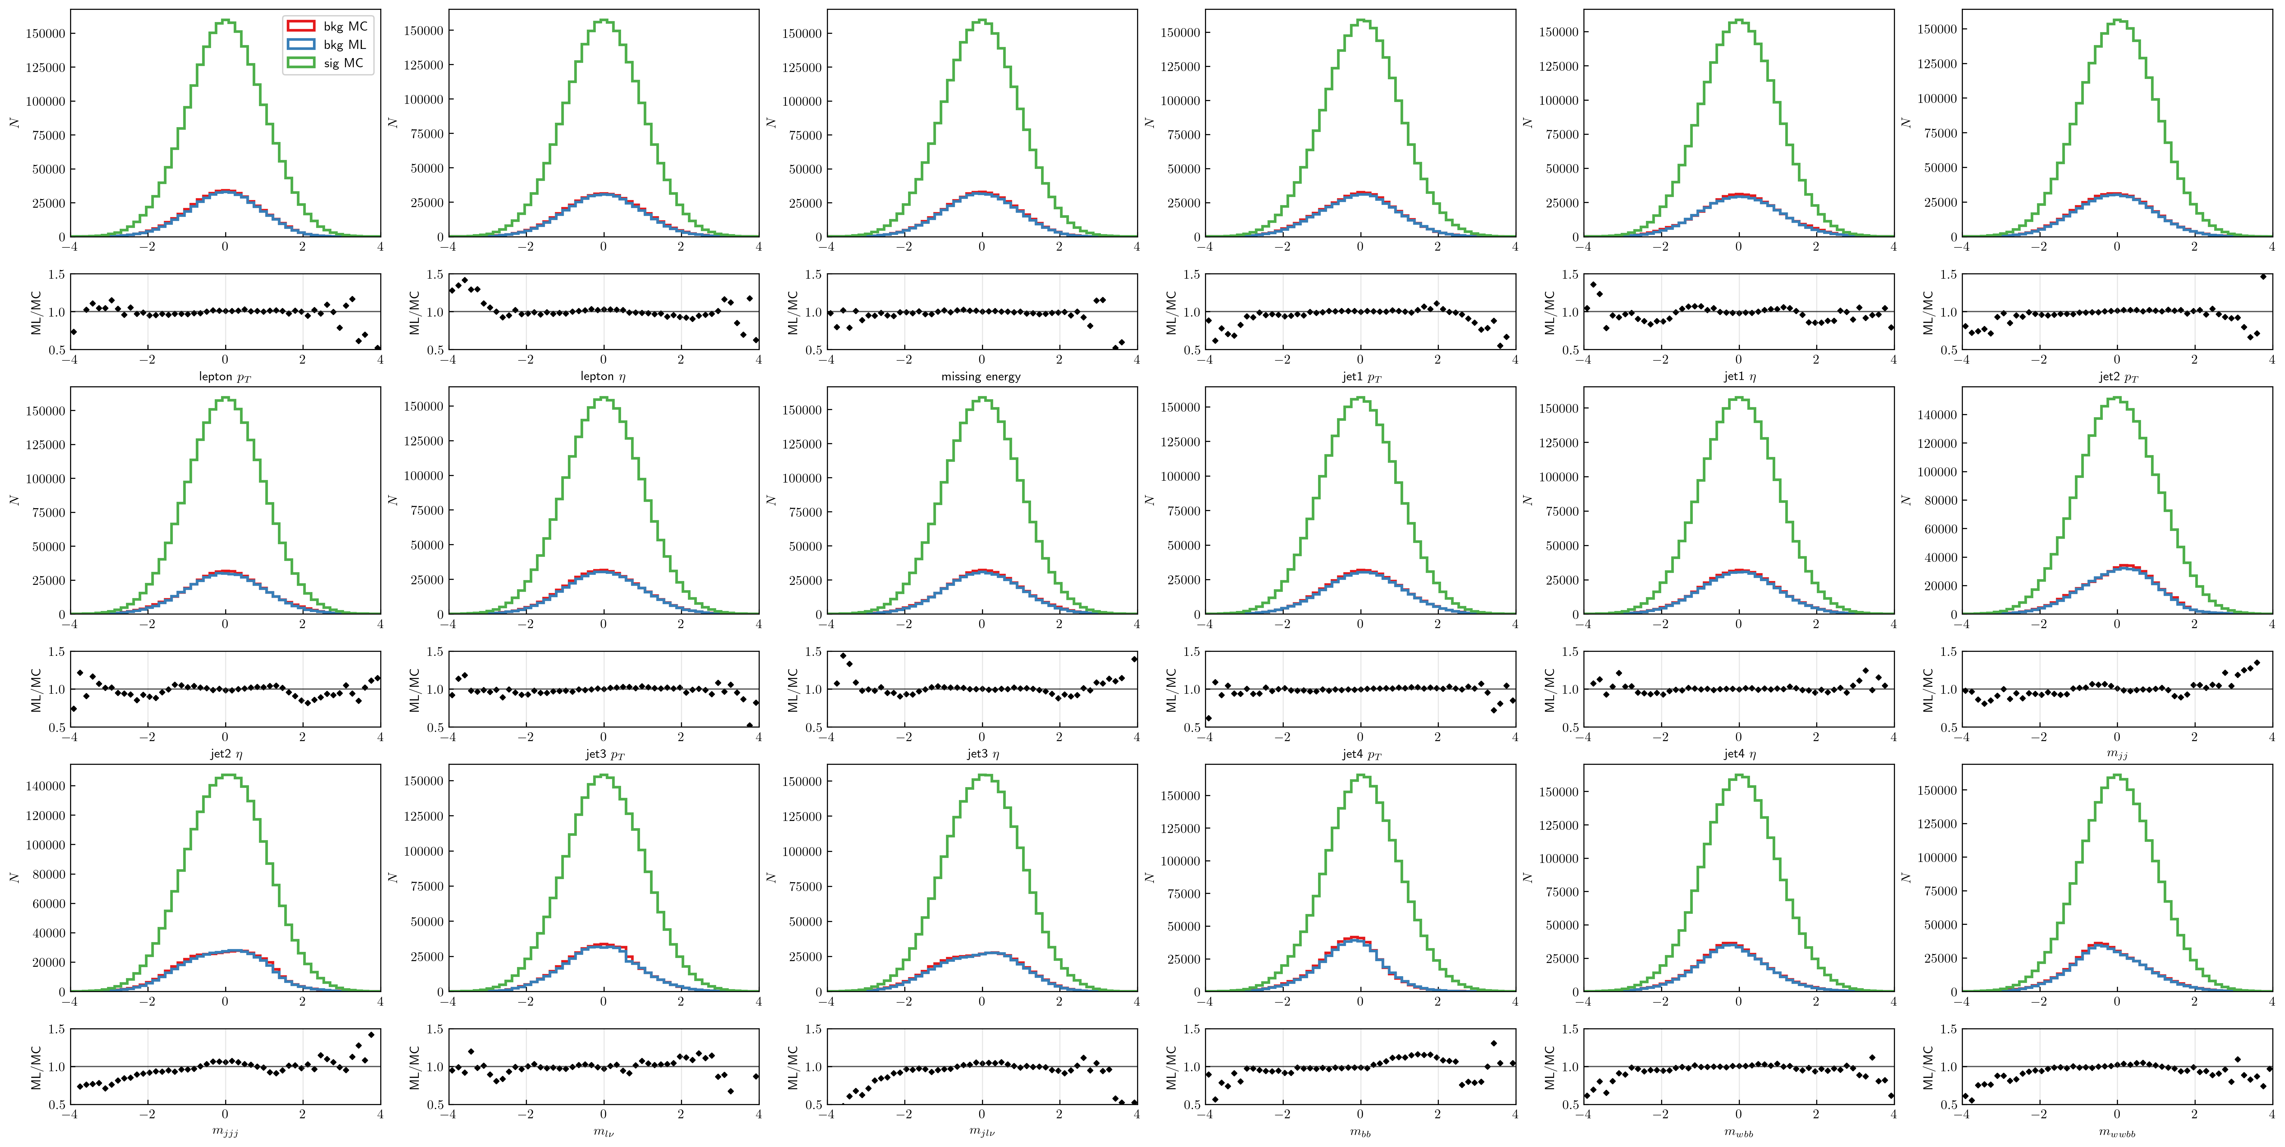
Distributions after the cut
EDM
DDPM
Distributions after the cut on the classifier, at score of 0.55 +
ratios of bkg. ML/MC densities

Slide 22
Todo list
EDM framework improvements: reweighing data, better networks?
New architectures → small data dim. = problems with conv. networks
Consistency models for fast sampling
Training parameter and sampling ODE solver parameter optimization
Power function EMA parameter optimization/quality quantification
Autoguidance?
Better preconditioning for DDPM

Slide 23
Conclusions
Promising frameworks: standard stohastic DDPM, EDM framework?
Score/SDE networks: ODE sampling = less steps, faster but lowers samples‘ variance / quality

Slide 24
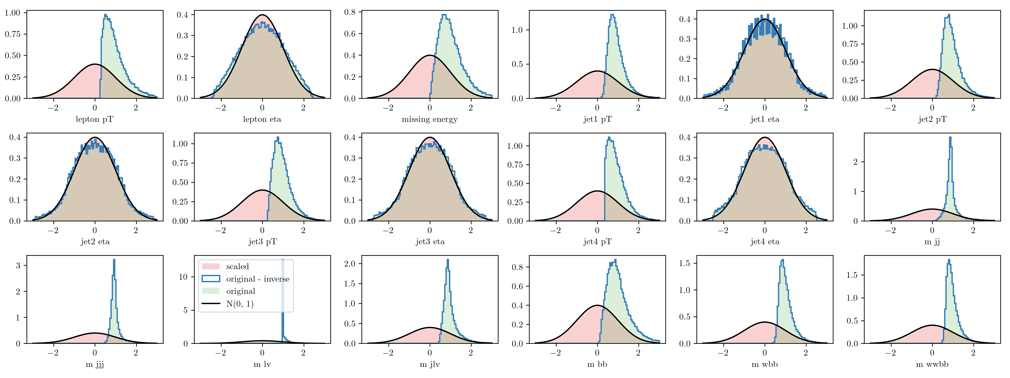
Supplementary info
Before training the data is transformed using the Rank → Gaussian scaler
Rank transform ~ ECDF/data sort and scale from -1 to 1
Apply invErf(scaled data) to get a normal distribution
Data, transfromed data, normal distribution (black) and inverse transform sanity checks.

Slide 25
Architectures + weight calculations
For most models an MLP U-net was used
Convolutional U-nets have prolems with small data dimesnionality, learning slower in most cases and not as successful
Standard sinusoidal time embedding
Weights saved using a (power funftion) exponential moving average (pfEMA): see Karras EDM2 paper, pg. 5 for details
Parameters to be optimized, qulatitative analysis (probably) needed

Slide 26
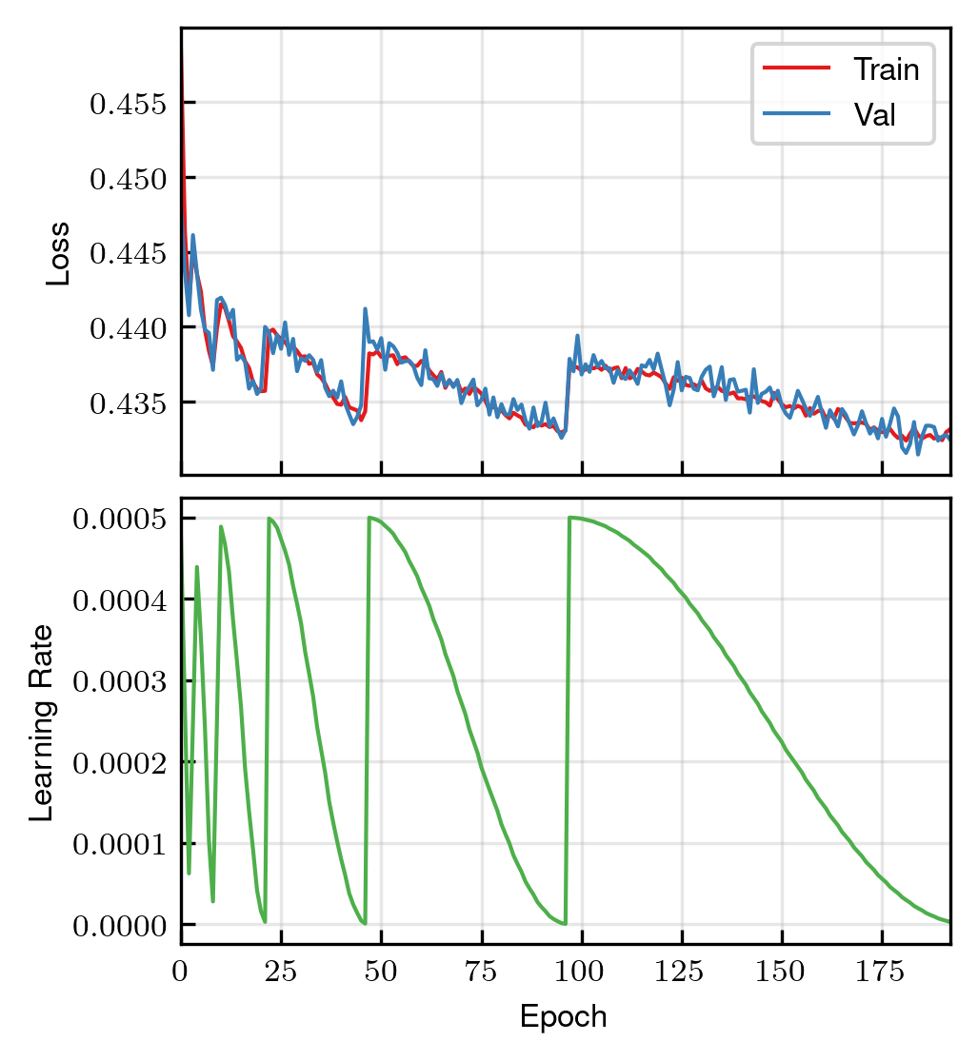
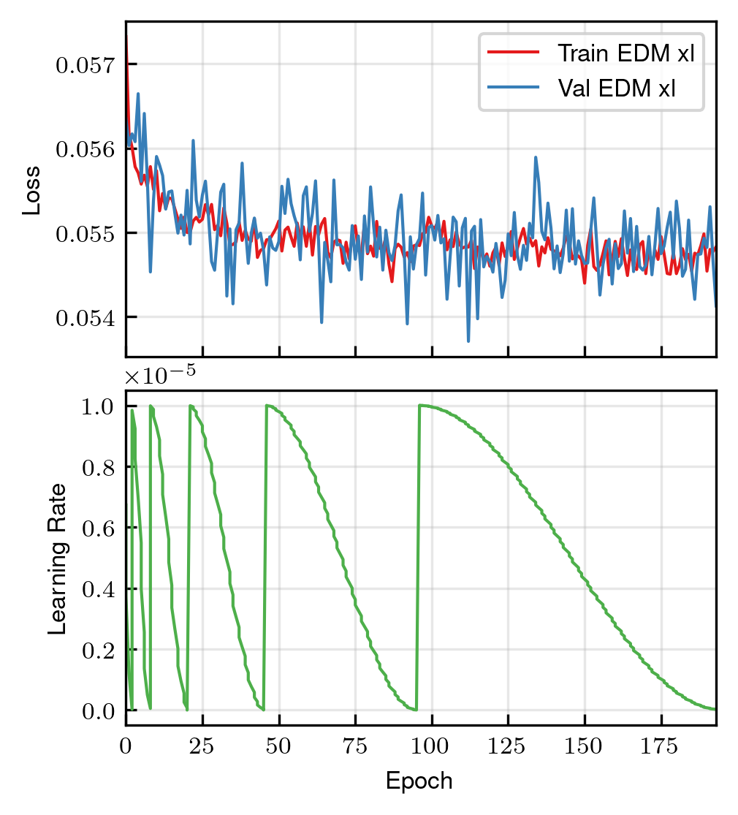
Training/validation loss
DDPM
EDM (xl model)

Slide 27
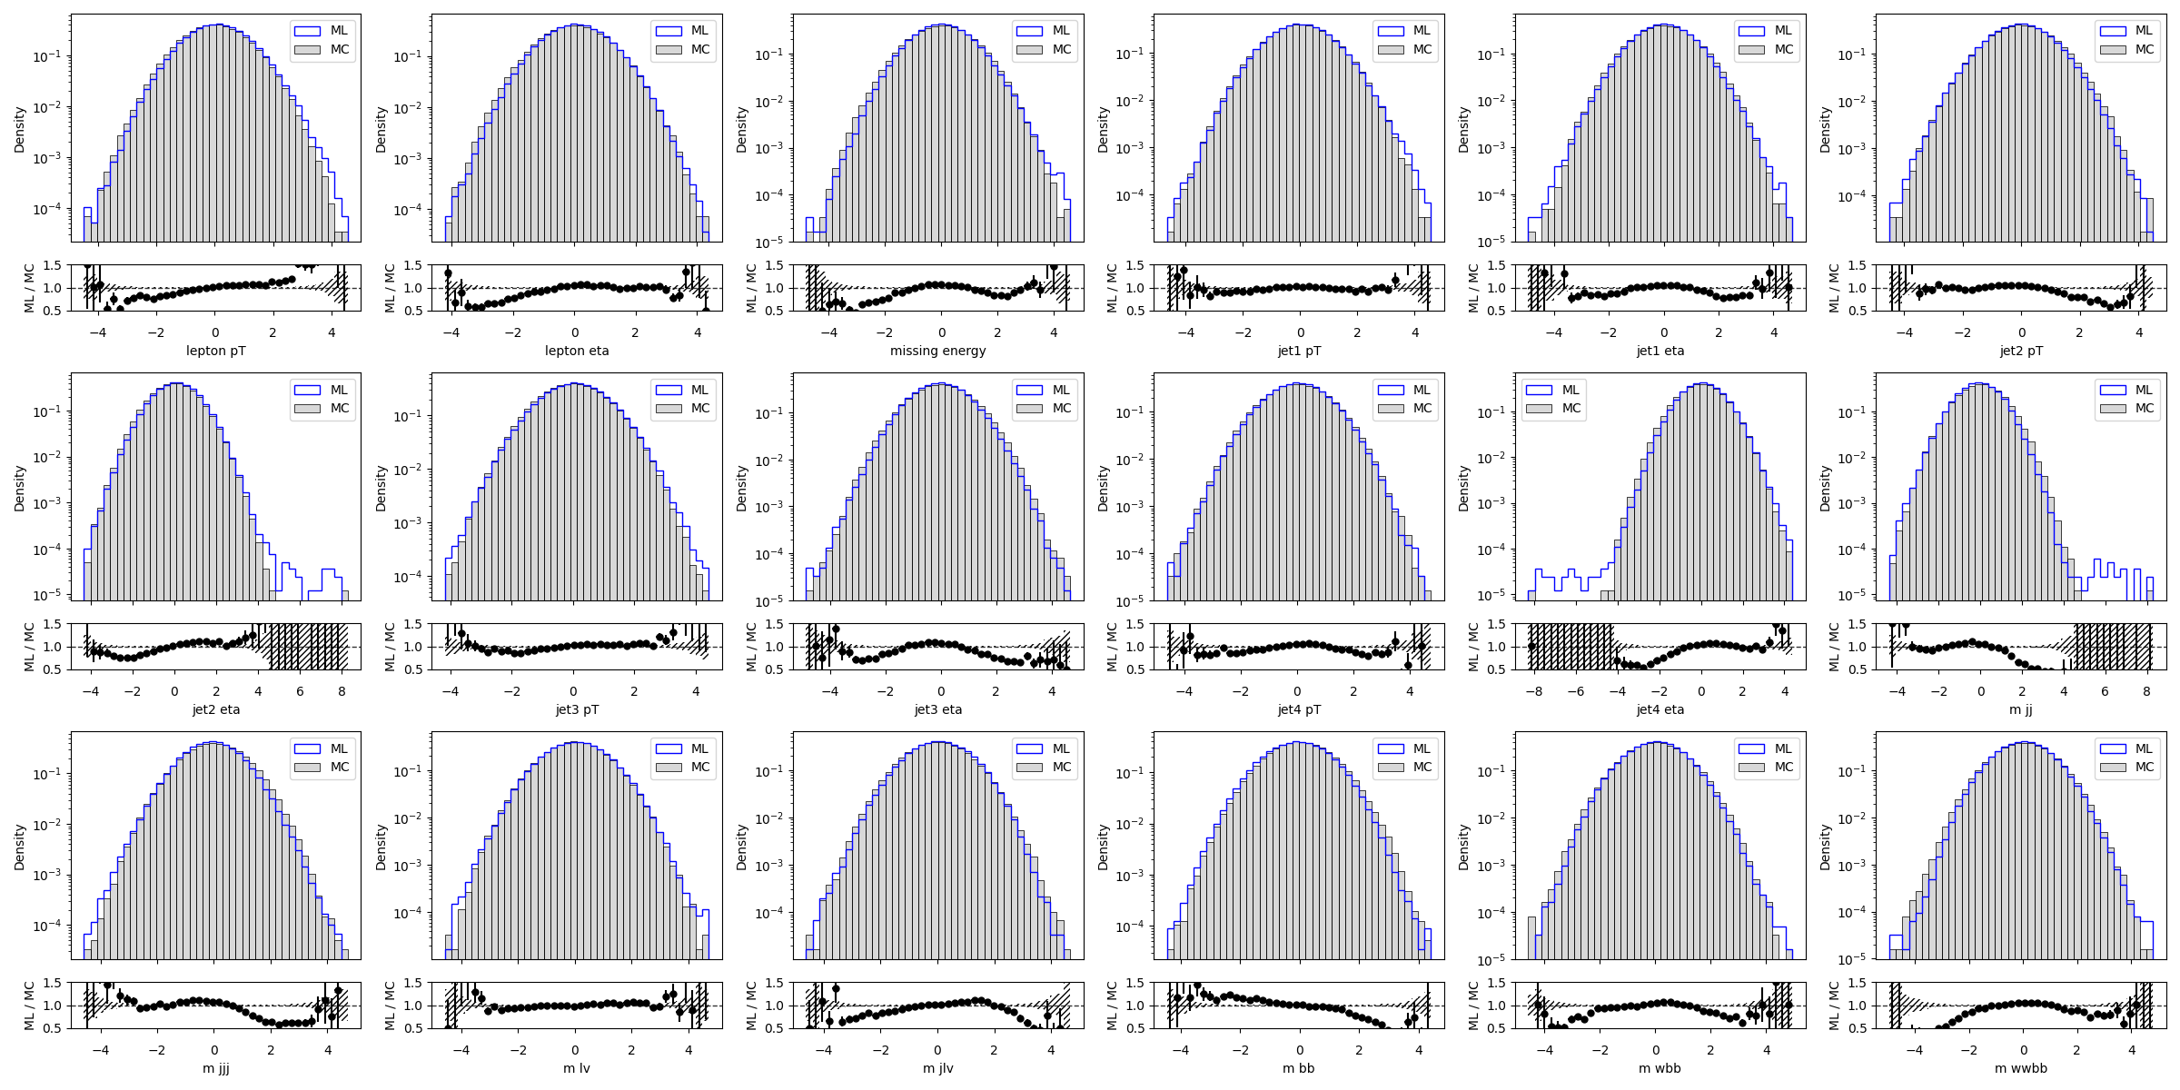
Training samples snapshots for DDPM
Epoch 0/190

Slide 28
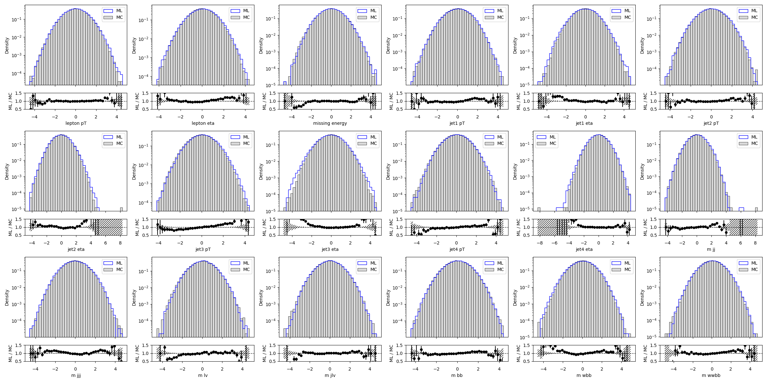
Training samples snapshots for DDPM
Epoch 114/190
Epoch 0/190

Slide 29
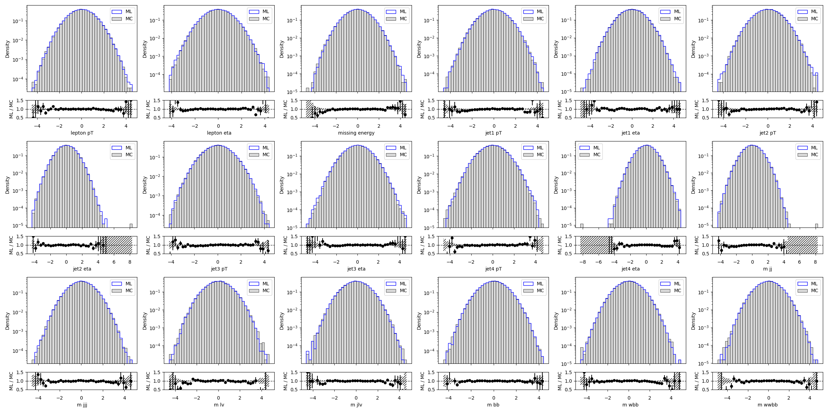
Training samples snapshots for DDPM
Epoch 190/196
Epoch 114/190
Epoch 0/190

Slide 30
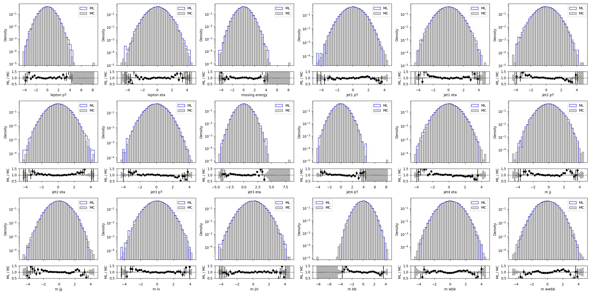
Training samples snapshots for EDM xl
Epoch 0/190

Slide 31
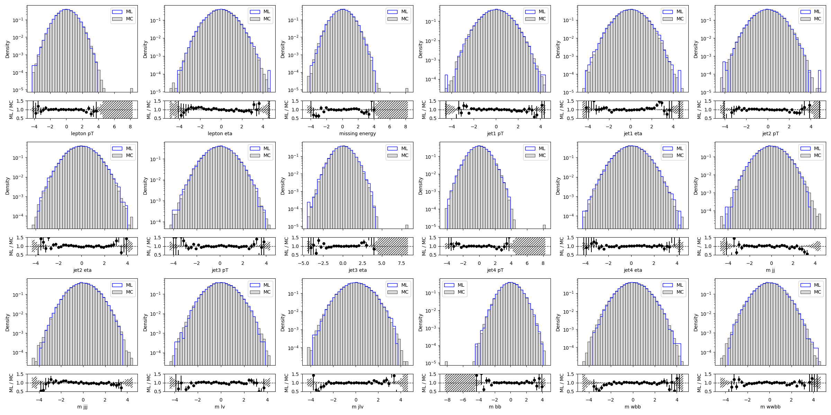
Training samples snapshots for EDM xl
Epoch 96/190
Epoch 0/190

Slide 32
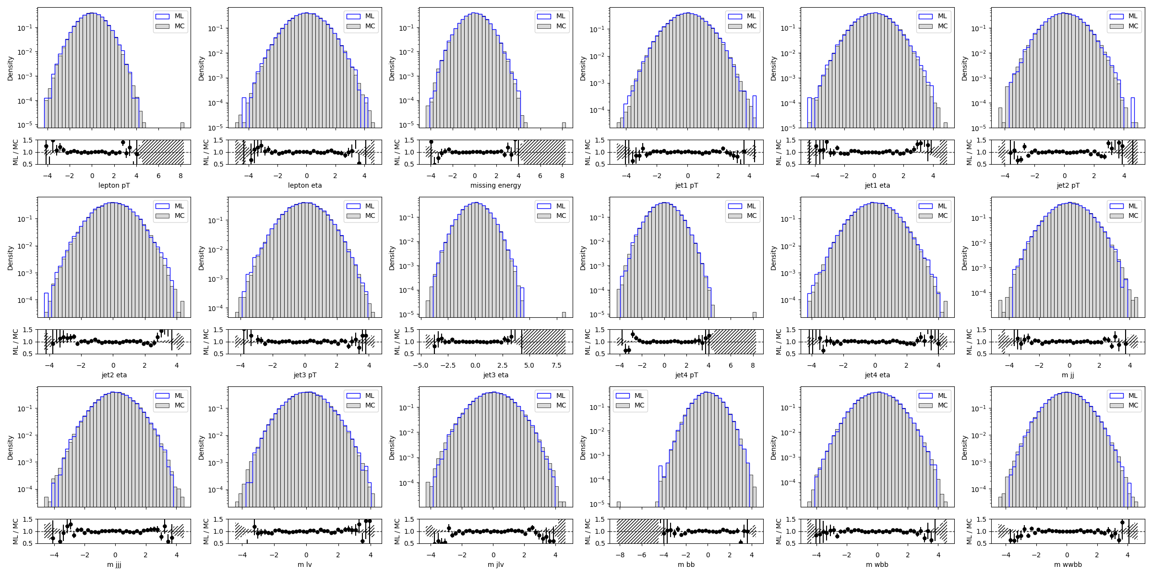
Training samples snapshots for EDM xl
Epoch 96/190
Epoch 192/196
Epoch 0/190

Slide 33
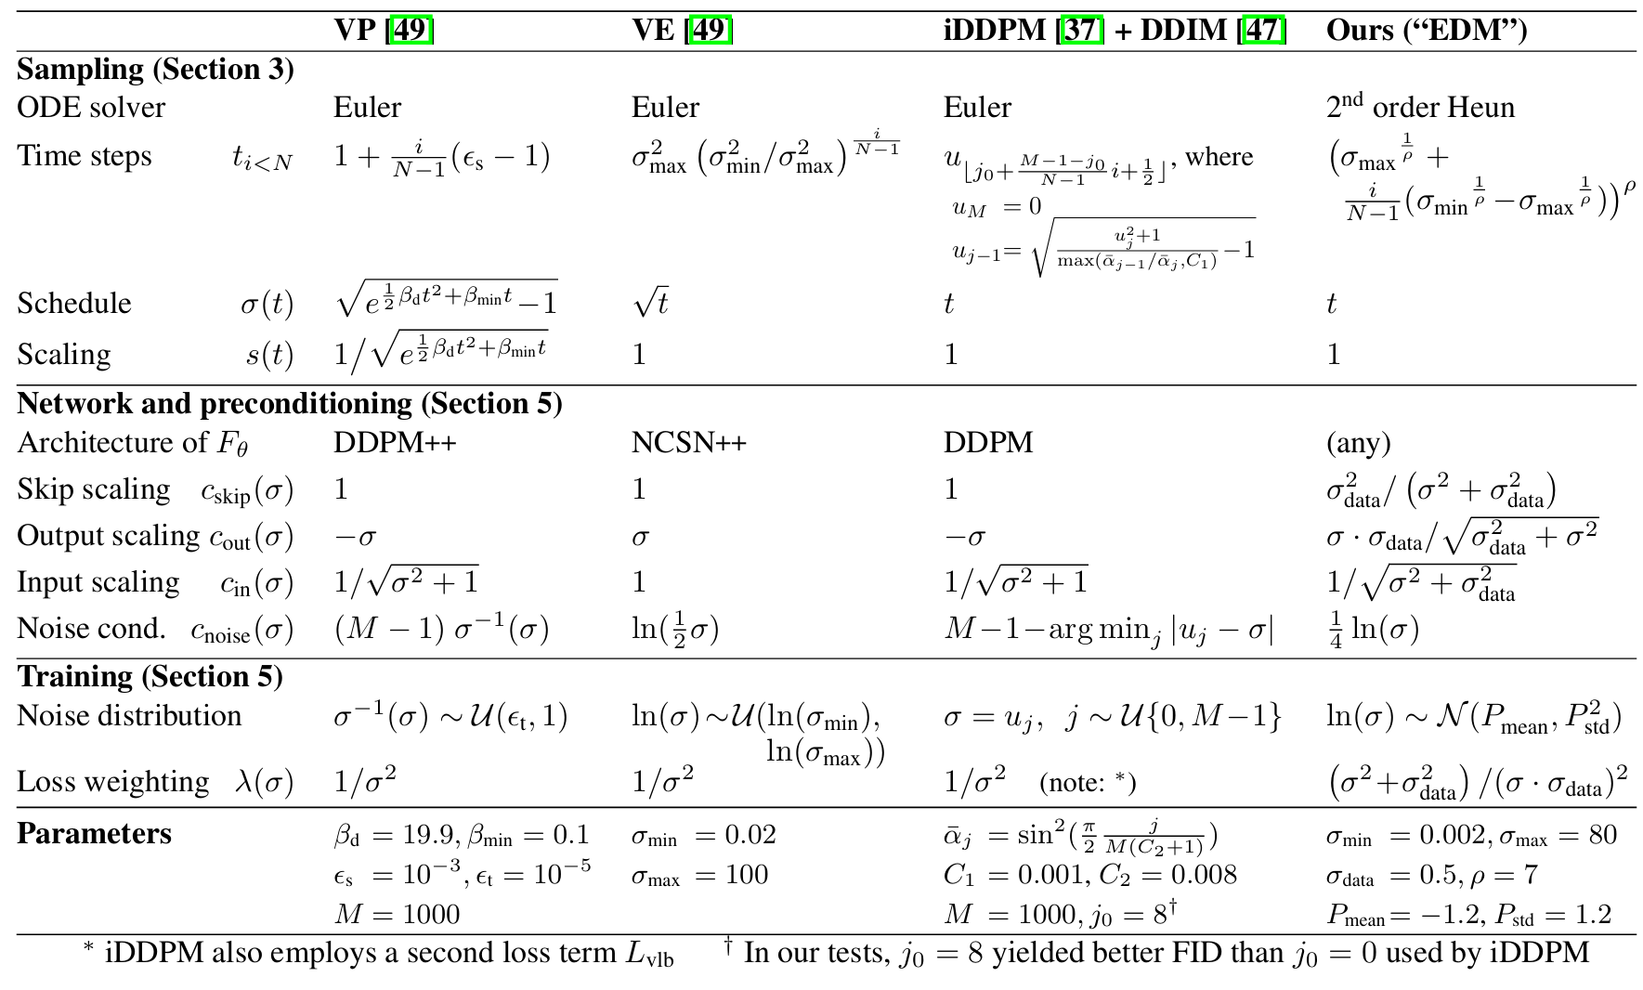
Parameters/SDE models overview

Slide 34
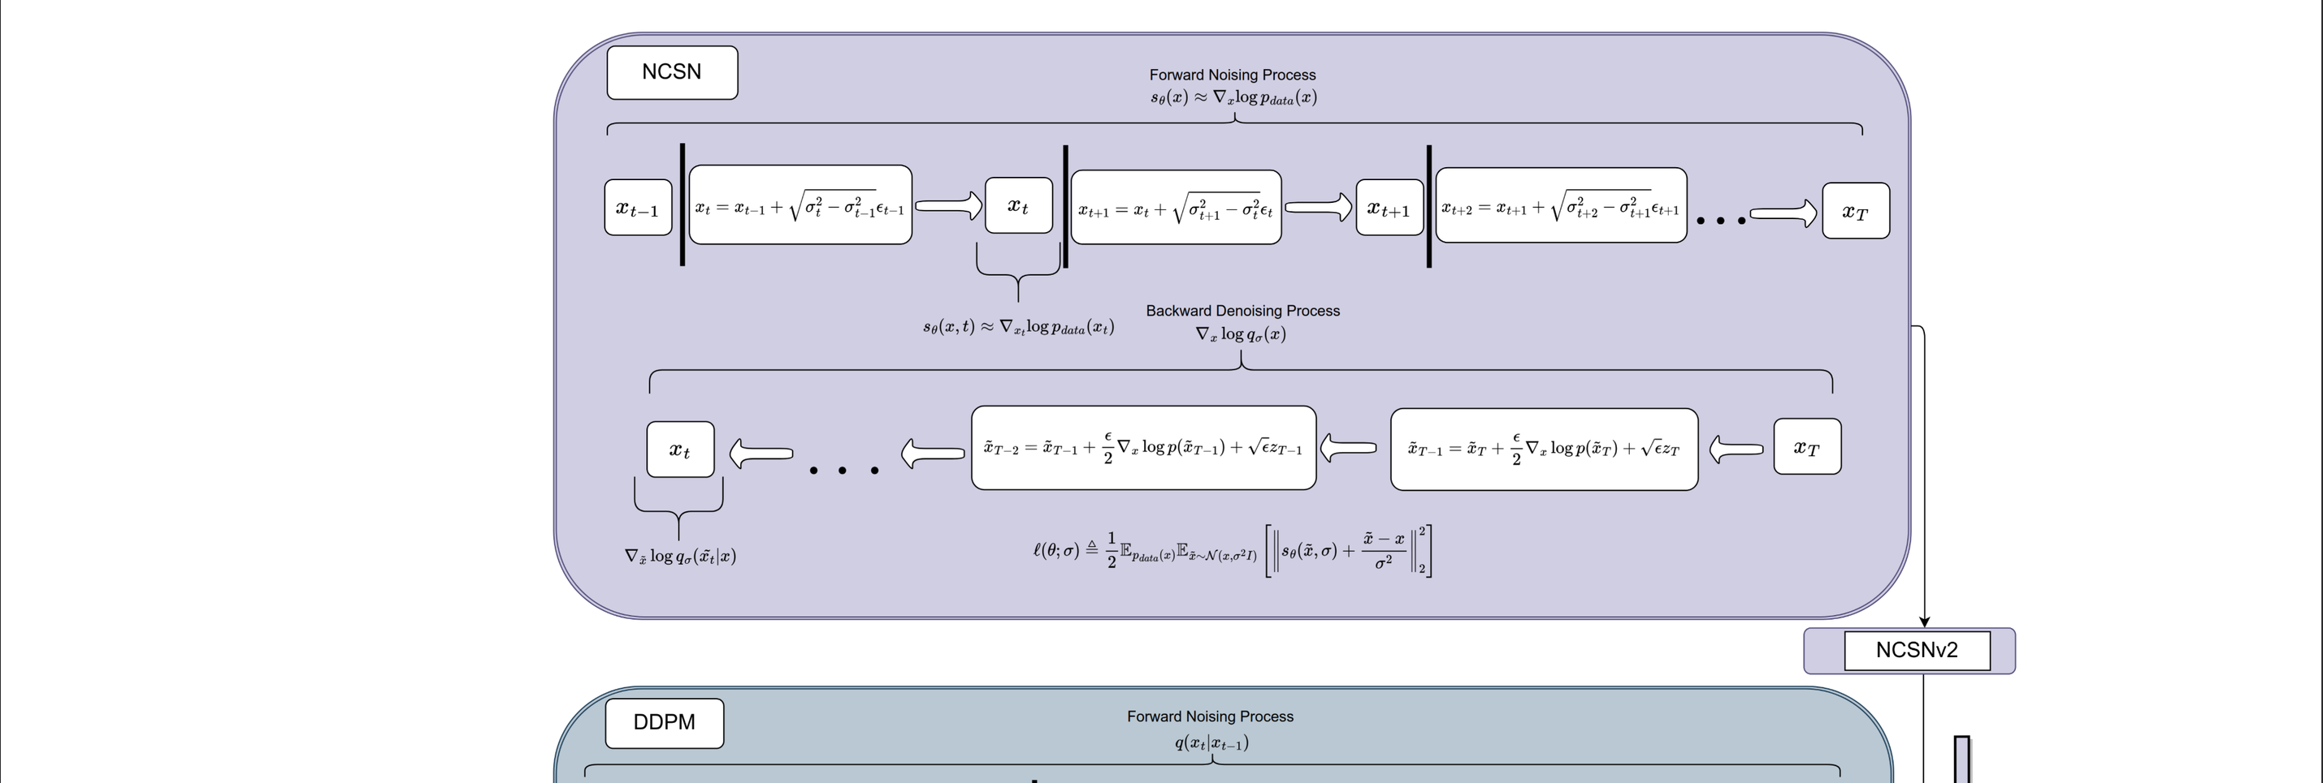
Diffusion models general overview

Slide 35
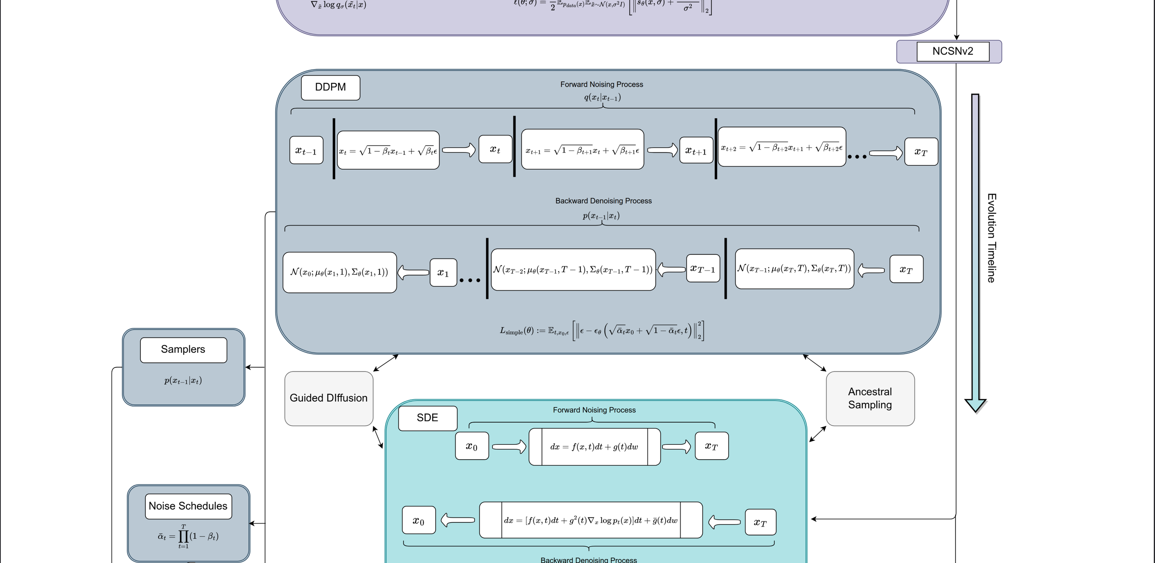

Slide 36
