Slide 1
An Introduction to the
Unified Modeling
Language (UML)

Slide 2
UML in One Sentence
The UML is a graphical language for
visualizing
specifying
constructing
documenting
artifacts of a software-intensive system.

Slide 3
Visualizing
explicit model facilitates communication
some structures transcend what can be represented in programming language
each symbol has well-defined semantics behind it

Slide 4
Specifying
The UML addresses the specification of all important analysis, design, and implementation decisions.

Slide 5
Constructing
Forward engineering: generation of code from model into programming language
Reverse engineering: reconstructing model from implementation
Round-trip engineering: going both ways

Slide 6
Documenting
Artifacts include:
deliverables, such as requirements documents, functional specifications, and test plans
materials that are critical in controlling, measuring, and communicating about a system during development and after deployment

Slide 7
UML and Blueprints
The UML provides a standard way to write a system’s “blueprints” to account for
conceptual things (business processes, system functions)
concrete things (C++/Java classes, database schemas, reusable software components)

Slide 8
Reasons to Model
to communicate the desired structure and behavior of the system
to visualize and control the system’s architecture
to better understand the system and expose opportunities for simplification and reuse
to manage risk

Slide 9
Principles of Modeling
choice of models to create very influential as far as how to attack problem and shape solution
every model may be expressed at different levels of precision
best models connected to reality
no single model is sufficient

Slide 10
Structural Diagrams
Used to visualize, specify, construct, document static aspects of system
class diagram
package diagram [not standard UML]
object diagram
component diagram
deployment diagram

Slide 11
Common Uses of Class Diagrams
to model vocabulary of the system, in terms of which abstractions are part of the system and which fall outside its boundaries
to model simple collaborations (societies of elements that work together to provide cooperative behavior)
to model logical database schema (blueprint for conceptual design of database)

Slide 12
Class
A class is a description of a set of objects that share the same attributes, operations, relationships, and semantics.
An attribute is a named property of a class that describes a range of values that instances of the property may hold.
An operation is a service that can be requested from an object to affect behavior.

Slide 13
Class Notation
Name
Attributes
Operations

Slide 14
Alternative Class Notations
Name
Name
Attributes
Attributes
Name
Operations
Operations
Responsibilities
italics
abstract

Slide 15
Relationships
connections between classes
dependency
generalization
association

Slide 16
Dependency
A dependency is a “using” relationship within which the change in the specification of one class may affect another class that uses it.
Example: one class uses another in operation
Window
Event
handleEvent()

Slide 17
Generalization
A generalization is a “kind of” or “is a” relationship between a general thing (superclass or parent) and a more specific thing (subclass or child).
Shape
Circle
Rectangle

Slide 18
Association
An association is a structural relationship within which classes or objects are connected to each other. (An association between objects is called a link.)
Person
Company

Slide 19
Association Adornments
name
role
multiplicity
aggregation
composition

Slide 20
Association Name
describes nature of relationship:
can also show direction to read name:
works for
Person
Company
works for
Person
Company

Slide 21
Association Roles
describe “faces” that classes present to each other within association
class can play same or different roles within different associations
employee
Person
Company
employer

Slide 22
Association Multiplicity
possible values same as for classes: explicit value, range, or * for “many”
Example: a Person is employed by one Company; a Company employs one or more Persons
1..*
Person
Company
1

Slide 23
Aggregation
Aggregation is a “whole/part” or “has a” relationship within which one class represents a larger thing that consists of smaller things.
Company
Department

Slide 24
Composition
Composition is a special form of aggregation within which the parts are inseparable from the whole.
Window
Frame

Slide 25
Association Classes
An association class has properties of both an association and a class.
Person
Company
Job
description
dateHired
salary

Slide 26
Interfaces
An interface is a named collection of operations used to specify a service of a class without dictating its implementation.
«interface»
Observer
Observer
update()

Slide 27
Interface Relationships
An interface may participate in generalization, association, and dependency relationships.
Tracker
Observer
Periodic
Observer
Observation

Slide 28
Realization
A realization is a relationship between an interface and the class that provides the interface’s services.
A class may realize many interfaces.
«interface»
Observer
TargetTracker
Observer
update()

Slide 29
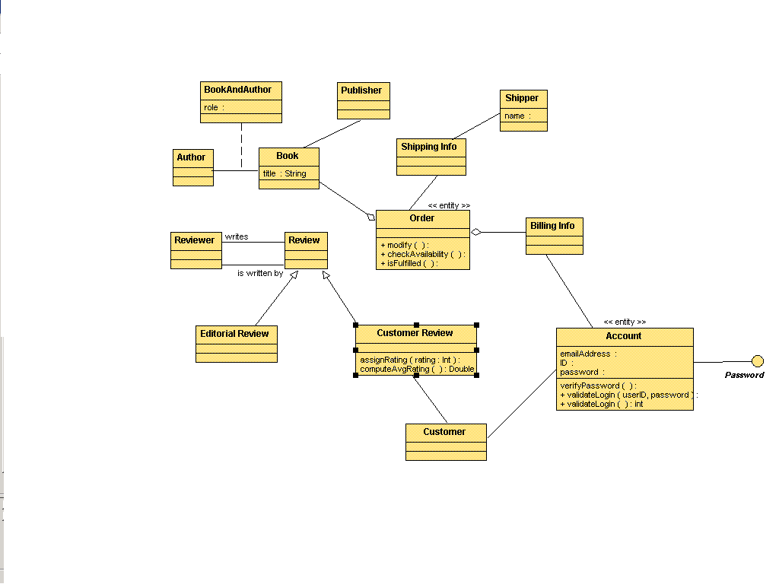

Slide 30
Adornments and Extensibility
An adornment is an item, such as a note, that adds text or graphical detail to a model.
The UML offers various mechanisms that you can use to extend the “official” language.
stereotypes
tagged values
constraints

Slide 31
Notes
A note is a graphical symbol containing text and/or graphics that offer(s) some comment or detail about an element within a model.
Check with Mike
on this.
See http://www.
softdocwiz.com
See encrypt.doc

Slide 32
Stereotypes
A stereotype is an extension of the vocabulary of the UML that allows you to create a new kind of “building block” that’s specific to the problem you’re trying to solve.
«interface»
Observer
«control»
TargetTracker
update()
Humidity Sensor

Slide 33
UML Standard Stereotypes
around 50, including:
become (indicates a dependency within which one object becomes another)
enumeration (specifies an enumerated type, including its possible values)
utility (indicates a class whose attributes and operations all have “class” scope)

Slide 34
Tagged Values
A tagged value is an extension of the properties of a model element that allows you to create new information within the specification of that element.
GL Account
{persistent}
TargetTracker
{release = 2.0}

Slide 35
Constraints
A constraint is an extension of the semantics of one or more model elements which specifies a condition that must be true.
Portfolio
Person
{secure}
{or}
Corporation
Bank Account

Slide 36
Package
A package is a general-purpose mechanism for organizing elements of a model, such as classes or diagrams, into groups.
Every element within a model is uniquely owned by one package. Also, that element’s name must be unique within that package.

Slide 37
Sample Package Diagrams
General Ledger
GL Account
Posting
Posting Rule
Accounting
A/P
G/L
A/R

Slide 38
Object Diagram
An object diagram shows a set of objects, and their relationships, at a specific point in time.
c: Company
d1: Department
: Contact Info
name = “R&D”
phone = “411”
p1: Person
ID = “13”

Slide 39
Component
A component is a physical, replaceable part of a system that conforms to, and provides the realization of, a set of interfaces.
examples:
dynamic link library (DLL)
COM+ component
Enterprise Java Bean (EJB)

Slide 40
Component Notation
Scheduler
-----------
----------
----------
----------
----------
----------
signal.cpp

Slide 41
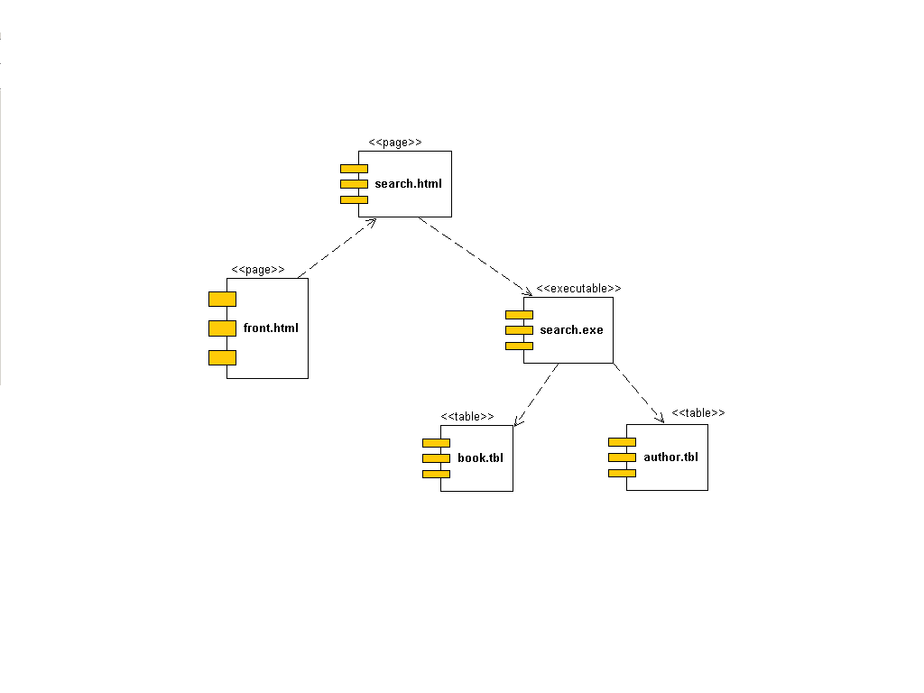

Slide 42
Node
A node is a physical element, which exists at run time, that represents some computation resource.
This resource generally has at least some memory; it often has processing capability.

Slide 43
Nodes and Components
Components are things that participate in the execution of a system; nodes are things that execute components.
A distribution unit is a set of components that have been allocated to a node as a group.

Slide 44
Deployment Diagram Notation
: kiosk
deploys
user.exe
«10-T Ethernet»
s: server
deploys
dbadmin.exe
: RAID farm
c: console
deploys
config.exe
«RS-232»

Slide 45
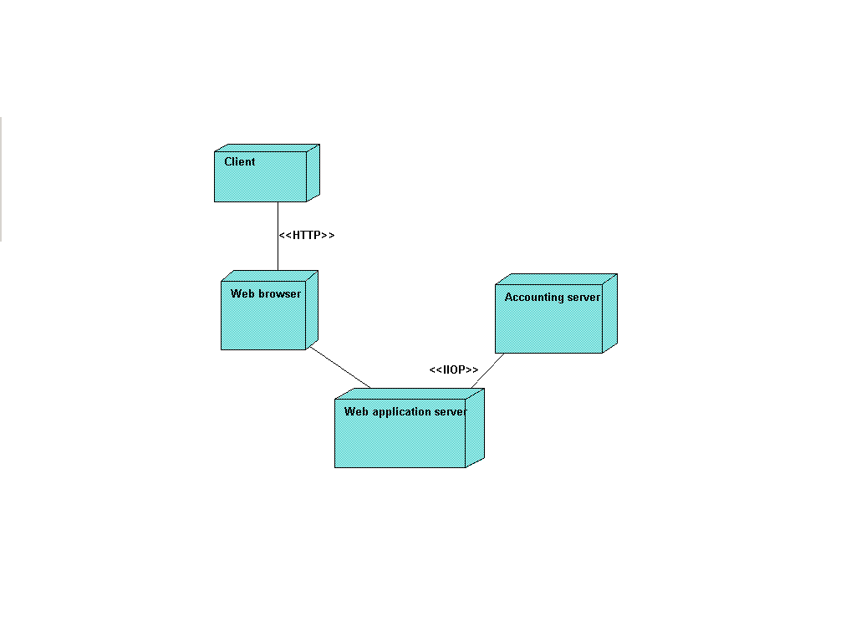

Slide 46
Behavioral Diagrams
Used to visualize, specify, construct, document dynamic aspects of system
use case diagram
sequence diagram
collaboration diagram
statechart diagram
activity diagram

Slide 47
Use Case and Actor
A use case is a sequence of actions, including variants, that a system performs to yield an observable result of value to an actor.
An actor is a coherent set of roles that human and/or non-human users of use cases play when interacting with those use cases.

Slide 48
Flows of Events
The main flow of events (basic course of action) describes the “sunny-day” scenario.
Each exceptional flow of events (alternate course of action) describes a variant, such as an error condition or an infrequently occurring path.

Slide 49
Simple Use Case Diagram
Do
Trade
Entry
Generate
Reports
Update
Portfolio
Info

Slide 50
Organizing Use Cases
packages
generalization
include
extend

Slide 51
Use Case Packages
Packages of use cases can be very useful in assigning work to sub-teams.
Portfolios
Create
New
Portfolio
Aggregate
Portfolios
View
Portfolio
Generate
Portfolio
Report

Slide 52
Use Case Generalization
You can generalize use cases just like you generalize classes: the child use case inherits the behavior and meaning of the parent use case, and can add to or override that behavior.
Check
Password
Validate
User
Perform
Retinal
Scan

Slide 53
Include
You can use the «include» stereotype to indicate that one use case “includes” the contents of another use case. This enables you to factor out frequent common behavior.
Place
Order
Validate
User
Track
Order
«include»
«include»

Slide 54
Extend
You can use the «extend» stereotype to indicate that one use case is “extended” by another use case. This enables you to factor out infrequent common behavior.
Validate
User
Place
Rush
Order
«extend»

Slide 55
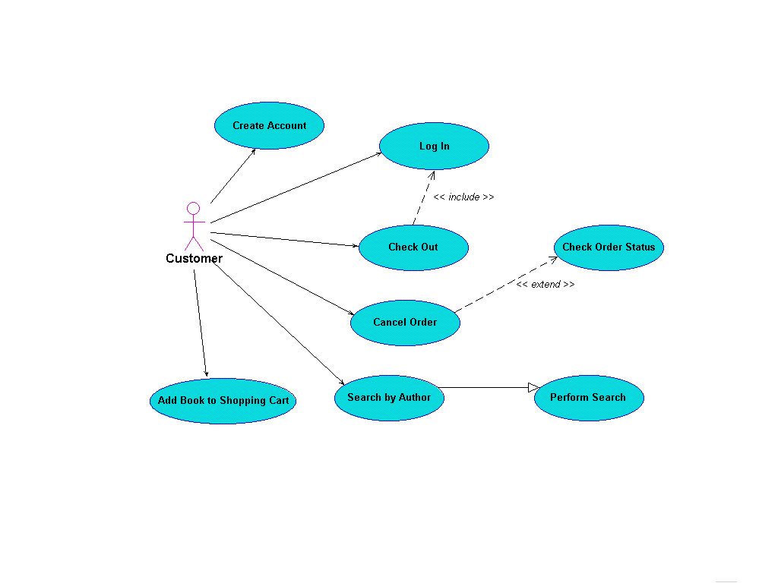

Slide 56
Interaction and Message
An interaction is a behavior that comprises a set of messages, exchanged among a set of objects, to accomplish a specific purpose.
A message is the specification of a communication between objects that conveys information, with the expectation that some kind of activity will ensue.

Slide 57
Sequence Diagram
A sequence diagram is an interaction diagram that emphasizes the time ordering of messages.
A lifeline is a vertical dashed line that represents the lifetime of an object.
A focus of control is a tall, thin rectangle that shows the period of time during which an object is performing an action.

Slide 58
Sequence Diagram Notation
c: Client
: Ticket Agent
«create»
setItinerary(i)
calculateRoute()
route

Slide 59
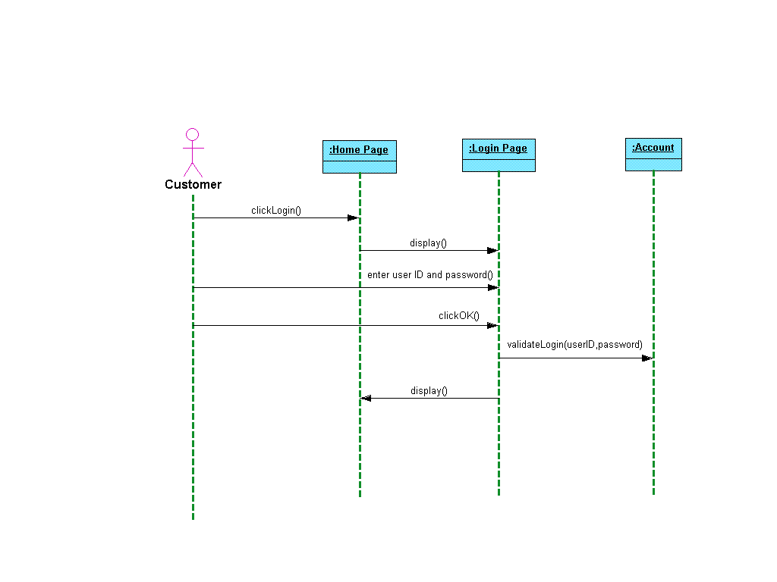

Slide 60
Collaboration Diagram
A collaboration diagram is an interaction diagram that emphasizes the organization of the objects that participate in the interaction.
A path is a link between objects, perhaps with a stereotype such as «local» attached.
Sequence numbers indicate the time ordering of messages, to one or more levels.

Slide 61
Collaboration Diagram Notation
c: Client
1: «create»
2: setActions (a,d,o)
3: «destroy»
«global»
: Transaction
p: ODBCProxy
2.1: setValues(d,3,4)
2.2: setValues(a,“CO”)

Slide 62
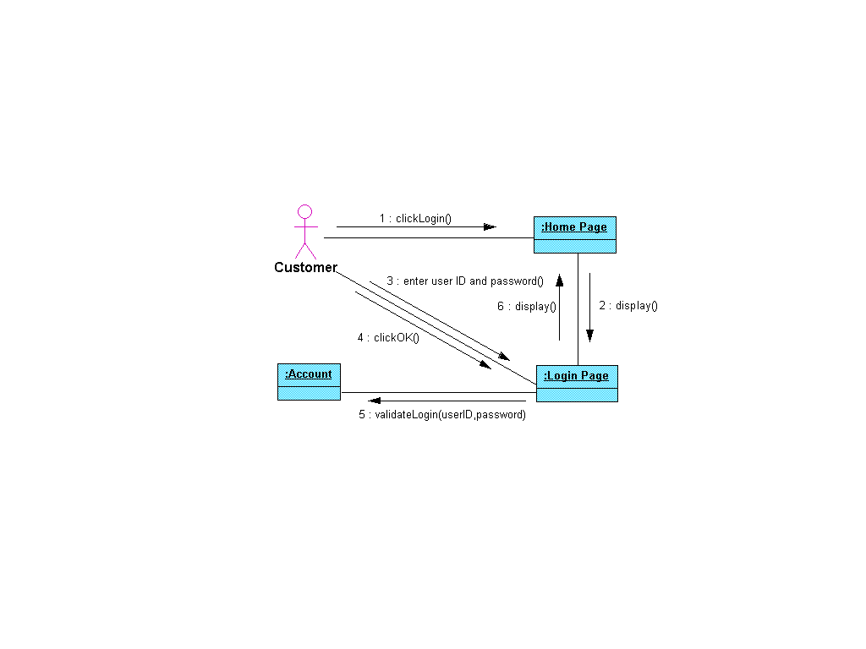

Slide 63
State, Event, and Signal
A state is a condition in which an object can reside during its lifetime while it satisfies some condition, performs an activity, or waits for an event.
An event is a significant occurrence that has a location in time and space.
A signal is an asynchronous communication from one object to another.

Slide 64
State Notation
Idle
Heating
Activating
Active
Cooling

Slide 65
State Machine and Transition
A state machine is a behavior that specifies the sequences of states that an object goes through in its lifetime, in response to events, and also its responses to those events.
A transition is a relationship between two states; it indicates that an object in the first state will perform certain actions, then enter the second state when a given event occurs.

Slide 66
Entry and Exit Actions
An entry action is the first thing that occurs each time an object enters a particular state.
An exit action is the last thing that occurs each time an object leaves a particular state.
Tracking
entry/setMode(onTrack)
exit/setMode(offTrack)

Slide 67
Activities
An activity is an interruptible sequence of actions that an object can perform while it resides in a given state. (Actions are not interruptible.)
Tracking
do/followTarget

Slide 68
Initial and Final States
The initial state is the default starting place for a state machine.
The final state indicates the completion of the state machine’s execution.

Slide 69
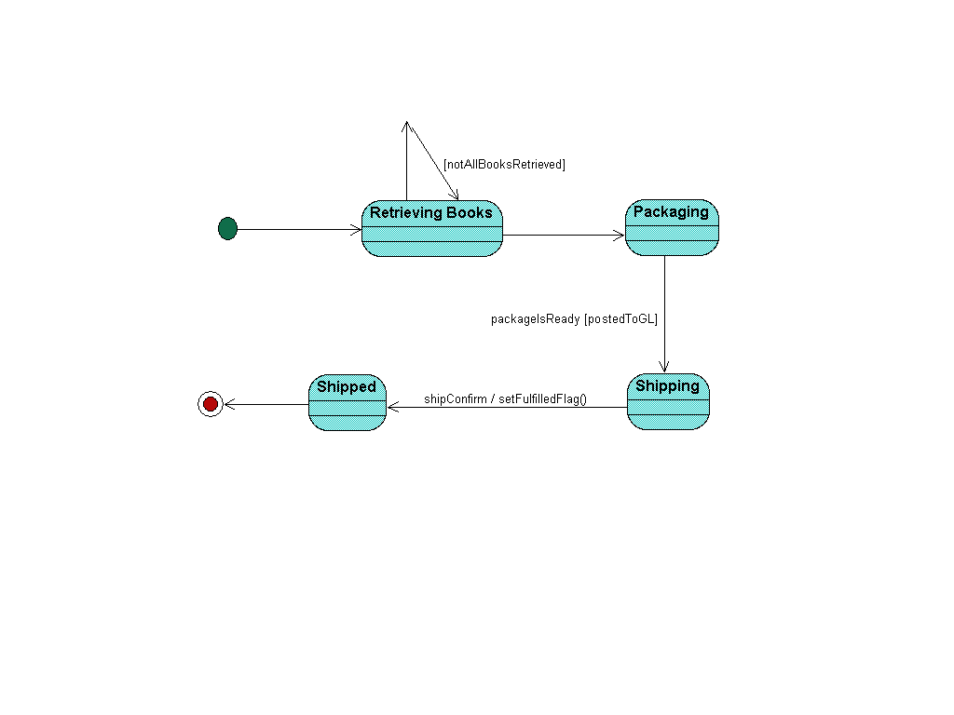

Slide 70
Why Activity Diagrams?
An activity diagram, which resembles a flowchart, is useful for modeling workflows and the details of operations.
While an interaction diagram looks at the objects that pass messages, an activity diagram looks at the operations that are passed among objects.

Slide 71
State Diagram Carryovers
The following items are common to state diagrams and activity diagrams:
activities
actions
transitions
initial/final states
guard conditions
Bid plan
Do construction
entry/setLock()

Slide 72
Breaking Up Flows
alternate paths:
branch
merge
parallel flows:
fork
join

Slide 73
Branching
A branch has one incoming transition and two or more outgoing transitions:
Charge credit
card
[today  7 days before show]
[today < 7 days before show]
Mail tickets
Hold in will-call

Slide 74
Merging
A merge has two or more incoming transitions and one outgoing transition:
Mail tickets
Customer picks
up tickets
Customer
sees show

Slide 75
Forking
A fork represents the splitting of a single flow of control into two or more concurrent flows of control:
Receive order
Log order
Process order

Slide 76
Joining
A join represents the synchronization of two or more flows of control into one sequential flow of control:
Receive product
Bill customer
Pay bill

Slide 77
Swimlanes
Swimlanes partition groups of activities based on, for instance, business organizations:
Customer
Billing
Receive product
Bill customer
Pay bill

Slide 78
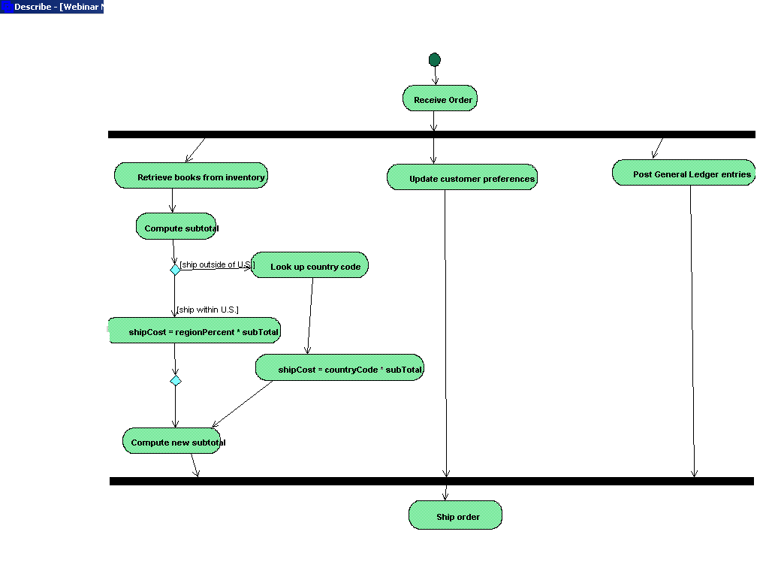

Slide 79
Organizing Collaborations
A collaboration realizes a classifier, such as a class or a use case, or an operation. A collaboration may also “refine” another one:
Place
Order
Order
Management
«refine»
Order
Validation

Slide 80
Analysis Classes
Introduced by Jacobson in his “white” book (Object-Oriented Software Engineering; Addison-Wesley, 1992)
Used in Analysis workflow of Unified Process
Boundary class
Control class
Entity class

Slide 81
Boundary Class
Used to model interactions between system and its actors and clarify and collect requirements on system’s boundaries
Often represent windows, screens, APIs

Slide 82
Control Class
Used to encapsulate control related to specific use case
Represent coordination, sequencing, transactions, and control of other objects

Slide 83
Entity Class
Used to model long-lived (possibly persistent) information
Usually correlates directly to class on class diagram

Slide 84
Robustness Analysis
Used to close gap between “what” (results of use case modeling) and “how” (detailed design)
See Chapter 4 of Use Case Driven Object Modeling with UML (Rosenberg/Scott)

Slide 85
