Slide 1
Group 5
Secondary storage systems
Jiajin Lei
Yimeei Lin
Chang Wei Lin
Kuangyi Miao
Mahesh Krishnan.

Slide 2
Objectives.
Disk structure
Hard disk partitions
Boot sector
Disk size and capacity
Read/write operation to disk sectors

Slide 3
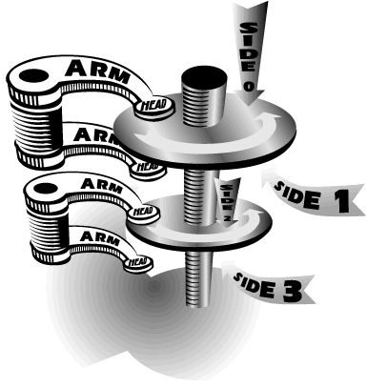
Hard disk Structure
Primary components of the disk.
Platter
made of finely polished glass, ceramic composites or aluminum, coated on both sides with a thin metal alloy.
attached to a central spindle, and a direct drive DC motor spinning at a speed of around 3600-7200 RPM.

Slide 4
Hard disk Structure
Primary components of the disk.
Read/Write heads
attached to the head stack assembly
responsible for reading and writing data on the platters.

Slide 5
Hard disk Structure
Primary components of the disk.
Actuator
Motor that moves the head stack assembly between the center and outer edge of the platters.
Drive controller
operates the hard disk
interprets bus commands from the computer
sends signals to move the disk stack assembly
reading and writing data etc.

Slide 6
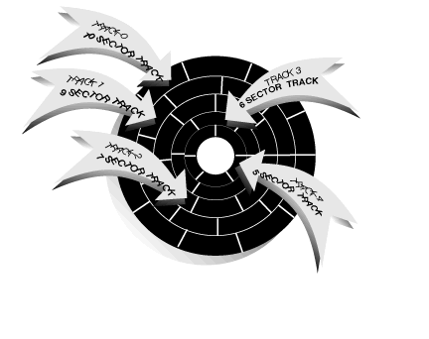
Hard disk Structure
Organizing Data on the disk.
The hard disk platter is organized into sectors and tracks by physically formatting it.
Tracks
Narrow concentric circles on the platter.
Read/Write heads move between the outermost track to the innermost track near the center of platter.
track 0 is the outermost track, track 1 the adjacent track towards the center and so on.

Slide 7
Hard disk Structure
Organizing Data on the disk.
Sectors
Chunks used by hard disks to store data.
Sectors contain 512 bytes of data.
Cylinders
Pairs of tracks on opposite side of the disk platter are called a cylinder.

Slide 8
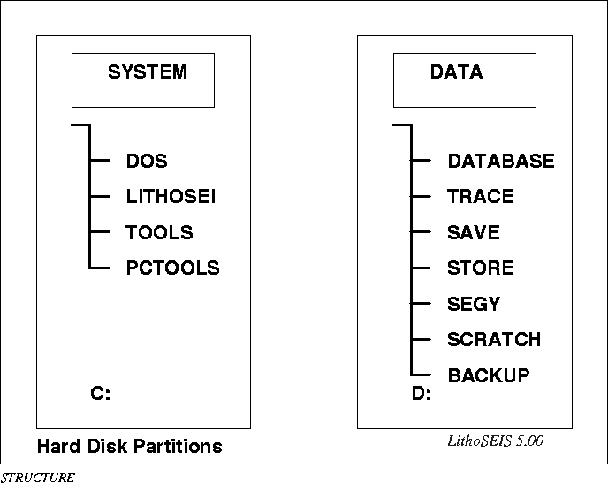
Hard disk Partitions

Slide 9
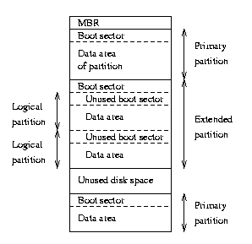
Hard disk Partitions
The MBR, boot sectors and partition table
Extended and logical partitions

Slide 10
The Boot sector on the hard disk
The Master Boot Record (MBR) loads the OS into the main memory.
MBR starts at cylinder 0, head 0, sector 1, i.e. at offset 0000.
MBR messages start at offset 008B.
The partition table starts at offset 01BE.
The signature starts at 01FE.

Slide 11
The Boot process
When a computer is powered on:
The processor to enter a reset state, and clear all memory locations to 0.
Perform a parity check of memory.
Set the CS register to segment address FFFF[0]H and the IP register to 0 ( Therefore the first instruction to execute is at the address formed by CS:IP pair, the is the entry point to BIOS in ROM).
BIOS routine beginning at FFFF0H checks the various ports to identify and initialize devices that are attached to the computer.
BIOS establishes two data areas: 1) An Interrupt Vector; 2) BIOS DATA areas which are largely concerned with the status of attached devices.

Slide 12
The Boot process
BIOS calls int 19 and tries to read a boot sector from the floppy disk. If found, then that boot sector is read into memory at location 0000:7C00.
If no boot sector is found on the floppy, BIOS tries to read the MBR from the first hard drive. If MBR is available, then it is read into memory at location 0000:7C00.
The boot sector contains a program that BIOS breaches to, which leads BIOS to jump to memory at location 0000:7C00.

Slide 13
The Boot process
BIOS begins to execute instructions there which will load the initial system file (for example, IO.SYS) from disk to RAM.
The initial file ( for example, a program called SYSINIT) then loads the rest of the operating system into RAM.
After all operating system files have been loaded, the operating system is given control of the computer and waits for the interrupts input from user. At this point the operating system has been successfully booted.

Slide 14
Important Information about the MBR:
The boot sector occupies exactly one sector on the disk(i.e. 512 bytes).
First entry of an active partition table is 80.
Before int 13 is called DL is loaded with 80.
Hence MBR is read only from device number 80 (drive c:).

Slide 15
Disk size and BIOS translation
BIOS limits size to 1024 cylinders, 256 heads, 63 sectors/track
Translate BIOS using Logical block addressing (LBA).
LBA numbers sectors sequentially
BIOS controls drive using sector number

Slide 16
Disk size and BIOS translation
Each sector is 512 bytes.
disk size of 6.448 MB
total of 12594960 sectors
The BIOS Logical CHS translation gives us
255 heads, 63 sectors per track.
6448619520/(63*255*512) = 784 cylinders

Slide 17
Read/Write operation to the disk
+----------------------------+-----------------------+-----------------------+
|7 6 5 4 3 2 1 0 | 7 6 5 4 3 2 1 0 | 7 6 5 4 3 2 1 0 |
+---------------------------+------------------------+-----------------------+
| H H H H H H H H | C C S S S S S S | C C C C C C C C |
+----------------------------+------------------------+----------------------+
| DH | CL |CH |
+----------------------------+------------------------+----------------------+
C: Cylinder
H:head
S:sector

Slide 18
Read/Write operation to the disk
Begin
es,cs,ds
Check driver
Bad driver
Good driver
Bad
sector
Address error/
Write protected
Format
sector
Write
sector
B
Good
sector
A

Slide 19
Read/Write to hard disk
A
Read
sector
Display
message
B
Exit
End

Slide 20
Read/Write operation to the disk
mov al,01 ; One sector
mov ah,03 ;Write operation
mov ch,0Fh ;Cylinder
mov cl,FFh ;Cyl/sector
mov dh,FEh ;head
mov dl,81h ;drive d.
lea bx, 'message to display : This is for 519 project!'
int 13h
cmp ah,0
jz inwrt

Slide 21
mov ah,40h ; Display
mov bx,01 ;file handle for display to screen
mov cx,37 ; 37 characters.
lea dx, '****Sector not valid, Cannot write***$'
int 21h
inwrt:
ret
writes endp

Slide 22
Conclusion
Understood some hard disk OS operation.
Our code works on Intel CPU only.
Could not test many features provided because of lack of adequate resources.

