Slide 1
THREAD MANAGEMENT
PROJECT BY:

Slide 2
OBJECTIVE
The goal of this project is to develop a thread management class in the Microsoft Windows environment using Microsoft Windows API.
The developed thread management class provides functionality to create a thread, delete the thread, processing threads of execution such as messaging, setting priority among threads, suspending, resuming and so on.
Develop sample program to demonstrate the use of developed thread management class

Slide 3
Definition
Lightweight process (LWP)
Comprises : a thread ID
a program counter
a register set
a stack
Shares with other threads belonging to the same process its code section, data section, and other operating-system resources, such as open files and signals.

Slide 4
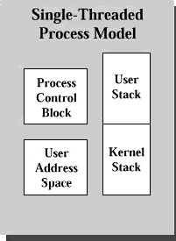
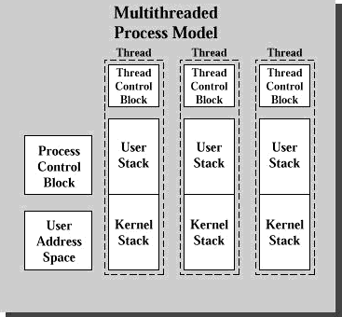
Architecture
-- SingleThread -- MultipleThread

Slide 5
Why Thread Management
Scalability
Safety
Efficiency
More intuitive for implementing concurrency if the application is a collection of execution units.

Slide 6
Examples
Foreground and background work
Asynchronous processing
Speed execution
Transaction processing

Slide 7
Program Design
Root Thread
-- Get Thread Id -- Create Child1 -- Create Child2 -- Suspend for certain time -- GetNo. of Thread
Child 1
-- Get Child1 Id -- Create Grand child -- Send Msg. to Grand Child -- Send Msg. to Child2
Child 2
-- Get Child2 Id -- Set Priority Lowest -- Check Priority -- Get Msg. from Child1 -- Terminate
Grand Child
-- Get GChild Id -- Get Msg. from Child1

Slide 8
Operations Of Thread Mgmt
ThreadCreate( )
ThreadSuspend( )
ThreadSuspend(time)
ThreadResume( )
ThreadTerminate( )
ThreadExit( )
SetPriority( )

Slide 9
Operations cont…
GetPriority( )
GetThreadId( )
GetNoOFThreads( )
SendMessage( )
GetMessage( )

Slide 10
Output
Root: I'm Root thread...
I'm created successfully!
My thread ID is: 1136
Total number of threads we have now (including myself) is: 1
After create my children, I will sleep for a while.
Child 1: In Root's Child thread 1...
I'm created successfully!
My thread ID is: 616
I sent a message to my child.
Grandchild: In Root's Grandchild thread...
I'm created successfully!
My thread ID is: 1856
I got the message from my parent:
My parent ID is: 616
Child 2: In Root's Child thread 2...
I'm created successfully!
My thread ID is: 1868
My priority is: THREAD_PRIORITY_LOWEST
I finished my job, and I have to quit.
I'm the root again, let me check how many threads we have
after I took my rest:
Right now we have: 3
I tested my thread class successfully. See you next time!
Press any key to continue

Slide 11


Problems faced….?

Slide 12
Conclusion
Thread Management is one of the most important component in any software development. We created a simple prototype of thread management class in our project to demonstrate the use of threads.
From this project we learned how to create and manage threads and also we studied various functions that can be used along with the thread functions such as messaging, priority

