Slide 1

ARDUINO BASED RADAR SYSTEM FOR OBJECT DETECTION
PRESENTED BY
SUPERVISED BY
Md.Esamy Azam(200205)
Md.Kornel Ahmed Rahul(200219)
Mst.Sheikh Tafriha Anika(200233)
Session:2019-2020
Department of EEE
Pabna University of Science and Technology
Pabna, Bangladesh
Rosni Sayed
Assistant Professor
Department of Electrical and Electronic Engineering
Pabna University of Science and Technology
Pabna, Bangladesh

Slide 2
CONTENTS
Introduction to Radar System
Rationale
Components and their description
Block Diagram
Circuit Diagram
Working Principle
Graphical Representation of Detecting Objects
Final project
Future work
Applications
References

Slide 3
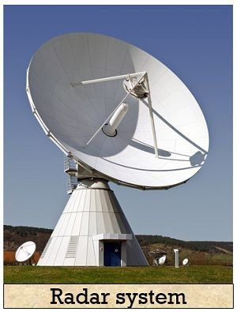
INTRODUCTION TO RADAR SYSTEM
Radar is a long-range object detection system that uses radio waves to establish certain parameters of an object like its range, speed and position
The project is based on Sonar technology as I will
be using an
Ultrasonic Sensor to determine the
presence of any object in a particular range.
Rader is an object detection system. It uses Microwaves to determine the range, altitude, direction, or speed of objects. The radar can transmit radio waves or microwaves which bounce off any object in their path. So, we can easily determine any object in the radar range.

Slide 4
RATIONALE
To develop an ultrasonic RADAR.
To detect the fixed or moving object.
To measure the distance of the object from the system.
To measure the angle of the moving object.
Reducing human time and effor

Slide 5
COMPONENTS
Hardware
  Arduino UNO
  HC-SR04 Ultrasonic Sensor
  Tower Pro SG90 Servo Motor
  Ultrasonic Sensor
  Jumper Cables + USB Cable (for Arduino)
  Breadboard
Software
  Arduino IDE
  Processing Application

Slide 6
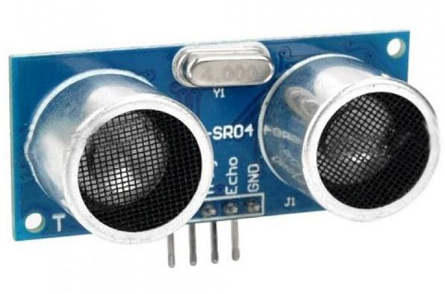
ULTRASONIC SENSOR
  Ultrasonic sensor is mainly used to determine the distance of the target object.
  Transmitter and receiver are two main parts of the sensor where former converts an electrical signal to ultrasonic waves while later converts that ultrasonic signals back to electrical signals.
  Its operating frequency is 4 MHz and its detection range is from 2cm to 400 cm
RATING
Measures the distance within a wide range of 2 cm to 400cm
Stable performance
Accurate distance measurement
High-density
Small blind distance

Slide 7
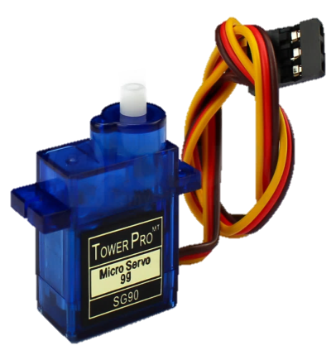
SERVO MOTOR
  Servo motor is a motor which requires +5V to operate and having a torque of 2.5kg/cm. It must be kept in mind that it can only rotate from 0°-180°
RATING
Operating Voltage is +5V typically
Torque: 2.5kg/cm
Operating speed is 0.1s/60°
Gear Type: Plastic
Rotation : 0°-180°
Weight of motor : 9gm
Package includes gear horns and screws

Slide 8
BLOCK DIAGRAM
SERVO MOTOR
ARDUINO
PC
AlTRASONIC
SENSOR
Fig: Block Diagram

Slide 9
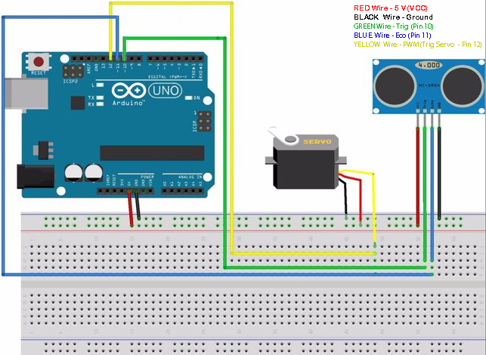
CIRCUIT DIAGRAM
Fig: Circuit Diagram

Slide 10
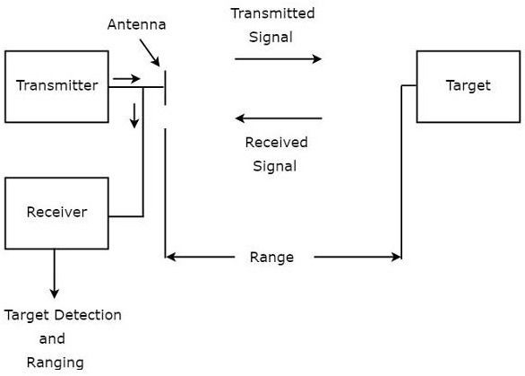
WORKING PRINCIPLE

Slide 11
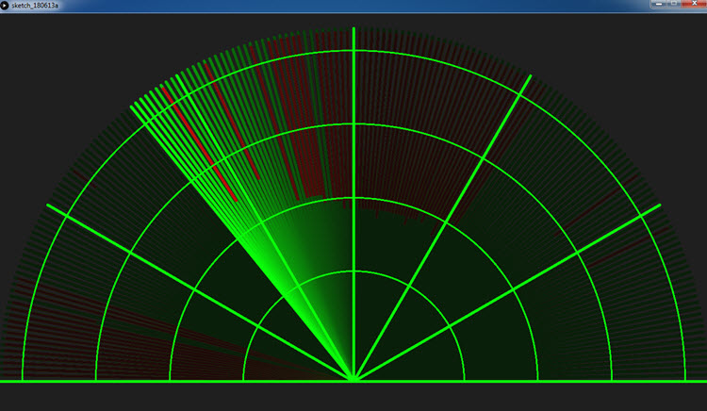
GRAPHICAL REPRESENTATION OF DETECTING OBJECTS

Slide 12
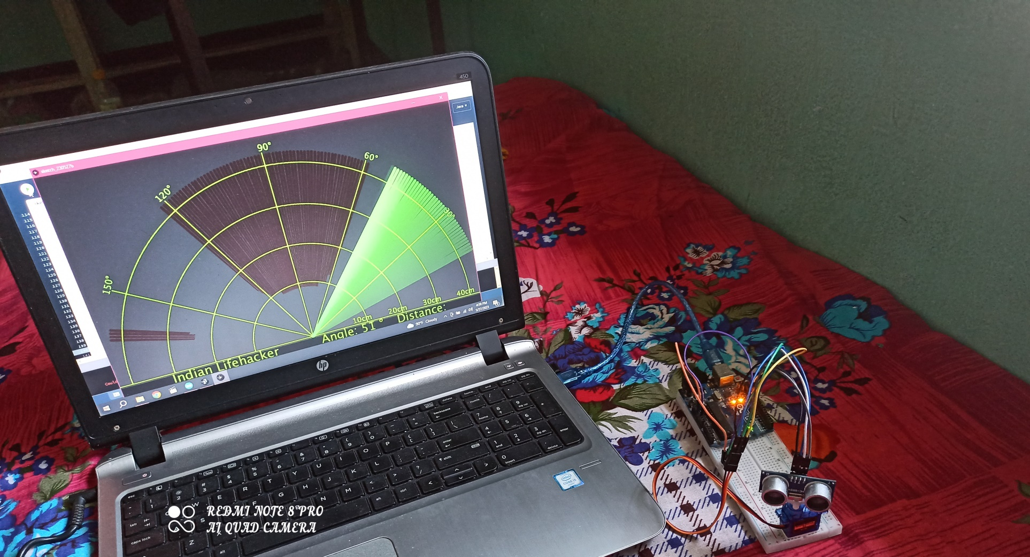
FINAL PROJECT

Slide 13
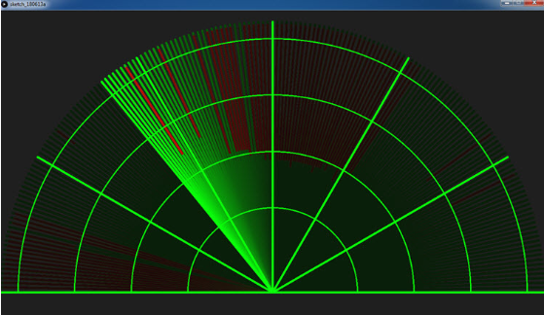
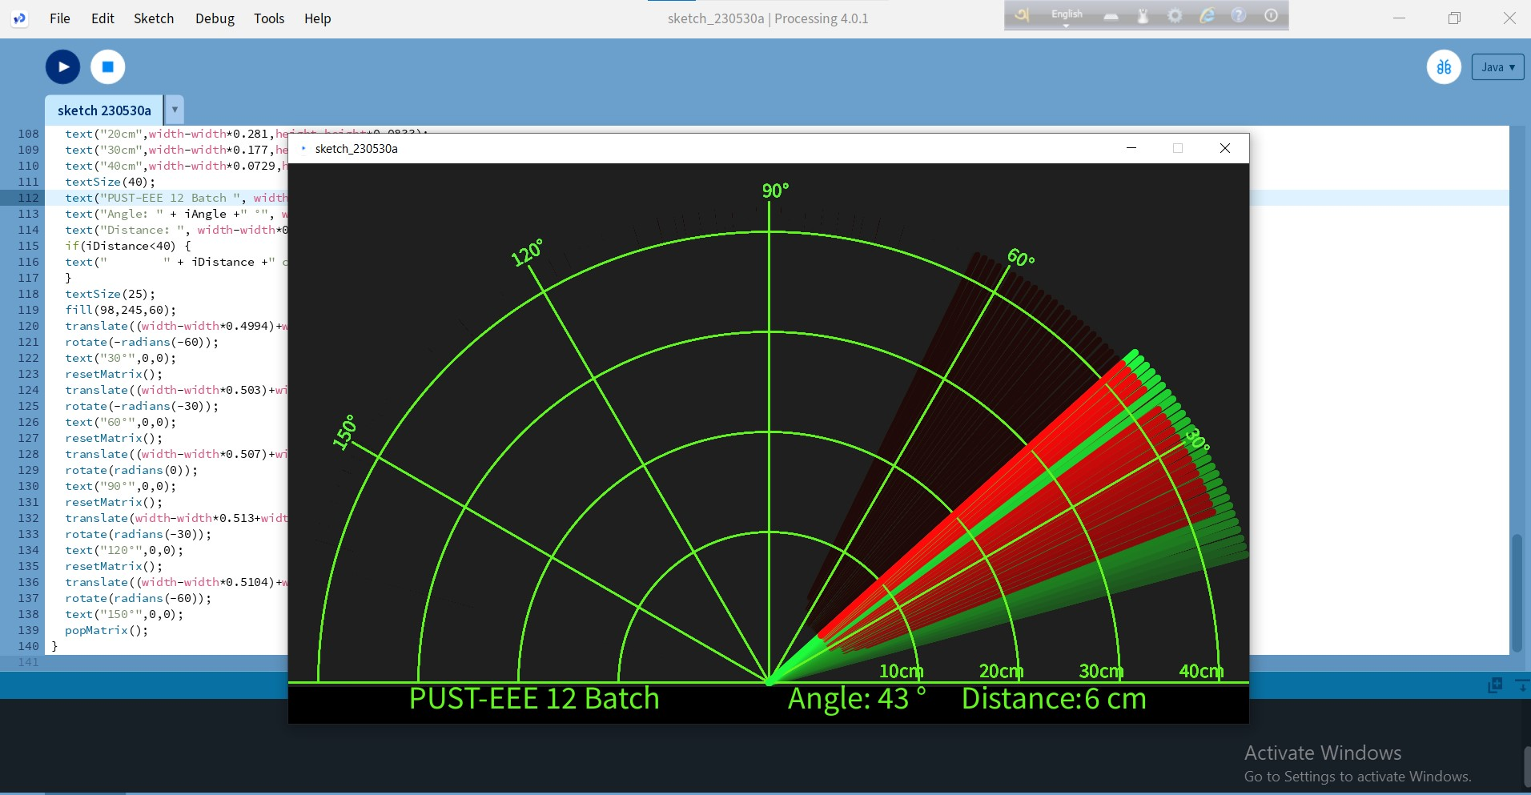
FUTURE WORK
Instead of providing a different voltage source for operating ultrasonic sensor and servo motor, we have used supply from the micro-controller. By this way we reduced the cost of voltage supplies.
Earlier the output screen was like this:
After making some changes in the coding the output screen looks like this:
Now, it will show us the accurate distance as well as angle of the object which is much more accurate as compared to the previous output. This output screen is based on the polar coordinates system.

Slide 14
APPLICATIONS
Radar is an electromagnetic system for the detection and location of target objects such as aircraft, ships, spacecraft, vehicles, people, and the natural environment which can reflect a signal back.
It uses electromagnetic radio waves to determine the angle, range, or velocity of objects.
The modern radar system is more advanced and the uses of radar are highly diverse. Such as Air traffic control, Air-defence system, Radar Astronomy, Antimissile system, Ocean Surveillance system, outer space surveillance and many more.

Slide 15
REFERENCES
[1] https://www.electronicshub.org/arduino-radar-project/
[2] http://www.studentsheart.com/arduino-based-radar-project/
[3] https://howtomechatronics.com/projects/arduino-radar-project/
[4] https://www.3ciencias.com/wp-content/uploads/2019/01/Art_1
[5] Mohanad Mahdi Abdulkareem,Qusay Adil Mohammed ,Muhammad Mahmood Shakir-“A Short Range Radar System“Rangefinder””4.pdf
[6] Srijan Dubey,Supragya Tiwari, Simit Roy -“ IMPLEMENTATION OF RADAR USING ULTRASONIC SENSOR” Indian J.Sci.Res. 2017

Slide 16
THANKS

