Slide 1
WELCOME
TO
PRESENTATION

Slide 2
Project Name
Line Follower Robot
Presented By:
Supervised By:
Naimur Rahaman Tusher (200201)
Md. Humayun Kabir Hasib (200217)
Md. Kornel Ahmed Rahul (200219)
Session : 2019-2020
Department of Electrical and
Electronic Engineering
Pabna University of Science and Technology
T. H. M. Sumon Rashid
Assistant Professor
Department of Electrical and
Electronic Engineering
Pabna University of Science and Technology

Slide 3
Contents
Introduction
Objectives
Components Required
Infrared Sensor(IR Sensor)
Motor Driver(L298N)
Circuit Diagram
Working Principle
Application
Conclusion
Final Project

Slide 4
Introduction
A line follower robot is an autonomous robotic vehicle that is designed to follow a specific path or track, typically a line on the ground or a contrasting surface.
The concept of line following is widely used in robotics competitions, educational projects, and industrial applications.

Slide 5
Objectives
The primary objective of a line follower robot is to accurately track and follow a designated path or line.
Line follower robots are designed to operate autonomously, without human intervention.
To achieve high speed and efficiency, should exhibit precise control and accurate positioning while following the line.

Slide 6
Components Required
Android Uno
Dc Gear Motor
Smart Robot Car Tyres Wheels
Infrared Sensor(IR Sensor)
Motor Driver(L298N)
Battery 7.4V
DC on/off Switch
Jumper Wire
Cardboard

Slide 7
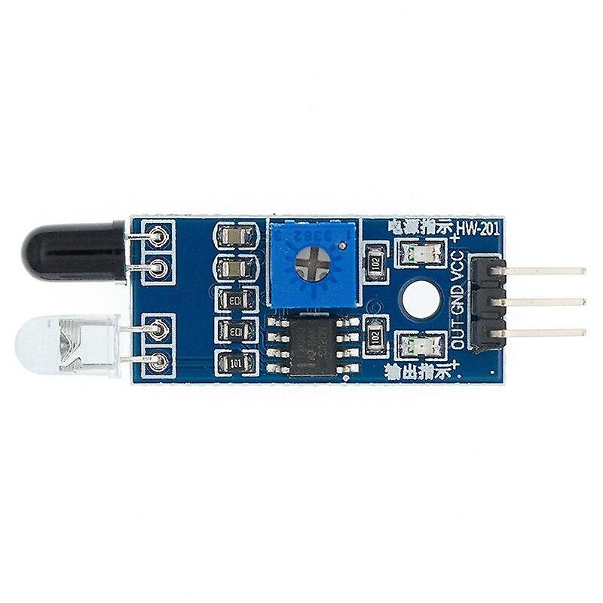
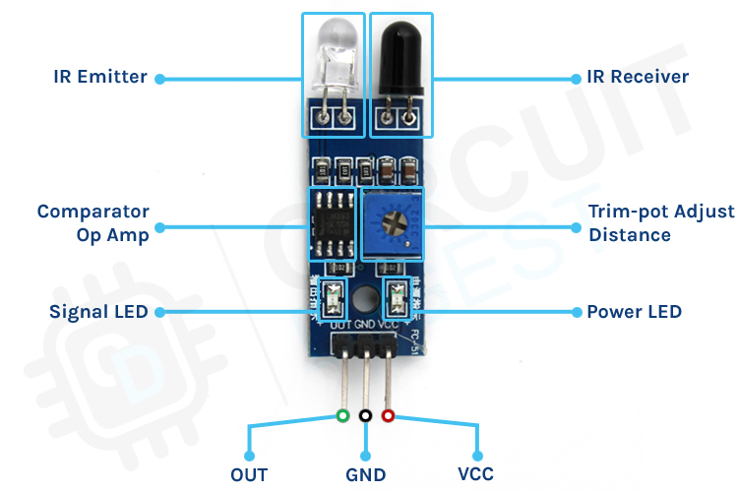
Infrared Sensor(IR Sensor)
An infrared (IR) sensor is a device that
detects and measures infrared radiation in its surrounding environment. IR sensors are commonly used in various applications, including line follower robots, security systems, temperature measurement and motion sensing. IR sensors typically consist of an IR emitter and an IR receiver. In line follower robots, active IR sensors are often used to detect the line on the ground. The emitter emits IR radiation, and the receiver detects the reflected radiation.

Slide 8
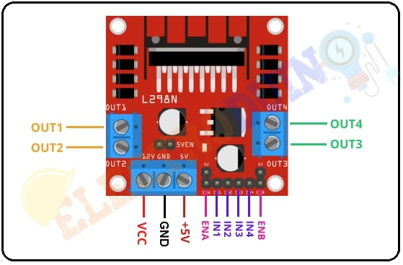
Motor Driver(L298N)
A Motor Drive is a mechanical system that includes an electric motor and drives the machine. Generally, it controls the speed, torque, directions .When we need to control the motor using a controller, we need a motor driver. We provide all motor categories like submersible dc water pump, servo motor, plastic gear motor, stepper motor for Arduino, brushless dc motors etc.

Slide 9
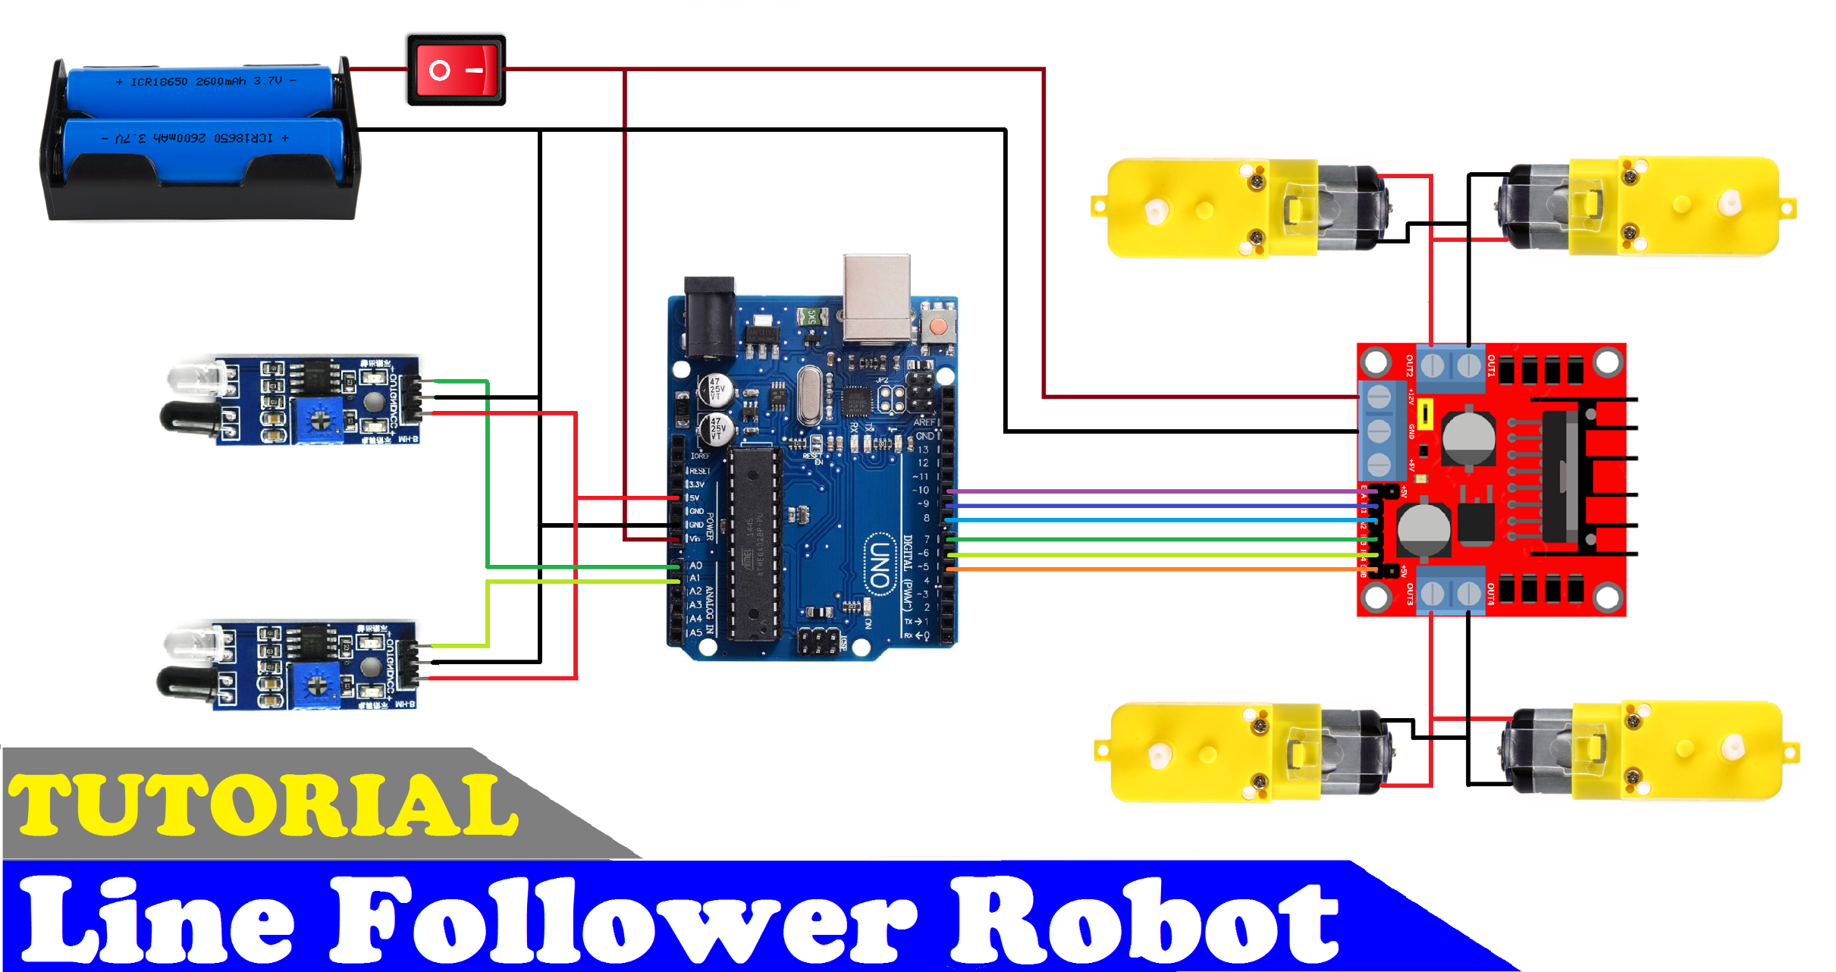

Circuit Diagram

Slide 10
Working Principle
The line follower robot is equipped with one or more sensors, typically infrared or color sensors, positioned close to the ground. These sensors continuously detect the surface beneath the robot and measure the intensity of reflected light or detect the contrast between the line and the surrounding surface.
The sensor readings provide information about the position of the line relative to the robot.
The sensor readings are processed by a microcontroller or a programmable logic controller (PLC) onboard the robot. The microcontroller analyzes the sensor data and makes decisions on how to adjust the robot's movements to stay on the line.
Based on the processed sensor data, the microcontroller sends commands to the motor drivers or actuators of the robot. These commands control the speed and direction of the robot's movement.
If the sensor readings indicate that the robot is deviating from the line, the microcontroller initiates appropriate corrective actions.

Slide 11
Application
Industrial Automation
Warehousing and Logistics
Surveillance and Security
Agriculture
Guided Vehicles
In Restaurant as Food Server
Education, Entertainment and Competitions

Slide 12
Conclusion
Line follower robots exemplify the fusion of mechanics, electronics, and software, showcasing the practicality and potential of robotics in various fields.
It’s ability to follow paths autonomously, line follower robots demonstrate the advancements in sensor technology, control algorithms, and robotic capabilities.
They continue to be a fascinating area of study, innovation, and application in the realm of robotics and automation.

Slide 13
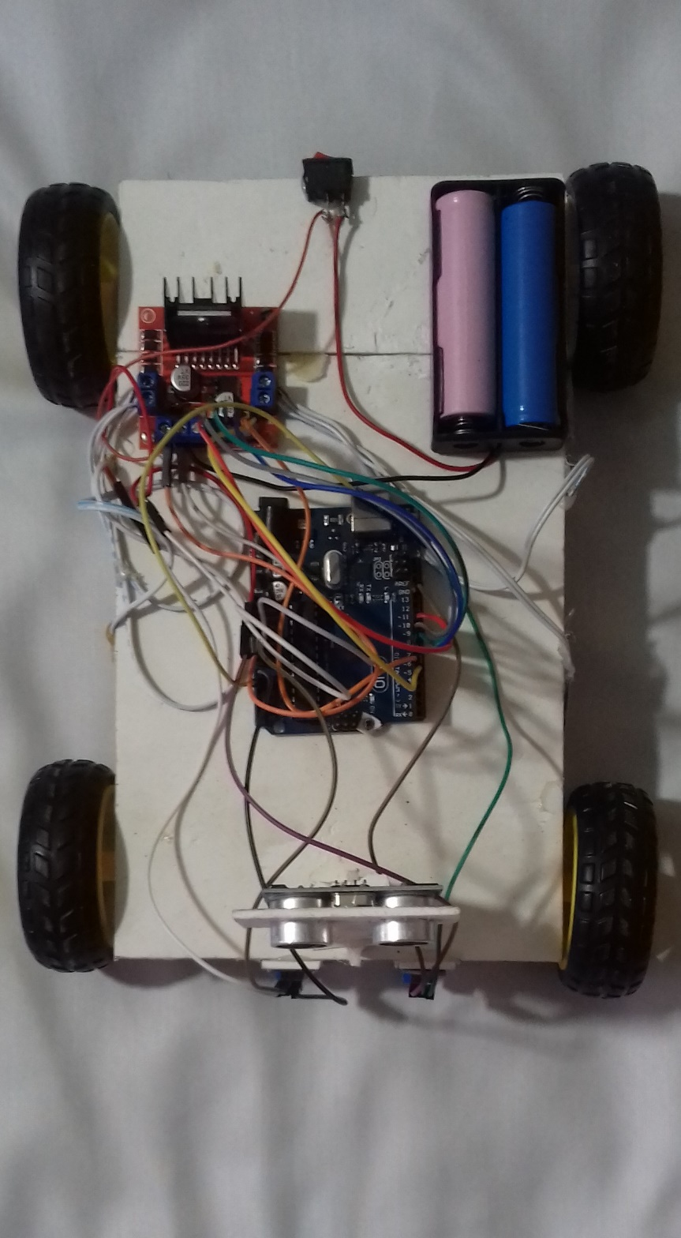
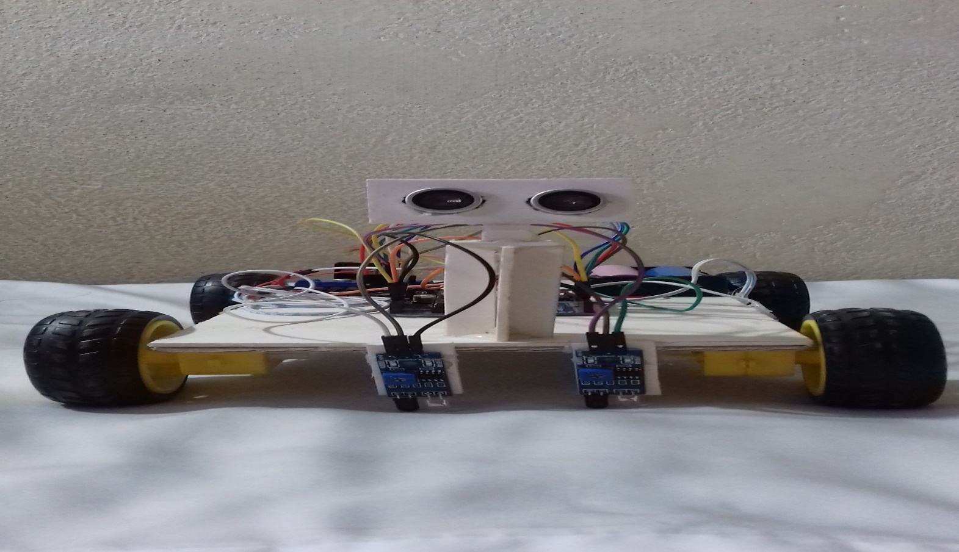
Final Project

Slide 14
Thank You

