Slide 1

Test program generation
for core-level verification of
cache memory
Evgeny Kornikhin
Moscow State University

Slide 2
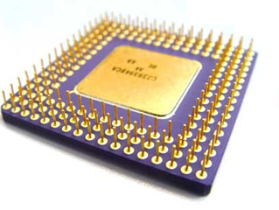
core-level verification
add r1,r2,r3
sub r4, r1, r2
lw r5, r1, 0
lui r2, r1, r4
Y/N
assembly program
( test program )
microprocessor

Slide 3
test program generation
model of microprocessor
coverage of
test situations and
dependencies (r/w, r/r)
R4000
add
lw
add r1,r2,r3 @ overflow
lw r4, r3, c @ hit
...
test templates
args
test situations
(logical form)
mov r2, 0xFF
add r1,r2,r3
lw r4, r3, 0
rd
rs
rt
overflow
regular
test programs
(executable form)

Slide 4
cache-hit
cache model
set №0
tag₀'
value₀'
tag₀''
value₀''
LOAD val, addr
(val := memory[addr])
addr
t = t' or
t = t''
t
s
tag
set
t = t''
set №s
t'
v'
t''
v''

Slide 5
cache-miss
cache model
set №0
tag₀'
value₀'
tag₀''
value₀''
LOAD val, addr
(val := memory[addr])
addr
next
level
t != t' and
t != t''
t
s
tag
set
set №s
t'
v'
t''
v''
evicted

Slide 6
LRU cache-hit(x)
LRU cache-miss(x)
1
2
x
4
1
2
1
2
3
4
4
shift
shift
to head
drop
to head
x
1
2
4
x
1
2
4
x
1
1
2
3

Slide 7
problem
LOAD x, y @ Hit
STORE u, z @ Miss
LOAD z, y @ Hit
initial state of cache
and registers = ?

Slide 8

key idea
test template
add ...
load …
sub …
div …
LOAD x, y @ Hit
constraint
?
?
variable
?
?
?
?
y ∈ {a,b,c}
variable
u ∉ {a,b,c}
cache model
x = z

Slide 9
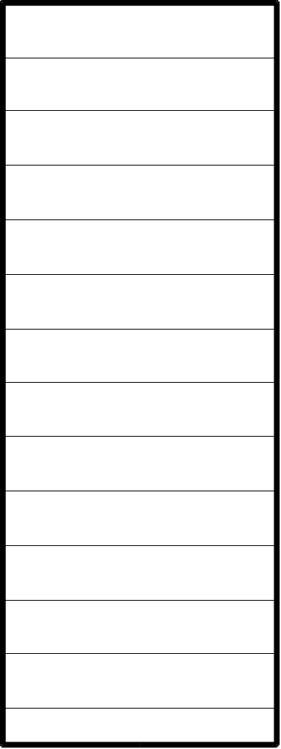

fully associative cache
z
x
z
x
y
...
N
y
{x,y,z,...} - current state
LRU

Slide 10
cache-hit hit(t)
z
t
x
z
x
y
...
N
y
t ∈{x,y,z...}

Slide 11
cache-miss miss(t)
z
t
x
z
x
y
...
N
y
t ∉ {x,y,z...}
new cache {x,y,z...}∪{t}\{?}

Slide 12
cache-miss miss(t→u)
z
t
x
z
x
y
...
N
y
t ∉ {x,y,z...}
u∈{x,y,z...}
new cache {x,y,z...}∪{t}\{u}

Slide 13
lru(u)
hit x1
hit x2
y = x2
miss x3->x4
{x3, x5} = L\{y}
hit x5
miss x6->y

Slide 14
lru(u)
hit x1
hit x2
y = x1
miss x3->x4
{x2, x3, x5}
= L\{y}
hit x5
miss x6->y
there are another cases..

Slide 15
example
α
initial
state:
β
γ
y∈{α,β,γ}
LOAD x, y @ Hit
z∉{α,β,γ}
STORE u, z @ Miss
→z0
z0∈{α,β,γ}
z0=β
{α,β,γ}\{z0}={γ,y}
LOAD z, y @ Hit
N = 3
y∈{α,β,γ,z}\{z0}

Slide 16
example
y = α
z∉{α,β,γ}
y∈{α,β,γ}
z∉{α,β,γ}
y=α=0
z0∈{α,β,γ}
β=1
z0=β
{α,β,γ}\{z0}={γ,y}
γ=2
z=3
y∈{α,β,γ,z}\{z0}

Slide 17

direct mapped cache
x
x
R(x)
y
cache
state:
R(y)
y
{x,y,z}
z
regions
are
different
z
R(z)

Slide 18
cache-hit hit(t)
x
x
R(x)
if R(t)=R(x)
y
if R(t)=R(y)
R(y)
y
t ∈{x,y,z}
z
z
R(z)
if R(t)=R(z)

Slide 19
cache-miss miss(t→u)
x
x
R(x)
t∉{x,y,z}
y
R(y)
y
new cache
{x,y,z,t}\{?}
z
z
R(z)

Slide 20
cache-miss miss(t→u)
x
x
R(x)
u∈{x,y,z}
t∉{x,y,z}
y
R(y)
y
new cache
{x,y,z,t}\{u}
z
z
R(z)
R(t)=R(u)

Slide 21
example
α
initial
state:
β
y∈{α,β,γ}
γ
z∉{α,β,γ}
LOAD x, y @ Hit
z0∈{α,β,γ}
STORE u, z @ Miss
→z0
R(z0) = R(z)
LOAD z, y @ Hit
y∈{α,β,γ,z}\{z0}

Slide 22
example
y=α
z∉{α,β,γ}
y∈{α,β,γ}
R(z)=R(β)
z∉{α,β,γ}
z0∈{α,β,γ}
y=α=0
R(z0) = R(z)
β=1
γ=2
y∈{α,β,γ,z}\{z0}
z=4

Slide 23
common cache
x
x
R(x)
y
R(y)
y
z
z
R(z)

Slide 24
Common case
hit(x) ==> x ∈ L
miss(x→y) ==>
y ∈ L, x ∉ L,
L∪{x}\{y} — new cache,
R(x) = R(y), lru(y)

Slide 25
lru(u)
hit x1
hit x2
y = x2
miss x3->x4
{x3, x5}∩R(y)
= (L\{y})∩R(y)
hit x5
miss x6->y

Slide 26
example
x1,x2 ∈ {a1,a2,b1,b2,c1,c2}
x3 ∉ {a1,a2,b1,b2,c1,c2}
R(x3) = R(y3)
x4 ∈ {a1,...,c2,x3}\{y3}
x5 ∉ {a1,...,c2,x3}\{y3}
y3 = c2
{y3} = ({a1,...,c2}\{x1,x2, y3})∩R(y3)
y5 = x2
{y5} = ({a1...c2,x3}\{y3,y5, x3,x4})∩R(y5)

Slide 27
solver
x ∈ {a,b,c}
(assert (or (= x a)
(= x b)(= x c)))
y ∉ {a,b,c}
(assert (and (/= y a)
(/= y b)(/= y c)))
x = z
(check)
SMT
SAT modulo theories
Yices

Slide 28
contacts
http://tesla-project.googlecode.com
http://hardware.ispras.ru
kornevgen@gmail.com

