Slide 1
SMT-based Test Program Generation for Cache Memory
Evgeny Kornikhin
Moscow State University

Slide 2
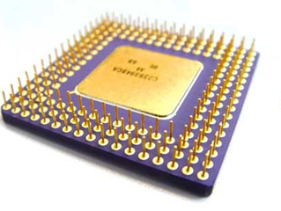
Testing by Test Programs
add r1,r2,r3
sub r4, r1, r2
lw r5, r1, 0
lui r2, r1, r4
Y/N
assembler program
( test program )
microprocessor

Slide 3
Test Programs Generation
model of microprocessor
coverage of
test situations and
dependencies (RAW, RAR)
R4000
add
lw
...
add r1,r2,r3 @ overflow
lw r4, r3, c @ hit
args
test situations
test templates
(abstract form)
rd
rs
rt
overflow
regular
mov r2, 0xFF
add r1,r2,r3
lw r4, r3, 0
test programs
(executable form)
Notes:
Тестовые программы строятся на основе модели микропроцессора. The next I consider some technical features about cache.

Slide 4
Cache model
cache model
set №0
tag₀'
value₀'
tag₀''
value₀''
set №s
t'
v'
t''
v''

Slide 5
LOAD behavior with Cache-hit
cache model
set №0
tag₀'
value₀'
tag₀''
value₀''
LOAD val, addr
(val := memory[addr])
addr
t = t' or
t = t''
t
s
tag
set
t = t''
set №s
t'
v'
t''
v''

Slide 6
LOAD behavior with Cache-miss
cache model
set №0
tag₀'
value₀'
tag₀''
value₀''
LOAD val, addr
(val := memory[addr])
addr
next
level
t != t' and
t != t''
t
s
tag
set
set №s
t'
v'
t''
v''
evicted
(lru)

Slide 7
Problem again
?
initial state of cache and y and z
LOAD x, y @ hit
STORE u, z @ miss
LOAD z, y @ hit
cache-hit with “y”
cache-miss with “z”
cache-hit with “y”
initial state of cache
and registers = ?
Notes:
Mathematical model is a system of equations on addresses and cache tags.

Slide 8
Huge exhaustive search
LOAD x, y @ hit
STORE u, z @ miss
LOAD z, y @ hit
select values
run template
x
0 .. 2⁶⁴-1
0 .. 2⁶⁴-1
0 .. 2⁶⁴-1
y
0 .. 2⁶⁴-1
0 .. 2⁶⁴-1
0 .. 2⁶⁴-1
z
0 .. 2⁶⁴-1
0 .. 2⁶⁴-1
0 .. 2⁶⁴-1
u
0 .. 2⁶⁴-1
0 .. 2⁶⁴-1
0 .. 2⁶⁴-1
initial registers’
values
initial cache state

Slide 9
Hard behavior constraints
LOAD x, y @ hit
(cache-hit with “y”)
index(L,y) > 0
L’ == inc_counter(L,y)
index(L’,z) == 0
counter(L’,z0) → min
L’’ == remove(L’,z0)
L’’’ == add(L’’,z)
STORE u,z @ miss→z0
(cache-miss with “z”)
LOAD z, y @ hit
(cache-hit with “y”)
index(L’’’,y) > 0
x, y, z, u, L = ?

Slide 10

Key Idea
test template
add ...
load …
sub …
div …
LOAD x, y @ hit
constraint
?
?
variable
?
?
?
?
y ∈ {a,b,c}
variable
u ∉ {a,b,c}
cache model
x = z

Slide 11
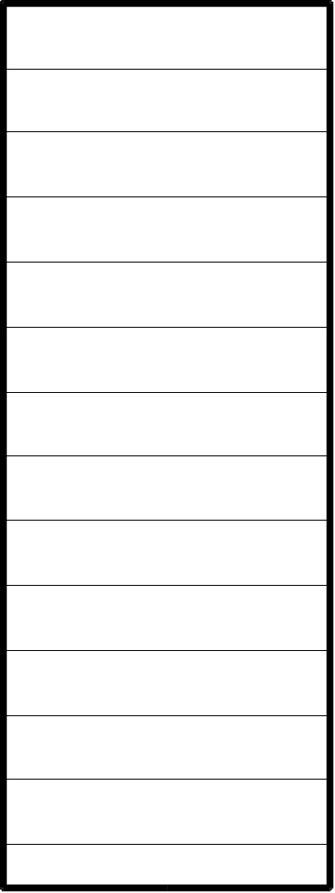

Fully Associative Cache
z
x
z
x
y
...
N
y
{x,y,z,...} - current state

Slide 12
Cache-hit hit(t)
z
t
x
z
x
y
...
N
y
t ∈{x,y,z...}

Slide 13
Cache-miss miss(t)
z
t
x
z
x
y
...
N
y
t ∉ {x,y,z...}
new cache {x,y,z...}∪{t}\{?}

Slide 14
Cache-miss miss(t)→u
z
t
x
z
x
y
...
N
y
t ∉ {x,y,z...}
u ∈ {x,y,z...}
new cache {x,y,z...}∪{t}\{u}

Slide 15
lru(u)
hit x1
hit x2
u = x2
miss x3→x4
{x3, x5} = L\{u}
hit x5
miss t→u

Slide 16
lru(u)
hit x1
hit x2
u = x1
miss x3→x4
{x2, x3, x5} = L\{u}
hit x5
miss t→u
there are another cases..

Slide 17
Example
α
initial
state:
β
y∈{α,β,γ}
γ
LOAD x, y @ hit
z∉{α,β,γ}
STORE u, z @ miss
→z0
z0∈{α,β,γ}
z0=β
{α,β,γ}\{z0}={γ,y}
LOAD z, y @ hit
y∈{α,β,γ,z}\{z0}
N = 3

Slide 18
Example
y = α
z∉{α,β,γ}
y∈{α,β,γ}
z∉{α,β,γ}
y=α=0
z0∈{α,β,γ}
β=1
z0=β
{α,β,γ}\{z0}={γ,y}
γ=2
y∈{α,β,γ,z}\{z0}
z=3

Slide 19
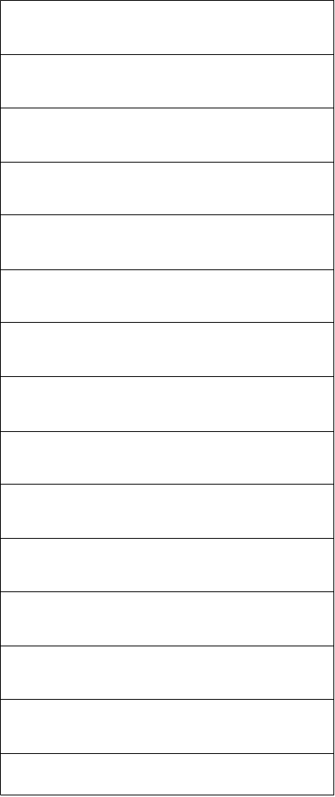
Common Cache
x
x
R(x)
y
R(y)
y
z
z
R(z)

Slide 20
Common Cache
hit(t)
t ∈ L
miss(t)→u
u ∈ L
t ∉ L
L∪{t}\{u} is the next cache
R(t) = R(u)
lru(u)

Slide 21
lru(u)
hit x1
hit x2
u = x2
miss x3→x4
{x3, x5}∩R(u)
= (L\{y})∩R(u)
hit x5
miss t→u

Slide 22
Example
x1,x2 ∈ {a1,a2,b1,b2,c1,c2}
x3 ∉ {a1,a2,b1,b2,c1,c2}
R(x3) = R(y3)
x4 ∈ {a1,...,c2,x3}\{y3}
x5 ∉ {a1,...,c2,x3}\{y3}
y3 = c2
{y3} = ({a1,...,c2}\{x1,x2, y3})∩R(y3)
y5 = x2
{y5} = ({a1...c2,x3}\{y3,y5, x3,x4})∩R(y5)

Slide 23
Solver
x ∈ {a,b,c}
(assert (or (= x a)
(= x b)(= x c)))
y ∉ {a,b,c}
(assert (and (/= y a)
(/= y b)(/= y c)))
x = z
(check)
SMT
SAT modulo theories
Yices

Slide 24
Conclusions

Slide 25
Contacts
http://tesla-project.googlecode.com
http://hardware.ispras.ru
kornevgen@gmail.com

Slide 26
Thank you for attention!

