Slide 1
Test data generation for arithmetic subsystem of CPUs MIPS64
Evgeni Kornikhin
MSU

Slide 2

test
data
…
lui t1, ??
lui t2, ??
add t1, t2, t3
…
…
lui t1, 0x1
lui t2, 0x0
add t1, t2, t3
…
compile
load
execute
test
template
test
program
cpu

Slide 3
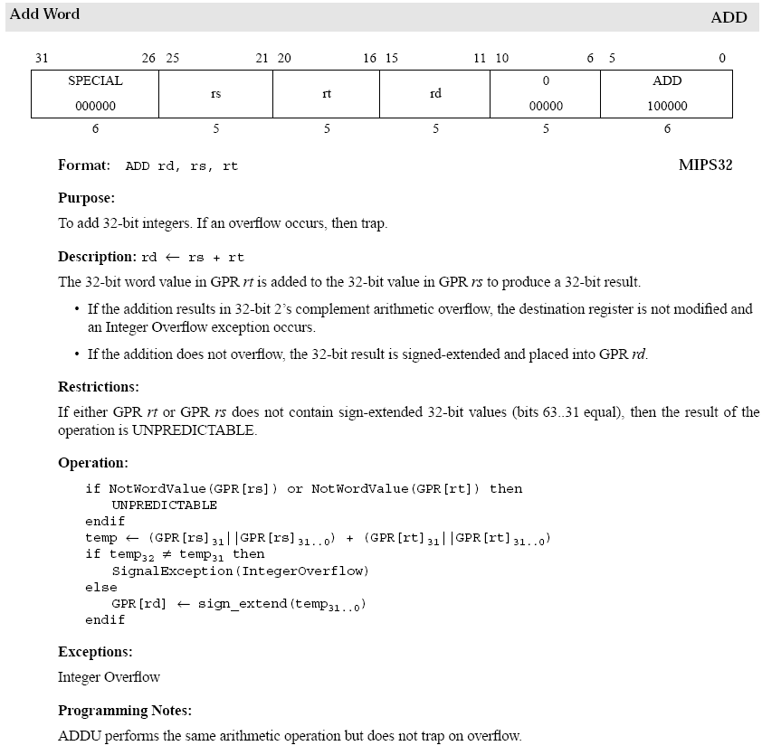
Branches
Functional
specification
Precondition
Pseudocode

Slide 4
add 0x01, 0x02, rd
-- test case
test situations
overflow
regular
…
add 0x8000, 0x8000, rd
add ??, ??, a
sub ??, ??, b
add ??, ??, c
…
add 0x0, 0x0, rd
test
template
test cases space

Slide 5
lui rt, 0x8000
ori rt, rt, 0x0
lui rs, 0x8000
ori rs, rs, 0x0
add rt, rs, rd
ADD: IntegerOverflow
The 32-bit word value in rt is added to the 32-bit value in rs to produce a 32-bit result.
If the addition results in 32-bit 2’s complement arithmetic overflow, the destination register is not modified and
an Integer Overflow exception occurs.
lui rt, 0x8012
ori rt, rt, 0x102
lui rs, 0x8005
ori rs, rs, 0x220
add rt, rs, rd
. . .
ASSERT WordValue(rs) AND WordValue(rt);
temp := rt[31].rt + rs[31].rt;
SITUATION IntOverflow IS temp[32] # temp[31].

