Slide 1
SMT-based Test Program Generation for Cache Memory
Evgeny Kornikhin
Moscow State University

Slide 2
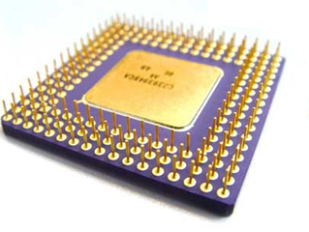
Testing by Test Programs
add r1,r2,r3
sub r4, r1, r2
lw r5, r1, 0
lui r2, r1, r4
Y/N
assembler program
( test program )
microprocessor

Slide 3
Test Programs Generation
model of microprocessor
coverage of
test situations and
dependencies (RAW, RAR)
R4000
add
lw
...
add r1,r2,r3 @ overflow
lw r4, r3, c @ hit
args
test situations
test templates
(abstract form)
rd
rs
rt
overflow
regular
mov r2, 0xFF
add r1,r2,r3
lw r4, r3, 0
test programs
(executable form)
Notes:
Тестовые программы строятся на основе модели микропроцессора. The next I consider some technical features about cache.

Slide 4
Cache memory behavior
addr is presented
cache
memory
addr
LOAD val, addr
val
cache hit situation
addr is absent
cache
memory
addr
addr
to the next
level of cache
or memory
LOAD val, addr
val
cache miss situation

Slide 5
Problem again
?
initial state of cache and y and z
LOAD x, y @ hit
STORE u, z @ miss
LOAD z, y @ hit
cache-hit with “y”
cache-miss with “z”
cache-hit with “y”
initial state of cache
(addresses of cached data)
and registers = ?
Notes:
Mathematical model is a system of equations on addresses and cache tags.

Slide 6
Huge exhaustive search
LOAD x, y @ hit
STORE u, z @ miss
LOAD z, y @ hit
select values
run template
x
0 .. 2⁶⁴-1
0 .. 2⁶⁴-1
0 .. 2⁶⁴-1
y
0 .. 2⁶⁴-1
0 .. 2⁶⁴-1
0 .. 2⁶⁴-1
z
0 .. 2⁶⁴-1
0 .. 2⁶⁴-1
0 .. 2⁶⁴-1
u
0 .. 2⁶⁴-1
0 .. 2⁶⁴-1
0 .. 2⁶⁴-1
initial registers’
values
initial cache state

Slide 7
Hard behavior constraints
LOAD x, y @ hit
(cache-hit with “y”)
index(L,y) > 0
L’ == inc_counter(L,y)
index(L’,z) == 0
counter(L’,z0) → min
L’’ == remove(L’,z0)
L’’’ == add(L’’,z)
STORE u,z @ miss→z0
(cache-miss with “z”)
LOAD z, y @ hit
(cache-hit with “y”)
index(L’’’,y) > 0
x, y, z, u, L = ?

Slide 8

Key Idea
test template
add ...
load …
sub …
div …
LOAD x, y @ hit
constraint
?
?
variable
?
?
?
?
y ∈ {a,b,c}
variable
u ∉ {a,b,c}
cache model
x = z

Slide 9
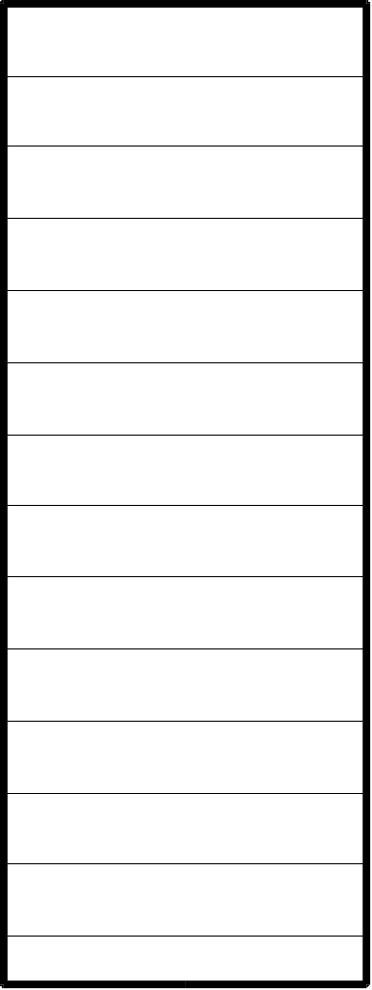

Fully Associative Cache
z
x
z
x
y
...
N
y
{x,y,z,...} - current state

Slide 10
Cache-hit hit(t)
z
t
x
z
x
y
...
N
y
t ∈{x,y,z...}

Slide 11
Cache-miss miss(t)
z
t
x
z
x
y
...
N
y
t ∉ {x,y,z...}
new cache {x,y,z...}∪{t}\{?}

Slide 12
Cache-miss miss(t)→u
z
t
x
z
x
y
...
N
y
t ∉ {x,y,z...}
u ∈ {x,y,z...}
lru(u)
new cache {x,y,z...}∪{t}\{u}

Slide 13
lru(u)
hit x1
hit x2
u = x2
miss x3→x4
{x3, x5} = L\{u}
hit x5
miss t→u

Slide 14
lru(u)
hit x1
hit x2
u = x1
miss x3→x4
{x2, x3, x5} = L\{u}
hit x5
miss t→u
there are another cases..

Slide 15
Example
α
initial
state:
β
y∈{α,β,γ}
γ
LOAD x, y @ hit
z∉{α,β,γ}
STORE u, z @ miss
→z0
z0∈{α,β,γ}
z0=β
{α,β,γ}\{z0}={γ,y}
LOAD z, y @ hit
y∈{α,β,γ,z}\{z0}
N = 3

Slide 16
Example
y = α
z∉{α,β,γ}
y∈{α,β,γ}
z∉{α,β,γ}
y=α=0
z0∈{α,β,γ}
β=1
z0=β
{α,β,γ}\{z0}={γ,y}
γ=2
y∈{α,β,γ,z}\{z0}
z=3

Slide 17
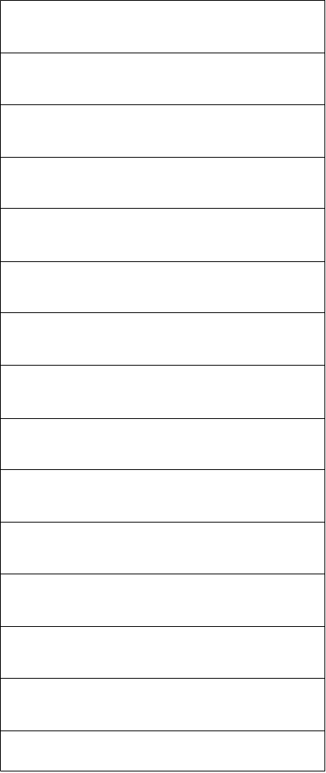
Common Cache
x
x
R(x)
y
R(y)
y
z
z
R(z)

Slide 18
Common Cache
hit(t)
t ∈ L
miss(t)→u
u ∈ L
t ∉ L
L∪{t}\{u} is the next cache
R(t) = R(u)
lru(u)

Slide 19
lru(u)
hit x1
hit x2
u = x2
miss x3→x4
{x3, x5}∩R(u)
= (L\{y})∩R(u)
hit x5
miss t→u

Slide 20
Example
x1,x2 ∈ {a1,a2,b1,b2,c1,c2}
x3 ∉ {a1,a2,b1,b2,c1,c2}
R(x3) = R(y3)
x4 ∈ {a1,...,c2,x3}\{y3}
x5 ∉ {a1,...,c2,x3}\{y3}
y3 = c2
{y3} = ({a1,...,c2}\{x1,x2, y3})∩R(y3)
y5 = x2
{y5} = ({a1...c2,x3}\{y3,y5, x3,x4})∩R(y5)

Slide 21
Solver
x ∈ {a,b,c}
(assert (or (= x a)
(= x b)(= x c)))
y ∉ {a,b,c}
(assert (and (/= y a)
(/= y b)(/= y c)))
x = z
(check)
SMT
SAT modulo theories
Yices

Slide 22
Conclusions
Cache behavior can be expressed using equations on addresses’ set
Equations can be solved by SMT-solver

Slide 23
Contacts
http://tesla-project.googlecode.com
http://hardware.ispras.ru
kornevgen@gmail.com

Slide 24
Thank you for attention!

