Slide 1
SMT-based Test Program Generation for Cache Memory
Evgeny Kornikhin
Moscow State University

Slide 2
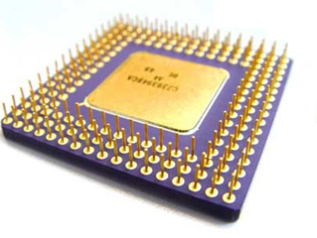
Testing by Test Programs
add r1,r2,r3
sub r4, r1, r2
lw r5, r1, 0
lui r2, r1, r4
Y/N
assembler program
( test program )
microprocessor

Slide 3
Test Programs Generation
model of microprocessor
coverage of
test situations and
dependencies (RAW, RAR)
R4000
add
lw
...
add r1,r2,r3 @ overflow
lw r4, r3, c @ hit
args
test situations
test templates
(abstract form)
rd
rs
rt
overflow
regular
mov r2, 0xFF
add r1,r2,r3
lw r4, r3, 0
test programs
(executable form)

Slide 4
Cache memory behavior
addr is presented
cache
memory
addr
LOAD val, addr
val
cache hit situation
addr is absent
cache
memory
addr
addr
to the next
level of cache
or memory
LOAD val, addr
val
lru data
addr
cache miss situation

Slide 5
Problem again
?
initial state of cache and y and z
LOAD x, y @ hit
STORE u, z @ miss
LOAD z, y @ hit
cache-hit with “y”
cache-miss with “z”
cache-hit with “y”
initial state of cache
(addresses of cached data)
and registers = ?

Slide 6
Huge exhaustive search
LOAD x, y @ hit
STORE u, z @ miss
LOAD z, y @ hit
select values
run template
x
0 .. 2⁶⁴-1
0 .. 2⁶⁴-1
0 .. 2⁶⁴-1
y
0 .. 2⁶⁴-1
0 .. 2⁶⁴-1
0 .. 2⁶⁴-1
z
0 .. 2⁶⁴-1
0 .. 2⁶⁴-1
0 .. 2⁶⁴-1
u
0 .. 2⁶⁴-1
0 .. 2⁶⁴-1
0 .. 2⁶⁴-1
initial registers’
values
initial cache state

Slide 7
Hard behavior constraints
x,y,z,u, L such as :
LOAD x, y @ hit
(cache-hit with “y”)
index(L,y) > 0
L’ == inc_counter(L,y)
index(L’,z) == 0
∃ z0:counter(L’,z0)→min
L’’ == remove(L’,z0)
L’’’ == add(L’’,z)
STORE u,z @ miss→z0
(cache-miss with “z”)
LOAD z, y @ hit
(cache-hit with “y”)
index(L’’’,y) > 0
x,y,z,u, L = ?

Slide 8

Key Idea
test template
add ...
load …
sub …
div …
LOAD x, y @ hit
constraint
?
?
variable
?
?
?
?
y ∈ {a,b,c}
variable
u ∉ {a,b,c}
cache model
x = z

Slide 9
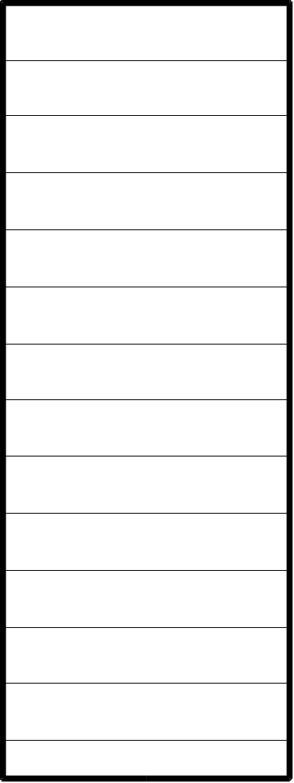

Fully Associative Cache
z
x
z
x
y
...
N
y
{x,y,z,...} - current state

Slide 10
Fully Associative Cache
hit(t)
t
t ∈{x,y,z...}
z
x
y
...
miss(t)→u
t ∉ {x,y,z...}
t
z
x
y
u ∈ {x,y,z...}
lru(u)
...
new cache {t,x,y,z...}\{u}
u

Slide 11
lru(u)
hit x1
hit x2
u = x2
miss x3→x4
{x3, x5} = L\{u}
hit x5
L
miss t→u

Slide 12
lru(u)
hit x1
hit x2
u = x1
miss x3→x4
{x2, x3, x5} = L\{u}
hit x5
L
miss t→u
there are another cases..

Slide 13
Example
α
initial
state:
β
y∈{α,β,γ}
γ
LOAD x, y @ hit
z∉{α,β,γ}
STORE u, z @ miss
→z0
z0∈{α,β,γ}
z0=β
{α,β,γ}\{z0}={γ,y}
LOAD z, y @ hit
y∈{α,β,γ,z}\{z0}
N = 3

Slide 14
Example
y = α
z∉{α,β,γ}
y∈{α,β,γ}
z∉{α,β,γ}
y=α=0
z0∈{α,β,γ}
β=1
z0=β
{α,β,γ}\{z0}={γ,y}
γ=2
y∈{α,β,γ,z}\{z0}
z=3

Slide 15
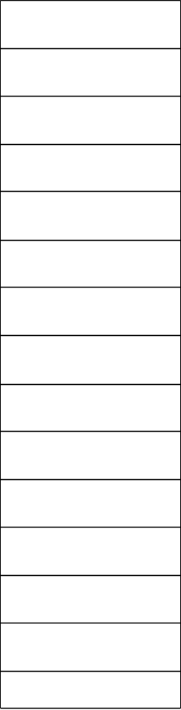
Common Cache
x
hit(t)
x
R(x)
t ∈ L
miss(t)→u
y
u ∈ L
t ∉ L
R(t) = R(u)
lru(u)
new cache:
L∪{t}\{u}
R(y)
y
z
z
R(z)
internal memory
cache memory

Slide 16
lru(u)
hit x1
hit x2
u = x2
miss x3→x4
{x3, x5}∩R(u)
= (L\{y})∩R(u)
hit x5
L
miss t→u

Slide 17
Equations for the whole test template
x1,x2 ∈ {a1,a2,b1,b2,c1,c2}
x3 ∉ {a1,a2,b1,b2,c1,c2}
R(x3) = R(y3)
x4 ∈ {a1,...,c2,x3}\{y3}
x5 ∉ {a1,...,c2,x3}\{y3}
y3 = c2
{y3} = ({a1,...,c2}\{x1,x2, y3})∩R(y3)
y5 = x2
{y5} = ({a1...c2,x3}\{y3,y5, x3,x4})∩R(y5)

Slide 18
Solver
x ∈ {a,b,c}
(assert (or (= x a)
(= x b)(= x c)))
y ∉ {a,b,c}
(assert (and (/= y a)
(/= y b)(/= y c)))
x = z
(check)
SMT
SAT modulo theories
Yices

Slide 19
Conclusions
Cache behavior can be expressed using equations on addresses’ set
Equations can be solved by SMT-solver

Slide 20
Contacts
http://tesla-project.googlecode.com
http://hardware.ispras.ru
kornevgen@gmail.com

Slide 21
Thank you for attention!

