Slide 1
SMT-based Test Program Generation for Cache Memory
Evgeny Kornikhin
Moscow State University

Slide 2
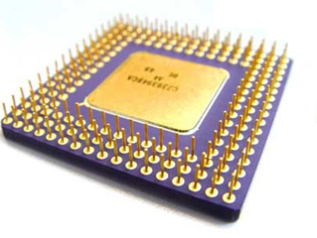
Core-level Verification
add r1,r2,r3
sub r4, r1, r2
lw r5, r1, 0
lui r2, r1, r4
Y/N
assembly program
( test program )
microprocessor

Slide 3
Test Program Generation
model of microprocessor
coverage of
test situations and
dependencies (r/w, r/r)
R4000
add
lw
add r1,r2,r3 @ overflow
lw r4, r3, c @ hit
...
test templates
args
test situations
(logical form)
mov r2, 0xFF
add r1,r2,r3
lw r4, r3, 0
rd
rs
rt
overflow
regular
test programs
(executable form)

Slide 4
Cache-hit
cache model
set №0
tag₀'
value₀'
tag₀''
value₀''
LOAD val, addr
(val := memory[addr])
addr
t = t' or
t = t''
t
s
tag
set
t = t''
set №s
t'
v'
t''
v''

Slide 5
Cache-miss
cache model
set №0
tag₀'
value₀'
tag₀''
value₀''
LOAD val, addr
(val := memory[addr])
addr
next
level
t != t' and
t != t''
t
s
tag
set
set №s
t'
v'
t''
v''
evicted

Slide 6
Problem again
LOAD x, y @ hit
STORE u, z @ miss
LOAD z, y @ hit
initial state of cache
and registers = ?

Slide 7

Key Idea
test template
add ...
load …
sub …
div …
LOAD x, y @ hit
constraint
?
?
variable
?
?
?
?
y ∈ {a,b,c}
variable
u ∉ {a,b,c}
cache model
x = z

Slide 8
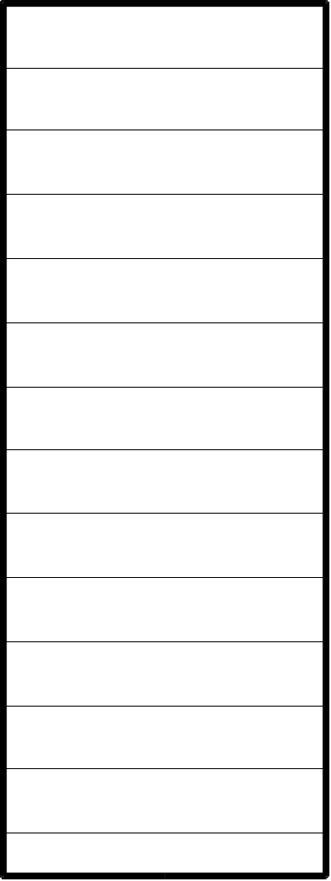

Fully Associative Cache
z
x
z
x
y
...
N
y
{x,y,z,...} - current state
LRU

Slide 9
Cache-hit hit(t)
z
t
x
z
x
y
...
N
y
t ∈{x,y,z...}

Slide 10
Cache-miss miss(t)
z
t
x
z
x
y
...
N
y
t ∉ {x,y,z...}
new cache {x,y,z...}∪{t}\{?}

Slide 11
Cache-miss miss(t→u)
z
t
x
z
x
y
...
N
y
t ∉ {x,y,z...}
u∈{x,y,z...}
new cache {x,y,z...}∪{t}\{u}

Slide 12
lru(u)
hit x1
hit x2
y = x2
miss x3->x4
{x3, x5} = L\{y}
hit x5
miss x6->y

Slide 13
lru(u)
hit x1
hit x2
y = x1
miss x3->x4
{x2, x3, x5}
= L\{y}
hit x5
miss x6->y
there are another cases..

Slide 14
Example
α
initial
state:
β
y∈{α,β,γ}
γ
LOAD x, y @ Hit
z∉{α,β,γ}
STORE u, z @ Miss
→z0
z0∈{α,β,γ}
z0=β
{α,β,γ}\{z0}={γ,y}
LOAD z, y @ Hit
N = 3
y∈{α,β,γ,z}\{z0}

Slide 15
Example
y = α
z∉{α,β,γ}
y∈{α,β,γ}
z∉{α,β,γ}
y=α=0
z0∈{α,β,γ}
β=1
z0=β
{α,β,γ}\{z0}={γ,y}
γ=2
z=3
y∈{α,β,γ,z}\{z0}

Slide 16
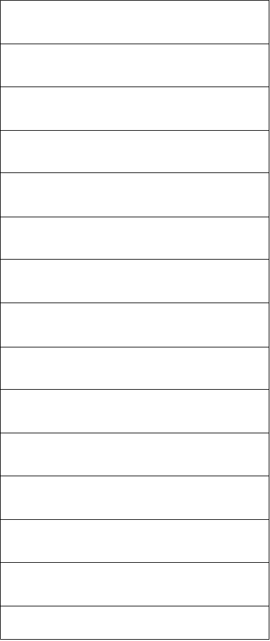
Common Cache
x
x
R(x)
y
R(y)
y
z
z
R(z)

Slide 17
Common Cache
hit(x) ==> x ∈ L
miss(x→y) ==>
y ∈ L, x ∉ L,
L∪{x}\{y} — new cache,
R(x) = R(y), lru(y)

Slide 18
lru(u)
hit x1
hit x2
y = x2
miss x3->x4
{x3, x5}∩R(y)
= (L\{y})∩R(y)
hit x5
miss x6->y

Slide 19
Example
x1,x2 ∈ {a1,a2,b1,b2,c1,c2}
x3 ∉ {a1,a2,b1,b2,c1,c2}
R(x3) = R(y3)
x4 ∈ {a1,...,c2,x3}\{y3}
x5 ∉ {a1,...,c2,x3}\{y3}
y3 = c2
{y3} = ({a1,...,c2}\{x1,x2, y3})∩R(y3)
y5 = x2
{y5} = ({a1...c2,x3}\{y3,y5, x3,x4})∩R(y5)

Slide 20
Solver
x ∈ {a,b,c}
(assert (or (= x a)
(= x b)(= x c)))
y ∉ {a,b,c}
(assert (and (/= y a)
(/= y b)(/= y c)))
x = z
(check)
SMT
SAT modulo theories
Yices

Slide 21
Contacts
http://tesla-project.googlecode.com
http://hardware.ispras.ru
kornevgen@gmail.com

