Slide 1
Django
Small introduction

Slide 2
What is Django
High-level Python Web framework for rapid application development
Code less, write more
MTV
Notes:
MTV - > Models + Templates + Views, where URLS are regular expression based

Slide 3
Structure
Project
FooApp
BarApp
BananaApp
….
ZApp
Notes:
Single project provides an umbrella for all underlying apps. Such app can be considered as plug & play mechanism
Project can be seen as entire website while apps are those parts which provides consecutive parts for it

Slide 4
Model – Django ORM
class Tag(models.Model): """ Each todo can be associated with tag, therefore it is easily accessible over custom name """ word = models.CharField(max_length=15, unique=True) """ word describes the content of the tag, therefore the verbose short version """ details = models.TextField(max_length=100, null=True) """ details can be used to describe something more beyond the tag """ def has_details(self): """ Determines if tag has details describing it """ return True if self.details else False def __str__(self): return '[ %s ]' % self.word
Notes:
Talk about models:
Defining fields
What is class Meta
How does it translates to the DB
Some logic here maybe ?
ForeignKey vs OneToOneField [associations]

Slide 5
Templates – Reusable chunks
{% extends 'base/base_site.html' %} {% load bootstrap3 %} {% block content %} <form action="" method="post"> {% csrf_token %} {% block form.errors %} {% bootstrap_form_errors form layout='inline' %} {% endblock %} {% block form.content %} {% bootstrap_form form layout='horizontal' %} {% endblock %} {% block form.actions %} {% buttons submit=buttons.submit reset=buttons.reset %} <button class="btn btn-warning">{{ buttons.cancel }}</button> {% endbuttons %} {% endblock %} </form> {% endblock %}
Notes:
Template represents extension of the base_site and adds content [main div]
Template is for the create/edit forms
Can be directly used somewhere or extended even more
We are referencing templates from views

Slide 6
View – Our view logic
class TodoCreateView(CreateView): model = Todo success_url = reverse_lazy('dtodo:todo:all') template_name = 'todo/todo-create-view.html' form_class = TodoForm @method_decorator(login_required) def dispatch(self, request, *args, **kwargs): return super().dispatch(request, *args, **kwargs) def get_context_data(self, **kwargs): context = super().get_context_data(**kwargs) context.update({ 'buttons': { 'submit': _('btn.ok'), 'reset': _('btn.reset'), 'cancel': _('bt.cancel') } }) return context

Slide 7
URL Namespacing and decoupling
urlpatterns = [ url(r'^dtodo/', include('DTodo.urls', namespace='dtodo')), url(r'^admin/', include(admin.site.urls)), url(r'^accounts/', include('DTodoRegister.urls', namespace='accounts')), ]

Slide 8
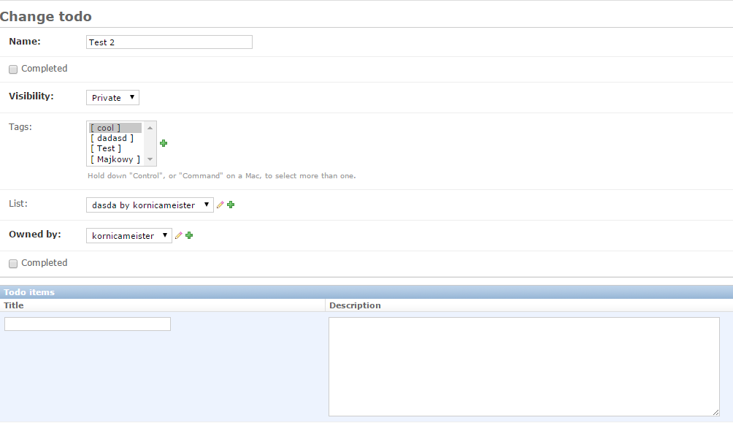
Django Admin – OOTB Admin Panel

Slide 9
Django Admin – OOTB Admin Panel - 2
@admin.register(Todo) class TodoAdmin(_AuditableAdminModel): list_filter = ['visibility', 'completed', 'owned_by'] actions = ['complete', 'un_complete'] inlines = [_TodoItemInline] def get_fields(self, request, obj=None): fields = super().get_fields(request, obj) if obj and obj.id: fields += ['completed'] return fields def complete(self, request, queryset):
pass def un_complete(self, request, queryset):
pass complete.short_description = _('Mark item as completed') un_complete.short_description = _('Mark item as not completed')

Slide 10
Best practices ?
Decouple url configuration and
Namespace them
Name them
Seperate different scopes of project into seperate apps within it
Fat models / Thin templates
Notes:
Fat models / Thin templates < put logic into model, dont make templates too big

