Slide 1
Clue
Let’s be detectives
Presented by korn sooksatra

Slide 2
background
There is a crime, and a person dies.
You job is to find
who the murderer is
what the weapon is
where the crime is.
There are 21 cards
6 for weapons
6 for suspects
9 for rooms

Slide 3
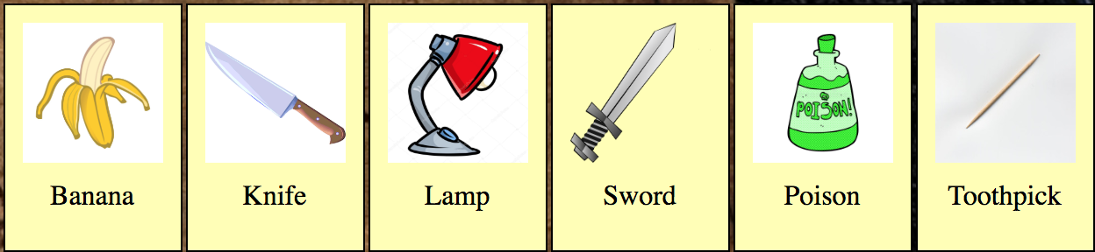
background
Weapon cards

Slide 4
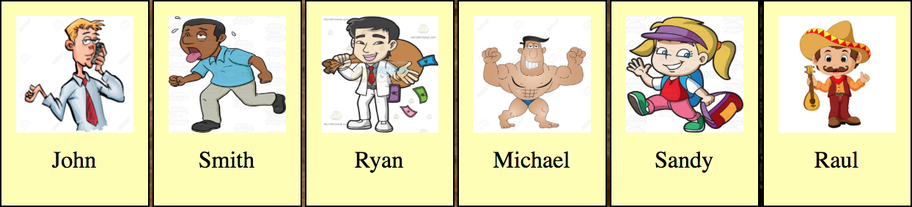
background
Suspect cards

Slide 5
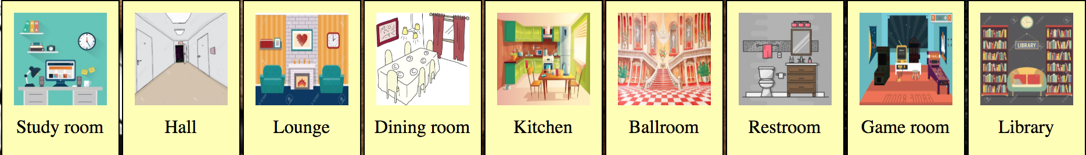
background
Room cards

Slide 6
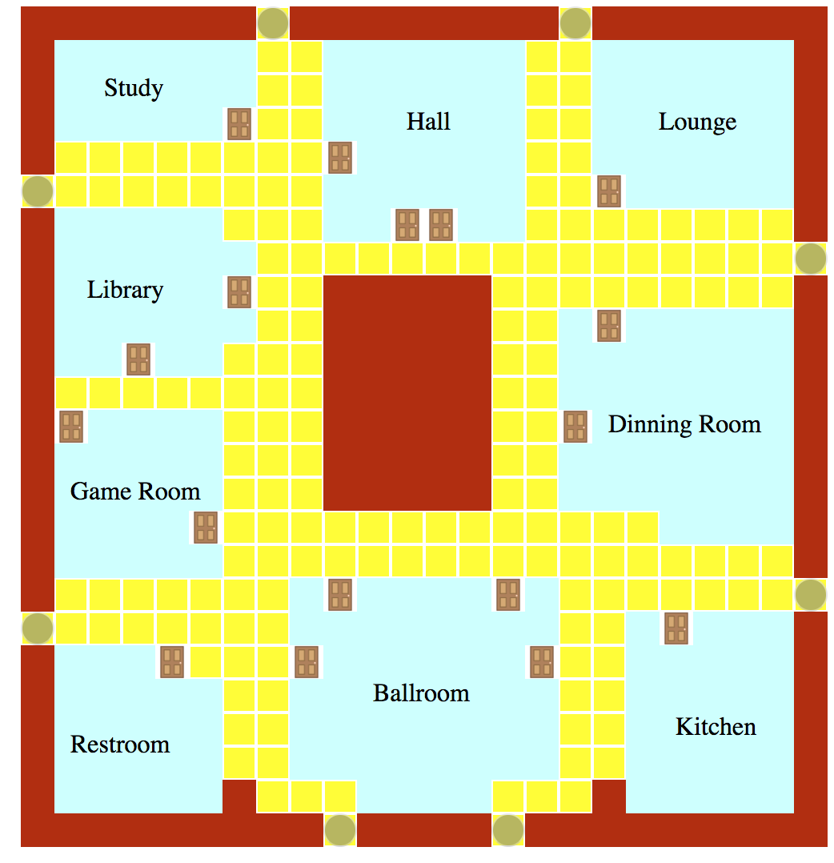
How to play
You can play 3 or 6 players
6 cards for each in 3-player mode
3 cards for each in 6-player mode
At first, each player need to select his/her starting point which is one of the black dots

Slide 7
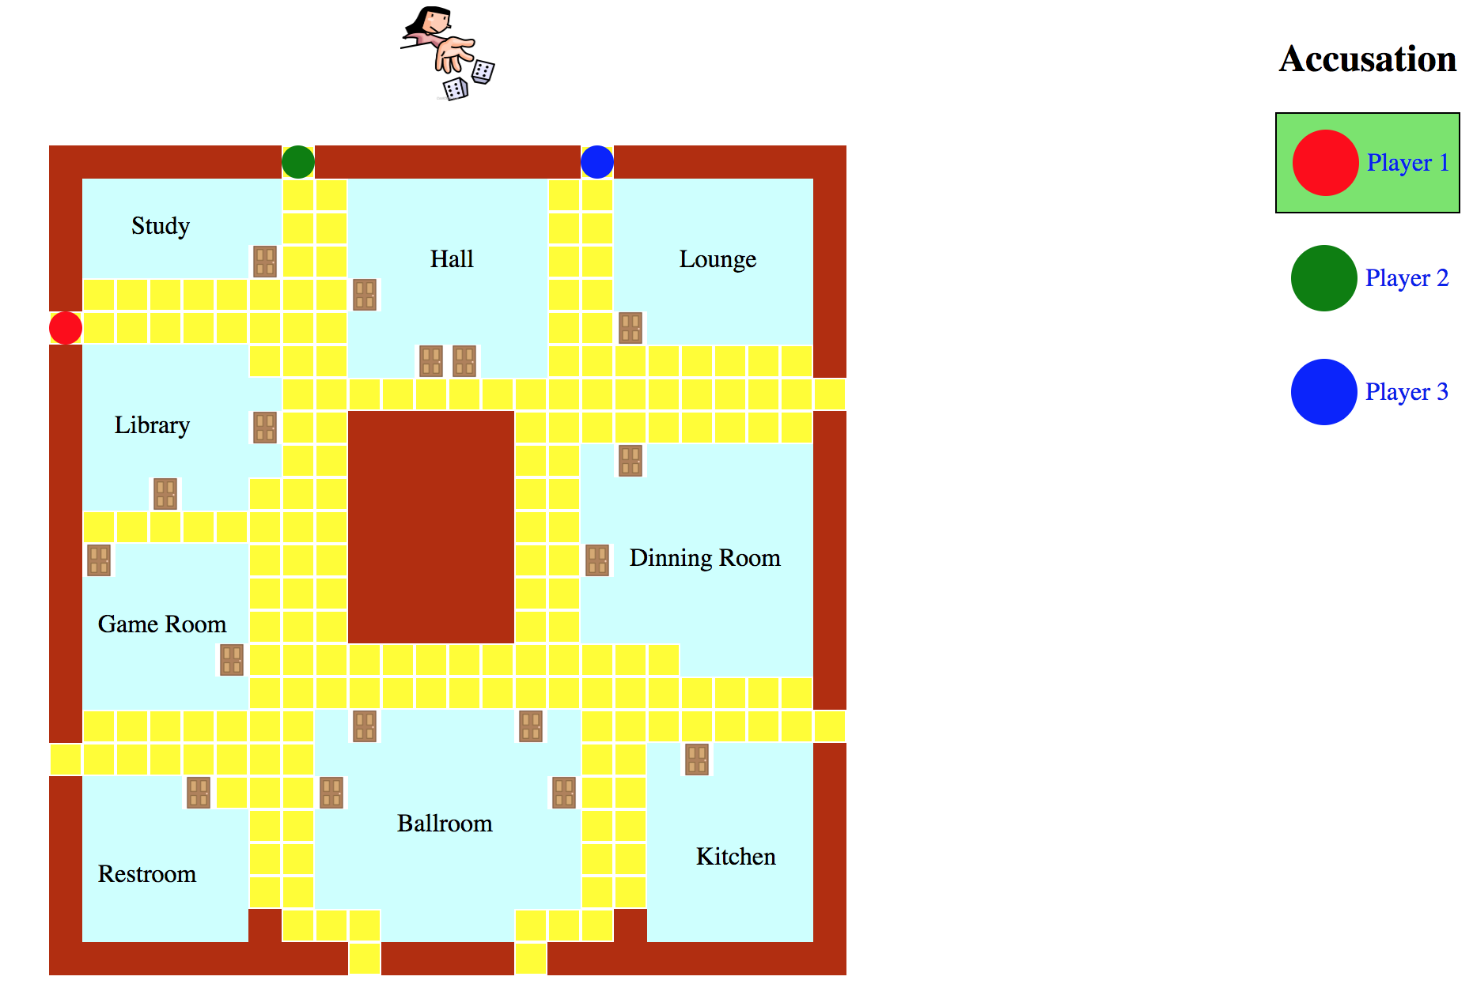
How to play
When everyone has his/her point in the board, there will be the dice icon on the top. He/she can click it to roll the dice.
The green background means that it’s that player’s turn

Slide 8
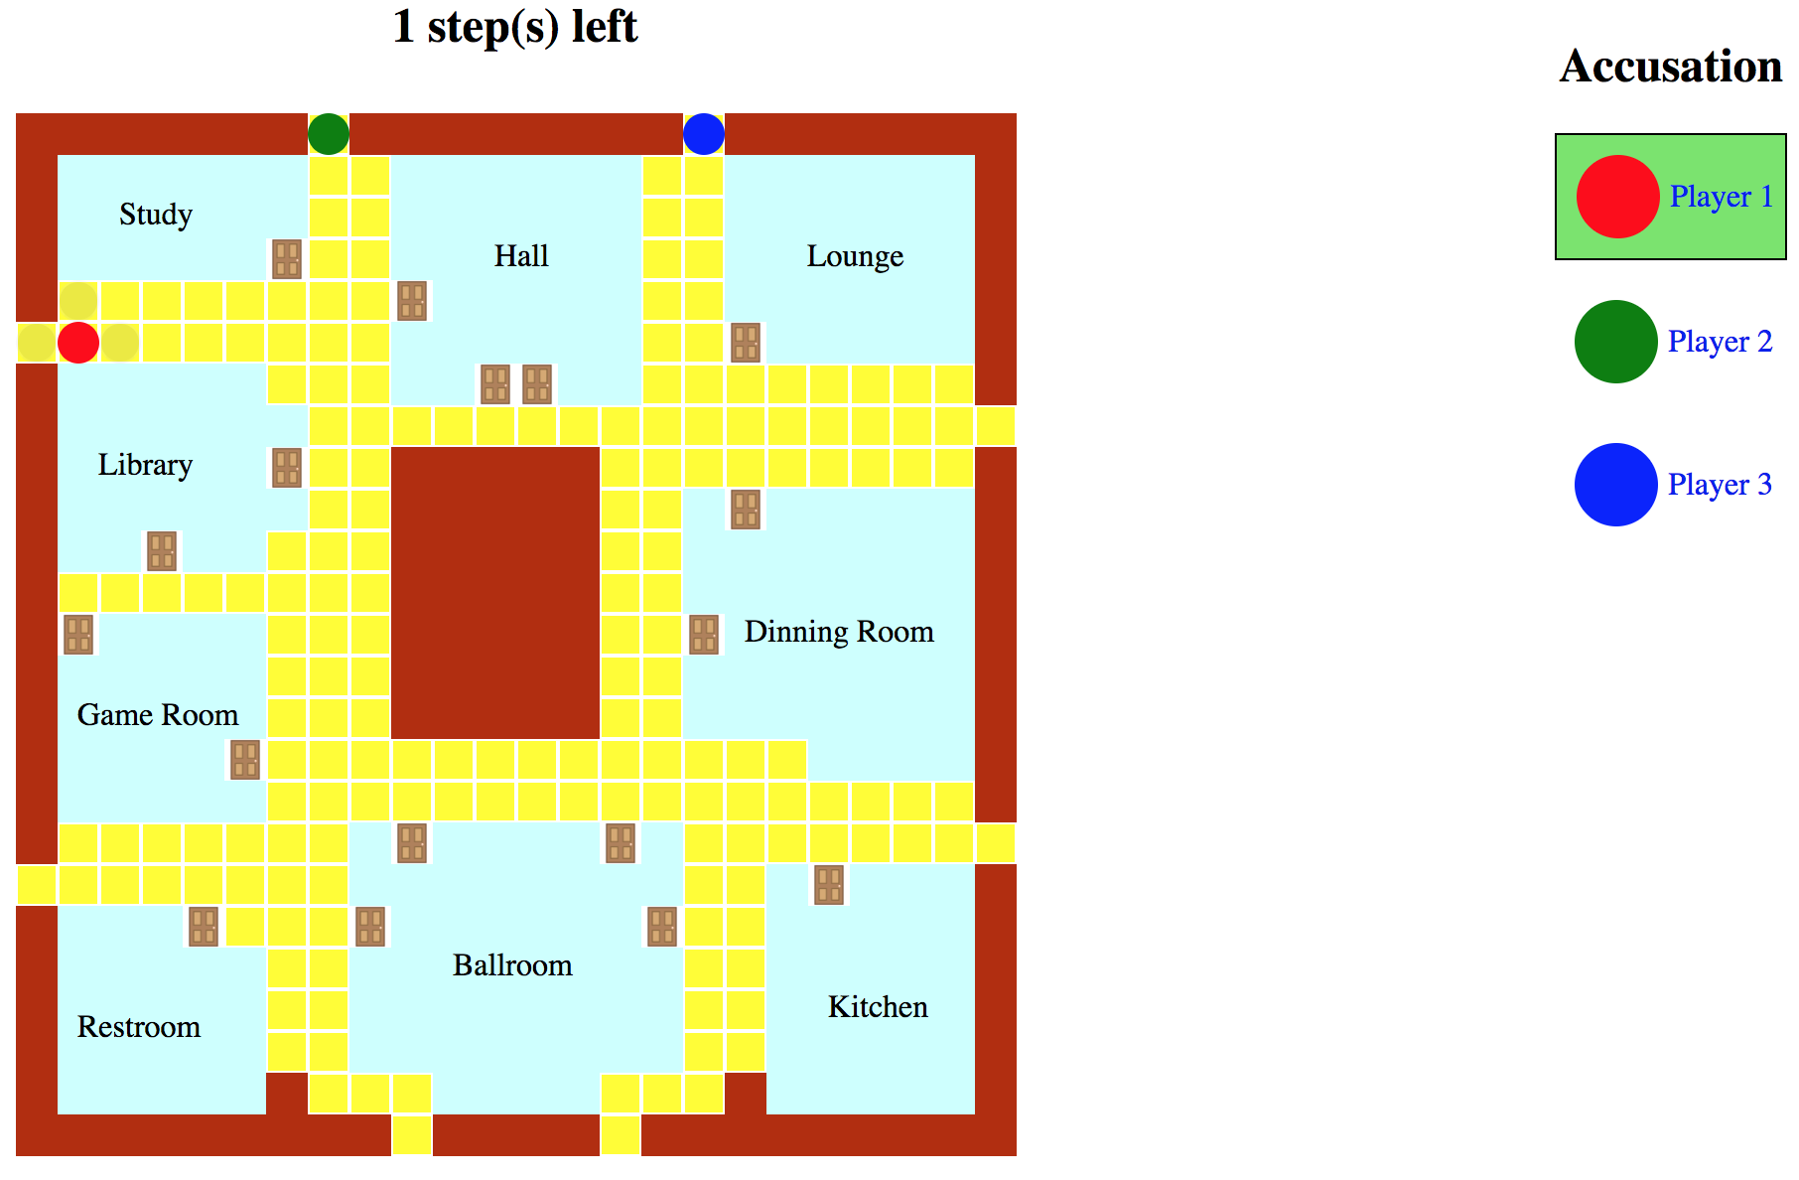
How to play
After the dice is rolled, you will be told how many steps you can take on the top, and the black dots mean available moves

Slide 9
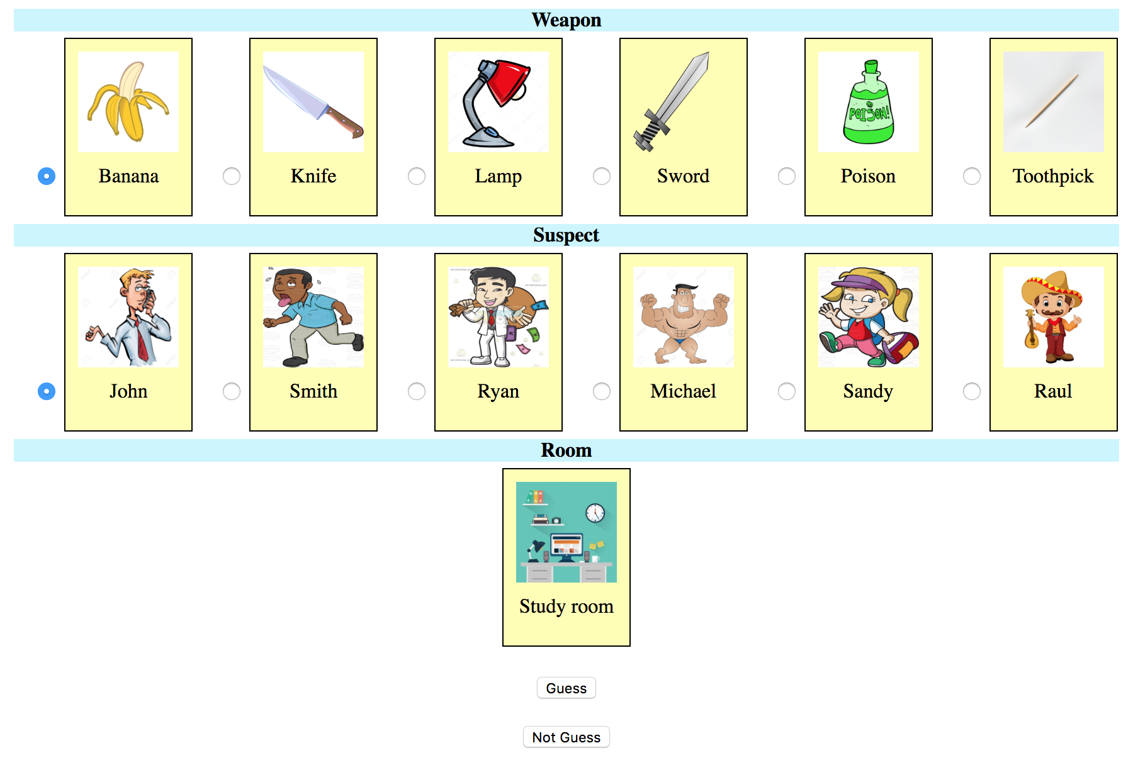
How to play
You can get in a room by its door. After that, you can guess
what the weapon is
who the murderer is
the crime scene will be in which room you are in

Slide 10
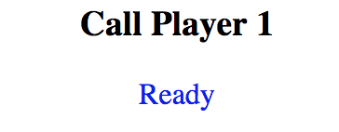
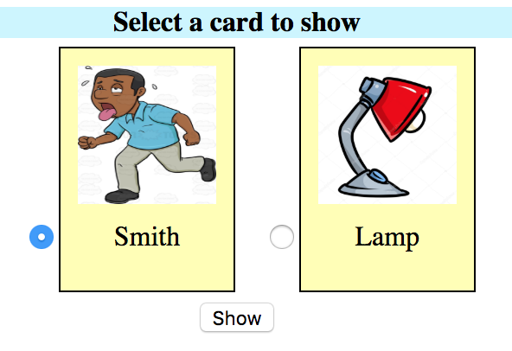
How to play
After that, it will check the cards in other players’ hands one by one until it finds some cards you guess

Slide 11
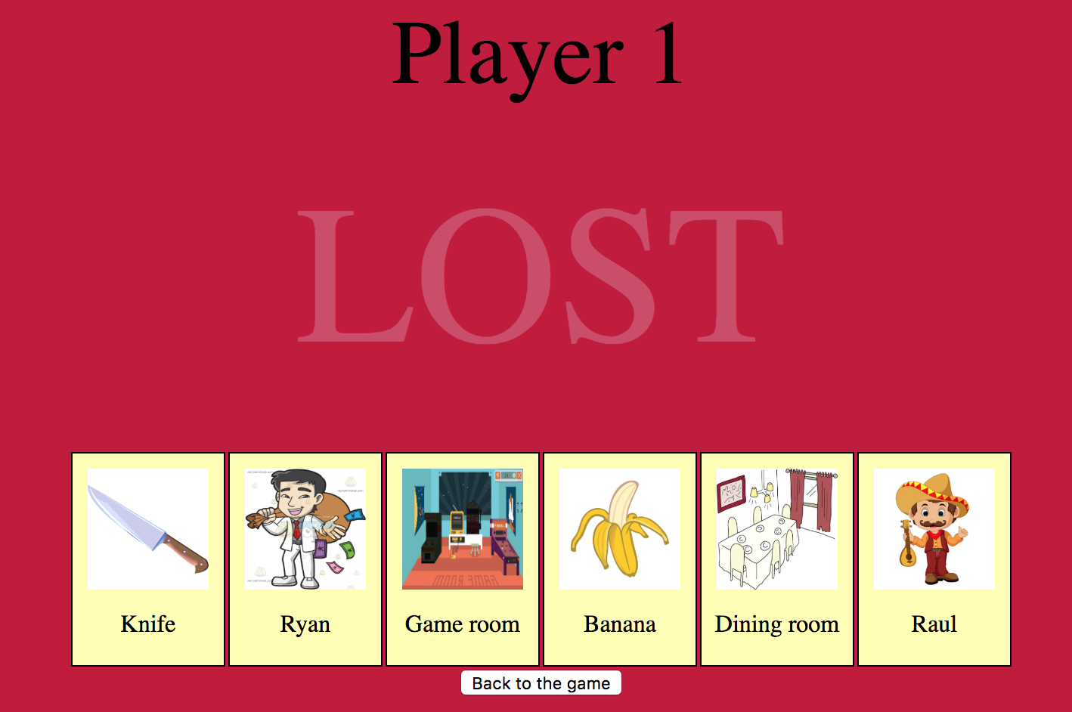
How to play
You can accuse anytime by clicking at you name on the right, but if you do not accuse the right suspect with the right weapon in the right room, you will be lose.

Slide 12
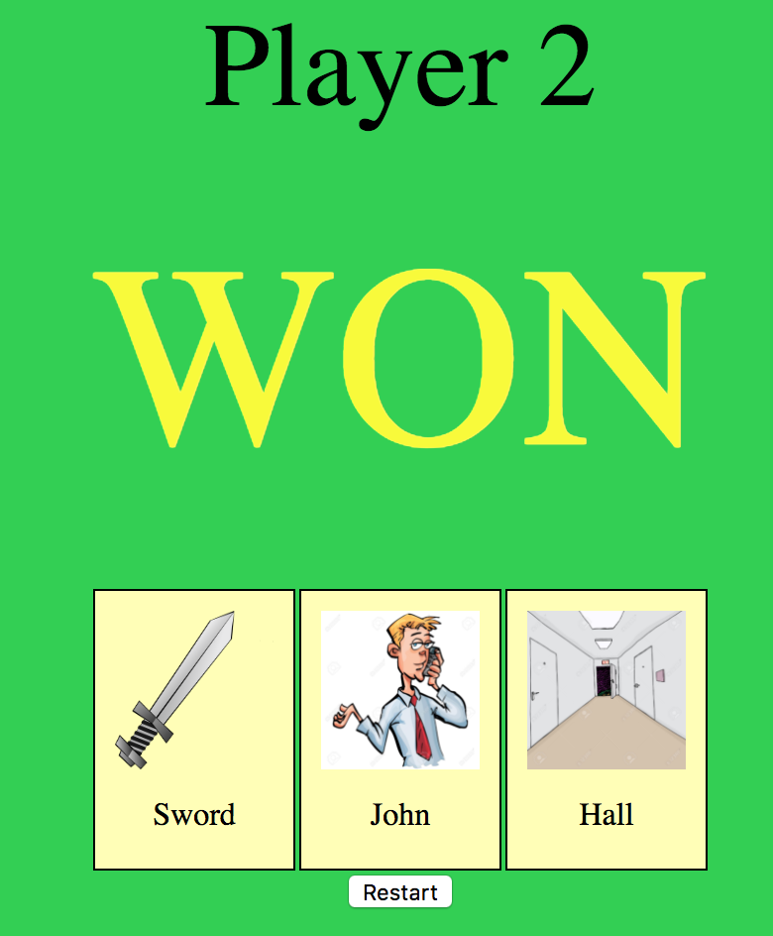
How to play
The game will end when someone wins.
You can win when either you accuse the right person with the right weapon in the right room, or you are the only one who is still in the game

Slide 13
demo

Slide 14
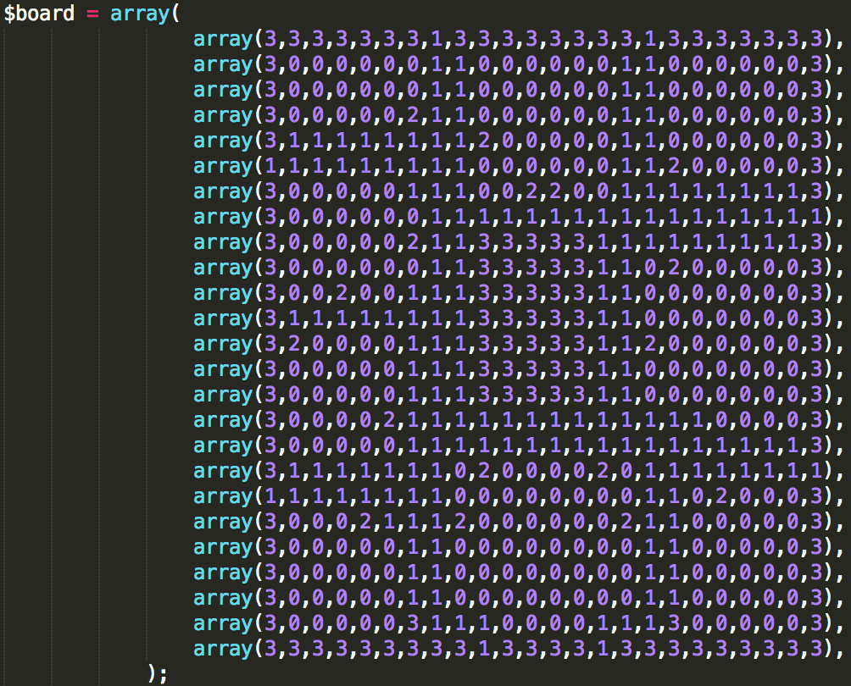
Code
My board is created by an array
1 represents an available block
0 represents a room block
2 represents a door block
3 represents an unavailable block

Slide 15
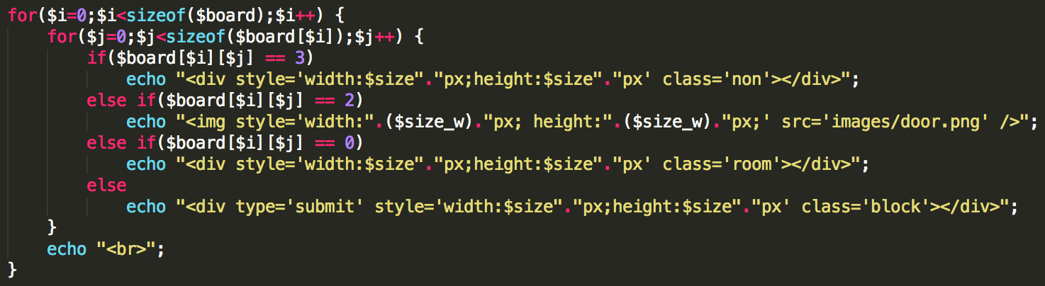
code
This is how I created the board

Slide 16
code
I represent each card by this
For example
w1 > Banana
s1 > John
r1 > Study room

Slide 17
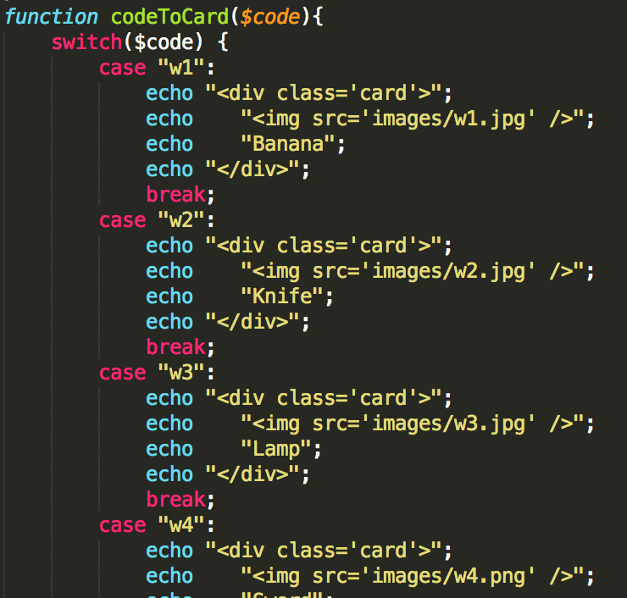
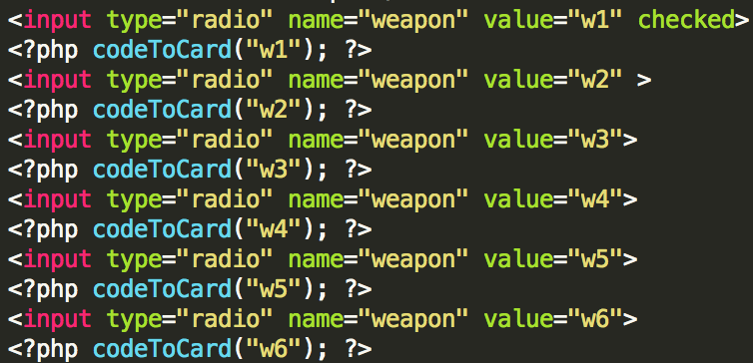
code
My cards are created by the function on the right

Slide 18
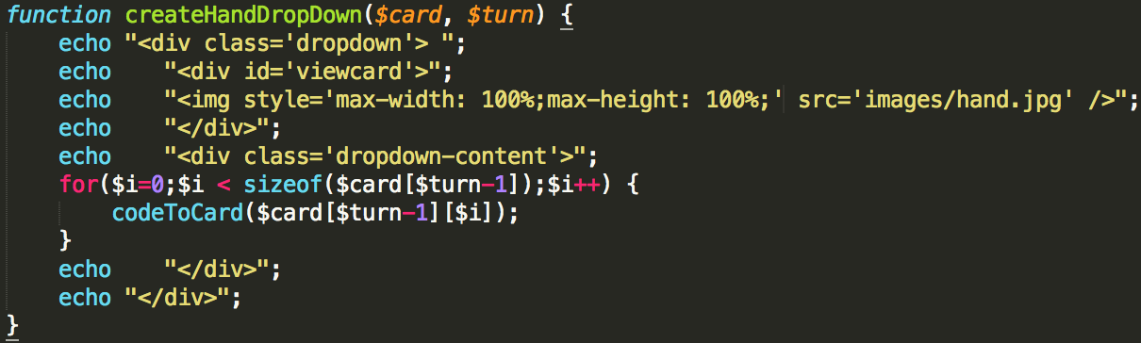
code
Code for drop down to view the cards in your hands

Slide 19
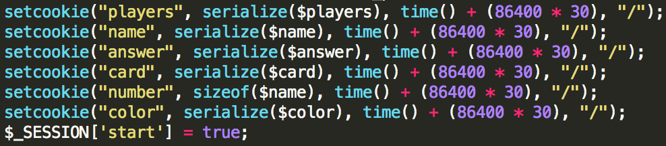
Cookie and session
Session
Start
State
Cookie
Positions of players
Players’ names
Players’ cards
Answer
Leaderboard

Slide 20
Future work
Make it online

Slide 21
Thank you

