Slide 1
Introduction to Quantum Information Applied to Quantum Chemistry
by Olivier Lebreux

Slide 2
Outline
What is a Qubit
Quantum Gates & Circuits
From Molecules to Qubit
Variational Quantum Eigensolver (VQE)
Live Tutorial - Qiskit Nature

Slide 3


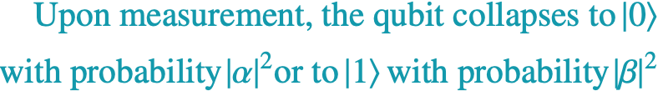
What is a Qubit ?
A classical bit is either 0 or 1.
A Qubit can be a superposition of both states simultaneously
where
Notes:
That probability/uncertainty is what gives the power to quantum computing. Before measurement, you have a quantum state on which you can apply operations to guide those statistics and explore de quantum space. At the moment you measure your qubit, your quantum state collapse and your state become classical -> either 0 or 1.

Slide 4
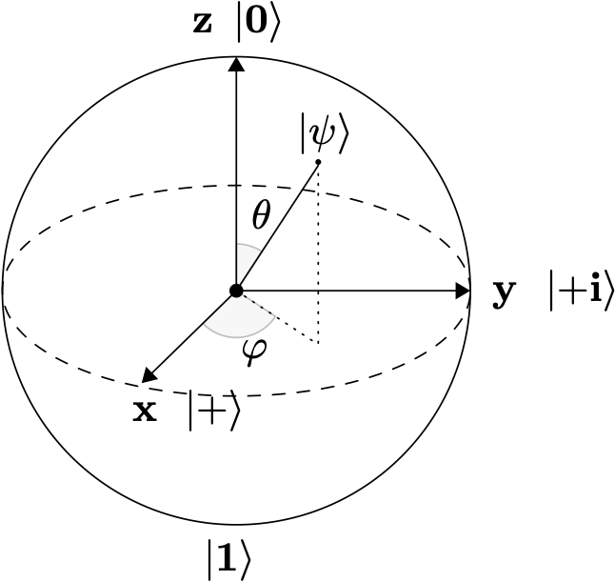

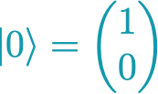
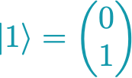


Bloch Sphere

Slide 5








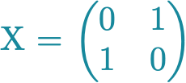
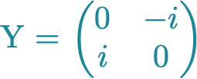
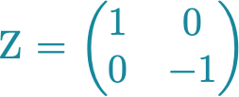
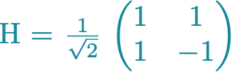
Quantum Gates & Circuits
Single-qubit gates :

Slide 6






Multi-Qubits Systems
Combine space of two isolated qubits :
General equation :

Slide 7

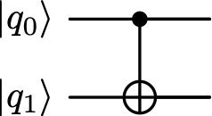
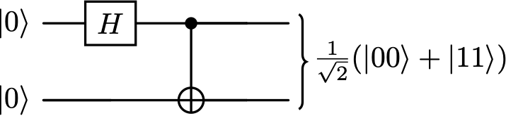
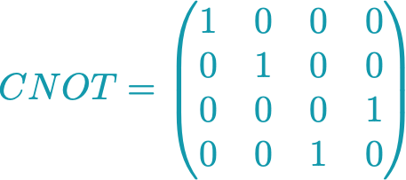

Quantum Gates & Circuits
Two-qubit gate :
CNOT - Flips the target qubit if the control qubit is

Slide 8


Entanglement
Two qubits are entangled when the state of one cannot be described independently of the other.
Measuring qubit 1 as instantly determines qubit 2 as

Slide 9


From Molecules to Qubits
Molecular Hamiltonian expressed in second quantization :
The Jordan-Wigner mapping translates each spin-orbital into one qubit :
unoccupied orbital
occupied orbital

Slide 10

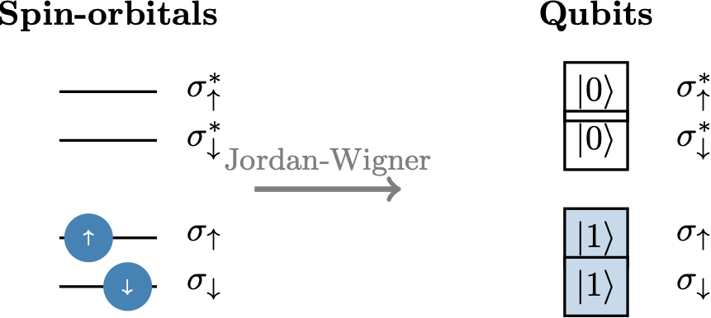
From Molecules to Qubits
The fermionic operators become tensor products of Pauli operators :

Slide 11

Variational Quantum Eigensolver
VQE is a hybrid quantum-classical algorithm that exploits the variational principle :
Notes:
Like playing a battleship game

Slide 12
Qiskit
Open-source Python-based Library from IBM

Slide 13
Thank you!
Links :
- Qiskit Tutorial
- Circuit Composer
- Bloch Sphere Simulator

