Slide 1

ADLC
Agentic Delivery Life Cycle
From an idea to merged, tested pull requests, delivered by a team of AI agents on our own infrastructure, with humans in charge
Notes:
ADLC is a framework that turns Claude Code into a delivery team: product discovery, architecture, backlog planning and the delivery of each issue as a reviewed pull request. It runs on our own dev server and GitHub. This deck goes from the big picture to the details; the appendix is reference material.

Slide 2

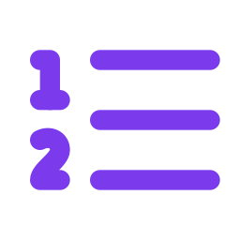
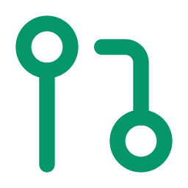

A delivery team that never sleeps, with you as the product owner
ADLC packages Claude Code into specialised agents, a repeatable process and guardrails. You describe the product and approve what matters; the agents do the specification, design, tests, code and reviews, and open a pull request for every issue.
15
8
1 PR
0
specialised agents
phases per issue
per issue
prod deploys by agents
each with one job, routed to the right model (Opus, Sonnet, Haiku)
understand → design → tests → build → verify → QA → review → PR
tested and reviewed, with every acceptance criterion traced to a test
production is deployed by a person, always
Notes:
The one-line pitch: ADLC is a delivery team made of agents. Four numbers to remember. Fifteen agents with narrow jobs, so each one is good at its job and cheap to run. Eight phases for every issue. One pull request per issue, traceable from acceptance criterion to test. And zero production deploys by agents.

Slide 3


Why ADLC: AI coding without the chaos
Without a framework
With ADLC
Ad-hoc prompting
Every session starts from zero; results depend on who prompts and how
A fixed process: discovery → architecture → backlog → delivery, with written artefacts at each step
Unreviewed changes
Agents push code nobody fully read, tests written after the fact
Tests first, AI code and security review, and a human merge for anything risky
Agents with your keys
Your account, your tokens, access to everything on the machine
A sandbox per project, its own GitHub identity, an internet allowlist, no prod access
Lost context
Decisions live in chat history and disappear
Specs, designs, ADRs and run reports are committed next to the code
Notes:
The problem ADLC solves is not whether AI can write code; it can. It is making that repeatable, reviewable and safe. Each row is a failure mode we see with ad-hoc AI coding, and the ADLC answer.

Slide 4







The lifecycle: five commands from an idea to a running backlog
/init
/discover
/architect
/plan-backlog
/deliver
Project setup
Product
Architecture
Backlog
Delivery
Repo, CI, registry, environments, secrets by name. One-time.
Guided interview → vision, PRD with acceptance criteria, glossary.
System design, ADRs, quality attributes, fitness checks.
Milestones, epics, issues with dependencies; walking skeleton first.
Each issue → a reviewed PR. Unattended, in dependency order.
Interactive with you: the first four run as conversations in the Claude app (Remote Control). You answer questions and approve each result as a pull request.
Unattended: /deliver runs by itself for every ready issue; you only review the pull requests that need you.
Notes:
Five slash commands. The first four are conversations: you are in the loop, answering questions and approving the output, which always lands as a pull request. Delivery is the only unattended step, and it only starts once the backlog exists.

Slide 5


Humans steer, agents do the work
You (the owner)
The agents
Describe the product and answer questions
Approve architecture, setup and high-risk PRs
Do owner tasks: accounts, credentials, legal, infrastructure
Answer agents' questions on blocked issues
Deploy to production and cut releases
Pause, resume and prioritise the pipeline
Turn ideas into PRDs, ADRs and a backlog
Write specs, designs and failing tests first
Implement in parallel, then verify and debug
Review code and security, run end-to-end QA
Open the PR with full traceability
Deploy merged work to the dev environment
Notes:
A clear split. You own decisions, approvals, anything needing your accounts or legal standing, and production. The agents own the engineering work up to a reviewed PR, and the dev environment. Owner tasks are real GitHub issues assigned to you, and the agents' work waits on them automatically.

Slide 6

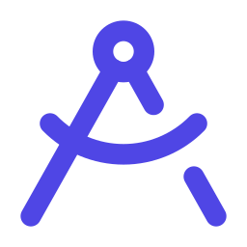
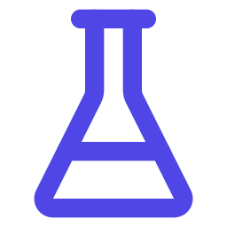
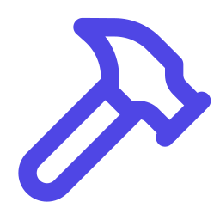



One issue, eight phases, a specialist for each
1
2
3
4
Understand
Design
Tests first
Build
scout · requirements analyst
feature architect
test designer
implementers (parallel)
Spec with testable acceptance criteria
Design, risk tier, small tasks
Failing tests, one per criterion
One task each, own git worktree
5
6
7
8
Verify
QA
Review
PR
build runner · debugger
QA engineer
code + security reviewers
release manager
Lint, types, architecture, tests
End-to-end on web and Android
Blocking findings get fixed
PR, labels, merge policy
Notes:
This is what /deliver does for each issue. A lead agent orchestrates and never reads code itself; specialists do the work and hand over through files. Tests are written before the code and must fail for the right reason. Implementers run in parallel on independent tasks. Verify retries with a debugger; review can send work back. Every phase is committed and pushed, so a crashed run resumes where it stopped.

Slide 7
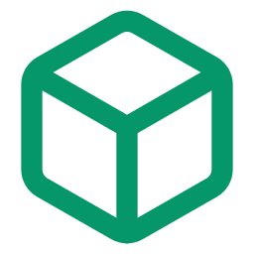

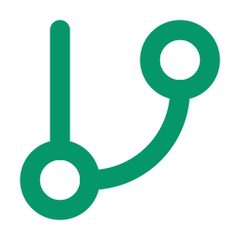

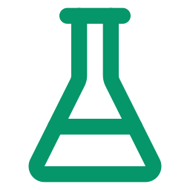

Guardrails are built in, not bolted on
Sandboxed runner
Its own GitHub identity
Branch protection
Each project runs in its own container with its own Docker engine. Internet access goes through an allowlist proxy.
Agents act as a GitHub App bot with 1-hour tokens for one repo. No admin rights, no access to your account.
Required CI checks, linear history. CI, deploy and build files need the owner's review (CODEOWNERS).
Risk tiers
Tests and reviews
Production stays human
Every change gets a risk tier. Only low risk may auto-merge; the rest waits for you.
Tests first, every acceptance criterion mapped to a test, AI code and security review.
No CI runner on prod. The owner deploys reviewed commits from main with one command.
Notes:
Six guardrails. The important idea: safety comes from structure, not from trusting the model. Agents simply don't have the credentials or network paths to do damage beyond the project sandbox, and anything that changes CI, deployment or the build needs a human approval enforced by GitHub itself.

Slide 8

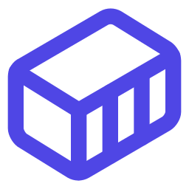


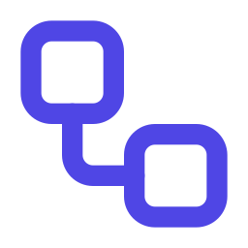

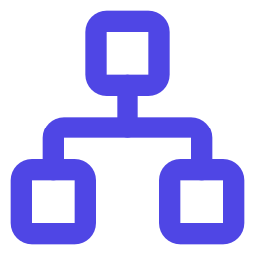

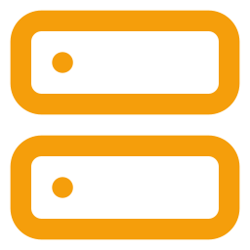
Where it runs: one dev server, GitHub and Claude
Dev server (Docker)
GitHub
Issues, PRs, CI, the backlog board
Runner (per project)
Claude Code, poller, Remote Control, dev deployer
Docker sidecar
Per-run test environments and preview URLs
Claude (subscription)
Agents; you via the Claude app
Egress proxy
Internet allowlist and audit log
CI runner
One-job runners in a separate engine
Container registry
Images published from main
Edge proxy
Routes previews and the dashboard
Dashboard
Read-only view, pause / resume
Production (Swarm)
Deployed by the owner only
Notes:
Everything runs on one dev server with Docker. Each project gets a runner container with Claude Code and the poller that picks up ready issues, a Docker sidecar for test environments, and an egress proxy. CI jobs run in a separate engine the agents can't reach. Outside: GitHub holds the work, Claude provides the models through the subscription, the registry holds images, and production is a separate Swarm cluster that only the owner deploys to.

Slide 9

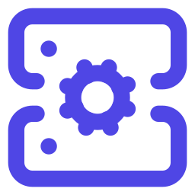

Stack packs: technology know-how as plugins
The core is technology-agnostic. A stack pack adds conventions, templates, test environments and review checklists for one technology. Projects enable the packs they use.
React Native
React web
Node API
Your stack next
Expo apps for iOS, Android and web; Android emulator; Playwright and Maestro end-to-end tests
Vite + React SPAs with shadcn/ui and Tailwind; nginx image; Vitest, Playwright and accessibility checks
Fastify, zod and OpenAPI; Postgres and Redis; migrations; containers and Swarm stacks
ESP32, Python, Go…: a pack is a folder of skills and templates; the core stays unchanged
Notes:
Stack packs keep the core generic. Each pack is a Claude Code plugin with skills: conventions, templates for Dockerfiles and compose files, test environment recipes and review checklists. Agents load the packs of the stacks a project enables. Adding a new technology means writing a pack, not changing the pipeline.

Slide 10

Operating it day to day
GitHub
The source of truth. Issues move through labels (queued → ready → in progress → PR open); you review PRs and answer questions on issues.
Dashboard
What's running with its live log, the queue, what needs you, history and health. Pause and resume. Works on a phone.
Claude app
Interactive sessions on the dev server via Remote Control: discovery, architecture, planning, or working on an issue with Claude.
adlc CLI
Set-up and operations on the dev server: up, status, logs, pause / resume, restart, ui.
Notes:
Four touch points. GitHub is where the work lives; the labels are the state machine. The dashboard is the window into the runner. The Claude app gives you interactive sessions on the dev server. The CLI is for setup and the occasional operational task.

Slide 11
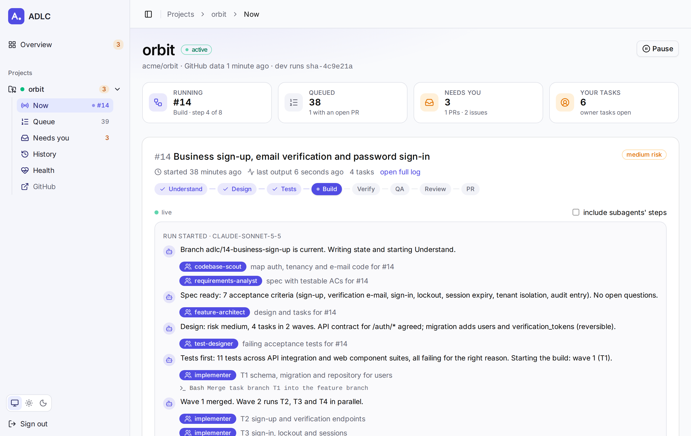


The dashboard: see the pipeline at a glance
Live run
Phase stepper and the agents' narrative as it happens
Needs you
PRs to review, blocked runs, your next tasks
Safe by design
Reads files only; no credentials, no Docker socket
Notes:
The dashboard runs next to the runners on the dev server. It shows every project, the active run with its live log and phase, the queue in the order work will happen, what needs your attention, history and component health. It only reads files and asks the runner to pause or resume, so compromising it gives nothing away.

Slide 12
Example: orbit, a multi-tenant booking platform
Booking web app for businesses, iOS and Android app for their customers, Node API and Postgres, payments, EU data. Illustrative example; figures are representative of a first ADLC project.
14
62
~25 min
1
ADRs
issues
issue → PR
owner
architecture decisions, reviewed by an independent agent
45 for agents, 9 owner tasks, 8 epics in 4 milestones
a walking-skeleton issue with 20+ acceptance criteria
approving PRs and doing owner tasks
Setup
Discovery
Architecture
Backlog
Delivery
repo, CI, registry, identity
PRD, journeys, ACs
14 ADRs, review debate
62 issues with dependencies
walking skeleton running
Notes:
orbit is an illustrative example of a first ADLC project, with representative figures. Discovery and architecture take a few interactive sessions; the backlog planner turns the PRD and architecture into issues with native GitHub dependencies, a walking skeleton first and owner tasks for everything only a person can do. A walking-skeleton issue with 20+ acceptance criteria goes from issue to pull request in about 25 minutes of agent time.

Slide 13

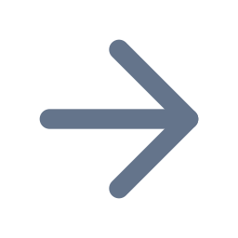
What the first real runs taught us, and what we fixed
Required checks without CI blocked every PR
CI is bootstrapped at setup; jobs switch on one by one as their commands work
A background subagent was cut off after 10 idle minutes
Unattended runs keep every subagent in the foreground
The poller didn't trust the bot-written backlog
ADLC's own identity is trusted; your adlc:ready approves outsiders
An agent pre-filled the owner as approver
Agents never record a human's approval; it shows as 'owner decision needed'
A prod CI runner was planned on the Swarm manager
Production is deployed by the owner only, with adlc-swarm-deploy
Notes:
Running a real project found real gaps, each now fixed in the framework so the next project doesn't hit them. The theme: when something goes wrong, the framework fails safe; nothing was merged or deployed that shouldn't have been.

Slide 14
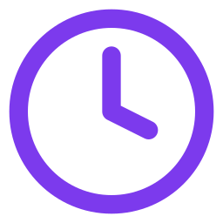
Getting started: from zero to the first delivery run
1
Prepare the dev server
Docker, the ADLC repo, adlc doctor
Typical effort
2
Create the GitHub App
Once per GitHub account; reused by every project
Dev server and app: about an hour
Setup and discovery: a few sessions
Architecture and backlog: a few more
Then: reviewing PRs and owner tasks
3
Start the project
adlc secrets, adlc up, adlc login
4
Set it up with Claude
/init → /discover → /architect → /plan-backlog
5
Let it deliver
Close the first owner tasks; review the PRs as they arrive
Notes:
Five steps. The README in the ADLC repo walks through each with exact commands. Most of the elapsed time goes into the conversations about the product and the architecture, which is where your judgement matters most.

Slide 15
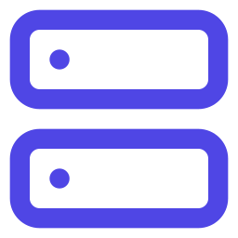

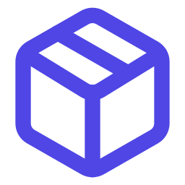
What you need
A dev server
A Claude subscription
Linux with Docker; 8+ cores, 32 GB RAM and 100 GB disk recommended. /dev/kvm for the Android emulator.
Claude Max: unattended runs and Remote Control use the subscription, not per-token billing.
GitHub Pro or Team
A container registry
Branch protection, CODEOWNERS and environments on private repos. One GitHub App per account.
Harbor or GHCR for the images CI publishes.
Notes:
The prerequisites. The subscription matters: unattended runs use a long-lived subscription token rather than API billing, and the runner backs off automatically when the usage limit is reached. Costs shown in the dashboard are API-equivalent, for comparison only.

Slide 16

Honest limits today
One run at a time per project
Parallel implementers inside a run, but issues are delivered one after another (configurable).
Your review is the bottleneck
With a cautious merge policy most PRs wait for you; loosen it as trust grows.
iOS end-to-end tests need a Mac
Written by the agents, run on the owner's Mac before a release.
Subscription usage limits
Long runs can hit the usage window; the runner pauses and resumes by itself.
Young framework
Proven on one project so far; expect rough edges and keep the fixes flowing back.
Notes:
Be upfront about the limits. The biggest practical one is review capacity: the framework produces PRs faster than one person reviews them carefully, so start with a cautious merge policy and relax it for low-risk work as you build trust.

Slide 17
Next steps
Pick a pilot project and a dev server
Read the README in the ADLC repo, then run adlc doctor
Share what you find: issues and stack packs are welcome
Notes:
Close with a concrete ask: one pilot project per team that is interested, and feedback into the framework.

Slide 18
Appendix
Reference: agents, commands, labels, risk, files, CI, security, production, CLI, dashboard
Notes:
Reference material for adopters. Each slide stands on its own.

Slide 19
A1 · The agents and their model routing
Agent | Model · effort | Job
requirements-analyst | Opus · high | Spec with testable acceptance criteria
feature-architect | Opus · high | Design, risk tier, tasks
backlog-planner | Opus · high | Epics, issues, dependencies
architecture-reviewer | Opus · xhigh | Independent architecture review
product-advisor | Opus · medium | Product suggestions in discovery
implementer | Sonnet · medium | One task in its own worktree
test-designer | Sonnet · medium | Failing acceptance tests first
code-reviewer | Sonnet · high | Correctness, spec, design gate
Agent | Model · effort | Job
debugger | Sonnet · high | Fixes failing verification
security-reviewer | Sonnet · medium | Security review of the diff
qa-engineer | Sonnet · medium | End-to-end and exploratory QA
researcher | Sonnet · medium | Facts with sources
codebase-scout | Haiku · low | Maps the relevant code
build-runner | Haiku · low | Runs lint, types, tests
release-manager | Haiku · low | PR, labels, merge policy
The delivery lead runs on Sonnet. Judgement-heavy work goes to Opus, routine execution to Haiku: quality where it counts, quota saved elsewhere.
Notes:
Fifteen agents. The routing is deliberate: specification, design and planning decide everything downstream, so they get the strongest model. Mechanical work such as running the build or opening the PR gets the fastest.

Slide 20
A2 · Commands, outputs and who merges
Command | Mode | Produces | Merge
/adlc-core:init | interactive | adlc.yaml, setup.md, CLAUDE.md block, provision.sh, CI bootstrap | you (setup PR)
/adlc-core:discover | interactive | docs/product: vision, PRD with ACs, glossary | auto (docs)
/adlc-core:architect | interactive | docs/architecture: architecture.md, ADRs, fitness, evolution; adlc.build.yaml | you
/adlc-core:plan-backlog | interactive | milestones, epics, issues with dependencies; .adlc/backlog.md | you approve the plan
/adlc-core:deliver <n> | unattended | spec, design, tests, code, reports → PR | by risk tier
--resume continues an interrupted interactive phase. --update (init) changes one setup section. --debate (architect) adds a reviewer debate before the verdict.
Notes:
The five commands with what each produces and who merges the result. Only delivery runs unattended.

Slide 21
A3 · Issue states are GitHub labels
adlc:queued
waiting on blockers
adlc:ready
can start
adlc:in-progress
a run is working
adlc:pr-open
PR waiting for merge
merged,
issue closed
adlc:needs-info
The run has a question (comment on the issue). Answer it, relabel ready.
adlc:blocked
The run stopped (summary comment). Fix the cause, relabel ready.
adlc:needs-human-review
Issue from a non-collaborator. Add adlc:ready to approve it.
adlc:owner
Your task. Agents never run it; closing it unblocks the work behind it.
adlc:risk-low · medium · high
Risk tier of the change; decides who merges.
Notes:
Labels are the state machine; the poller moves issues along it. The poller promotes queued to ready when all GitHub blocked-by issues are closed, picks ready issues by milestone due date then age, and only trusts issues from collaborators, from ADLC itself, or approved by a collaborator.

Slide 22
A4 · Risk tiers decide who merges
Low
What lands here
Small, contained changes with tests; no new dependencies; no CI, deploy or schema changes
Who merges
Auto-merge after green CI and approving AI reviews, if the project allows it
Medium
What lands here
Feature work across layers, additive schema changes, new endpoints
Who merges
Policy per project (adlc.yaml autonomy.auto_merge); a cautious start: you merge
High
What lands here
CI or workflows, deployment, auth, data migrations, new dependencies, ADR deviations
Who merges
Always you. Changes to /.github, /deploy and adlc.build.yaml also need your code-owner review
Notes:
The feature architect assigns the tier with a rubric and errs upwards. The merge policy lives in adlc.yaml, which unattended agents cannot edit, so they can never raise their own autonomy.

Slide 23
A5 · What ADLC adds to a project repository
adlc.yaml
Policy and setup values: stacks, environments, identity, autonomy, network. Read-only for unattended agents.
adlc.build.yaml
Build profile: install, lint, typecheck, arch_check, test commands; test environment lifecycle; e2e targets; CI switch-on (status, ci.active).
CLAUDE.md
Short project context loaded by every agent, with a generated setup block.
docs/product · docs/architecture
PRD, glossary, architecture, ADRs, fitness checks: the binding decisions.
.adlc/runs/<n>/
Per run: issue, spec, design, tasks, tests.md (AC → test), verify and review reports.
.github/ · deploy/
CI workflows with the gate, compose files for dev and test, Swarm stack files for prod.
Notes:
Everything ADLC needs is in the repository, versioned with the code. A new person, or a new agent session, can understand any decision from these files.

Slide 24
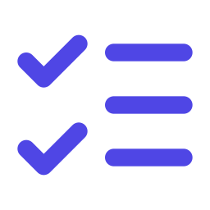
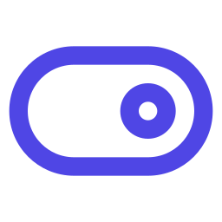
A6 · CI: required checks from the first PR
Six required checks
A gate in every job
lint, typecheck, arch-check, test, e2e-web, e2e-android. Job names never change.
Skips with success until the job is switched on (ci.active, then status: active), and on docs-only changes. Fails closed.
Self-hosted, one job each
Publish from main only
Just-in-time runners in a separate Docker engine, wiped between jobs; GitHub-hosted runners as a fallback.
Images are built and pushed with credentials that exist only in the publish environment.
Notes:
CI exists from the setup PR, so required checks always report. Until the walking skeleton proves each command, the jobs skip with success; the skeleton switches them on one by one. CI jobs run on the dev server in an engine the agents cannot reach, one job per throwaway runner.

Slide 25
A7 · Security model: threats and controls
Threat | Control
Agent-written code misbehaves on the host | Per-project container and Docker engine; egress allowlist proxy; no host mounts beyond the project
Agents act with the owner's rights | GitHub App bot, 1-hour single-repo tokens, no admin; checked before every run
Agents change CI, deploy or their own autonomy | CODEOWNERS on /.github, /deploy, adlc.build.yaml; adlc.yaml read-only in unattended runs
Secrets leak | Never in the repo or chat; prompted, stored mode 600; publish credentials only in the main-only environment
A PR workflow reaches production | No runner on the Swarm manager; owner-run deploys of commits on main only
Strangers' issues drive the agents | Only collaborators, ADLC itself, or a collaborator's adlc:ready start work
Release tags created by agents | Tag ruleset: v* tags for repository admins only
Notes:
Each threat maps to a structural control enforced by Docker, GitHub or the runner, rather than by instructions to the model.

Slide 26
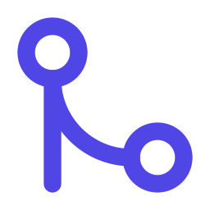

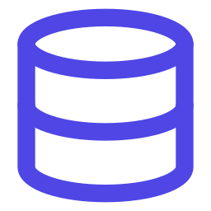


A8 · Production: deployed by a person, from main only
Merge to main
CI publishes
Owner runs
Checks
Pre-deploy
Rolling update
Reviewed PRs only
Images tagged sha-<7>
adlc-swarm-deploy <repo> <ref>
Commit on main; every image exists
Migrations as a one-off job
Start-first, automatic rollback
Why no deploy workflow? A self-hosted runner registered to a repository also runs pull-request workflows from any branch. One agent-written workflow could reach the production manager. The deploy script runs nothing from CI and accepts only commits that went through branch protection. Several stacks (e.g. data and app) deploy separately; rollback is deploying the previous release.
Notes:
Production deployment is the one step that stays fully manual by design. The script is idempotent, records a deployment history and makes rollback a single command.

Slide 27
A9 · adlc command line (on the dev server)
adlc doctor
check the host
adlc secrets <slug>
store credentials (prompted)
adlc up <slug>
build and start or update
adlc app <slug> --id --key
use the GitHub App
adlc login <slug>
one-time Claude login
adlc session <slug>
interactive session
adlc status <slug> [--all]
state and the queue
adlc pause | resume <slug>
stop or start new runs
adlc logs <slug> <what>
poller, run <n>, ci, …
adlc restart <slug>
reload plugins
adlc audit <slug>
egress domains seen
adlc ui up | token
the dashboard
Notes:
The CLI covers setup and operations. Day to day most people only use status, logs and the dashboard.

Slide 28



A10 · How the dashboard stays safe
Browser
Dashboard server
Runner (poller)
Token login, HttpOnly SameSite cookie, CSRF header
Read-only mounts; no Docker socket, no tokens; internal network only
Writes logs, state and a GitHub snapshot; applies requests within seconds
HTTP + live streams
shared files only
The contract is files: the dashboard reads run logs, state and the snapshot; pause and resume are request files the poller applies, logs and deletes. Anything else is ignored. If the dashboard were compromised, an attacker could read logs and ask for a pause, nothing more.
Notes:
The dashboard is deliberately unprivileged. It is useful because it can see everything, and safe because it cannot change anything except asking for a pause or resume.

