Slide 1


TabMaker
Group members: Riccardo Di Bella, Stefano Ravasi, Yan Zhuang
ACTM – CMRM Project
A.Y. 2022/23

Slide 2
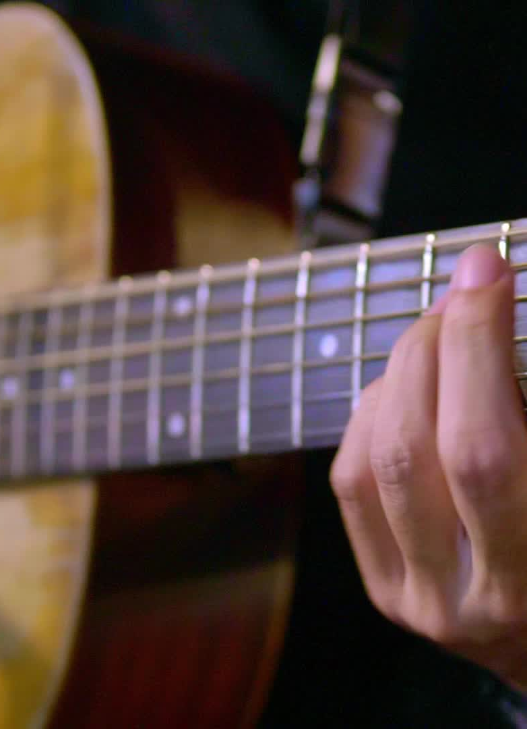
MAIN GOAL
Convert a chord sequence into a feasible and «musical» voicing sequence on guitar
Follow voicing principles
Sequence is found algorithmically
More possibilities
Support alternate tunings
Notes:
Basically, the main idea is to develop an application which takes as input a sequence of chords and find a voicing for the guitar which is both physically playable and musically pleasant.
More precisely, by «musically pleasant» we mean it will try to follow some common rules adopted for chord voicings and cadences.
The key aspect is that the guitar voicing is not found in a look-up fashion, by searching the chord among some database of commonly used positions, but is found in an algorithmic way.
This is obviously less efficient in terms of time, but it offers some advantages
-obviously the first one is that we are not constrained by the positions which are stored in the database
-secondly, this can work with different guitar tunings, and possibly even with other stringed instruments which have more or less than 6 strings. This is particularly important because guitar with seven or eight strings and employing alternate tunings are nowadays extremely popular.

Slide 3
FEATURES
Chords selection: input the chord sequence
Sequence player: listen to the result
Fretboard/TAB visualization: view result on fretboard or TAB format
Notes:
So these are the 3 main features:
-there is the chord input part, where the user is able to select an ordered sequence of chords. There’s also the ability to select the chords by playing them on a MIDI keyboard.
-There is an included player which can be used to have an immediate acoustic feedback for the generated voicing
-There is visualization section, which can switch between two different types of visualization

Slide 4
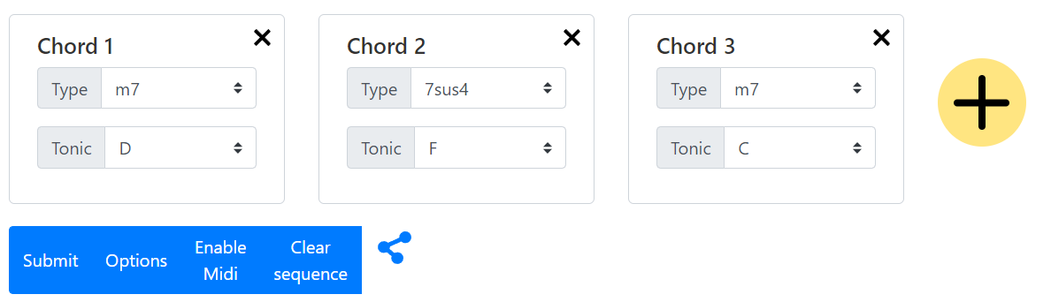
GUI
Top part dedicated to the input
Add or remove chords from the sequence
Specify root and type
Submit button generates the voicing sequence
Options button
Enable MIDI button
Clear sequence button
Chord cards can be moved around
Notes:
The top part is dedicated to the user input. The «plus» button allows to add a chord to the sequence, or we can also remove chords by clicking the «x» button.
For each chord we can select the root and the type, for example major, minor, delta, dominant seventh, and so on.
By clicking the submit button the voicing is generated and displayed.
There is also an option button, which opens a popup menu. Right now there are only a couple of options supported;
-one allows to switch between easy and difficult mode, depending on the desired technical complexity of the voicing
-the other is to allow the use of chord inversions when generating the voicings.
Then we have the «Enable midi» button, which enables the selection of the input chord sequence via MIDI messages. When this mode is enabled, we can play some chords on a midi instrument, and these will be recognized and appended at the end of the current chord sequence.
The clear sequence button simply empties the chord sequence.
We can also click on the chord cards to reorder the way they appear in the sequence.
Finally we have a «share button» which basically just copies the customized url which embeds the chord sequence, allowing to re-open the same chord sequence without having to select the chords again.

Slide 5
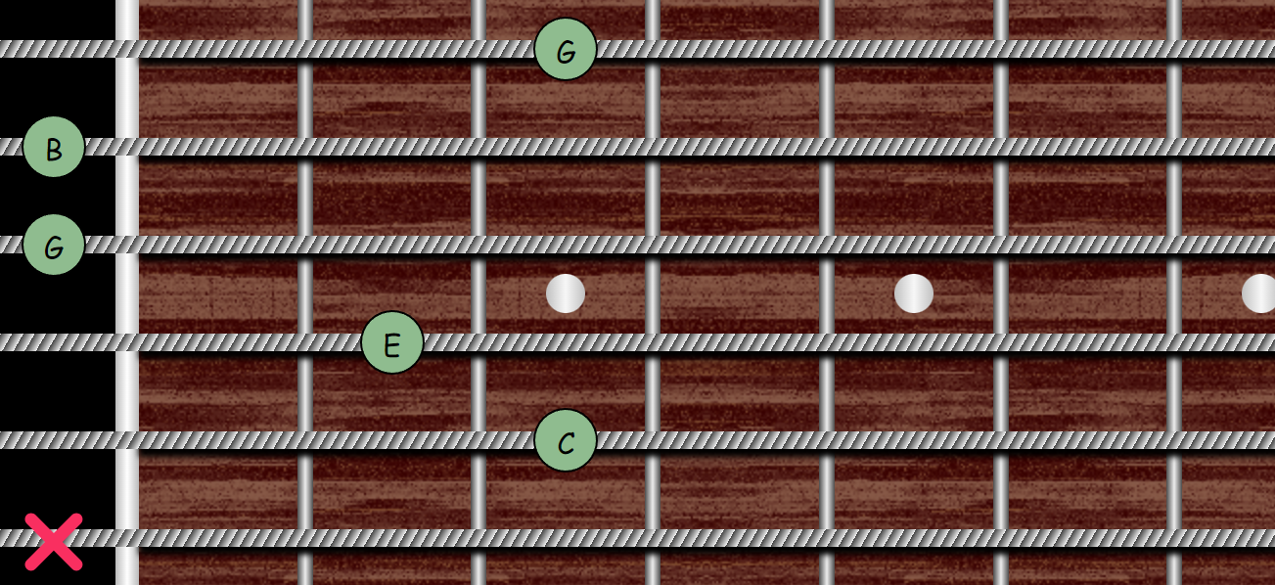
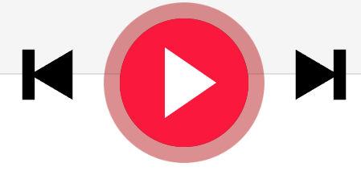
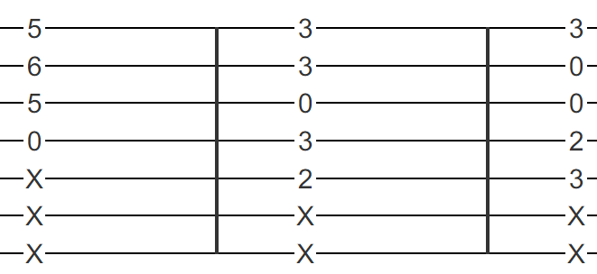
GUI
The lower section of the GUI is devoted to chord and sequence playing/visualization:
Play/forward/backward buttons to listen to the sequence
Change view between fretboard or TAB
Tuning menu
Notes:
The bottom part is devoted to the visualization and the player of the generated sequence.
The user can switch between two different views: one shows the chords on a guitar fretboard, including the note names, the other uses a common tablature visualization.
The play button allows for starting and stopping the audio, and there are also backward and forward buttons for easier navigation.
There is also a tuning button which allows to customize the tuning of the guitar.

Slide 6


Frameworks and Technologies Used
Entire application is developed in Javascript/HTML/CSS
Vue.js framework used for the GUI
Web MIDI API for MIDI interaction
Tonal js music theory library
Chords notes
Musical intervals
AudioSynth
Generating guitar sound for chord player
Notes:
The entire application was developed in javascript, html and css.
In particular we used the Vue JS framework to simplify the creation of the user interface and the connection with the application state.
We obviously used the Web MIDI API to handle midi instruments and messages in javascript.
Besides this, we developed most of the code ourselves, though we used two external libraries for some tasks, namely:
-tonal js, which is a javascript music theory library, to have the corresponde between notes and chords, and to compute the intervallic distances
-AudioSynth to synthesize the guitar sound for the player
Approx 4 minutes up until here

Slide 7
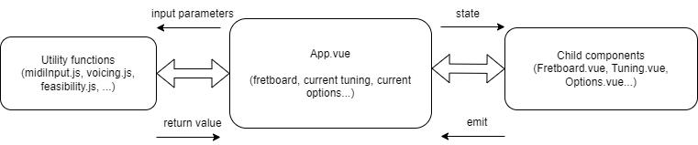
Code Structure
Main component: App.vue
Child components:
Input: Tuning.vue, Options.vue, ToggleButton.vue
Output: Fretboard.vue, Tablature.vue
Utility functions:
voicing.js
feasibility.js
freatbordModel.js
midiInput.js
note.js
sound.js
Notes:
The application is structured like this:
We have a main component called «App.vue». This is the the main entry point for the user interaction. It contains the HTML code for the user interface and the state variables.
Then we have other child vue components. These can be dedicated to input or output function, for the output we have
The fretboard component, which handles the fretboard visualization of the generated sequence
While for the output we have:
The tuning and the options component, which both show a pop up menu used to change the tuning or the user options
The child component receive the state variables from the main app component, and then they send back the modified state through the emit function
----We could split around here to have a first 5 minutes part
Then we have a bunch of utility functions. Differently from the components, these do not have a graphic part but only contains some functions and variables needed to perform some tasks. For example:
The voicing.js contains utility functions related to voicing generation
Feasibility.js contains utility functions to check feasibility
FretboardModel.js contains functions related to the modeling of the notes on fretboard, and searching notes on the fretboard
MidiInput.js contains utility functions to handle midi messages and chord recognition
Note.js specifies the Note class used to represent notes, and functions to operate on them
Sound.js contains utility functions for the sound synthesis
Around 6 minutes here

Slide 8
fretboardModel.js
Data model to represent the guitar fretboard as a matrix of Note objects (note.js)
Note: pitch class and octave
Equality supports enharmonic representations
Functions to analyze the fretboard:
getNote(position)
findPositions(fretboard, note, ignoreOctave)
Notes:
The fretboardModel.js module is used to create and handle the data model for the guitar fretboard, not the graphical one but the one used for voicing generation.
Basically the fretboard is considered as a matrix of custom Note objects, as specified in the note.js module.
Each note has both a pitch class, such as C, D, E and so on, and an octave represented by an integer.
The note.js module also implements other functions, such as an advanced note equality function which also takes account all enharmonic representation of the same note, so it can correctly recognizes that a C sharp is the same notes as a D flat for example.
Among the utility functions, the most important ones are
-getNote, which returns the note corresponding to a position
-findPositions, which returns all the possible positions for a given note on the fretboard. The parameter ignoreOctave tells the function if we care or not about a specific octave.

Slide 9
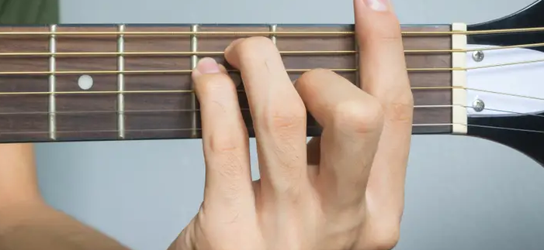
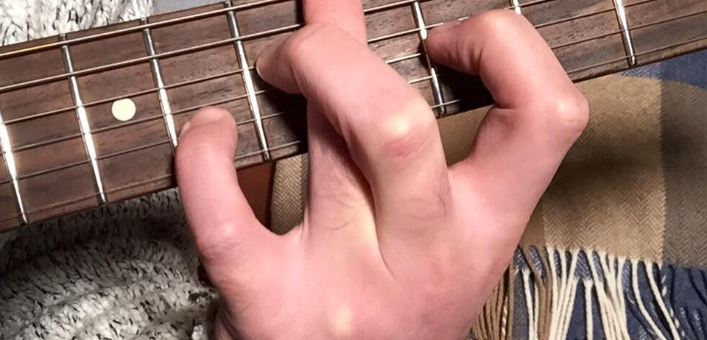
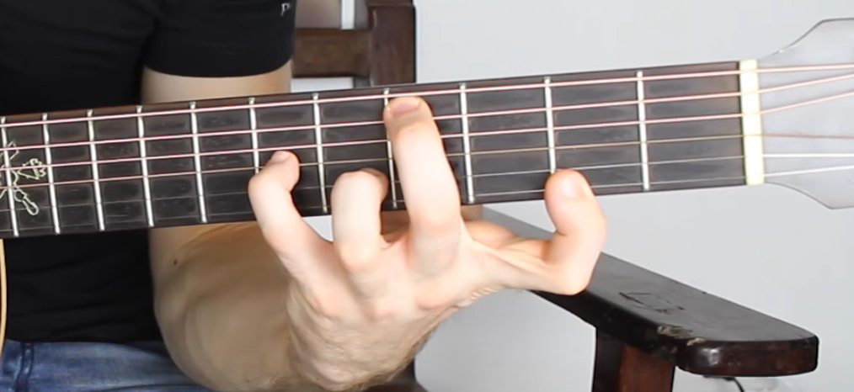
feasibility.js – Checking feasibility
First check: only search within limited range
Second check:
More complex rules
Assign an integer to each finger → fingers list = [0, 1, 2, 3]
Assign a finger to each pressed fret
Easy to implement checks
E.g. finger crossing check → (finger-usedFinger)*(currentFret-usedFret) < 0
Find a finger-frets assignment that doesn’t violate constraints
Notes:
To check if a chord is feasible there are actually two steps.
Firstly, we consider the tones to be included in the voicing only within a limited range of the fretboard, otherwise we would have too many useless possibilities.
But after this first process, we still need to perform a more thorough check, which consider the position where each individual finger is placed.
The implementation is based on the fact that we assign each finger an integer from 0 to 3. So initially we have this list containing all the fingers.
Each time we encounter a new pressed fret we assign one of the available finger to the fret that doesn’t violate the constraints, removing it from the list.
Using this model it’s easy to implement various kind of checks, for example one obvious check is that we can’t cross fingers, and this can be implemented, given «finger» which is the currently examined finger, and usedFinger which refers to a previously placed finger, by checking if the product between the fret and the finger increment is positive. In fact, for the fingers to not cross both quantities must either increase or decrease.

Slide 10

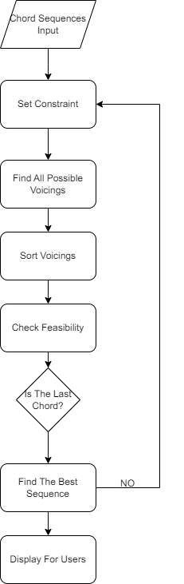



voicing.js -
Voicing Algorithm Overview
Notes:
Here we have an overview of the main steps performed by the voicing algorithm, which is definitely the most complex part of the program.
We start by setting the constraints on the notes or intervals which can be included in the current chord, which can depend
1)On the individual chord played
2)Or also on the chords before or after the current one
After this, we find all possible voicings for the chord. These voicings are sorted in a decreasing order of preference.
Then there is the in-depth feasibility check for the voicings.
The process is repeated for all the chords in the sequence
Finally,we build the sequence by choosing the best fitting voicing for each chord.

Slide 11
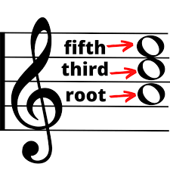
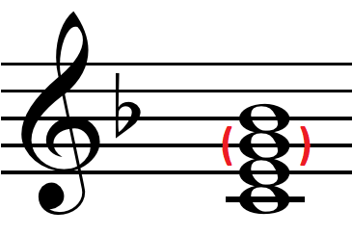
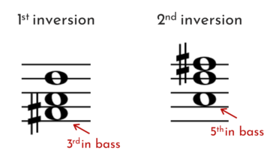
voicing.js – positions search
recursivePositionSearch finds all possible positions for a chord
Consider all possible «paths» from the top to the bottom string
findNextPositions find all valid positions on the next string
Stops as soon as it violates constraints
Notes:
For what concerns a single chord, the main function which is responsible to find all possible voicings is the recursivePositionSearch function.
This function works by starting from a valid note on the lowest string, and then proceed descending string by string searching for all possible sequences of positions which are valid, according to some constraints related to chord voicings.
When we find a path is not valid we stop following it, to avoid wasting time.
The function works in a recursive way, since each time it calls itself on a subset of the original number of strings, and in this way we consider all possible combinations of positions.
Approx 10 minutes here

Slide 12
voicing.js – Voicing Sequence Building
Find “optimal” sequence:
Distance between consecutive chords is minimized
Number of tritone resolutions between consecutive chords is maximized
Only a local short “window” of chords is considered (4 chords)
Notes:
Then we have functions dedicated to the generation of the entire voicing sequence. Basically, starting from a list of voicings for each chord, we consider all possible sequences, and try to find the «optimal» one, according to some criteria.
We measure a sequence quality using two criteria:
1) The minimum distance between consecutive pairs. In a simple intuitive way, the distance between two voicings represents the distance in frets between the two string by string. But some attention is needed if we want this measure to actually perform in a nice way
If a string is played in one chord but not in the next, we consider this as a distance of 4 frets. This is done to avoid a bias towards chords with less strings when progressing in the sequence
The total distance (sum of distances on all strings) is divided by the number of strings played. This is again done to avoid prioritizing chords with less notes
2) The highest number of tritone risolution
We consider the presence of a tritone risolution if there is a sequence of two intervals (from one voicing to the next) played on the same strings where
A diminished 5th is followed by a M3 or a P4, or alternatively
An augmented fourth is followed by a P5 or a m6
As one can imagine, this is a quite expensive process. In fact, for this reason we don’t actually consider the entire sequence of chords when selecting the best voicing sequence, as this would make the algorithm extremely slow for any sequence longer than 4 chords.
Instead we have a sliding window of 4 chords, which are considered when building the sequence, and chords which come after this windows are not considered. This «sliding windows» also have an overlap of one chord, meaning that each window will also consider the last chord coming from the previous window when building the sequence, to avoid «ugly» transitions between two windows.
To be more specific, the length of this window is what we call the «recursiveDepth» in the algorithm, since it bounds the level of recursion that the function can reach.
In pratice, we found 4 to be the best recursive Depth, as it allows for quick computation while returning good results, and generally increasing this beyond 4 will not improve the result significantly.

Slide 13
midiInput.js – Handle MIDI input
Chord recognition:
Consider notes within a 200 ms window
When we have at least 3 notes
Recognize chord using Chord.detect(notes) from tonal.js library
Use callback to App.vue to append chord to sequence
Notes:
The midiInput.js module contains functions for handling the MIDI chord input. The chord recognition algorithms works like this:
-we consider notes within a 200 ms window as belonging to the same chord. So the first note to come set the chord onset time. When we have following notes, if they fall within 200ms from this first one, we add it to the chord. Otherwise, we consider a new chord to have started. If the previous one had at least 3 notes, before replacing it we call the function Chord.detect from the tonal.js library, and then we have a callback function from the main component, which adds the recognized chord to the sequence.

Slide 14
CONCLUSIONS AND FURTHER DEVELOPMENTS
Chord sequences are playable and enjoyable from a musical perspective
Simple but effective GUI
Implement more interesting voicing rules
Add more user options (e.g. interacting with the resulting sequence)
Add musical staff notation for chord input/visualization
Notes:
In conclusion, the program is able to work fine with simple chords, such as triads or seventh chords, and the generated sequence are usually musically enjoyable and feasible to play.
The interface is very minimal but effective for the intented purpose.
And there are many ideas which could be further developed in the future starting from we achieved so far, for example
- Adding support for extended chords
We only implemented few and basic voicing rules, which only consider the current chord and at most one neighbouring chord, and it doesn’t take into account a reference key. But it would be interesting to implement some more complex voicing rules, perhaps something which is able to generate some form of voice leading inside the chord progression.
It would be nice to add more user options and make the interface more «interactive», for example by allowing the user to customize the returned sequence, and maybe re-generate the sequence saying which position you want to keep or not
Or being able to parse the sequence from standard music notation, and similarly show the output using musical notation
If we don’t add the swap chord and clear sequence buttons, I would suggest adding them as further developments here.
Total time: around 14:30 mins

