Slide 1


TabMaker
Group members: Riccardo Di Bella, Stefano Ravasi, Yan Zhuang
ACTM – CMRM Project
A.Y. 2022/23

Slide 2
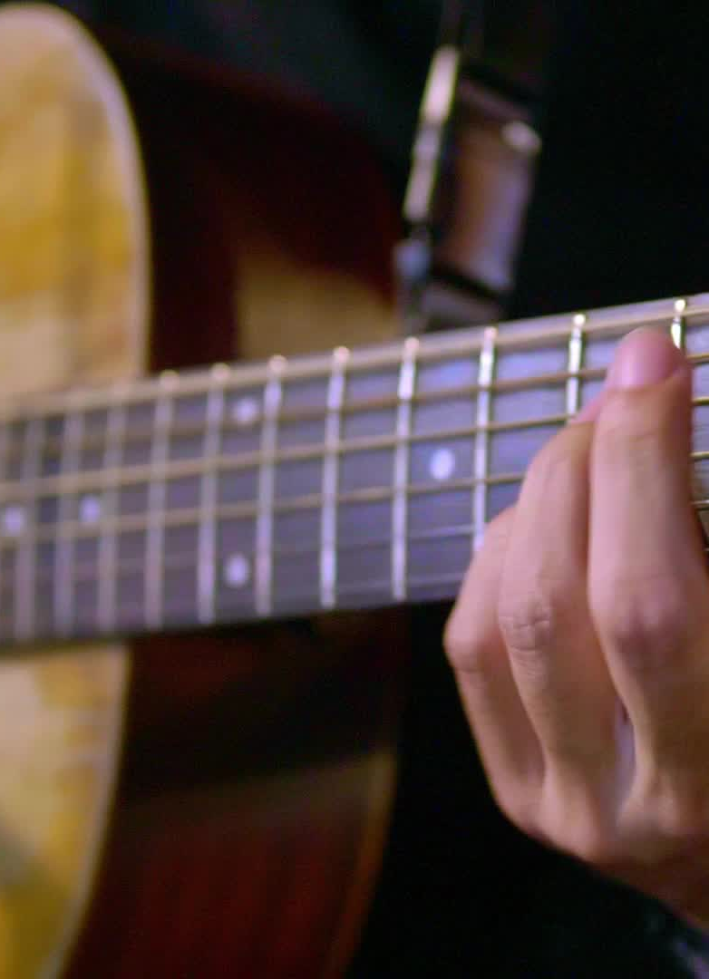
MAIN GOAL
Convert a chord sequence into a feasible and «musical» voicing sequence on guitar
Follow voicing principles
Sequence is found algorithmically
More possibilities
Support alternate tunings

Slide 3
FEATURES
Chords selection: input the chord sequence
Sequence player: listen to the result
Fretboard/TAB visualization: view result on fretboard or TAB format

Slide 4
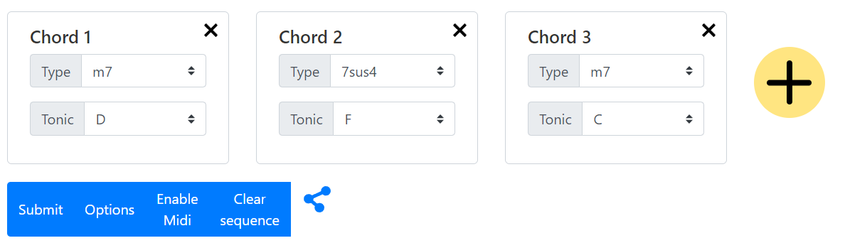
GUI
Top part dedicated to the input
Add or remove chords from the sequence
Specify root and type
Submit button generates the voicing sequence
Options button
Enable MIDI button
Clear sequence button
Chord cards can be moved around

Slide 5
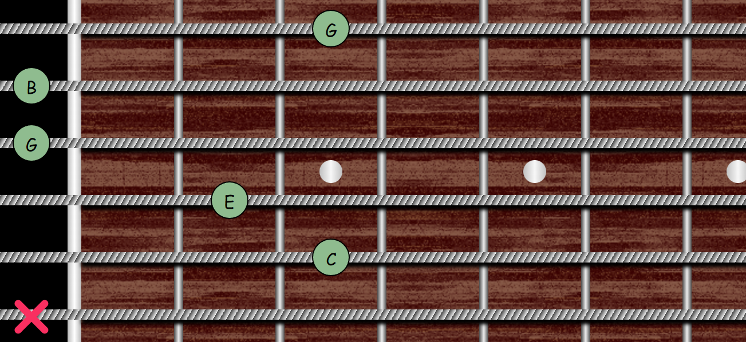
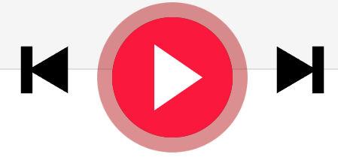
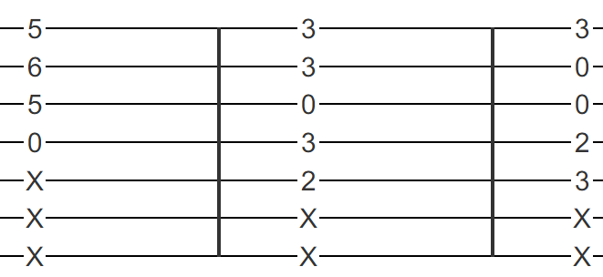
GUI
The lower section of the GUI is devoted to chord and sequence playing/visualization:
Play/forward/backward buttons to listen to the sequence
Change view between fretboard or TAB
Tuning menu

Slide 6


Frameworks and Technologies Used
Entire application is developed in Javascript/HTML/CSS
Vue.js framework used for the GUI
Web MIDI API for MIDI interaction
Tonal js music theory library
Chords notes
Musical intervals
AudioSynth
Generating guitar sound for chord player

Slide 7
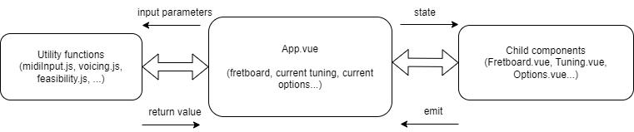
Code Structure
Main component: App.vue
Child components:
Input: Tuning.vue, Options.vue, ToggleButton.vue
Output: Fretboard.vue, Tablature.vue
Utility functions:
voicing.js
feasibility.js
freatbordModel.js
midiInput.js
note.js
sound.js

Slide 8
fretboardModel.js
Data model to represent the guitar fretboard as a matrix of Note objects (note.js)
Note: pitch class and octave
Equality supports enharmonic representations
Functions to analyze the fretboard:
getNote(position)
findPositions(fretboard, note, ignoreOctave)

Slide 9
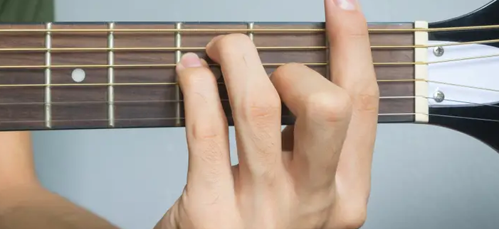
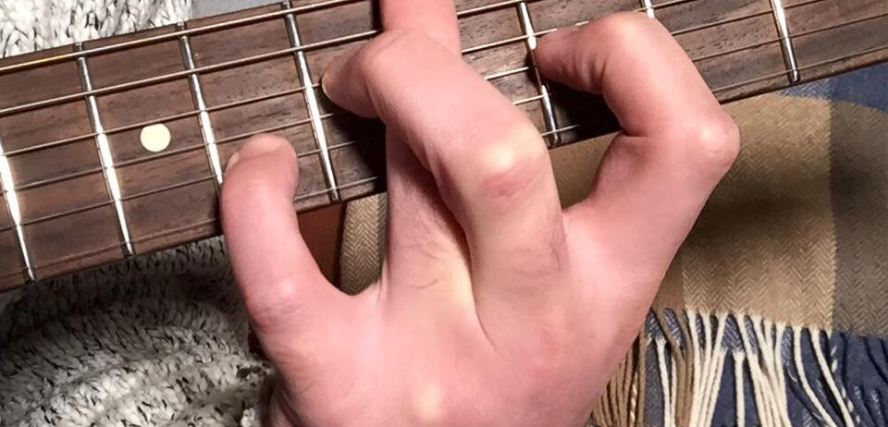
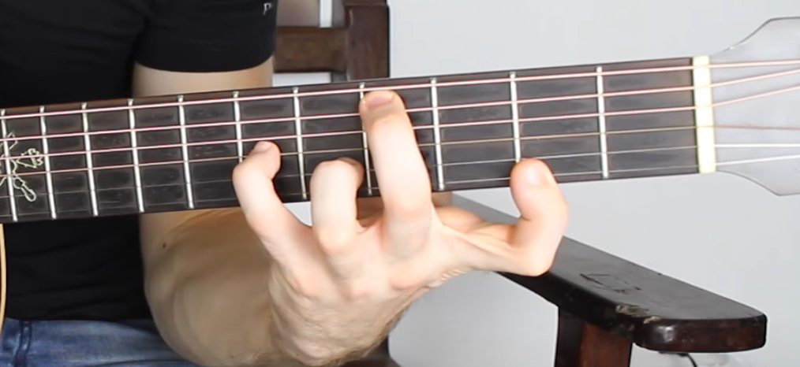
feasibility.js – Checking feasibility
First check: only search within limited range
Second check:
More complex rules
Assign an integer to each finger → fingers list = [0, 1, 2, 3]
Assign a finger to each pressed fret
Easy to implement checks
E.g. finger crossing check → (finger-usedFinger)*(currentFret-usedFret) < 0
Find a finger-frets assignment that doesn’t violate constraints

Slide 10

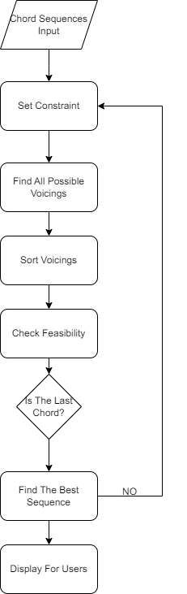



voicing.js -
Voicing Algorithm Overview

Slide 11
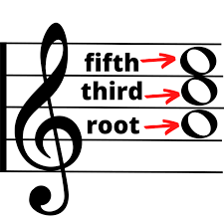
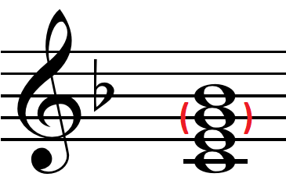
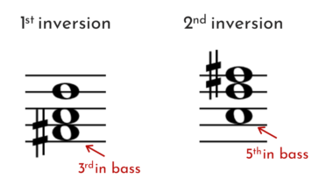
voicing.js – positions search
recursivePositionSearch finds all possible positions for a chord
Consider all possible «paths» from the top to the bottom string
findNextPositions find all valid positions on the next string
Stops as soon as it violates constraints

Slide 12
voicing.js – Voicing Sequence Building
Find “optimal” sequence:
Distance between consecutive chords is minimized
Number of tritone resolutions between consecutive chords is maximized
Only a local short “window” of chords is considered (4 chords)

Slide 13
midiInput.js – Handle MIDI input
Chord recognition:
Consider notes within a 200 ms window
When we have at least 3 notes
Recognize chord using Chord.detect(notes) from tonal.js library
Use callback to App.vue to append chord to sequence

Slide 14
CONCLUSIONS AND FURTHER DEVELOPMENTS
Chord sequences are playable and enjoyable from a musical perspective
Simple but effective GUI
Implement more interesting voicing rules
Add more user options (e.g. interacting with the resulting sequence)
Add musical staff notation for chord input/visualization

