Slide 1


TabMaker
Group members: Riccardo Di Bella, Stefano Ravasi, Yan Zuhang
ACTM – CMRM Project
A.Y. 2022/23

Slide 2
FEATURES
The main features implemented are:
Chords selection: the user is able to select an ordered sequence of chords
Sequence play: the found sequence of voicings can be played back for acoustic feedback (first as an arpeggio, then as a strum)
Fretboard/TAB visualization: once the sequence is computed, it is visualized on the guitar fretboard or in TAB notation

Slide 3
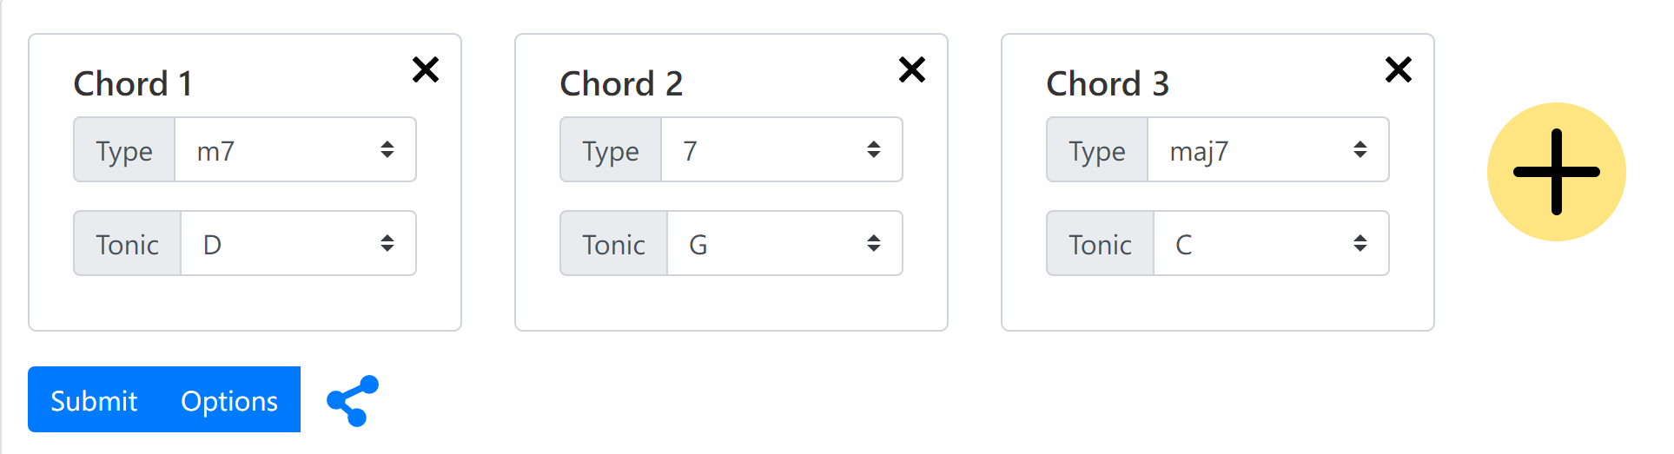
GUI
The higher section of the GUI is devoted to chord selection and sequence building:
The sequence can be built by adding an arbitrary number of chords: the root and the type can be selected for each of them
The algorithm is started by clicking the submit button

Slide 4
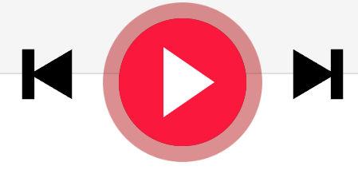
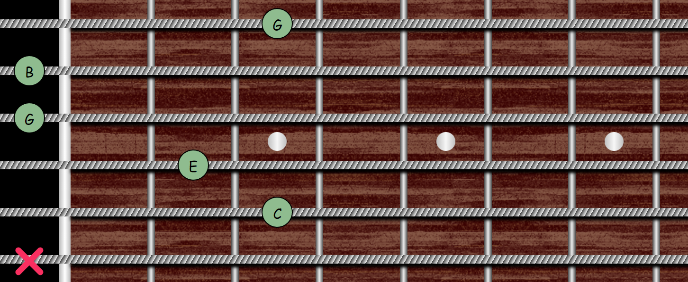
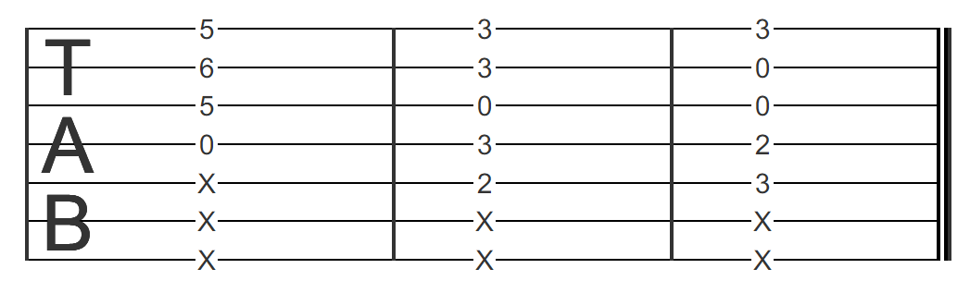
GUI
The lower section of the GUI is devoted to chord and sequence playing/visualization:
The sequence can be played/stopped by clicking the play button
The view can be chosen between fretboard single chord visualization and sequence TAB visualization: while playing the guitar strings move accordingly and the notes are highlighted in TAB notation

Slide 5
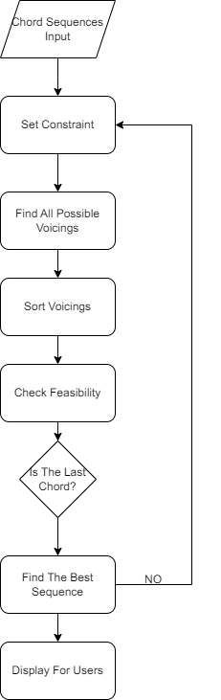
OVERVIEW STRUCTURE

Slide 6
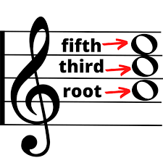
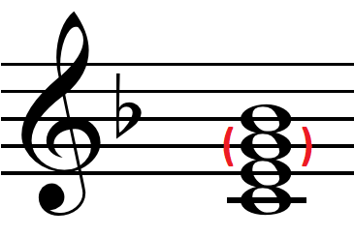
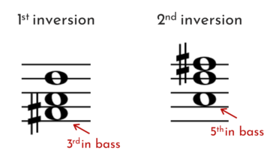
CHORD CONSTRAINTS
A triad must contain all the tones
In a tetrade the 5th can be skipped
Only 1st and 2nd inversions are allowed (7th can not be in bass)

Slide 7
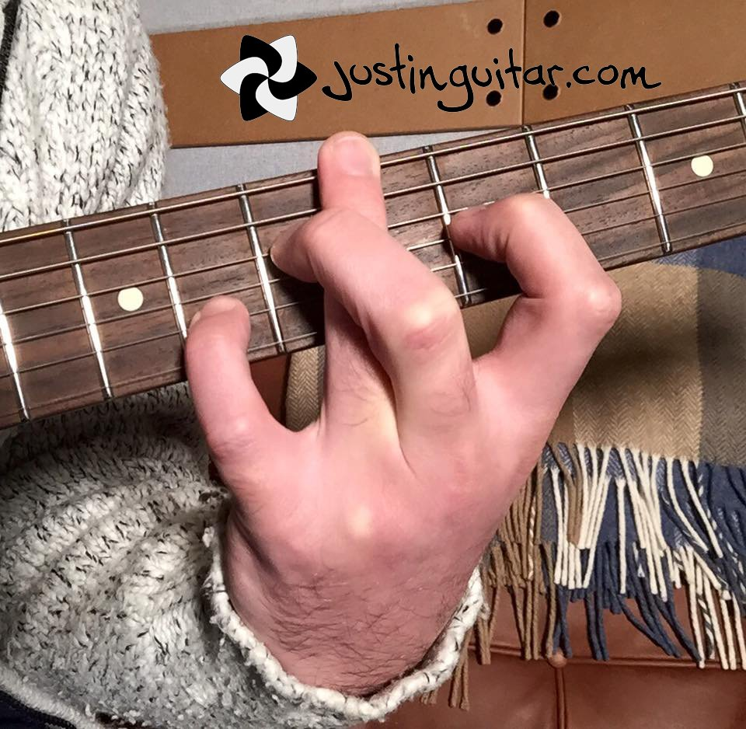
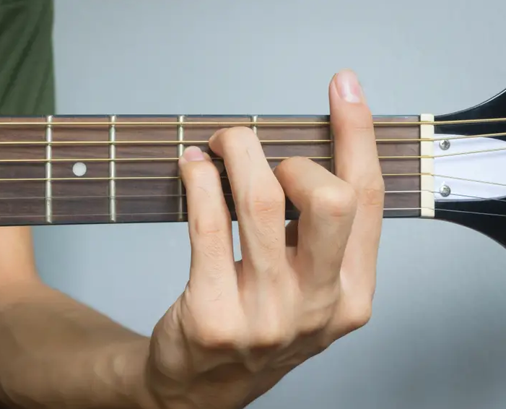
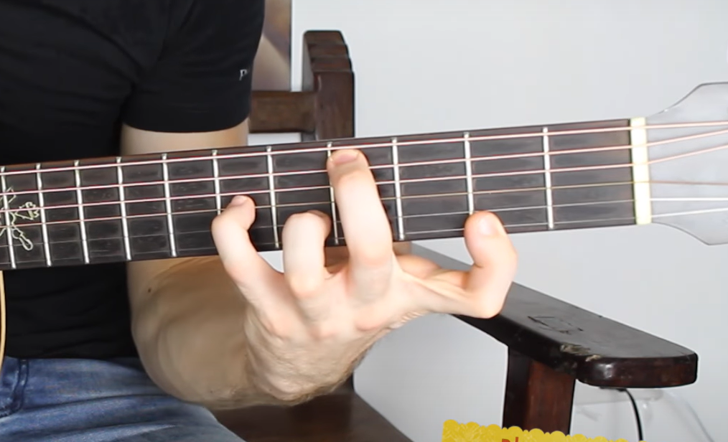
FEASIBILITY CONSTRAINTS
Fingers can not cross
First fret will always be assigned to the index finger (always possible to find a voicing)
Adjacent fingers must press adjacent frets (1stretch allowed in difficult mode)
Maximum chord width must not exceed 4 frets (5 in difficult mode)

Slide 8
VOICING BUILDING
The doubling of the 3rd is avoided if the chord has a dominant function
Having two perfect 4th intervals is avoided when chords are inverted
Open chords (at least one unfretted open string) are preferred whenever possible
If there are more than 4 fretted notes, a check is performed to discover if the barre (one finger to press down multiple strings across a single fret) can be used

Slide 9
SEQUENCE BUILDING
First chord can not be inverted (generally unpleasant results)
Distance between consecutive chords is minimized
Number of tritone resolutions between consecutive chords is maximized
Chords with the highest number of distinct pitches are preferred

Slide 10
CONCLUSIONS
The developed project gave satisfying results:
Works perfectly with all triads and tetrades
Classic and original voicing found are feasible and pleasant to hear
Chord sequences are playable and enjoyable from a musical perspective
Graphic user interface is interactive and easy to use: it allows the user to learn/test chord voicings and to find interesting harmonic progressions

Slide 11
FURTHER IMPROVEMENTS
The following ideas could be developed in the future:
Improve the algorithm to make it work with chords built with more than 4 tones
Improve the algorithm efficiency to allow a higher recursion depth
Add MIDI capabilities for chord recognition and selection
Add musical staff notation for chord input/visualization

