Slide 1

Tomato Leaf Disease Detection
21AIE213- Robotic Operating Systems
TEAM 9
CH.EN.U4AIE21107 – Aparna S
CH.EN.U4AIE21113 – G V Rohan
CH.EN.U4AIE21115 – Harshitha M
CH.EN.U4AIE21122 – Korrayi Saiteja
CH.EN.U4AIE21125 – M Sravani

Slide 2
Agenda
Agenda
Tomato disease prediction involves the development of models and techniques to forecast and predict the occurrence and severity of diseases affecting tomato plants. It aims to provide early detection, enable timely intervention, and enhance disease management strategies.
We aim to develop a model for detecting the tomato leaf diseases like bacterial spot, early blight, late blight, leaf mold.

Slide 3
Introduction
INTRODUCTION
The main crops such as tomatoes, wheat, sugar, potatoes, etc are being affected by n number of diseases. Even though every plant has the potential to get affected by plant diseases this has become a major drawback in the agricultural sector even if pesticides are given for the infected plant. Therefore, disease prediction plays a crucial role in the prediction of plant diseases especially if the disease is known. Crop diseases are the key point of food security. In this project, we implement Robot simulation where the robot navigates around the agricultural field and detects the percentage of the disease affected. In this era, modern technologies have the capability to produce enough food to meet the needs of 8 billion people. The first crucial step in identifying the disease is efficient disease management. There is another approach for disease prediction is the traditional approach which is done by collecting the samples from the local plant clinics.
Moreover, it is very important to design a method that allows the farmers to quickly diagnose the disease using deep learning methods, with the best accuracy rate and better prediction.

Slide 4
Objectives
The main aim of this project is to develop a model for the prediction of tomato leaf disease using deep learning algorithms.
To implement deep learning algorithms like Convolutional Neural Networks (CNN), Support Vector Machine (SVM), Stochastic Gradient boosting, Resnet, and VGG with XGBoost (Hybrid model) to achieve the best accuracy.
This system predicts the diseases of tomato leaf-like Tomato_Bacterial_spot, early_blight, late_blight, and leaf_mold. It also monitors the health of the tomato leaf.

Slide 5
Existing Works
Existing Works
Author Name | Algorithms & Methods Used | Description | Remarks | Accuracy
Prajwala Tm, Alla Pranathi, Nagaratna, B. Chittaragi | CNN, LeNet | Tomato Leaf disease detection using Convolutional Neural Networks | This paper was published on the 2018. The main goal of the project is to find tomato leaf disease detection using simplest methods. | 94-95%
Usama Mokhtar Mona A | Gabor wavelet, transform method, Support Vector Machine (SVM) | Tomato leaf detection methods using support vector machine | This article was published in February 2016. Support vector machine with several kernel functions was used to test the capability of the method. | 99.5%
Rajasekaran Thangaraj, S. Anandamurugan | Convolutional Image Processing and machine learning algorithms | Artificial Intelligence in Tomato Leaf Disease Detection: A Comprehensive Review and Discussion | This arcticle was published in 2021. This focus on the present recent work in the field of tomato leaf search | 96%
Mosin Hasan Tanawala Bhavesh | Tensor flow, CNN, Transfer learning. | Deep learning precision farming. Tomato leaf detection by transfer learning. | This article was published in 2019. The page is divided into 3 different types as good, fair and bad. It will give 99 percent accuracy. | 99%

Slide 6
Author Name | Algorithms & Methods Used | Description | Remarks | Accuracy
Ashqar Belal A.M Samy S | Convolutional neural network (CNN) | Image based tomato leaves detection using deep learning techniques. | This article was published in the year 2018. In this paper they trained convolutional neural networks to detect 5 diseases. | 98%
Mohit Agarwala, Abhishek Singh, Siddhartha Arjaria, Amit Sinha, Suneet Gupta | CNN VGG (Visual Geometry Group) | Tomato Leaf Disease Detection using Convolution Neural | This paper was published in the year 2019. The classification accuracy varies from 76% to 100% with respect to classes and average accuracy of the proposed model is 91.2%. | 91.2%
Xibei Huang Aibin Chen Xin Zhang. | FCN(Full convolutional network). VGG-16 model. DPN(Dual path netorks) | Tomato leaf disease detection system based on FC-SNDPN. | This paper was published on 2022. VGG-16 model is used to segment the target crop image. The accuracy of this project is 97.59 percent. | 97.59%
Iftikhar Ahmad, Muhammad Hamid, Suhail Yousaf, Muhammad Ovais Ahmad | CNN VGG-16,VGG-19, ResNet, and Inception V3 | Optimizing Pretrained Convolutional Neural Networks for Tomato Leaf Disease Detection | Combination of learning algorithms and various splits of training and testing and reported an accuracy of 99.35% | 99.35%
Hsing-Chung Chen, Agung Mulyo Widodo, Andika Wisnujati | AlexNet Convolutional Neural Network, Adam optimizer, | Tomato leaf disease detection and classification using AlexNet Convolutional Neural Network. | This paper was published on 2021. In this article authors implemented ALexNet on android platform to predict the disease. The overall accuracy was 98 percent. | 98%
Belal A. M. Ashqar, Samy S. Abu-Naser | Convolutional Neural Network (CNN) | Image-Based Tomato Leaves Diseases Detection Using Deep Learning | Accuracy of 99.84% on a held-out test set, and second best model (Gray-Scale) achieved an accuracy of 95.54% | 99.84% and 95.4%

Slide 7
Author Name | Algorithms & Methods Used | Description | Remarks | Accuracy
Haridas D. K. Kirange | Segmentation, Feature extraction, Training and classification. | Tomato leaf disease diagnosis and severity measurement | This paper was proposed was proposed on July 2020. This article analysed the performance of different feature extraction including colour, texture and shape.. | 96%
Azeddine Elhassouny Floretin | Convolutional Neural Network (CNN) , MobileNet | Smart mobile application to recognize the tomato leaf detection using convolutional network. | This paper was published in the year 2019. This paper uses tomato leaves dataset and used in smart mobile system to perform tomato disease diagnostics. | 95.8%
Mosin Hasan, Bhavesh Tanawala, Krina J. Patel | CNN (ReLU) | Deep Learning Precision Farming: Tomato Leaf Disease Detection by Transfer Learning | 99% accuracy is achieved when training percentage is increased to 85% . | 85%

Slide 8

Research Gap
Limited and Imbalanced Datasets: This model requires large and diverse datasets for effective training. However, obtaining a comprehensive dataset for tomato leaf diseases that covers a wide range of pathogens, environmental conditions, and disease severities can be challenging.
Limited Disease Coverage: Many existing disease prediction models focus on specific diseases or groups of diseases, neglecting the comprehensive coverage of the wide range of tomato leaf diseases. There is a need for more inclusive models that can accurately predict a broader spectrum of diseases, including emerging or less common pathogens that can cause significant damage to tomato crops.
Lack of Interpretable Models: Deep learning models, such as convolutional neural networks (CNNs) considered they lack interpretability. Understanding the reasoning behind the predictions made by these models is crucial for gaining trust and acceptance from end-users, such as farmers. Developing techniques to interpret and explain the decisions made by deep learning models in the context of tomato leaf disease prediction is an important research direction.

Slide 9
Research Gap
4. Integration of Management Recommendations: Disease prediction models often focus on identifying the presence or absence of diseases but provide limited guidance on appropriate management strategies. Integrating actionable management recommendations into prediction models can help farmers make informed decisions and implement effective disease control measures.
5. Transferability and Generalization: Deep learning models trained on one dataset or region may not generalize well to different locations or growing conditions. Tomato leaf diseases can exhibit variations across different regions, climates, and tomato varieties. Developing transferable models that can adapt to diverse environments and accurately predict diseases in unseen datasets is a significant research challenge.

Slide 10
Proposed Algorithm
Proposed Algorithm
The classification was done using the below-listed models:
SVM classifier
CNN
Stochastic boosting
Resnet
VGG with XGBoost (Hybrid model)

Slide 11
Methodology
Data collection
Data Preprocessing
Train and test
Apply classification
1. SVM Classifier
2. Convolutional Neural Network (CNN)
3. Stochastic boosting
4. Resnet
5. VGG with XGBoost (Hybrid model)
Evaluation parameter
Comparative analysis

Slide 12
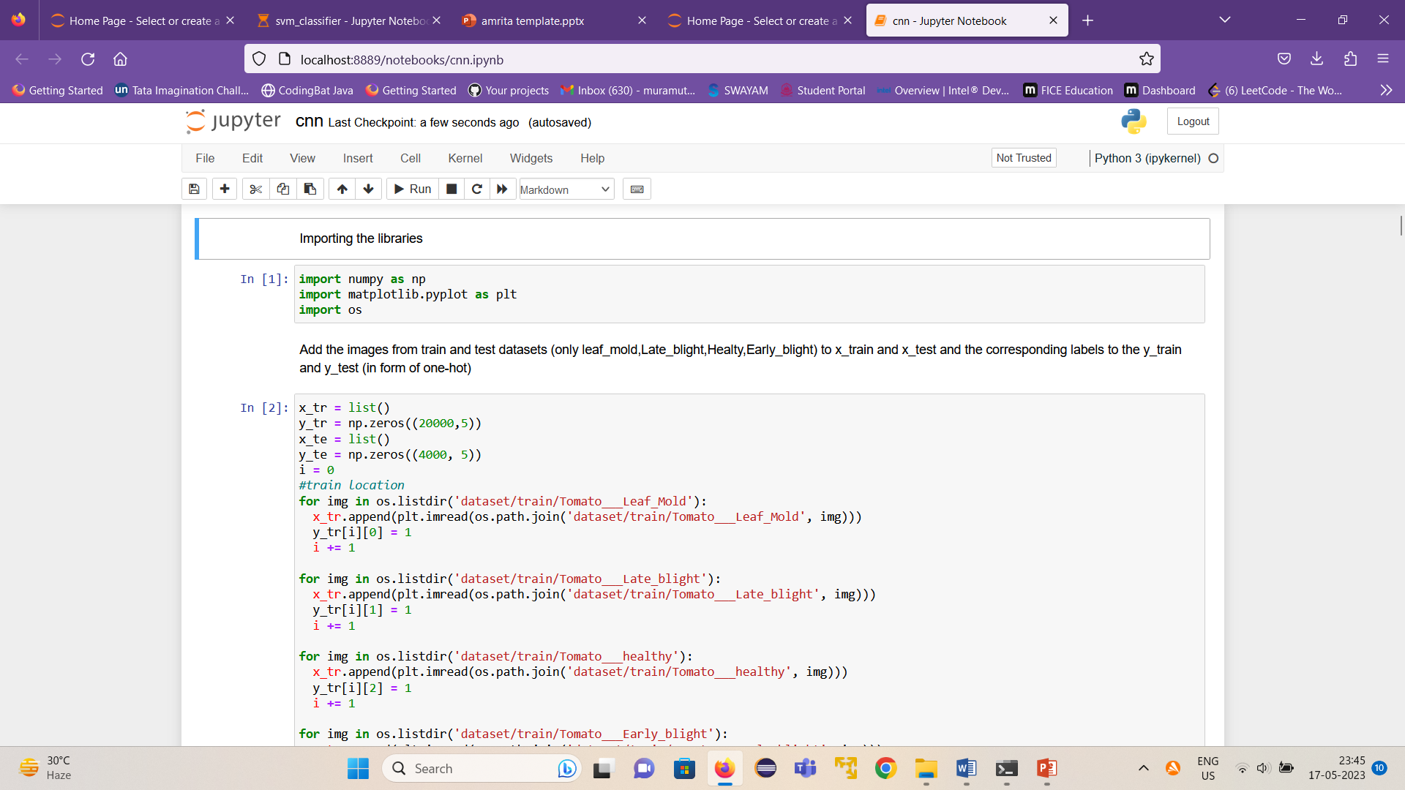
Implementation Details
Implementation Details - CNN

Slide 13
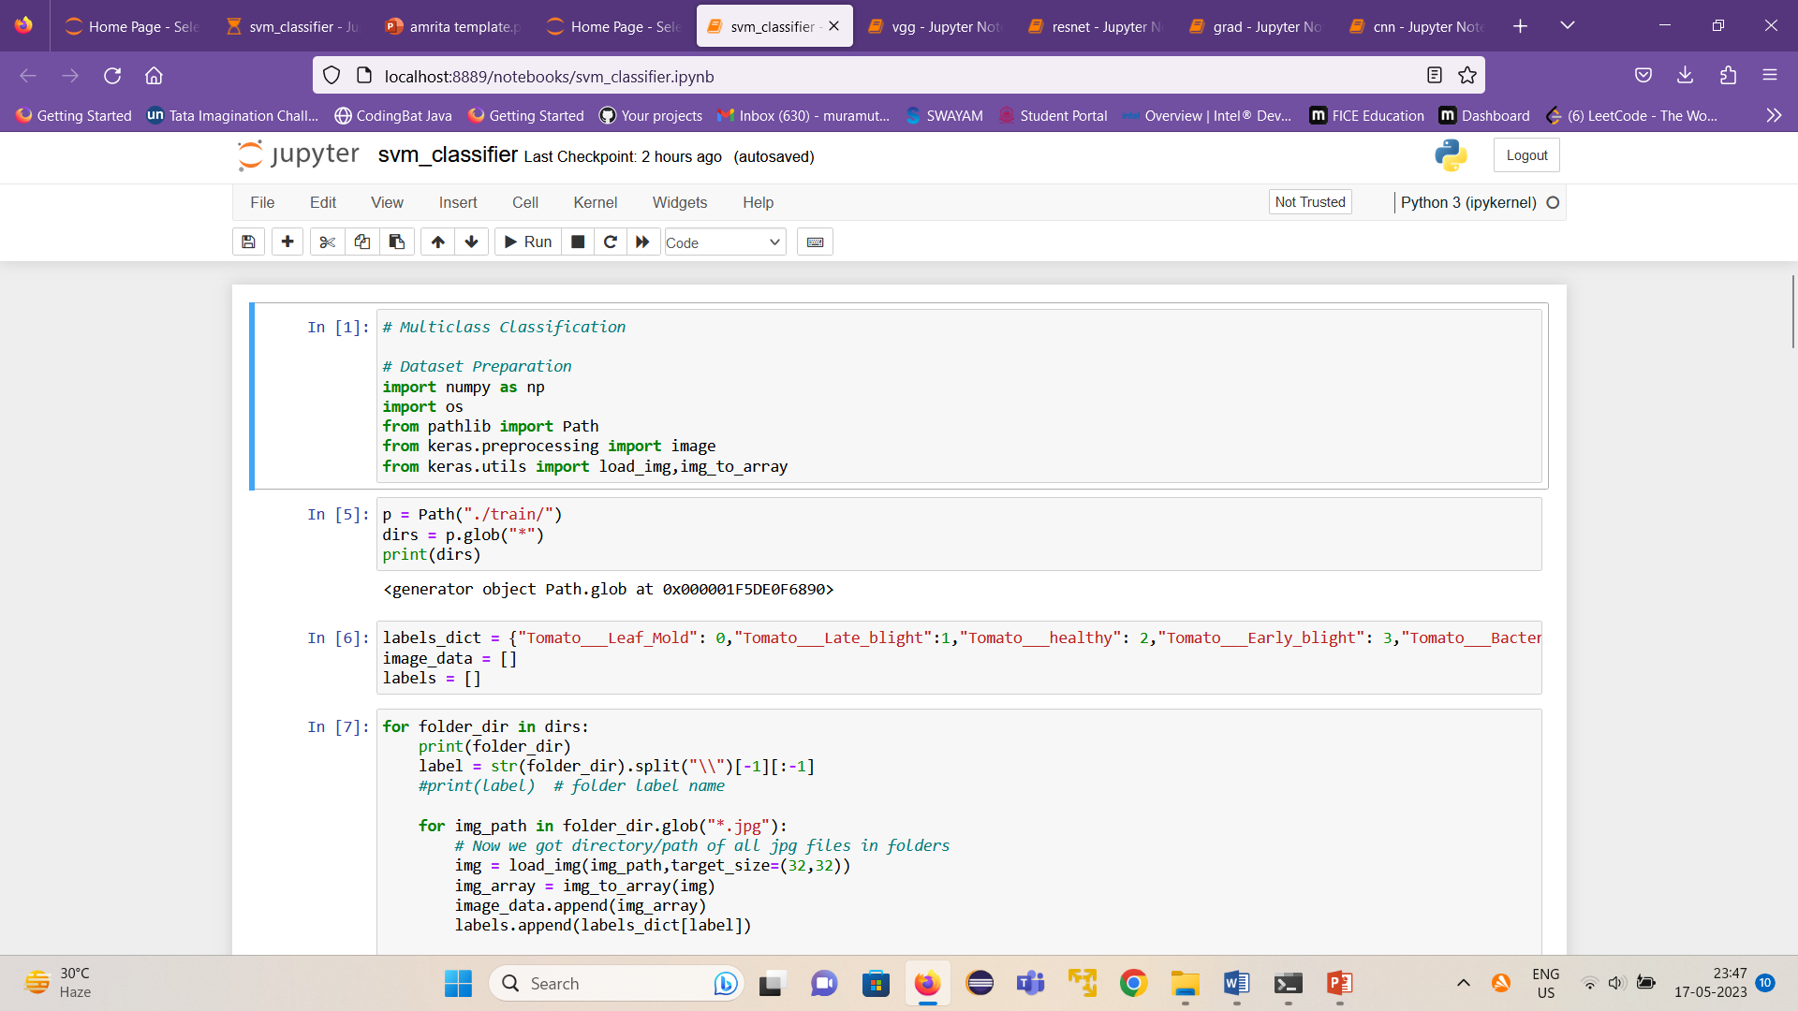
Implementation Details
Implementation Details - SVM

Slide 14
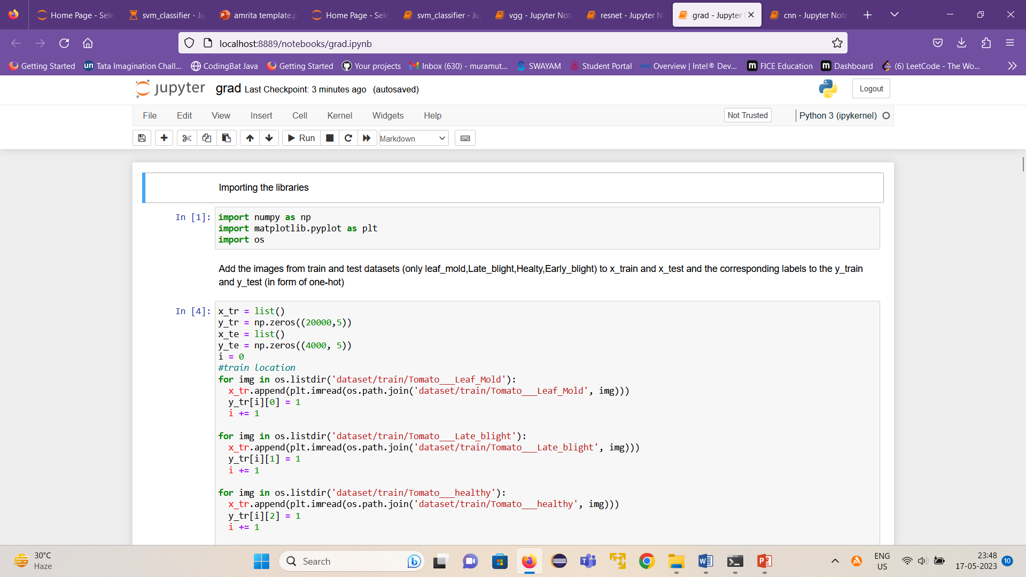
Implementation Details
Implementation Details – Stochastic descent

Slide 15
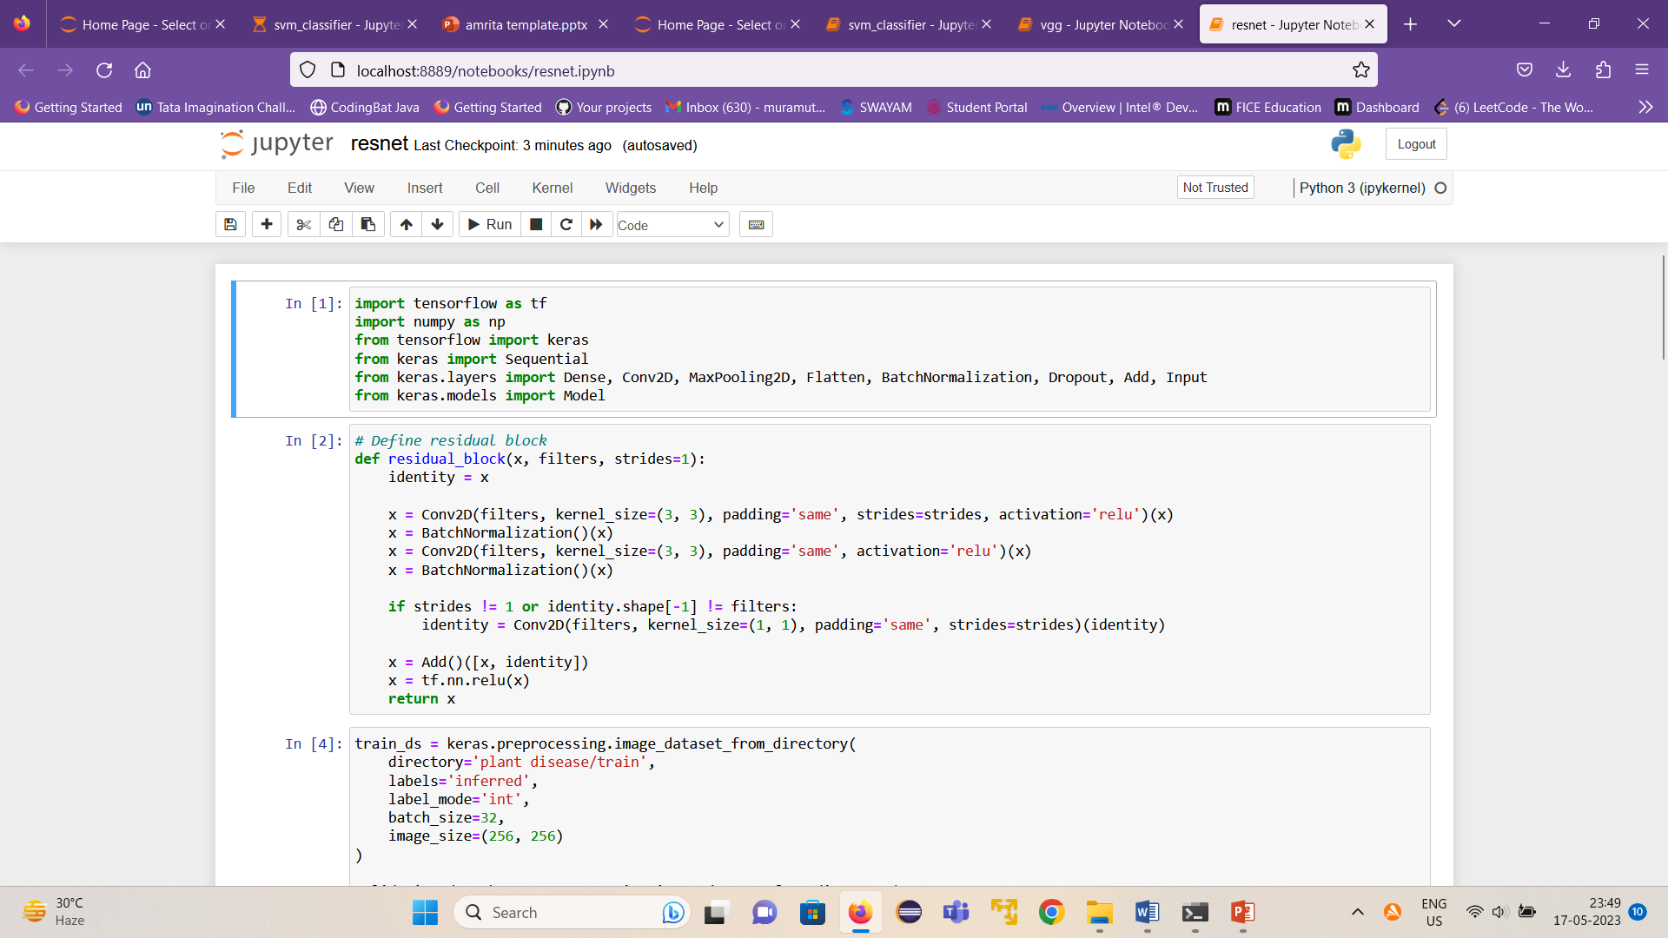
Implementation Details
Implementation Details - Resnet

Slide 16
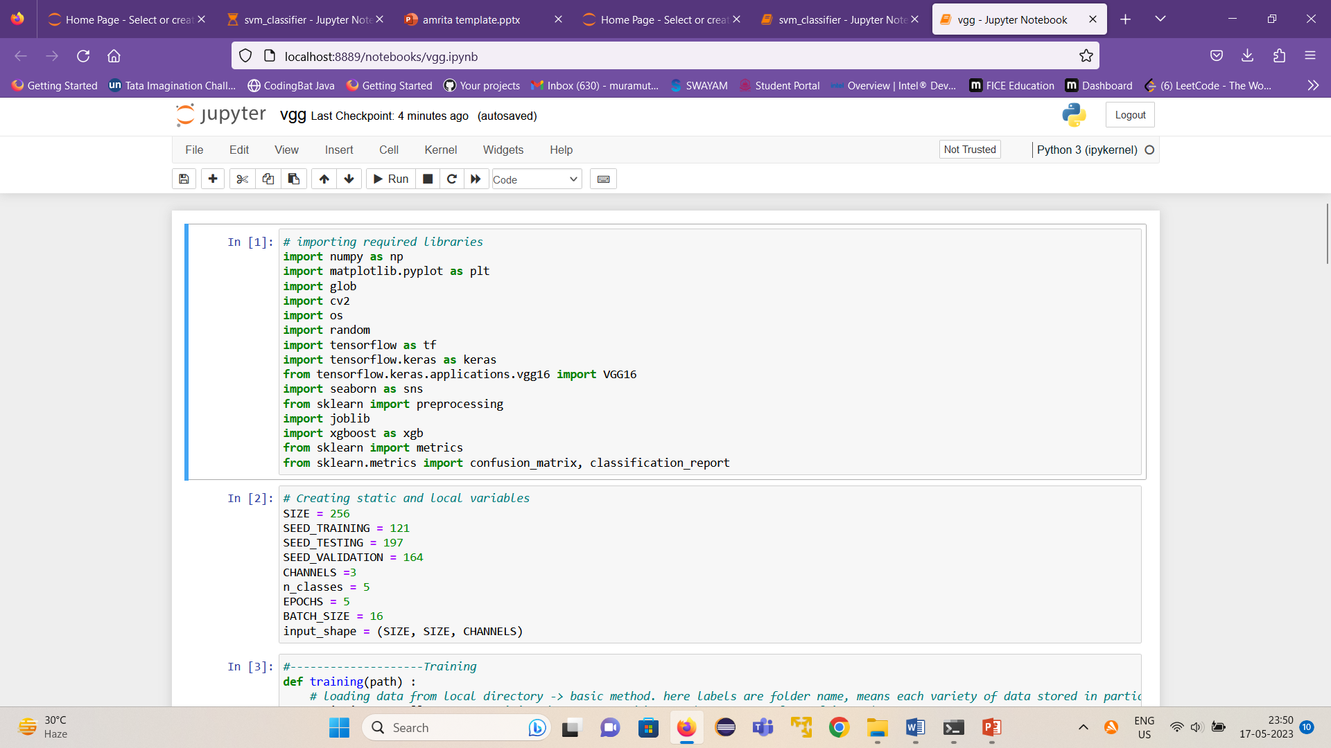
Implementation Details
Implementation Details – VGG with XGBoost

Slide 17
Results
DEEP LEARNING MODEL | ACCURACY
CNN | 86.67%
SVM classifier | 18.57%
Stochastic gradient boosting | 100%
Resnet | 20.87%
VGG with XGBoost (Hybrid mode | 85%

Slide 18
Conclusion
Conclusion
Tomato leaf disease detection using deep learning can contribute to sustainable agriculture practices, reducing crop losses, optimizing resource utilization, and improving food security.
The advantages of deep learning in tomato disease prediction include high accuracy, speed, and scalability.
Deep learning models can quickly process and analyze vast amounts of data, enabling rapid detection and diagnosis of diseases.
The conclusion of studies on tomato disease prediction using deep learning is that these models have the potential to revolutionize disease management in tomato cultivation.
By training the models on extensive datasets containing images of healthy and diseased tomato plants, deep-learning algorithms can learn to recognize patterns and symptoms associated with specific diseases.

Slide 19
THANK YOU

