Slide 1

Coal Mine Monitoring System using Machine Learning
21AIE211-Introduction to Computer Networks
TEAM 9
CH.EN.U4AIE21107 – Aparna S
CH.EN.U4AIE21113 – G V Rohan
CH.EN.U4AIE21115 – Harshitha M
CH.EN.U4AIE21122 – Korrayi Saiteja
CH.EN.U4AIE21125 – M Sravani

Slide 2
Agenda
Introduction
A safe and secure environment in places like coal mines is a crucial aspect and is in need of the hour. Countless accidents are caused due to the lack of a proper monitoring system.
Coal mine monitoring System using Machine Learning has numerous advantages in intelligent analysis and decision-making. Our project includes a safe coal mine monitoring system using machine learning algorithms. It monitors the concentration of gas and the values of temperatures as the parameters if the values of the parameter the alarm will ring.
We present machine learning based web interface which is designed on SVM, KNN, Decision Tree, Random Forest, Gradient Boosting.
Using Streamlit we deploy machine learning model into a user-friendly Web Interface.

Slide 3
Problem Statement
The current coal mine monitoring systems lack the ability to effectively analyze and interpret the vast amount of data generated in real-time, resulting in suboptimal safety practices, increased risk exposure, and inefficient resource allocation.
There is a critical need to develop a monitoring system that utilizes machine learning models to analyze the data collected from various sensors and parameters within the coal mine.

Slide 4
Objectives
Our project focuses mainly to develop various machine learning models to make informed decisions, making analysis more effective.
Machine learning algorithms like Decision Tree, Logistic Regression, KNN, Gradient Boosting, SVM and Random Forest are used to develop the model.
To design a user-friendly web interface for monitoring the coal mining system using Streamlit.

Slide 5
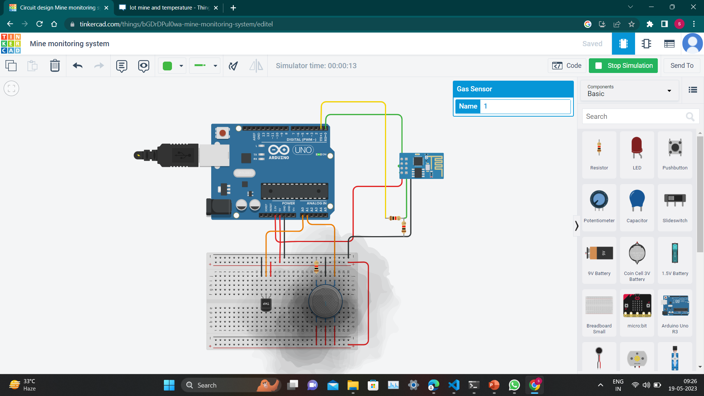
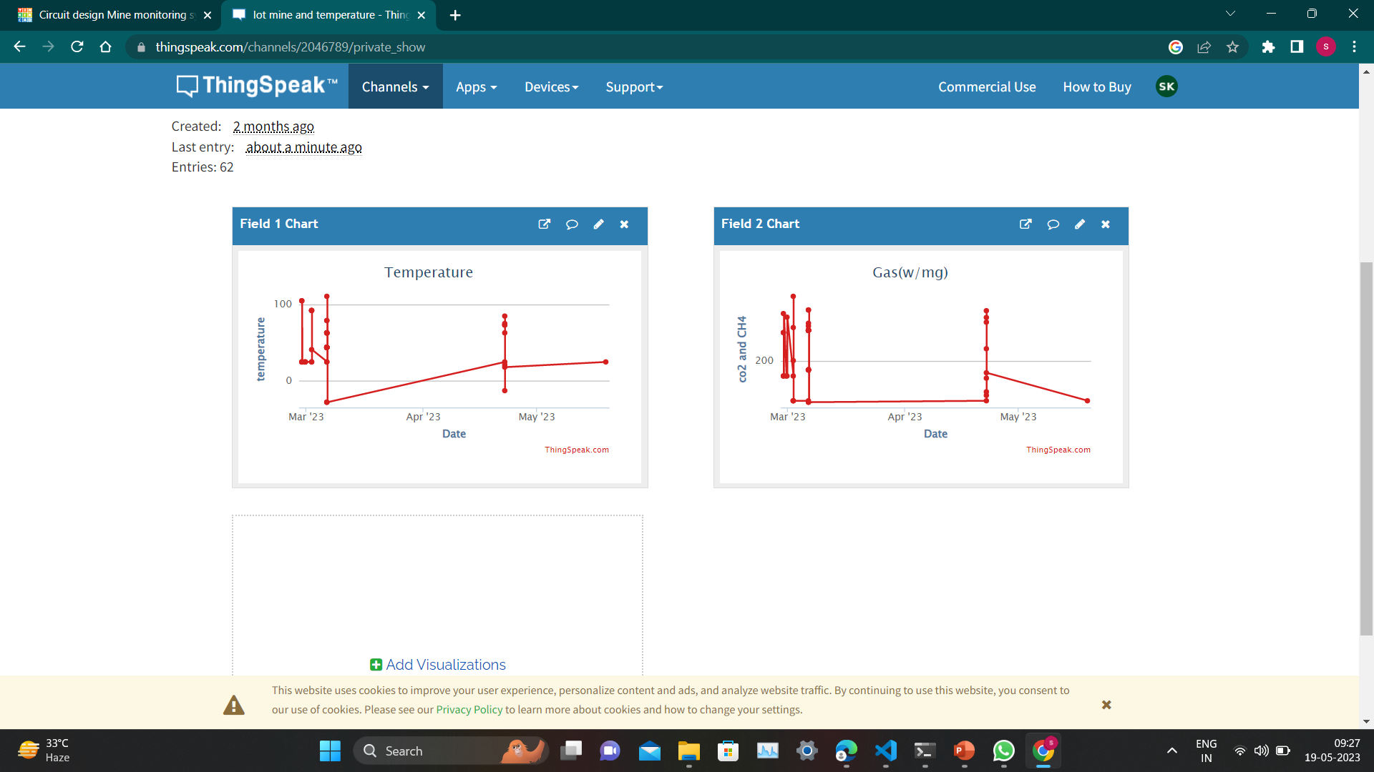
Data collection
Collecting Data in ThingSpeak
Circuit in Tinkercard

Slide 6
Existing Works
Existing Works
Author Name | Algorithms & Methods Used | Description | Remarks
M. Fatemeh | IoT, Wireless Sensor Networks ( WSNS) | A Comprehensive review of the Internet of Things (IoT) and its impact on the mining industry | They explored the current challenges facing the coal mine industry and make recommendations in 2020 to build better models for the industry’s different risks.
Duarte J Rodrigues F Branco JC | IoT | Sensing Technology Applications In the Mining Industry- A Systematic Review | They developed a technique in 2022 that analyzes the measured data by creating a wireless connection at the edge with the help of sensors that uses less electricity
SathisKumar N | IoT using LoRaWAN | Clean IoT based coal mine safety and health monitoring using LoRaWAN | They developed an integrated communication and data transmission system using deep learning services in the article. And they created a graphical user interface of different underground body sensor devices with the help of visual techniques.

Slide 7
Existing Works
Existing Works
Author Name | Algorithms & Methods Used | Description | Remarks
Yang L Birhane GE | IoT | Mining employees safety and the application of information technology in coal mining | They presented a review paper in 2021 where the safety issues of the workers in the coal mines are discussed along with the significant of the information technology.
Matloob S Li Y Khan KZ | AI and ML | Safety assessment and risk assessment for the coal mining industry using artificial intelligence and machine learning | They developed several models for improving safety measures in mines. However, the need for big data management degrades physical performance.
Skora M Gilerson A Sherikar M Mitra R | Wireless transmission system | Design and survey to evaluate singlewire and wireless transmission systems in the blast zone of underground mines | The authors developed several models for improving safety measures in mines. However, the need for big data management degrades physical performance.

Slide 8

Research Gap
Sensor Technology: The development of advanced sensor technologies can accurately detect and monitor various parameters in coal mines.
Wireless Communication: Most coal mines are vast and complex environments, making wireless communication crucial for transmitting data from sensors to the monitoring system.
Real-time Monitoring and Warning Systems: Enhancing real-time monitoring capabilities and developing effective warning systems are vital for ensuring safety of coal mine workers.
Automation and Robots: Integration of automation and robotics technology in coal mine monitoring systems can improve efficiency.

Slide 9
Proposed Algorithm
Proposed Algorithm
SVM (Support Vector Machine)
KNN
Decision tree
Random Forest
Gradient Boosting
Logistic Regression

Slide 10
Proposed Architecture
Data collection
Data preprocessing
Data labeling
Splitting data
Testing model
Evaluating model
Training model
Selecting model architecture
Deploying model
Web Interface of model

Slide 11
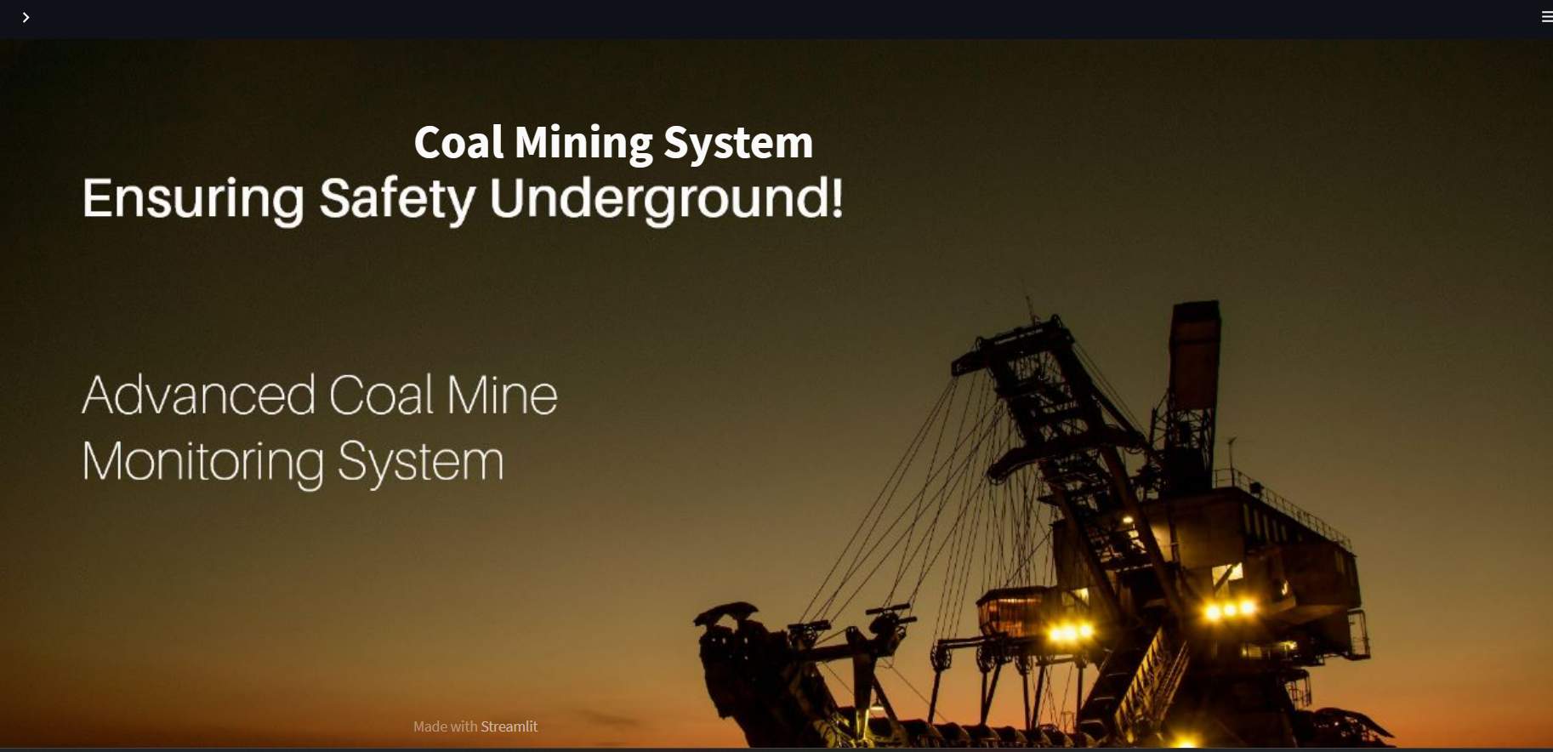
Implementation Details
Implementation Details
In this project we are using streamlit to deploy the machine learning model. The trained machine learning models are deployed in Stream lit – a python framework to make it as a user-friendly web interface.

Slide 12
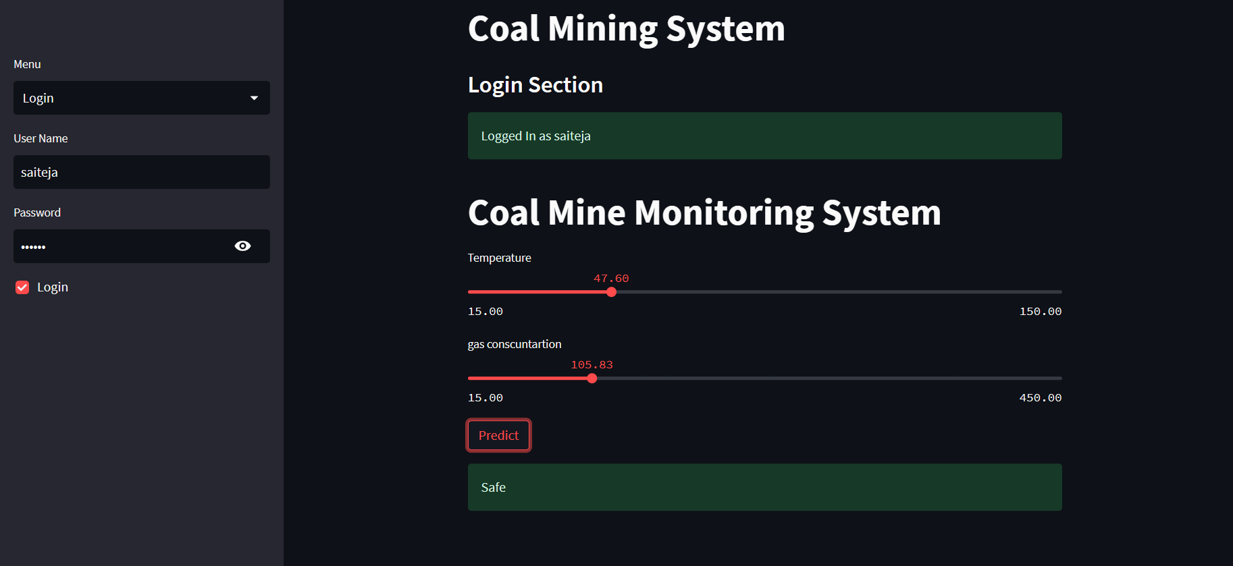
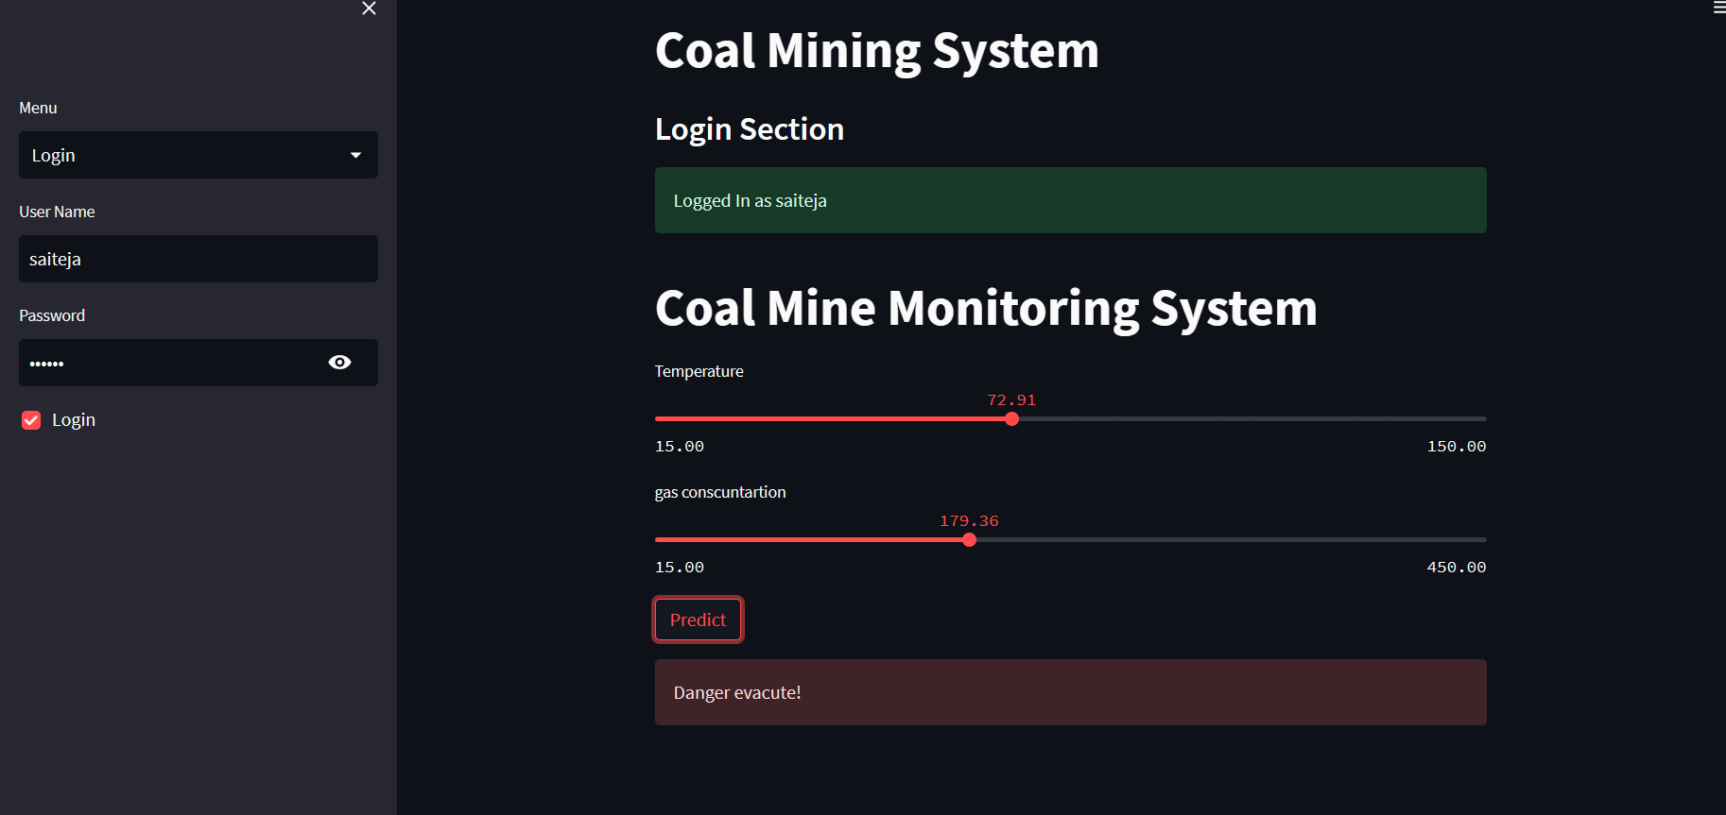
Implementation Details
Implementation Details

Slide 13
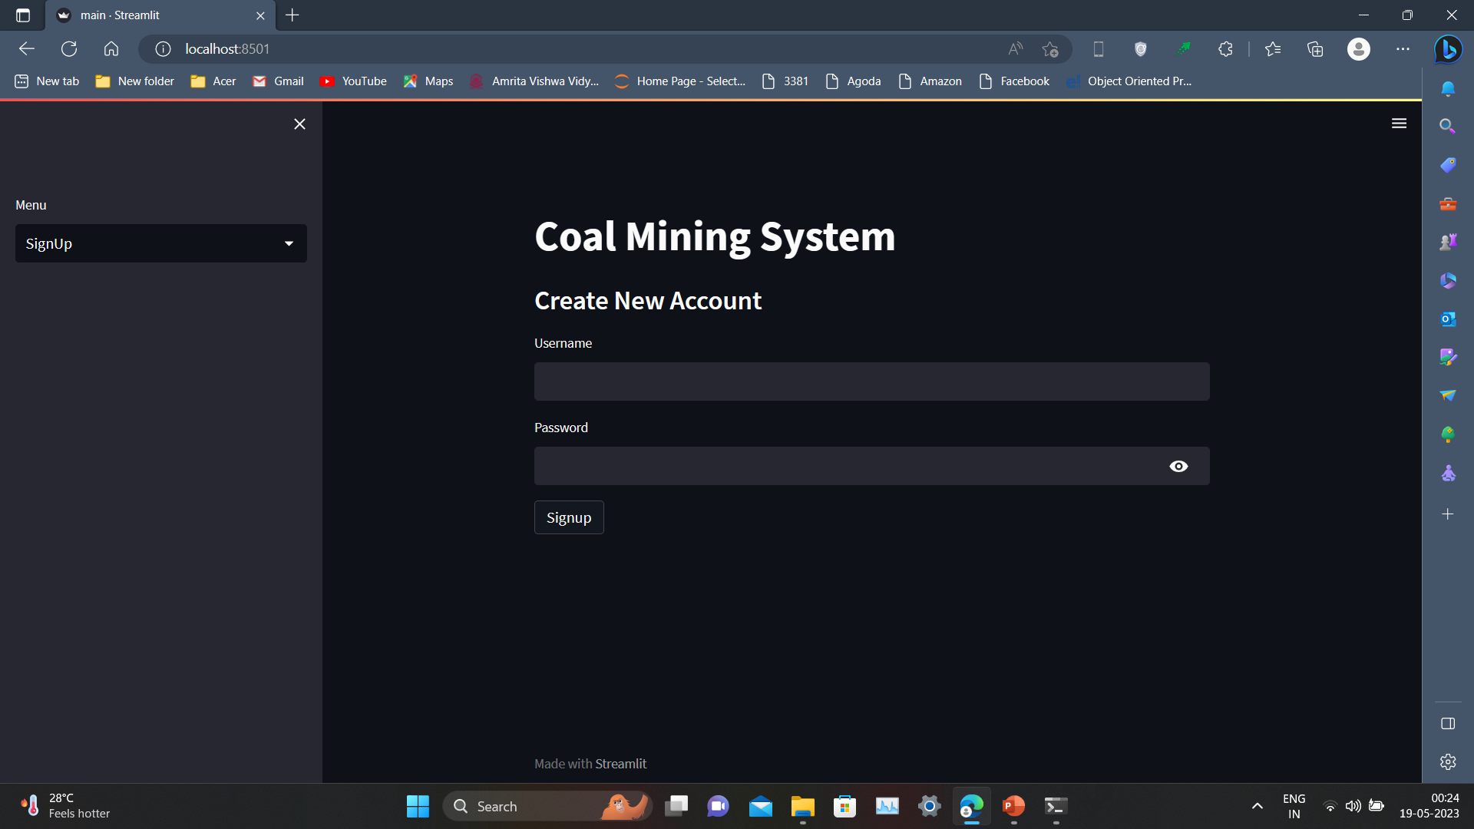
Implementation Details
Implementation Details

Slide 14
Results
S.NO | Algorithm | Training Accuracy | Testing Accuracy
1. | Logistic regression | 78.86 | 85.52
2. | KNearestNeighbors | 93.20 | 94.73
3. | SVM | 80.16 | 85.52
4. | Decision Tree | 99.71 | 88.15
5. | Random Forest | 97.16 | 92.16
6. | Gradient Boosting | 99.71 | 93.42

Slide 15
Conclusion
Conclusion
We conclude, our project shed new light on making effective decisions, monitoring 24/7, and alerting the employees through sensors.
Machine Learning Models such as Decision tree, logistic regression, K-nearest neighbor, gradient boosting, Support vector machine (SVM), random forest is compared in various aspects to obtain the most accurate prediction and consequently improve the coherence of a traditional monitoring system.

Slide 16
Conclusion
Futurescope
In this project we are using only two parameters like concentration of gas, and temperature.
In the future we would like to add some more parameters like humidity, pressure, etc. Our project improves the efficiency, sustainability, and safety of the coal mine monitoring system. We can improve the scalability of the web interface.

Slide 17
THANK YOU

