Slide 1
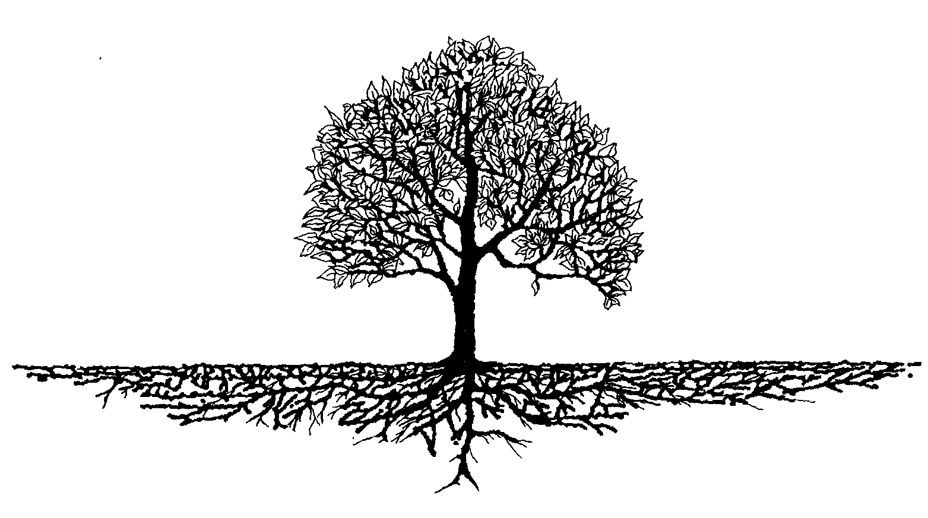
DIDs (Decentralized IDentifiers): Solving the Root Identity Problem
Drummond Reed Trustee Sovrin Foundation
Blockchain in Healthcare Code-A-Thon March 14 2017

Slide 2
Work on the DID specification has been funded in part by a Small Business Innovation Research (SBIR) grant from the U.S. Department of Homeland Security Science and Technology Directorate.
The content of this specification does not necessarily reflect the position or the policy of the U.S. Government and no official endorsement should be inferred.

Slide 3
What is a DID?
DIDs (Decentralized IDentifiers) are a new type of globally unique identifier
DIDs enable Internet-scale digital identity without centralized registry services
DIDs are designed for “blockchain identity”—they are generated, registered, and verified cryptographically

Slide 4
Why is blockchain identity a breakthrough?
Distributed ledgers (blockchains) are massively secure, scalable, and reliable
For digital identity, a distributed ledger can solve the “root of trust” problem:
How can there be a global source of identity that everyone trusts, but isn’t owned or controlled by any one company or government?
Enables truly self-sovereign identity

Slide 5
DIDs work with all blockchain models
Validation
Permissionless
Permissioned
Bitcoin Ethereum
Sovrin
Public
Access
Hyperledger Sawtooth*
Hyperledger (Fabric, Sawtooth, Iroha) R3 Corda CU Ledger
Private
* in permissionless mode

Slide 6
What does a DID look like?

Slide 7
URN Syntax (RFC 2141)
urn:uuid:ae84-d5c2-9fb785ea-72cd34
Namespace-Specific Identifier
Namespace
Scheme

Slide 8
DID Syntax
did:sov:3k9dg356wdcj5gf2k9bw8kfg7a
Method-Specific Identifier
Method
Scheme

Slide 9
Initial DID Method specs
Method | DID prefix
Sovrin | did:sov:
Bitcoin Reference | did:btcr:
Ethereum uPort | did:uport:
Ethereum Consent | did:cnsnt:

Slide 10
The 3 purposes of DID methods
Specify the syntax of the method-specific identifier
Specify any method-specific elements of the DDO (DID descriptor object)
Specify the CRUD (Create, Read, Update, Delete) operations on DIDs and DDOs for the target ledger

Slide 11
What is a DDO?

Slide 12
{ “Key”: “Value” }
{ “DID”: “DDO” }
Decentralized Identifier
DID Descriptor Object

Slide 13
The primary elements of a DDO
DID (self-describing)
List of public keys (for the owner)
List of controlling DIDs (for key recovery)
List of service endpoints (for interaction)
Timestamps (for audit history)
Signature (for integrity)

Slide 14
What does a DDO look like?

Slide 15
DID and owner public key blocks
{
"@context": "https://example.org/did/v1",
"id": "did:sov:21tDAKCERh95uGgKbJNHYp",
"owner": [{
"id": "did:sov:21tDAKCERh95uGgKbJNHYp#key-1",
"type": ["CryptographicKey", "EdDsaPublicKey"],
"curve": "ed25519",
"expires": "2017-02-08T16:02:20Z",
"publicKeyBase64": "lji9qTtkCydxtez/bt1zdLxVMMbz4SzWvlqgOBmURoM="
}, {
"id": "did:sov:21tDAKCERh95uGgKbJNHYp#key-2",
"type": ["CryptographicKey", "RsaPublicKey"],
"expires": "2017-03-22T00:00:00Z",
"publicKeyPem": "----BEGIN PUBLIC KEY-----\r\nMIIBOgIBAAJBAKkb
SUT9/Q2uBfGRau6/XJyZhcF5abo7b37I5hr3EmwGykdzyk8GSyJK3TOrjyl0
sdJsGbFmgQaRyV\r\n-----END PUBLIC KEY-----"
}],

Slide 16
Control and service endpoint blocks
"control": [{
"type": "OrControl",
"signer": [
"did:sov:21tDAKCERh95uGgKbJNHYp",
"did:sov:8uQhQMGzWxR8vw5P3UWH1j"
]
}],
"service": {
"openid": "https://openid.example.com/456",
"xdi": "https://xdi.example.com/123"
},

Slide 17
Timestamp and signature blocks
"created": "2002-10-10T17:00:00Z",
"updated": "2016-10-17T02:41:00Z",
"signature": {
"type": "RsaSignature2016",
"created": "2016-02-08T16:02:20Z",
"creator": "did:sov:8uQhQMGzWxR8vw5P3UWH1j#key/1",
"signatureValue": "IOmA4R7TfhkYTYW87z640O3GYFldw0
yqie9Wl1kZ5OBYNAKOwG5uOsPRK8/2C4STOWF+83cMcbZ3CBMq2/
gi25s="
}
}

Slide 18
What is a guardian?

Slide 19
A Guardian manages a DID for a Dependent
Some individuals are not able to manage their own private keys
Young children or elderly parents
People without computing or Internet access
The ¼ of the world without legal identity
Dependents can use the services of a Guardian to manage a set of DIDs

Slide 20
Example DID under guardianship
{
"@context": "https://example.org/did/v1",
"id": "did:sov:21tDAKCERh95uGgKbJNHYp",
"guardian": "did:sov:8uQhQMGzWxR8vw5P3UWH1j"
"control": [ "did:sov:8uQhQMGzWxR8vw5P3UWH1j" ],
"service": {
"openid": "https://openid.example.com/456",
"xdi": "https://xdi.example.com/123"
},
"created": "2002-10-10T17:00:00Z",
"updated": "2016-10-17T02:41:00Z",
"signature": {
"type": "RsaSignature2016",
"created": "2016-02-08T16:02:20Z",
"creator": "did:sov:8uQhQMGzWxR8vw5P3UWH1j#key-1",
"signatureValue": "IOmA4R7TfhkYTYW87z640O3GYFldw0yqie9Wl1kZ5OBYNAKOwG5uOsPRK8/2C4STOWF+83cMcbZ3CBMq2/gi25s="
}

Slide 21
Final Notes

Slide 22
DID paths and fragments
A DID itself always identifies a person, organization, or thing
But a DID may be followed by a path, a fragment, or both
A DID path represents another resource “rooted” on the DID
A DID fragment is a pointer into the DDO

Slide 23
Five Rules for Respecting Privacy
Plan for multiple DIDs to enable persona and pseudonym management
Avoid correlation of keys across DDOs
Avoid correlation of off-ledger pointers (service endpoints) across DDOs
Avoid storing personal/private data on a public ledger (even when encrypted)
Use anonymous credentials (zero-knowledge proofs) whenever possible

Slide 24
DID Specification Links
Implementer’s Draft 01 November 21 2016
PDF Version (static) | https://github.com/WebOfTrustInfo/rebooting-the-web-of-trust-fall2016/blob/master/final-documents/did-implementer-draft-10.pdf
Google Doc Version (living document – accepts comments) | https://docs.google.com/document/d/1Z-9jX4PEWtyRFD5fEyyzEnWK_0ir0no1JJLuRu8O9Gs/edit?usp=sharing
Discussion Forum | http://forum.sovrin.org/c/technical/did
Implementers: please send feedback!

Slide 25
Q & A
Or send questions to:
drummond.reed@evernym.com

Slide 26
Extra Slides

Slide 27
Background: Identifiers on the Web
URI (Uniform Resource Identifier)
RFC 3986 (Internationalized version is RFC 3987)
Standard for identifiers for the entire Web
URL (Uniform Resource Locator)
Any URI that is dereference-able (but not necessarily persistent)
URN (Uniform Resource Name)
RFC 2141
A specific URI namespace for persistent identifiers (but not for dereferencing them)

Slide 28
The 3 motivations for DIDs
Persistent AND dereference-able
Essentially a URN that can be resolved to one or more URLs
MUST NOT require centralized registration
Thus the need for DLTs or P2P networks
Cryptographically verifiable
Thus the fit with “blockchain identity”

Slide 29
About DID method specifications
DID Method specs are to the DID spec
What URI scheme specs are to RFC 3986 (the URI spec) and 3987 (the IRI spec)
What URN namespace specs are to RFC 2141 (the URN spec)
The req’s for a conformant DID Method spec are specified in the DID spec

