Slide 1
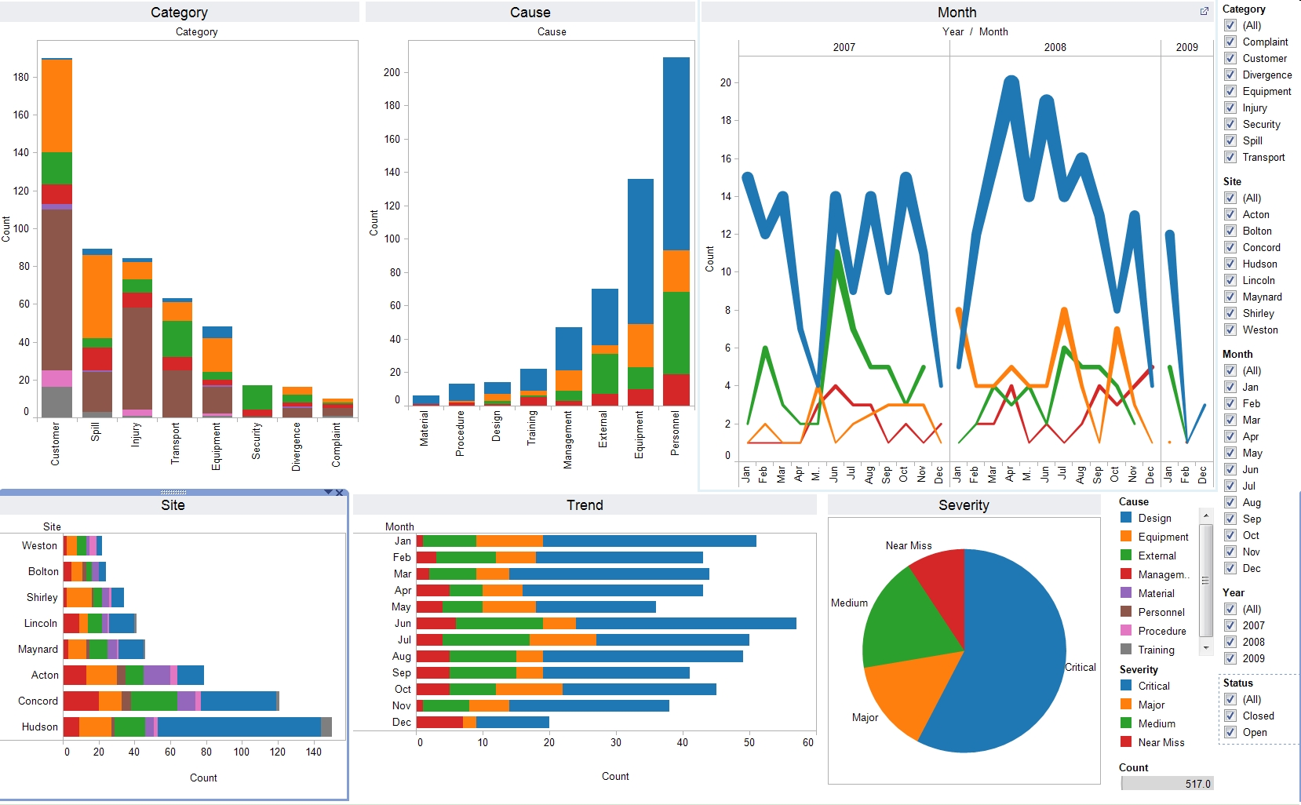
Liferay Reports
Groovy RESTClient
Other Data
Spring Boot
Report
Sender
Agent
µ-service
report-rest-service
ETL
Agent
Report
AdminPortlet
Agent
HTTP/REST
Health
µ-service
No-sql
document
Neo4j /
Hadoop
Spring Integration
Nosql
Big data?
Queue
MongoDB->
Cassandra?
Spring Boot
Qlikview
Extractor
RabbitMQ

Slide 2
ENABLE / DISABLE MODULE
CONFIGURE JASKULA LOCATION
LOCAL/REMOTE
If (JASKULA==LOCAL)
JASKULA CONFIG

Slide 3
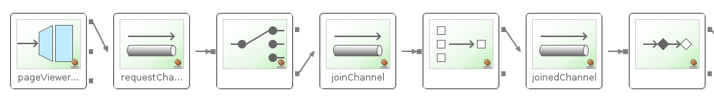
Router
HTTP client
JASKULA
PLG
PLG
Jaskula
Remote
Event
Jaskula
Local

