Slide 1
Exploring the relationship between Yelp rating and price
Aaron Ronay
John McDonald
Talemanie Borsay

Slide 2
Research Question:
Is there a relationship between Yelp rating and price point?
Are businesses with more stars more expensive?
Are businesses with less stars less expensive?
Can businesses with more stars increase their prices?

Slide 3
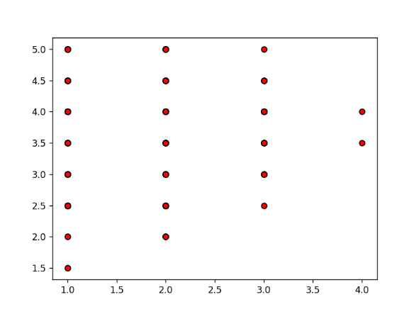
Cleveland Scatter Plot
Notes:
Scatter plots show how much one variable is affected by another. Neither a negative or a positive correlation could be determined by this data. The dataset for the X- axis, representing price, was a range of numbers between 1 and 4 ($1 to $4). Numbers from 1 to 5 represent star rating. The small difference between between numbers made it difficult to show an effect between variables.

Slide 4
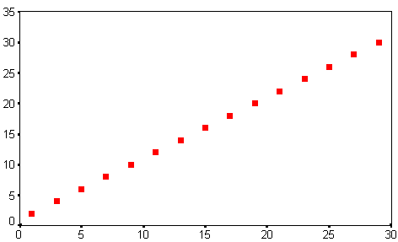
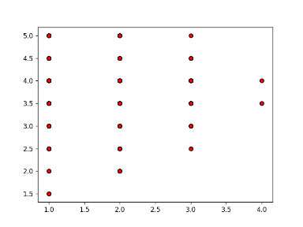
Correlation Comparison
Positive Correlation
Cleveland

Slide 5
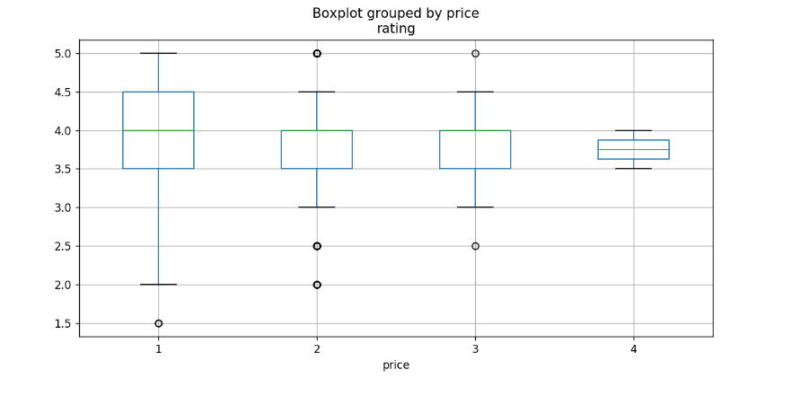
Cleveland Box Plot
Notes:
Cleveland: F onewayResult(statistic=0.8661337463567835, pvalue=0.45816872413662013)
(Since our p-value is 0.45 which is greater than 0.05, we will accept our null hypothesis, so price does not have an affect on rating.

Slide 6
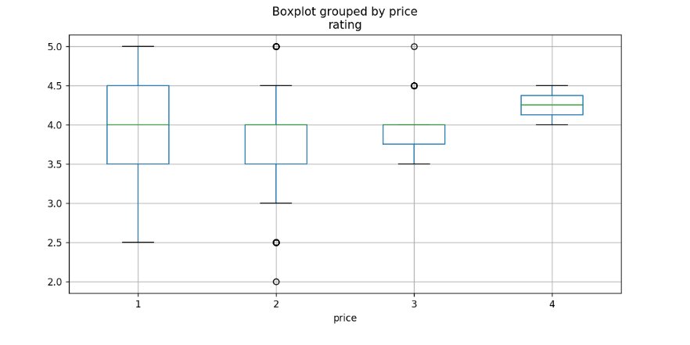
St Paul Box Plot
Notes:
St. Paul: F onewayResult (statistic=7.385650681591276, pvalue=6.802371940731888e-05)

Slide 7
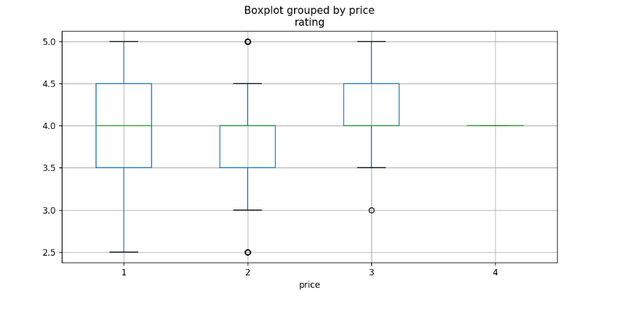
St Louis Box Plot
Notes:
St. Louis: F onewayResult(statistic=8.71055680049366, pvalue=1.0531307945525159e-05)

Slide 8
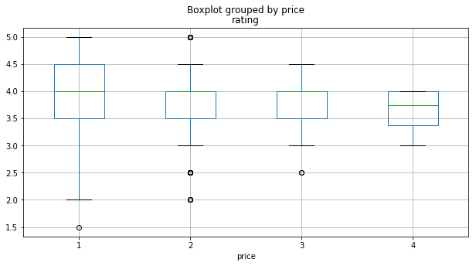
Detroit Box Plot

Slide 9
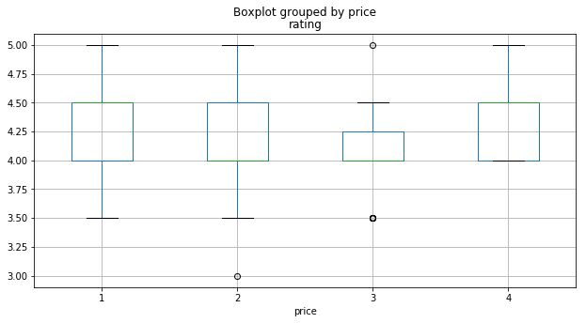
Portland Box Plot

Slide 10
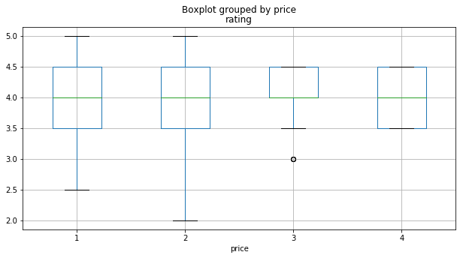
Cincinnati Box Plot

Slide 11
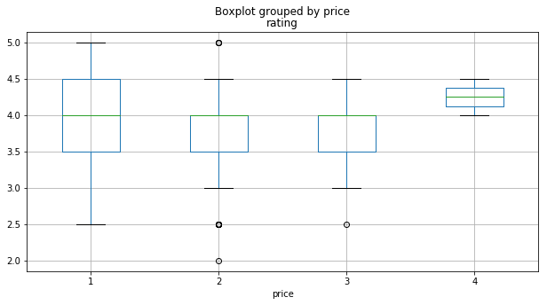
Columbus Box Plot

