Slide 1
Exploring the relationship between Yelp rating and price
Aaron Ronay
John McDonald
Talemanie Borsay

Slide 2
How many restaurants did we review?
11,000

Slide 3
Research Question:
Is there a relationship between Yelp rating and price point?
Does price-level affect rating?
Are businesses with more stars more expensive?
Are businesses with less stars less expensive?
Can businesses with more stars increase their prices?

Slide 4
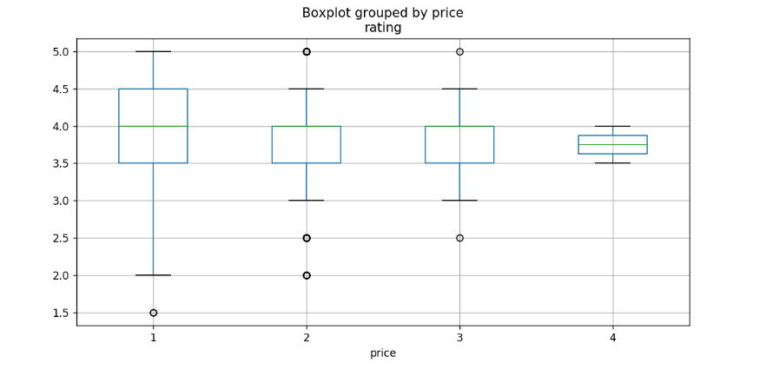
Cleveland Box Plot
P Value: 0.45816872413662013
Notes:
Cleveland: F onewayResult(statistic=0.8661337463567835, pvalue=0.45816872413662013)
(Since our p-value is 0.45 which is greater than 0.05, we will accept our null hypothesis, so price does not have an affect on rating.

Slide 5
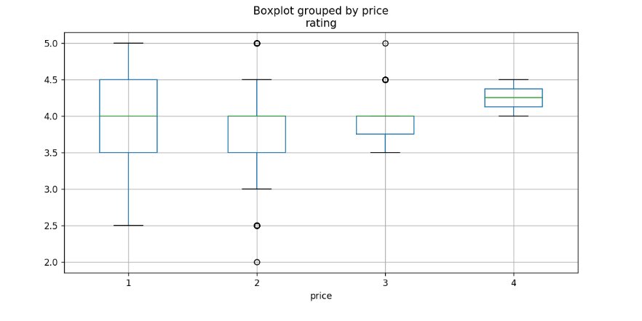
St Paul Box Plot
P value: 6.802371940731888e-05
Notes:
St. Paul: F onewayResult (statistic=7.385650681591276, pvalue=6.802371940731888e-05)

Slide 6
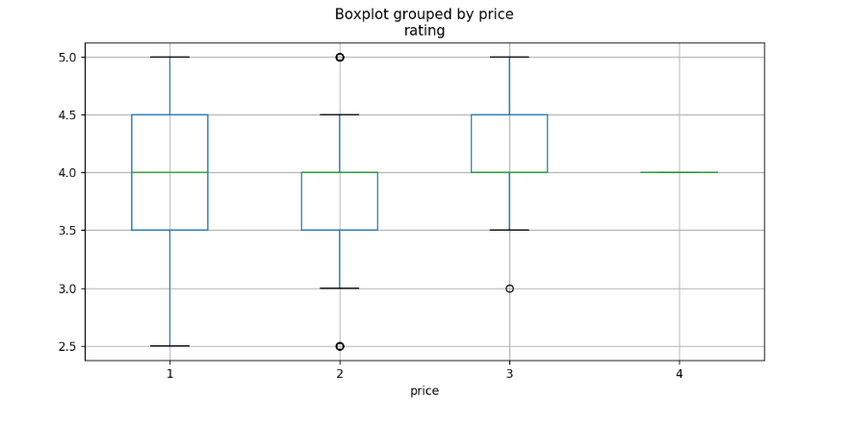
St Louis Box Plot
P Value: 1.053130794552519e-05
Notes:
St. Louis: F onewayResult(statistic=8.71055680049366, pvalue=1.0531307945525159e-05)

Slide 7
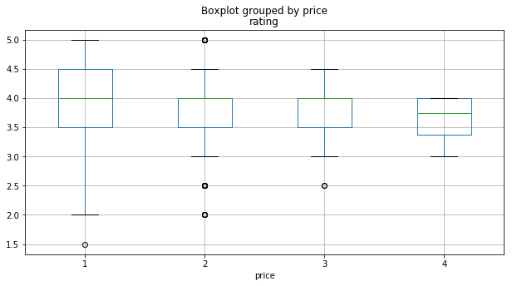
Detroit Box Plot
P Value: 4.027990181085553e-05

Slide 8
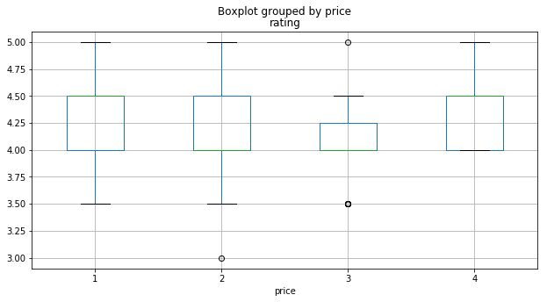
Portland Box Plot
P Value: 2.6352230480028464e-14

Slide 9
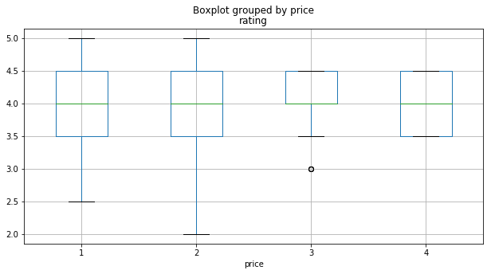
Cincinnati Box Plot
P Value: 0.427699307999016

Slide 10
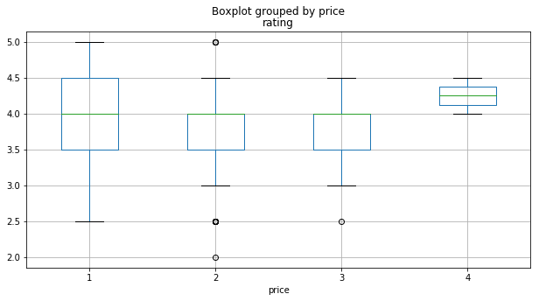
Columbus Box Plot
P-value: 5.414948758580707e-05

Slide 11
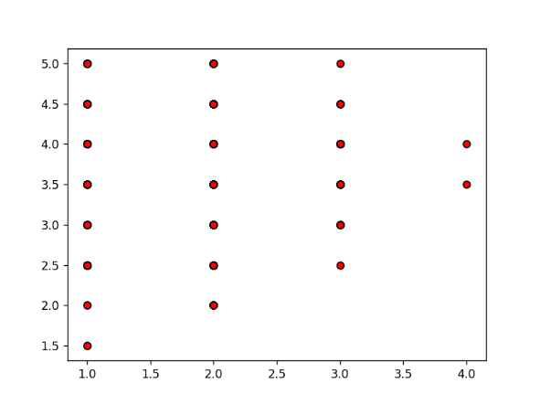
Cleveland Scatter Plot
Notes:
Scatter plots show how much one variable is affected by another. Neither a negative or a positive correlation could be determined by this data. The dataset for the X- axis, representing price, was a range of numbers between 1 and 4 ($1 to $4). Numbers from 1 to 5 represent star rating. The small difference between between numbers made it difficult to show an effect between variables.

Slide 12
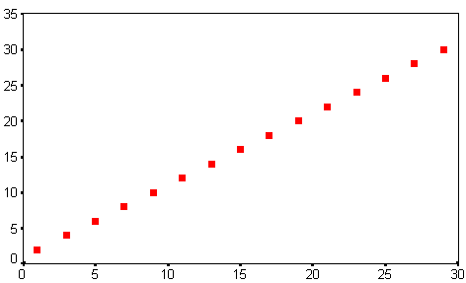
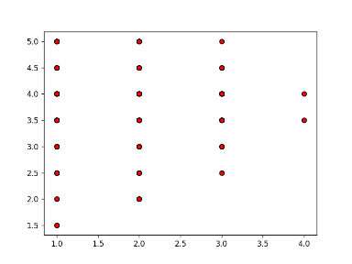
Correlation Comparison
Positive Correlation
Cleveland

Slide 13
Conclusions
Price has no affect on rating.
Several factors affect customer satisfaction.
The more money you pay the more likely you are going to enjoy the experience.

