Slide 1


AI-Driven 2D Mesh Network-on-Chip Router
Intelligent Congestion-Aware Routing for Multi-Core Systems
Team Members: I. Prasad
K. Gowtham
B. Dhoni Madhav Eswar
K. Aarthi Lakshmi Devi
K. Yoga Sri Durga
K. Lakshmi Kavya
Guide: Ch. Seetha Mahalakshmi
Institution: Aditya Engineering College

Slide 2
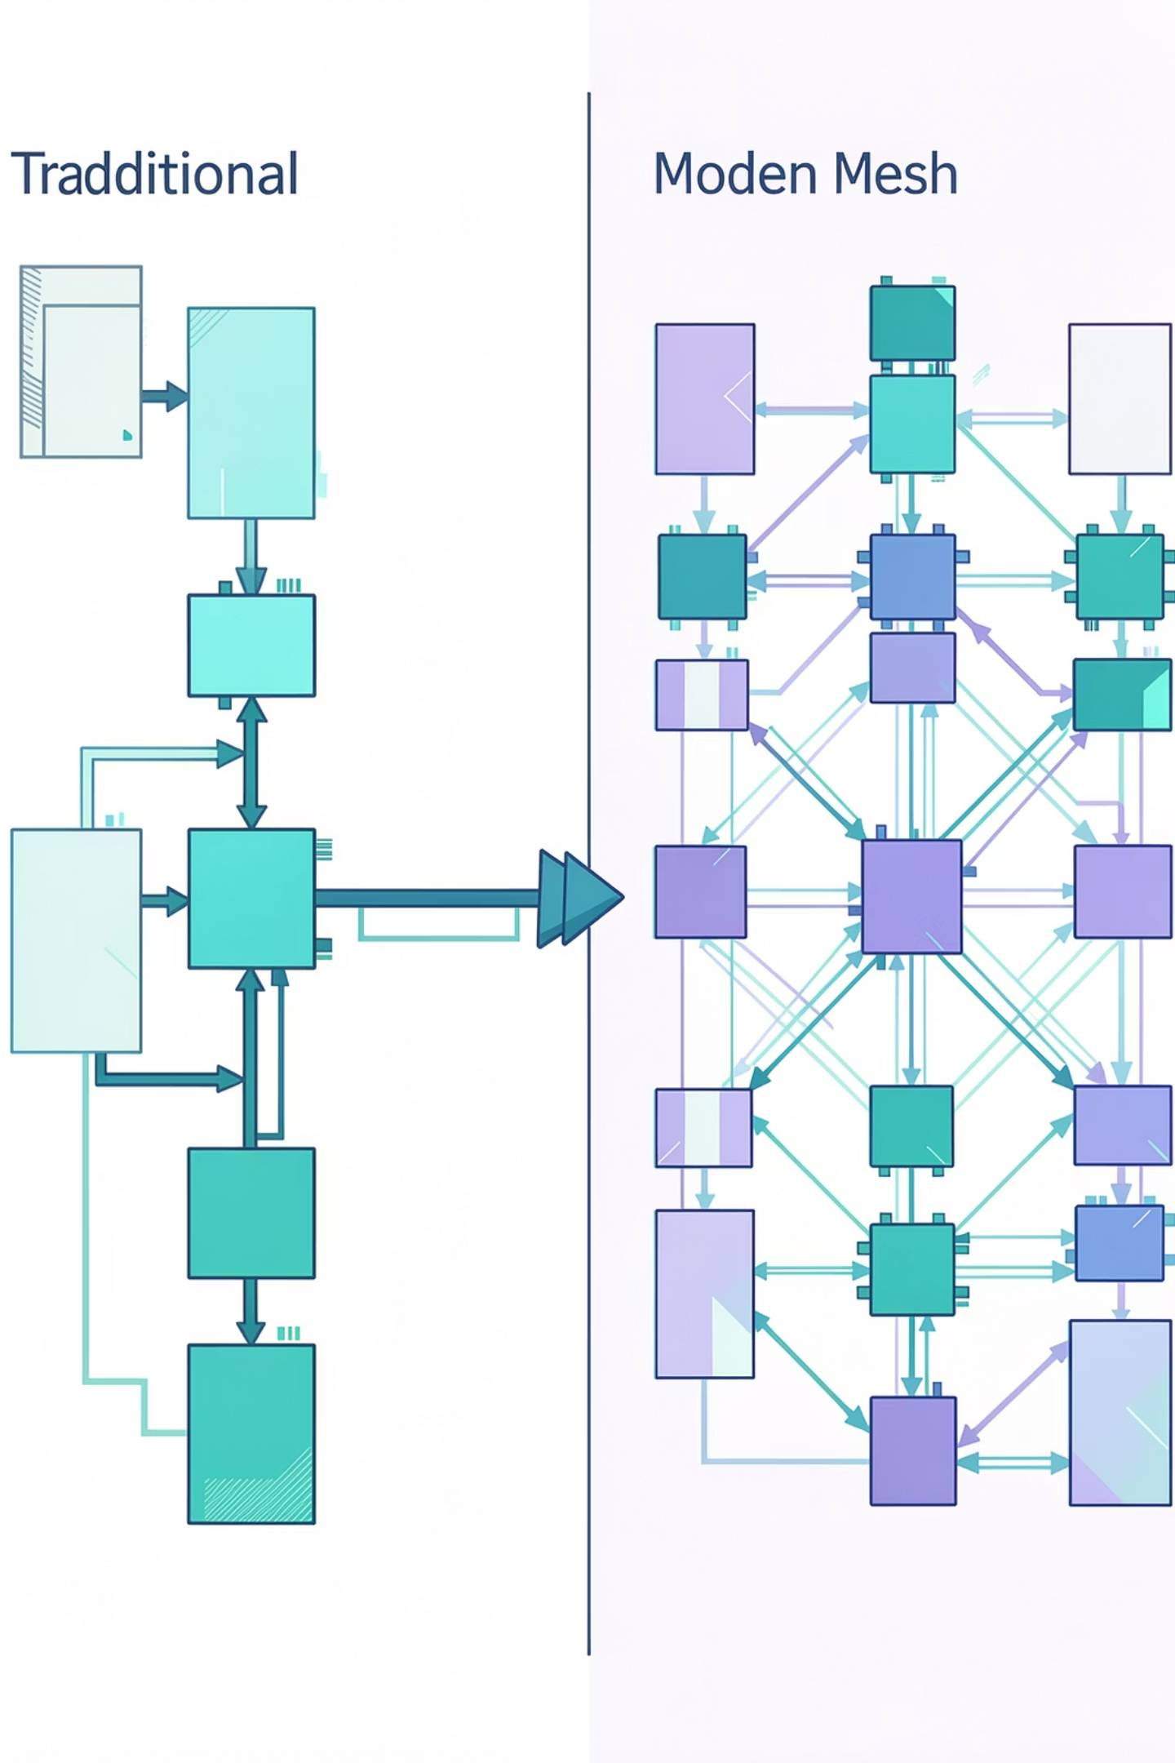
Introduction & Problem Statement
The Challenge
The Solution
Traditional bus-based communication systems face critical limitations in multi-core processors:
Network-on-Chip (NoC) architecture provides distributed, scalable communication. AI-driven routing enables intelligent path selection, congestion prediction, and adaptive load balancing for optimal performance.
Network congestion during peak traffic
High latency in packet transmission
Poor scalability with increasing cores
Excessive power consumption

Slide 3
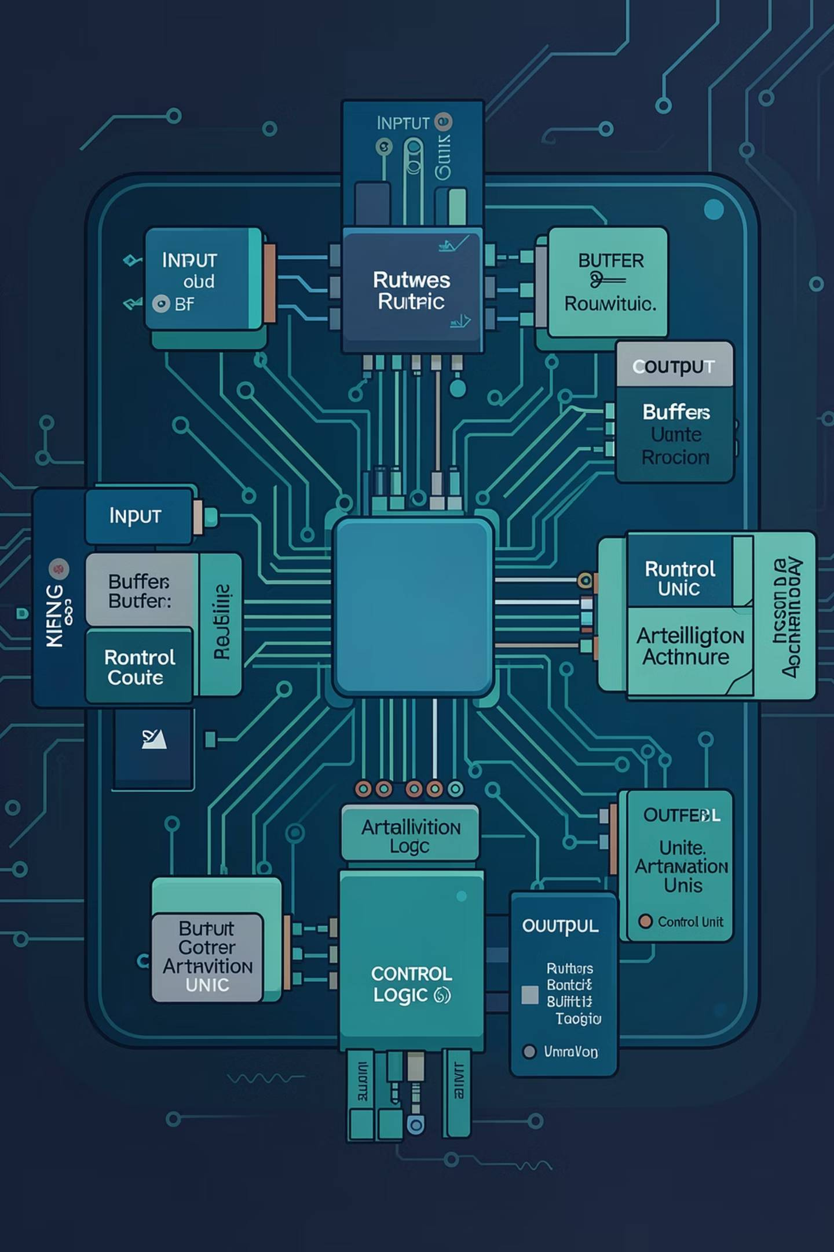
Existing System vs Proposed System
Traditional NoC Router
Static XY routing algorithm
No congestion awareness
Fixed path selection
Poor load balancing
Increased packet delay
AI-Driven NoC Router
Intelligent adaptive routing
Real-time congestion prediction
Dynamic path selection
Optimized QoS
Reduced latency

Slide 4
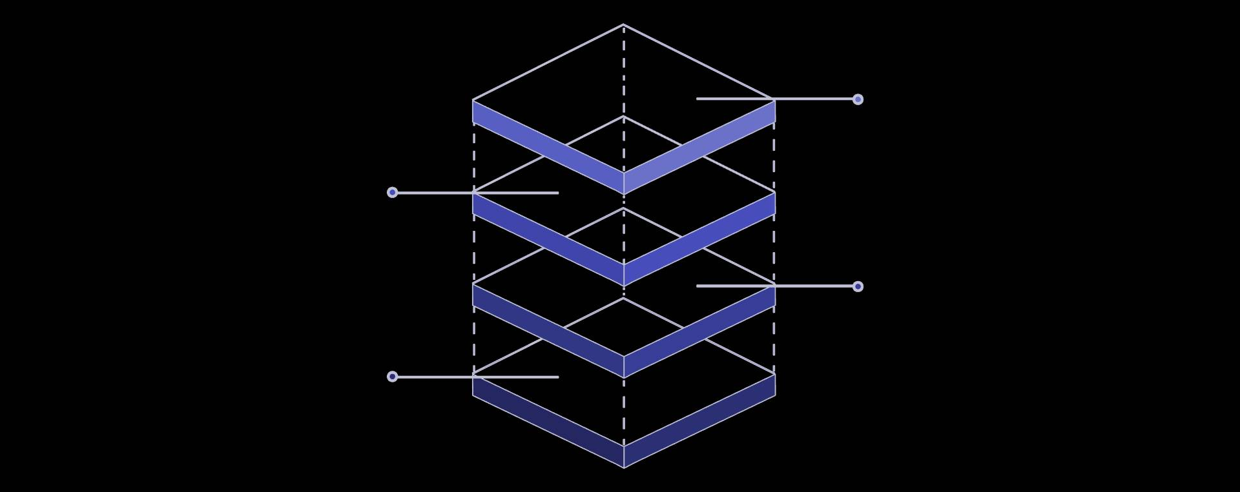

2D Mesh Topology & Router Architecture
Control Unit
AI controller and arbiter
Router Core
Input buffer and routing logic
Cardinal Links
North, South, East, West connections
Mesh Grid
Routers arranged in a 2D grid
Router Connections
Internal Components
North: Upward communication
South: Downward communication
East: Rightward communication
West: Leftward communication
Input Buffer & Routing Logic
AI Controller & Arbiter
Crossbar Switch
Output Ports

Slide 5






AI Controller & Working Methodology
Buffer Monitoring
Continuous occupancy tracking
AI Analysis
Threshold-based congestion detection
Dynamic Routing
Alternate path selection
Optimization
Real-time latency reduction
Implementation: SystemVerilog HDL | EDA Tools: Cadence & Vivado |
Verification: DUT & Testbench methodology

Slide 6
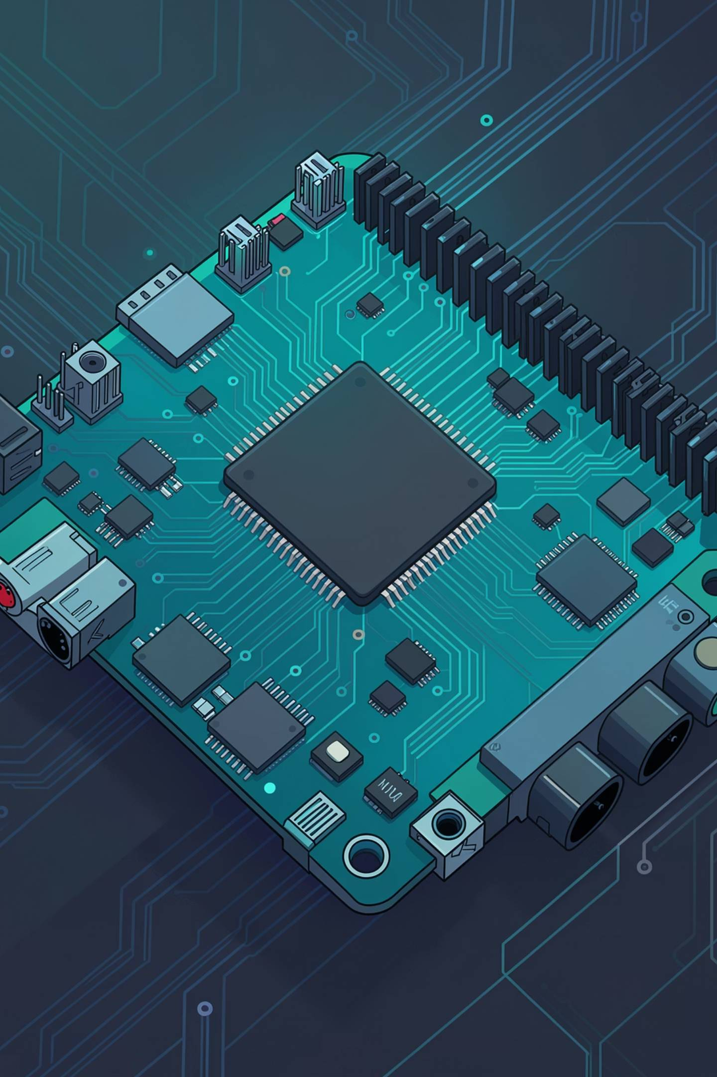

Advantages, Applications & Technologies
Performance Benefits
Reduced congestion, improved throughput, lower latency, better QoS, and efficient packet delivery
Target Applications
Multi-core processors, GPUs, AI accelerators, embedded systems, HPC, and data centers
Technology Stack
SystemVerilog, Cadence EDA tools, Xilinx Vivado, DUT & Testbench verification methodology

Slide 7


Conclusion & Future Scope
40%
30%
Expected Latency Reduction
Throughput Improvement
50%
Scalability Increase
Key Achievements
Future Enhancements
Intelligent routing improves NoC efficiency
Congestion-aware adaptive routing reduces latency
Better scalability for future AI systems
Machine Learning-based prediction models
Reinforcement Learning routing algorithms
Power-aware and fault-tolerant routing
Thank You

