Slide 1
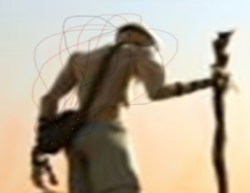

nomad.m
1
2
3
4
SettingGUI.m
SchemGUI.m
AssignMuxGUI.m
OutputGUI.m
nomad.jpg
mtg_head_plot.m
nomad.jpg
export_fig.m
channel_stat_plot.m
helmet_schem_maker.m
a) helm_draw_mtg_out.m
helm_draw_mtg.m
b) output_mtg_combined.m
make_the_montage.m
c) GDF_TextFileGenerator_KM.m
helm_draw_schem.m
assign_the_mux.m
make_colormap.m
helm_mouse_ixy.m
get_BoxyColorcode.m
ginputax.m
assign_mux.m
assign_mux_parallel.m
assign_mux_src.m
mc_det.m
mc_detmux.m
dsatur2_rand.m
greedy_rand.m
Custom Import
/elp/
Load Struct
helmet_name.elp
MathewsonMuxCheck.m
Save Struct
GDF Folder
Dist Map
.mtg file
Schematics
/Examples/
/GDF
/DOIL1_Large
/Session A|B
/DC|AC|PH/
/reg/
/reg/
/reg/
XXX_large.mat
XXX_large_Dist.bmp
XXX_large.mtg
XXX_large_A.bmp
XXX_large_B.bmp
Large_SeshA_DOIL1_DetA_DC.txt

