Slide 1
Math is Everywhere and Why you should care
Brian Korzynski
@bkorzynski
https://github.com/korz

Slide 2

About Me
Lead Developer at UseTech Design L.L.C. (UTD)
A consulting firm based in Troy, MI
Professional Developer for 5+ years
Windows Forms
Web
Mobile
SQL Optimization
Data Analysis
Mathematics
Big Data

Slide 3
Cryptography
“the branch of mathematics that studies techniques for secure communication in the presence of third parties.”

Slide 4
Cryptography
Too advanced to cover in an hour
Hashing
A hash function maps data of arbitrary size to data of fixed size, where slight differences in input produce very big differences in the output.
Algorithms: MD5, SHA1, SHA256, etc.
Very useful to determine if two string or two files are equivalent

Slide 5
DEMO

Slide 6
Recursion

Slide 7
Definition
“… a process of repeating items in a self-similar way”
Methods that meet 2 conditions
The method must call it self
The method must define at least one stop condition, so you know when to stop the recursion (this avoids things like stack overflows, segmentation faults, etc.)
Notes:
Stack overflows, segmentation faults, or whatever the equivalent is in your language of choice.
I can generate about 40 #’s recursively before running into issues, and I stopped counting after 1 million iteratively

Slide 8


Factorial
The product of all positive integers less than or equal to $n$
static int factorial(int n)
{
if (n == 0) return 1;
return
n * factorial(n -1);
}
$5!=5 ∗4 ∗3 ∗2 ∗1=120$
$5!=5 ∗4!=120$
$4!=4 ∗3!=24$
$3!=3 ∗2!=6$
$2!=2 ∗1!=2$
$1!=1$

Slide 9
A Walk Through the Call Stack
static int factorial(int n)
{
if (n == 0) return 1;
return
n * factorial(n -1);
}
n | result (down the stack) | result (up the stack)
n | result (down the stack) | result (up the stack)
3
n | result (down the stack) | result (up the stack)
3 | 3 * Factorial(2)
n | result (down the stack) | result (up the stack)
3 | 3 * Factorial(2)
2
n | result (down the stack) | result (up the stack)
3 | 3 * Factorial(2)
2 | 2 * Factorial(1)
n | result (down the stack) | result (up the stack)
3 | 3 * Factorial(2)
2 | 2 * Factorial(1)
1
n | result (down the stack) | result (up the stack)
3 | 3 * Factorial(2)
2 | 2 * Factorial(1)
1 | 1 * Factorial(0)
n | result (down the stack) | result (up the stack)
3 | 3 * Factorial(2)
2 | 2 * Factorial(1)
1 | 1 * Factorial(0)
0
n | result (down the stack) | result (up the stack)
3 | 3 * Factorial(2)
2 | 2 * Factorial(1)
1 | 1 * Factorial(0)
0 | 1
n | result (down the stack) | result (up the stack)
3 | 3 * Factorial(2)
2 | 2 * Factorial(1)
1 | 1 * Factorial(0)
0 | 1 | 1
n | result (down the stack) | result (up the stack)
3 | 3 * Factorial(2)
2 | 2 * Factorial(1)
1 | 1 * Factorial(0) | 1 * 1 = 1
0 | 1 | 1
n | result (down the stack) | result (up the stack)
3 | 3 * Factorial(2)
2 | 2 * Factorial(1) | 2 * 1 = 2
1 | 1 * Factorial(0) | 1 * 1 = 1
0 | 1 | 1
n | result (down the stack) | result (up the stack)
3 | 3 * Factorial(2) | 3 * 2 = 6
2 | 2 * Factorial(1) | 2 * 1 = 2
1 | 1 * Factorial(0) | 1 * 1 = 1
0 | 1 | 1
Notes:
Notice how we are storing a lot of state on the call stack. This is a drawback to recursion and the reason why it can be limiting.
This is why you should use recursion only when necessary.

Slide 10


Fibonacci Numbers
Definition
a recursive series of numbers in which each number is the sum of the previous two numbers
Formula
$$F_{n}={F_{n−1} + F}_{n−2}$$
Seed Values
$F_{0}=0$
$F_{1}=1$
$F_{2}=1+0=1$
$F_{3}=1+1=2$
$F_{4}=2+1=3$
$F_{5}=3+2=5$
$F_{6}=5+3=8$
$F_{7}=8+5=13$
$F_{8}=13+8=21$
$F_{9}=21+13=34$
$F_{10}=34+21=55$
Notes:
Next 9 values

Slide 11
DEMO

Slide 12
Data Structures / ADT
Abstract Data Types

Slide 13

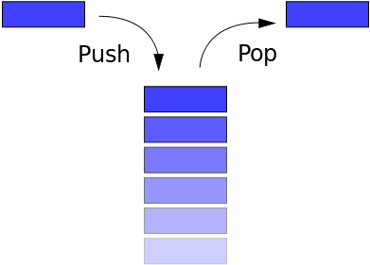
Stack
Last In First Out (LIFO) ADT

Slide 14
DEMO

Slide 15
Stack Use Cases
String parsing where you need to do secondary processing and it has to be in the proper order
Breadcrumbs
Recursing thru trees where you need access to the parent or follow the path back to the root node.

Slide 16

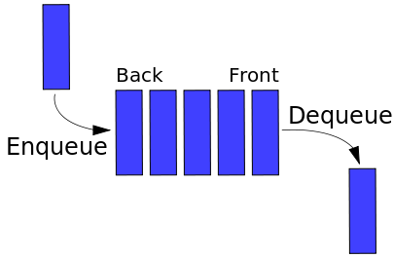
Queue
First In First Out (FIFO) ADT

Slide 17
DEMO

Slide 18
Queue Use Cases
Anytime things need to be processed in order, for example you have an ecommerce site and who ever when to the site and placed their order first is who’s should get processed.

Slide 19


Linked List
Linear ADT similar to an array or list, except each node has a pointer to either the next node or the next and previous nodes
Insert / Delete (beginning): $O(1)$
Insert / Delete (end): $O(1)$ or $O(n)$
Insert / Delete (middle): search time + $O(1)$
Lookup: $O(n)$

Slide 20
DEMO

Slide 21
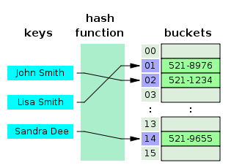

Hash Table
Associative array that maps keys to values
Are faster than a dictionary because they employ a hash function
Useful whenever you need to perform a lot of lookup operations
Insert / Delete: $O(1)$
Lookup: $O(1)$

Slide 22
DEMO

Slide 23

Tree
Stores hierarchical data
Helpful for when you care about relationships between objects
Tons of implementations
Inserts / Deletes: $O(logN)$
Lookups: $O(logN)$

Slide 24
DEMO

Slide 25
Tree Use Cases
Searching
Holding Hierarchical data
Object Graphs are technically trees

Slide 26
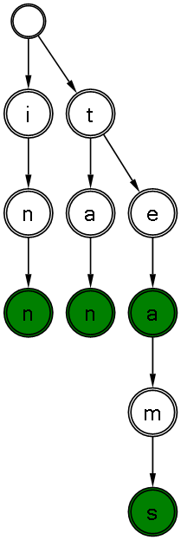

Trie
Combination of a Hash Table and a Tree
The key is typically a string and the value is whatever you like
Designed for very quick lookups
Inserts / Deletes: $O(logN)$
Lookups: $O\left(m\right), m$ being the length of the search string

Slide 27
Advantages of Tries over Hash Tables
Tries are quicker than Hash Tables for doing lookups
Tries are ordered; Hash Tables are pseudorandom with respect to its hashing algorithm
String comparison is quicker than running thru a hash method
Tries don’t have indices. Hash tables have to constantly be rebuilding their indices especially once they become full.

Slide 28
Set Theory
“the branch of mathematics that studies collections of objects”

Slide 29
DEMO

Slide 30
Functions

Slide 31
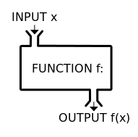
Function
Notes:
As the name implies are fun
Black box since it encapsulations the calculation that is being performed

Slide 32

Examples
$f\left(x\right)= x^{2}$
void Awesomeness(int x)
{
this.Graph.BackgroundColor = Color.Red;
x = x * x;
var contents = System.IO.File.ReadAllLines(@"c:\awesomness.txt");
}
Notes:
Notice that math removes the implementation details (noise) while at the same time it genericizes the method. So for example we could plug in 2 and get 4, or we can plug in 2.5 and get 6.25. It doesn’t care.

Slide 33
Functional Programming
The mathematical definition of a function (“pure function”) is the basis of Functional Programming
Always return the same output, given the same input
Never mutate (change) state
Notes:
When we typically think of methods in programming we think in terms of state. For example I could change the background color of the graph, I could change the value of x, or I could read input from a file. All of these affect the call stack and as a result we will lose some performance.
You should strive to treat your functions like math functions when ever you can to make sure you are getting the most out of them.

Slide 34
Combinatorics
“the branch of mathematics that studies finite countable discrete structures”

Slide 35
Definition
In short, the branch of math that deals with counting
Turns out, we suck at counting

Slide 36

Probability
What is the probability that a spade will come up?
$\frac{13}{52}=25\%$
What is the probability that a red queen will come up?
$\frac{2}{52} =3.85\%$
What is the probability that a spade will come up in Euchre?
$\frac{6}{24}=25\%$
What is the probability that a red queen will come up in Euchre?
$\frac{2}{24}=8.33\%$
Notes:
Different things can be counted differently depending on the context

Slide 37
Example: IP Address
How many unique combinations of IP addresses can we make?
Four Slots for input:
___ ___ ___ ___
Each slot can contain a number from 0 to 255.

Slide 38


Example: IP Address
Total Combinations
$256 ∗ 256 ∗ 256 ∗ 256 =4, 294, 967, 296$
Total Combinations in the 192.168.x.x subnet
$1 ∗ 1 ∗ 256 ∗ 256 =$65,536

Slide 39
Arity
“the number of arguments a function accepts”
The higher the arity, the more test cases you have to write
Combinatorics can help you figure out how many tests you need to get proper code coverage. This is how code coverage tools work.
Also helps us understand why some methods are so complicated.

Slide 40

Arity - Example
static int factorial(int n)
{
if (n == 0) return 1;
return
n * factorial(n -1);
}
Think of possible values you would want to test for $n$.
I chose a scheme like this
-1, 0, 1
So what happens to our method if we pass a negative number?

Slide 41


Permutations
“a way of selecting members from a group, such that the order of selection matters”
Formula
$$P\left({n \atop k}\right)=\frac{n!}{(n−k)!}$$
Where $n$ is the total number of elements and $k$ is how many we are picking at a time.
Example: Given set {1, 2, 3}. How many unique pairs of digits we can get?
$P\left({3 \atop 2}\right)=\frac{3!}{(3−2)!}=\frac{3!}{1!}=\frac{3!}{1}=3∗2=6$
12, 13, 21, 23, 31, 32

Slide 42


Combinations
“a way of selecting members from a group, such that the order of selection does not matter”
Formula
$$C\left({n \atop k}\right)=\frac{n!}{k!(n−k)!}$$
Where $n$ is the total number of elements and $k$ is how many we are picking at a time.
Example: Given set {1, 2, 3}. How many unique pairs of digits we can get?
$C\left({3 \atop 2}\right)=\frac{3!}{2!(3−2)!}=\frac{3!}{2! ∗ 1!}=\frac{3 ∗2!}{2!}=3$
12, 13, 23

Slide 43
Trick - Setup
static int add(int a, int b) { return a + b; }
Possible Values for a: -1, 0, 1
Possible Values for b: -1, 0, 1
Total Possible Values: -1, 0, 1, -1, 0, 1
Label them as a, b, c, d, e, f

Slide 44
Trick
Go to Wolfram Alpha and type in one of these commands and it will tell you how many combinations/permutations there are and what they are.
Combinations[{a, b, c, d, e, f}, {2}]
Permutations[{a, b, c, d, e, f}, {2}]

Slide 45
Big Data

Slide 46
What is Big Data?
A way of thinking about data when you can’t use traditional techniques because the data is too large or complex.
New term around old concepts

Slide 47
Big Data Categories
Needs to be Persisted
Doesn’t Need to be Persisted

Slide 48
Needs to be Persisted
All data is saved
Phone Company Logs
100+ million customers
If each customer had exactly 2 phone calls in a month than they are adding 200 million records a month to their databases
Notes:
This is an unrealistic amount since no one makes only two calls and it doesn’t also factor in things like customer bills and payments.

Slide 49
Doesn’t Need to be Persisted
Not all data needs to be saved
Knowing what data to save and what data not to can save a lot in time and space complexities
Notes:
For when you only care about the solution
Only store the data that leads to the solution
Cuts down on time and space complexities, this is where the huge benefits come in

Slide 50
Traveling Salesman Problem
Given a list of cities and the distances between each pair of cities. What is the shortest possible route that visits each city exactly once and returns to the starting city?
10 Cities = 10! = 3,628,800
We only care about the most optimal solution not the others
We need to calculate all combinations in order to find the best one

Slide 51

Big Data, Small Data
We need to get out of the mind set of being able to retrieve all the data at one time.
Instead, we need to store big data, and report against the data, in order to answer questions we care about.
100 million records $→$ 1 page report

Slide 52
Types of Questions
Summaries
How many calls were made in CA?
Specific
How many times did the customer call this number?
Patterns
What patterns or trends can we learn from this data?
How you segment your data is crucial to the types of questions you want to answer.
Not a new concept. Same as analysis cubes in databases

Slide 53
Analytics - Terms
Data Science: the study of extracting knowledge from data
Data Mining: the process of discovering patterns in large data sets
Machine Learning: a set of methods that can automatically detect patterns in data and create models to predict future data or make decisions under uncertainty
All are forms of Artificial Intelligence (AI)

Slide 54
Map/Reduce
Program composed of a Map() method and a Reduce() method
Map() performs filtering and sorting operations
Reduce() performs summary operations
_.map([1, 2, 3], function(num) { return num * 3; })
=> [3, 6, 9]
var sum = _.reduce([1, 2, 3], function(num) { return num % 2 == 0; }, 0);
=> 2

Slide 55
Map/Reduce - SQL
SELECT c.Name, SUM(o.Total)
FROM Customers c INNER JOIN Orders o ON c.Id = o.CustomerId
WHERE c.Name = ‘UTD’
GROUP BY c.Name
Map
SELECT c.Name, SUM(o.Total)
FROM Customers c INNER JOIN Orders o ON c.Id = o.CustomerId
WHERE c.Name = ‘UTD’
Reduce
GROUP BY c.Name

Slide 56
Big Data - Summary
Every few days we create as much information as we did from the dawn of time till yesterday.
When you are talking big data picking the wrong algorithm or data structure can be very expensive.
Gone are the days where we just request all data
Notes:
The world is quickly moving toward big data

Slide 57
Summary
Everything is programming comes from Math and the more math you understand the better you understand the programming concepts and the better programmer you can be.
Computers are built upon complex math. Knowing the math can help you to better understand the problems you are trying to solve, and the proper way to go about it.
Math is at least 3000 years older than computer science, so someone else has already figured these things out.

Slide 58
QUESTIONS
GitHub: https://github.com/korz
Twitter: @bkorzynski

