Slide 1
Machine Learning in C#
Brian Korzynski

Slide 2
About Me
Principal Architect – Iron Mountain
Owner of Korzynski L.L.C.
Professional Developer for 12+ years
Windows Forms
Web
Mobile
SQL Optimization
Data Analysis
Mathematics
Big Data
Cloud
Machine Learning

Slide 3
Disclaimer
What this talk is?
Focusing on the tools and options you have a C# developer
Going to show you how you can do ML in C# or consume Python-built ML models model in C# applications.
Provide you with samples to get you started on your ML journey.
What this talk is not?
Going to teach you everything about ML
Be the definitive source on what is right for your company

Slide 4
What is ML?
Allows the computer to perform development tasks that are traditional very hard to develop, such as object detection in images or document classification.
This is done by providing data samples and what they are so that the machine can learn what the rules should be.
Fraud of Not Fraud
Spam or Not Spam
Think of a rules engine without you have to explicitly specify the rules.

Slide 5
Why C#?
Already C# developers, and would like to try this work without having to learn languages and its nuances on top of ML.
Use tooling you are already familiar with
Many companies build their entire application stack around the tooling that they use to build their models instead of picking the correct tools for the correct jobs

Slide 6
SciSharp Stack
TensorFlow
Keras
Numpy
OpenCV
Pandas
PyTorch
Pillow (PIL)
Matplotlib
scikit-learn
TensorFlow.Net
Keras.Net
Numpy.Net, NumSharp, NumSharp.Lite
SharpCV
Pandas.NET
Torch.NET
PillowSharp
Matplotlib.NET
scikit-learn.net

Slide 7
SciSharp Stack
Brings the best in class tooling from Python into C#, allowing you to use the tools and language you already use
All libraries support .Net Core and work on all major platforms supported by .Net Core.
They provide ready-made Docker Images and Jupyter notebooks to allow you to play around with it without having to do a lot of setup. Very helpful when deploying to the cloud.
You can easily port existing Python logic or examples into C# without much conversion

Slide 8
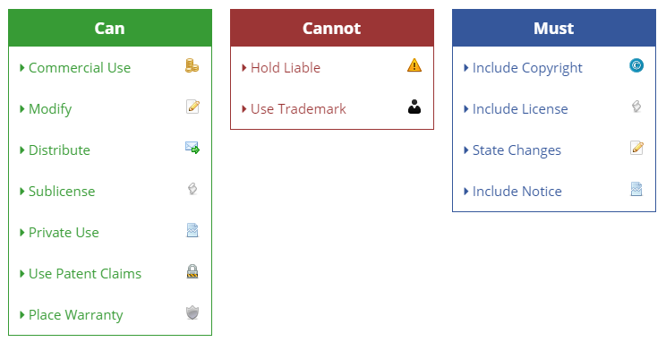
Caveats for SciSharp
Apache 2.0 License (see details on right)
Some of the libraries require Python and the associated package to be installed.
https://tldrlegal.com/license/apache-license-2.0-(apache-2.0)

Slide 9
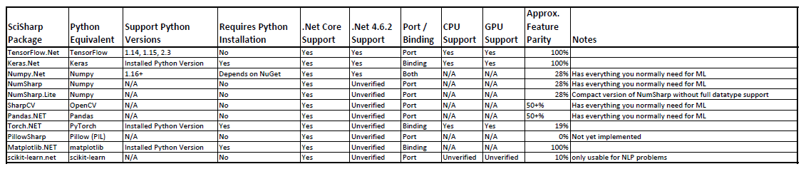

Slide 10
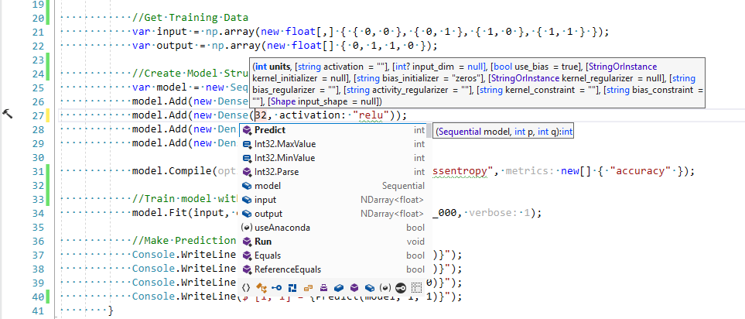
Keras.NET (also uses TensorFlow and Numpy)
Binding around Keras
You have to have Python and Keras installed in order to use this
We’ll talk more about this later on
Easier to play around with in C#, thanks to Intellisense
Notes:
https://github.com/SciSharp/Keras.NET

Slide 11
Install Python and Packages
Download and Install Python
Download and Install Anaconda
Open the Anaconda Prompt (from start menu)
Install the following packages using the pip command
pip install TensorFlow
pip install keras
pip install keras2onnx
pip install onnx
pip install onnxmltools
Note this will install all required packages like Numpy
Links are on the links slide

Slide 12
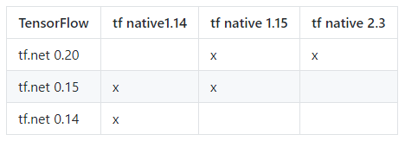
Using Keras.NET
Install the following NuGet packages:
Keras.NET
pythonnet_netstandard_py{pyVersion}_{os}
pythonnet_netstandard_py35_linux for Python 3.5.x on Linux
pythonnet_netstandard_py37_osx for Python 3.7.x on Mac OS X
pythonnet_netstandard_py38_win for Python 3.8.x on Windows
SciSharp.TensorFlow.Redist
should be compatible with the version of TF you want to use
https://github.com/SciSharp/TensorFlow.NET

Slide 13
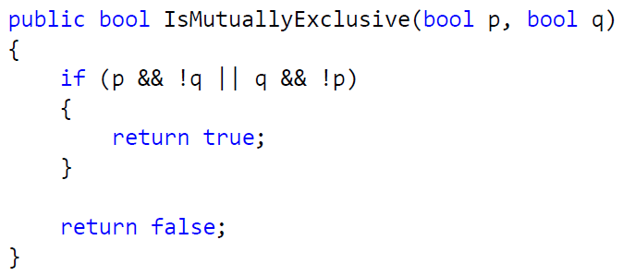
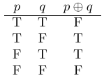
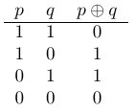
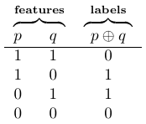
Mutual Exclusion (XOR) Problem
Given two variables p and q, p and q are mutually exclusive if p is true and q is not, or if q is true and p is not.
C#
Math
ML

Slide 14
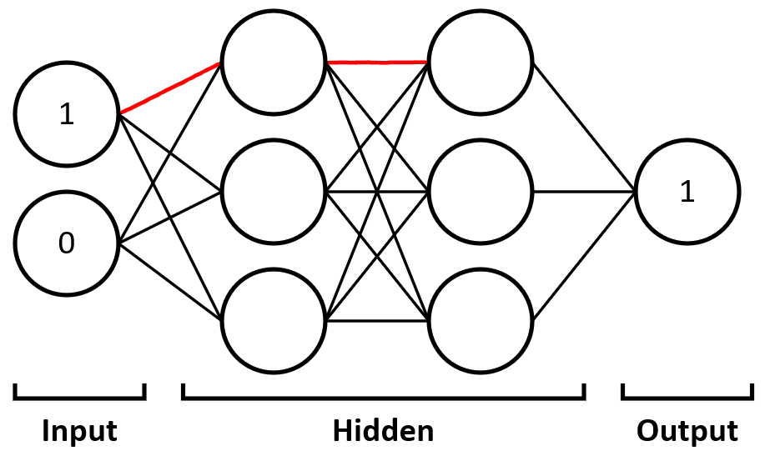
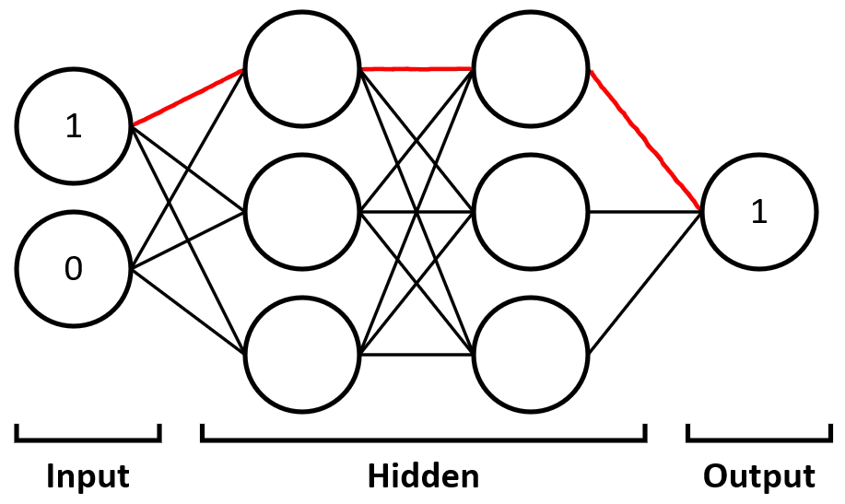
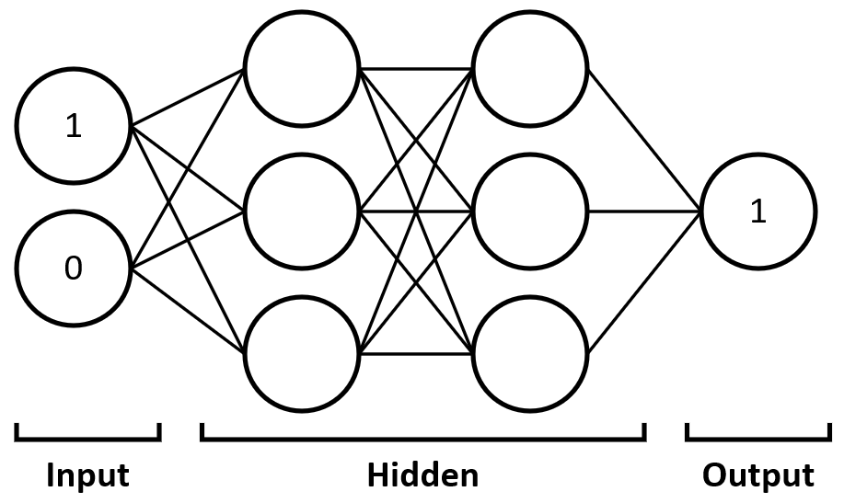
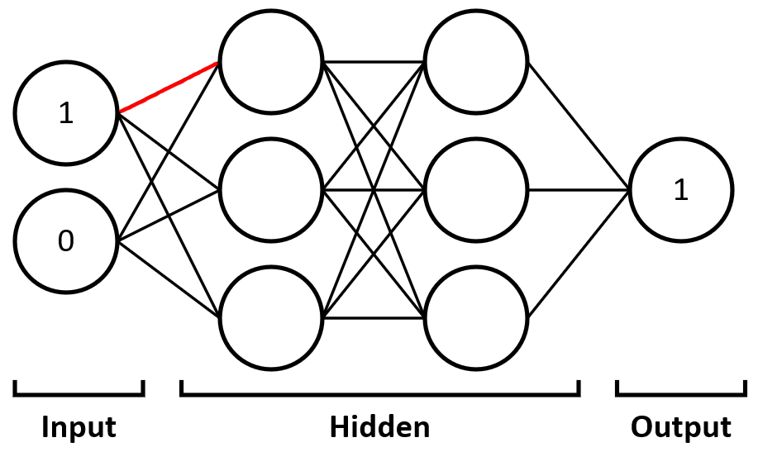
Neural Network Diagram

Slide 15
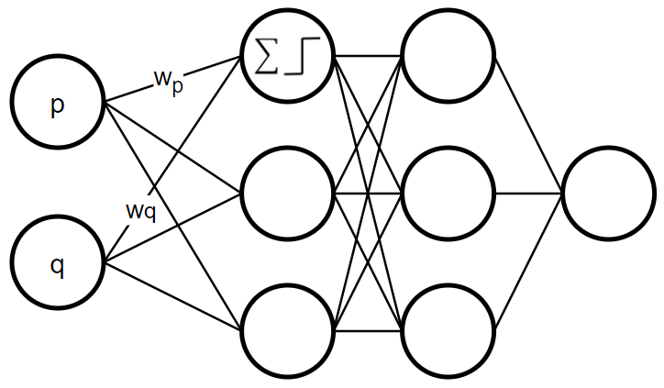
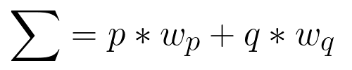

Perceptron

Slide 16
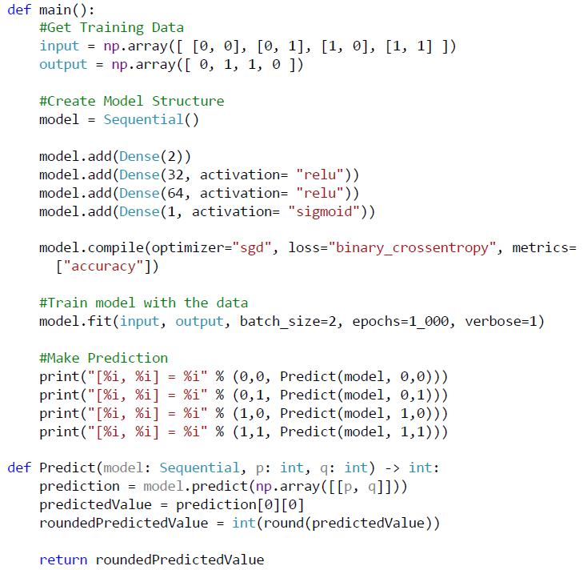
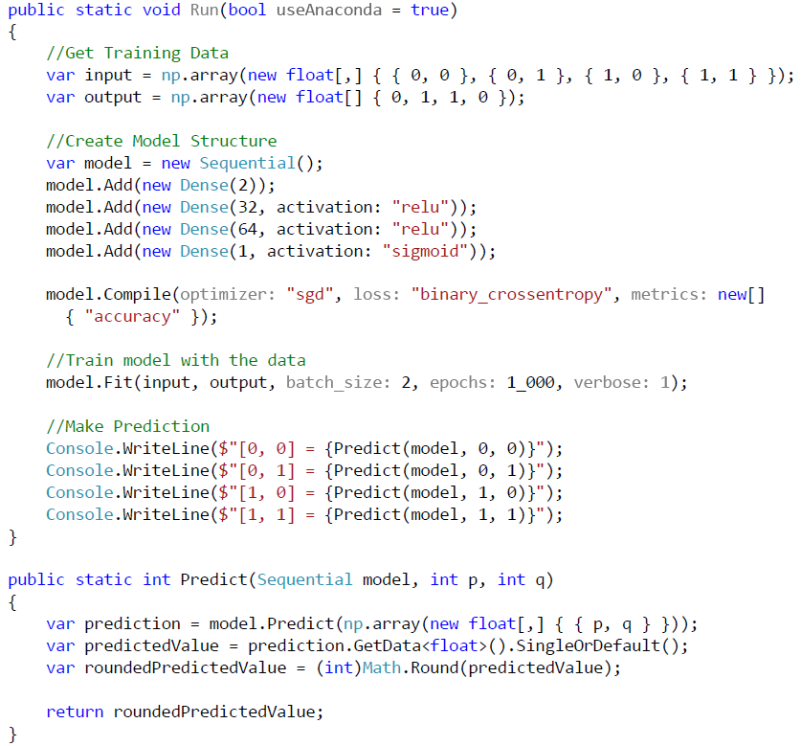
Python
C#

Slide 17
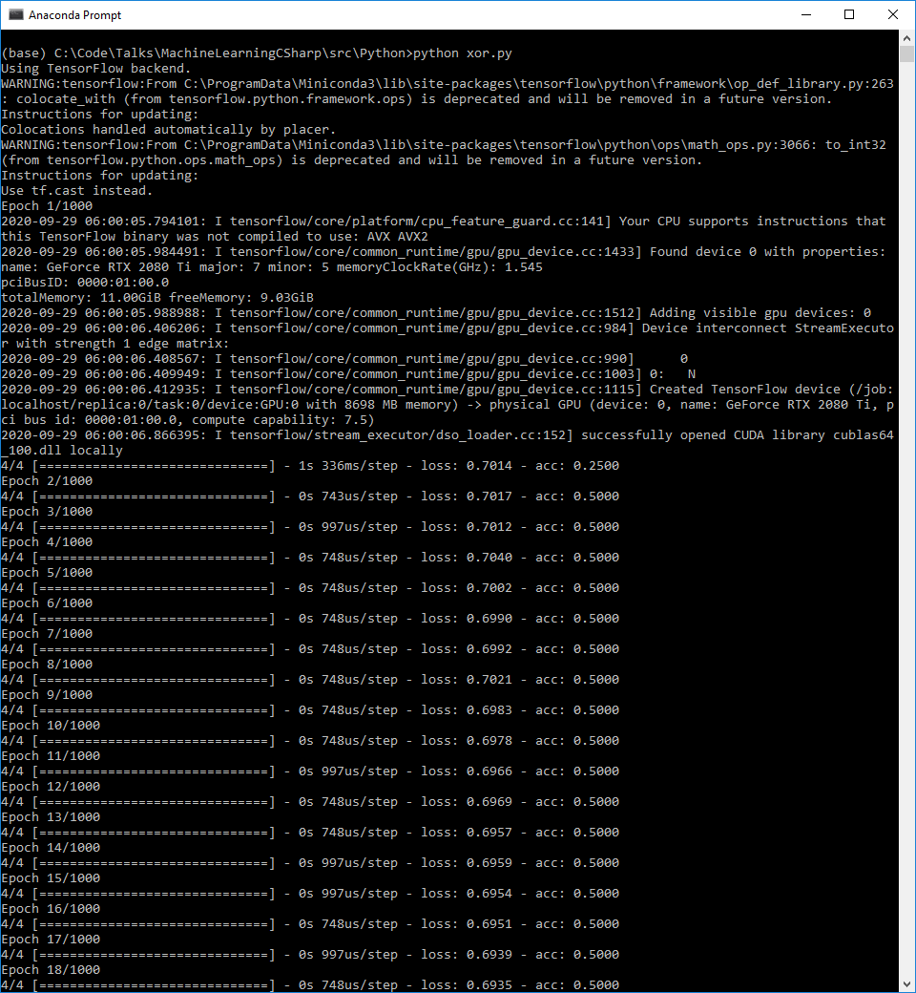
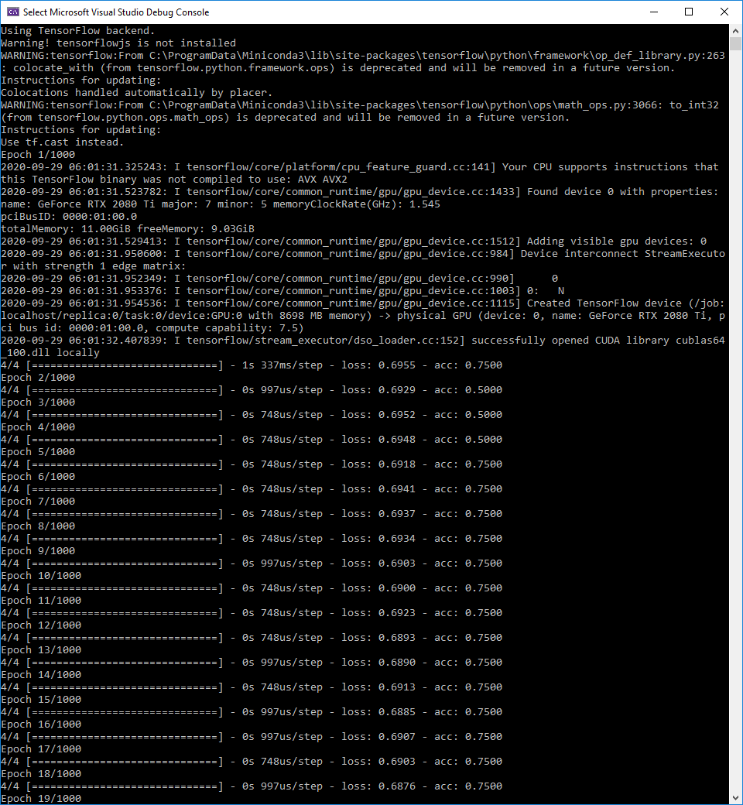
Python
C#

Slide 18
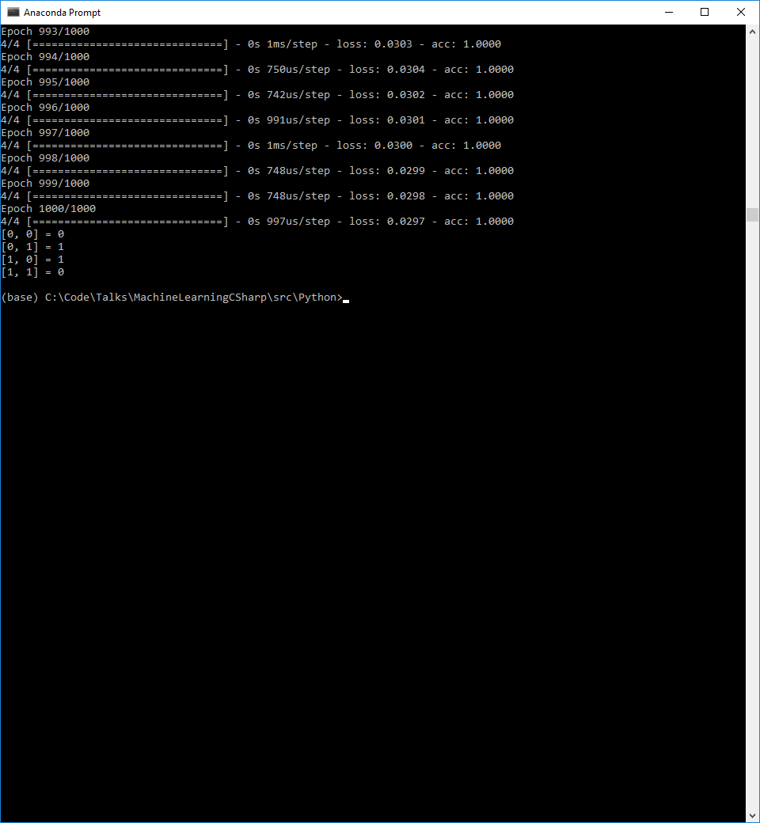
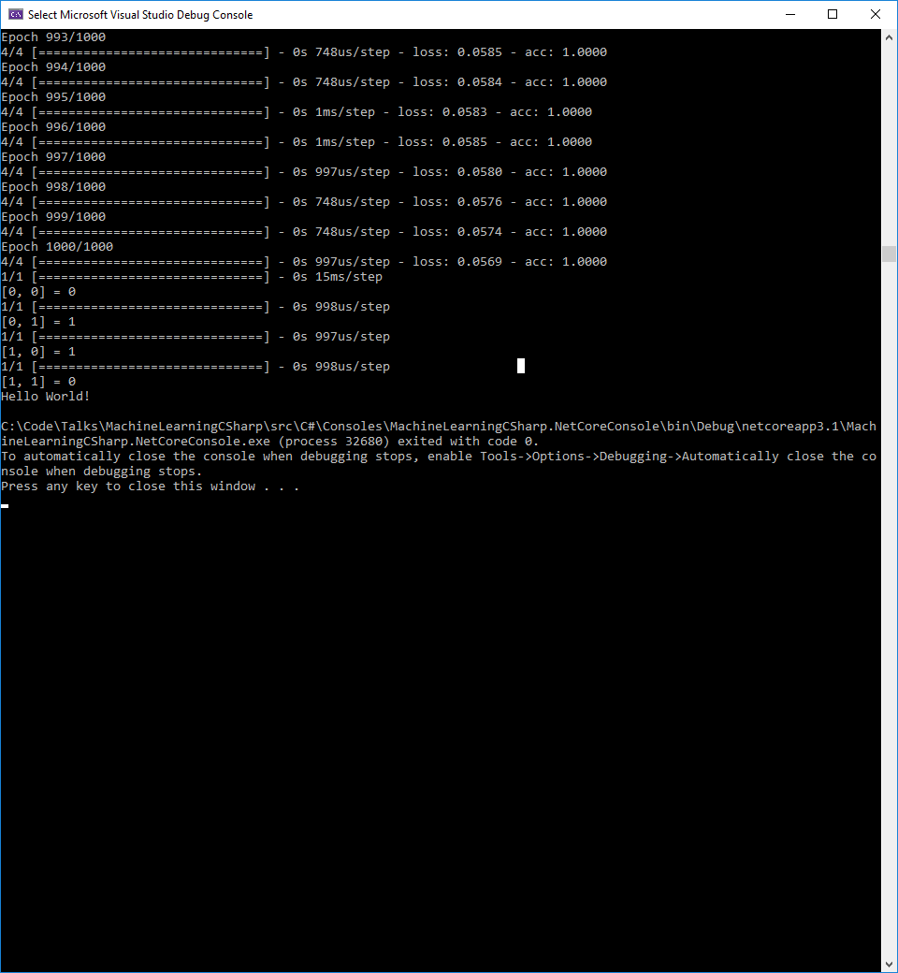
Python
C#

Slide 19
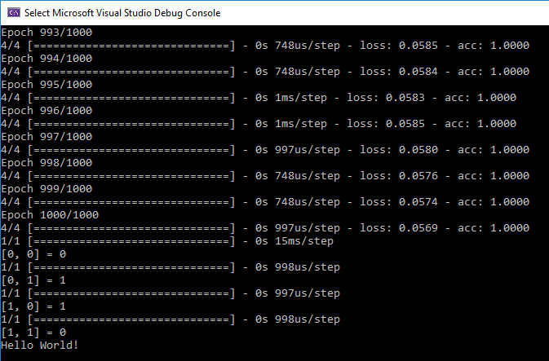

Slide 20
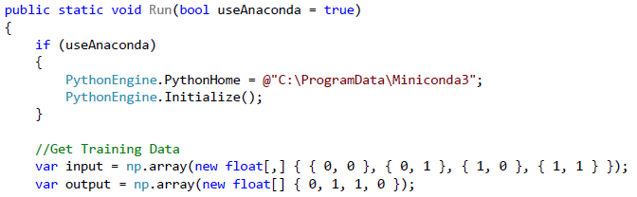
Caveat for Keras.NET
If you are using Virtual Environments then you need to set the PythonHome path and initialize the engine

Slide 21
Keras.Net
Kind of cool, but crappy, since we must:
Install Python, Keras, and any dependencies
Tie our code to a specific version of Python and Operating System (separate projects for Linux and Windows). pythonnet_netstandard_py38_win
Tied to a specific version of TensorFlow
Perform the virtual environment work around if different applications need different versions of the same library
Meaning that our deployment environment must, exactly, mirror the same as development
So then, why would I suggest doing this?
So how do we fix this, so we don’t have to deal with this nightmare?
We’ll look at two options: ONNX and ML.NET

Slide 22
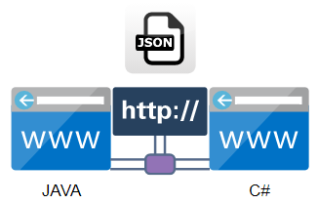
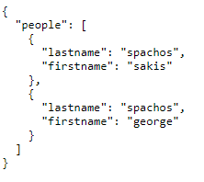
Question
Say we have two web apps, one written in Java, and one in C#, how can they communicate and pass data back and forth?
HTTP Protocol
JSON Data Format
https://www.wix.com/corvid/forum/community-discussion/wixfetch-json-help

Slide 23
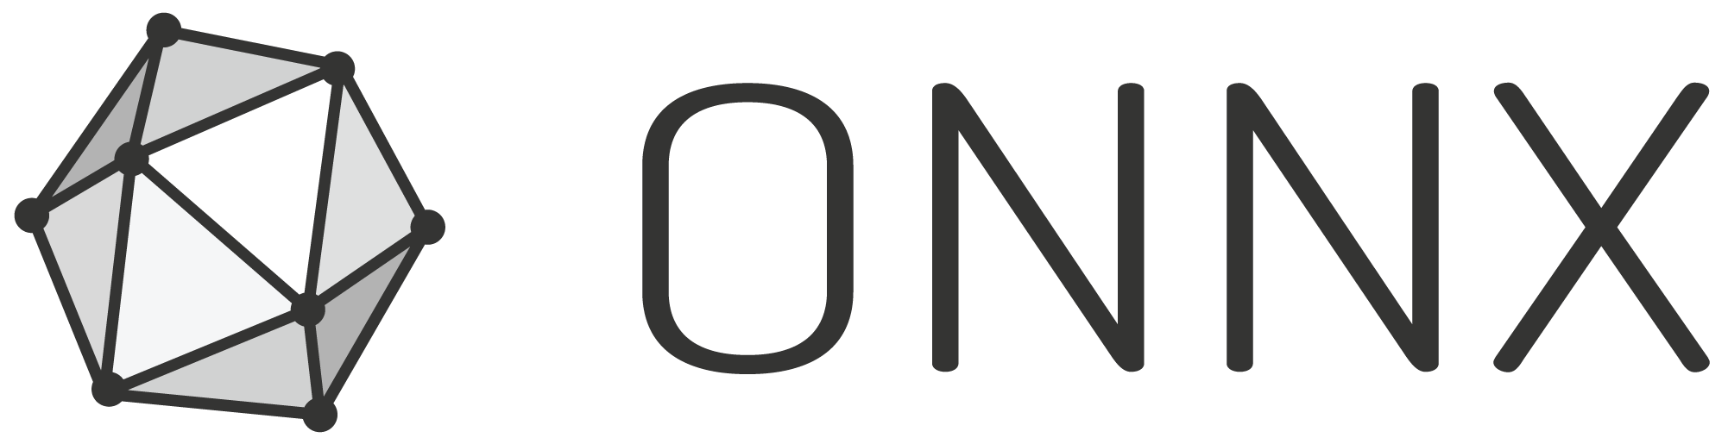
ONNX
Stands for Open Neural Network Exchange
Has two parts:
File format (similar to JSON) for representing ML models
Runtime which provides the building blocks of ML so that you can take a model build in one system and use it in another
Built by Microsoft and Facebook
In short, its…Pure Awesomeness
https://commons.wikimedia.org/wiki/File:ONNX_logo_main.png

Slide 24
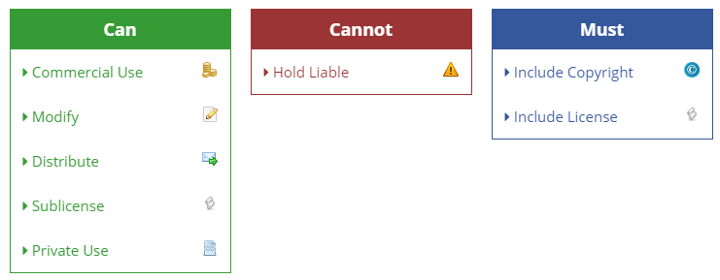
License
MIT
https://tldrlegal.com/license/mit-license

Slide 25
Why do we care?
As a ML Engineer (MLE):
Can use different libraries and languages to create models e.g. Billy likes PyTorch and John like Keras, so it doesn’t matter if they both deliver models in the ONNX format
We can use third-party libraries with the library we choose
All without making the model any slower to run predictions
As a developer:
If we work at a company that has data scientists or MLE’s they can do their work in Python, then can just give us an ONNX model without us having to install Python, packages, or even knowing what it was built in.
We can have proper separation of concerns, because our entire ecosystem doesn’t have to be Python-based just because the model was built in Python
Use the correct tool for the correct job
In the case of our XOR example, we can deploy code consuming our model without the need to install Python or its dependencies.

Slide 26
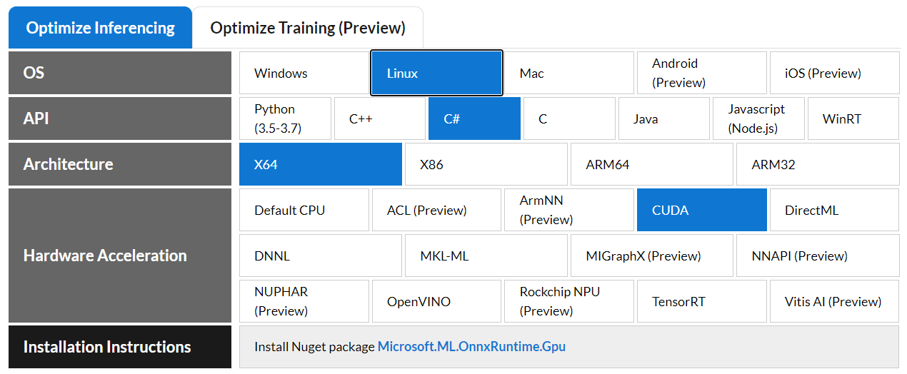
ONNX Support
Works with:
PyTorch
OnnxXmlTools – Keras.Net to ONNX
scikit-learn (SKLearn)
Keras
TensorFlow
Azure AutoML
WinMLTools – ML.NET to ONNX
Apple Core ML
Works with Hardware Accelerators
nVidia CUDA
nVidia TensorRT
Intel OpenVINO
https://microsoft.github.io/onnxruntime/

Slide 27
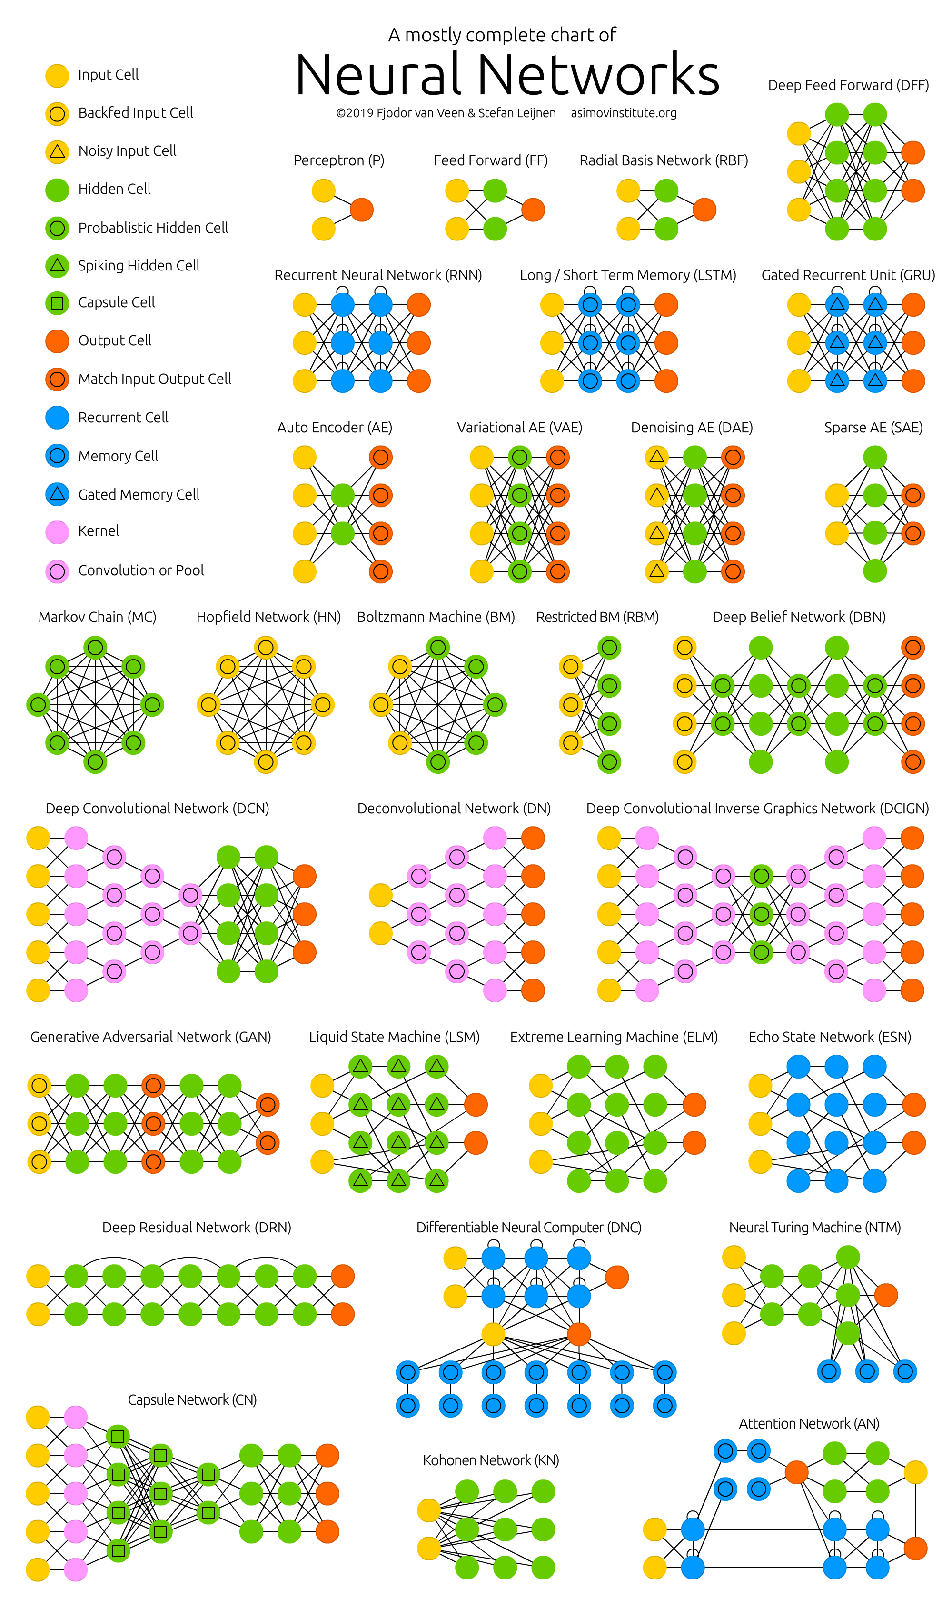
ONNX Model Support
Feed Forward
Recurrent (RNN)
Convolutional (CNN)
GAN
Long Short-Term Memory (LSTM)
Markov Models
and many more…
https://www.asimovinstitute.org/neural-network-zoo/

Slide 28
XOR
Take our XOR model we created:
Export it to ONNX
Consume the ONNX model in Python
Consume the ONNX model is C#

Slide 29
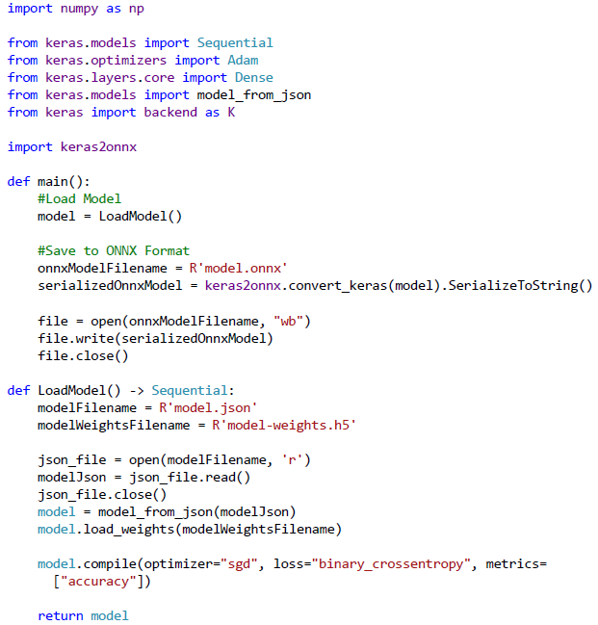
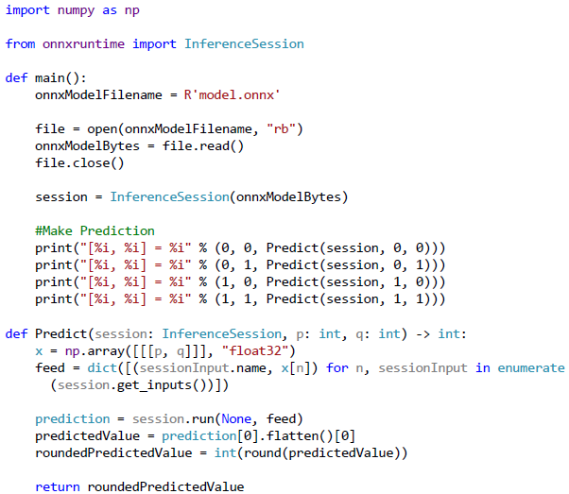
Save XOR ONNX Model (Python)
Use XOR ONNX Model (Python)

Slide 30
Consume XOR in C#
Single NuGet package
Microsoft.ML.OnnxRuntime for CPU support
Microsoft.ML.OnnxRuntime.GPU for GPU support
DEMO

Slide 31
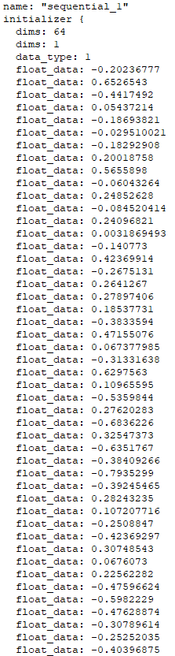
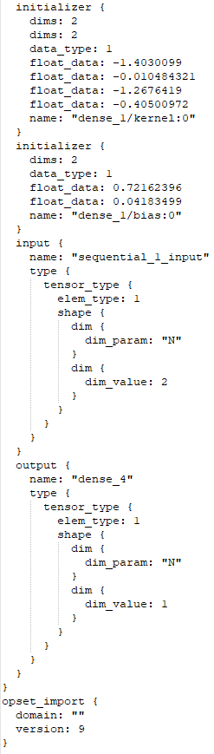
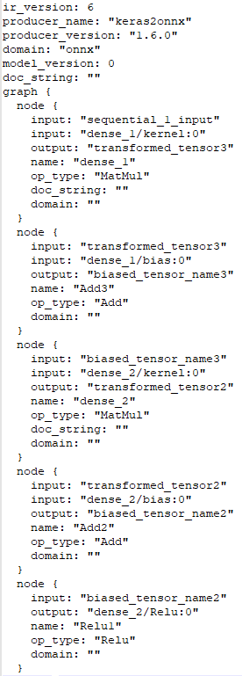
ONNX File

Slide 32
ONNX Caveats
You may have to include additional DLL’s when deploying ONNX models, such as
Microsoft.ML.OnnxRuntime.dll
onnxruntime.dll & onnxruntime.lib
Windows.AI.MachineLearning.dll & Windows.AI.MachineLearning.lib
System.Numerics.Tensors.dll
System.Runtime.CompilerServices.Unsafe.dll
Microsoft.Win32.Primitives.dll
I recommend deploying to another machine, and try running it, if you are getting errors then start adding these in the above specified order, one at a time.

Slide 33
ML.NET
Cross-Platform Machine Learning Framework
Built for .Net developers
Supports ONNX
Microsoft uses it for Power BI, Microsoft Defender, Outlook and Bing
Supports AutoML (more on this in a bit)
Supports most ML problems: classification, regression, object detection, sentiment analysis, time series data
NuGet: Microsoft.ML

Slide 34
ML.NET
Pros
It is great for ML newbies, since the transformations handle the conversion from say text to numerical values for training, which can be very complex for certain problems.
Entirely C#, no third-party libraries
Has a ton of samples running the gamut of ML problems
Works with ONNX, so you can build models entirely in C#, then port them for use in Python
Cons
Opinionated
Modeled off of Entity Framework, which is a rather odd choice
Looks very different from other ML libraries
Can be overly complicated to use
Is confusing to use if you have an ML background

Slide 35
ML.NET
DEMO

Slide 36
Other Options
nuML - http://numl.net/
Pros
Great for traditional ML applications such as decision trees, KNN, and SVM
Great Linear Algebra and Statistics library
Great examples for Recommendation Engines, Reinforcement Learning, Clustering, and PCA
Cons
Limited support for Neural Networks
Overlap in functionality with ML.NET, but takes a different approach
Encog - https://www.heatonresearch.com/encog/
Pros
Very easy to use if you know Neural Networks
Supports early training termination and pruning
Cons
has been abandoned
No .Net Core support
TensorFlowSharp – https://github.com/migueldeicaza/TensorFlowSharp
Pros
1:1 port of TensorFlow to C#
Cons
No CUDA support
Abandoned (they recommend using TensorFlow.NET)

Slide 37
Deployment
2 Questions:
On-Prem or Cloud?
Separate (MLaaS) or integrated into an app?
Normal style: console app, web app, web service, mobile, microservice, etc.
Cloud (MLaaS):
Azure Machine Learning
AWS SageMaker
Google Cloud Datalab
IBM Watson Machine Learning

Slide 38
AutoML
2 Types:
Pre-built solutions to ML problems such as image classification, or object detection
You give it your data, and it tries different algorithms and hyperparameter tunings to find the most optimal model for you
Implementations create the entire pipeline for you
Parse Data -> Convert to Numbers -> Normalize -> Vectorize -> Train
Examples
Azure Cognitive Services
Google Cloud AutoML

Slide 39
AutoML
Pros
Very easy for non-ML developers to add ML to their applications
Very fast to implement
Cons
A lot of times the only thing you can tweak is the data
Limited ML problem support
Can be expensive, depending on how you use it

Slide 40
MLaaS vs. AutoML
MLaaS is you do the machine learning work and deploy it to the cloud, so it there is any pre or post processing that would your responsibility to write
AutoML is transfer learning built for special tasks such as image classification, handling all of the pre and post processing steps for you.
AutoML makes it very easy for developers to add ML without needing to know a lot about ML
Same argument as buy vs. build like with any other software

Slide 41
Links
Python - https://www.python.org/
Anaconda - https://docs.anaconda.com/anaconda/install/windows/
SciSharp - https://scisharp.github.io/SciSharp/
ONNX - https://microsoft.github.io/onnxruntime/
ONNX GitHub - https://github.com/microsoft/onnxruntime

Slide 42
Questions
@bkorzynski
github.com/korz

