Slide 1
Machine Learning in C#
Brian Korzynski

Slide 2

About Me
Chief Executive Officer – Intelligent Document Processing Solutions (IDPS)
Professional Developer for 18+ years
Applications:
Windows Forms
Web
Mobile
Cloud
Analysis
SQL Optimization
Data Analysis
Mathematics
AI (9+)
Big Data
Machine Learning
Artificial Intelligence

Slide 3
Disclaimer
What this talk is?
Focusing on the tools and options you have a C# developer
Going to show you how you can do ML in C# or consume Python-built ML models model in C# applications.
Provide you with samples to get you started on your ML journey.
What this talk is not?
Going to teach you everything about ML
A definitive source on what is right for your company
Assuming the type of AI/ML work that you are doing

Slide 4
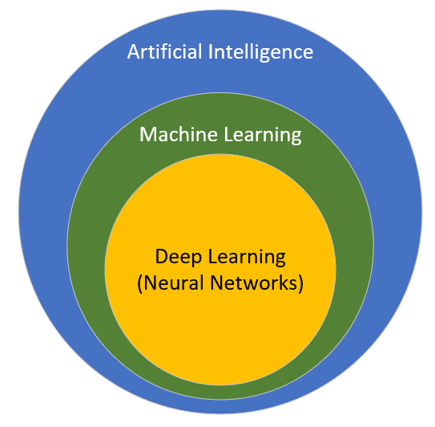
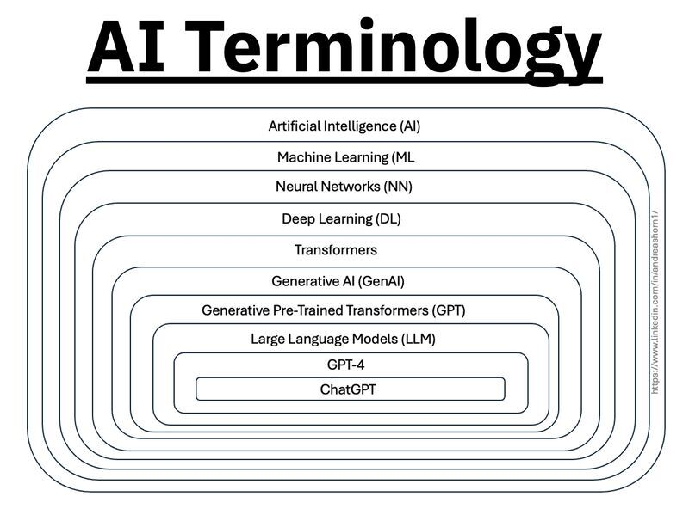
What is AI?
AI allows the computer to perform tasks that are easy for humans but very hard to code.

Slide 5
What is ML? How is it different than AI?
Machine Learning is AI that focuses on building systems by learning patterns from data instead of explicitly relying on hard-corded rules
You provide a lot of samples and expected results and let it learn the rules.
Think of it as a rules engine where you don’t explicitly specify the rule, or sometimes even know the rules.
Some examples
Fraud of Not Fraud
Spam or Not Spam
Deep Learning is Machine Learning that uses Neural Networks

Slide 6
Why C#?
You are already a C# developer.
Machine Learning already has a lot of complexity and things to learn such as: normalization, quantization, and tensorization, so we don’t need to add Python, libraries, and frameworks on top of that. So using tools your already familiar with makes it easier.
I believe in picking the right tool for the job, instead of building your companies entire tech stack around Python, just because it is good for building models.
It is often way faster to run models in C# than in Python. In my experience it has been about 20 times faster than Python, but changes depending on the project and its complexity.

Slide 7
A
PROBLEM

Slide 8
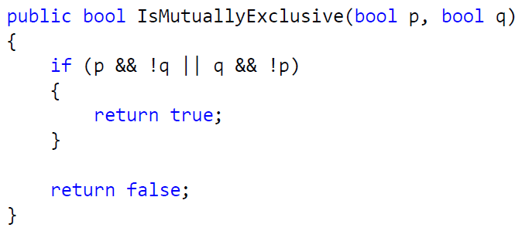
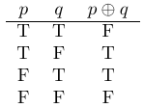
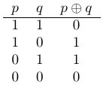
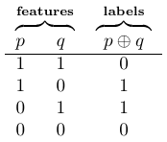
Mutual Exclusion (XOR) Problem
Given two variables p and q, p and q are mutually exclusive if p is true and q is not, or if q is true and p is not.
C#
Math
ML

Slide 9
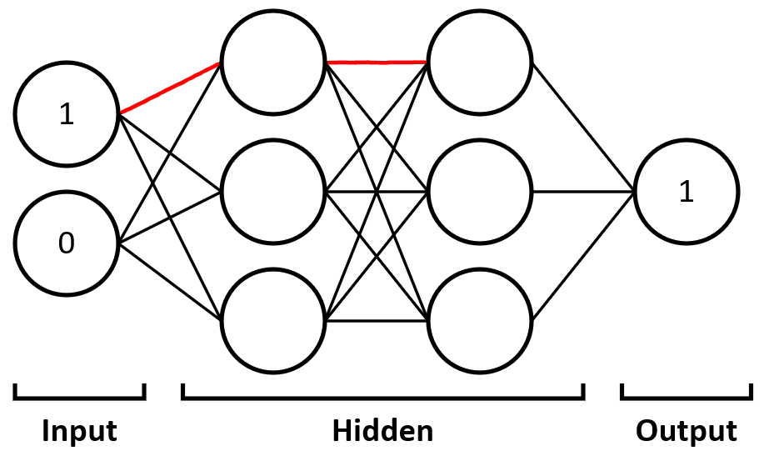
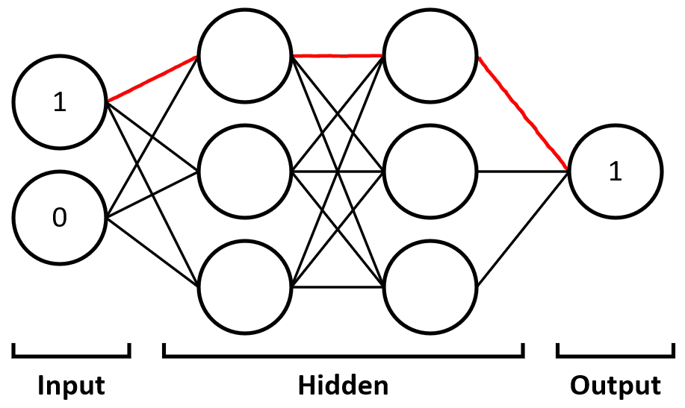
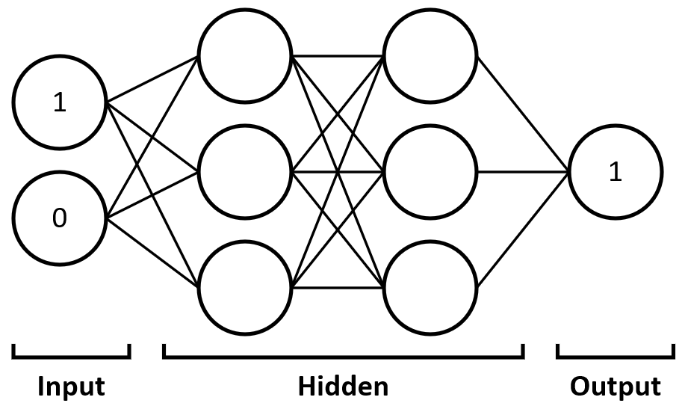
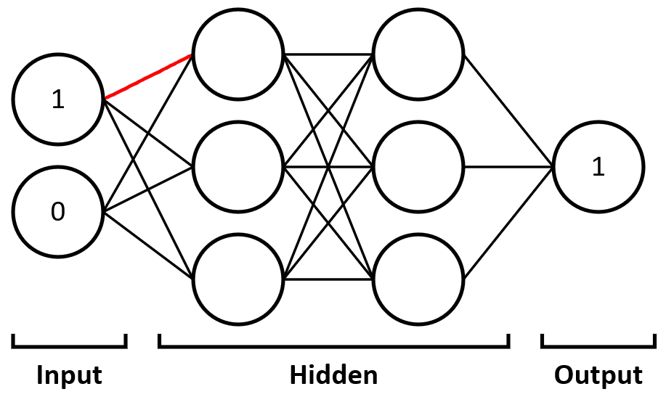
Neural Network Diagram

Slide 10
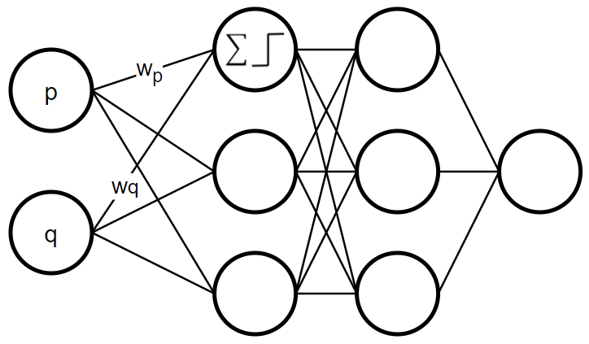
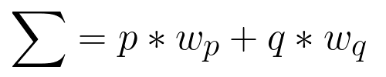

Perceptron

Slide 11
BUILDING MODELS

Slide 12
Option1. ML.NET
Cross-Platform Machine Learning Framework
Built for .NET developers
Has ONNX & ONNX Runtime Support (more on this later)
Microsoft uses it for Power BI, Microsoft Defender, Outlook and Bing
Supports AutoML
Wide ML Problem Support: classification, regression, object detection, sentiment analysis, time series data
NuGet: Microsoft.ML

Slide 13
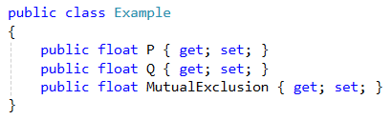
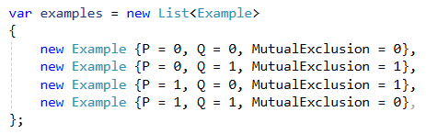
Code. Setup Data for Training
Data can come from anywhere
Databases
Files
Services
Getting the data is a separate concern of training the model

Slide 14
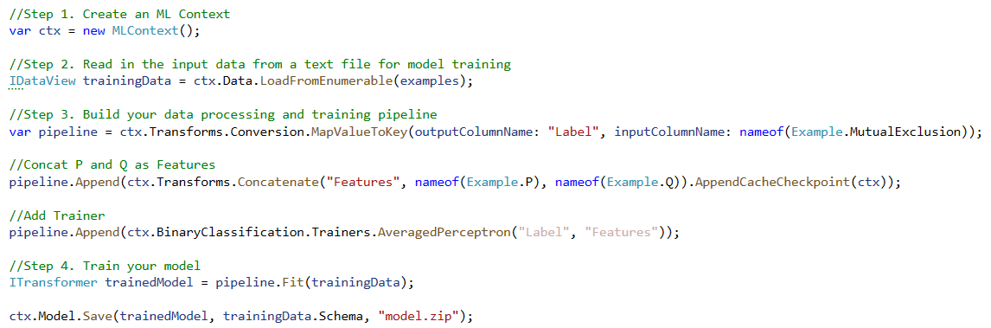
Code. Setup, Train, and Save Model

Slide 15

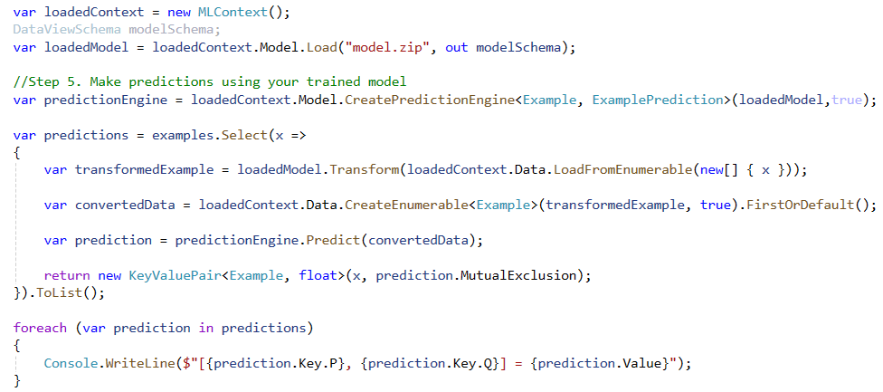
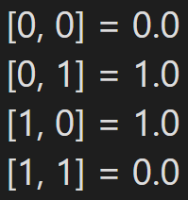
Code. Load Model and Perform Inference

Slide 16
ML.NET
Pros
Wide ML example support and tutorials
Great for developers without ML experience, since the transforms handle a lot of ML complexity for you
Entirely C#, no third-party libraries*
Can export models to ONNX (more on this later)
Cons
Has a limited number of build-in transforms, which either limits use cases or adds additional development and requiring deeper understanding of ML.NET internals
Opinionated, and if modeled off Entity Framework, therefore looks very different from other ML libraries
Can be overly complicated to use, and down- right confusing if you have an ML background and are used to building models in other platforms
Uses CPU-first driven training and inference
Doesn’t directly support CUDA, instead relies on DirectML (in Windows) then communicates with CUDA via Python-based backends like TensorFlow, which you have to setup and maintain. This can cause issues and slow downs, and I 100% don’t recommend for production deployment.

Slide 17
Option2. SciSharp Stack
TensorFlow
Keras
Numpy
OpenCV
Pandas
PyTorch
Pillow (PIL)
Matplotlib
scikit-learn
TensorFlow.Net
Keras.Net
Numpy.Net, NumSharp, NumSharp.Lite
SharpCV
Pandas.NET
Torch.NET
PillowSharp
Matplotlib.NET
scikit-learn.net

Slide 18
SciSharp Stack
Brings the best-in-class tooling from Python into C#, allowing you to use the tools and language you already use
All libraries support .NET, .NET Core, and .NET Framework.
They provide ready-made Docker Images and Jupyter notebooks to allow you to play around with it without having to do a lot of setup. Very helpful when deploying to the cloud.
You can easily port existing Python logic or examples into C# without much conversion

Slide 19
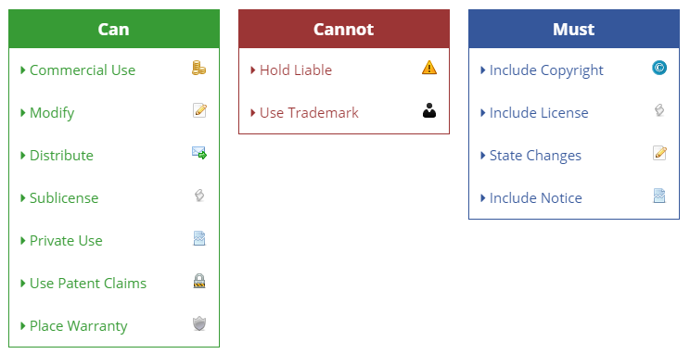
Caveats for SciSharp
Apache 2.0 License (see details on right)
Some of the libraries require Python and the associated package to be installed.
https://tldrlegal.com/license/apache-license-2.0-(apache-2.0)

Slide 20
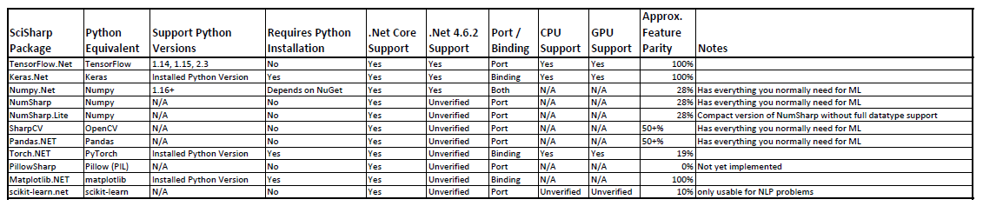

Slide 21
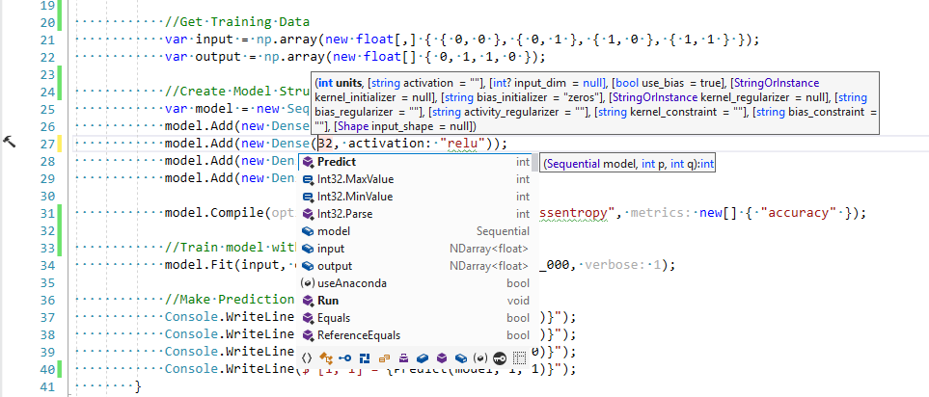
Keras.NET (also uses TensorFlow and Numpy)
Since Keras.NET is a “Binding” we must have Python, Keras, and a Keras backend (such as TensorFlow), and any dependences installed to use it
Keras is easier to explore in C#, thanks to Intellisense
Notes:
https://github.com/SciSharp/Keras.NET

Slide 22
Install Python and Packages
Download and Install Python
Download and Install Anaconda
Open the Anaconda Prompt (from start menu)
Install the following packages using the pip command
pip install TensorFlow
pip install keras
pip install keras2onnx
pip install onnx
pip install onnxmltools
Note this will install all required packages like Numpy
Links are on the links slide

Slide 23
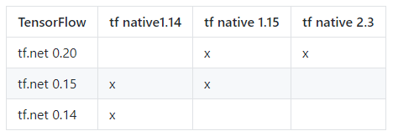
Using Keras.NET
Install the following NuGet packages:
Keras.NET
pythonnet_netstandard_py{pyVersion}_{os}
pythonnet_netstandard_py35_linux for Python 3.5.x on Linux
pythonnet_netstandard_py37_osx for Python 3.7.x on Mac OS X
pythonnet_netstandard_py38_win for Python 3.8.x on Windows
Add SciSharp.TensorFlow.Redist NuGet
should be compatible with the version of TF you want to use
https://github.com/SciSharp/TensorFlow.NET

Slide 24
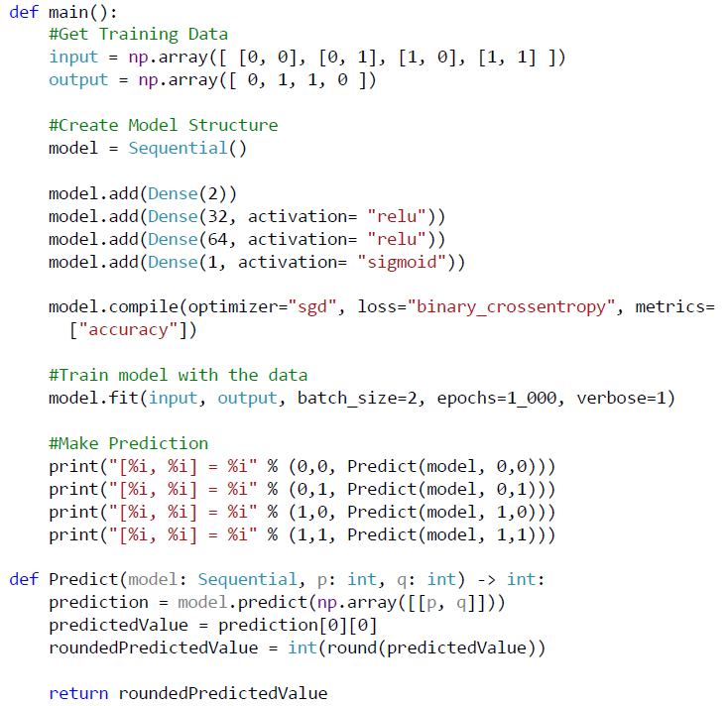
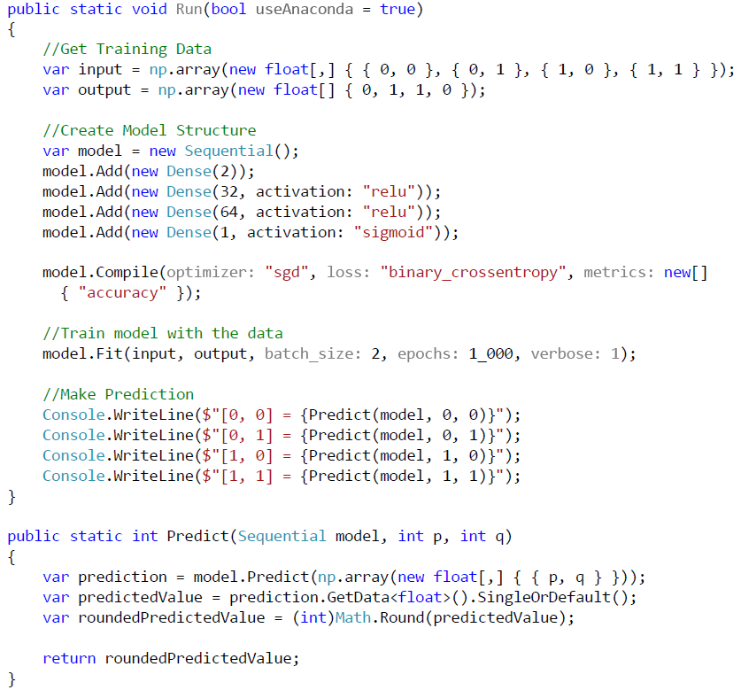
Python
C#

Slide 25
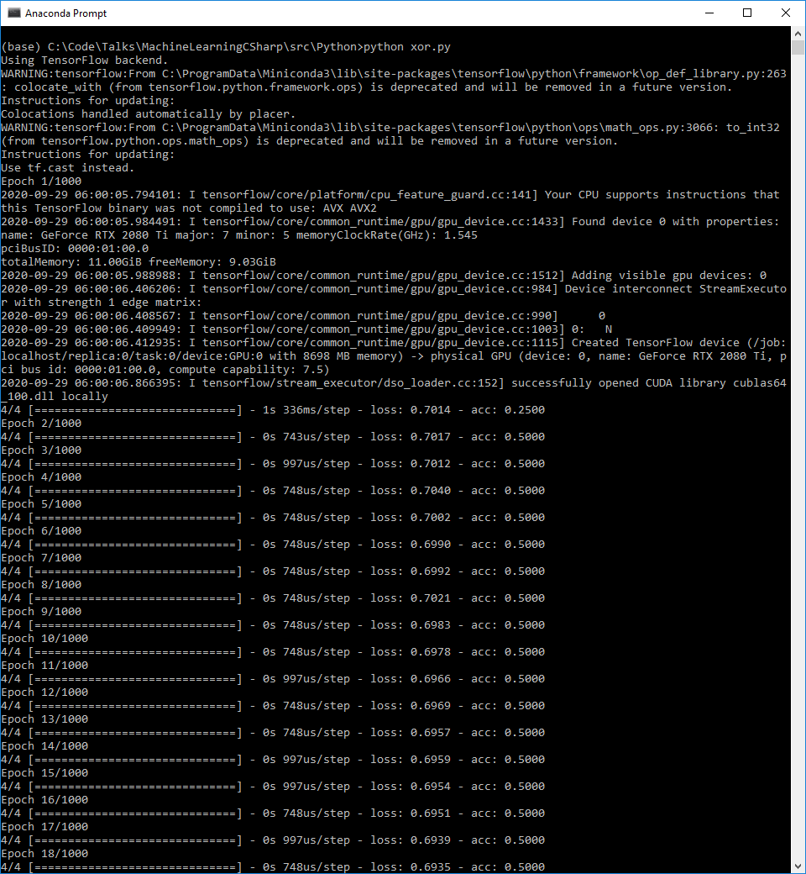
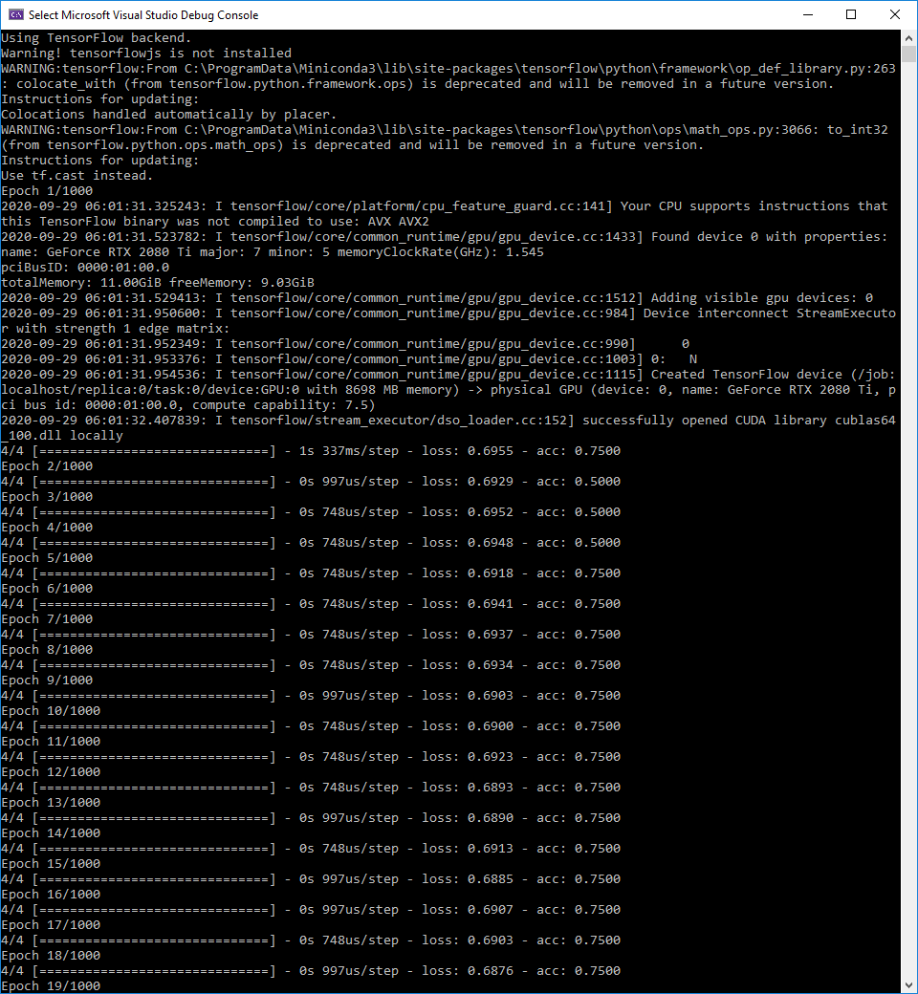
Python
C#

Slide 26
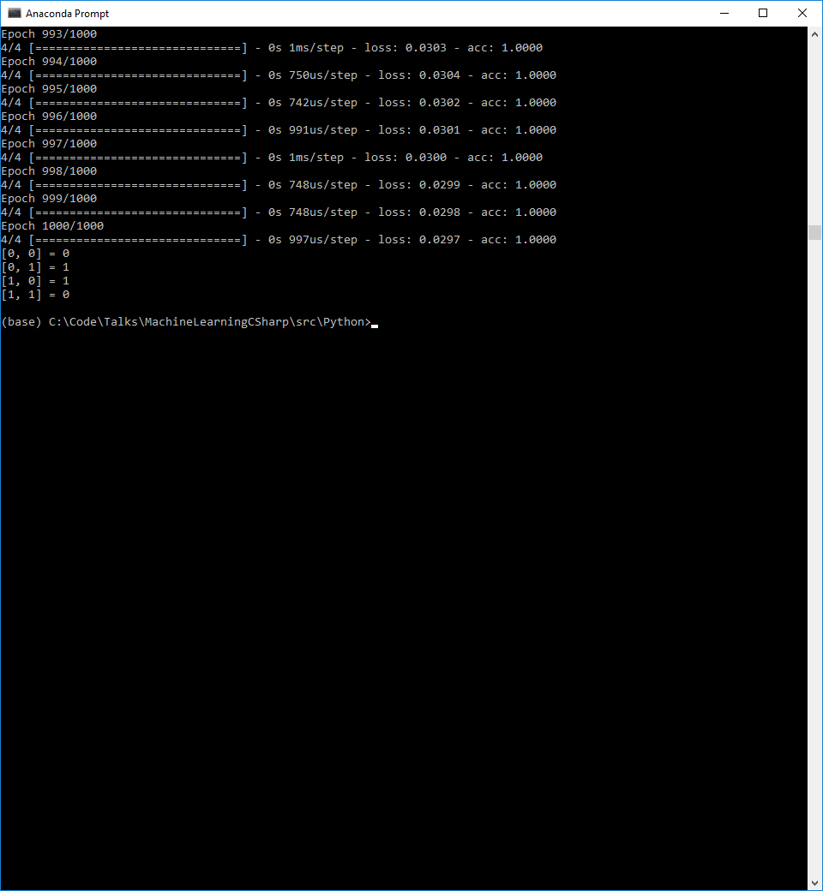
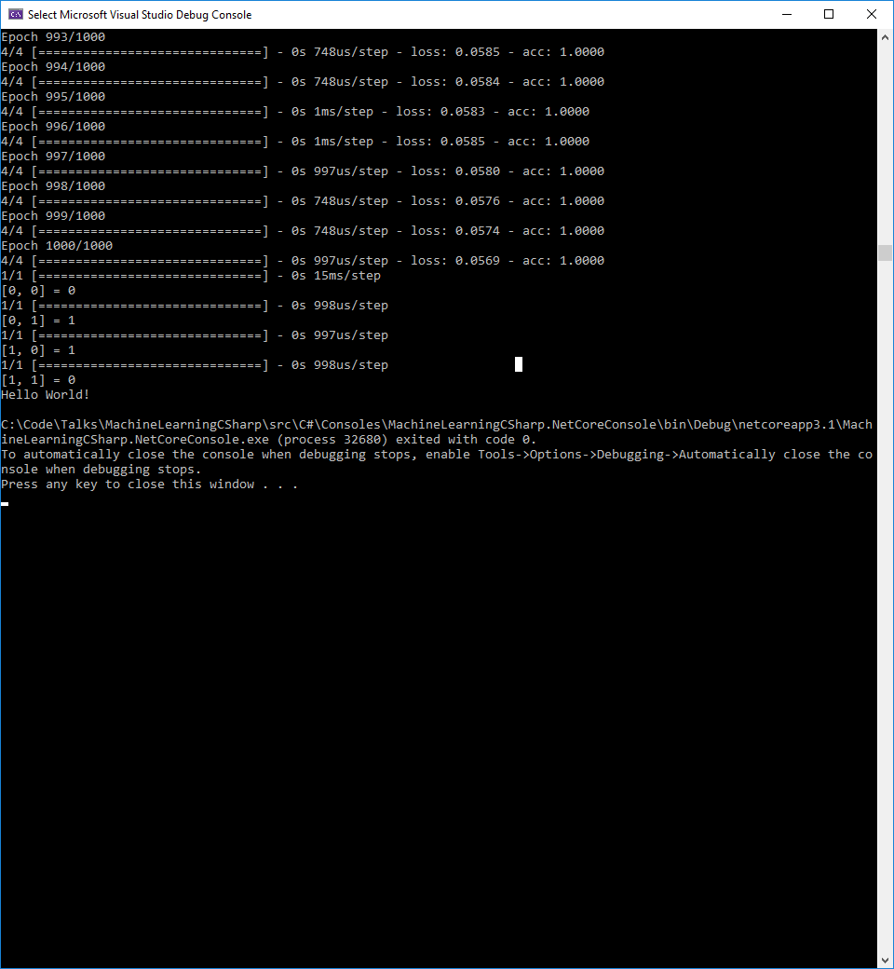
Python
C#

Slide 27
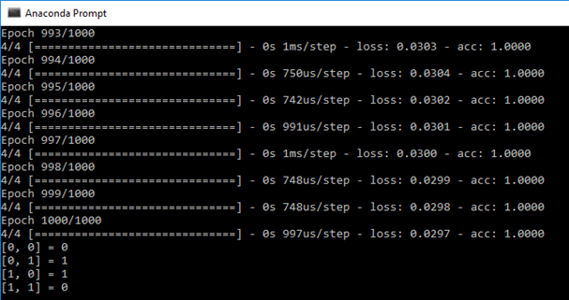

Slide 28
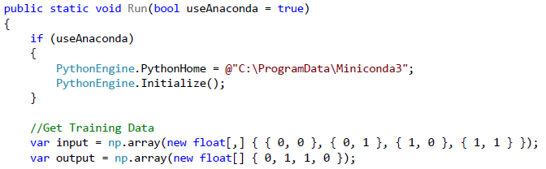
Caveat for Keras.NET
If you are using Python Virtual Environments, then you need to set the PythonHome path and initialize the engine

Slide 29
Keras.Net
Kind of cool, but crappy, since we must:
Install Python, Keras, and any dependencies
Tie our code to a specific version of Python and Operating System (separate projects for Linux and Windows). pythonnet_netstandard_py38_win
Be tied to a specific version of TensorFlow
Perform the virtual environment work around if different applications need different versions of the same library
Then deployment environments must exactly mirror development or we will get issues that are hard to find and track down, since “It Works on my machine”.
So, how can we solve these issues, make it so deployment isn’t a nightmare, and have consistency across environments.
Thoroughly document the development setup and environment, so all dev’s are on the same page.
Move this “Keras Training” processes into separate projects and don’t deploy them (just like how we don’t deploy test projects)
Run these projects locally to train and build the models for inference
Only deploy the inference model
Other options
Wrap the model into a service and call the service (MLaaS)
Deploy using Docker containers so you can ensure consistency between .NET and Python dependencies and runtimes
Utilize ONNX

Slide 30
SciSharp Stack More Packages
BotSharp: open-source AU agent application framework
BotSharp-UI: UI for BotSharp
LLamaSharp: cross-platform library to run LLaMA models locally
SharpCV: image library combining OpenCV and NumSharp
Awesome-DotNET-MCP: a curated list of MCP resources for .Net

Slide 31
Option 3. Build Elsewhere and Run in C#
Build (or download) a model wherever you like: Python, Java, Google Collab, HuggingFace, etc.
Save the model to a format that can be consumed by C#
Run the model in C# without external dependencies

Slide 32
CONSUMING MODELS

Slide 33
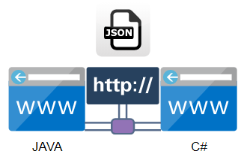
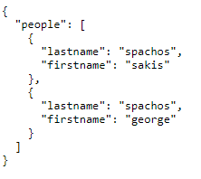
First: A Question
Say we have two web apps, one written in Java, and one in C#, how can they communicate and pass data back and forth?
HTTP Protocol
JSON Data Format
https://www.wix.com/corvid/forum/community-discussion/wixfetch-json-help

Slide 34
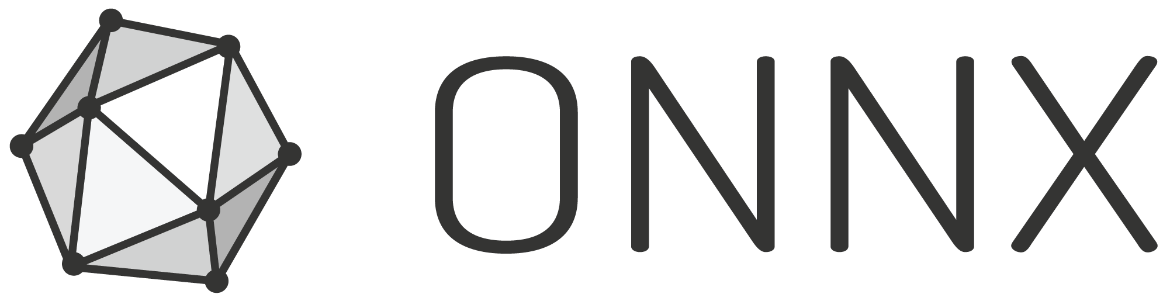
ONNX
Stands for Open Neural Network Exchange
Has two parts:
File format (similar to JSON) for representing ML models
Runtime (similar to protocol) which provides the building blocks of ML so that you can take a model build in one system and use it in another
Built by Microsoft and Facebook in 2017
In short, its…Pure Awesomeness
https://commons.wikimedia.org/wiki/File:ONNX_logo_main.png

Slide 35
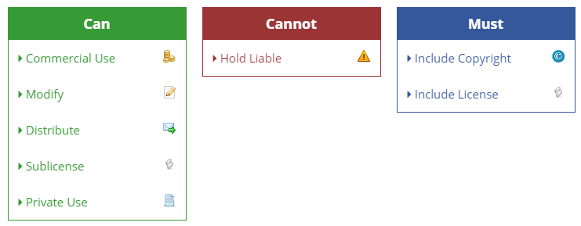
License
MIT
https://tldrlegal.com/license/mit-license

Slide 36
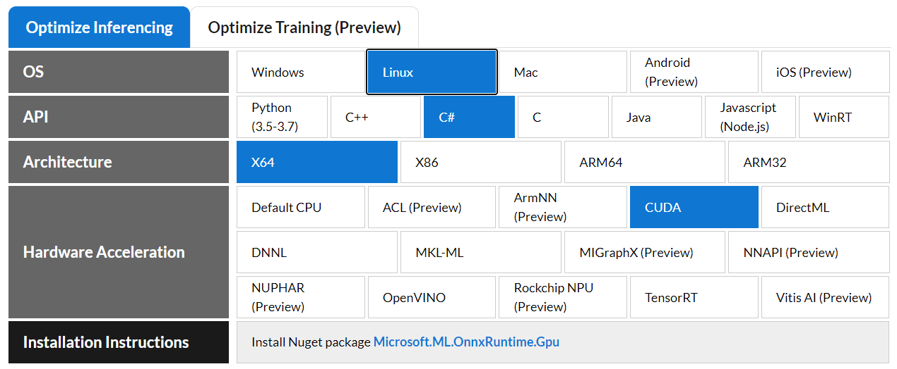
ONNX Support
Works with:
PyTorch
OnnxXmlTools – Keras.Net to ONNX
scikit-learn (SKLearn)
Keras
TensorFlow
Azure AutoML
WinMLTools – ML.NET to ONNX
Apple Core ML
Works with Hardware Accelerators
nVidia CUDA
nVidia TensorRT
Intel OpenVINO
https://microsoft.github.io/onnxruntime/

Slide 37
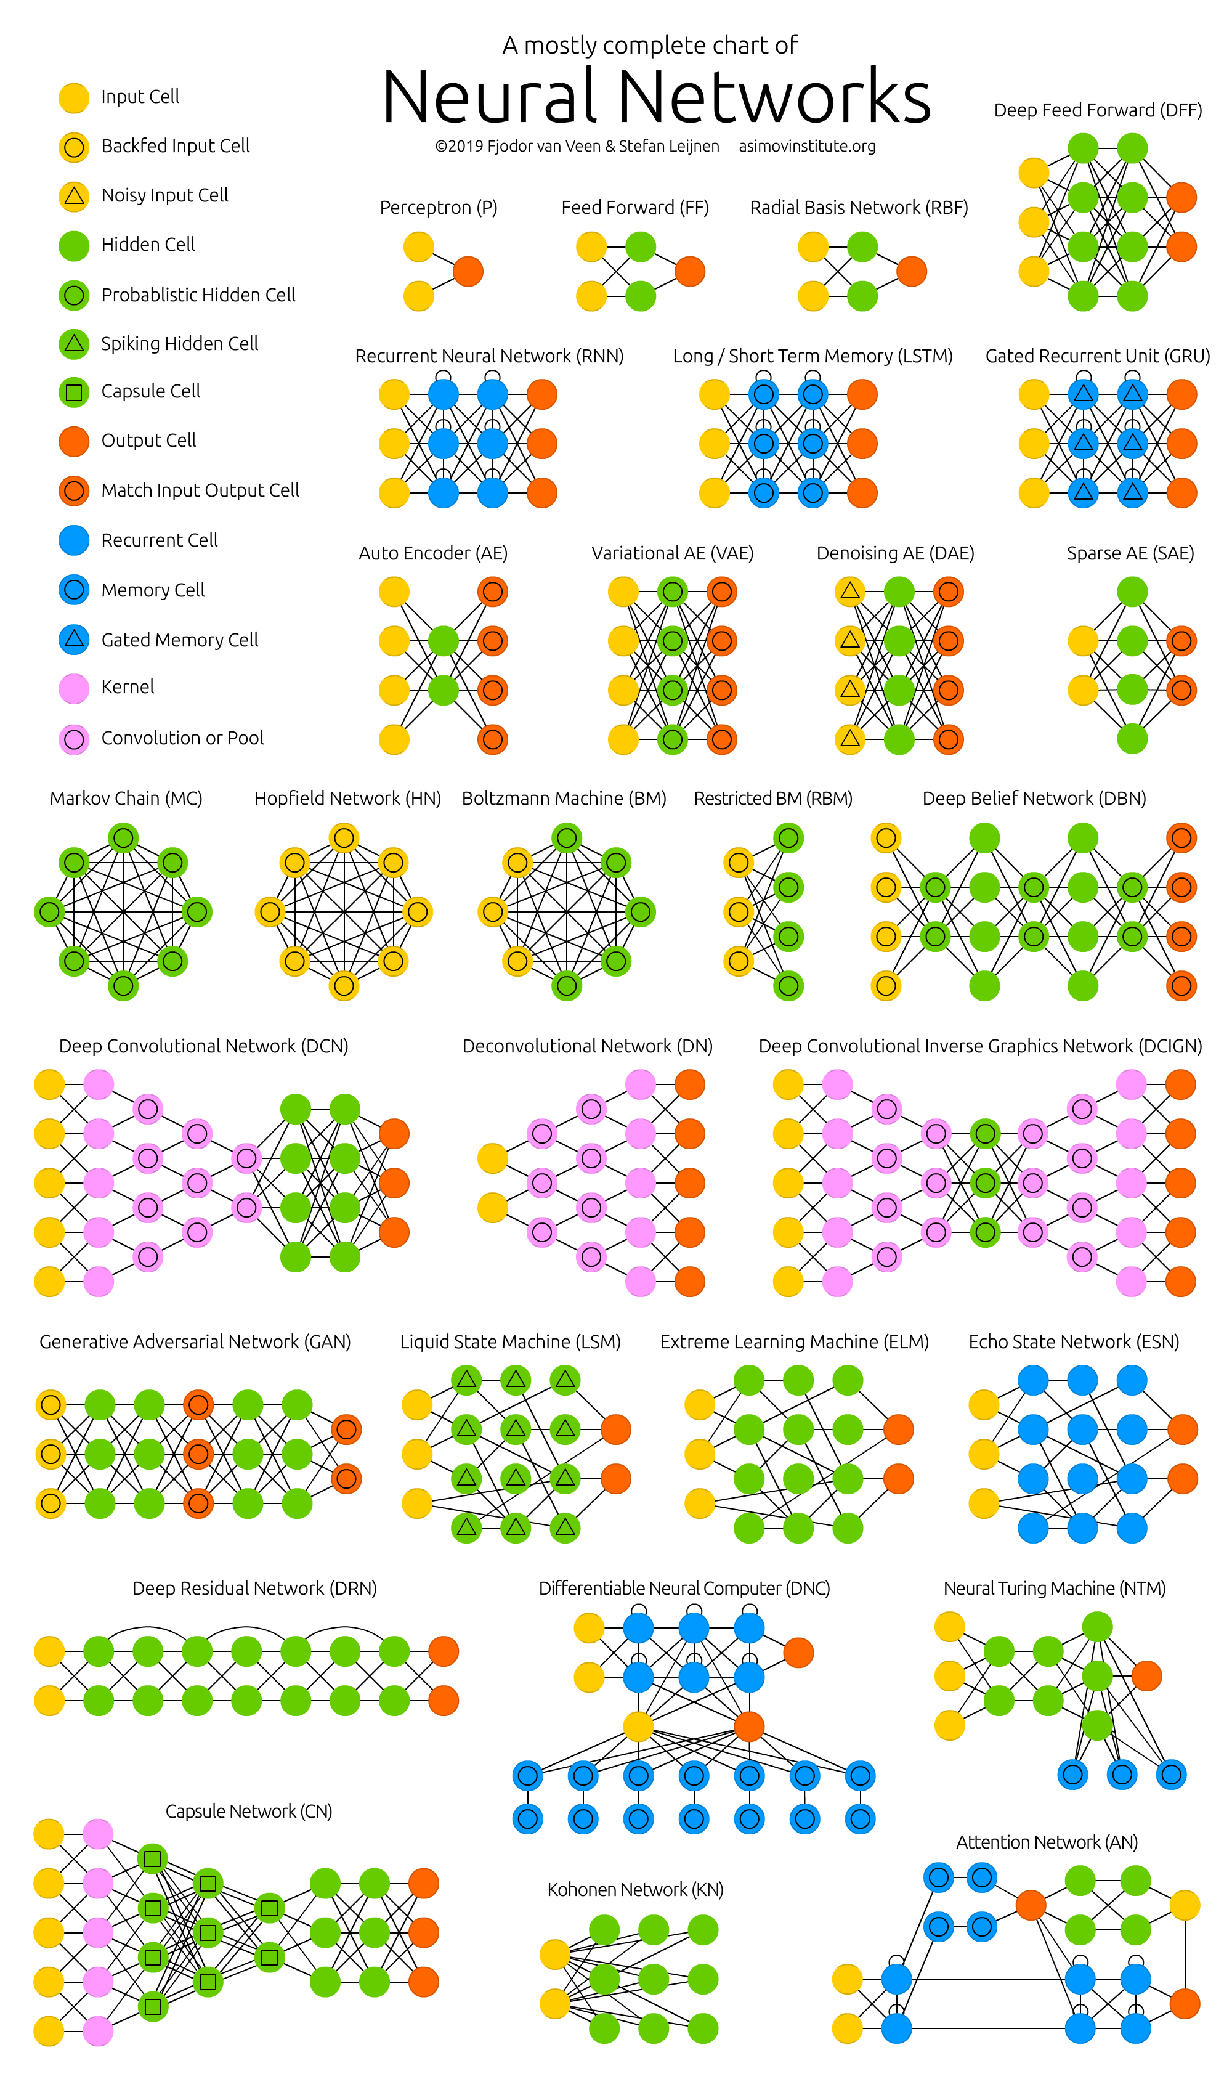
ONNX Model Support
Feed Forward
Recurrent (RNN)
Convolutional (CNN)
GAN
Long Short-Term Memory (LSTM)
Markov Models
and many more…
And yes, even some LLMs
https://www.asimovinstitute.org/neural-network-zoo/

Slide 38
Why do we care about ONNX?
As a ML Engineer (MLE):
Can use different libraries and languages to create models e.g. Billy likes PyTorch and John like Keras, so it doesn’t matter if they both deliver models in the ONNX format
We can use third-party libraries with the library of our choice
All without making the model any slower to run predictions
As a developer:
Proper separation of concerns. MLEs can use Python because it is best suited to their job, and we (devs) can use C# because it is best suited to ours. Both teams can use the best tool for their job. I’ve seen a lot of companies get this wrong.
Decoupling. Having a shared interface means that teams can work independently without having one team waiting until the other team is finished before starting.
Provides a sharable format for using models across teams, platforms, and technology stacks. Removing all Python dependencies for .NET apps that want to run a model.
For our XOR example, this means we can deploy code consuming our model without the need to install Python or its dependencies in our production environments.

Slide 39
XOR
Remember Option 3. Build Elsewhere and Run in C#
Build (or download) a model wherever you like: Python, Java, Google Collab, HuggingFace, etc.
Save the model to a format that can be consumed by C# (ONNX)
Run the model in C# without external dependencies (ONNX Runtime)
Take our XOR model we created:
Export it to ONNX
Consume the ONNX model in Python
Consume the ONNX model is C#

Slide 40
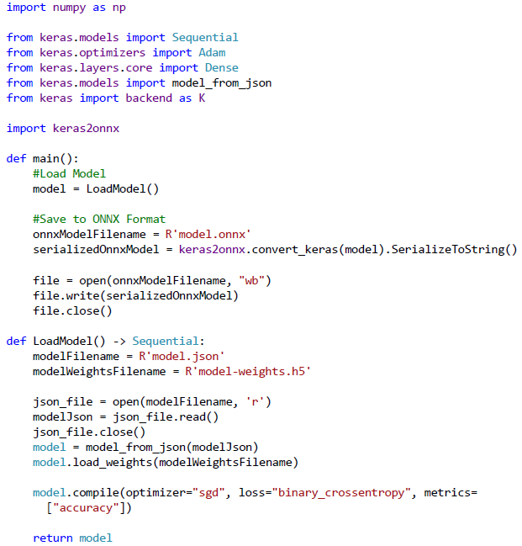
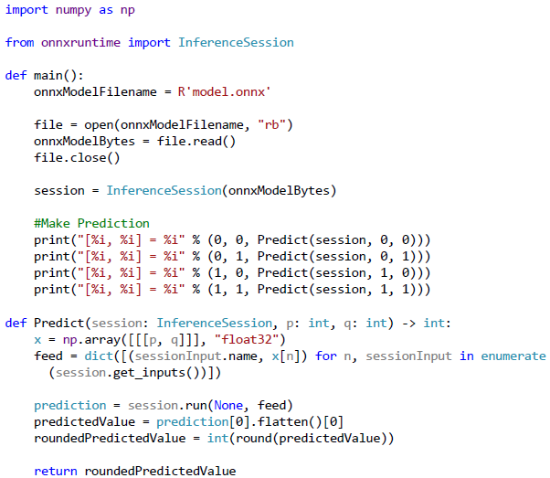
Save XOR ONNX Model (Python)
Use XOR ONNX Model (Python)

Slide 41
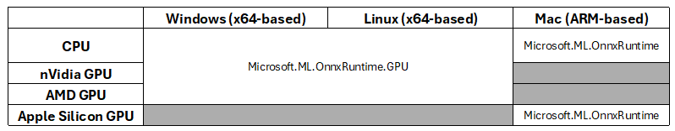
Consume XOR ONNX Model in C#
Create C# Project
Add ONNX Runtime NuGet Package
Notes:
Don’t add both since they can conflict with one another and cause issues.
Using the GPU variant will use the GPU if available and CPU if it isn’t. So you can have that logic without recompiling.
Mac needs the non-GPU variant because it uses the CoreML provider, which isn’t included in the GPU variant.

Slide 42
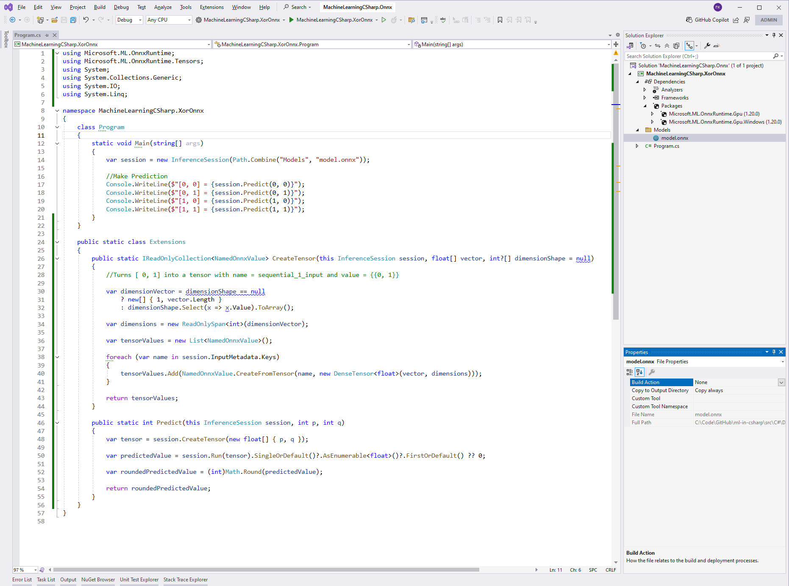
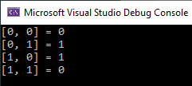

Slide 43
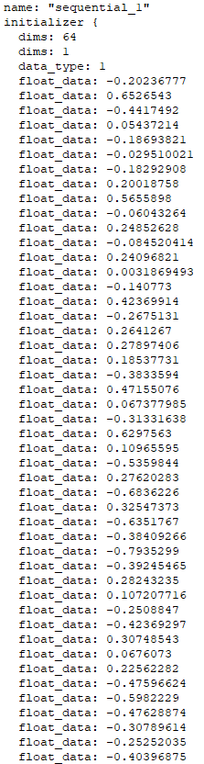
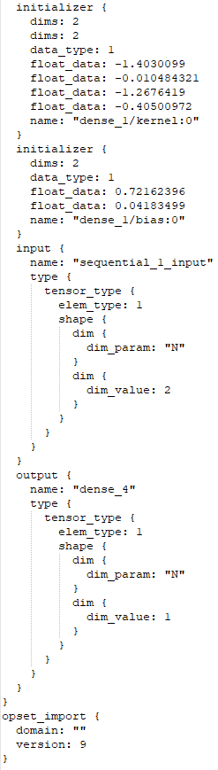
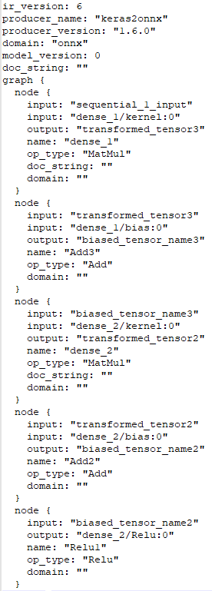
ONNX File

Slide 44
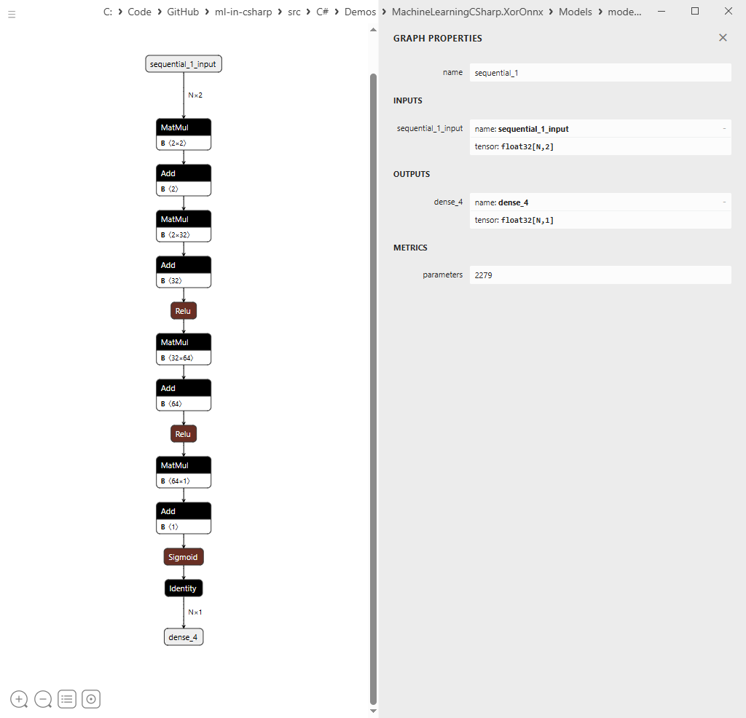
ONNX Model Visual - NETRON

Slide 45

ONNX Caveats
You may have to include additional DLLs to get ONNX working with CUDA
These are the CUDA and cuDNN versions, as well as the DLL locations for my nVidia RTX 5090 GPU
I recommend adding the CUDA provider and making sure the model is actually running on the GPU.
C:\Program Files\NVIDIA GPU Computing Toolkit\CUDA\v12.9\bin: cublas64_12.dll cublasLt64_12.dll cudart64_12.dll cufft64_11.dll
C:\Program Files\NVIDIA\CUDNN\v9.10\bin\12.9: cudnn_adv64_9.dll cudnn_cnn64_9.dll cudnn_engines_precompiled64_9.dll cudnn_engines_runtime_compiled64_9.dll cudnn_graph64_9.dll cudnn_heuristic64_9.dll cudnn_ops64_9.dll cudnn64_9.dll

Slide 46
Other ways to Consume Models in C#
Run the models using the code used to create them as shown for ML.NET and Keras.NET XOR examples (load model and call predict)
MLaaS (Machine Learning as a Service): direct calls from C# to a ML service, typically over HTTP/REST or using SDK
OCR: Azure Document Intelligence, AWS Textract, ABBYY
IDPS Comprehend (document classification and data extraction service)
LLMaaS (LLMs as a Service):
Direct: OpenAI ChatGPT APIs, Claude Code
Indirect: Langchain, SemanticKernel, Ollama, or OpenRouter

Slide 47

Links
SciSharp - https://scisharp.github.io/SciSharp/
SciSharp GitHub - https://github.com/SciSharp
ONNX - https://onnxruntime.ai/
ONNX GitHub - https://github.com/microsoft/onnxruntime
ML.NET - https://dotnet.microsoft.com/en-us/apps/ai/ml-dotnet
ML.NET Tutorials - https://learn.microsoft.com/en-us/dotnet/machine-learning/tutorials/
This talk

Slide 48
Key Takeaways
AI is more than just Generative AI, LLMs, and Agentic workflows. Each has its place and purpose. Not one is better than another.
I have document classifications models that far outperform LLMs in terms of both speed and accuracy, without all the overhead. My latest only takes 2ms to classify.
You can run virtually any ML model in C# using the ONNX Runtime, and you don’t need the additional baggage of Python and libraries used therein to create the models.
All models work pretty much the same way as described here.
Running ML models in C# via the ONNX Runtime is orders of magnitude faster than in Python.
Most of my models run about 20 times faster in C# then they do in Python without loss of accuracy or precision.
Running models in the ONNX Runtime in Python is about 2.5 times faster than running the equivalent PyTorch (or other frameworks) model that it was created from. So ONNX is recommended even if you are using Python as your main language.

Slide 49
Questions
@bkorzynski
@bkorzynski.bsky.social
github.com/korz
This talk

